Slide 1
The Software in SDN
Programming in Opendaylight

Slide 2
Presenter’s Note
This presentation borrows heavily from a presentation on App Development by Srini Seetharaman and are available at http://sdnhub.org

Slide 3
OpenDaylight embraces the full spectrum of choices
Orchestration
Orchestration
Orchestration
REST
NETCONF/YANG, REST
NETCONF/YANG, REST
Orchestration
Applications
Legacy control plane
Other apps
Applications
Controller
NETCONF/YANG
OpenFlow, P4
Controller
Controller
Legacy control plane
Legacy control plane
OF Agent
OpenFlow, P4
OpenFlow, P4
Data plane
Data plane
OF Agent
OF Agent
Data plane
Data plane
Solving only operational issue
Purist-model
Hybrid-model
Backward-compatible
Risk

Slide 4
Lithium: List of Projects (Total: 40)
Project keyword | Description
aaa | AAA Project
alto* | Application-Layer Traffic Optimization
bgpcep | BGP/PCEP protocol library
capwap* | Control and Provisioning of Wireless Access Point
controller | OpenDaylight Controller
defense4all | Radware Defense4All
didm* | Device Identification and Drive Management
discovery | Discovery Service
dlux | OpenDaylight UI
docs | Documentation Project
groupbasedpolicy | Group Based Policy Plugin
integration | Integration Framework
iotdm* | IoT Data-centric Middleware
l2switch | Separate Layer 2 switching
lacp* | Link Aggregation Control Protocol
lispflowmapping | LISP Mapping Service
nic* | Network Intent Composition
openflowjava | OpenFlow Protocol Library
openflowplugin | OpenFlow Plugin
opflex* | OpFlex protocol
ovsdb | OVSDB protocol and OpenStack integration
packetcable | PacketCable PCMM/COPS
pss* | Persistence Store Service
plugin2oc | Southbound plugin to the OpenContrail platform
reservation* | Dynamic Resource Reservation project
sdninterfaceapp | SDNi Cross-controller interface
sfc | Service Function Chaining
snbi | Secure Network Bootstrap Infrastructure
snmp4sdn | SNMP4SDN Plugin
snmp* | SNMP Southbound Plugin
sxp* | Source-Group Tag eXchange Protocol
tcpmd5 | TCP-MD5 Support library
toolkit | Quickstart Toolkit
tpf* | Topology Processing Framework
tsdr* | Time Series Data Repository
ttp | TTP Project
usc* | Unified Secure Channel
vtn | VTN (Virtual Tenant Network)
yangtools | YANG Tools
* → New in Lithium release

Slide 5
4th Release “Beryllium”
Production-Ready Open SDN Platform
Graphical User Interface Application and Toolkit (DLUX / NeXT UI)
AAA AuthN Filter
OpenDaylight APIs REST/RESTCONF/NETCONF/AMQP
Base Network Functions
Enhanced Network Services
Network Abstractions (Policy/Intent)
Host Tracker
AAA
Messaging 4Transport
SNMP4SDN
ALTO Protocol Manager
Controller Platform Services/Applications
L2 Switch
Centinel – Streaming Data Hdlr
NetIDE
Time Series Data Repository
Fabric as a Service
OpenFlow Forwarding Rules Mgr
Controller Shield
Neutron Northbound
Unified Secure Channel Mgr
Group Based Policy Service
OpenFlow Stats Manager
Dev Discovery, ID & Drvr Mgmt
OVSDB Neutron
User Network Interface Mgr
NEMO
OpenFlow Switch Manager
DOCSIS Abstraction
SDN Integration Aggregator
Virtual Private Network
Network Intent Composition
Link Aggregation Ctl Protocol
Service Function Chaining
Virtual Tenant Network Mgr.
Topology Processing
LISP Service
Service Abstraction Layer/Core
Data Store (Config & Operational)
Messaging (Notifications / RPCs)
OpenFlow
OF-Config
OVSDB
NETCONF
LISP
BGP
PCEP
CAPWAP
OPFLEX
SXP
SNMP
USC
SNBI
IoT
Http/CoAP
LACP
PCMM/COPS
Southbound Interfaces &
Protocol Plugins
OpenFlow Enabled Devices
Open vSwitches
Additional Virtual & Physical Devices
Data Plane Elements
(Virtual Switches, Physical Device Interfaces)
Notes:
Lithium Diagram, July 2015

Slide 6
What does it mean to program in ODL?
Get familiar with the Model-View-Control approach for app development in a modular fashion
YANG (Yet Another Next Generation) Model for data, RPC and notifications
RESTconf View generated automatically
Implementation in Java to handle data changes, notifications and RPC call backs
Get familiar with platform essentials (maven, config subsystem, dependencies) and useful tools
Learn about existing projects and reuse modules
No need to change code of other projects. Just link them as binary libraries

Slide 7
YANG modeling

Slide 8
YANG
Data modeling language that is also the preferred configuration language for NETCONF protocol
Further reads:
YANG introductory tutorial
RFC 6020 - YANG - A data modeling language for NETCONF
module model1 {
namespace "urn:model1";
prefix model1;
yang-version 1;
revision 2015-04-06 {
description "Initial revision";
}
grouping A {
list B {
key id;
leaf id {
type uint32;
}
leaf D {
type uint32;
}
}
}
container C {
uses A;
}
}

Slide 9
MD-SAL Data Access
Model-driven SAL is the kernel of the OpenDaylight controller!
It manages the contracts and state exchanges between every application. It does this adaptation by managing centralized state
Takes in the YANG model at runtime and constructs the tree in the data store
For the YANG model in previous slide, here is the view of the root and its children
Module model1
Namespace “urn:model1”
C
/restconf/config/model1:C
B
id=1
B
id=2
B
id=3
/restconf/config/model1:C/B/3
Leaf D
Val=9
Leaf D
Val=16
Leaf D
Val=2

Slide 10
MD-SAL Data Access (contd.)
When the model is compiled with maven, you will see classes generated in Model1Data. java, B.java, and C.java
InstanceIdentifier is used as a pointer to a child. Following points to the first child node in the figure
ReadOnlyTransaction, and WriteTransaction are used to access the data store.
Transaction can also be batched
InstanceIdentifier iid = InstanceIdentifier.builder(C.class)
.child(B.class, new BKey((long)1))
.build();
B updatedB = new BBuilder().setD((long)19).build();
WriteTransaction modification = dataBroker.newWriteOnlyTransaction();
modification.merge(LogicalDataStoreType.CONFIGURATION, iid, updatedB, true);
modification.submit();

Slide 11
Two types of data store
For the same model, there are two types of data store maintained by MD-SAL
Config store: App developers typically use this to store user input and associated derived state for apps
Operational store: Typically used to keep transient ephemeral state
Choice of store has implications on RESTconf and persistence
Config store is always kept persistent. There is control on how many replicas to keep
Operational store cannot be changed over RESTconf

Slide 12
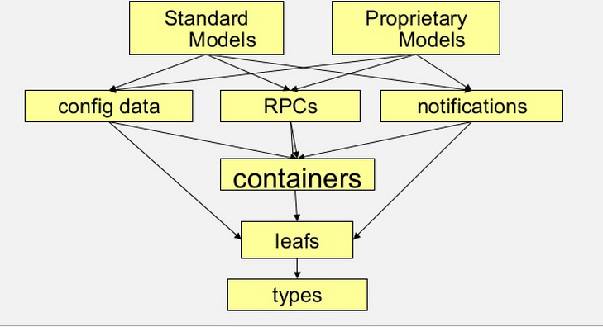
YANG not restricted to Just Data Store
Notifications:
Publish one or more notifications to registered listeners
RPC:
Perform procedure call with input/output, without worrying about actual provider for that procedure

Slide 13
Poking into the basic platform

Slide 14
Java, Interface, Maven, OSGi, Karaf
Java chosen as an enterprise-grade, cross-platform compatible language
Java Interfaces are used for event listening, specifications and forming patterns
Maven – build system for Java
OSGi:
Allows dynamically loading bundles
Allows registering dependencies and services exported
For exchanging information across bundles
Karaf: Light-weight Runtime for loading modules/bundles
OSGi based. Primary distribution mechanism for Helium
FeatureA
FeatureB
SAL
…
Karaf
OSGi Framework (Equinox)

Slide 15
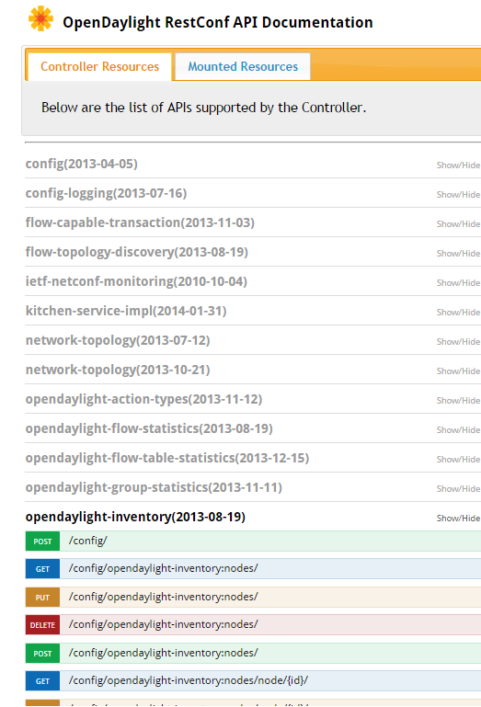
REST APIs
OpenDaylight has significant support for REST APIs
Restconf allows for checking config and operational state
feature:install odl-restconf
http://localhost:8181/restconf/....
List of exposed Northbound APIs are autogenerated using swagger.
feature:install odl-mdsal-apidocs
http://localhost:8181/apidoc/explorer

Slide 16
ODL’s opendaylight-inventory.yang (Lithium)
module opendaylight-inventory {
namespace "urn:opendaylight:inventory";
prefix inv;
typedef node-id {
type inet:uri;
}
typedef node-connector-id {
type inet:uri;
}
typedef node-ref {
type instance-identifier;
}
typedef node-connector-ref {
type instance-identifier;
}
grouping node {
leaf id {
type node-id;
}
list "node-connector" {
key "id";
uses node-connector;
}
}
grouping node-connector {
leaf id {
type node-connector-id;
}
}
container nodes {
list node {
key "id";
uses node;
. . .
}
}
notification node-updated {
status deprecated;
leaf node-ref {
type node-ref;
}
uses node;
}
notification node-connector-updated {
status deprecated;
leaf node-connector-ref {
type node-connector-ref;
}
uses node-connector;
}
notification node-removed {
status deprecated;
leaf node-ref {
type node-ref;
}
}
notification node-connector-removed {
status deprecated;
leaf node-connector-ref {
type node-connector-ref;
}
}
}
Augmentation made by OpenFlow plugin for storing: 1. All switch description
2. All OpenFlow features
3. All tables and its flows
4. All meters, groups

Slide 17
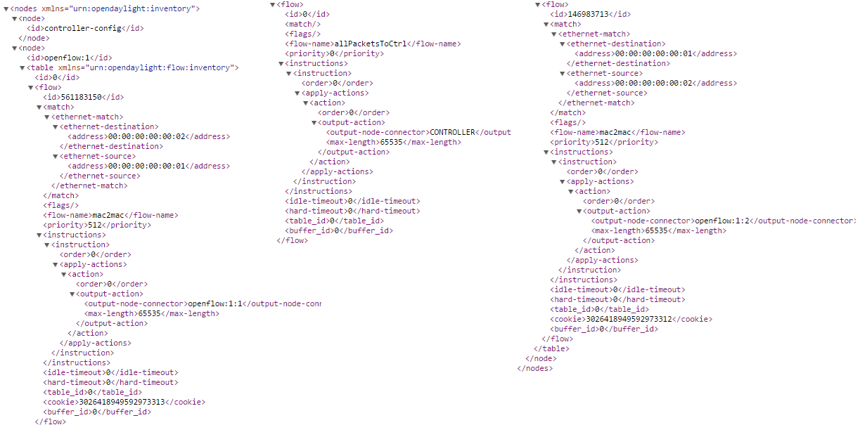
ODL’s Inventory Config Data Store http://localhost:8181/restconf/config/opendaylight-inventory:nodes

Slide 18
ODL’s network-topology.yang (Beryllium) http://localhost:8181/restconf/operational/network-topology:network-topology
module network-topology {
namespace "urn:TBD:params:xml:ns:yang:network-topology";
typedef topology-ref {
type leafref {
path "/network-topology/topology/inet:uri";
}
}
typedef node-ref {
type leafref {
path "/network-topology/topology/node/inet:uri";
}
}
typedef link-ref {
type leafref {
path "/network-topology/topology/link/inet:uri";
}
}
grouping tp-attributes {
leaf tp-id {
type inet:uri;
}
leaf-list tp-ref {
type tp-ref;
}
}
grouping node-attributes {
leaf node-id {
type inet:uri;
}
list supporting-node {
key "node-ref";
leaf node-ref {
type node-ref;
}
}
}
grouping link-attributes {
leaf link-id {
type inet:uri;
}
container source {
leaf source-node {
mandatory true;
type node-ref;
}
leaf source-tp {
type tp-ref;
}
}
container destination {
leaf dest-node {
mandatory true;
type node-ref;
}
leaf dest-tp {
type tp-ref;
}
}
list supporting-link {
key "link-ref";
leaf link-ref {
type link-ref;
}
}
}
container network-topology {
list topology {
key "topology-id";
leaf topology-id {
type inet:uri;
}
container topology-types {
}
list underlay-topology {
key "topology-ref";
leaf topology-ref {
type topology-ref;
}
}
list node {
key "node-id";
uses node-attributes;
list termination-point {
key "tp-id";
uses tp-attributes;
}
}
list link {
key "link-id";
uses link-attributes;
}
}
}
}

Slide 19
Extension to models through Augments
Unless specified otherwise, YANG models can be augmented in a new namespace to add extra data within an existing data model.
For example, odl-l2-switch augments above inventory to store hosts learned
import opendaylight-inventory { prefix inv; revision-date 2013-08-19; }
augment "/inv:nodes/inv:node/inv:node-connector" {
ext:augment-identifier "address-capable-node-connector";
uses address-node-connector;
}
curl http://localhost:8080/restconf/operational/opendaylight-inventory:nodes/node/openflow:1/node-connector/openflow:1:1
{ "node-connector":
[ { "id": "openflow:1:1",
"address-tracker:addresses": [ {
"address-tracker:last-seen": 1404918398057,
"address-tracker:ip": "10.0.0.1",
"address-tracker:first-seen": 1404918392926,
"address-tracker:mac": "f2:0c:dd:80:9f:f7"
}]
}]
}

Slide 20
Code Design
yangtools generates data model classes
Builders for generating immutable objects also generated
identity mapped to interfaces
All else are mapped to classes
Identity is the only one that allows inheritance
Developers have to write the gateway adapters
Converting from one data model to another
Translating between a non-ODL source and ODL app
https://wiki.opendaylight.org/view/YANG_Tools:YANG_to_Java_Mapping

Slide 21
Data Store Management
Persistence
Everything that gets into a shard is stored in-memory and on the disk.
Restarting the controller will reconstitute the state of the shards from the persisted data.
Clustering
Multiple controller instances can interwork and share state (for backup reasons rather than load-sharing)
One leader (writer) and multiple followers (read-only) where state consistency is achieved using RAFT algorithm
Sharding
The big in-memory MD-SAL tree is broken up into a bunch of smaller sub-trees such that 1 model is 1 shard (e.g., inventory, topology and default).

Slide 22
Southbound Plugins: OpenFlow and NETCONF

Slide 23
OpenDaylight External Interfaces
Southbound:
Built-in NETCONF client and BGP speaker to interact with legacy control planes and orchestrate them
Plugin for OpenFlow 1.0 and 1.3 support
Plugin for OVSDB that works with OVS schema (VTEP schema in future)
Northbound:
REST and NETCONF for receiving intent data
NETCONF
REST
Controller platform
Service intent and policy
Service models
Network functions
State mgmt
App/
Logic
Device models
Device manager
OpenFlow
OVSDB
NETCONF
BGP

Slide 24
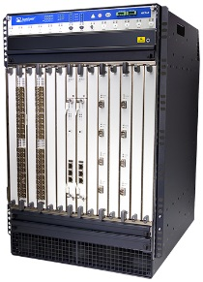
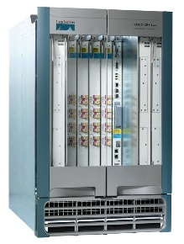
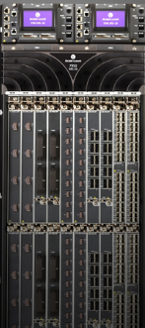
NETCONF based Multi-Vendor OSS
Orchestrator
Service models
OSS Engine
Models are vendor specific and still need vendor specific adapters in the orchestrator layer. This makes case for OpenConfig
Device models
NETCONF
CLI

Slide 25
Questions?

