Slide 1
ACI REF
Introduction to OpenFlow
and Why it Matters to You
https://github.com/downloads/mininet/mininet/mininet-2.0.0-113012-amd64-ovf.zip
Notes:
Welcome to the mid-morning session of the University of Oklahoma, Advanced CyberInfrastructure - Research and Education Facilitators mid-morning presentation!

Slide 2
ACI REF
Introduction to OpenFlow
and Why it Matters to You
Notes:
This talk is presented by the University of Oklahoma, the OU Supercomputing Center for Education and Research (OSCER), as well as the University of Oklahoma Information Technology (IT) department.

Slide 3
Goals of the Presentation
Arm you with a basic understanding of computer networks so that you can provide justification for your “unique” requirements to your fellow IT staff.
Provide you with a common set of nomenclature that you can use when conversing with research peers regarding data exchange.
Notes:
As an overview, we will discuss:
The Evolution of the “Science DMZ”, as well as the definition of a Science DMZ.
Software Defined Networking, as well as the components that make up an SDN.
And, finally, deep-dive into OpenFlow and discuss the role within a Science DMZ.

Slide 4
Overview
The Evolution of the Science DMZ
Software Defined Networking and its Components
OpenFlow and Why it Matters
Notes:
As an overview, we will discuss:
The Evolution of the “Science DMZ”, as well as the definition of a Science DMZ.
Software Defined Networking, as well as the components that make up an SDN.
And, finally, deep-dive into OpenFlow and discuss the role within a Science DMZ.

Slide 5
The Definition of Science DMZ
Wikipedia Definition:
“The term Science DMZ refers to a computer subnetwork that is structured to be secure, but without the performance limits that would otherwise result from passing data through a stateful firewall. The Science DMZ is designed to handle high volume data transfers, typical with scientific and high-performance computing, by creating a special DMZ to accommodate those transfers. It is typically deployed at or near the local network perimeter, and is optimized for a moderate number of high-speed flows, rather than for general-purpose business systems or enterprise computing.”
http://en.wikipedia.org/wiki/Science_DMZ_Network_Architecture
Notes:
Here is a long, boring definition of Science DMZ courtesy of Wikipedia.

Slide 6
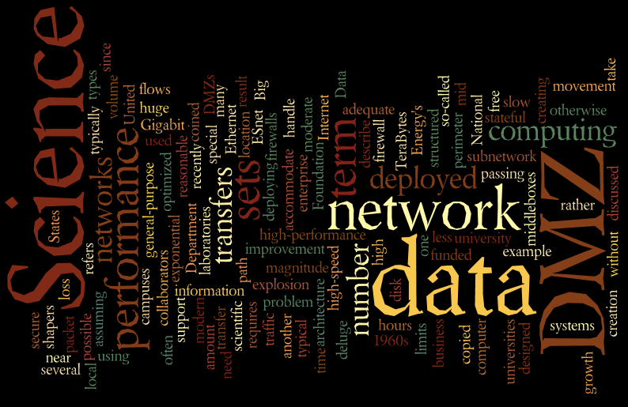
The “Wordly” of Science DMZ
Notes:
Here is a Wordle visualization of the same definition…

Slide 7
The Evolution of Science DMZ
Corporate Environment:
Offer Goods
and Services
Notes:
Now let’s talk about how Science DMZ’s came about…
First, let’s touch on the corporate environment.
The items that are most important to our corporate counterparts are the goods and services that they offer…

Slide 8
The Evolution of Science DMZ (cont.)
Corporate Environment:
Lock them away in an “online” experience.
Notes:
Which they make orderable through a secure perimeter. Think of this as analogous to a bank vault: customers that want to do business with the bank are allowed controlled access to the resources, and are generally only presented with items of interest to them. Other items (such as bank loans) are available… for the right price.

Slide 9
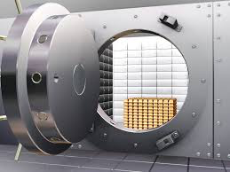
The Evolution of Science DMZ (cont.)
Corporate Environment:
And make them available when someone is willing to pay…
Notes:
Sticking with our bank vault analogy: with the right methods (e.g. secure protocols), and the right incentives (e.g. “money”), the bank will open the vault and present you with their goods and services.

Slide 10
The Evolution of Science DMZ (cont.)
Corporate Environment:
“It’s just good business…”
Notes:
This is simply good business.

Slide 11
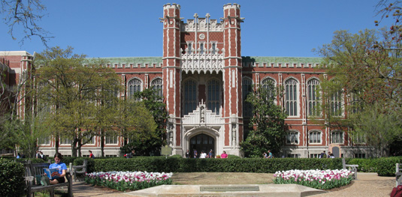
The Evolution of Science DMZ (cont.)
Academic Environment:
Notes:
By contrast, let’s discuss the academic environment…

Slide 12
The Evolution of Science DMZ (cont.)
Academic Environment: A stark contrast…
Student
Data
Notes:
The things that are most important to academia, such as student data (courses taken, grades, date of birth, student ID, FERPA data, etc.)

Slide 13
The Evolution of Science DMZ (cont.)
Academic Environment: A stark contrast…
Student
Data
Intellectual
Property
Notes:
…and intellectual property (such as course material and research data, which could also include human research data susceptible to HIPAA rules)

Slide 14
The Evolution of Science DMZ (cont.)
Academic Environment: A stark contrast…
Student
Data
Intellectual
Property
Payroll &
Accounting
Notes:
As well as human resources, payroll, and accounting information (which could fall under PCI compliance)

Slide 15
The Evolution of Science DMZ (cont.)
Academic Environment: A stark contrast…
Notes:
Are locked away, with little or no external access.

Slide 16
The Evolution of Science DMZ (cont.)
Academic Environment: A stark contrast…
Notes:
And placed within a “secure” environment.

Slide 17
The Evolution of Science DMZ (cont.)
Academic Environment: A stark contrast…
“WAN”
Notes:
That is defined by Information Technology with funny names like “WAN”

Slide 18
The Evolution of Science DMZ (cont.)
Academic Environment: A stark contrast…
“Firewall”
“WAN”
Notes:
Or “firewall”…

Slide 19
The Evolution of Science DMZ (cont.)
Academic Environment: A stark contrast…
Intrusion
Prevention
“Firewall”
“WAN”
Notes:
Or more scary terms like “intrusion prevention”

Slide 20
The Evolution of Science DMZ (cont.)
Academic Environment: A stark contrast…
Bureaucracy
(aka “Paperwork”)
Intrusion
Prevention
“Firewall”
“WAN”
Notes:
And they require you to fill out forms or paperwork to gain access to the data held inside, or even to allow your own data to leave the security perimeter.

Slide 21
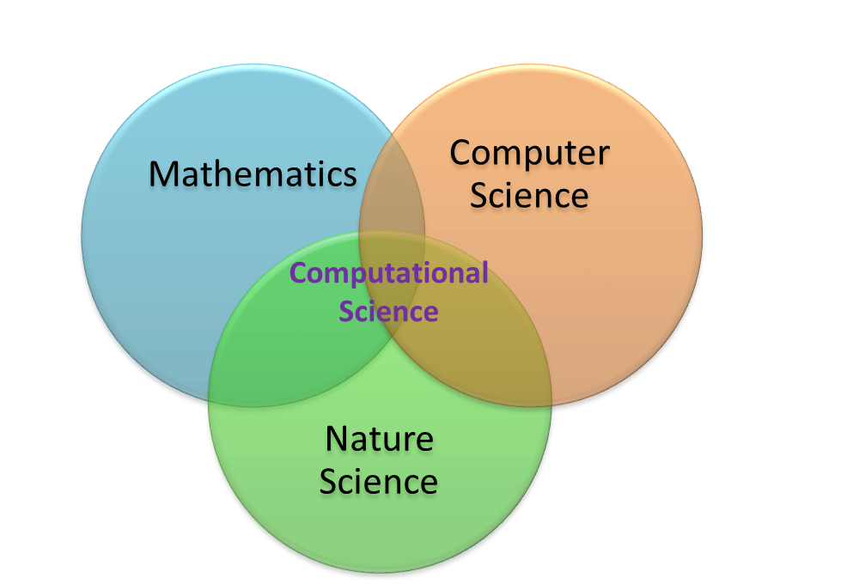
The Evolution of Science DMZ (cont.)
Academic Environment: Enter Computational Research…
Notes:
And this presents a challenge to todays computational researcher

Slide 22
The Evolution of Science DMZ (cont.)
Academic Environment: Computational Research…
Notes:
Who may be leveraging mathematical models to generate data sets for things like particle collisions (High Energy Physics) or weather predictions (National Weather Services)

Slide 23
The Evolution of Science DMZ (cont.)
Academic Environment: Computational Research…
Notes:
Or gathering biological, zoological, or genomic data in the field to provide categorical classifications, analyze environmental trends, or provide treatment options for diseases.

Slide 24
The Evolution of Science DMZ (cont.)
Academic Environment: Computational Research…
Notes:
Or even further the advancements of mankind through electronic or programmatic means…

Slide 25
The Evolution of Science DMZ (cont.)
Computational Research…
Notes:
…but these can create challenges for the more traditional methods of transporting data.

Slide 26
The Evolution of Science DMZ (cont.)
Computational Research and an Analogy…
Computational
Research
Notes:
Imagine, if you will, that data-driven, computational research

Slide 27
The Evolution of Science DMZ (cont.)
Computational Research and an Analogy…
=
Computational
Research
Notes:
A velociraptor!

Slide 28
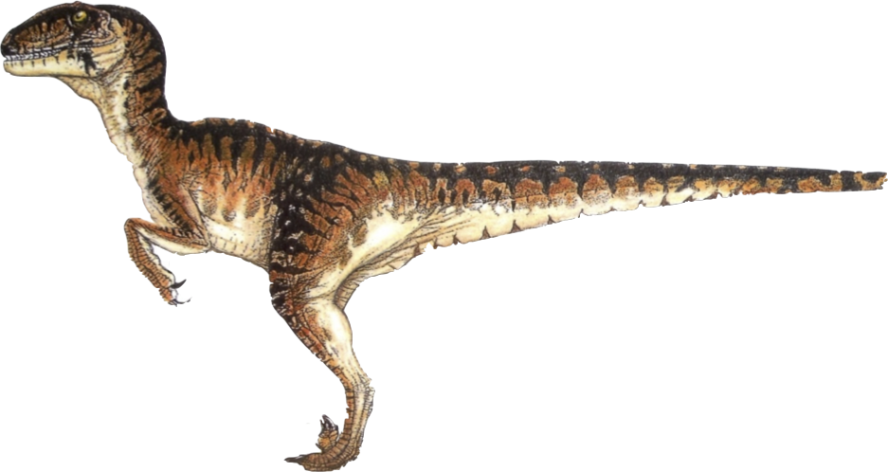
The Evolution of Science DMZ (cont.)
Computational Research and an Analogy…
=
Computational
Research
Velociraptor
Notes:
Add prisoner analogy

Slide 29
The Evolution of Science DMZ (cont.)
Computational Research and an Analogy…
~
=
Computational
Research
Velociraptor
Notes:
Well, “approximately”…

Slide 30
The Evolution of Science DMZ (cont.)
Proof that the analogy is valid…
Notes:
As proof that this analogy holds true.

Slide 31
The Evolution of Science DMZ (cont.)
Notes:
We will use a Venn diagram!

Slide 32
The Evolution of Science DMZ (cont.)
Agile
Notes:
Both computational research and velociraptors are agile. Each of them need to change their behavior to match environmental constraints.

Slide 33
The Evolution of Science DMZ (cont.)
Agile
Moves Rapidly
Notes:
Both tend to move rapidly!

Slide 34
The Evolution of Science DMZ (cont.)
Agile
Moves Rapidly
More Effective
In Groups
Notes:
Both work more effectively as a group.

Slide 35
The Evolution of Science DMZ (cont.)
Agile
Moves Rapidly
More Effective
In Groups
Consumes All
Available Resources
Notes:
And both will consume any (and all) available resources that are presented to them.

Slide 36
The Evolution of Science DMZ (cont.)
Agile
Moves Rapidly
More Effective
In Groups
Consumes All
Available Resources
Cool!
Notes:
And both are really, really cool!

Slide 37
The Evolution of Science DMZ (cont.)
Agile
Moves Rapidly
More Effective
In Groups
Is not reptile
Is reptile
Consumes All
Available Resources
Cool!
Notes:
But there are a few differences…

Slide 38
The Evolution of Science DMZ (cont.)
When Computational Science Meets Traditional Networks
Notes:
Velociraptor analogy

Slide 39
The Evolution of Science DMZ (cont.)
When Computational Science Meets Traditional Networks
Pardon me good sirs…
Notes:
Velociraptor analogy

Slide 40
The Evolution of Science DMZ (cont.)
When Computational Science Meets Traditional Networks
Yes?
Notes:
Velociraptor analogy

Slide 41
The Evolution of Science DMZ (cont.)
When Computational Science Meets Traditional Networks
I have some important research data…
Notes:
Velociraptor analogy

Slide 42
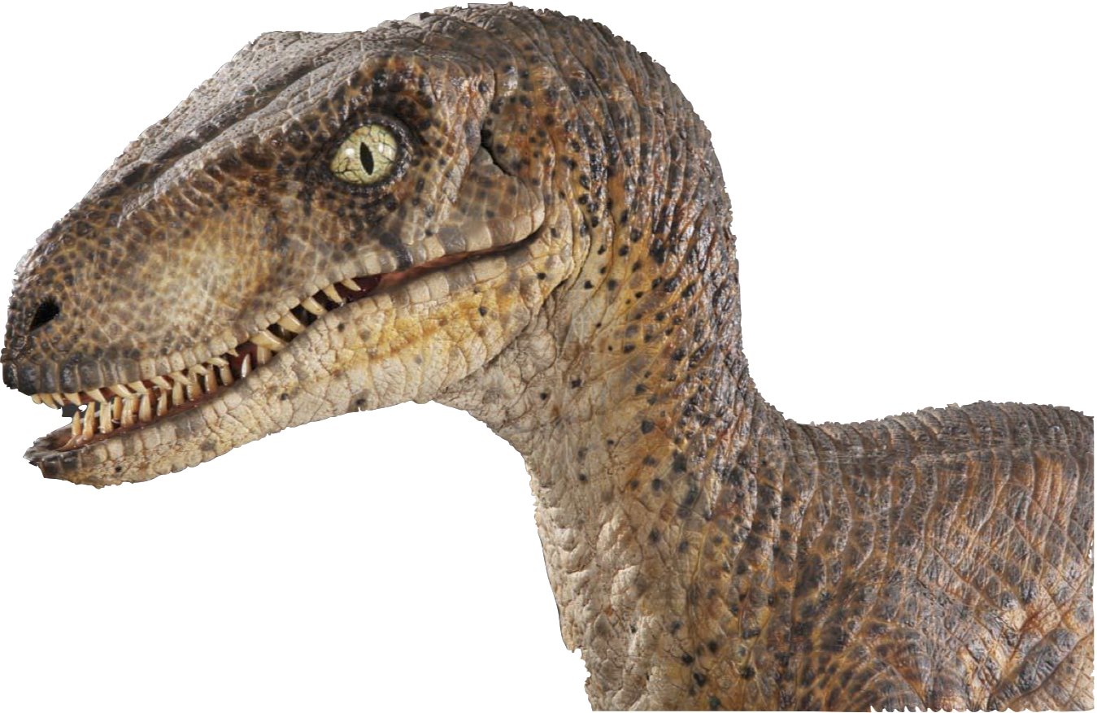
The Evolution of Science DMZ (cont.)
…that is highly important to myself, the educational community, and all of mankind as a whole. It is imperative that this data be reasonably secured; yet, available to my research peers. The datasets are rather large, as they have been collected over a number of years.
Notes:
Velociraptor analogy

Slide 43
The Evolution of Science DMZ (cont.)
Would it be possible to place this in a secure, reliable, flexible, accessible, as well as high performing infrastructure?
Notes:
Velociraptor analogy

Slide 44
The Evolution of Science DMZ (cont.)
When Computational Science Meets Traditional Networks
Ummm…
Notes:
Velociraptor analogy

Slide 45
The Evolution of Science DMZ (cont.)
When Computational Science Meets Traditional Networks
Lemme check…
Notes:
Velociraptor analogy

Slide 46
The Evolution of Science DMZ (cont.)
When Computational Science Meets Traditional Networks
Hey, Jim!
Notes:
Velociraptor analogy

Slide 47
The Evolution of Science DMZ (cont.)
When Computational Science Meets Traditional Networks
Yo!
Notes:
Velociraptor analogy

Slide 48
The Evolution of Science DMZ (cont.)
When Computational Science Meets Traditional Networks
Gotta guy here. Says he needs stuff.
Notes:
Velociraptor analogy

Slide 49
The Evolution of Science DMZ (cont.)
When Computational Science Meets Traditional Networks
What kinda stuff?
Notes:
Velociraptor analogy

Slide 50
The Evolution of Science DMZ (cont.)
When Computational Science Meets Traditional Networks
Something about security and connectivity (maybe).
Notes:
Velociraptor analogy

Slide 51
The Evolution of Science DMZ (cont.)
When Computational Science Meets Traditional Networks
We got plenty of that! Send ‘em in.
Notes:
Velociraptor analogy

Slide 52
The Evolution of Science DMZ (cont.)
When Computational Science Meets Traditional Networks
Notes:
Velociraptor analogy

Slide 53
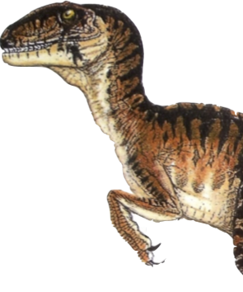
The Evolution of Science DMZ (cont.)
When Computational Science Meets Traditional Networks
ROAR!!!
Notes:
Velociraptor analogy

Slide 54
The Evolution of Science DMZ (cont.)
When Computational Science Meets Traditional Networks
Ye gads!
Notes:
Velociraptor analogy

Slide 55
The Evolution of Science DMZ (cont.)
When Computational Science Meets Traditional Networks
AHHHH!!
Ye gads!
Notes:
Velociraptor analogy

Slide 56
The Evolution of Science DMZ (cont.)
When Computational Science Meets Traditional Networks
AHHHH!!
THE INHUMANITY!!!
Ye gads!
Notes:
Velociraptor analogy

Slide 57
The Evolution of Science DMZ (cont.)
When Computational Science Meets Traditional Networks
AHHHH!!
THE INHUMANITY!!!
Ye gads!
HOM! NOM! NOM!
Notes:
The realization eventually sets in that the needs of the computational researcher are actually adversely impacting the campus network!

Slide 58
The Evolution of Science DMZ (cont.)
OBSERVATION: The requirements of the computational researcher and the capabilities of the traditional campus computer network do not always align!
Ya’ think?!
Notes:
The requirements of the computational researcher simply do not align easily with the traditional capabilities of campus networks.

Slide 59
The Evolution of Science DMZ (cont.)
This can result in adverse consequences:
Poor network performance for production systems
Poor security performance for the campus as a whole
Bandwidth congestion
Overutilization of available resources
Increased Help Desk calls
General grumbling and complaining
Notes:
One example is High Energy Physics on the Norman Campus of the University of Oklahoma. At one point in time, HEP was running at a steady 6Gb/s… and the campus network was only capable of handling 10Gb/s!

Slide 60
The Evolution of Science DMZ (cont.)
This can result in adverse consequences:
Poor network performance for production systems
Poor security performance for the campus as a whole
Bandwidth congestion
Overutilization of available resources
Increased Help Desk calls
General grumbling and complaining
But how do we overcome this? I can’t stop my research just because the network can’t keep up!
Notes:
The need for a Science DMZ provides OPPORTUNITY for both the computational researcher, as well as the local IT staff! The DMZ environment provides a means for the IT staff to leverage new technologies before they go into production, provides an avenue for testing production workflows in a high-performance environment, and also bridges the collaboration gap between research and production.

Slide 61
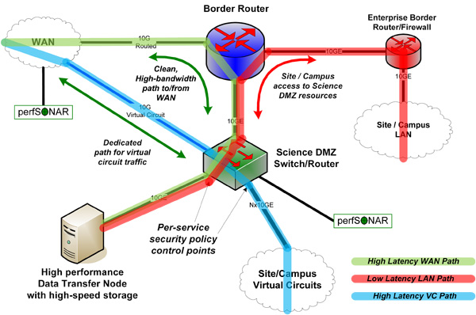
The Evolution of Science DMZ (cont.)
Enter the Science DMZ!
https://fasterdata.es.net/science-dmz/science-dmz-architecture/
Notes:
Here is a “logical topology” of what a science DMZ looks like…
perfSONAR is used for measurement of network performance
The Data Transfer Node (DTN) is used to take data from a campus-hosted system, and transfer that data to another DTN at another site
The Science DMZ switch/router is “dedicated” to the transfer of research data, and is not tied directly into the local campus network… but it does connect to the “front door” of the campus network.

Slide 62
The Evolution of Science DMZ (cont.)
What makes the Science DMZ important
Dedicated Data Transfer Node to ship datasets
Dedicated network resources outside of the campus
Dedicated, high-speed capacity (typically 10-Gig)
Dedicated “circuits” between research sites
“Programmable”
Notes:
Here is a list of the benefits of a science DMZ. We will focus on the “Programmable” aspect in a bit…

Slide 63
The Evolution of Science DMZ (cont.)
What makes the Science DMZ important
Dedicated Data Transfer Node to ship datasets
Dedicated network resources outside of the campus
Dedicated, high-speed capacity (typically 10-Gig)
Dedicated “circuits” between research sites
“Programmable”
Sounds like it meets my requirements!
Notes:
A science DMZ provides for dedicated resources that the computational researcher needs to easily move datasets from site to site.

Slide 64
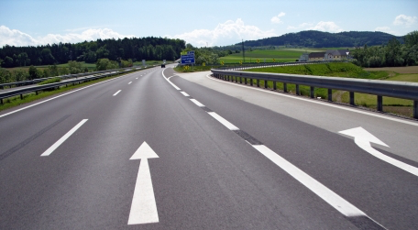
The Evolution of Science DMZ (cont.)
Sort of like an Interstate highway… no stop lights, and dedicated on and off ramps:
Notes:
A science DMZ is a bit like a highway. It allows for greater than usual speeds, no stops, and graceful on and off-ramps to easily control the flow of traffic.

Slide 65
The Evolution of Science DMZ (cont.)
Science DMZ and the Campus Network…
Notes:
Revisiting our velociraptor analogy…

Slide 66
The Evolution of Science DMZ (cont.)
Science DMZ and the Campus Network…
Notes:
A science DMZ gives our computational researchers a dedicated “highway”.

Slide 67
The Evolution of Science DMZ (cont.)
Science DMZ and the Campus Network…
???
Notes:
Complete with on and off ramps into and out of the campus network.

Slide 68
The Evolution of Science DMZ (cont.)
Science DMZ and the Campus Network…
Notes:
That can be easily leveraged by other computational researchers to exchange and collaborate on large datasets.

Slide 69
The Evolution of Science DMZ (cont.)
Science DMZ and the Campus Network…
Notes:
Which makes the IT staff, and the business offices as a whole, very happy!

Slide 70
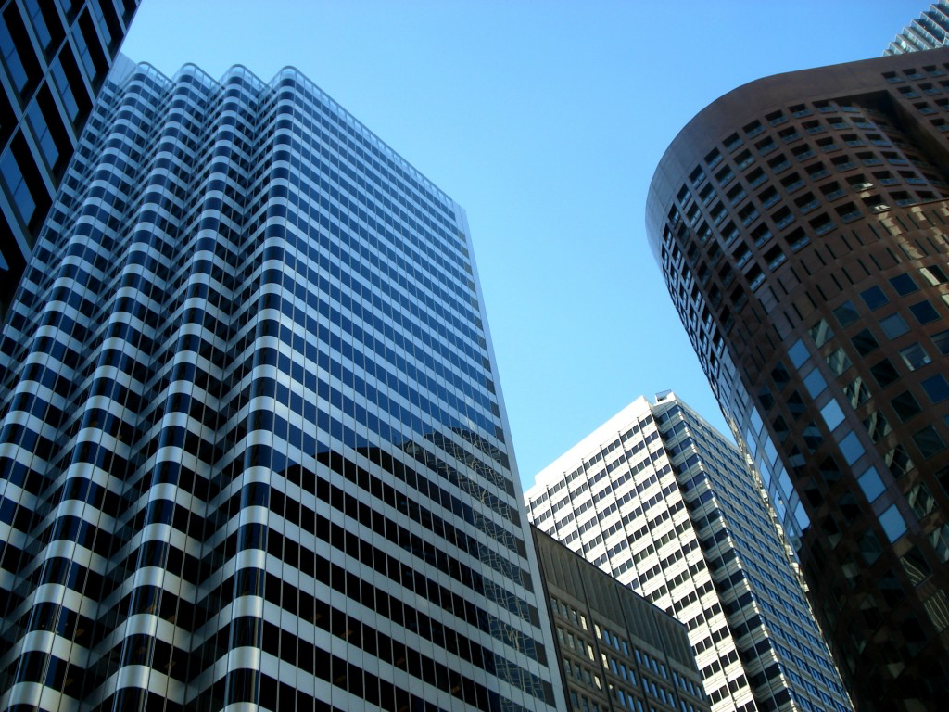
ANALOGY RECAP…
Corporate
Network
Sealed
Vault
Campus
Network
Prison
Notes:
Let’s recap those analogies…

Slide 71
ANALOGY RECAP…
Science
DMZ
Interstate
Computational
Research
Velociraptor
Notes:
Let’s recap those analogies…

Slide 72
Remember that “Programmable” Aspect of Science DMZ?
Notes:
Now let’s cover the “programmable” aspect of a Science DMZ…

Slide 73
Remember that “Programmable” Aspect of Science DMZ?
Notes:
Remember slide 62?

Slide 74
Remember that “Programmable” Aspect of Science DMZ?
Notes:
Here is the list revisited…

Slide 75
Science DMZ is like…
Notes:
Prepare for another analogy…

Slide 76
Science DMZ is like…
An onion!
Notes:
A Science DMZ has lots of layers…

Slide 77
Science DMZ Layers
Science DMZ
Dedicated Paths
Transfer Nodes
perfSONAR
Notes:
On the surface of our Science DMZ are all of the perquisites for building a parallel network that lies outside of our traditional campus network. These include our dedicated, high-speed pathways; our data transfer nodes; our perfSONAR monitoring components, as well as our interconnects to both the traditional campus network, as well as our uplinks to R&E networks.

Slide 78
Science DMZ Layers
Science DMZ
Dedicated Paths
Transfer Nodes
perfSONAR
SDN
Controller
Network Switches
Notes:
Just under the Science DMZ surface lies the hardware that makes traffic flow through the infrastructure. These include the network devices, which are typically Ethernet switches, as well as the servers that house the SDN controller software.

Slide 79
Science DMZ Layers
Science DMZ
Dedicated Paths
Transfer Nodes
perfSONAR
SDN
OpenFlow
Northbound APIs
East-West Monitoring
SDN
Controller
Network Switches
Notes:
At the heart of our Science DMZ layers are our traditional Software Defined Network programmatic process flows. These include things like API calls, OpenFlow messages, and monitoring flows.

Slide 80
Science DMZ Layers
Science DMZ
Dedicated Paths
Transfer Nodes
perfSONAR
SDN
OpenFlow
Northbound APIs
East-West Monitoring
SDN
Controller
Network Switches
Campus
Network
Notes:
Note that the campus network, while not a “direct” layer of the Science DMZ onion, still has some adjacency to the Science DMZ for traditional connectivity.

Slide 81
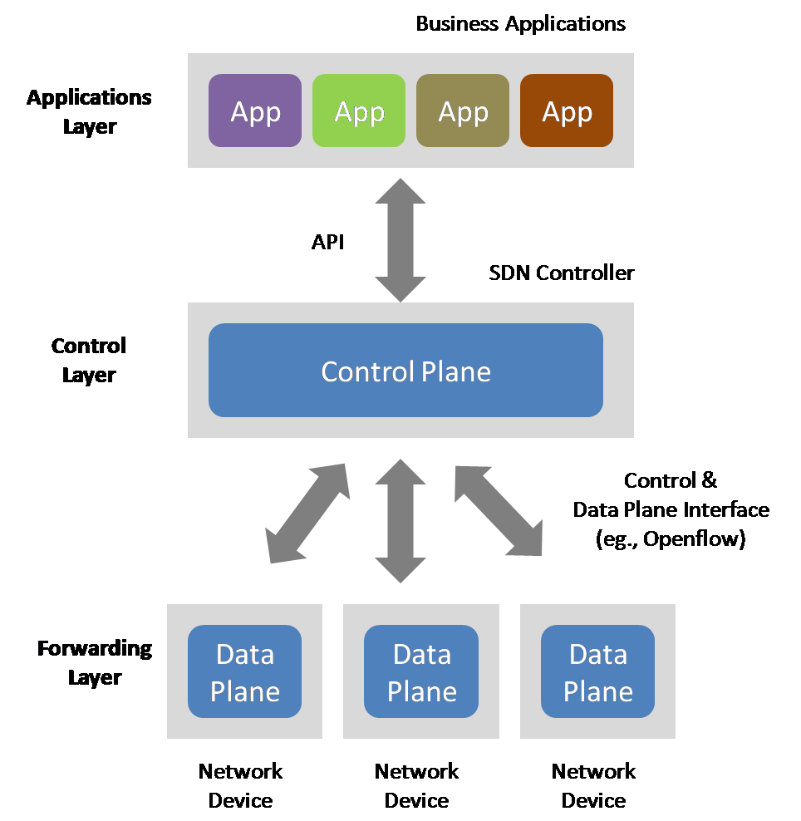
Software Defined Networks (SDN)
Components of SDN
Controller
Devices
Northbound APIs
East/West monitoring
OpenFlow communications
Notes:
Here is a common SDN Diagram and a list of the components that are typically involved in creating a software defined network.

Slide 82
Software Defined Networks (SDN)
Components of SDN
Controller
Devices
Northbound APIs
East/West monitoring
OpenFlow communications
For the purpose of this discussion,
we will focus on an SDN that
involves OpenFlow!
Notes:
“SDN” means many things to many vendors. The “Software” term can be very liberal in its definition. For the purpose of our discussions, we will focus very specifically on SDN’s that involve the use of OpenFlow communications between controllers and network devices.

Slide 83
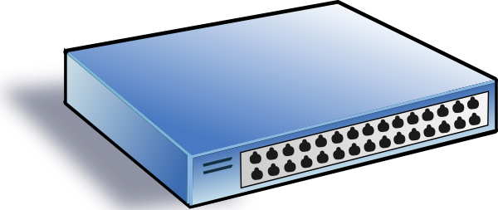
Software Defined Networks (SDN)
Notes:
The basic premise of software defined networking is to take a typical, commodity network device (a switch, in our case)…

Slide 84
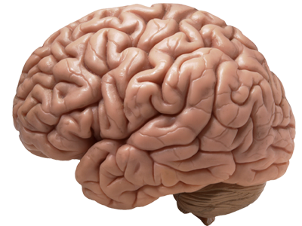
Software Defined Networks (SDN)
Notes:
Separate the programming, logic, and decision making capabilities from the switch.

Slide 85
Software Defined Networks (SDN)
Notes:
And move those pieces of logic, the “Control Plane”, to a centralized server. This leaves the traffic-passing components, or the “Data Plane”, behind.

Slide 86
Software Defined Networks (SDN)
Notes:
We then connect the central controller to the switch using Ethernet communications.

Slide 87
Software Defined Networks (SDN)
OpenFlow
X 1000
Notes:
And repeat the same process for all of our network devices that we want to centrally control.

Slide 88
Software Defined Networks (SDN)
API
OpenFlow
X 1000
Notes:
Once this is completed, we can leverage applications that talk to the controller via API calls to control the behavior of traffic as it crosses our data plane. This behavior can emulate things like network switches, firewalls, intrusion prevention services, and server load balancers; without having to purchase the traditional hardware required to provide those services.

Slide 89
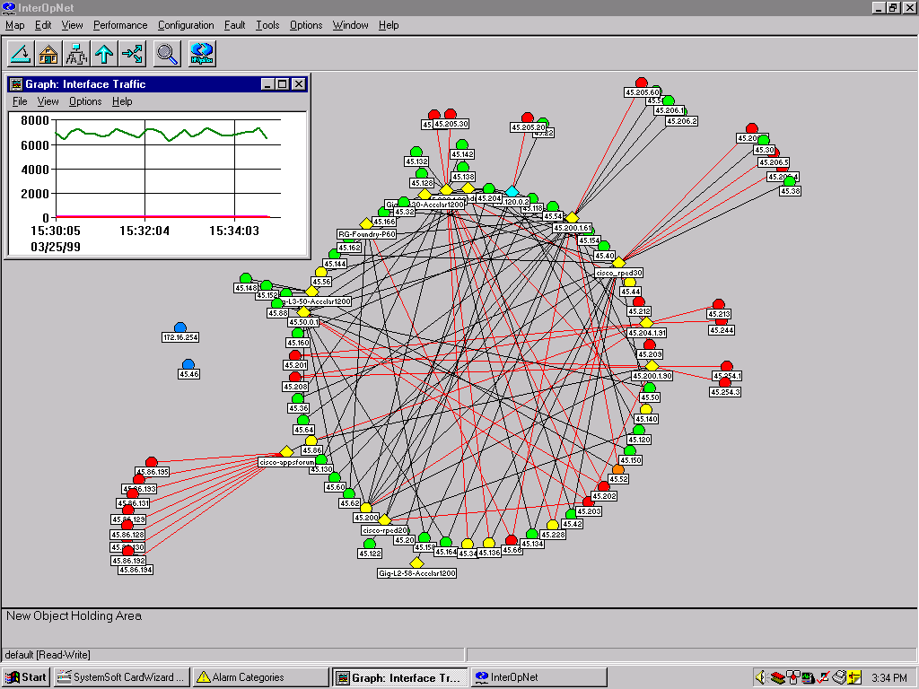
Software Defined Networks (SDN)
API
OpenFlow
X 1000
SNMP
Syslog
Flow
Notes:
We can also natively export the traditional statistics from the data plane hardware to provide things like trend analysis, visual analytics, and overall health and performance of our software defined network.

Slide 90
Software Defined Networks (SDN)
Notes:
Here is a simplified diagram of a simple software defined network in its most basic components. This will be very familiar as we work through the labs over the coming days.

Slide 91
Why Even Do SDN?
Orchestration!
Flexibility
Self Service
Agility
More “holistic”
Notes:
There are many reasons for both the IT community and the computational researcher to adopt Software Defined Networking.

Slide 92
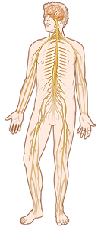
Why Even Do SDN?
Orchestration!
Flexibility
Self Service
Agility
More “holistic”
Notes:
Software Defined Networking allow a large network of traditionally autonomous devices to be treated as a seamless, ubiquitous system. A much better analogy would be ant or bee colonies, where the entire group behaves more like a single entity.

Slide 93
Why Even Do SDN?
Imagine if your brain were distributed throughout your body.
How would you walk? Run? Shop?
SDN is just a natural evolution of computer networking.
Notes:
How would this even work? Fight or flight instinct goes out the window if you have to manually instruct each part of the body on how to respond to stimuli.

Slide 94
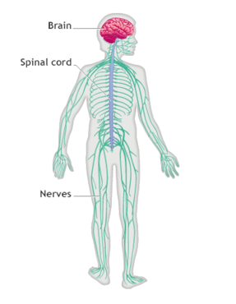
OpenFlow
OpenFlow is like the “Nerves” of the body
Controller (brain)
Devices (arms/lets/mouth/tail)
Northbound APIs (eyes/ears/tongue/nose)
East/West monitoring (pain/soreness/sick)
Carries messages from the controller to the devices, and vice-versa.
Notes:
Another analogy (sorry…)

Slide 95
OpenFlow
“OpenFlow is an open standard network protocol used to manage traffic between commercial Ethernet switches, routers and wireless access points. OpenFlow enables software-defined networking (SDN) for programmable networks and is based on an Ethernet switch, with an internal flow-table and a standardized interface to add and remove flow entries.”
http://www.webopedia.com/TERM/O/openflow.html
Notes:
Here is a great definition of OpenFlow. Note that OpenFlow is not an IEEE specification; it is an open standard developed by community efforts.

Slide 96
OpenFlow: What you need to know…
Specifications: Located at the Open Network Foundation web site (www.opennetwork.org)
Leverages TCP for communication
Port 6653 is most commonly used
Specification recommends TLS encryption
Notes:
The largest take-away detail is that OpenFlow requires Ethernet connectivity back to a controller, operates over TCP port 6653, and can be encrypted using TLS.

Slide 97
OpenFlow: What you need to know… (cont)
OpenFlow Message Types:
OpenFlow 1.3 has 30 different message types
Details at www.flowgrammable.org
Includes things like table requests, table insertions, ports in, ports out, get config, set config, etc.
Notes:
We are not going into great detail here. However, flowgrammable.org is a great, intuitive resource where you can read up on the OpenFlow message details.

Slide 98
OpenFlow: Lab this afternoon!
You will have the opportunity to see these messages in real time.
Notes:
The lab will be offered in person, on BlueJeans conferencing, and also as a take-away PDF document.

Slide 99
In Summary
When properly equipped…
The computational researcher can use Science DMZ, Software Defined Networks, and OpenFlow communications for more effective data collaboration.
Notes:
Science DMZ’s, and especially the underlying software controls, are an instrument that enable the success of the computational scientist.

Slide 100
Thank You!
https://www.dropbox.com/sh/h7y0c3z9n0eq15b/AAB97wqUY54MzClbZsRKA_RAa?dl=0
Matt Younkins
younkinsm@ou.edu
Notes:
Questions? Feel free to contact me!

Slide 101
Reminder: Lab Prereq’s
Download and install both VirtualBox and the VirtualBox extension pack: https://www.virtualbox.org/wiki/Downloads
Download the SDN Hub All-in-One App Development Starter virtual machine: https://github.com/downloads/mininet/mininet/mininet-2.0.0-113012-amd64-ovf.zip
***NEW*** Lab instructions can be downloaded here: https://www.dropbox.com/sh/h7y0c3z9n0eq15b/AAB97wqUY54MzClbZsRKA_RAa?dl=0
Notes:
Questions? Feel free to contact me!

