Slide 1
Exploring OpenDaylight
Matt Younkins
younkinsm@ou.edu
Notes:
Advanced Cyberinfrastructure Research & Education Facilitator
(ACI-REF) Virtual Residency Summer Workshop 2015

Slide 2
SDN, NFV and OpenDaylight
New Revenue
Open, Programmable APIs
Service Agility
Orchestration, Automation and MANO
SDN
NFV
Virtualization and Abstraction Layer
Lower Cost
Notes:
Software Defined Networking (SDN) separates the control plane from the data plane within the network, allowing the intelligence and state of the network to be managed centrally while abstracting the complexity of the underlying physical network. Great strides have been made within the industry toward this goal with standardized protocols such as OpenFlow. However, greater collaboration leveraging open source development best practices will significantly accelerate real, deployable solutions for the industry at large.
Similarly, by evolving network services from an appliance model to one that leverages virtual compute, storage, and networking, Network Functions Virtualization (NFV) promises to drastically improve both the agility of when and where to run network functions as well as the cost structure of doing so.
SDN and NFV are a new way of deploying network infrastructure. A software-defined network adapts to the requirements of applications deployed on the network. Current generation networks and architectures are statically configured and vertically integrated. New generation applications such as Hadoop, video delivery, and virtualized network functions require networks to be agile and to flexibly adapt to application requirements.

Slide 3
Why SDN?
New architecture with separate Control and Data planes
Open Programmable Networks and APIs
New business models and revenue opportunities
Efficiency in both capital and operational expenses
Enterprise apps
Security, load
balancing, etc. services
APIs
Software-Defined Network (SDN) Platform
Open protocols with enablement for proprietary extensions
Focus Area
for OpenDaylight
Physical Network
Physical Network
Notes:
http://go.linuxfoundation.org/l/6342/2015-05-29/2fy2s9/6342/126488/OpenDaylight_Briefing_Deck_052815.pptx

Slide 4
SDN Architecture Characteristics
Directly programmable
Agile
Centrally managed
Programmatically configure
Open standards-based and vendor-neutral
Notes:
https://www.opennetworking.org/sdn-resources/sdn-definition
Directly programmable: Network control is directly programmable because it is decoupled from forwarding functions.
Agile: Abstracting control from forwarding lets administrators dynamically adjust network-wide traffic flow to meet changing needs.
Centrally managed: Network intelligence is (logically) centralized in software-based SDN controllers that maintain a global view of the network, which appears to applications and policy engines as a single, logical switch.
Programmatically configured: SDN lets network managers configure, manage, secure, and optimize network resources very quickly via dynamic, automated SDN programs, which they can write themselves because the programs do not depend on proprietary software.
Open standards-based and vendor-neutral: When implemented through open standards, SDN simplifies network design and operation because instructions are provided by SDN controllers instead of multiple, vendor-specific devices and protocols.

Slide 5
SDN Overview
Notes:
https://www.opennetworking.org/images/stories/downloads/sdn-resources/technical-reports/TR_SDN_ARCH_1.0_06062014.pdf
Page 13

Slide 6
What is OpenDaylight?
Open source project
Modular, pluggable, and flexible controller at its core
Implemented strictly in software
Contained within its own Java Virtual Machine (JVM)
Deployable on any hardware and OS that supports Java

Slide 7
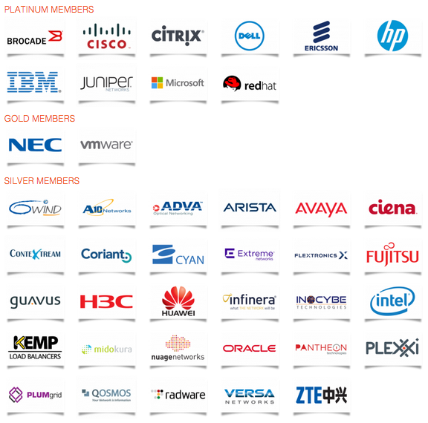
Who is in OpenDaylight Project?
Continuous Growth to 41 Members
Notes:
http://www.opendaylight.org/project/members
http://go.linuxfoundation.org/l/6342/2015-05-29/2fy2s9/6342/126488/OpenDaylight_Briefing_Deck_052815.pptx
Slide 11

Slide 8
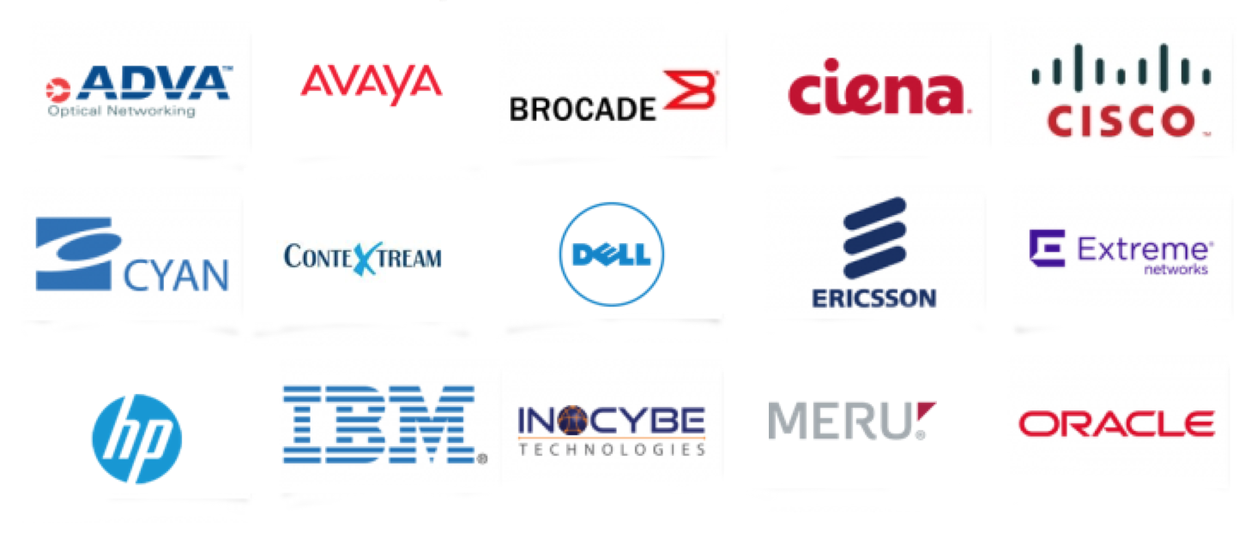
Who makes products based on Open Daylight?
Notes:
http://go.linuxfoundation.org/l/6342/2015-05-29/2fy2s9/6342/126488/OpenDaylight_Briefing_Deck_052815.pptx
Slide 13

Slide 9
4th Release “Beryllium”
Production-Ready Open SDN Platform
Graphical User Interface Application and Toolkit (DLUX / NeXT UI)
AAA AuthN Filter
OpenDaylight APIs REST/RESTCONF/NETCONF/AMQP
Base Network Functions
Enhanced Network Services
Network Abstractions (Policy/Intent)
Host Tracker
AAA
Messaging 4Transport
SNMP4SDN
ALTO Protocol Manager
Controller Platform Services/Applications
L2 Switch
Centinel – Streaming Data Hdlr
NetIDE
Time Series Data Repository
Fabric as a Service
OpenFlow Forwarding Rules Mgr
Controller Shield
Neutron Northbound
Unified Secure Channel Mgr
Group Based Policy Service
OpenFlow Stats Manager
Dev Discovery, ID & Drvr Mgmt
OVSDB Neutron
User Network Interface Mgr
NEMO
DOCSIS Abstraction
SDN Integration Aggregator
Virtual Private Network
Network Intent Composition
OpenFlow Switch Manager
Link Aggregation Ctl Protocol
Service Function Chaining
Virtual Tenant Network Mgr.
Topology Processing
LISP Service
Service Abstraction Layer/Core
Data Store (Config & Operational)
Messaging (Notifications / RPCs)
OpenFlow
OF-Config
OVSDB
NETCONF
LISP
BGP
PCEP
CAPWAP
OPFLEX
SXP
SNMP
USC
SNBI
IoT
Http/CoAP
LACP
PCMM/COPS
Southbound Interfaces &
Protocol Plugins
OpenFlow Enabled Devices
Open vSwitches
Additional Virtual & Physical Devices
Data Plane Elements
(Virtual Switches, Physical Device Interfaces)
Notes:
Lithium Diagram, July 2015

Slide 10
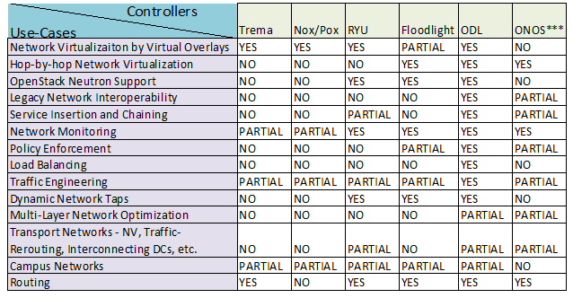
Is Opendaylight the only Open Source SDN Controller Available?

Slide 11
OpenDaylight Tools and Paradigms
Java interfaces
for event listening, specifications and forming patterns
Maven -
Build and dependency management
OSGi -
Backend container framework that allows dynamically loading bundles
Karaf -
OSGi based runtime
Notes:
http://sdnhub.org/tutorials/opendaylight/
Service Abstraction Layer (SAL) is your friend for most development aspects.
Java interfaces:
used for event listening, specifications and forming patterns
main way in which specific bundles implement call-back functions for events and also to indicate awareness of specific state.
Maven
Maven uses pom.xml (Project Object Model for this bundle) to script the dependencies between bundles and also to describe what bundles to load on start.
OSGi: This framework in the backend of OpenDayLight allows dynamically loading bundles and packaged Jar files, and binding bundles together for information exchange.
Karaf: Karaf is a small OSGi based runtime which provides a lightweight container for loading different modules.

Slide 12
What is an Application Programming Interface (API)?
set of rules ('code') and specifications that software programs can follow to communicate with each other.

Slide 13
What is a Representational State Transfer (REST) API?
A REST API is an API in a specific architectural style
originally communicated by Roy Fielding in his doctoral dissertation
http://www.ics.uci.edu/~fielding/pubs/dissertation/rest_arch_style.htm
Notes:
The REST architectural style describes six constraints. These constraints, applied to the architecture, were originally communicated by Roy Fielding in his doctoral dissertation (see http://www.ics.uci.edu/~fielding/pubs/dissertation/rest_arch_style.htm)

Slide 14
What defines a ‘RESTful’ API?
Six constraints
Start with Null Style
Client-Server
Stateless (Server)
Cache
Uniform Interface
Layered System
Notes:
see http://www.ics.uci.edu/~fielding/pubs/dissertation/rest_arch_style.htm) and defines the basis of RESTful-style.
The six constraints are: (click the constraint to read more)
Start with Null Style
an empty set of constraints
Client-Server
Stateless
Cache
Uniform Interface
Layered System

Slide 15
What distinguishes REST?
Emphasis on uniform interface between components
Four constraints
identification of resources
manipulation of resources through representations
self-descriptive messages
hypermedia as the engine of application state.
Notes:
see http://www.ics.uci.edu/~fielding/pubs/dissertation/rest_arch_style.htm) and defines the basis of RESTful-style.
Uniform Interface
identification of resources
manipulation of resources through representations
self-descriptive messages
hypermedia as the engine of application state.
From 5.1.5 Uniform Interface
“By applying the software engineering principle of generality to the component interface, the overall system architecture is simplified and the visibility of interactions is improved. Implementations are decoupled from the services they provide, which encourages independent evolvability. The trade-off, though, is that a uniform interface degrades efficiency, since information is transferred in a standardized form rather than one which is specific to an application's needs. The REST interface is designed to be efficient for large-grain hypermedia data transfer, optimizing for the common case of the Web, but resulting in an interface that is not optimal for other forms of architectural interaction. ”

Slide 16
Why a ‘RESTful’ API
Principle of generality
Simplifies overall system architecture
Visibility of interactions improved
Notes:
see http://www.ics.uci.edu/~fielding/pubs/dissertation/rest_arch_style.htm) and defines the basis of RESTful-style.
From 5.1.5 Uniform Interface
“By applying the software engineering principle of generality to the component interface, the overall system architecture is simplified and the visibility of interactions is improved. Implementations are decoupled from the services they provide, which encourages independent evolvability. “

Slide 17
Questions? Thoughts?
Matt Younkins
younkinsm@ou.edu

Slide 18
Extra Slides

Slide 19
Legend
AAA: Authentication, Authorization & Accounting
AuthN: Authentication
BGP: Border Gateway Protocol
COPS: Common Open Policy Service
DLUX: OpenDaylight User Experience
DDoS: Distributed Denial Of Service
DOCSIS: Data Over Cable Service Interface Specification
FRM: Forwarding Rules Manager
GBP: Group Based Policy
LISP: Locator/Identifier Separation Protocol
OVSDB: Open vSwitch DataBase Protocol
PCEP: Path Computation Element Communication Protocol
PCMM: Packet Cable MultiMedia
Plugin2OC: Plugin To OpenContrail
SDNI: SDN Interface (Cross-Controller Federation)
SFC: Service Function Chaining
SNBI: Secure Network Bootstrapping Infrastructure
SNMP: Simple Network Management Protocol
TTP: Table Type Patterns
VTN: Virtual Tenant Network
“HELIUM”
DLUX
VTN Coordinator
OpenStack Neutron
SDNI Wrapper
DDoS Protection
Network Applications
Orchestrations & Services
AAA- AuthN Filter
OpenDaylight APIs (REST)
Base Network Service Functions
OpenStack Service
GBP Service
SCF
AAA
DOCSIS Abstraction
Controller Platform
Topology Manager
Stats Manager
Switch Manager
FRM
Host Tracker
VTN Manager
OVSDB Neutron
Plugin20C
LISP Service
L2 Switch
SDNI Aggregator
Service Abstraction Layer (SAL)
(Plugin Manager, Capability Abstractions, Flow Programming, Inventory, etc.)
GBP Renderers
OpenFlow
OVSDB
NETCONF
PCMM/COPS
SNBI
LISP
BGP
PCEP
SNMP
Plugin20C
Southbound Interfaces &
Protocol Plugins
OpenFlow Enabled Devices
Open vSwitches
Additional Virtual & Physical Devices
Data Plane Elements
(Virtual Switches, Physical Device Interfaces)
Notes:
Helium Diagram, October 2014
https://wiki.opendaylight.org/view/File:Helium-diagram.pptx
http://www.opendaylight.org/project/technical-overview
Network Apps & Orchestration: The top layer consists of business and network logic applications that control and monitor network behavior. In addition, more complex solution orchestration applications needed for cloud and NFV thread services together and engineer network traffic in accordance with the needs of those environments.
Controller Platform: The middle layer is the framework in which the SDN abstractions can manifest, providing a set of common APIs to the application layer (commonly referred to as the northbound interface) while implementing one or more protocols for command and control of the physical hardware within the network (typically referred to as the southbound interface).
Physical & Virtual Network Devices: The bottom layer consists of the physical & virtual devices, switches, routers, etc., that make up the connective fabric between all endpoints within the network.

Slide 20
What is Karaf?
Small OSGi based runtime
Lightweight container
various components and applications can be deployed
Notes:
https://karaf.apache.org/

Slide 21
What is OSGi (Open Service Gateway Initiative)?
Java framework for developing and deploying modular software programs and libraries
Two components
Specification for modular components called bundles
Java Virtual Machine (JVM)-level service registry
Notes:
first part is a specification for modular components called bundles, which are commonly referred to as plug-ins. The specification defines an infrastructure for a bundle's life cycle and determines how bundles will interact. The second part of OSGi is a Java Virtual Machine (JVM)-level service registry that bundles can use to publish, discover and bind to services in a service-oriented architecture (SOA).

Slide 22
What are the drawbacks of REST?
Uniform interface degrades efficiency
information transferred in a standardized form rather than form specific to an application's needs
Notes:
see http://www.ics.uci.edu/~fielding/pubs/dissertation/rest_arch_style.htm) and defines the basis of RESTful-style.
From 5.1.5 Uniform Interface
“… The trade-off, though, is that a uniform interface degrades efficiency, since information is transferred in a standardized form rather than one which is specific to an application's needs. The REST interface is designed to be efficient for large-grain hypermedia data transfer, optimizing for the common case of the Web, but resulting in an interface that is not optimal for other forms of architectural interaction. ”

