Slide 1
The Shifting Landscape
of CI Funding
Dan Voss
Director of Research Computing
University of Kansas
dan.voss@ku.edu
Henry Neeman’s 2016 Super Awesome ACI-REF Virtual Residency Workshop

Slide 2
Where’s the $$?

Slide 3
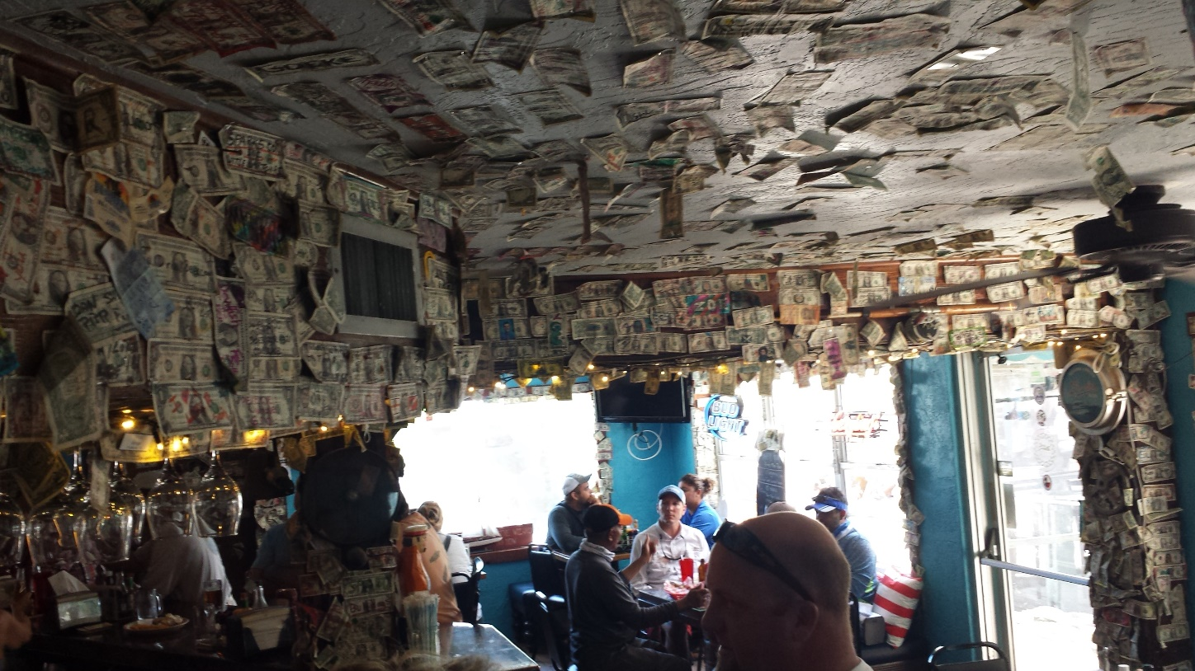
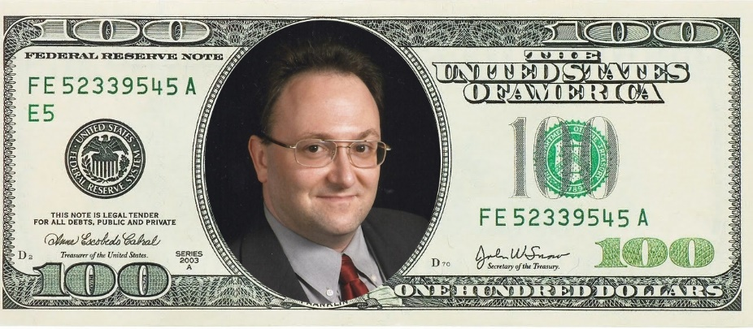
Everywhere…

Slide 4
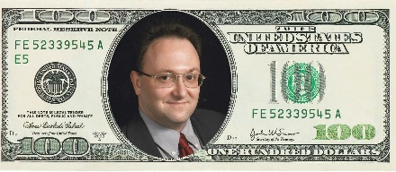
Funding Agencies
National Science Foundation (NSF)
eXtreme Science & Engineering Discovery Environment (XSEDE)
Open Science Grid (OSG)
Campus Cyberinfrastructure (CC)
Computer & Information Science & Engineering (CISE) Research Infrastructure (CRI)
Major Research Instrumentation (MRI)
Experimental Program to Stimulate Competitive Research (EPSCoR)
Department of Energy (DOE)
Innovative and Novel Computational Impact on Theory and Experiment (INCITE)
National Energy Research Scientific Computing Center (NERSC)
Department of Defense (DOD)
Defense University Research Instrumentation Program (DURIP)
National Institutes of Health (NIH)
Shared Instrument Grant (SIG)
High-End Instrumentation Grant (HEI)
United States Department of Agriculture (USDA), Private, Other?

Slide 5
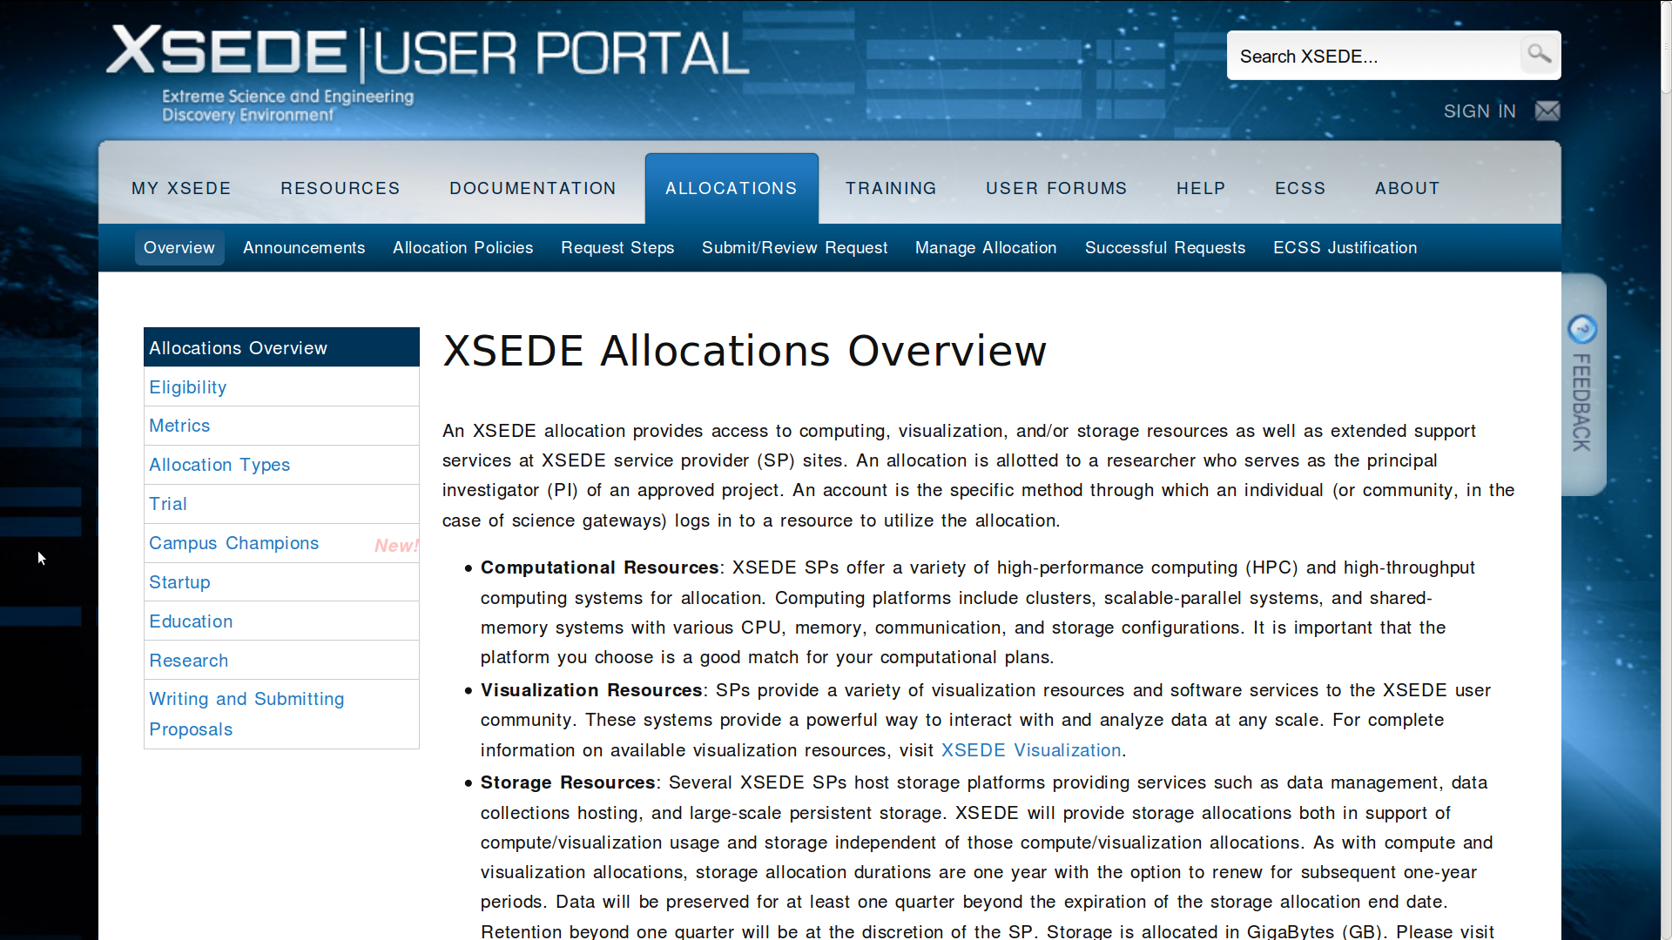
NSF XSEDE = Free $$ (cycles)!!
portal.xsede.org/allocations-overview

Slide 6
DOE & NSF OSG = Free $$ (cycles)!!
Might have to trade cycles/sysadmin time
display.grid.iu.edu
single threaded
< 2 GB memory
1-12 hours

Slide 7
NSF CC-NIE, CC*IIE, CC*DNI, CC*
Network Infrastructure and Engineering, 2012 - 2013
Infrastructure, Innovation, and Engineering, 2014
Data, Networking, and Innovation, 2015
*, August 23, 2016 (12 days from now)
www.nsf.gov/funding/pgm_summ.jsp?pims_id=504748

Slide 8
NSF CC*
www.nsf.gov/funding/pgm_summ.jsp?pims_id=504748

Slide 9
NSF CC*
www.nsf.gov/funding/pgm_summ.jsp?pims_id=504748
Awards Area_________________________________________________
1 - 2 Data Driven Multi-Campus/Multi-Institution Model Implementations awards will be supported at up to $3,000,000 total for up to 4 years.
2 – 4 Cyber Team awards will be supported at up to $1,500,000 total for up to 3 years.
5 - 10 Data Driven Networking Infrastructure for the Campus and Researcher awards will be supported at up to $500,000 total for up to 2 years.
5 – 8 Network Design and Implementation for Small Institutions awards will be supported at up to $400,000 total for up to 2 years.
2 – 5 Network Integration and Applied Innovation awards will be supported at up to $1,000,000 total for up to 2 years.
2 – 4 Campus Computing awards will be supported at up to $500,000 for up to 3 years.
4 – 8 Innovative Integrated Storage Resources awards will be supported at up to $200,000 for up to 2 years.

Slide 10
NSF CRI
www.nsf.gov/funding/pgm_summ.jsp?pims_id=12810
Two classes of awards:
Institutional Infrastructure (II) awards support the creation of
new (II-NEW) CISE research infrastructure or the enhancement (II-EN)
of existing CISE research infrastructure to enable world-class
CISE research opportunities at the awardee and collaborating institutions.
2. Community Infrastructure (CI) awards support the planning (CI-P) for
new CISE community research infrastructure, the creation of new (CI-NEW)
CISE research infrastructure, the enhancement (CI-EN) of existing
CISE infrastructure, or the sustainment (CI-SUSTAIN) of existing CISE
community infrastructure to enable world-class CISE research opportunities
for broad-based communities of CISE researchers that extend well
beyond the awardee institutions. Each CI award may support the
operation of such infrastructure, ensuring that the awardee institution(s)
is (are) well positioned to provide a high quality of service to CISE
community researchers expected to use the infrastructure to realize
their research goals.

Slide 11
NSF MRI
www.nsf.gov/od/oia/programs/mri/
FY 2014 AWARD INFORMATION
811 proposals reviewed
205 awards (a success rate of 25%).
$1/4$ development (<24% success)
$3/4$ acquisition (<26% success)
$1/8$requested budgets > $1 million (20% success)
Biological Sciences 20%
Computer and Information Science and Engineering 45%
Engineering 20%
Geosciences 32%
Mathematical and Physical Sciences 25%
Social Behavioral and Economic Sciences 37%
* Success varies - some directorates co-fund MRI awards with non-IA
program funds while others do not.

Slide 12
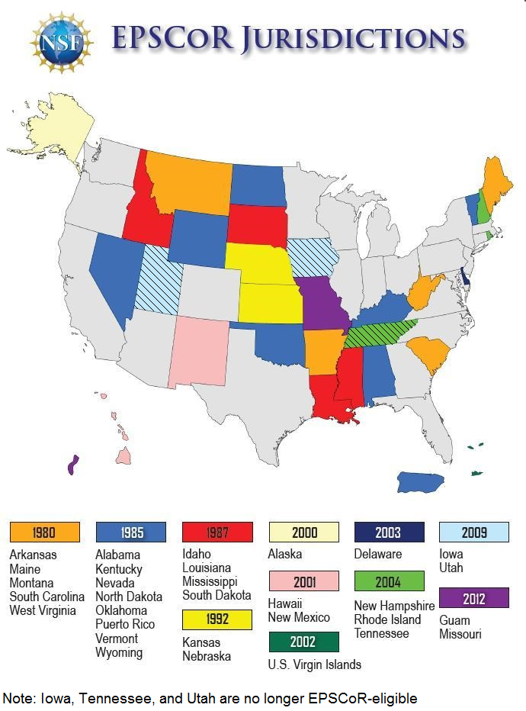
EPSCoR

Slide 13
EPSCoR
www.nsf.gov/od/oia/programs/epscor/
Research Infrastructure Improvement Program Track-1 (RII Track-1)
$20 million total for 5 years to support physical, human, and
cyber infrastructure improvements in research areas selected by
the jurisdiction's EPSCoR steering committee as having the best
potential to improve future R&D competitiveness of the jurisdiction.
Research Infrastructure Improvement Program: Track-2 (RII Track-2)
$1.5 to 2.0 million per year for up to 3 years to consortia of EPSCoR jurisdictions.
The awards promote opportunities for collaborations among EPSCoR jurisdictions
in all areas of science, engineering, and education supported by the NSF.
RII Track-2 proposals must describe a clear, comprehensive, and integrated
vision to drive discovery, and train a skilled workforce capable of solving
science and engineering challenges of regional, thematic, and national relevance.

Slide 14
DOE INCITE
www.doeleadershipcomputing.org/incite-program/
Nearly six billion core-hours will be allocated for CY 2017
Average awards per project for CY 2017 are expected to be on
the order of 75 million core-hours for Titan and 100 million core-hours
for Mira, but could be as much as several hundred million core hours.
Proposals may be for up to three years.
Requests for small awards of time (typically 1 to 5 million core-hours) can
be requested throughout the year from the Director’s Discretionary Program

Slide 15
DOE NERSC
www.nersc.gov/users/accounts/allocations/overview/
NERSC supports research that reflects the mission of DOE's Office of Science. All Principal Investigators funded by the Office of Science may apply for an allocation of NERSC resources. In addition, researchers who aren't directly funded by DOE SC
but with projects that are relevant to its mission may also apply to use NERSC resources. If you are not funded by the DOE Office of Science you should explain how your research falls within the DOE mission.

Slide 16
DOD DURIP
www.defense.gov/News/Article/Article/684740/
pentagon-announces-research-equipment-awards
Army Research Office (ARO)
Office of Naval Research (ONR)
Air Force Office of Scientific Research (AFOSR)
Current Awards
176 proposals funded from 96 academic institutions (28%)
$50.1 million
Received 622 proposals requesting $209 million
Awards range from $53,000 to $1.4 million
Average approximately $300,000 per award

Slide 17
NIH SIG & HEI
dpcpsi.nih.gov/orip/diic/shared_instrumentation
Office of Research Infrastructure Programs (ORIP)
Shared Instrumentation Grant Program (S10)
$50,000 to $600,000 range
FY 2015, 91 awards to biomedical research institutions
in 31 states totaling $40,293,834
High-End Instrumentation Grant Program (S10)
$600,000 to $2,000,000 range
FY 2015, 19 awards to research institutions
in 13 states totaling $26,162,569

Slide 18
USDA, Private, Other?
United States Department of Agriculture
Telemedicine
www.rd.usda.gov/programs-services/distance-learning-telemedicine-grants
Silicon Mechanics Research Grant
www.siliconmechanics.com/i43744/research-cluster-grant-winners-circle.php
Other?

Slide 19
Questions?
Comments?
dan.voss@ku.edu

