Slide 1
Advanced Cyberinfrastructure Research & Education Facilitators Virtual Residency: Overview
Henry Neeman, University of Oklahoma
Director, OU Supercomputing Center for Education & Research (OSCER)
Assistant Vice President, Information Technology - Research Strategy Advisor
Associate Professor, College of Engineering
Adjunct Faculty, School of Computer Science
ACI-REF Virtual Residency Workshop 2016
Sunday August 7 2016

Slide 2
Let’s Introduce Ourselves!
Let’s go around the room.
Tell us:
your name;
your institution;
your role at your institution;
why you wanted to attend the ACI-REF Virtual Residency;
What do you hope to get out of this week?

Slide 3
Outline
This is an experiment!
Advanced Cyberinfrastructure Research & Education Facilitators
National Science Foundation’s Campus Cyberinfrastructure Programs
You’re Next …

Slide 4
This is an Experiment!
Everything about this week is exciting and new.
Those of you who are new are only the second cohort of what we want to be a national program.
This means that you’re helping us to pioneer a new way of developing the next generation Cyberinfrastructure (CI) workforce.

Slide 5
You Voted with Your Feet
We thought most of the interest would be in learning how to be a Campus CI Engineer.
But it turned out that a big chunk of the national need is learning how to help researchers do the computing- and data-intensive parts of their research.
2015: Science DMZ Track: 14% (7 of 50)
2016: Science DMZ Track: 21% (22 of 104)
Since we do both here, we can teach both here.
So we can serve both sides of the national need.

Slide 6
Only You …
… can make this Virtual Residency a success.
Ask questions -- the only dumb question is the one you don’t ask.
Volunteer your ideas and experiences.
Ultimately, it’s you who will have to be in charge, not us.

Slide 7
Advanced Cyberinfrastructure Research & Education Facilitators

Slide 8
What is an ACI-REF?
Advanced Cyberinfrastructure Research & Education Facilitator (term coined by Miron Livny)
Work with users -- researchers and educators -- to help them improve their research and/or education productivity and aspirations using advanced cyberinfrastructure.
Typically, one or a few ACI-REFs have responsibility for an entire institution, or multiple institutions.
At some institutions, CI facilitation is part time; at other institutions, it’s a full time job. It can come from:
faculty or former faculty;
postdocs or former postdocs;
research staff or former research staff;
IT professionals;
graduate or undergraduate students.

Slide 9
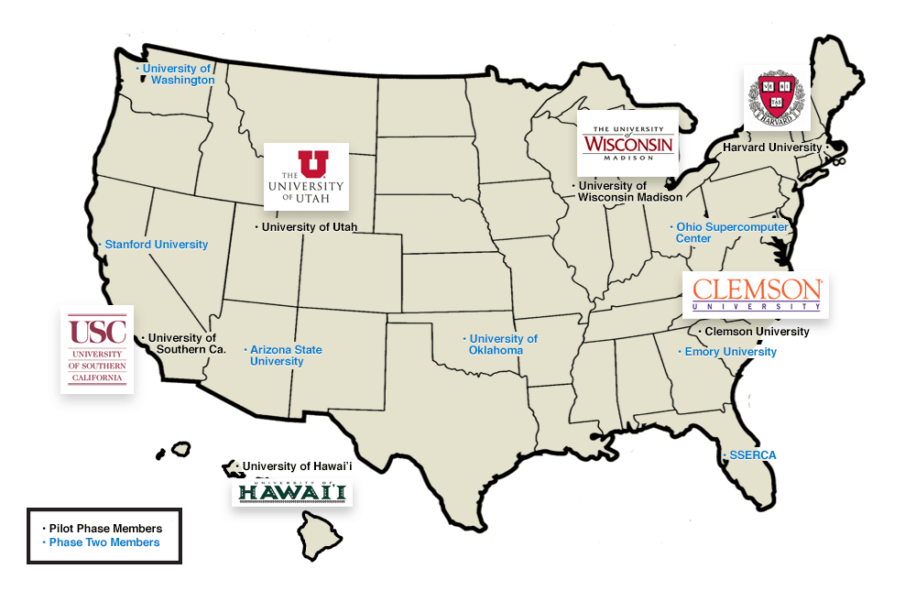
A Little Background
In 2013, a team of 13 institutions led by Clemson U submitted an 8-figure proposal on this issue, to provide multiple ACI-REFs at each institution over a 4 year period.
The proposal also included funding for advanced networking.
http://www.aciref.org/wp-content/uploads/2014/04/map.png

Slide 10
OU’s Piece
OU’s piece included some extra components:
a component about EPSCoR jurisdictions, shared with HI, SC, UT (note that UT is now graduating from EPSCoR);
EPSCoR: Experimental Program for the Stimulation of Competitive Research: federal program to promote and increase STEM research in states that get less than 0.75% of federal research funding.
NSF, Dept of Energy, Dept of Defense, NASA
NIH (known as INBRE)
a Virtual Residency to teach how to be an ACI-REF -- THIS!

Slide 11
Ah, if only ….
“Phase 1:”
Clemson U
Harvard U
U Hawai’i
U Southern California
U Utah
U Wisconsin
“Phase 2:”
Arizona State U
Emory U
Ohio Supercomputer Center
Stanford U
Sunshine State Education & Research Computing Alliance (SSERCA)
U Oklahoma
U Washington
Unfortunately, the NSF wasn’t able to fully fund that proposal. The team ended up reducing down to 6 institutions for 2 years, and no advanced networking.

Slide 12
National Science Foundation’s Campus Cyberinfrastructure Programs

Slide 13
And then …
In 2012-13, the NSF had a program called “Campus Cyberinfrastructure - Networking Infrastructure & Engineering” (CC-NIE).
Two subprograms: One for deploying networking equipment, one for innovative networking research.
OU, OSU, Oklahoma Innovation Institute, Langston U, OneNet: “OneOklahoma Friction Free Network”
In 2014, that was followed by “Campus Cyberinfrastructure - Infrastructure, Innovation & Engineering” (CC*IIE).
Several new subprograms, including “Campus CI Engineer.”

Slide 14
So …
In 2014, OU submitted a proposal to the Campus CI Engineer subprogram:
“A Model for Advanced Cyberinfrastructure Research and Education Facilitators”
$400K
Highlights the relationship between OU and the ACI-REF project.
We have Clemson’s Phase 1 PI on our External Advisory Committee.
OU is the only institution that is all of:
ACI-REF Phase 2 (so already involved)
EPSCoR (and was to have co-lead the ACI-REF EPSCoR thrust)
CC-NIE awardee (so need a Campus CI Engineer already)

Slide 15
Objectives
Data-Intensive Research Facilitation: Via Software Defined Networking (SDN) across OFFN, facilitate end-to-end management, by researchers, of high bandwidth/high performance data flows through a distributed hierarchy of open standards tools, providing researchers with a new layer of transparency into network transport at OU, among OneOCII institutions, and with ACI-REF members.
Oklahoma ACI-REF project: Lead and facilitate adoption of the ACI-REF approach across Oklahoma, leveraging extant and emerging capabilities within OneOCII.
National training regime: Provide a “virtual residency” program for Campus CI Engineers and other ACI-REFs, open to not only CC*IIE awardees and ACI-REF members but any institution that needs.
Research Experiences for Undergraduates (REU) Sites/Supplements: Foster undergraduate research at OU via a culture of integrating REU sites and supplements into Science, Technology, Engineering & Mathematics (STEM) research, including by all research themes on this proposed CC*IIE project.

Slide 16
Success!
Reviewer comments
“This energetic, detailed and ambitious proposal from the University of Oklahoma deserves the highest priority for support. … There are no major weaknesses in the proposal and many strengths. …”
“The broader impacts are nicely defined in terms of … the idea of a residency program …. A residency program and enhancement of undergraduate research are strong enhancements to the proposal. …”
“This is one of the better proposals regarding … additional outreach via the budgeted virtual residency program. …”

Slide 17
Even More Success!
From a review from a recently funded proposal that joins the teams of the Clemson-led ACI-REF Phase 1 and OU’s Campus CI Engineer grant, regarding Phase 1 broader impacts:
“The ACI-REF virtual residency held at OU Supercomputing Center may be … notable … (the web site’s description of the workshop looked outstanding) -- assuming it was available to a broader community and not just the [Phase 1] awardees.”
2015: 49 of 50 participants, from 37 of 38 institutions, were “not just the [Phase 1] awardees.”
2016: 95 of 104 accepted registrants, from 69 of 75 institutions, were “not just the [Phase 1] awardees.”

Slide 18
Virtual Residency

Slide 19
Lots of Interest 2014
For OU’s 2014 Campus CI Engineer proposal, we had 33 institutions in 23 US states and territories that expressed interest in the Virtual Residency workshops, including:
19 institutions in 13 EPSCoR states;
3 Minority Serving Institutions;
7 non-PhD-granting institutions.

Slide 20
Lots of Interest 2015
In 2015:
We had applications from over 65 people at 50 institutions in 31 US states and territories.
The final headcount was 50 (28 onsite, 22 remote) from 38 institutions in 29 US states and territories, including:
19 attendees from 14 institutions in 12 EPSCoR states;
5 attendees from 5 Minority Serving Institutions;
5 attendees from 5 non-PhD-granting institutions.

Slide 21
Lots of Interest 2016
In 2016, as of Sat Aug 6:
Applications: 116 from 80 institutions in 35 US states plus 4 other countries (Canada, India, Nigeria, UK)
Confirmed registrants: 104 from 74 institutions in 34 US states plus 4 other countries (as above), including:
27 attendees from 21 institutions in 13 EPSCoR states;
10 attendees from 9 minority serving institutions;
13 attendees from 13 non-PhD-granting institutions (including 3 from 3 @ MSIs;
43 registrants onsite, 61 attendees remote;
of 2015’s 38 institutions, 24 (63%) are registered to return, plus 2 of 2015’s attendees who are now at new institutions;
73 registrants are from 47 institutions that have Campus Champions, including 33 Champions.

Slide 22
Agenda
You’ve got a copy of the agenda in front of you.
Everything on it is subject to change without notice:
We may drop some of the sessions.
We may add sessions that we think are needed.
You’re going to help us learn how to help you learn.

Slide 23
What Are We Here to Accomplish?
Learn how to work with researchers who are using CI.
Learn how to talk to them.
Learn how to help them.
Learn how to contribute to, and ultimately to lead, grant proposals.
Some of you already know how to do this, so you’ll help us help the rest to learn.
Not everyone here will do this for a living, but it’ll help you to understand it regardless, because your customers do it.
Science DMZ Track
Learn about Science DMZs, Software Defined Networking etc.
Computational Science & Engineering Track
Get some practice working with researchers.

Slide 24
What Aren’t We Trying to Do?
On the Computational & Data-enabled Science & Engineering track, we AREN’T trying to teach you a lot of technical content.
You can learn that from other sources.
Instead, our goal is to teach you the PROFESSION of CI facilitation.

Slide 25
What Are We Really Here For?
We’re really here to prepare for an upcoming transition to:
more need for this kind of skilled workforce, but
fewer people who know how to do it, with
no mechanism to prepare a sufficiently large cohort.
Some of us here already know how to do this.
But it took a very long time to learn on our own.
To keep up with demand, the community needs us to streamline the process so that new CI facilitators can become fully productive quickly.
You’re the leaders of tomorrow.

Slide 26
You’re Next …
http://freapp.us/apps/android/com.im.uncle.sam/

Slide 27
A Growing Need, a Growing Breed
The Coalition for Academic Scientific Computation (CASC) is a group of most of the mid-to-large academic and government CI centers in the US.
When OU joined CASC in 2004, there were roughly 35 member institutions.
Now there are ~85.
So the growth has been significant.
There are a total of 329 institutions that have a Carnegie classification of “doctoral.”
So the growth potential is substantial.

Slide 28
Get Ready to Be in Charge
Baby Boomers: born 1946-1964 (ages 52-71)
Generation X: 1965-1984 (ages 32-51)
Millenials: roughly ages 12-32
“Roughly 10,000 Baby Boomers will turn 65 today, and about 10,000 more will cross that threshold every day for the next 19 years.” -- Pew Research Center, 2010 http://www.pewresearch.org/daily-number/baby-boomers-retire/
Who do you think is going to have to take up the mantle they’re currently carrying?

Slide 29
Why ACI-REF is the Best Job Ever
Every day, you get to see how the work you do helps other people to be successful.

Slide 30
Acknowledgements
Portions of this material are based upon work supported by the National Science Foundation and the Department of Defense under the following grants:
Grant No. EPS-0814361, “Building Oklahoma's Leadership Role in Cellulosic Bioenergy”
Grant No. EPS-0919466, “A cyberCommons for Ecological Forecasting”
Grant No. EPS-1006919, “Oklahoma Optical Initiative”
Grant No. OCI-10310029, “MRI: Acquisition of Extensible Petascale Storage for Data Intensive Research”
Grant No. OCI-1126330, “Acquisition of a High Performance Compute Cluster for Multidisciplinary Research”
Grant No. ACI- 1229107, “Acquisition of a High Performance Computing Cluster for Research and Education”
Grant No. EPS-1301789, “Adapting Socio-ecological Systems to Increased Climate Variability”
Grant No. ACI-1341028, “OneOklahoma Friction Free Network”
Grant No. ACI-1440783, “A Model for Advanced Cyberinfrastructure Research and Education Facilitators”
Grant No. ACI-1440774, “ENabling CyberInfrastructure via Training and Engagement”
Grant No. ACI-1531128, “MRI: Acquisition of Shared High Performance Compute Cluster for Multidisciplinary Computational and Data-Intensive Research,” OSU, $950K
Grant No. ?, “DURIP-ARO: Heterogeneous Cluster for Cyber-Physical System Security Analytics,” TU, $200K
Grant No. CNS-1531270, “MRI: Development of Heterogeneous Cluster for Cyber-Physical System Hybrid Analytics,” TU, $180K
Grant No. ACI-1546711, “EAGER: Fact-Gathering and Planning for a National-Scale Cyberpractitioner Program,” Internet2, $41K
Grant No. ACI-1620695, “RCN: Advancing Research and Education Through a National Network of Campus Research Computing, Infrastructures – The CaRC Consortium, “ Clemson U, $748K
Dell provided seed systems for the OU Research Cloud (“OURcloud”) and the OU Science DMZ.

Slide 31
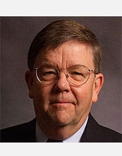
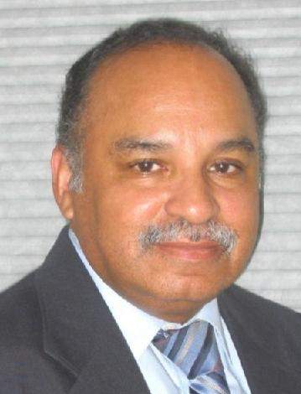
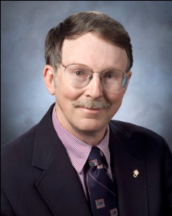
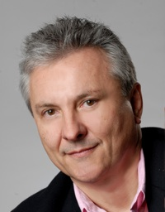
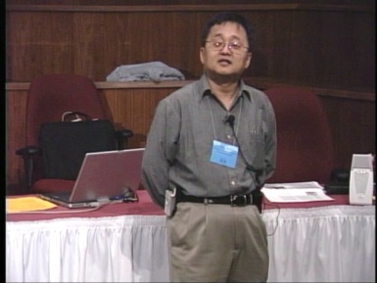
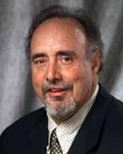
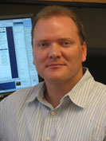
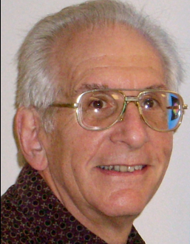
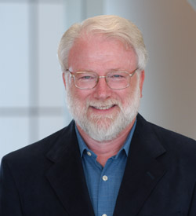
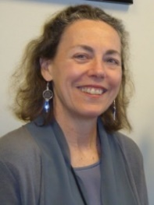
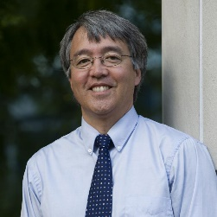
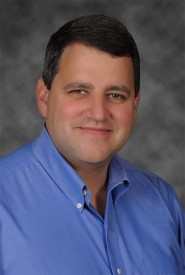
OK Supercomputing Symposium 2016
2003 Keynote:
Peter Freeman
NSF
Comp & Info Sci & Engr
Assistant Director
2004 Keynote:
Sangtae Kim
NSF Shared
Cyberinfrastructure
Division Director
2005 Keynote:
Walt Brooks
NASA Advanced
Supercomputing
Division Director
2006 Keynote:
Dan Atkins
Head of NSF’s
Office of
Cyberinfrastructure
2007 Keynote:
Jay Boisseau
Director
Texas Advanced
Computing Center
U. Texas Austin
2008 Keynote: José Munoz Deputy Office Dir Sr Sci Advisor NSF Office of Cyberinfrastructure
2009 Keynote: Douglass Post Chief Scientist US Dept of Defense HPC Modernization Program
2010 Keynote Horst Simon Deputy Director Lawrence Berkeley Nat’l Laboratory
FREE!
Wed Sep 21 2016
@ OU
Over 235 registra2ons already!
Over 152 ie first day, over 200 in the first week, over 225 in the first month.
2011 Keynote Barry Schneider Program Manager National Science Foundation
2012 Keynote Thom Dunning Director National Center for Supercomputing Applications
2013 Keynote: John Shalf Dept Head CS Lawrence Berkeley Nat’l Lab CTO, NERSC
2014 Keynote: Irene Qualters Division Dir Advanced Cyberinfrastructure Division, NSF
2015 Keynote: Jim Kurose Asst Director Comp & Info Sci & Engr Directorate, NSF
Reception/Poster Session
Tue Sep 20 2015 @ OU
Symposium
Wed Sep 21 2015 @ OU
2016 Keynote:
Dan Stanzione
Exec Director
Texas Advanced
Computing Center
U. Texas Austin

Slide 32
Thanks for your attention! Questions? hneeman@ou.edu

