Slide 1
So You Want to Write a Cyberinfrastructure Proposal
Henry Neeman, University of Oklahoma
Director, OU Supercomputing Center for Education & Research (OSCER)
Assistant Vice President, Information Technology - Research Strategy Advisor
Associate Professor, Gallogly College of Engineering
Adjunct Associate Professor, School of Computer Science
ACI-REF Virtual Residency Workshop 2016
Friday August 12 2016

Slide 2
Outline
Equipment Location and Type (MRI/CRI)
Vision
Research Activities to be Enabled
Includes Results from Prior NSF Support
Description of the equipment and Needs
Impact on Research and Training Infrastructure
Management Plan
Cost Share & Institutional Commitment

Slide 3
Read the Solicitation
The NSF provides an extensive, reasonably detailed solicitation.
Read it.
Obey it.
Failure to obey the solicitation can be grounds for returning your proposal without review.

Slide 4
Vision
Describe the overall project.
Give your project a name. Use it often.
It’s great if the name obviously relates to your institution.
Justify: In your first paragraph, quote a report from a national body (e.g., NSF, national academies, etc) saying that this sort of project is important.
What will be the outcome if the proposal isn’t funded?
Don’t whine about how little your institution has or how old your current infrastructure is. That’s not the NSF’s problem.
Give a quick list of research projects.
Give a quick description of the equipment.
Provide a table of all projects, including how much of the resource they need, their funding and headcounts.
If the proposal has no unifying science theme, provide a list of themeless funded grants from past instances of the same program.

Slide 5
Research Projects
Each research project to be served by the equipment should have anywhere from a page to a few sentences of description, along with the answers to the questions on the next few slides.
Prove that it’ll be full a lot, ideally oversubscribed.
Prove that what fills it is important, transformative research.
Hero projects should get the most proposal real estate and should come first; gradually reduce the length of later, less shiny projects.
For a Cyberinfrastructure proposal, the biggest consumers of the resource should be early, but you don’t have to go in order of consumption -- go from most compelling to least.
For Small Institution proposals, there’s room to use teaching.

Slide 6
Equipment Proposal Questions #1
For each research project:
How much funding does your research currently have? How much is pending? Planned? From what sources?
How many faculty, staff, postdocs, grad students and undergrads on your team will be served by this equipment?
What makes your research transformational?
What are the broader impacts?
Not just in the STEM research sense
Underrepresented populations
Integration of education and research
Dissemination
Societal impact
etc

Slide 7
Equipment Proposal Questions #2
How much of the proposed resource (CPU hours, storage, bandwidth, whatever) do you expect to need over the next N years?
How did you calculate this amount?
Please give me a one page summary of your research that incorporates these issues.
This is typically straightforward, because faculty often have either a 1 page summary from a grant proposal or a more broad research statement.

Slide 8
MRI/CRI for HPC Cluster Questions #1
How many CPU core hours or node hours will you need over the next N years?
How did you determine that?
Have you benchmarked your code?
On what platform?
What is the expected performance improvement on the proposed equipment, compared to the platform you benchmarked on? How did you come up with that estimate?
If it’s your own code (or if you’re part of the development team for a community code), do you plan to optimize the software? If so, what performance improvement do you anticipate?
Be conservative with your estimates. Wild claims of amazing speedup won’t impress the reviewers, they’ll just think you’re naïve or BSing.
http://www.nsf.gov/pubs/2011/nsf11011/nsf11011.jsp

Slide 9
MRI/CRI for HPC Cluster Questions #2
If the proposal is for a new type of platform (for example, accelerators such as GPUs or Intel Xeon Phi/MIC):
Who will be responsible for porting the code to the new platform?
If this is either a community code or a commercial code, the porting may already have been done by the developers. Say that.
Have they committed to do so? How reliable is that commitment? How is that being funded?
What speedup is expected on the new platform? How was that number determined?

Slide 10
MRI/CRI for HPC or Storage Questions
How much storage will be needed for this project?
If this is for live storage: What is the maximum amount of storage at a time that will be needed for this project?
If this is for archival storage: What is the total amount of storage needed over the lifetime of the equipment?
How was that calculated?

Slide 11
CC* Questions #1
What is the expected typical size of each dataset being transferred?
(It would be helpful to know expected growth rate: Are you expecting it to stay roughly the same over the next several years, or to double every two years, or what?)

Slide 12
CC* Questions #2
Where are such datasets originating, and where are they being transferred to?
Why do such datasets need to be transferred between these endpoints?
(That is, what requirement do these data transfers address for your team’s research?)

Slide 13
CC* Questions #3
What is the time window for transferring each such dataset?
Why does each such dataset need to be transferred during that specific time window?
That is, what's the negative impact of the transfer taking
(a) marginally longer and (b) much longer?
How often do you expect to have such a data transfer need?

Slide 14
Prior Results
Every NSF proposal has to have a section on “Results from Prior NSF Support.”
If your team has lots of that, you can’t fit it all. The solicitation and the NSF’s Grant Proposal Guide provide useful guidelines on that.
The PI and each Co-PI should each provide the one most relevant grant.
For an MRI, preference should be given to equipment grants, especially other MRIs.
If you don’t have anything relevant, say that.
If you do, is there a way that you can fit this proposal into a more coherent story about how your institution does CI?

Slide 15
Equipment Description
Give a rationale for the equipment. This reinforces your vision statement.
Describe the purchase process.
Describe current similar equipment at your institution or otherwise available to your researchers.
Just because there’s another one nearby doesn’t mean your proposal isn’t fundable.
Just because there are national centers with bigger resources doesn’t mean your proposal isn’t fundable.
Describe the role of the equipment.

Slide 16
Equipment Description
Describe the equipment in detail. You can express lots of technical information in a modest number of paragraphs.
Describe how the equipment will be accessed.
Give the expected performance.
Describe delivery, installation and operations training.

Slide 17
Impact
Describe how the equipment will attract researchers. Will it be used to attract new faculty and/or new students?
Refer back to the research section to describe the impact on your team’s research.

Slide 18
Broader Impacts
Describe the broader impacts.
Impact on STEM research
Integration of research and education
Underrepresented populations
minorities, women, disabled
non-PhD-granting institutions
rural vs urban
Societal impact: e.g., health, economic development etc
National defense
Refer back to the individual research projects’ broader impacts.
You don’t need to have all of these items, but have some.
Your broader impacts are judged more on what you’ve already done that on what you claim you’re going to do.

Slide 19
Management Plan
Describe the facility where the equipment will reside, in detail.
Operations labor: who, what credentials, who will manage them.
You can make them or their boss Senior Personnel.
Apportioning: Who will get how much?
Decision making: Describe the procedure.
Advisory committee(s)
External: one CI, one researcher, one broader impacts.
You can also have an Internal Advisory Committee.
Timeline and milestones
Sustainability plan: What happens when the grant ends?

Slide 20
Management Plan: Facility
Where will the equipment reside? (e.g., data center)
What capabilities does that location have?
Space
Power
UPS? Generator?
Cooling
Fire suppression?
Network
Security
Accessibility: Describe the path from loading dock to data center floor.

Slide 21
Cost Share
For some programs (e.g., Major Research Instrumentation), cost share is mandatory for PhD-granting institutions and non-degree-granting institutions.
MRI: 30% of total project budget (NSF pays 70%).
For some programs (e.g., Major Research Instrumentation), cost share is forbidden for non-PhD-granting degree-granting institutions.
Cost share can only be done at exactly the level required in the solicitation.
There is NO SUCH THING as voluntary cost share: If they don’t ask for it, you can’t include it.
Your proposal may be returned without review if you do.

Slide 22
Institutional Commitment
Not the same as cost share.
Not required, not prohibited.
Strange rules:
CANNOT mention any dollar figures (or anything that can be straightforwardly translated into dollar figures).
MUST appear in the Facilities section (preference for at the end).
SHOULD be confirmed in a letter of commitment from someone who has the authority to commit.
MAY appear in the project description (which is a good idea).

Slide 23
CC: Cyberinfrastructure Plan
Description of campus network: detail is good!
Description of statewide network, if appropriate
Relevant networking grants, if any
IPv6
perfSonar
InCommon
BCP 38 (or uRPF)
Connection to Internet2, AL2S, ESnet, etc
Other relevant services (e.g., Globus Online, Cilogon)
Be concise and specific ….

Slide 24
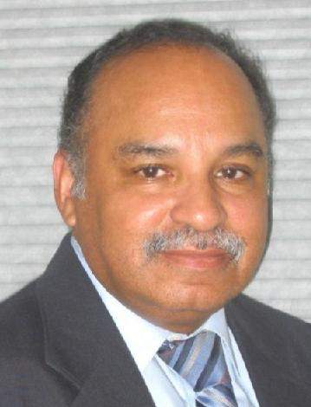
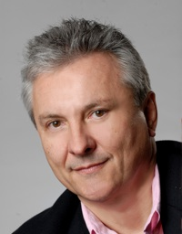
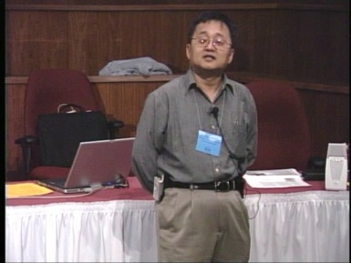
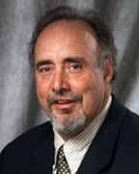
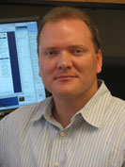
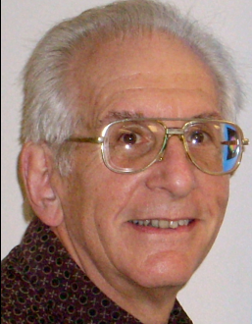
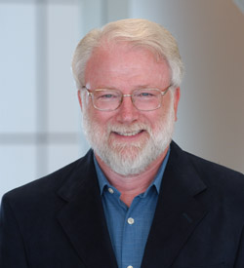
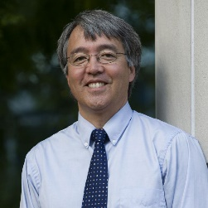
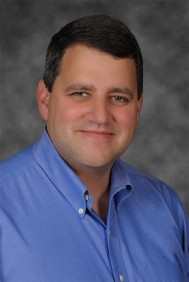
OK Supercomputing Symposium 2016
2002 Keynote:
Ron Cooper
Center of
Excellence in
IT & Telecom
Exec Director
2003 Keynote:
Peter Freeman
NSF
Comp & Info Sci & Engr
Assistant Director
2005 Keynote:
Walt Brooks
NASA Advanced
Supercomputing
Division Director
2007 Keynote:
Jay Boisseau
Director
Texas Advanced
Computing Center
U. Texas Austin
2008 Keynote: José Munoz Deputy Office Dir Sr Sci Advisor NSF Office of Cyberinfrastructure
2004 Keynote:
Sangtae Kim
NSF Shared
Cyberinfrastructure
Division Director
2006 Keynote:
Dan Atkins
Head of NSF’s
Office of
Cyberinfrastructure
2009 Keynote: Douglass Post Chief Scientist US Dept of Defense HPC Modernization Program
2010 Keynote Horst Simon Deputy Director Lawrence Berkeley Nat’l Laboratory
FREE!
Wed Sep 21 2016
@ OU
Over 235 registra2ons already!
Over 152 ie first day, over 200 in the first week, over 225 in the first month.
2011 Keynote Barry Schneider Program Manager National Science Foundation
2012 Keynote Thom Dunning Director National Center for Supercomputing Applications
2013 Keynote: John Shalf Dept Head CS Lawrence Berkeley Nat’l Lab CTO, NERSC
2014 Keynote: Irene Qualters Division Dir Advanced Cyberinfrastructure Division, NSF
2015 Keynote: Jim Kurose Asst Director Comp & Info Sci & Engr Directorate, NSF
Reception/Poster Session
Tue Sep 20 2015 @ OU
Symposium
Wed Sep 21 2015 @ OU
2016 Keynote:
Dan Stanzione
Exec Director
Texas Advanced
Computing Center
U. Texas Austin

Slide 25
Thanks for your attention! Questions? hneeman@ou.edu

