Slide 1
Multi-Scale Spatiotemporal Mining of Atmospheric Data
Amy McGovern
Schools of Computer Science and Meteorology
amcgovern@ou.edu

Slide 2
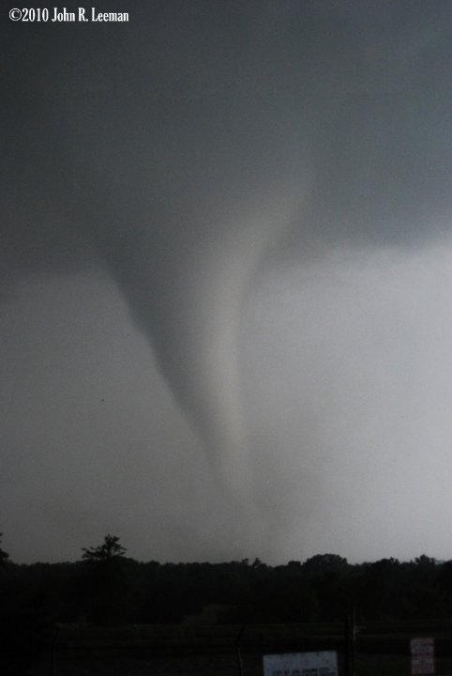
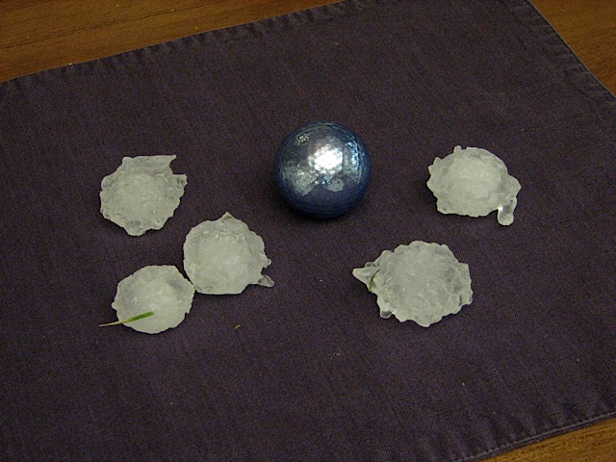
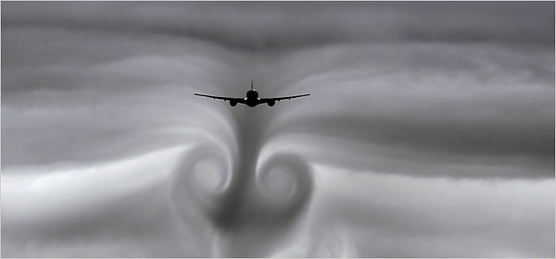
Why?
Image from the Norman Transcript
Photo from Amy McGovern
Image Courtesy: New York Times
Notes:
Put in turbulence picture

Slide 3
Goals
Fundamentally transform our understanding of the causes of high-impact weather
  Tornadoes
  Turbulence
  Polar vortices
  Hail
  Severe wind
  Thunderstorm initiation
  Rainfall (floods, drought)
Improve the prediction and modeling of these events

Slide 4
Tornado prediction performance

Slide 5
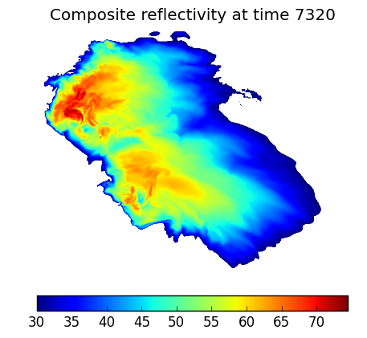
Big weather data: Tornadoes
100 m horizontal resolution in center of nested grid
Stretched vertical grid
1536 × 1536 × 99 ≈ 234 million model grid points
Data saved at every grid point every 30 seconds of simulated time

Slide 6
Data Intensive Computing: Tornadoes
Simulations
  Run the simulation
  Post-process the simulation
Data mining and visualization
  Visualizations/Data verification
  Vortex identification and extraction
  Object identification and extraction
  Generating metadata for data mining
  Data mining

Slide 7
Simulation details
Run the simulations:
  Goal of 100 simulations
  Requires a supercomputer!
    4.5 hours on 3600 cores (darter)
    6-8 hours on 1800 cores (schooner)
Post-process the simulations
  1 hour, 128 cores (darter)
  1-2 hours, 4 cores (schooner)

Slide 8
Data Intensive Computing: Tornadoes
Simulations
  Run the simulation
  Post-process the simulation
Data mining and visualization
  Visualizations/Data verification
  Vortex identification and extraction
  Object identification and extraction
  Generating metadata for data mining
  Data mining
OSCER

Slide 9
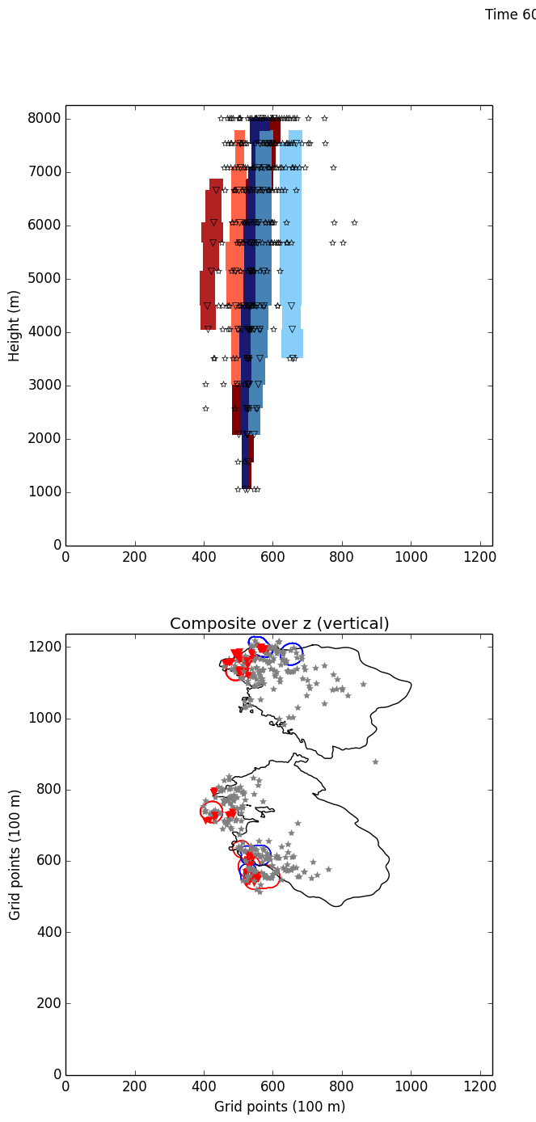
Vortex identification and extraction
Purpose: Identify the vortices to find the tornadoes and mesocylones
Computational challenges:
  Each process takes ~15 minutes
    Primarily mathematical (gradient descent)
  17 vertical levels x 300 time steps x 3 parameter settings = 15300 independent jobs
  IO bound:
    Memory footprint fairly minimal
    Reads in a LOT of netcdf files and outputs a LOT of small files

Slide 10
OSCER’s solutions
Vortex identification and extraction went from ~1 week of running time to a few hours
  Consultation with Henry identified key inefficiencies
Henry has identified key issues to fix in other steps as well
  In process of being implemented as we transition to schooner
OSCER helped my students and I learn about HPC
  Our simulations outgrew boomer so we looked to XSEDE
  We are moving back to schooner to better share data within OU
  OSCER continued to help us even when our work was on XSEDE machines

Slide 11
Research Outcomes
Created unique set of supercell simulations
  252 storms at a 500 m horizontal resolution
  ~60 storms (in progress) at 100 m horizontal resolution
  Shared with researchers at OU and outside of OU
Developed and applied unique spatiotemporal data mining methods to a wide variety of high-impact weather phenomena
  NSF funded projects: CAREER, REU supplements
  NSF pending projects: BIGDATA
  Publications: 17 publications facilitated by HPC knowledge that wouldn’t be possible without OSCER’s help

Slide 12
Research Outcomes: Students
OSCER has helped to train many of my MS and PhD students!
  Now located at:
    Amazon
    National Center for Atmospheric Research (NCAR)
    National Hurricane Center
    Seagate
    And more

