Slide 1
Introduction to Research Facilitation
Henry Neeman, University of Oklahoma
Director, OU Supercomputing Center for Education & Research (OSCER)
Assistant Vice President, Information Technology - Research Strategy Advisor
Associate Professor, College of Engineering
Adjunct Faculty, School of Computer Science
ACI-REF Virtual Residency 2016
Sunday August 7 2016

Slide 2
Lore vs Data
At the end of this session, we’re going to go around the room, and each of us will:
say whether you’ve done research facilitation before;
if so, tell a story about a research facilitation experience you had and what you learned from it.

Slide 3
Some History at OU
In 2001, even before we founded the OU Supercomputing Center for Education & Research (OSCER), I was already going around to researchers and helping them.
In the early years, I did “rounds,” where I’d go to someone’s office for an hour a week to help with the computing- and/or data-intensive aspects of their research.
Once we got to 20 different groups getting rounds each week, we started to run out of Henry-hours, so we switched to a help session approach, where I’d do 3 hours a week in a PC lab, so I could help multiple people at a time.
Then, one of our operations team members started showing up and listening in.
Then, he started doing some of the facilitation.

Slide 4
History at OU (cont’d)
Then, other OSCER operations team members started doing it.
Then, I stopped doing it and they were doing all of it.
Then, they switched to an ad hoc approach, where people can make an appointment with an OSCER team member to meet either in the researcher’s office or in one of our offices.
Now, we’re switching back to regularly scheduled help sessions.

Slide 5
Goal
Get them as productive as possible as quickly as possible.

Slide 6
What Are We Asked to Do?
Beginner: Teach them basic Unix commands; show them how to use a batch system.
Intermediate: Help them deploy (or deploy for them) community software, either in their home directory or in a central software repository.
Advanced: Help them parallelize their code or otherwise optimize it for the platform they want to run it on.
Guru: Help them design the project; identify the right resources and how to get access to them; co-author the grant proposal; co-author the publications.

Slide 7
What Don’t We Do?
We don’t have to become experts on their research domain -- but we do have to become sufficiently knowledgeable that we can have an intelligent conversation about it.
We don’t have to be experts on STEM -- but we do have to become experts on how STEM research is done.
We don’t have to write their code for them -- they’re better served if we teach them how to write the code.

Slide 8
Lore vs Data
Let’s go around the room, and each of us will:
say whether we’ve done research facilitation before;
if so, tell a story about a research facilitation experience you had and what you learned from it.

Slide 9
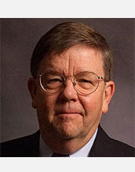
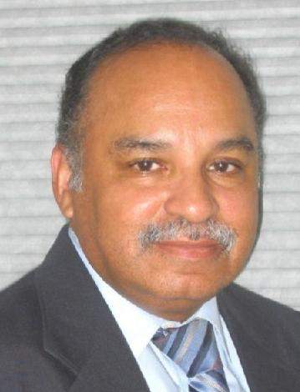
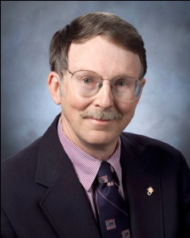
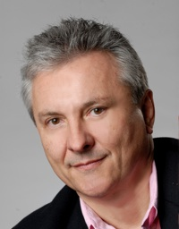
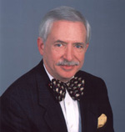
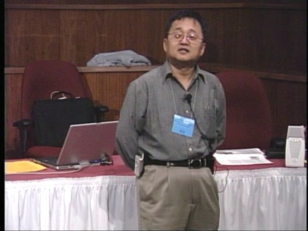
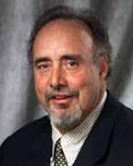
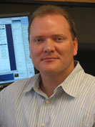
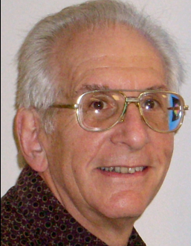
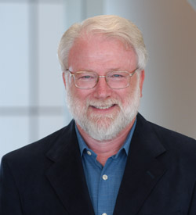
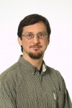
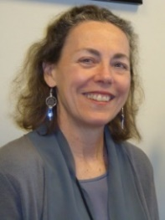
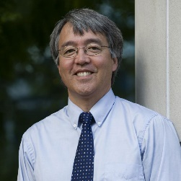
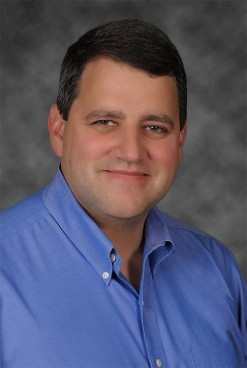
OK Supercomputing Symposium 2016
2003 Keynote:
Peter Freeman
NSF
Comp & Info Sci & Engr
Assistant Director
2004 Keynote:
Sangtae Kim
NSF Shared
Cyberinfrastructure
Division Director
2005 Keynote:
Walt Brooks
NASA Advanced
Supercomputing
Division Director
2006 Keynote:
Dan Atkins
Head of NSF’s
Office of
Cyberinfrastructure
2007 Keynote:
Jay Boisseau
Director
Texas Advanced
Computing Center
U. Texas Austin
2008 Keynote: José Munoz Deputy Office Dir Sr Sci Advisor NSF Office of Cyberinfrastructure
2009 Keynote: Douglass Post Chief Scientist US Dept of Defense HPC Modernization Program
2010 Keynote Horst Simon Deputy Director Lawrence Berkeley Nat’l Laboratory
FREE!
Wed Sep 21 2016
@ OU
Over 235 registra2ons already!
Over 152 ie first day, over 200 in the first week, over 225 in the first month.
2011 Keynote Barry Schneider Program Manager National Science Foundation
2012 Keynote Thom Dunning Director National Center for Supercomputing Applications
2013 Keynote: John Shalf Dept Head CS Lawrence Berkeley Nat’l Lab CTO, NERSC
2014 Keynote: Irene Qualters Division Dir Advanced Cyberinfrastructure Division, NSF
2015 Keynote: Jim Kurose Asst Director Comp & Info Sci & Engr Directorate, NSF
Reception/Poster Session
Tue Sep 20 2015 @ OU
Symposium
Wed Sep 21 2015 @ OU
2016 Keynote:
Dan Stanzione
Exec Director
Texas Advanced
Computing Center
U. Texas Austin

Slide 10
Thanks for your attention! Questions? hneeman@ou.edu

