Slide 1
Effective Communication: How to Talk to Researchers about Their Research
Henry Neeman, University of Oklahoma
Director, OU Supercomputing Center for Education & Research (OSCER)
Assistant Vice President, Information Technology - Research Strategy Advisor
Associate Professor, College of Engineering
Adjunct Faculty, School of Computer Science
ACI-REF Virtual Residency Workshop 2016
Monday August 8 2016

Slide 2
Outline
How to Talk to Researchers: Research Terminology
Researcher Types
The Mindset Gap
Things to Say to a Researcher
How to Find Researchers
How to Find Researchers’ Projects

Slide 3
How to Talk to Researchers:
Research Terminology

Slide 4
Is Oxygen a Metal?
How many of you believe that oxygen is a metal?

Slide 5
Oxygen in Real Life
Atomic number 8
Chalcogen
Key element in life
Also fire, rust
http://en.wikipedia.org/wiki/Oxygen

Slide 6
Oxygen in Astronomy
The universe is made of the following:
Hydrogen
Atomic number 1
75% of all baryonic mass
Most stars are made of hydrogen plasma
Helium
Atomic number 2
Noble gas (inert)
24% of total elemental mass
Other
http://en.wikipedia.org/wiki/Hydrogen
http://en.wikipedia.org/wiki/Helium

Slide 7
Planets etc
What are planets made of?
Cores of iron, nickel etc
Earth’s core is 89% iron, 6% nickel, 5% other
Mantles of silicates
http://en.wikipedia.org/wiki/Planets#Mass
http://en.wikipedia.org/wiki/Earth

Slide 8
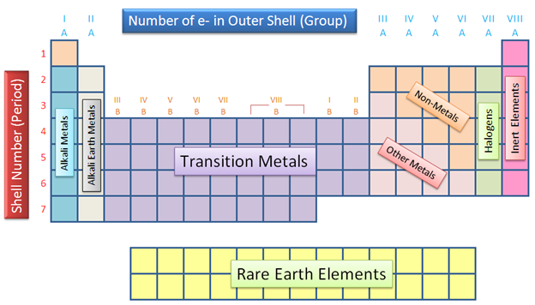
So What’s a Metal?
To a chemist, metals have a very specific chemical definition.
To an astronomer (especially a cosmologist), metals are anything that isn’t hydrogen or helium.
http://user.astro.columbia.edu/~gbryan/Site/IGM_files/gas_density_z0.png
http://images.tutorcircle.com/cms/images/44/periodic-table11.PNG

Slide 9
Projection
What happens if you put a mathematician, a psychologist and a movie producer into a room and ask them to discuss projection?

Slide 10
Scale
At quantum scale during femtoseconds, how much does gravity matter?
How about at cosmological scale over eons?

Slide 11
CS or IT?
What happens if a domain scientist refers to CS as IT?
Wait, CS people do research? I thought they were just there to help everyone else with their real research.

Slide 12
Is Simulated Data Actually Data?
I had a colleague in Chemical Engineering who told me that, if he referred to data from a simulation as “data” in front of his colleagues, he’d be laughed out of the discipline.

Slide 13
Science vs Engineering
Science is focused on discovery.
Engineering is focused on design.
In which case:
Is a design project research?
Do engineers do science research?
What is research about software?

Slide 14
Researcher Types

Slide 15
Researcher Types
Faculty
Tenure-Track Faculty
Tenured Faculty
Research Faculty
Staff
Postdocs

Slide 16
Tenure-Track Faculty
At research-intensive institutions:
Incentive Structure: I need to publish lots of papers, bring in lots of grant money and graduate lots of students, or I’m fired.
Need: I need stuff to work now and keep working reliably.
Timeline
I have 7 years (typical tenure-track duration), BUT
I have 6 years (the 7th year is finding a job elsewhere if I don’t get tenure), BUT
I have 5 years (the 6th year is when my materials are evaluated), BUT
I have 4 ½ years, because it typically takes a journal article 6 months from submitted to published.

Slide 17
Tenured Faculty
At research-intensive institutions:
Incentive Structure: I need to publish lots of papers, bring in lots of grant money and graduate lots of students, or I don’t get a raise and I don’t get a named chair.
Need: I need stuff to work now and keep working reliably.

Slide 18
Research Faculty
If I don’t bring in grant money, I’m laid off.
I need to publish a lot to keep bringing in grant money.

Slide 19
Postdocs
I need to publish a lot or I’ll lose my postdoc.
I need to learn how to get lots of grant money, and even actually get some of my own, so I can get a permanent position.

Slide 20
Students
My first goal is to graduate.
Anything that delays graduation costs me money.

Slide 21
Probability of Success
National Science Foundation, FY2015: 24% overall
BIO 27%, CISE 23%, EHR 20%, ENG 20%, GEO 25%, MPS 28%, SBE 24%
EPSCoR jurisdictions: Northern Marianas Islands 0% (no PhD-granting), ND 12%, AL/PR 15%, AR/ID 16%, KY/MS/NV 17%, OK/SD 18%, NE/NM/SC/VT 19%, AK/MO/WV 20%, IA/WY 21%, LA 22%, DE/HI/KS 23%, MT 24%, ME/NH 26%, Guam/USVI 33%, RI 36%
Non-EPSCoR jurisdictions: FL 20%, TN/TX 21%, AZ/OH/VA 22%, UT 23%, CT/IN/NJ/NC 24%, CO/GA/MI/NY 25%, MD/PA/WI 26%, CA/MA/OR 27%, IL/MN 28%, WA 30%, DC 37%
Funding is governed by the Law of Large Numbers: You have to submit lots of proposals to get any funding. http://dellweb.bfa.nsf.gov/awdfr3/default.asp

Slide 22
The Mindset Gap

Slide 23
The Mindset Gap
In the olden days -- say, 10 years ago -- we used to say that our typical new Cyberinfrastructure user came from a Windows desktop or laptop background.
Those days are long gone ….
Nowadays, we say that our typical new user comes from an iOS or Android background.
How has that changed our job?

Slide 24
Mental Distance
What’s the mental distance between a handheld vs Linux, command line, batch computing?
Installing software
Handheld: Tap 3 times.
Large scale: EasyBuild if you’re lucky, configure/make with modest dependencies if you’re unlucky, bizarre random weirdness in practice.
Installing storage
Handheld: Buy a card for $10-50, pop it into the slot, the OS automatically recognizes it and starts using it.
Large scale: RFP, bid evaluation, configuration, purchase, deployment, maintenance.

Slide 25
What’s the Cost of Storage?
Handheld: tens or hundreds of dollars (which gets you tens or hundreds of GB).
Large scale
~1 PB raw tape: ~$15K
~1 PB raw spinning disk : ~$100K (ultra-cheap version)
~1 PB raw SSD: ~$1M

Slide 26
Things to Say to a Researcher

Slide 27
Cost
“This other way of doing it is cheaper than how you’re currently doing it.”
“For the same cost, it could be so much better.”

Slide 28
Control
“You get to decide how to use your piece.”
“You can share it with whoever you want.”

Slide 29
Administration
“Your students won’t have to spend their time taking care of this.”

Slide 30
How to Find Researchers

Slide 31
Where are the CDS&E Researchers?
Go to your institution’s website.
Click on Academics.
Search for departmental websites.
On each departmental website, find the list of faculty (the link is usually “Faculty” or “People”).
Read their research descriptions.

Slide 32
Keywords to Look For
Computational
Numerical
Parallel (especially in CS)
Informatics
For Chemistry, look for Physical Chemists and Biochemists.
There are plenty of others – over time you’ll develop a feel for it.

Slide 33
Contact Them!
Contact those faculty.
Tell them what your role is.
If it’s for a proposal, tell them:
what the program is;
what the due date is;
how much money is on the table.
Ask them what their computational/storage/network/whatever needs are.

Slide 34
Go to New Faculty Meet-n-Greets
Does your institution have events for new faculty?
Go to them!

Slide 35
Visit Them!
Make an appointment to visit with them.
Even better, offer to take them to lunch.
If you can get your institution to pay for the lunch, even better.
Ask them questions:
At a high level, what’s your research about?
What are the computing- and/or data-intensive aspects of your research?
If you had an infinitely large, infinitely fast computer, what research would you want to do?

Slide 36
Specific, Open-Ended Questions
These are questions whose answers you don’t really care about – but they’ll lead to useful discussions.
What language is your software written in?
Is it parallelized?
Who wrote it?
What operating system(s) has it been run on?
Briefly describe the science problem it's used for.
Briefly describe the numerical method or algorithm.

Slide 37
Questions cont’d
How big is the memory footprint when running?
How many timesteps/iterations do you plan to run per experiment?
How many such experiments do you plan to run per year?
Does it have no input, a little bit of input or a lot of input?
Does it have a little bit of output or a lot of output?
etc …

Slide 38
How to Find Researchers’ Projects

Slide 39
Know Their Research
If you’ve already talked to the researchers, you probably have a pretty good idea of who’s got big data and/or big compute needs.
Now you need to find out specifically how much Cyberinfrastructure capacity they need.
You can always ask, but you’ll get more information if you’re writing an equipment proposal.
“I’m going to get you free goodies. Please send me a one page project summary plus the following details.”

Slide 40
Equipment Proposal Questions #1
How much funding does your research currently have? How much is pending? Planned? From what sources?
How many faculty, staff, postdocs, grad students and undergrads on your team will be served by this equipment?
What makes your research transformational?
What are the broader impacts?

Slide 41
Equipment Proposal Questions #2
How much of the proposed resource (CPU hours, storage, bandwidth, whatever) do you expect to need over the next N years?
How did you calculate this amount?
Please give me a one page summary of your research that incorporates these issues.
This is typically straightforward, because faculty often have either a 1 page summary from a grant proposal or a more broad research statement.

Slide 42
MRI/CRI for HPC Cluster Questions #1
How many CPU core hours or node hours will you need over the next N years?
How did you determine that?
Have you benchmarked your code?
On what platform?
What is the expected performance improvement on the proposed instrument, compared to the platform you benchmarked on?
Do you plan to optimize the software? If so, what performance improvement do you anticipate?
[This only applies to their own homebrew codes.]
http://www.nsf.gov/pubs/2011/nsf11011/nsf11011.jsp

Slide 43
MRI/CRI for HPC Cluster Questions #2
If the proposal is for a new type of platform (for example, accelerators such as GPUs or Intel Xeon Phi/MIC):
Who will be responsible for porting the code to the new platform?
If this is either a community code or a commercial code, the porting may already have been done by the developers.
Have they committed to do so?
What speedup is expected on the new platform?

Slide 44
MRI/CRI for Storage Questions
How much storage will be needed for this project?
If this is a live storage MRI/CRI: What is the maximum amount of storage at a time that will be needed for this project?
If this is an archival storage MRI/CRI: What is the total amount of storage needed over the lifetime of the instrument?
How was that calculated?

Slide 45
Campus CI Questions #1
What is the expected typical size of each dataset being transferred?
(It would be helpful to know expected growth rate: Are you expecting it to stay roughly the same over the next several years, or to double every two years, or what?)

Slide 46
Campus CI Questions #2
Where are such datasets originating, and where are they being transferred to?
Why do such datasets need to be transferred between these endpoints?
(That is, what requirement do these data transfers address for your team’s research?)

Slide 47
Campus CI Questions #3
What is the time window for transferring each such dataset?
Why does each such dataset need to be transferred during that specific time window?
That is, what's the negative impact of the transfer taking
(a) marginally longer and (b) much longer?
How often do you expect to have such a data transfer need?

Slide 48
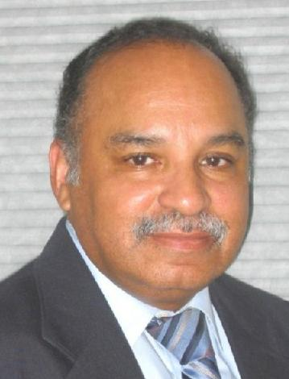
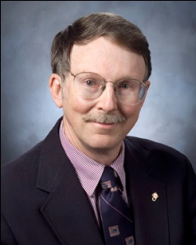
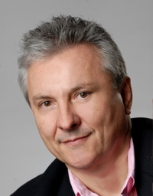
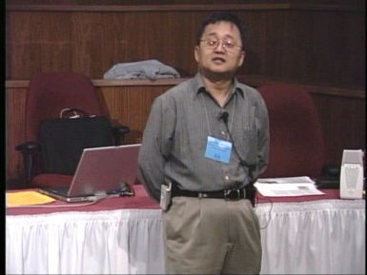
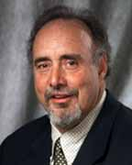
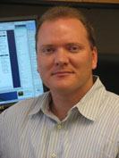
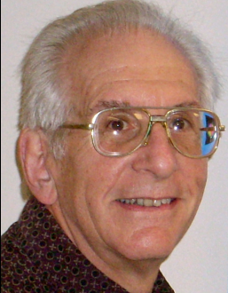
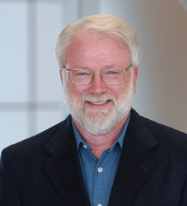
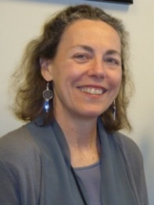
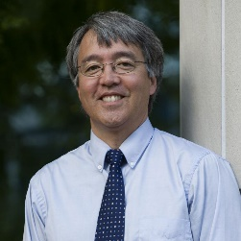
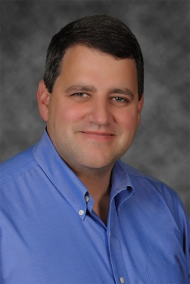
OK Supercomputing Symposium 2016
2003 Keynote:
Peter Freeman
NSF
Comp & Info Sci & Engr
Assistant Director
2004 Keynote:
Sangtae Kim
NSF Shared
Cyberinfrastructure
Division Director
2005 Keynote:
Walt Brooks
NASA Advanced
Supercomputing
Division Director
2006 Keynote:
Dan Atkins
Head of NSF’s
Office of
Cyberinfrastructure
2007 Keynote:
Jay Boisseau
Director
Texas Advanced
Computing Center
U. Texas Austin
2008 Keynote: José Munoz Deputy Office Dir Sr Sci Advisor NSF Office of Cyberinfrastructure
2009 Keynote: Douglass Post Chief Scientist US Dept of Defense HPC Modernization Program
2010 Keynote Horst Simon Deputy Director Lawrence Berkeley Nat’l Laboratory
FREE!
Wed Sep 21 2016
@ OU
Over 235 registra2ons already!
Over 152 ie first day, over 200 in the first week, over 225 in the first month.
2011 Keynote Barry Schneider Program Manager National Science Foundation
2012 Keynote Thom Dunning Director National Center for Supercomputing Applications
2013 Keynote: John Shalf Dept Head CS Lawrence Berkeley Nat’l Lab CTO, NERSC
2014 Keynote: Irene Qualters Division Dir Advanced Cyberinfrastructure Division, NSF
2015 Keynote: Jim Kurose Asst Director Comp & Info Sci & Engr Directorate, NSF
Reception/Poster Session
Tue Sep 20 2015 @ OU
Symposium
Wed Sep 21 2015 @ OU
2016 Keynote:
Dan Stanzione
Exec Director
Texas Advanced
Computing Center
U. Texas Austin

Slide 49
Thanks for your attention! Questions? hneeman@ou.edu

