Slide 1
So You Want to Write an NSF Grant Proposal
Dana Brunson
Oklahoma State
Brian Stengel
University of Pittsburgh
Content provided by Henry Neeman - OU

Slide 2
Acknowledgement
Much of this material came from a talk by Greg Monaco and Kate Adams of the Great Plains Network, used with permission.
And then from Henry Neeman to us.

Slide 4
Objectives
Gain a working knowledge of the grant proposal process at the National Science Foundation.
Have a clearer idea of what you hope to accomplish when writing an NSF grant proposal.
Identify common elements for grant proposals.

Slide 5
The NSF Proposal Process
You write and submit proposal via NSF’s Fastlane or grants.gov.
Proposal review process initiated
Proposals tallied by program director by category.
Panel dates set.
Reviewers selected.
Review criteria are furnished.
Assignments made to reviewers.
Reviewers submit reviews.
Review panel(s) assembled.

Slide 6
About the Reviewers
The reviewers may be subject matter experts in an area relevant to your proposal -- or they may not be.
You’re writing your review for the review panel.
But you have no idea who they are: not when you’re writing, nor when you find out the NSF’s decision, nor ever after.
The panel has zero authority -- they recommend, not decide.
More panel members than actual readers of each proposal.
Each panel member reviews multiple proposals, and each proposal has multiple reviewers, but usually no one reviews all of the proposals that the panel gets.
You get to suggest reviewers in your proposal -- but the NSF program officer isn’t bound by your suggestions.
Become a reviewer! It’s the best way to learn how they think.

Slide 7
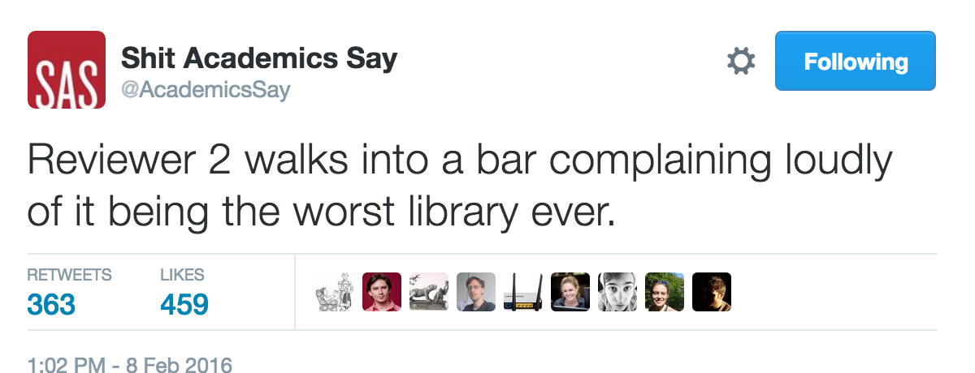
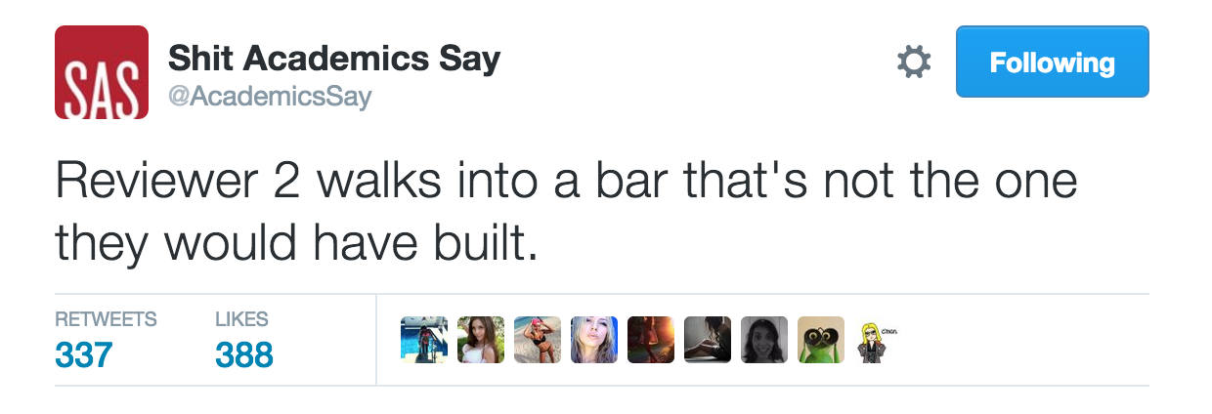
Funny Stuff
Stuff
Stuff
Stuff

Slide 8
The Proposal Process (cont’d)
Panel recommendation made to the program officer.
“Highly Competitive,” “Competitive,” “Non-competitive”
Program officer reviews recommendations from all panels.
There may be multiple panels for the same program.
If the program officer selects your proposal to be funded, that doesn’t mean you’ve won yet.
You may be contacted to respond to panel concerns, in which case you’ll be expected to prove that you’ve got those concerns addressed.
The program officer makes the final decision for funding -- but they’ve got to be able to justify the heck out of their decision to their boss, and so on up the chain of command.
Always make the program officer’s job easy ….

Slide 9
The Proposal Process (cont’d)
Preliminary (non-binding) decision by program officer.
You probably will be asked to submit follow-up materials.
At least an abstract to be publicly posted after the official decision has been announced
Confidentially, because no official decision has been made.
Official decision publicly announced.

Slide 10
Before you begin, remember
Sometimes you win, some times you lose.
“You cannot close what you don’t propose.”
Great proposals often don’t get funded.
Sometimes they have too many great proposals to fund.
Sometimes your reviewers misunderstand your proposal.
That’s your fault.
Which means, you can do better on the resubmit -- which means this is something you have a good deal of control over.
Resubmits are much more likely to get funded than the first time.
Lousy proposals rarely get funded.
It often takes more than one try to get funded (law of large numbers)..

Slide 11
Probability of Success
National Science Foundation, FY2015: 24% overall
BIO 27%, CISE 23%, EHR 20%, ENG 20%, GEO 25%, MPS 28%, SBE 24%
EPSCoR jurisdictions: Northern Marianas Islands 0% (no PhD-granting), ND 12%, AL/PR 15%, AR/ID 16%, KY/MS/NV 17%, OK/SD 18%, NE/NM/SC/VT 19%, AK/MO/WV 20%, IA/WY 21%, LA 22%, DE/HI/KS 23%, MT 24%, ME/NH 26%, Guam/USVI 33%, RI 36%
Non-EPSCoR jurisdictions: FL 20%, TN/TX 21%, AZ/OH/VA 22%, UT 23%, CT/IN/NJ/NC 24%, CO/GA/MI/NY 25%, MD/PA/WI 26%, CA/MA/OR 27%, IL/MN 28%, WA 30%, DC 37%
Funding is governed by the Law of Large Numbers: You have to submit lots of proposals to get any funding. http://dellweb.bfa.nsf.gov/awdfr3/default.asp

Slide 12
Proposal Components
Cover Page
Project Summary
Project Description
References
Budget
Budget Justification
Biographical sketches
Current and Pending Support
Conflict of Interest List
Facilities and Equipment
Data Management Plan
Postdoc Mentoring Plan
Supplementary Documentation (varies by program)

Slide 13
Note
Each piece of the proposal is another opportunity to make your case.
Think in terms of using each section to enhance your argument.

Slide 14
Pointers
Read the solicitation.
Ask the program officer about any questions you might have.
Read the solicitation.
Pay attention to
Section II: Program Description
Program-wide Criteria
Program Areas
Section V A: Proposal Preparation Instructions
Full Proposals
Program Areas
Section VI A: Review Criteria
There are Solicitation Specific Review Criteria

Slide 15
Pointers (cont.)
Read the solicitation.
Aim to make a compelling argument.
Be satisfied with a competent argument.
Demonstrate that you know what you don’t know – and what you are going to learn…
And who you will be contributing to greater knowledge and/or improving the state of the art.

Slide 16
What Are You Trying to Achieve?
Give reviewers reasons to recommend your proposal for funding.
Never give the reviewers an excuse to say no.
If they’re going to say no, at least they should have to earn it.
Consider what the reviewer will think after reading your proposal:
“I see where they’re going with this.”
“They really know their stuff.”
“I didn’t know they had all that going on over there!”
“Wow! This will mean a lot to that campus.”
“They have their act together. (I wish we communicated as well on my campus.)”
“This is a GREAT investment!”
Everything in your proposal should support this.

Slide 17
Proposal Beginning
Cover Page
Title
PIs/Co-PIs
Project Summary
One Page
Brief project description -- executive summary
Intellectual Merit statement
Broader Impacts statement
Make it easy for the reviewers and program officer to be able to tell what you plan to do, why it’ll work, and how it’ll help.

Slide 18
Project Description
15 pages long (usually)
Introduction/Vision
This is a good place to quote from a major national report that says that the kind of work you’re planning is very important.
Project Objectives (typically 3 or 4)
Intellectual Merit
Implementation Plan
Broader Impacts
Management Plan
Evaluating Progress

Slide 19
Broader Impacts
Advancement of scientific knowledge
Activities that contribute to achievement of societally relevant outcomes
Full participation of women, persons with disabilities, and underrepresented minorities in STEM
Improved STEM education and educator development at any level
Increased public scientific literacy and public engagement with science and technology
Improved well-being of individuals in society
Development of a diverse, globally competitive STEM workforce
Increased partnerships between academia, industry, and others
Improved national security
Increased economic competitiveness of the US
Enhanced infrastructure for research and education
Your broader impacts are judged on what you’ve already done.

Slide 20
Results from Prior NSF Support
Every NSF proposal has to have a section on “Results from Prior NSF Support.”
If your team has lots of that, you can’t fit it all. The solicitation and the NSF’s Grant Proposal Guide provide useful guidelines on that.
The PI and each Co-PI should each provide the one most relevant grant.
Each should include explicit sections on Intellectual Merit, Broader Impacts and a list of publications (or “No publications were produced under this award.”).
If you don’t have anything relevant, say that.
If you do, is there a way that you can fit this proposal into a more coherent story?

Slide 21
Management Plan
Who will do what?
Decision making: Describe the procedure.
Advisory committee(s)
External: one CI, one researcher, one broader impacts.
You can also have an Internal Advisory Committee.
Timeline and milestones
Sustainability plan: What happens when the grant ends?

Slide 22
Budget
People: Start with salary, then add in fringe benefits and Indirect Costs (also known as Facilities & Administration).
For professionals, typically the “fully loaded” amount roughly doubles the salary amount.
Things
Permanent equipment over $5000: not subject to IDC
Other: subject to full IDC
Subcontracts: The first $25,000 of each subcontract may be subject to IDC by both the lead institution and the subcontracting institution.
You can do a Collaborative proposal, which waives that.
Submitting a collaborative proposal is painful.
The lead institution has zero control over the other institutions’ budgets.

Slide 23
Budget (cont’d)
Participant support: not subject to IDC
Travel, subsistence, stipends etc for participants in workshops and similar events.

Slide 24
Cost Share
Cost Share
Either mandatory or forbidden
Can only be done at exactly the level required.
There is NO SUCH THING as voluntary cost share: if they don’t ask for it, you can’t include it.
Your proposal can be returned without review.
Typically has to be items that could otherwise be funded on the grant budget.
Typically has to be paid from non-federal funds.

Slide 25
Institutional Commitment
Not the same as cost share.
Not required nor prohibited.
Strange rules:
CANNOT mention any dollar figures (or anything that can be straightforwardly translated into dollar figures).
MUST appear in the Facilities, Equipment and Other Resources section, because it’s an “other resource” (preference for at the end).
SHOULD be confirmed in a letter of collaboration from someone who has the authority to commit.
MAY appear in the project description.
MAY be (and usually is) contingent on getting grant.

Slide 26
Everything Else
Budget & Budget Justification
Many institutions provide a template
Data Management Plan (dmptool.org)
Letters of Commitment/Collaboration
Some solicitations put restrictions on these, others don’t.
Letters of support (“This is a swell project”) are FORBIDDEN unless explicit allowed by the solicitation.
Biographical Sketches (PI, Co-PIs, Senior Personnel)
Current & Pending Support (PI, Co-PIs, Sr Personnel)
You may not have any.
You MUST list this proposal.
Conflict of Interest List (PI, Co-PIs, Sr Personnel) -- NEW!

Slide 27
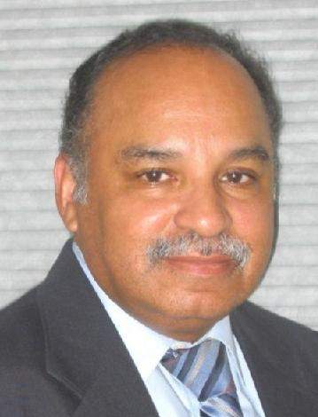
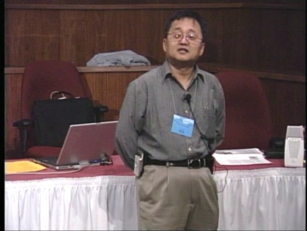
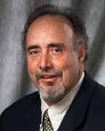
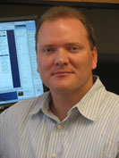
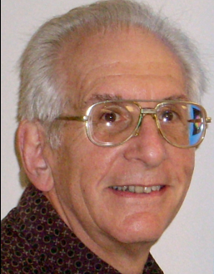
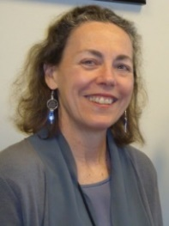
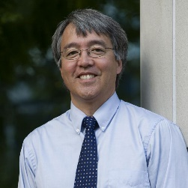
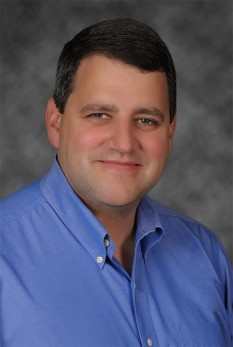
OK Supercomputing Symposium 2016
2003 Keynote:
Peter Freeman
NSF
Comp & Info Sci & Engr
Assistant Director
2004 Keynote:
Sangtae Kim
NSF Shared
Cyberinfrastructure
Division Director
2005 Keynote:
Walt Brooks
NASA Advanced
Supercomputing
Division Director
2006 Keynote:
Dan Atkins
Head of NSF’s
Office of
Cyberinfrastructure
2007 Keynote:
Jay Boisseau
Director
Texas Advanced
Computing Center
U. Texas Austin
2008 Keynote: José Munoz Deputy Office Dir Sr Sci Advisor NSF Office of Cyberinfrastructure
2009 Keynote: Douglass Post Chief Scientist US Dept of Defense HPC Modernization Program
2010 Keynote Horst Simon Deputy Director Lawrence Berkeley Nat’l Laboratory
FREE!
Wed Sep 21 2016
@ OU
Over 235 registra2ons already!
Over 152 ie first day, over 200 in the first week, over 225 in the first month.
2011 Keynote Barry Schneider Program Manager National Science Foundation
2012 Keynote Thom Dunning Director National Center for Supercomputing Applications
2013 Keynote: John Shalf Dept Head CS Lawrence Berkeley Nat’l Lab CTO, NERSC
2014 Keynote: Irene Qualters Division Dir Advanced Cyberinfrastructure Division, NSF
2015 Keynote: Jim Kurose Asst Director Comp & Info Sci & Engr Directorate, NSF
Reception/Poster Session
Tue Sep 20 2015 @ OU
Symposium
Wed Sep 21 2015 @ OU
2016 Keynote:
Dan Stanzione
Exec Director
Texas Advanced
Computing Center
U. Texas Austin

Slide 28
Thanks for your attention! Questions? hneeman@ou.edu

