Slide 1
How do Design a Cluster
Dana Brunson
Asst. VP for Research Cyberinfrastructure
Director, High Performance Computing Center
Adjunct Assoc. Professor, CS & Math Depts.
Oklahoma State University
http://hpcc.okstate.edu

Slide 2
It depends.
-- Henry Neeman

Slide 3
What is a Cluster?
“… [W]hat a ship is … It's not just a keel and hull and a deck and sails. That's what a ship needs. But what a ship is ... is freedom.”
– Captain Jack Sparrow
“Pirates of the Caribbean”
Credit: Henry Neeman

Slide 4
What a Cluster is…
A cluster needs of a collection of small computers, called nodes, hooked together by an interconnection network (or interconnect for short).
It also needs software that allows the nodes to communicate over the interconnect.
But what a cluster is … is all of these components working together as if they’re one big computer ... a super computer.
Credit: Henry Neeman

Slide 5
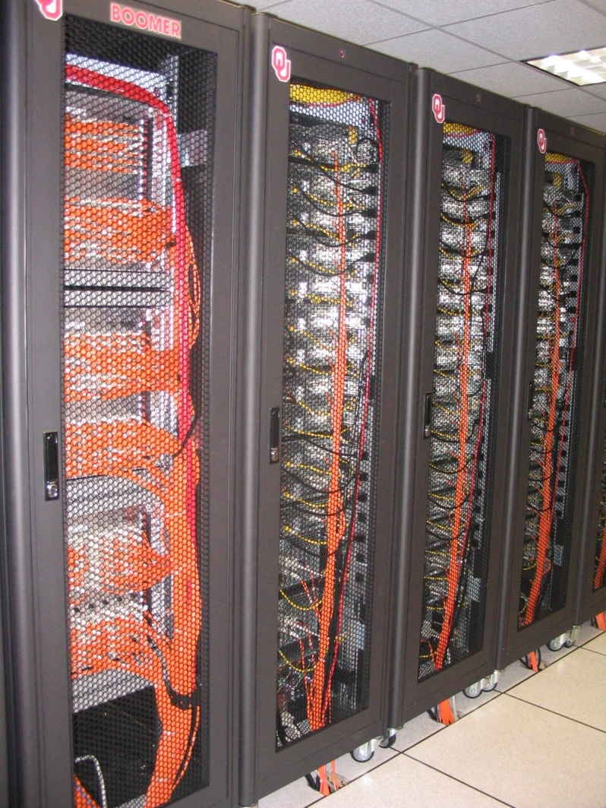
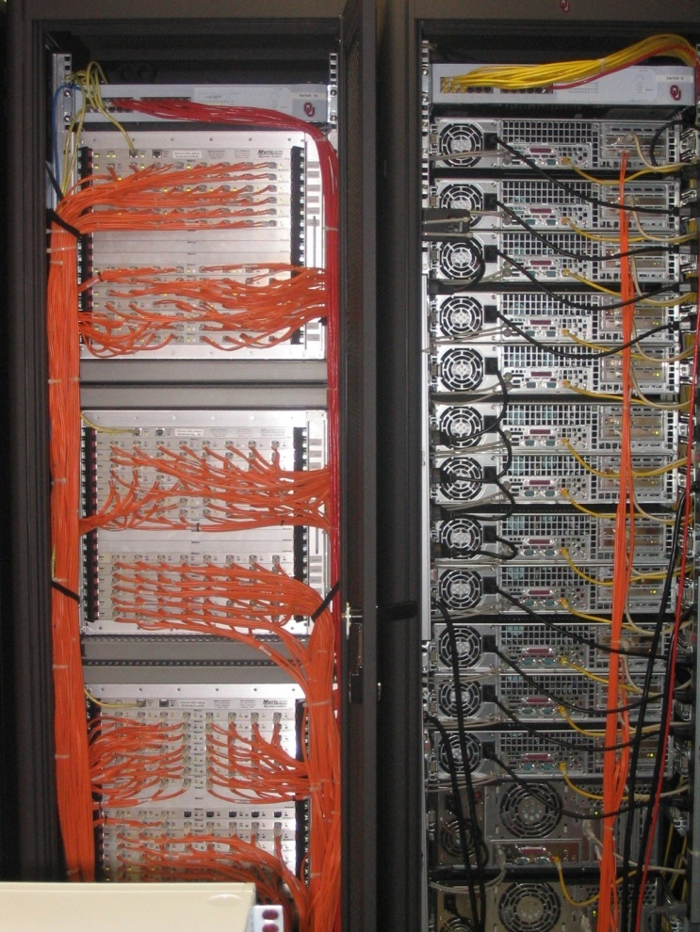
An Actual Cluster
Interconnect
Also named Boomer, in service 2002-5.
Nodes
Credit: Henry Neeman

Slide 6
Considerations
Your budget
Power, space, and cooling
Your researchers’ workload
Your funding cycle
Your staff
What else?

Slide 7
OSU’s considerations
Budget ~ $1.3M
Building out new power & cooling
Workload is mix of single core, shared memory and jobs up to ~512 cores
Funding cycle is one big purchase every 4-ish years (thanks NSF!)
Staff = 1 dedicated person for combined sysadmin, user support, application installation.

Slide 8
Components overview
Compute Nodes (standard, large memory, accelerated)
Storage (slow & fast)
Interconnects (slow & fast)
Login nodes
Management nodes
Other? (Data transfer node, web interfaces, etc.)

Slide 9
Compute nodes
“Standard” compute nodes
Processor type
RAM (speed, # channels to fill)
Cheap as possible and still make users happy
Special compute nodes
Large memory
Accelerators
Choices depends on your users’ needs and the sweet spot in pricing.

Slide 10
OSU’s latest basic outline: Compute nodes
Compute Nodes: (depends on sweet spot of pricing)
Standard: processor 2620 or better, 32-64 GB RAM
Large memory: One 1 TB RAM, 4x 256 GB
GPU nodes (specs will come from the researcher wanting them.)
We already have Xeon Phi from recent purchase

Slide 11
Storage
Scratch: Do you need a parallel filesystem?
Needs staff and/or great support (expensive)
Size depends on workload and purge policy
Home -- small and simple and is often backed up.
Work – big, not too slow.
Archive – PetaStore (what do others do?)

Slide 12
OSU’s latest basic outline: Storage
Home: ~20TB storage appliance x3 (we want this redundant-ish)
Scratch: 100TB appliance with 800 number on it (unclear if we can get it this small.)
Work: 1 PB (servers full of disks, NFS, RAID6, cheap and simple.)

Slide 13
Interconnects
Gigabit Ethernet – workhorse
Infiniband/Omnipath
Depends on workload (oversubscription can save money if your workload doesn’t have many large parallel jobs.)
IPMI network for out-of-band mgmt
Worth the small expense

Slide 14
OSU’s latest basic outline: Interconnects
Infiniband/Omnipath:
as cheap as we can get it
Highly oversubscribed – all our parallel jobs fit within a single switch
GigE – top of rack, uplinked to central 10G
IPMI

Slide 15
Login & Management
Login nodes
Get enough to handle all your users
>1 can give high availability
Round robin DNS
Management nodes:
Much diversity in how this is done
Where you can run all the cluster-wide services
Depends on size of cluster, services needed
Very small clusters often have a single server for both login and management…

Slide 16
OSU’s latest basic outline: Management
2x login nodes (same proc as compute)
3x mgmt nodes
We also want Vendor installation and support (remember 1 FTE dedicated to the technical stuff.)

Slide 17
Other optional bits
Data Transfer node (see ESNet for specs)
Web interfaces/science gateways, etc.
What else?
OSU – yes to DTN, we already have sufficient webby stuff (aka virtual server pool)

Slide 18
Strategy
We gave this list to any vendor that wanted to talk to us.
We told them the budget
The resulting quotes were very informative – go over them carefully!
We have plenty of time because we’re waiting for the new power and cooling to be installed.
We will go out for bid

Slide 19
Watch out for:
Enterprise vendors have a completely different mindset: uptime, redundancy, etc.
The level of redundancy on a cluster is the compute node.
Get references from someone who bought from that vendor a similarly sized cluster who has a similarly sized staff
Compare notes with as many people as possible

Slide 20
Be warned:
No matter what you do, the minute you send out the PO you’ll think of something you should’ve done differently.
And it’s okay, we all feel that way.

Slide 21
Topics from Etherpad
Advertising specs
casual or RFP?
Scheduler & policies
what meets your researchers needs?
Provisioning mgmt. system
Rocks, xcat, openhpc, razor, puppet, vendor supplied, etc.
Replacement schedule
What’s your funding cycle like?

Slide 22
Topics from etherpad
Single system vs two?
we keep our old system around a while to ease transition
Liquid cooling?
$$$$
Voltage
Depends on how much and what you have available
UPS > 100KW are usually (only?) 3 phase 408V
Rack standards
Space available? Density of cooling available?

Slide 23
Acquisition start to finish (was part 2 plan)
Get money
Spec system based on what’s needed
Get bids (informally or formally)
Buy
Don’t sign acceptance before you test everything with at least some of your workload

Slide 24
Thanks!
Questions?
Dana Brunson
dana.brunson@okstate.edu
OSU High Performance Computing Center
http://hpcc.okstate.edu

