Slide 1
Research Data Services at University of Iowa
2016-8-12
Marina Zhang
Engineering & Informatics Librarian
University of Iowa Libraries

Slide 2
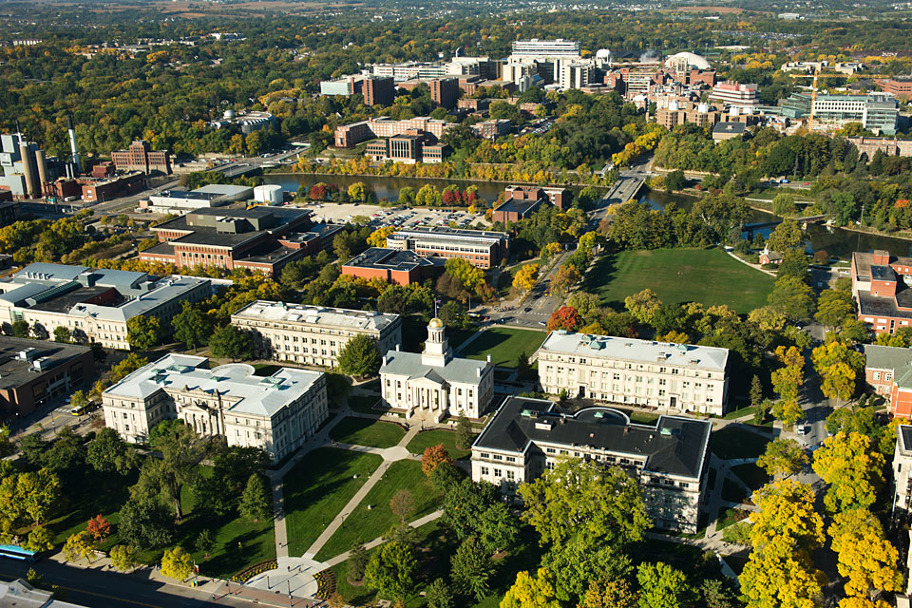
About University of Iowa
32,150 students; 72.6% undergrads
1,585 tenured & tenure-track faculty
200+ majors, minors & certificate programs
2,240 grants & contracts
$565.2 M in total external funding in FY 2015
27% undergrads involved in research
Image from Internet

Slide 3
Collaborating with Other Stakeholders
Research Data Interest Group
University Libraries
Division of Sponsored Programs
Information Technology Services
Iowa Informatics Initiative
SharePoint and listserv
Monthly meetings
Library guide
Resources on RDM
Archive past events
Image from Internet

Slide 4
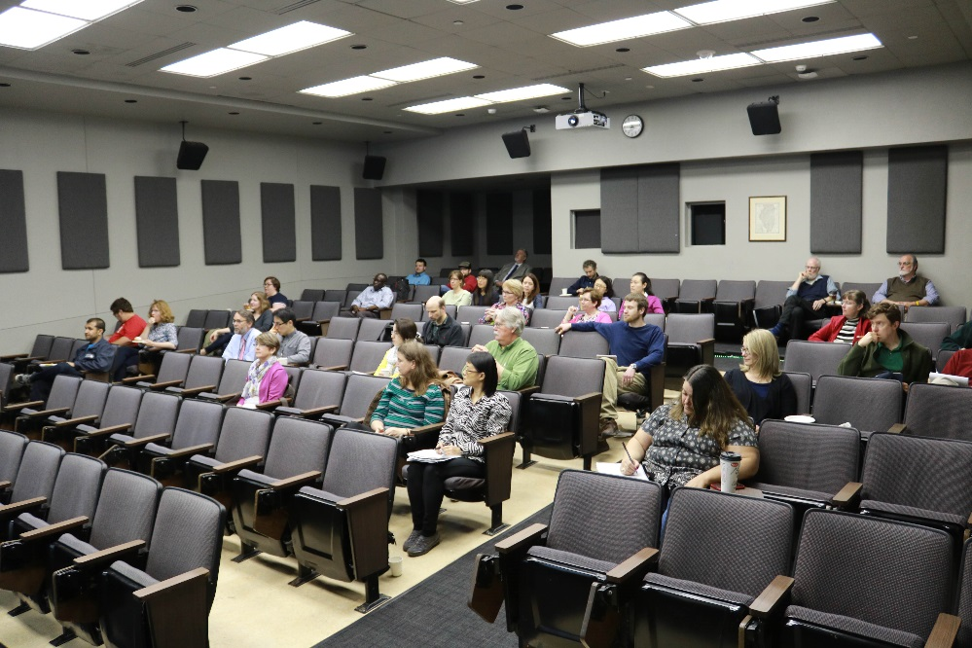
Promoting RDS
Collaborative consulting
lib-data@uiowa.edu
Include librarian liaisons
Workshops
Training for librarians and other campus service providers
Training for researchers
By request; include liaisons
In-class presentations
Data events

Slide 5
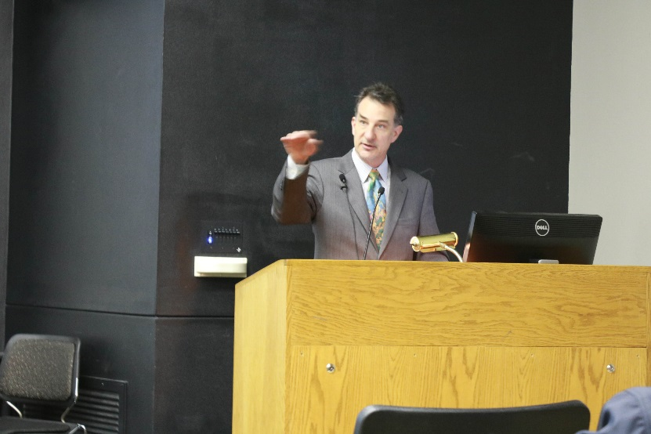
Data Events
Dr. Heidi Imker, Director of Research Data Service at University of Illinois – Urbana Champaign
Dr. Jeff de La Beaujardiere, Data Management Architect at NOAA

Slide 6
Future
ACRL Roadshow on Research Data Management for Iowa Region
Formalize RDS Team/Advisory Committee
Develop Partnerships w/ RDS at other institutions
Develop Data Policies
Create a Position for RDS Coordinator

Slide 7
References
Sara Scheib, Engaging Liaisons: Information or Communication? Research Data Access and Preservation Summit, May 4, 2016, Atlanta, GA
About the University. Retrieved from http://www.uiowa.edu/homepage/about-university

