Slide 1
Advanced Cyberinfrastructure Research & Education Facilitators: Overview
Henry Neeman, University of Oklahoma
Director, OU Supercomputing Center for Education & Research (OSCER)
Assistant Vice President, Information Technology - Research Strategy Advisor
Associate Professor, College of Engineering
Adjunct Faculty, School of Computer Science
ACI-REF Virtual Residency 2015
Sunday May 31 2015

Slide 2
Let’s Introduce Ourselves!
Let’s go around the room.
Say your name, your institution, your role, and why you wanted to attend the ACI-REF Virtual Residency.
What do you hope to get out of this week?

Slide 3
Outline
This is an experiment!
Advanced Cyberinfrastructure Research & Education Facilitators
National Science Foundation’s Campus Cyberinfrastructure Programs
You’re Next …

Slide 4
This is an Experiment!
Everything about this week is exciting and new.
You are the first cohort of what we want to be a national program.
This means that you are helping us to pioneer a new way of developing the next generation workforce.

Slide 5
You Voted with Your Feet
We thought most of the interest would be in learning how to be a Campus CI Engineer.
But it turned out that a big chunk of the national need is learning how to help researchers do the computing- and data-intensive parts of their research.
Since we do both here, we can teach both here.
So we can serve both sides of the national need.

Slide 6
Only You …
… can make this Virtual Residency a success.
Ask questions -- the only dumb question is the one you don’t ask.
Volunteer your ideas and experiences.
Ultimately, it’s you who will have to be in charge, not us.

Slide 7
Advanced Cyberinfrastructure Research & Education Facilitators

Slide 8
What is an ACI-REF?
Advanced Cyberinfrastructure Research & Education Facilitator (term invented by Miron Livny)
Work with users -- researchers and educators -- to help them improve their research and/or education productivity using advanced cyberinfrastructure.
Typically, one or a few ACI-REFs have responsibility for an entire institution, or multiple institutions.
Some ACI-REFs are:
faculty or former faculty;
postdocs or former postdocs;
research staff or former research staff;
IT professionals;
graduate or undergraduate students.

Slide 9
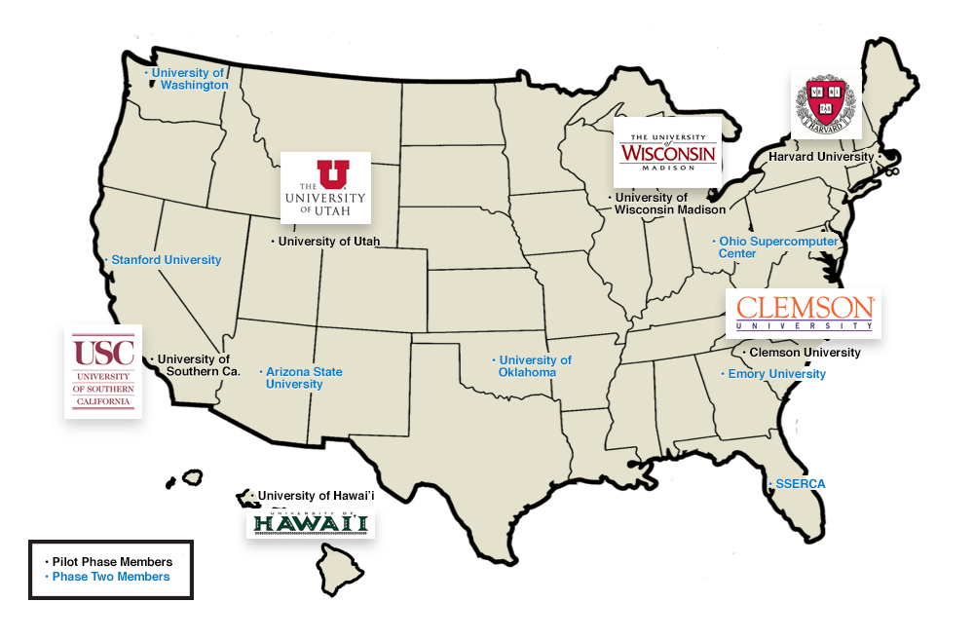
A Little Background
In 2013, a team of 13 institutions led by Clemson U submitted an 8-figure proposal on this issue, to provide multiple ACI-REFs at each institution over a 4 year period.
The proposal also included funding for advanced networking.
http://www.aciref.org/wp-content/uploads/2014/04/map.png

Slide 10
OU’s Piece
OU’s piece included some extra components:
a component about EPSCoR jurisdictions, shared with HI, SC, UT;
a Virtual Residency to teach how to be an ACI-REF.

Slide 11
Ah, if only ….
“Phase 1:”
Clemson U
Harvard U
U Hawai’i
U Southern California
U Utah
U Wisconsin
“Phase 2:”
Arizona State U
Emory U
Ohio Supercomputer Center
Stanford U
Sunshine State Education & Research Computing Alliance (SSERCA)
U Oklahoma
U Washington
Unfortunately, the NSF wasn’t able to fully fund that proposal. The team ended up reducing down to 6 institutions for 2 years, and no advanced networking.

Slide 12
National Science Foundation’s Campus Cyberinfrastructure Programs

Slide 13
And then …
In 2012-13, the NSF had a program called “Campus Cyberinfrastructure - Networking Infrastructure & Engineering” (CC-NIE).
Two subprograms: One for deploying networking equipment, one for innovative networking research.
OU, OSU, Oklahoma Innovation Institute, Langston U, OneNet: “OneOklahoma Friction Free Network”
In 2014, that was followed by “Campus Cyberinfrastructure - Infrastructure, Innovation & Engineering” (CC*IIE).
Several new subprograms, including “Campus CI Engineer.”

Slide 14
So …
OU submitted a proposal to the Campus CI Engineer subprogram:
“A Model for Advanced Cyberinfrastructure Research and Education Facilitators”
$400K
Highlights the relationship between OU and the ACI-REF project.
OU is the only institution that is all of:
ACI-REF Phase 2 (so already engaged)
EPSCoR (and was to have co-lead the ACI-REF EPSCoR thrust)
CC-NIE awardee (so need a Campus CI Engineer already)

Slide 15
Objectives
Data-Intensive Research Facilitation: Via Software Defined Networking (SDN) across OFFN, facilitate end-to-end management, by researchers, of high bandwidth/high performance data flows through a distributed hierarchy of open standards tools, providing researchers with a new layer of transparency into network transport at OU, among OneOCII institutions, and with ACI-REF members.
Oklahoma ACI-REF project: Lead and facilitate adoption of the ACI-REF approach across Oklahoma, leveraging extant and emerging capabilities within OneOCII.
National training regime: Provide a “virtual residency” program for Campus CI Engineers and other ACI-REFs, open to not only CC*IIE awardees and ACI-REF members but any institution that needs.
Research Experiences for Undergraduates (REU) Sites/Supplements: Foster undergraduate research at OU via a culture of integrating REU sites and supplements into Science, Technology, Engineering & Mathematics (STEM) research, including by all research themes on this proposed CC*IIE project.

Slide 16
Success!
Reviewer comments
“This energetic, detailed and ambitious proposal from the University of Oklahoma deserves the highest priority for support. … There are no major weaknesses in the proposal and many strengths. …”
“The broader impacts are nicely defined in terms of … the idea of a residency program …. A residency program and enhancement of undergraduate research are strong enhancements to the proposal. …”
“This is one of the better proposals regarding … additional outreach via the budgeted virtual residency program. …”

Slide 17
Virtual Residency

Slide 18
Lots of Interest
For the proposal, we had 33 institutions in 23 states and territories that expressed interest in the residency workshops, including 3 Minority Serving Institutions, 19 institutions in 13 EPSCoR states and 7 non-PhD-granting institutions.
We had applications from over 65 people at 50 institutions in 31 states and territories.
The final headcount is 52 (29 onsite, 23 remote) from 40 institutions in 26 states and territories, including 19 institutions in 12 EPSCoR states, 5 Minority Serving Institutions and 5 non-PhD-granting institutions.

Slide 19
Agenda
You’ve got a copy of the agenda in front of you.
Everything on it is subject to change without notice:
We may drop some of the sessions.
We may add sessions that we think are needed.
You’re going to help us learn how to help you learn.

Slide 20
What Are We Here to Accomplish?
Learn how to work with researchers who are using CI.
Learn how to talk to them.
Learn how to help them.
Learn how to contribute to, and ultimately to lead, grant proposals.
Some of you already know how to do this, so you’ll help us help the rest to learn.
Science DMZ Track
Learn how to manage a Science DMZ.
Computational Science & Engineering Track
Get some practice working with researchers.

Slide 21
What Aren’t We Trying to Do?
On the Computational & Data-enabled Science & Engineering track, we AREN’T trying to teach you a lot of technical content.
You can learn that from other sources.
Instead, our goal is to teach you the PROFESSION of ACI-REF.

Slide 22
What Are We Really Here For?
We’re really here to prepare for an upcoming transition to:
more need for this kind of skilled workforce, but
fewer people who know how to do it, with
no mechanism to prepare a sufficiently large cohort.
Some of us here already know how to do this.
But it took a very long time to learn on our own.
To keep up with demand, the community needs us to streamline the process so that new ACI-REFs can become fully productive quickly.
You’re the leaders of tomorrow.

Slide 23
You’re Next …
http://freapp.us/apps/android/com.im.uncle.sam/

Slide 24
A Growing Need, a Growing Breed
The Coalition for Academic Scientific Computation (CASC) is a group of most of the mid-to-large academic and government CI centers in the US.
When OU joined CASC in 2004, there were roughly 35 member institutions.
Now there are 82.
So the growth has been significant.
There are a total of about 300 institutions on the US News rankings of STEM graduate programs.
So the growth potential is substantial.

Slide 25
Get Ready to Be in Charge
Baby Boomers: born 1946-1964 (ages 50-69)
Generation X: 1965-1984 (ages 31-50)
Millenials: roughly ages 10-30
“Roughly 10,000 Baby Boomers will turn 65 today, and about 10,000 more will cross that threshold every day for the next 19 years.” -- Pew Research Center, 2010 http://www.pewresearch.org/daily-number/baby-boomers-retire/
Who do you think is going to have to take up the mantle they’re currently carrying?

Slide 26
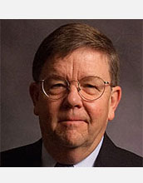
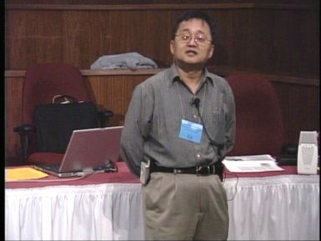
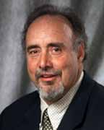
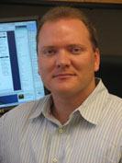
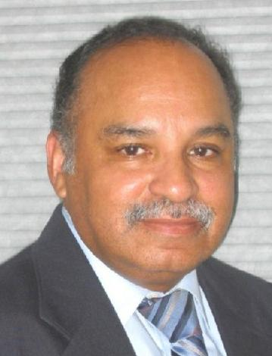
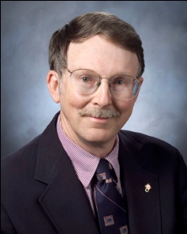
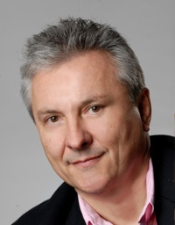
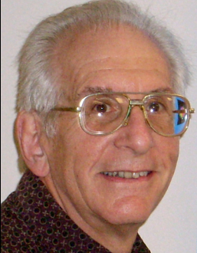
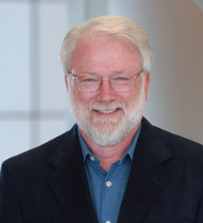
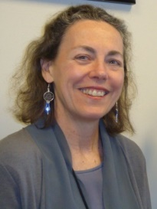
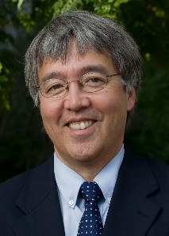
OK Supercomputing Symposium 2015
2003 Keynote:
Peter Freeman
NSF
Computer & Information
Science & Engineering
Assistant Director
2004 Keynote:
Sangtae Kim
NSF Shared
Cyberinfrastructure
Division Director
2005 Keynote:
Walt Brooks
NASA Advanced
Supercomputing
Division Director
2006 Keynote:
Dan Atkins
Head of NSF’s
Office of
Cyberinfrastructure
2007 Keynote:
Jay Boisseau
Director
Texas Advanced
Computing Center
U. Texas Austin
2008 Keynote: José Munoz Deputy Office Director/Senior Scientific Advisor NSF Office of Cyberinfrastructure
2009 Keynote: Douglass Post Chief Scientist US Dept of Defense HPC Modernization Program
FREE!
Wed Sep 23 2015
@ OU
Over 235 registra2ons already!
Over 150 in the f dy, over 200 in the first week, ver 225 in the firstmonth.
Reception/Poster Session
Tue Sep 22 2015 @ OU
Symposium
Wed Sep 23 2015 @ OU
2010 Keynote: Horst Simon Deputy Director Lawrence Berkeley National Laboratory
2011 Keynote: Barry Schneider Program Manager National Science Foundation
2012 Keynote: Thom Dunning Director National Center for Supercomputing Applications
2013 Keynote: John Shalf Dept Head CS Lawrence Berkeley Lab CTO, NERSC
2014 Keynote: Irene Qualters Division Director Advanced Cyberinfarstructure Division, NSF
2015 Keynote:
Jim Kurose
NSF
Computer & Information
Science & Engineering
Assistant Director

Slide 27
Thanks for your attention! Questions? hneeman@ou.edu

