Slide 1
Cyberinfrastructure User Support
Henry Neeman, University of Oklahoma
Director, OU Supercomputing Center for Education & Research (OSCER)
Assistant Vice President, Information Technology - Research Strategy Advisor
Associate Professor, College of Engineering
Adjunct Faculty, School of Computer Science
ACI-REF Virtual Residency Workshop 2015
Monday June 1 2015

Slide 2
Targets for this session
Points of interest:
Differences between CI and conventional IT
CI user categories and differences in their support
Human aspect of CI support (i.e. politics, conflicts)
Problems common to most institutions/centers supporting CI
Exchange different approaches/solutions to common problems
CI education and training
Lessons we’ve learned
These slides were provided by Mehmet (Memo) Belgin
Of Georgia Tech and are used with his permission.
Modest edits have been made.

Slide 3
Outline
Part I: CI user expectations, categorization and commonalities
Part II: Policies, Politics, Conflicts and Personality Management
Part III: Outreach and Education
Part IV: Lessons learned

Slide 4
Differences of CI from Conventional IT
Application performance as the primary target
Usually relies on conventional IT services (by a separate team)
More focus on supporting end-users than services
Uses common IT technologies in uncommon ways
Requires specific middleware and software layers
Requires code compilations using complicated mechanisms
May require specific knowledge about the application/science
Has irregular usage patterns (maybe not so different than IT?)

Slide 5
PART I
CI user expectations, categorization and commonalities

Slide 6
CI User Expectations
Faculty (a.k.a PI) (owner of research and maybe of resources, but not active users):
Their students and collaborators have everything they need to get the work done (and on time).
Maximum availability of resources
Minimum communication with CI support staff
Regular status reports

Slide 7
CI user expectations
Students/Collaborators (or computationally active PIs) :
Ultra-fast learning curve
Simple and instant solutions to complex problems
Maximum communication with CI support staff
Simulations running faster than their laptops (not always possible!)
Help with diagnosing problems that are NOT related to systems
An “insider friend” in the CI support staff
Answers that match their level of knowledge

Slide 8
CI User Categories
Three coarse categories:
Novice
Intermediate
Advanced
Difficult to identify a user's category without any prior interaction
The language used in requests is a good indicator
Replies to follow-up questions also reveal their level of proficiency
In case of uncertainty, assume “novice”

Slide 9
Category 1: Novice Users
Common Points:
75-80% of the support requests
No/little Linux skills
No/little experience with running the domain specific packages
No/little understanding of the scientific fundamentals behind the packages
Mostly identical or similar requests with straightforward solutions
Usually not aware of the standard help channels
May ask the impossible
May type the examples in the help documents literally
May feel insecure or apologetic when seeking for help

Slide 10
Category 1: Novice Users
Common Needs:
Cluster orientation
Linux 101
E-mail list
Easy text editor (nano?)
Help with configuring their MS Windows/OSX systems
Location of existing software
Installation of new software
Help with tools to move data in/out
Help with the very first job submission script

Slide 11
Category 1: Novice Users
Common approaches for effective support:
Do everything to build mutual trust.
Provide regular orientations and help opportunities.
Maintain up-to-date web documentation.
Provide links to existing help locations.
Suggest proper web search terms.
Make them feel better about their simple (or sometimes stupid) questions.
Explain all the steps for resolution in simple, replicable terms.
Prefer exact list of commands to general/conceptual answers.
Be very patient and polite!

Slide 12
Category 2: Intermediate Users
Common Points:
10-25% of the support requests
Largest portion of the compute activity on the cluster
Experience with clusters in the same or other institutions
First to notice and report system problems
Hybrid mix of straightforward and complex questions
Advanced and multi-step scientific workflows
Aware of the standard help channels
Suggest solutions to their own problems and may not like what you did
Act as the local technical expert and often train novice users in their group

Slide 13
Category 2: Intermediate Users
Common Needs:
Advanced (and group-specific) information sessions
Well-explained effective solutions
More performance/efficiency from already running codes
Specific modules/patches/versions for existing software
Higher level of control on their jobs
Access to specialized computational resources
Configurations that may conflict with system defaults
Code development/debugging/profiling support
Data/statistics for the resolution of conflicts with other users

Slide 14
Category 2: Intermediate Users
Common approaches for effective support:
Do everything to build mutual trust.
Hold advanced classes to “teach how to fish.”
Schedule one-on-one meetings.
Add exceptional/advanced cases to existing help pages.
Present solid data/evidence instead of speculation.
Admit to speculation if it is inevitable.
Show complete transparency: they can separate excuses from facts.
Get help from vendor support and user forums, keeping users CC'ed.
Be very patient and polite!

Slide 15
Category 3: Advanced Users
Common Points:
Experience with and access to multiple clusters
Only a small fraction of support requests
Inclination for bypassing the ticket system
Usually complex problems with long resolution time
Try to fix problems themselves, and see CI support as a last resort (i.e. when it's too late)
Usually on the extremes; either hostile or extremely collaborative
Too busy or advanced to act as the local expert for their group
Have complex to incomprehensible workflows
Usually acknowledge challenging problems, open to workarounds
Suggest improvements on the systems (hardware and software) and provide useful feedback
Open to experimentation with new systems and software
Find bugs in libraries and applications

Slide 16
Category 3: Advanced Users
Common Needs:
VIP treatment
Direct and open communication channels
Social contact
Acknowledgement of their level of knowledge and intelligence
High-level and direct vendor/developer support
Lots of exceptions, even though they require violation of existing policies
Almost everything else listed under “common intermediate users needs”
Root password (the answer is still no)

Slide 17
Category 3: Advanced Users
Common approaches for effective support:
Do everything to build mutual trust.
Schedule one-on-one meetings.
Try to learn more about their research, deadlines and aspirations.
Be very careful saying that something is impossible.
Make small exceptions as long as it does not impact other users.
Avoid speculation as much as possible (as with all users).
Be completely transparent: they can easily separate excuses from facts.
Encourage them to contact vendor support or user forums.
Be very patient and polite!

Slide 18
PART II
Policies, Politics, Conflicts and Personality Management

Slide 19
Policies
Clear policies help keep user demands under control.
Publish policies in places easy to find (online).
Be prepared to explain the reasoning behind each policy item.
Make policies as strict as possible, be open to exceptions when necessary.
Encourage users to openly discuss and criticize the policies.
Don’t hesitate updating policies frequently to stay relevant.
Build trust and effective communication with decision makers.
Seek delegation privileges to speed things up.
Don’t make policies for resources you don’t own, but influence them.

Slide 20
Politics and Conflicts
Tricky but inevitable
No magic formula, needs case-specific creative solutions
Biggest challenge: conflicts due to limited resources
Configure systems to exactly match policies.
Collect and store data for past and present usage.
Provide users with tools to browse data/statistics for their accounts.
Run regular audits to defuse problems before they explode.

Slide 21
Tiers of Conflict
Internal to a group/department: Usually easier to solve with communication and informal agreements.
Between groups/department: Can get messy quick.
Between users and CI support staff: Have clear policies handy as a basis for declining impossible requests, and keep solid statistics/data as evidence.

Slide 22
Personality Management
Some users are difficult than others; why they behave that way is irrelevant.
Do not take anything personally; report any harassment you may receive and do not retaliate.
In most cases users do not mean bad, but they are extremely frustrated.
If your mistake caused frustration, take responsibility and offer an apology.
Show empathy and demonstrate sincere intention for resolution.
Acknowledge that:
you understand the problem;
you are aware of its particular impact on the user.
Be aware of, and show tolerance for cultural differences and language difficulties.
Humor is powerful only when used appropriately, avoid being awkward or insulting.
Don’t wait until having a resolution, respond immediately to inform that you started working on the problem, and provide frequent updates.

Slide 23
PART III
Outreach and Education

Slide 24
Trainings and Tutorials
Novice Users:
How to ask for help
Usage limitations and best practices
Basic Linux usage
Basic cluster access, concepts, scheduling system, software
Troubleshooting job related problems
Intermediate Users
Debugging/optimization of codes (including parallel)
System architecture specific details
Advanced use of common tools (Scientific Python, Parallel MATLAB)

Slide 25
Group Consultations
Mini-orientations for newly joining groups
Departmental meetings to provide feedback for resolution of internal conflicts
Resolution of technical problems that are specific to a group
Technical feedback to assist in policy making and system purchases
Introduction of services to new groups with interest in getting resources

Slide 26
Grant Writing Help
Level 1: Answer questions (e.g. hardware specs, software licenses)
Level 2: Contribute facilities document, budget, letters of supports
Level 3: Writing and revising portions of the grant
Level 4: Initiate new grants to get more resources

Slide 27
Collaborations with Researchers and Vendors
Research scientists helping research scientists
Crucial for staying relevant
Collaborative grant writing
Collaborative projects/papers (in acknowledgements or as co-authors)
Support for classes and workshops
Developer/vendor collaborations
Bug tracking and fixes
Hardware/software feedback, evaluation of new systems and technology
Pilot studies

Slide 28
Scheduled Maintenance
Set regular, strict dates, advance announcement.
Specify primary and bonus goals, announce them beforehand.
Predefined worst case downtime.
Provide a summary of completed tasks after maintenance.
Plan ahead in details:
Team member / task associations.
Estimated task duration.
Critical paths and B plans.
Prepare to have unforeseen problems during and after the maintenance days.
Show best effort for minimal impact.
Configure the scheduler to have no running jobs.
Disable user access to resources during the maintenance activities.

Slide 29
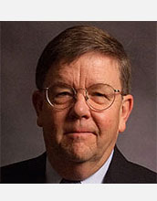
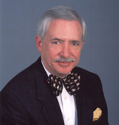
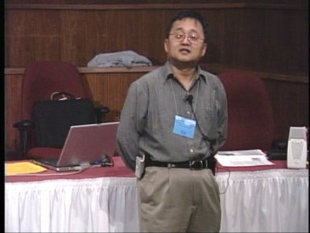
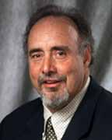
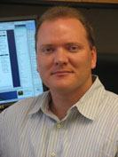
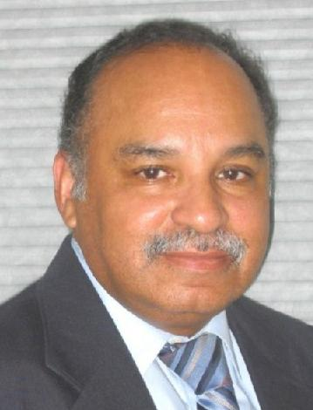
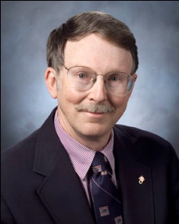
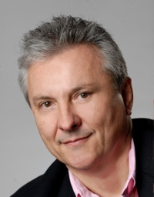
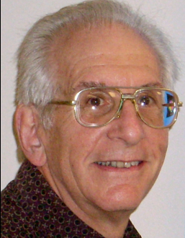
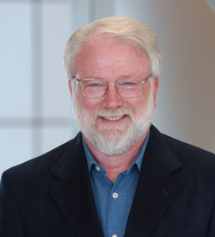
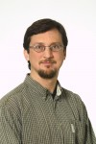
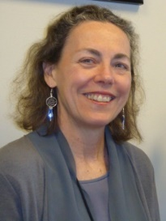
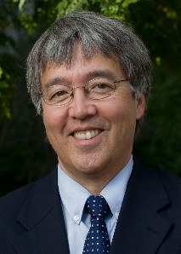
OK Supercomputing Symposium 2015
2003 Keynote:
Peter Freeman
NSF
Computer & Information
Science & Engineering
Assistant Director
2004 Keynote:
Sangtae Kim
NSF Shared
Cyberinfrastructure
Division Director
2005 Keynote:
Walt Brooks
NASA Advanced
Supercomputing
Division Director
2006 Keynote:
Dan Atkins
Head of NSF’s
Office of
Cyberinfrastructure
2007 Keynote:
Jay Boisseau
Director
Texas Advanced
Computing Center
U. Texas Austin
2008 Keynote: José Munoz Deputy Office Director/Senior Scientific Advisor NSF Office of Cyberinfrastructure
2009 Keynote: Douglass Post Chief Scientist US Dept of Defense CI Modernization Program
FREE!
Wed Sep 23 2015
@ OU
Over 235 registra2ons already!
Over 150 in the f dy, over 200 in the first week, ver 225 in the firstmonth.
Reception/Poster Session
Tue Sep 22 2015 @ OU
Symposium
Wed Sep 23 2015 @ OU
2010 Keynote: Horst Simon Deputy Director Lawrence Berkeley National Laboratory
2011 Keynote: Barry Schneider Program Manager National Science Foundation
2012 Keynote: Thom Dunning Director National Center for Supercomputing Applications
2013 Keynote: John Shalf Dept Head CS Lawrence Berkeley Lab CTO, NERSC
2014 Keynote: Irene Qualters Division Director Advanced Cyberinfarstructure Division, NSF
2015 Keynote:
Jim Kurose
NSF
Computer & Information
Science & Engineering
Assistant Director

Slide 30
Thanks for your attention! Questions? hneeman@ou.edu

