Slide 1
Exploring OpenDaylight
David Brockus
dbrockus@ou.edu
Notes:
Advanced Cyberinfrastructure Research & Education Facilitator
(ACI-REF) Virtual Residency Summer Workshop 2015

Slide 2






Why SDN?
New architecture with separate Control and Data planes
Open Programmable Networks and APIs
New business models and revenue opportunities
Efficiency in both capital and operational expenses
Enterprise apps
Security, load
balancing, etc. services
APIs
Software-Defined Network (SDN)
Platform
Open protocols with enablement for proprietary extensions
Focus Area
for OpenDaylight
Physical Network
Physical Network
Notes:
http://go.linuxfoundation.org/l/6342/2015-05-29/2fy2s9/6342/126488/OpenDaylight_Briefing_Deck_052815.pptx

Slide 3
SDN Architecture Characteristics
Directly programmable
Agile
Centrally managed
Programmatically configure
Open standards-based and vendor-neutral
Notes:
https://www.opennetworking.org/sdn-resources/sdn-definition
Directly programmable: Network control is directly programmable because it is decoupled from forwarding functions.
Agile: Abstracting control from forwarding lets administrators dynamically adjust network-wide traffic flow to meet changing needs.
Centrally managed: Network intelligence is (logically) centralized in software-based SDN controllers that maintain a global view of the network, which appears to applications and policy engines as a single, logical switch.
Programmatically configured: SDN lets network managers configure, manage, secure, and optimize network resources very quickly via dynamic, automated SDN programs, which they can write themselves because the programs do not depend on proprietary software.
Open standards-based and vendor-neutral: When implemented through open standards, SDN simplifies network design and operation because instructions are provided by SDN controllers instead of multiple, vendor-specific devices and protocols.

Slide 4
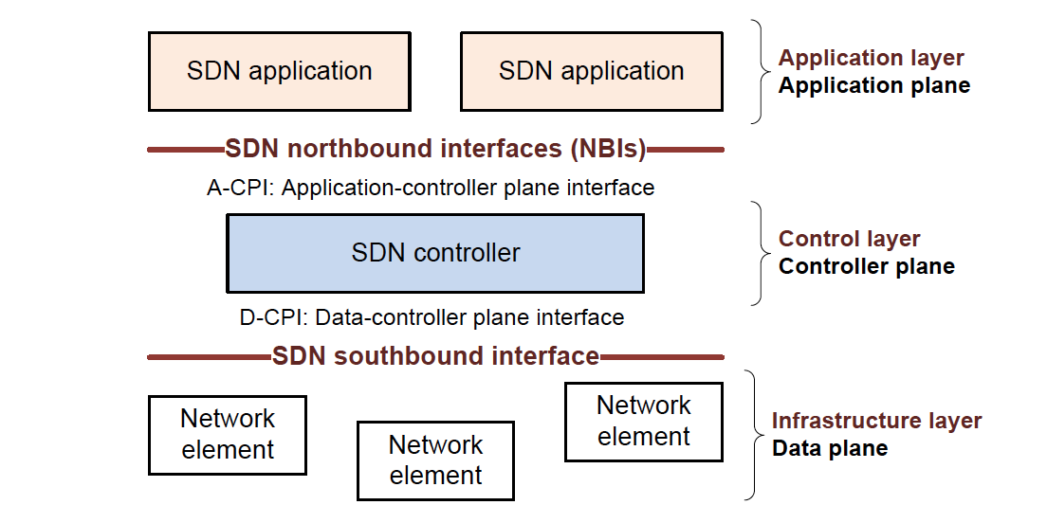
SDN Overview
Notes:
https://www.opennetworking.org/images/stories/downloads/sdn-resources/technical-reports/TR_SDN_ARCH_1.0_06062014.pdf
Page 13

Slide 5
What is OpenDaylight?
Open source project
Modular, pluggable, and flexible controller at its core
Implemented strictly in software
  Contained within its own Java Virtual Machine (JVM)
Deployable on any hardware and OS that supports Java

Slide 6









Who is the OpenDaylight Project?
Platinum
Gold
Notes:
http://www.opendaylight.org/project/members
http://go.linuxfoundation.org/l/6342/2015-05-29/2fy2s9/6342/126488/OpenDaylight_Briefing_Deck_052815.pptx
Slide 11

Slide 7
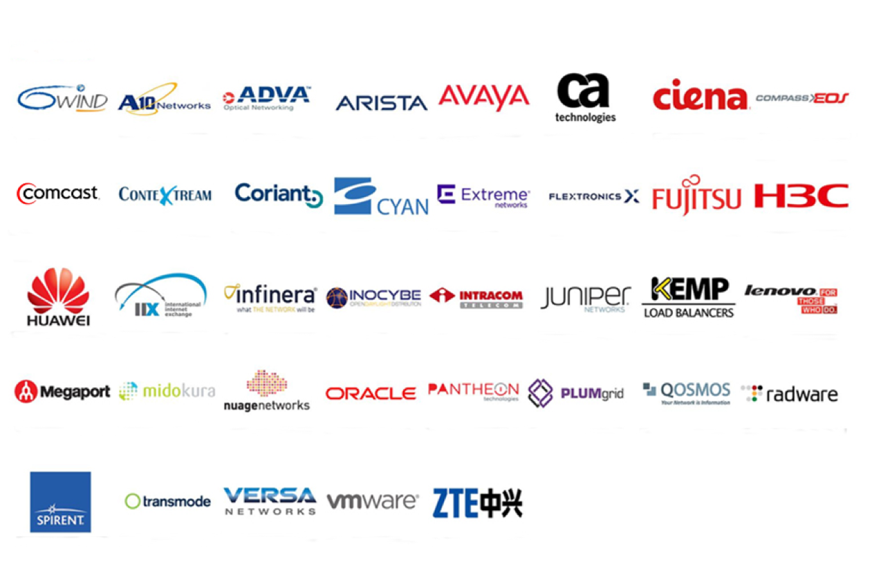
Who is the OpenDaylight Project? (cont.)
Silver
Notes:
http://www.opendaylight.org/project/members
http://go.linuxfoundation.org/l/6342/2015-05-29/2fy2s9/6342/126488/OpenDaylight_Briefing_Deck_052815.pptx
Slide 12

Slide 8
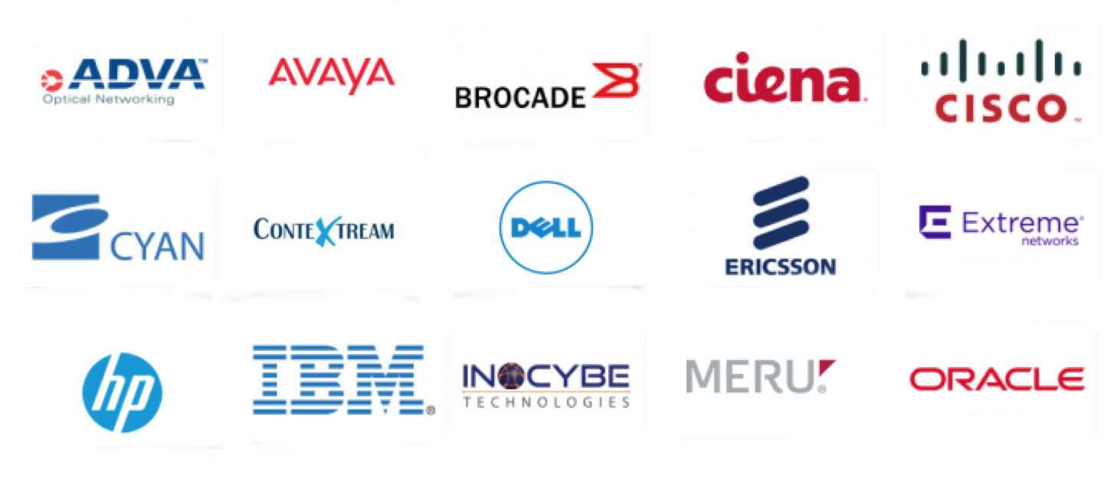
Who makes products based on Open Daylight?
Notes:
http://go.linuxfoundation.org/l/6342/2015-05-29/2fy2s9/6342/126488/OpenDaylight_Briefing_Deck_052815.pptx
Slide 13

Slide 9


Legend
AAA: Authentication, Authorization & Accounting
AuthN: Authentication
BGP: Border Gateway Protocol
COPS: Common Open Policy Service
DLUX: OpenDaylight User Experience
DDoS: Distributed Denial Of Service
DOCSIS: Data Over Cable Service Interface Specification
FRM: Forwarding Rules Manager
GBP: Group Based Policy
LISP: Locator/Identifier Separation Protocol
OVSDB: Open vSwitch DataBase Protocol
PCEP: Path Computation Element Communication Protocol
PCMM: Packet Cable MultiMedia
Plugin2OC: Plugin To OpenContrail
SDNI: SDN Interface (Cross-Controller Federation)
SFC: Service Function Chaining
SNBI: Secure Network Bootstrapping Infrastructure
SNMP: Simple Network Management Protocol
TTP: Table Type Patterns
VTN: Virtual Tenant Network
“HELIUM”
DLUX
VTN Coordinator
OpenStack Neutron
SDNI Wrapper
DDoS Protection
Network Applications
Orchestrations & Services
AAA- AuthN Filter
OpenDaylight APIs (REST)
Base Network Service Functions
OpenStack Service
GBP Service
SCF
AAA
DOCSIS Abstraction
Controller Platform
Topology Manager
Stats Manager
Switch Manager
FRM
Host Tracker
VTN Manager
OVSDB Neutron
Plugin20C
LISP Service
L2 Switch
SDNI Aggregator
Service Abstraction Layer (SAL)
(Plugin Manager, Capability Abstractions, Flow Programming, Inventory, etc.)
GBP Renderers
OpenFlow
OVSDB
NETCONF
PCMM/COPS
SNBI
LISP
BGP
PCEP
SNMP
Plugin20C
Southbound Interfaces &
Protocol Plugins
OpenFlow Enabled Devices
Open vSwitches
Additional Virtual & Physical Devices
Data Plane Elements
(Virtual Switches, Physical Device Interfaces)
Notes:
Helium Diagram, October 2014
https://wiki.opendaylight.org/view/File:Helium-diagram.pptx
http://www.opendaylight.org/project/technical-overview
Network Apps & Orchestration: The top layer consists of business and network logic applications that control and monitor network behavior. In addition, more complex solution orchestration applications needed for cloud and NFV thread services together and engineer network traffic in accordance with the needs of those environments.

Slide 10
Legend
AAA: Authentication, Authorization & Accounting
AuthN: Authentication
BGP: Border Gateway Protocol
COPS: Common Open Policy Service
DLUX: OpenDaylight User Experience
DDoS: Distributed Denial Of Service
DOCSIS: Data Over Cable Service Interface Specification
FRM: Forwarding Rules Manager
GBP: Group Based Policy
LISP: Locator/Identifier Separation Protocol
OVSDB: Open vSwitch DataBase Protocol
PCEP: Path Computation Element Communication Protocol
PCMM: Packet Cable MultiMedia
Plugin2OC: Plugin To OpenContrail
SDNI: SDN Interface (Cross-Controller Federation)
SFC: Service Function Chaining
SNBI: Secure Network Bootstrapping Infrastructure
SNMP: Simple Network Management Protocol
TTP: Table Type Patterns
VTN: Virtual Tenant Network
“HELIUM”
DLUX
VTN Coordinator
OpenStack Neutron
SDNI Wrapper
DDoS Protection
Network Applications
Orchestrations & Services
AAA- AuthN Filter
OpenDaylight APIs (REST)
Base Network Service Functions
OpenStack Service
GBP Service
SCF
AAA
DOCSIS Abstraction
Controller Platform
Topology Manager
Stats Manager
Switch Manager
FRM
Host Tracker
VTN Manager
OVSDB Neutron
Plugin20C
LISP Service
L2 Switch
SDNI Aggregator
Service Abstraction Layer (SAL)
(Plugin Manager, Capability Abstractions, Flow Programming, Inventory, etc.)
GBP Renderers
OpenFlow
OVSDB
NETCONF
PCMM/COPS
SNBI
LISP
BGP
PCEP
SNMP
Plugin20C
Southbound Interfaces &
Protocol Plugins
OpenFlow Enabled Devices
Open vSwitches
Additional Virtual & Physical Devices
Data Plane Elements
(Virtual Switches, Physical Device Interfaces)
Notes:
Helium Diagram, October 2014
https://wiki.opendaylight.org/view/File:Helium-diagram.pptx
http://www.opendaylight.org/project/technical-overview
Physical & Virtual Network Devices: The bottom layer consists of the physical & virtual devices, switches, routers, etc., that make up the connective fabric between all endpoints within the network.

Slide 11
Legend
AAA: Authentication, Authorization & Accounting
AuthN: Authentication
BGP: Border Gateway Protocol
COPS: Common Open Policy Service
DLUX: OpenDaylight User Experience
DDoS: Distributed Denial Of Service
DOCSIS: Data Over Cable Service Interface Specification
FRM: Forwarding Rules Manager
GBP: Group Based Policy
LISP: Locator/Identifier Separation Protocol
OVSDB: Open vSwitch DataBase Protocol
PCEP: Path Computation Element Communication Protocol
PCMM: Packet Cable MultiMedia
Plugin2OC: Plugin To OpenContrail
SDNI: SDN Interface (Cross-Controller Federation)
SFC: Service Function Chaining
SNBI: Secure Network Bootstrapping Infrastructure
SNMP: Simple Network Management Protocol
TTP: Table Type Patterns
VTN: Virtual Tenant Network
“HELIUM”
DLUX
VTN Coordinator
OpenStack Neutron
SDNI Wrapper
DDoS Protection
Network Applications
Orchestrations & Services
AAA- AuthN Filter
OpenDaylight APIs (REST)
Base Network Service Functions
OpenStack Service
GBP Service
SCF
AAA
DOCSIS Abstraction
Controller Platform
Topology Manager
Stats Manager
Switch Manager
FRM
Host Tracker
VTN Manager
OVSDB Neutron
Plugin20C
LISP Service
L2 Switch
SDNI Aggregator
Service Abstraction Layer (SAL)
(Plugin Manager, Capability Abstractions, Flow Programming, Inventory, etc.)
GBP Renderers
OpenFlow
OVSDB
NETCONF
PCMM/COPS
SNBI
LISP
BGP
PCEP
SNMP
Plugin20C
Southbound Interfaces &
Protocol Plugins
OpenFlow Enabled Devices
Open vSwitches
Additional Virtual & Physical Devices
Data Plane Elements
(Virtual Switches, Physical Device Interfaces)
Notes:
Helium Diagram, October 2014
https://wiki.opendaylight.org/view/File:Helium-diagram.pptx
http://www.opendaylight.org/project/technical-overview
Controller Platform: The middle layer is the framework in which the SDN abstractions can manifest, providing a set of common APIs to the application layer (commonly referred to as the northbound interface) while implementing one or more protocols for command and control of the physical hardware within the network (typically referred to as the southbound interface).
The controller exposes open northbound APIs
which are used by applications.
OpenDaylight supports the OSGi framework and bidirectional REST for the northbound API.
OSGi framework is used for applications that will run in the same address space as the controller
REST (web based) API is used for applications that do not run in the same address space (or even necessarily on the same machine) as the controller.
The business logic and algorithms reside in the applications. These applications use the controller to gather network intelligence, run algorithms to perform analytics, and then use the controller to orchestrate the new rules, if any, throughout the network.
The controller platform itself contains a collection of dynamically pluggable modules to perform needed network tasks.
There are a series of base network services for such tasks as understanding what devices are contained within the network and the capabilities of each, statistics gathering, etc.
In addition, platform oriented services and other extensions can also be inserted into the controller platform for enhanced SDN functionality.
Southbound interface capable of supporting multiple protocols (as separate plugins),
OpenFlow 1.0,
OpenFlow 1.3,
BGP-LS
These modules are dynamically linked into a Service Abstraction Layer (SAL).
Exposes device services to which the modules north of it are written
Determines how to fulfill the requested service irrespective of the underlying protocol used between the controller and the network devices.

Slide 12
OpenDaylight Tools and Paradigms
Java interfaces
  for event listening, specifications and forming patterns
Maven -
  Build and dependency management
OSGi -
  Backend container framework that allows dynamically loading bundles
Karaf -
  OSGi based runtime
Notes:
http://sdnhub.org/tutorials/opendaylight/
Service Abstraction Layer (SAL) is your friend for most development aspects.
Java interfaces:
used for event listening, specifications and forming patterns
main way in which specific bundles implement call-back functions for events and also to indicate awareness of specific state.
Maven
Maven uses pom.xml (Project Object Model for this bundle) to script the dependencies between bundles and also to describe what bundles to load on start.
OSGi: This framework in the backend of OpenDayLight allows dynamically loading bundles and packaged Jar files, and binding bundles together for information exchange.
Karaf: Karaf is a small OSGi based runtime which provides a lightweight container for loading different modules.

Slide 13
What is an Application Programming Interface (API)?
set of rules ('code') and specifications that software programs can follow to communicate with each other.

Slide 14
What is a Representational State Transfer (REST)
API?
A REST API is an API in a specific architectural style
  originally communicated by Roy Fielding in his doctoral dissertation
    http://www.ics.uci.edu/~fielding/pubs/dissertation/rest_arch_style.htm
Notes:
The REST architectural style describes six constraints. These constraints, applied to the architecture, were originally communicated by Roy Fielding in his doctoral dissertation (see http://www.ics.uci.edu/~fielding/pubs/dissertation/rest_arch_style.htm)

Slide 15
What defines a ‘RESTful’ API?
Six constraints
  Start with Null Style
  Client-Server
  Stateless (Server)
  Cache
  Uniform Interface
  Layered System
Notes:
see http://www.ics.uci.edu/~fielding/pubs/dissertation/rest_arch_style.htm) and defines the basis of RESTful-style.
The six constraints are: (click the constraint to read more)
Start with Null Style
an empty set of constraints
Client-Server
Stateless
Cache
Uniform Interface
Layered System

Slide 16
What distinguishes REST?
Emphasis on uniform interface between components
  Four constraints
    identification of resources
    manipulation of resources through representations
    self-descriptive messages
    hypermedia as the engine of application state.
Notes:
see http://www.ics.uci.edu/~fielding/pubs/dissertation/rest_arch_style.htm) and defines the basis of RESTful-style.
Uniform Interface
identification of resources
manipulation of resources through representations
self-descriptive messages
hypermedia as the engine of application state.
From 5.1.5 Uniform Interface
“By applying the software engineering principle of generality to the component interface, the overall system architecture is simplified and the visibility of interactions is improved. Implementations are decoupled from the services they provide, which encourages independent evolvability. The trade-off, though, is that a uniform interface degrades efficiency, since information is transferred in a standardized form rather than one which is specific to an application's needs. The REST interface is designed to be efficient for large-grain hypermedia data transfer, optimizing for the common case of the Web, but resulting in an interface that is not optimal for other forms of architectural interaction. ”

Slide 17
Why a ‘RESTful’ API
Principle of generality
  Simplifies overall system architecture
  Visibility of interactions improved
Notes:
see http://www.ics.uci.edu/~fielding/pubs/dissertation/rest_arch_style.htm) and defines the basis of RESTful-style.
From 5.1.5 Uniform Interface
“By applying the software engineering principle of generality to the component interface, the overall system architecture is simplified and the visibility of interactions is improved. Implementations are decoupled from the services they provide, which encourages independent evolvability. “

Slide 18

Acknowledgments
Partially funded by National Science Grant no. ACI-1440783
("CC*IIE Engineer: A Model for Advanced Cyberinfrastructure Research and Education Facilitators," 10/1/2014 - 9/30/2016).
Notes:
This event is partially funded by National Science Grant no. ACI-1440783 ("CC*IIE Engineer: A Model for Advanced Cyberinfrastructure Research and Education Facilitators," 10/1/2014 - 9/30/2016).

Slide 19
Questions? Thoughts?
David Brockus
dbrockus@ou.edu

Slide 20
Extra Slides

Slide 21
Legend
AAA: Authentication, Authorization & Accounting
AuthN: Authentication
BGP: Border Gateway Protocol
COPS: Common Open Policy Service
DLUX: OpenDaylight User Experience
DDoS: Distributed Denial Of Service
DOCSIS: Data Over Cable Service Interface Specification
FRM: Forwarding Rules Manager
GBP: Group Based Policy
LISP: Locator/Identifier Separation Protocol
OVSDB: Open vSwitch DataBase Protocol
PCEP: Path Computation Element Communication Protocol
PCMM: Packet Cable MultiMedia
Plugin2OC: Plugin To OpenContrail
SDNI: SDN Interface (Cross-Controller Federation)
SFC: Service Function Chaining
SNBI: Secure Network Bootstrapping Infrastructure
SNMP: Simple Network Management Protocol
TTP: Table Type Patterns
VTN: Virtual Tenant Network
“HELIUM”
DLUX
VTN Coordinator
OpenStack Neutron
SDNI Wrapper
DDoS Protection
Network Applications
Orchestrations & Services
AAA- AuthN Filter
OpenDaylight APIs (REST)
Base Network Service Functions
OpenStack Service
GBP Service
SCF
AAA
DOCSIS Abstraction
Controller Platform
Topology Manager
Stats Manager
Switch Manager
FRM
Host Tracker
VTN Manager
OVSDB Neutron
Plugin20C
LISP Service
L2 Switch
SDNI Aggregator
Service Abstraction Layer (SAL)
(Plugin Manager, Capability Abstractions, Flow Programming, Inventory, etc.)
GBP Renderers
OpenFlow
OVSDB
NETCONF
PCMM/COPS
SNBI
LISP
BGP
PCEP
SNMP
Plugin20C
Southbound Interfaces &
Protocol Plugins
OpenFlow Enabled Devices
Open vSwitches
Additional Virtual & Physical Devices
Data Plane Elements
(Virtual Switches, Physical Device Interfaces)
Notes:
Helium Diagram, October 2014
https://wiki.opendaylight.org/view/File:Helium-diagram.pptx
http://www.opendaylight.org/project/technical-overview
Network Apps & Orchestration: The top layer consists of business and network logic applications that control and monitor network behavior. In addition, more complex solution orchestration applications needed for cloud and NFV thread services together and engineer network traffic in accordance with the needs of those environments.
Controller Platform: The middle layer is the framework in which the SDN abstractions can manifest, providing a set of common APIs to the application layer (commonly referred to as the northbound interface) while implementing one or more protocols for command and control of the physical hardware within the network (typically referred to as the southbound interface).
Physical & Virtual Network Devices: The bottom layer consists of the physical & virtual devices, switches, routers, etc., that make up the connective fabric between all endpoints within the network.

Slide 22
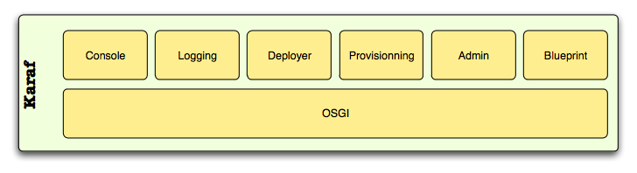
What is Karaf?
Small OSGi based runtime
Lightweight container
  various components and applications can be deployed
Notes:
https://karaf.apache.org/

Slide 23
What is OSGi (Open Service Gateway Initiative)?
Java framework for developing and deploying modular software programs and libraries
Two components
  Specification for modular components called bundles
  Java Virtual Machine (JVM)-level service registry
Notes:
first part is a specification for modular components called bundles, which are commonly referred to as plug-ins. The specification defines an infrastructure for a bundle's life cycle and determines how bundles will interact. The second part of OSGi is a Java Virtual Machine (JVM)-level service registry that bundles can use to publish, discover and bind to services in a service-oriented architecture (SOA).

Slide 24
What are the drawbacks of REST?
Uniform interface degrades efficiency
  information transferred in a standardized form rather than form specific to an application's needs
Notes:
see http://www.ics.uci.edu/~fielding/pubs/dissertation/rest_arch_style.htm) and defines the basis of RESTful-style.
From 5.1.5 Uniform Interface
“… The trade-off, though, is that a uniform interface degrades efficiency, since information is transferred in a standardized form rather than one which is specific to an application's needs. The REST interface is designed to be efficient for large-grain hypermedia data transfer, optimizing for the common case of the Web, but resulting in an interface that is not optimal for other forms of architectural interaction. ”

