Slide 1
Academic Life: Tenure, Promotion, & More
or Congratulations, you’ve just won the Lottery!

Slide 2
Know your audience

Slide 3
Academic Vocabulary Test
Assistant Prof
Associate Prof
Professor
Chair
Dean
Director
Endowed Prof
Endowed Chair
Grad Assistant
Instructor
President
Provost
Renewable Term Prof
Research Prof
Vice President

Slide 4
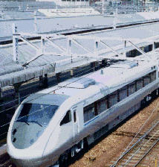
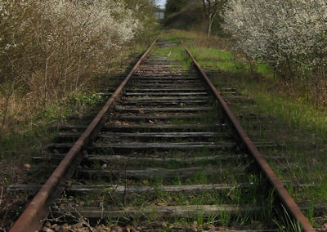
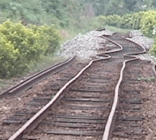
The “Tenure Track”

Slide 5
Academic Time-Line
Prof – Year
Tenure Asoc. Prof – Year
Tenure Track Asst. Prof – Year
Finish PhD – Year
Graduate School – Year 0

Slide 6
Why Tenure?
Tenure … is a means to assure unfettered, unbiased, unencumbered search, verification, and communication OF TRUTH by professional scholars and teachers. Tenure is designed to provide faculty members with freedom from political, doctrinaire, and other pressures, restraints, and reprisals which would otherwise inhibit the independent thought and actions in their professional responsibility of search, verification, and communication OF TRUTH.
OU Faculty Handbook

Slide 7
The Tenure Decision
New Assistant Professor
(External) Reviews
Six Years of Academic Productivity
Write Life Story
Departmental Vote
Campus Tenure Committee
Dean/College
Provost
President/Regents

Slide 8
Academic Productivity
Papers
Money
Books
Papers
Money
Collaborations
Talks
Papers
Money

Slide 9
Tenure Evaluation
Official
Reality
Research
Teaching
Service

Slide 10
No Tenure, You Leave

Slide 11
After Tenure 1: Promotion
Assistant Professor
Proven, Established, International Recognition
Associate Professor
Full Professor
Almost always with the Tenure Decision

Slide 12
Post-Tenure Academic Productivity
Papers
Money
Books
Talks
Conference Committees
Collaborations
Disciplinary Service
Public/Professional Service
Leadership
Instruction & Outreach

Slide 13
Research Focus
Measurement of the ttbar production cross section and top quark mass extraction using dilepton events in ppbar collisions
To Swear Like a Sailor: Language, Culture, and Meaning in the American Maritime World, 1750 – 1850
Elimination of threading dislocations in as-grown PbSe film on patterned Si(111) substrate using molecular beam epitaxy

Slide 14
Evaluation
Official
Reality
Research
Teaching
Service

Slide 15
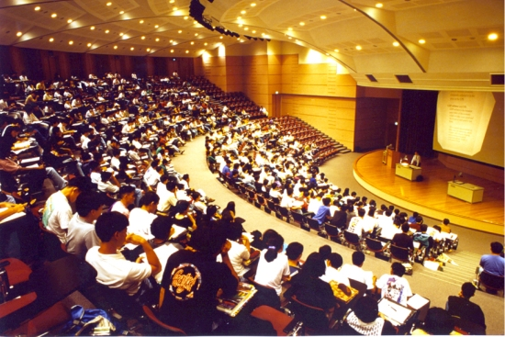
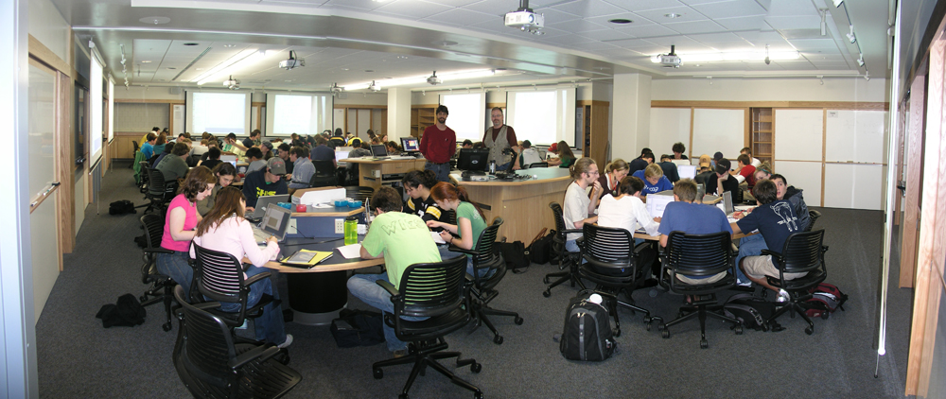
Teaching?

Slide 16
After Tenure 2: “PTR”
5 Year Self Evaluation
Annual Evaluations
Departmental Evaluation
Prof. Dev. Plan
Dean & Provost
Okay for Next 5 Years

Slide 17
Abrogation of Tenure
Incompetence or Dishonesty
Substantial Failure to Fulfill Duties
Personal Behavior
Failure to Adhere to University Policies
Violations of the Law
Elimination of Academic Unit
Financial Emergency

Slide 18
Academic Vocabulary Test
Assistant Prof
Associate Prof
Professor
Chair
Dean
Director
Endowed Prof
Endowed Chair
Grad Assistant
Instructor
President
Provost
Renewable Term Prof
Research Prof
Vice President

