Slide 1




Supercomputing in Plain English
Grab Bag: Scientific Libraries,
I/O Libraries, Visualizations
Henry Neeman, Director
OU Supercomputing Center for Education & Research (OSCER)
University of Oklahoma
Tuesday April 16 2013

Slide 2
This is an experiment!
It’s the nature of these kinds of videoconferences that FAILURES ARE GUARANTEED TO HAPPEN! NO PROMISES!
So, please bear with us. Hopefully everything will work out well enough.
If you lose your connection, you can retry the same kind of connection, or try connecting another way.
Remember, if all else fails, you always have the toll free phone bridge to fall back on.

Slide 3
H.323 (Polycom etc) #1
If you want to use H.323 videoconferencing – for example, Polycom – then:
If you AREN’T registered with the OneNet gatekeeper (which is probably the case), then:
  Dial 164.58.250.47
  Bring up the virtual keypad.
  On some H.323 devices, you can bring up the virtual keypad by typing:
  #
  (You may want to try without first, then with; some devices won't work with the #, but give cryptic error messages about it.)
  When asked for the conference ID, or if there's no response, enter:
  0409
  On most but not all H.323 devices, you indicate the end of the ID with:
  #

Slide 4
H.323 (Polycom etc) #2
If you want to use H.323 videoconferencing – for example, Polycom – then:
If you ARE already registered with the OneNet gatekeeper (most institutions aren’t), dial:
2500409
Many thanks to Skyler Donahue and Steven Haldeman of OneNet for providing this.

Slide 5
Wowza #1
You can watch from a Windows, MacOS or Linux laptop using Wowza from either of the following URLs:
http://www.onenet.net/technical-resources/video/sipe-stream/
OR
https://vcenter.njvid.net/videos/livestreams/page1/
Wowza behaves a lot like YouTube, except live.
Many thanks to Skyler Donahue and Steven Haldeman of OneNet and Bob Gerdes of Rutgers U for providing this.

Slide 6
Wowza #2
Wowza has been tested on multiple browsers on each of:
Windows (7 and 8): IE, Firefox, Chrome, Opera, Safari
MacOS X: Safari, Firefox
Linux: Firefox, Opera
We’ve also successfully tested it on devices with:
Android
iOS
However, we make no representations on the likelihood of it working on your device, because we don’t know which versions of Android or iOS it might or might not work with.

Slide 7
Wowza #3
If one of the Wowza URLs fails, try switching over to the other one.
If we lose our network connection between OU and OneNet, then there may be a slight delay while we set up a direct connection to Rutgers.

Slide 8
Toll Free Phone Bridge
IF ALL ELSE FAILS, you can use our toll free phone bridge:
800-832-0736
* 623 2847 #
Please mute yourself and use the phone to listen.
Don’t worry, we’ll call out slide numbers as we go.
Please use the phone bridge ONLY if you cannot connect any other way: the phone bridge can handle only 100 simultaneous connections, and we have over 350 participants.
Many thanks to OU CIO Loretta Early for providing the toll free phone bridge.

Slide 9
Please Mute Yourself
No matter how you connect, please mute yourself, so that we cannot hear you.
(For Wowza, you don’t need to do that, because the information only goes from us to you, not from you to us.)
At OU, we will turn off the sound on all conferencing technologies.
That way, we won’t have problems with echo cancellation.
Of course, that means we cannot hear questions.
So for questions, you’ll need to send e-mail.

Slide 10
Questions via E-mail Only
Ask questions by sending e-mail to:
sipe2013@gmail.com
All questions will be read out loud and then answered out loud.

Slide 11
TENTATIVE Schedule
Tue Jan 22: Overview: What the Heck is Supercomputing?
Tue Jan 29: The Tyranny of the Storage Hierarchy
Tue Feb 5: Instruction Level Parallelism
Tue Feb 12: Stupid Compiler Tricks
Tue Feb 19: Shared Memory Multithreading
Tue Feb 26: Distributed Multiprocessing
Tue March 5: Applications and Types of Parallelism
Tue Apr 9: Grab Bag Madness
Tue March 19: NO SESSION (OU's Spring Break)
Tue Apr 9: High Throughput Computing
Tue Apr 9: Grab Bag: Number Crunching in Your Graphics Card
Tue Apr 9: Grab Bag: Scientific Libraries, I/O Libraries, Visualization

Slide 12
Supercomputing Exercises
Want to do the “Supercomputing in Plain English” exercises?
The 3rd exercise will be posted soon at:
http://www.oscer.ou.edu/education/
If you don’t yet have a supercomputer account, you can get a temporary account, just for the “Supercomputing in Plain English” exercises, by sending e-mail to:
hneeman@ou.edu
Please note that this account is for doing the exercises only, and will be shut down at the end of the series. It’s also available only to those at institutions in the USA.
This week’s Introductory exercise will teach you how to compile and run jobs on OU’s big Linux cluster supercomputer, which is named Boomer.

Slide 13
Supercomputing Exercises #2
You’ll be doing the exercises on your own (or you can work with others at your local institution if you like).
These aren’t graded, but we’re available for questions:
hneeman@ou.edu

Slide 14
Thanks for helping!
OU IT
  OSCER operations staff (Brandon George, Dave Akin, Brett Zimmerman, Josh Alexander, Patrick Calhoun)
  Horst Severini, OSCER Associate Director for Remote & Heterogeneous Computing
  Debi Gentis, OU Research IT coordinator
  Kevin Blake, OU IT (videographer)
  Chris Kobza, OU IT (learning technologies)
  Mark McAvoy
Kyle Keys, OU National Weather Center
James Deaton, Skyler Donahue and Steven Haldeman, OneNet
Bob Gerdes, Rutgers U
Lisa Ison, U Kentucky
Paul Dave, U Chicago

Slide 15
This is an experiment!
It’s the nature of these kinds of videoconferences that FAILURES ARE GUARANTEED TO HAPPEN! NO PROMISES!
So, please bear with us. Hopefully everything will work out well enough.
If you lose your connection, you can retry the same kind of connection, or try connecting another way.
Remember, if all else fails, you always have the toll free phone bridge to fall back on.

Slide 16
Coming in 2013!
From Computational Biophysics to Systems Biology, May 19-21, Norman OK
Great Plains Network Annual Meeting, May 29-31, Kansas City
XSEDE2013, July 22-25, San Diego CA
IEEE Cluster 2013, Sep 23-27, Indianapolis IN
OKLAHOMA SUPERCOMPUTING SYMPOSIUM 2013, Oct 1-2, Norman OK
SC13, Nov 17-22, Denver CO

Slide 17
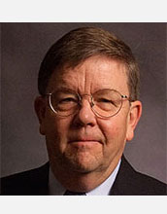
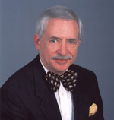
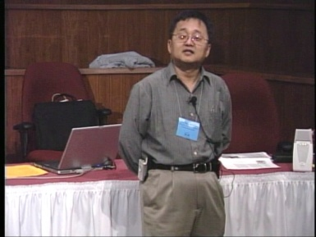
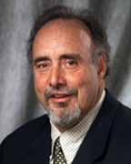
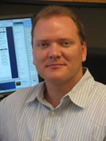
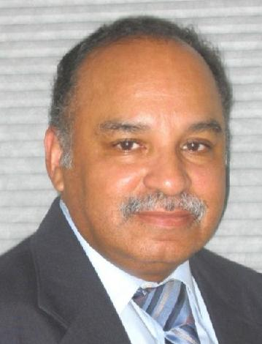
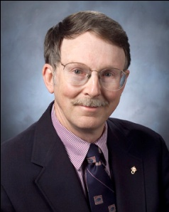
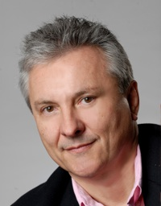
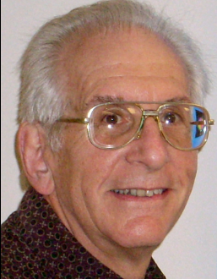
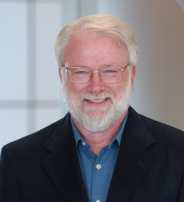
OK Supercomputing Symposium 2013
2003 Keynote:
Peter Freeman
NSF
Computer & Information
Science & Engineering
Assistant Director
2004 Keynote:
Sangtae Kim
NSF Shared
Cyberinfrastructure
Division Director
2005 Keynote:
Walt Brooks
NASA Advanced
Supercomputing
Division Director
2006 Keynote:
Dan Atkins
Head of NSF’s
Office of
Cyberinfrastructure
2007 Keynote:
Jay Boisseau
Director
Texas Advanced
Computing Center
U. Texas Austin
2008 Keynote: José Munoz Deputy Office Director/ Senior Scientific Advisor NSF Office of Cyberinfrastructure
2013 Keynote to be announced!
2009 Keynote: Douglass Post Chief Scientist US Dept of Defense HPC Modernization Program
2010 Keynote: Horst Simon Deputy Director Lawrence Berkeley National Laboratory
FREE! Wed Oct 2 2013 @ OU
Over 235 registra2ons already!
Over 150 in the first day, over 200 in the first week, over 225 in the first month.
2011 Keynote: Barry Schneider Program Manager National Science Foundation
2012 Keynote: Thom Dunning Director National Center for Supercomputing Applications
http://symposium2013.oscer.ou.edu/
Reception/Poster Session
Tue Oct 1 2013 @ OU
Symposium Wed Oct 2 2013 @ OU

Slide 18
Outline
Scientific Computing Pipeline
Scientific Libraries
I/O Libraries
Scientific Visualization

Slide 19
Scientific Computing Pipeline
Real World
Physics
Mathematical Representation (continuous)
Numerical Representation (discrete)
Algorithm
Implementation (program)
Port (to a specific platform)
Result (run)
Analysis
Verification
Thanks to Julia Mullen of MIT Lincoln Lab for this concept.

Slide 20
Five Rules of Scientific Computing
Know the physics.
Control the software.
Understand the numerics.
Achieve expected behavior.
Question unexpected behavior.
Thanks to Robert E. Peterkin for these.

Slide 21
Scientific Libraries

Slide 22
Preinvented Wheels
Many simulations perform fairly common tasks; for example, solving systems of equations:
Ax = b
where A is the matrix of coefficients, x is the vector of unknowns and b is the vector of knowns.

Slide 23
Scientific Libraries
Because some tasks are quite common across many science and engineering applications, groups of researchers have put a lot of effort into writing scientific libraries: collections of routines for performing these commonly-used tasks (for example, linear algebra solvers).
The people who write these libraries know a lot more about these things than we do.
So, a good strategy is to use their libraries, rather than trying to write our own.

Slide 24
Solver Libraries
Probably the most common scientific computing task is solving a system of equations
Ax = b
where A is a matrix of coefficients, x is a vector of unknowns, and b is a vector of knowns.
The goal is to solve for x.

Slide 25
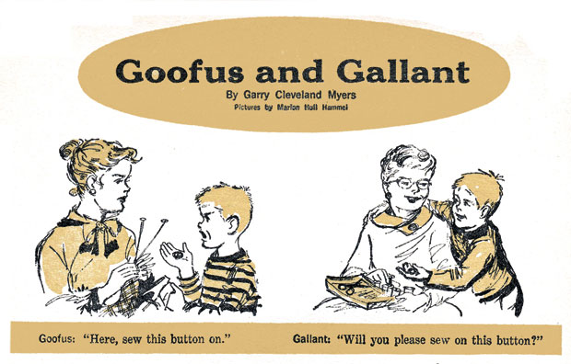
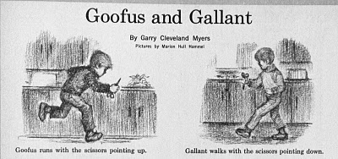
Solving Systems of Equations
Don’ts:
Don’t invert the matrix (x = A⁻¹b). That’s much more costly than solving directly, and much more prone to numerical error.
Don’t write your own solver code. There are people who devote their whole careers to writing solvers. They know a lot more about writing solvers than we do.

Slide 26
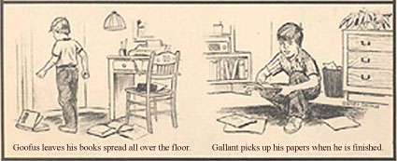
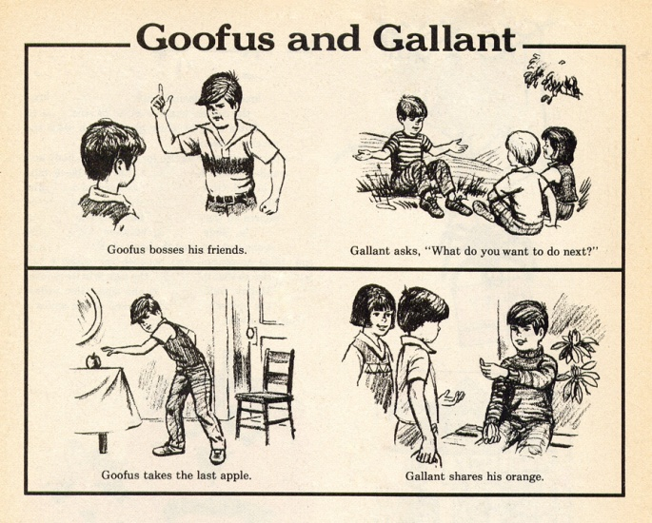
Solving Do’s
Do’s:
Do use standard, portable solver libraries.
Do use a version that’s tuned for the platform you’re running on, if available.
Do use the information that you have about your system of equations to pick the most efficient solver.

Slide 27
All About Your Matrix
If you know things about your matrix, you maybe can use a more efficient solver.
Symmetric: a_{i,j} = a_{j,i}
Positive definite: x^{T}Ax > 0 for all x ≠ 0 (for example, if all eigenvalues are positive)
Banded:
zero
except
on the
bands
Tridiagonal:
0
and …
0

Slide 28
Sparse Matrices
A sparse matrix is a matrix that has mostly zeros in it. “Mostly” is vaguely defined, but a good rule of thumb is that a matrix is sparse if more than, say, 90-95% of its entries are zero. (A non-sparse matrix is dense.)

Slide 29
Linear Algebra Libraries
BLAS ^{[1],[2]}
ATLAS^{[3]}
LAPACK^{[4]}
ScaLAPACK^{[5]}
PETSc^{[6],[7],[8]}

Slide 30
BLAS
The Basic Linear Algebra Subprograms (BLAS) are a set of low level linear algebra routines:
Level 1: Vector-vector (for example, dot product)
Level 2: Matrix-vector (for example, matrix-vector multiply)
Level 3: Matrix-matrix (for example, matrix-matrix multiply)
Many linear algebra packages, including LAPACK, ScaLAPACK and PETSc, are built on top of BLAS.
Most supercomputer vendors have versions of BLAS that are highly tuned for their platforms.

Slide 31
ATLAS
The Automatically Tuned Linear Algebra Software package (ATLAS) is a self-tuned version of BLAS (it also includes a few LAPACK routines).
When it’s installed, it tests and times a variety of approaches to each routine, and selects the version that runs the fastest.
ATLAS is substantially faster than the generic version of BLAS.
And, it’s FREE!

Slide 32
Goto BLAS
Several years ago, a new version of BLAS was released, developed by Kazushige Goto (then at UT Austin, now at Intel).
http://en.wikipedia.org/wiki/Kazushige_Goto
This version is unusual, because instead of optimizing for cache, it optimizes for the Translation Lookaside Buffer (TLB), which is a special little cache that often is ignored by software developers.
Goto realized that optimizing for the TLB would be more efficient than optimizing for cache.

Slide 33
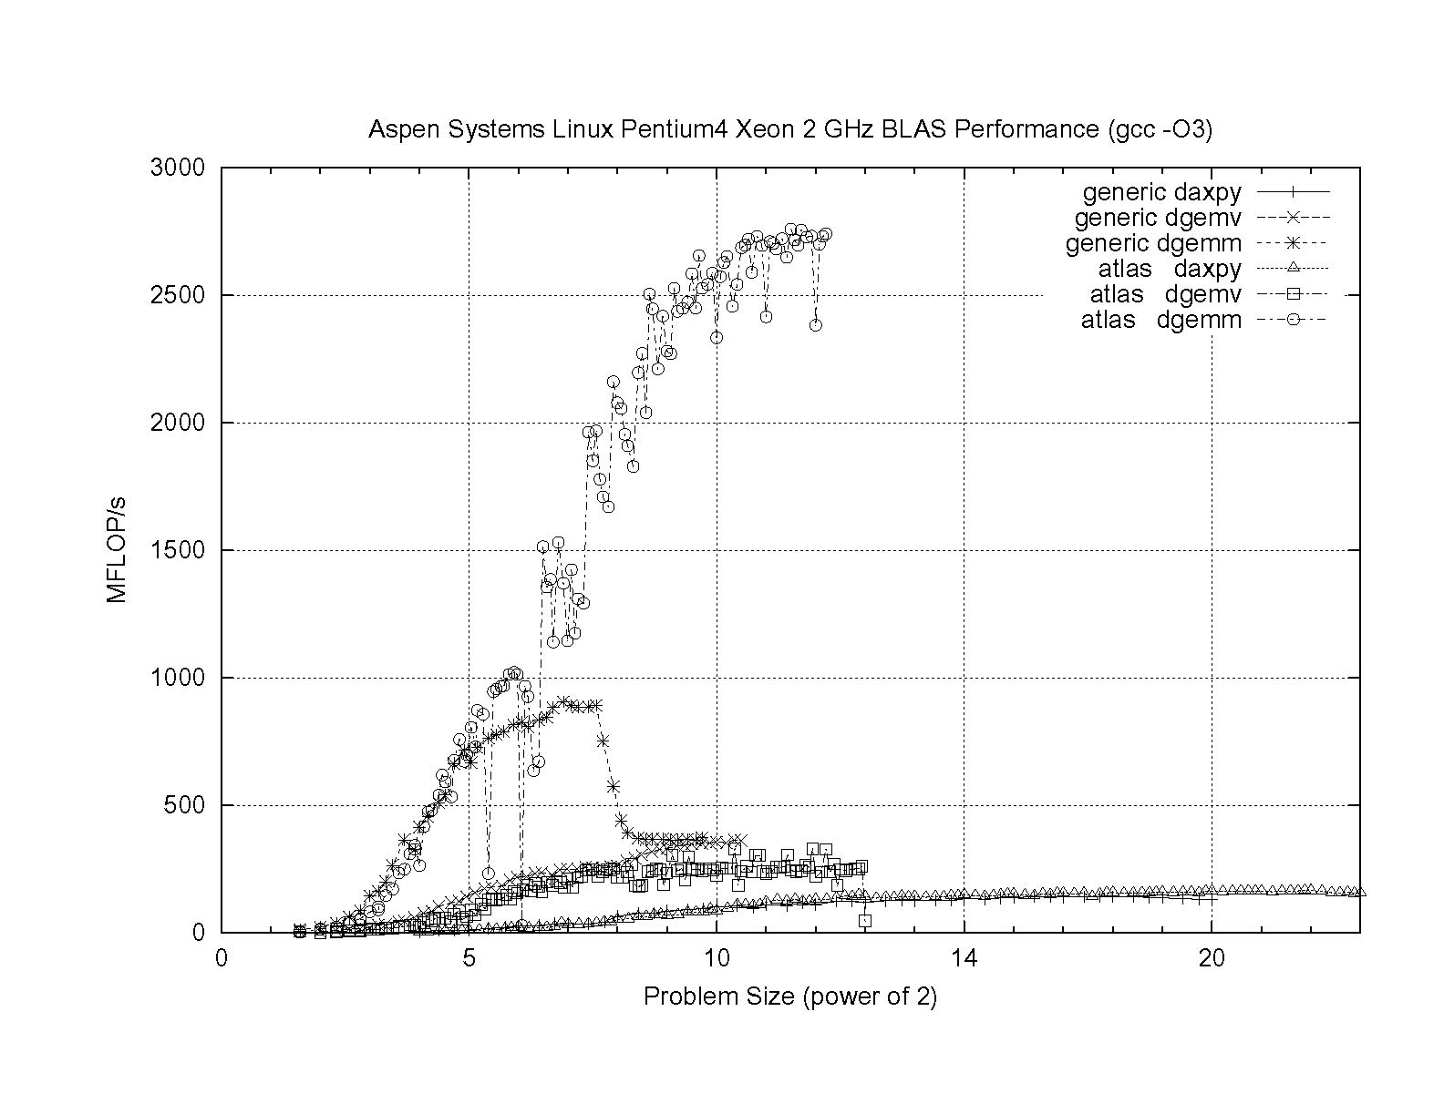
ATLAS vs. Generic BLAS
BETTER
ATLAS DGEMM: 2.76 GFLOP/s = 69% of peak
Generic DGEMM: 0.91 GFLOP/s = 23% of peak
DGEMM: Double precision GEneral Matrix-Matrix multiply
DGEMV: Double precision GEneral Matrix-Vector multiply

Slide 34
LAPACK
LAPACK (Linear Algebra PACKage) solves dense or special-case sparse systems of equations depending on matrix properties such as:
Precision: single, double
Data type: real, complex
Shape: diagonal, bidiagonal, tridiagonal, banded, triangular, trapezoidal, Hesenberg, general dense
Properties: orthogonal, positive definite, Hermetian (complex), symmetric, general
LAPACK is built on top of BLAS, which means it can benefit from ATLAS.

Slide 35
LAPACK Example
REAL,DIMENSION(numrows,numcols) :: A
REAL,DIMENSION(numrows) :: B
REAL,DIMENSION(numcols) :: X
INTEGER,DIMENSION(numrows) :: pivot
INTEGER :: row, col, info, numrhs = 1
DO row = 1, numrows
B(row) = …
END DO
DO col = 1, numcols
DO row = 1, numrows
A(row,col) = …
END DO
END DO
CALL sgesv(numrows, numrhs, A, numrows, pivot, &
& B, numrows, info)
DO col = 1, numcols
X(col) = B(col)
END DO

Slide 36
LAPACK: A Library and an API
LAPACK is a library that you can download for free from the Web:
www.netlib.org
But, it’s also an Application Programming Interface (API): a definition of a set of routines, their arguments, and their behaviors.
So, anyone can write an implementation of LAPACK.

Slide 37
It’s Good to Be Popular
LAPACK is a good choice for non-parallelized solving, because its popularity has convinced many supercomputer vendors to write their own, highly tuned versions.
The API for the LAPACK routines is the same as the portable version from NetLib, but the performance can be much better, via either ATLAS or proprietary vendor-tuned versions.
Also, some vendors have shared memory parallel versions of LAPACK.

Slide 38
LAPACK Performance
Because LAPACK uses BLAS, it’s about as fast as BLAS.
For example, DGESV (Double precision General SolVer) on a 2 GHz Pentium4 using ATLAS gets 65% of peak, compared to 69% of peak for Matrix-Matrix multiply.
In fact, an older version of LAPACK, called LINPACK, is used to determine the top 500 supercomputers in the world.

Slide 39
ScaLAPACK
ScaLAPACK is the distributed parallel (MPI) version of LAPACK. It actually contains only a subset of the LAPACK routines, and has a somewhat awkward Application Programming Interface (API).
Like LAPACK, ScaLAPACK is also available from
www.netlib.org.

Slide 40
PETSc
PETSc (Portable, Extensible Toolkit for Scientific Computation) is a solver library for sparse matrices that uses distributed parallelism (MPI).
PETSc is designed for general sparse matrices with no special properties, but it also works well for sparse matrices with simple properties like banding and symmetry.
It has a simpler, more intuitive Application Programming Interface than ScaLAPACK.

Slide 41
Pick Your Solver Package
Dense Matrix
  Serial: LAPACK
  Shared Memory Parallel: threaded LAPACK
  Distributed Parallel: ScaLAPACK
Sparse Matrix: PETSc

Slide 42
I/O Libraries

Slide 43
I/O Challenges
I/O presents two important challenges to scientific computing:
Performance
Portability
The performance issue arises because I/O is much more time-consuming than computation, as we saw in the “Storage Hierarchy” session.
The portability issue arises because different kinds of computers can have different ways of representing real (floating point) numbers.

Slide 44
Storage Formats
When you use a PRINT statement in Fortran or a printf in C or output to cout in C++, you are asking the program to output data in human-readable form:
x = 5
PRINT *, x
But what if the value that you want to output is a real number with lots of significant digits?
1.3456789E+23

Slide 45
Data Output as Text
1.3456789E+23
When you output data as text, each character takes 1 byte.
So if you output a number with lots of digits, then you’re outputting lots of bytes.
For example, the above number takes 13 bytes to output as text.
Jargon: Text is sometimes called ASCII (American Standard Code for Information Interchange).

Slide 46
Output Data in Binary
Inside the computer, a single precision real number (Fortran REAL, C/C++ float) typically requires 4 bytes, and a double precision number (DOUBLE PRECISION or double) typically requires 8.
That’s less than 13.
Since I/O is very expensive, it’s better to output 4 or 8 bytes than 13 or more.
Happily, Fortran, C and C++ allow you to output data as binary (internal representation) rather than as text.

Slide 47
Binary Output Problems
When you output data as binary rather than as text, you output substantially fewer bytes, so you save time (since I/O is very expensive) and you save disk space.
But, you pay two prices:
Readability: Humans can’t read binary.
Portability: Different kinds of computers have different ways of internally representing numbers.

Slide 48
Binary Readability: No Problem
Readability of binary data isn’t a problem in scientific computing, because:
You can always write a little program to read in the binary data and display its text equivalent.
If you have lots and lots of data (that is, MBs or GBs), you wouldn’t want to look at all of it anyway.

Slide 49
Binary Portability: Big Problem
Binary data portability is a very big problem in scientific computing, because data that’s output on one kind of computer may not be readable on another, and so:
You can’t output the data on one kind of computer and then use them (for example, visualize, analyze) on another kind.
Some day the kind of computer that output the data will be obsolete, so there may be no computer in the world that can input it, and thus the data are lost.

Slide 50
Portable Binary Data
The HPC community noticed this problem some years ago, and so a number of portable binary data formats were developed.
The two most popular are:
HDF (Hierarchical Data Format) from the National Center for Supercomputing Applications:
http://www.hdfgroup.org/
NetCDF (Network Common Data Form) from Unidata:
http://www.unidata.ucar.edu/software/netcdf

Slide 51
Advantages of Portable I/O
Portable binary I/O packages:
give you portable binary I/O;
have simple, clear APIs;
are available for free;
run on most platforms;
allow you to annotate your data (for example, put into the file the variable names, units, experiment name, grid description, etc).
Also, both HDF and netCDF support distributed parallel I/O.

Slide 52
Scientific Visualization

Slide 53
Too Many Numbers
A typical scientific code outputs lots and lots of data.
For example, the ARPS weather forecasting code, running a 5 day forecast over the continental U.S. with a resolution of 1 km horizontal and 0.25 km vertical outputting data for every hour would produce about 10 terabytes (10¹³ bytes).
No one can look at that many numbers.

Slide 54
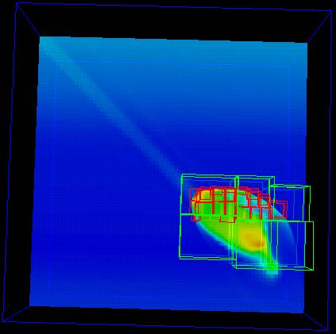
A Picture is Worth …
… millions of numbers.
This is Comet Shoemaker-Levy 9, which hit Jupiter in 1994; the image is from 35 seconds after hitting Jupiter’s inner atmosphere.^{[9]}

Slide 55
Types of Visualization
Contour lines
Slice planes
Isosurfaces
Streamlines
Volume rendering
… and many others.
Note: except for the volume rendering, the following images were created by Vis5D,^{[10]} which you can download for free.

Slide 56
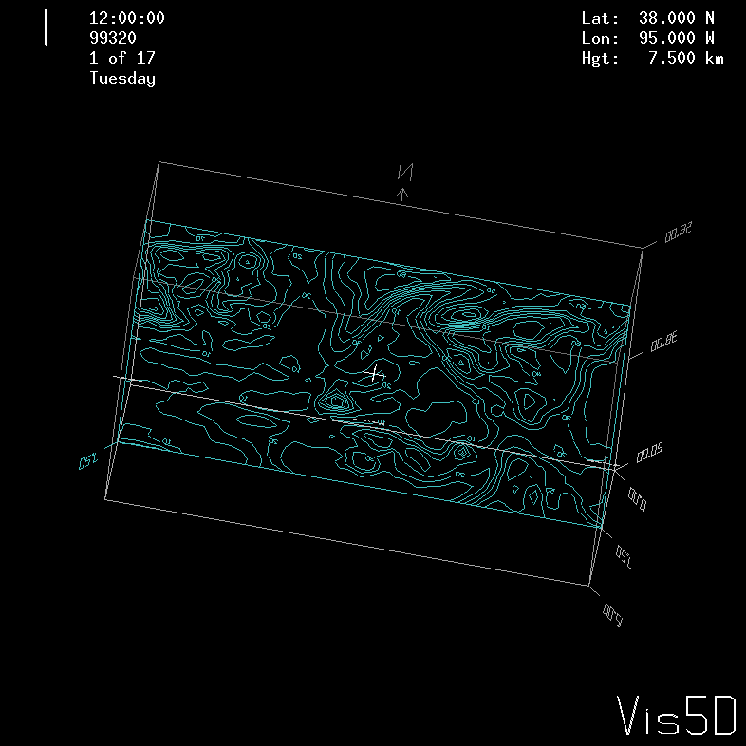
Contour Lines
This image shows contour lines of relative humidity. Each contour line represents a single humidity value.

Slide 57
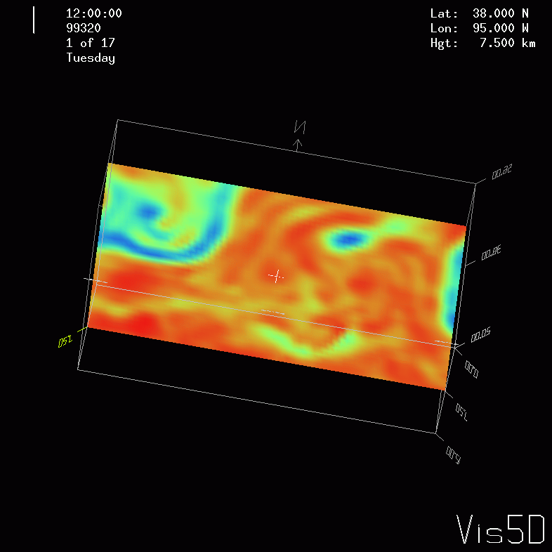
Slice Planes
A slice plane is a single plane passed through a 3D volume. Typically, it is color coded by mapping some scalar variable to color (for example, low vorticity to blue, high vorticity to red).

Slide 58
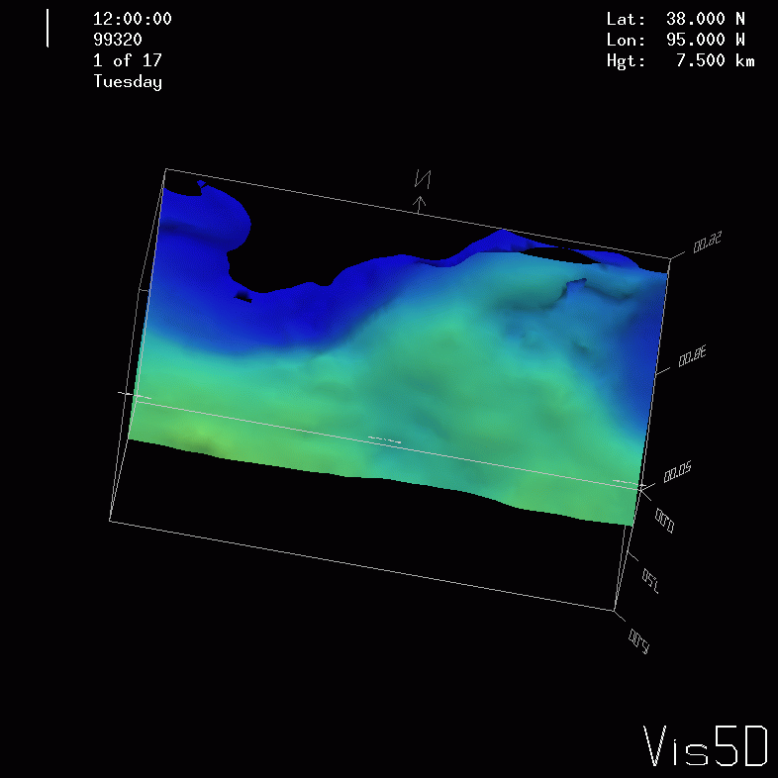
Isosurfaces
An isosurface is a surface that has a constant value for some scalar quantity. This image shows an isosurface of temperature at 0º Celsius, colored with pressure.

Slide 59
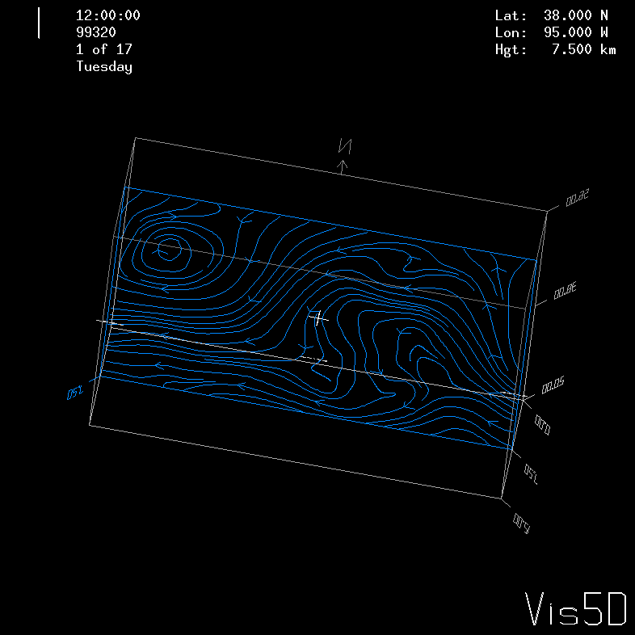
Streamlines
A streamline traces a vector quantity (for example, velocity).

Slide 60
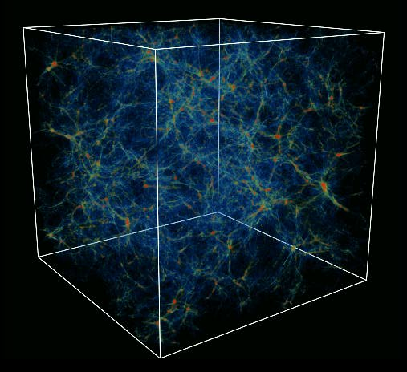
Volume Rendering
A volume rendering is created by mapping some variable (for example, energy) to color and another variable (for example, density) to opacity.
This image shows the overall structure of the universe.^{[11]}
Notice that the image looks like thick colored smoke.

Slide 61
References
[1] C. L. Lawson, R. J. Hanson, D. Kincaid, and F. T. Krogh, Basic Linear Algebra Subprograms for FORTRAN Usage, ACM Trans. Math. Soft., 5 (1979), pp. 308--323.
[2] http://www.netlib.org/blas/
[3] http://math-atlas.sourceforge.net/
[4] E. Anderson, Z. Bai, C. Bischof, S. Blackford, J. Demmel, J. Dongarra, J. Du Croz, A. Greenbaum, S. Hammarling, A. McKenney, D. Sorensen, LAPACK Users' Guide, 3rd ed, 1999. http://www.netlib.org/lapack/
[5] L. S. Blackford, J. Choi, A. Cleary, E. D'Azevedo, J. Demmel, I. Dhillon, J. Dongarra, S. Hammarling, G. Henry, A. Petitet, K. Stanley, D. Walker, R. C. Whaley, ScaLAPACK Users' Guide, 1997. http://www.netlib.org/scalapack/
[6] S. Balay, K. Buschelman, W. D. Gropp, D. Kaushik, L. Curfman McInnes and B. F. Smith, PETSc home page, 2001. http://www.mcs.anl.gov/petsc
[7] S. Balay, W. D. Gropp. L. Curfman McInnes and B. Smith, PETSc Users Manual, ANL-95/11 - Revision 2.1.0, Argonne National Laboratory, 2001.
[8] S. Balay, W. D. Gropp, L. Curfman McInnes and B. F. Smith, "Efficient Management of Parallelism in Object Oriented Numerical Software Libraries", in Modern Software Tools in Scientific Computing, E. Arge, A. M. Bruaset and H. P. Langtangen, editors, Birkhauser Press, 1997, 163-202.
[9] http://hneeman.oscer.ou.edu/hamr.html
[10] http://www.ssec.wisc.edu/~billh/vis5d.html
[11] Image by Greg Bryan, MIT.

Slide 62
OK Supercomputing Symposium 2013
2003 Keynote:
Peter Freeman
NSF
Computer & Information
Science & Engineering
Assistant Director
2004 Keynote:
Sangtae Kim
NSF Shared
Cyberinfrastructure
Division Director
2005 Keynote:
Walt Brooks
NASA Advanced
Supercomputing
Division Director
2006 Keynote:
Dan Atkins
Head of NSF’s
Office of
Cyberinfrastructure
2007 Keynote:
Jay Boisseau
Director
Texas Advanced
Computing Center
U. Texas Austin
2008 Keynote: José Munoz Deputy Office Director/ Senior Scientific Advisor NSF Office of Cyberinfrastructure
2013 Keynote to be announced!
2009 Keynote: Douglass Post Chief Scientist US Dept of Defense HPC Modernization Program
2010 Keynote: Horst Simon Deputy Director Lawrence Berkeley National Laboratory
FREE! Wed Oct 2 2013 @ OU
Over 235 registra2ons already!
Over 150 in the first day, over 200 in the first week, over 225 in the first month.
2011 Keynote: Barry Schneider Program Manager National Science Foundation
2012 Keynote: Thom Dunning Director National Center for Supercomputing Applications
http://symposium2013.oscer.ou.edu/
Reception/Poster Session
Tue Oct 1 2013 @ OU
Symposium Wed Oct 2 2013 @ OU

Slide 63
Thanks for your attention!
Questions? www.oscer.ou.edu

