Slide 1




Supercomputing in Plain English
Applications and Types of Parallelism
Henry Neeman, Director
OU Supercomputing Center for Education & Research (OSCER)
University of Oklahoma
Tuesday March 5 2013

Slide 2
This is an experiment!
It’s the nature of these kinds of videoconferences that FAILURES ARE GUARANTEED TO HAPPEN! NO PROMISES!
So, please bear with us. Hopefully everything will work out well enough.
If you lose your connection, you can retry the same kind of connection, or try connecting another way.
Remember, if all else fails, you always have the toll free phone bridge to fall back on.

Slide 3
H.323 (Polycom etc) #1
If you want to use H.323 videoconferencing – for example, Polycom – then:
If you AREN’T registered with the OneNet gatekeeper (which is probably the case), then:
  Dial 164.58.250.47
  Bring up the virtual keypad.
  On some H.323 devices, you can bring up the virtual keypad by typing:
  #
  (You may want to try without first, then with; some devices won't work with the #, but give cryptic error messages about it.)
  When asked for the conference ID, or if there's no response, enter:
  0409
  On most but not all H.323 devices, you indicate the end of the ID with:
  #

Slide 4
H.323 (Polycom etc) #2
If you want to use H.323 videoconferencing – for example, Polycom – then:
If you ARE already registered with the OneNet gatekeeper (most institutions aren’t), dial:
2500409
Many thanks to Skyler Donahue and Steven Haldeman of OneNet for providing this.

Slide 5
Wowza #1
You can watch from a Windows, MacOS or Linux laptop using Wowza from either of the following URLs:
http://www.onenet.net/technical-resources/video/sipe-stream/
OR
https://vcenter.njvid.net/videos/livestreams/page1/
Wowza behaves a lot like YouTube, except live.
Many thanks to Skyler Donahue and Steven Haldeman of OneNet and Bob Gerdes of Rutgers U for providing this.

Slide 6
Wowza #2
Wowza has been tested on multiple browsers on each of:
Windows (7 and 8): IE, Firefox, Chrome, Opera, Safari
MacOS X: Safari, Firefox
Linux: Firefox, Opera
We’ve also successfully tested it on devices with:
Android
iOS
However, we make no representations on the likelihood of it working on your device, because we don’t know which versions of Android or iOS it might or might not work with.

Slide 7
Wowza #3
If one of the Wowza URLs fails, try switching over to the other one.
If we lose our network connection between OU and OneNet, then there may be a slight delay while we set up a direct connection to Rutgers.

Slide 8
Toll Free Phone Bridge
IF ALL ELSE FAILS, you can use our toll free phone bridge:
800-832-0736
* 623 2847 #
Please mute yourself and use the phone to listen.
Don’t worry, we’ll call out slide numbers as we go.
Please use the phone bridge ONLY if you cannot connect any other way: the phone bridge can handle only 100 simultaneous connections, and we have over 350 participants.
Many thanks to OU CIO Loretta Early for providing the toll free phone bridge.

Slide 9
Please Mute Yourself
No matter how you connect, please mute yourself, so that we cannot hear you.
(For Wowza, you don’t need to do that, because the information only goes from us to you, not from you to us.)
At OU, we will turn off the sound on all conferencing technologies.
That way, we won’t have problems with echo cancellation.
Of course, that means we cannot hear questions.
So for questions, you’ll need to send e-mail.

Slide 10
Questions via E-mail Only
Ask questions by sending e-mail to:
sipe2013@gmail.com
All questions will be read out loud and then answered out loud.

Slide 11
TENTATIVE Schedule
Tue Jan 29: Apps & Par Types: What the Heck is Supercomputing?
Tue Jan 29: The Tyranny of the Storage Hierarchy
Tue March 5: Instruction Level Parallelism
Tue March 5: Stupid Compiler Tricks
Tue March 5: Apps & Par Typesory Multithreading
Tue March 5: Distributed Multiprocessing
Tue March 5: Applications and Types of Parallelism
Tue March 12: Multicore Madness
Tue March 19: NO SESSION (OU's Spring Break)
Tue March 26: High Throughput Computing
Tue Apr 2: GPGPU: Number Crunching in Your Graphics Card
Tue Apr 9: Grab Bag: Scientific Libraries, I/O Libraries, Visualization

Slide 12
Supercomputing Exercises #1
Want to do the “Supercomputing in Plain English” exercises?
The 3rd exercise will be posted soon at:
http://www.oscer.ou.edu/education/
If you don’t yet have a supercomputer account, you can get a temporary account, just for the “Supercomputing in Plain English” exercises, by sending e-mail to:
hneeman@ou.edu
Please note that this account is for doing the exercises only, and will be shut down at the end of the series. It’s also available only to those at institutions in the USA.
This week’s Introductory exercise will teach you how to compile and run jobs on OU’s big Linux cluster supercomputer, which is named Boomer.

Slide 13
Supercomputing Exercises #2
You’ll be doing the exercises on your own (or you can work with others at your local institution if you like).
These aren’t graded, but we’re available for questions:
hneeman@ou.edu

Slide 14
Thanks for helping!
OU IT
  OSCER operations staff (Brandon George, Dave Akin, Brett Zimmerman, Josh Alexander, Patrick Calhoun)
  Horst Severini, OSCER Associate Director for Remote & Heterogeneous Computing
  Debi Gentis, OU Research IT coordinator
  Kevin Blake, OU IT (videographer)
  Chris Kobza, OU IT (learning technologies)
  Mark McAvoy
Kyle Keys, OU National Weather Center
James Deaton, Skyler Donahue and Steven Haldeman, OneNet
Bob Gerdes, Rutgers U
Lisa Ison, U Kentucky
Paul Dave, U Chicago

Slide 15
This is an experiment!
It’s the nature of these kinds of videoconferences that FAILURES ARE GUARANTEED TO HAPPEN! NO PROMISES!
So, please bear with us. Hopefully everything will work out well enough.
If you lose your connection, you can retry the same kind of connection, or try connecting another way.
Remember, if all else fails, you always have the toll free phone bridge to fall back on.

Slide 16
Coming in 2013!
From Computational Biophysics to Systems Biology, May 19-21, Norman OK
Great Plains Network Annual Meeting, May 29-31, Kansas City
XSEDE2013, July 22-25, San Diego CA
IEEE Cluster 2013, Sep 23-27, Indianapolis IN
OKLAHOMA SUPERCOMPUTING SYMPOSIUM 2013, Oct 1-2, Norman OK
SC13, Nov 17-22, Denver CO

Slide 17
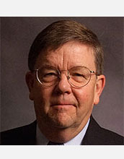
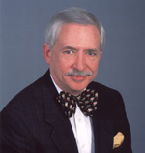
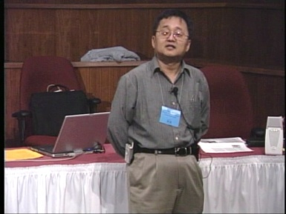
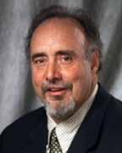
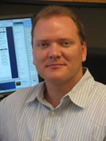
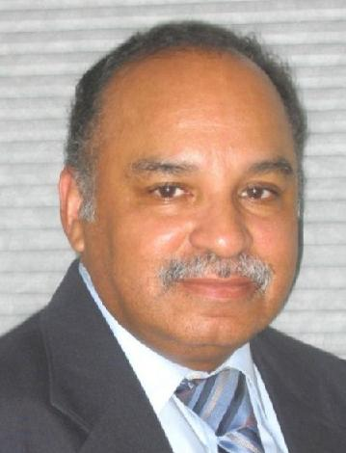
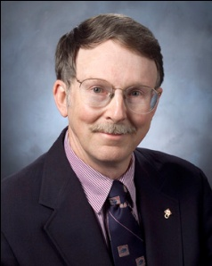
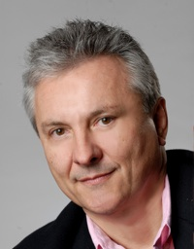
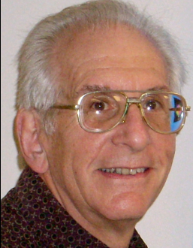
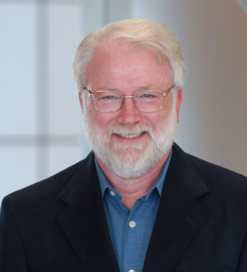
OK Supercomputing Symposium 2013
2003 Keynote:
Peter Freeman
NSF
Computer & Information
Science & Engineering
Assistant Director
2004 Keynote:
Sangtae Kim
NSF Shared
Cyberinfrastructure
Division Director
2005 Keynote:
Walt Brooks
NASA Advanced
Supercomputing
Division Director
2006 Keynote:
Dan Atkins
Head of NSF’s
Office of
Cyberinfrastructure
2007 Keynote:
Jay Boisseau
Director
Texas Advanced
Computing Center
U. Texas Austin
2008 Keynote: José Munoz Deputy Office Director/ Senior Scientific Advisor NSF Office of Cyberinfrastructure
2013 Keynote to be announced!
2009 Keynote: Douglass Post Chief Scientist US Dept of Defense HPC Modernization Program
2010 Keynote: Horst Simon Deputy Director Lawrence Berkeley National Laboratory
FREE! Wed Oct 2 2013 @ OU
Over 235 registra2ons already!
Over 150 in the first day, over 200 in the first week, over 225 in the first month.
2011 Keynote: Barry Schneider Program Manager National Science Foundation
2012 Keynote: Thom Dunning Director National Center for Supercomputing Applications
http://symposium2013.oscer.ou.edu/
Reception/Poster Session
Tue Oct 1 2013 @ OU
Symposium Wed Oct 2 2013 @ OU

Slide 18
Outline
Monte Carlo: Client-Server
N-Body: Task Parallelism
Transport: Data Parallelism

Slide 19
Monte Carlo:
Client-Server
[1]

Slide 20
Embarrassingly Parallel
An application is known as embarrassingly parallel if its parallel implementation:
can straightforwardly be broken up into roughly equal amounts of work per processor, AND
has minimal parallel overhead (for example, communication among processors).
We love embarrassingly parallel applications, because they get near-perfect parallel speedup, sometimes with modest programming effort.
Embarrassingly parallel applications are also known as loosely coupled.

Slide 21
Monte Carlo Methods
Monte Carlo is a European city where people gamble; that is, they play games of chance, which involve randomness.
Monte Carlo methods are ways of simulating (or otherwise calculating) physical phenomena based on randomness.
Monte Carlo simulations typically are embarrassingly parallel.

Slide 22
Monte Carlo Methods: Example
Suppose you have some physical phenomenon. For example, consider High Energy Physics, in which we bang tiny particles together at incredibly high speeds.
BANG!
We want to know, say, the average properties of this phenomenon.
There are infinitely many ways that two particles can be banged together.
So, we can’t possibly simulate all of them.

Slide 23
Monte Carlo Methods: Example
Suppose you have some physical phenomenon. For example, consider High Energy Physics, in which we bang tiny particles together at incredibly high speeds.
BANG!
There are infinitely many ways that two particles can be banged together.
So, we can’t possibly simulate all of them.
Instead, we can randomly choose a finite subset of these infinitely many ways and simulate only the subset.

Slide 24
Monte Carlo Methods: Example
Suppose you have some physical phenomenon. For example, consider High Energy Physics, in which we bang tiny particles together at incredibly high speeds.
BANG!
There are infinitely many ways that two particles can be banged together.
We randomly choose a finite subset of these infinitely many ways and simulate only the subset.
The average of this subset will be close to the actual average.

Slide 25
Monte Carlo Methods
In a Monte Carlo method, you randomly generate a large number of example cases (realizations) of a phenomenon, and then take the average of the properties of these realizations.
When the average of the realizations converges (that is, doesn’t change substantially if new realizations are generated), then the Monte Carlo simulation stops.

Slide 26
MC: Embarrassingly Parallel
Monte Carlo simulations are embarrassingly parallel, because each realization is completely independent of all of the other realizations.
That is, if you’re going to run a million realizations, then:
you can straightforwardly break into roughly (Million / N_{p}) chunks of realizations, one chunk for each of the N_{p} processors, AND
the only parallel overhead (for example, communication) comes from tracking the average properties, which doesn’t have to happen very often.

Slide 27
Serial Monte Carlo (C)
Suppose you have an existing serial Monte Carlo simulation:
int main (int argc, char** argv)
{ /* main */
read_input(…);
for (realization = 0;
realization < number_of_realizations;
realization++) {
generate_random_realization(…);
calculate_properties(…);
} /* for realization */
calculate_average(…);
} /* main */
How would you parallelize this?

Slide 28
Serial Monte Carlo (F90)
Suppose you have an existing serial Monte Carlo simulation:
PROGRAM monte_carlo
CALL read_input(…)
DO realization = 1, number_of_realizations
CALL generate_random_realization(…)
CALL calculate_properties(…)
END DO
CALL calculate_average(…)
END PROGRAM monte_carlo
How would you parallelize this?

Slide 29
Parallel Monte Carlo (C)
int main (int argc, char** argv)
{ /* main */
[MPI startup]
if (my_rank == server_rank) {
read_input(…);
}
mpi_error_code = MPI_Bcast(…);
for (realization = 0;
realization < number_of_realizations / number_of_processes;
realization++) {
generate_random_realization(…);
calculate_realization_properties(…);
calculate_local_running_average(...);
} /* for realization */
if (my_rank == server_rank) {
[collect properties]
}
else {
[send properties]
}
calculate_global_average_from_local_averages(…)
output_overall_average(...)
[MPI shutdown]
} /* main */

Slide 30
Parallel Monte Carlo (F90)
PROGRAM monte_carlo
[MPI startup]
IF (my_rank == server_rank) THEN
CALL read_input(…)
END IF
CALL MPI_Bcast(…)
DO realization = 1, number_of_realizations / number_of_processes
CALL generate_random_realization(…)
CALL calculate_realization_properties(…)
CALL calculate_local_running_average(...)
END DO
IF (my_rank == server_rank) THEN
[collect properties]
ELSE
[send properties]
END IF
CALL calculate_global_average_from_local_averages(…)
CALL output_overall_average(...)
[MPI shutdown]
END PROGRAM monte_carlo

Slide 31
N-Body:
Task Parallelism and Collective Communication
[2]

Slide 32
N Bodies

Slide 33
N-Body Problems
An N-body problem is a problem involving N “bodies” – that is, particles (for example, stars, atoms) – each of which applies a force to all of the others.
For example, if you have N stars, then each of the N stars exerts a force (gravity) on all of the other N–1 stars.
Likewise, if you have N atoms, then every atom exerts a force (nuclear) on all of the other N–1 atoms.

Slide 34
1-Body Problem
When N is 1, you have a simple 1-Body Problem: a single particle, with no forces acting on it.
Given the particle’s position P and velocity V at some time t₀, you can trivially calculate the particle’s position at time t₀+Δt:
P(t₀+Δt) = P(t₀) + VΔt
V(t₀+Δt) = V(t₀)

Slide 35
2-Body Problem
When N is 2, you have – surprise! – a 2-Body Problem: exactly 2 particles, each exerting a force that acts on the other.
The relationship between the 2 particles can be expressed as a differential equation that can be solved analytically, producing a closed-form solution.
So, given the particles’ initial positions and velocities, you can trivially calculate their positions and velocities at any later time.

Slide 36
3-Body Problem
When N is 3, you have – surprise! – a 3-Body Problem: exactly 3 particles, each exerting a force that acts on the other 2.
The relationship between the 3 particles can be expressed as a differential equation that can be solved using an infinite series, producing a closed-form solution, due to Karl Fritiof Sundman in 1912.
However, in practice, the number of terms of the infinite series that you need to calculate to get a reasonable solution is so large that the infinite series is impractical, so you’re stuck with the generalized formulation.

Slide 37
N-Body Problems (N > 3)
When N > 3, you have a general N-Body Problem: N particles, each exerting a force that acts on the other N-1 particles.
The relationship between the N particles can be expressed as a differential equation that can be solved using an infinite series, producing a closed-form solution, due to Qiudong Wang in 1991.
However, in practice, the number of terms of the infinite series that you need to calculate to get a reasonable solution is so large that the infinite series is impractical, so you’re stuck with the generalized formulation.

Slide 38
N-Body Problems (N > 3)
For N > 3, the relationship between the N particles can be expressed as a differential equation that can be solved using an infinite series, producing a closed-form solution, but convergence takes so long that this approach is impractical.
So, numerical simulation is pretty much the only way to study groups of 3 or more bodies.
Popular applications of N-body codes include:
astronomy (that is, galaxy formation, cosmology);
chemistry (that is, protein folding, molecular dynamics).
Note that, for N bodies, there are on the order of N² forces, denoted O(N²).

Slide 39
N Bodies

Slide 40
Force #1
A

Slide 41
Force #2
A

Slide 42
Force #3
A

Slide 43
Force #4
A

Slide 44
Force #5
A

Slide 45
Force #6
A

Slide 46
Force #N-1
A

Slide 47
N-Body Problems
Given N bodies, each body exerts a force on all of the other N – 1 bodies.
Therefore, there are N • (N – 1) forces in total.
You can also think of this as (N • (N – 1)) / 2 forces, in the sense that the force from particle A to particle B is the same (except in the opposite direction) as the force from particle B to particle A.

Slide 48
Aside: Big-O Notation
Let’s say that you have some task to perform on a certain number of things, and that the task takes a certain amount of time to complete.
Let’s say that the amount of time can be expressed as a polynomial on the number of things to perform the task on.
For example, the amount of time it takes to read a book might be proportional to the number of words, plus the amount of time it takes to settle into your favorite easy chair.
C₁ . N + C₂

Slide 49
Big-O: Dropping the Low Term
C₁ . N + C₂
When N is very large, the time spent settling into your easy chair becomes such a small proportion of the total time that it’s virtually zero.
So from a practical perspective, for large N, the polynomial reduces to:
C₁ . N
In fact, for any polynomial, if N is large, then all of the terms except the highest-order term are irrelevant.

Slide 50
Big-O: Dropping the Constant
C₁ . N
Computers get faster and faster all the time. And there are many different flavors of computers, having many different speeds.
So, computer scientists don’t care about the constant, only about the order of the highest-order term of the polynomial.
They indicate this with Big-O notation:
O(N)
This is often said as: “of order N.”

Slide 51
N-Body Problems
Given N bodies, each body exerts a force on all of the other N – 1 bodies.
Therefore, there are N • (N – 1) forces total.
In Big-O notation, that’s O(N²) forces.
So, calculating the forces takes O(N²) time to execute.
But, there are only N particles, each taking up the same amount of memory, so we say that N-body codes are of:
O(N) spatial complexity (memory)
O(N²) temporal complexity (calculations)

Slide 52
O(N²) Forces
A
Note that this picture shows only the forces between A and everyone else.

Slide 53
How to Calculate?
Whatever your physics is, you have some function, F(B_{i},B_{j}), that expresses the force between two bodies B_{i} and B_{j}.
For example, for stars and galaxies,
F(A,B) = G · m_{Bi} · m_{Bj} / dist(B_{i}, B_{j})²
where G is the gravitational constant and m is the mass of the body in question.
If you have all of the forces for every pair of particles, then you can calculate their sum, obtaining the force on every particle.
From that, you can calculate every particle’s new position and velocity.

Slide 54
How to Parallelize?
Okay, so let’s say you have a nice serial (single-core) code that does an N-body calculation.
How are you going to parallelize it?
You could:
have a server feed particles to processes;
have a server feed interactions (particle pairs) to processes;
have each process decide on its own subset of the particles, and then share around the summed forces on those particles;
have each process decide its own subset of the interactions, and then share around the summed forces from those interactions.

Slide 55
Do You Need a Server?
Let’s say that you have N bodies, and therefore you have ½ N (N - 1) interactions (every particle interacts with all of the others, but you don’t need to calculate both B_{i} → B_{j} and B_{j} → B_{i}).
Do you need a server?
Well, can each processor determine, on its own, either (a) which of the bodies to process, or (b) which of the interactions to process?
If the answer is yes, then you don’t need a server.

Slide 56
Parallelize How?
Suppose you have N_{p} processors.
Should you parallelize:
by assigning a subset of N / N_{p} of the bodies to each processor, OR
by assigning a subset of N (N - 1) / N_{p} of the interactions to each processor?

Slide 57
Data vs. Task Parallelism
Data Parallelism means parallelizing by giving a subset of the data to each process, and then each process performs the same tasks on the different subsets of data.
Task Parallelism means parallelizing by giving a subset of the tasks to each process, and then each process performs a different subset of tasks on the same data.

Slide 58
Data Parallelism for N-Body?
If you parallelize an N-body code by data, then each processor gets N / N_{p} pieces of data.
For example, if you have 8 bodies and 2 processors, then:
Processor P₀ gets the first 4 bodies;
Processor P₁ gets the second 4 bodies.
But, every piece of data (that is, every body) has to interact with every other piece of data, to calculate the forces.
So, every processor will have to send all of its data to all of the other processors, for every single interaction that it calculates.
That’s a lot of communication!

Slide 59
Task Parallelism for N-body?
If you parallelize an N-body code by task, then each processor gets all of the pieces of data that describe the particles (for example, positions, velocities, masses).
Then, each processor can calculate its subset of the interaction forces on its own, without talking to any of the other processors.
But, at the end of the force calculations, everyone has to share all of the forces that have been calculated, so that each particle ends up with the total force that acts on it (global reduction).

Slide 60
MPI_Reduce (C)
Here’s the C syntax for MPI_Reduce:
mpi_error_code =
MPI_Reduce(sendbuffer, recvbuffer,
count, datatype, operation,
root, communicator, mpi_error_code);
For example, to do a sum over all of the particle forces:
mpi_error_code =
MPI_Reduce(
local_particle_force_sum,
global_particle_force_sum,
number_of_particles,
MPI_DOUBLE, MPI_SUM,
server_process, MPI_COMM_WORLD);

Slide 61
MPI_Reduce (F90)
Here’s the Fortran 90 syntax for MPI_Reduce:
CALL MPI_Reduce(sendbuffer, recvbuffer, &
& count, datatype, operation, &
& root, communicator, mpi_error_code)
For example, to do a sum over all of the particle forces:
CALL MPI_Reduce( &
& local_particle_force_sum, &
& global_particle_force_sum, &
& number_of_particles, &
& MPI_DOUBLE_PRECISION, MPI_SUM, &
& server_process, MPI_COMM_WORLD, &
& mpi_error_code)

Slide 62
Sharing the Result
In the N-body case, we don’t want just one processor to know the result of the sum, we want every processor to know.
So, we could do a reduce followed immediately by a broadcast.
But, MPI gives us a routine that packages all of that for us: MPI_Allreduce.
MPI_Allreduce is just like MPI_Reduce except that every process gets the result (so we drop the server_process argument).

Slide 63
MPI_Allreduce (C)
Here’s the C syntax for MPI_Allreduce:
mpi_error_code =
MPI_Allreduce(
sendbuffer, recvbuffer, count,
datatype, operation,
communicator);
For example, to do a sum over all of the particle forces:
mpi_error_code =
MPI_Allreduce(
local_particle_force_sum,
global_particle_force_sum,
number_of_particles,
MPI_DOUBLE, MPI_SUM,
MPI_COMM_WORLD);

Slide 64
MPI_Allreduce (F90)
Here’s the Fortran 90 syntax for MPI_Allreduce:
CALL MPI_Allreduce( &
& sendbuffer, recvbuffer, count, &
& datatype, operation, &
& communicator, mpi_error_code)
For example, to do a sum over all of the particle forces:
CALL MPI_Allreduce( &
& local_particle_force_sum, &
& global_particle_force_sum, &
& number_of_particles, &
& MPI_DOUBLE_PRECISION, MPI_SUM, &
& MPI_COMM_WORLD, mpi_error_code)

Slide 65
Collective Communications
A collective communication is a communication that is shared among many processes, not just a sender and a receiver.
MPI_Reduce and MPI_Allreduce are collective communications.
Others include: broadcast, gather/scatter, all-to-all.

Slide 66
Collectives Are Expensive, But Cheap
Collective communications are very expensive relative to point-to-point communications, because so much more communication has to happen.
But, they can be much cheaper than doing zillions of point-to-point communications, if that’s the alternative.

Slide 67
Transport:
Data Parallelism
[2]

Slide 68
What is a Simulation?
All physical science ultimately is expressed as calculus (for example, differential equations).
Except in the simplest (uninteresting) cases, equations based on calculus can’t be directly solved on a computer.
Therefore, all physical science on computers has to be approximated.

Slide 69
I Want the Area Under This Curve!
How can I get the area under this curve?

Slide 70
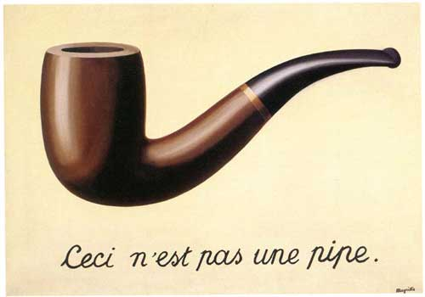
A Riemann Sum
Area under the curve ≈
[3]
y_{i}
{
Δx
Ceci n’est pas un area under the curve: it’s approximate!

Slide 71
A Riemann Sum
Area under the curve ≈
y_{i}
{
Δx
Ceci n’est pas un area under the curve: it’s approximate!

Slide 72
A Better Riemann Sum
Area under the curve ≈
y_{i}
{
Δx
More, smaller rectangles produce a better approximation.

Slide 73
The Best Riemann Sum
Area under the curve =
In the limit, infinitely many infinitesimally small rectangles produce the exact area.

Slide 74
The Best Riemann Sum
Area under the curve =
In the limit, infinitely many infinitesimally small rectangles produce the exact area.

Slide 75
Differential Equations
A differential equation is an equation in which differentials (for example, dx) appear as variables.
Most physics is best expressed as differential equations.
Very simple differential equations can be solved in “closed form,” meaning that a bit of algebraic manipulation gets the exact answer.
Interesting differential equations, like the ones governing interesting physics, can’t be solved in close form.
Solution: approximate!

Slide 76
A Discrete Mesh of Data
Data live here!

Slide 77
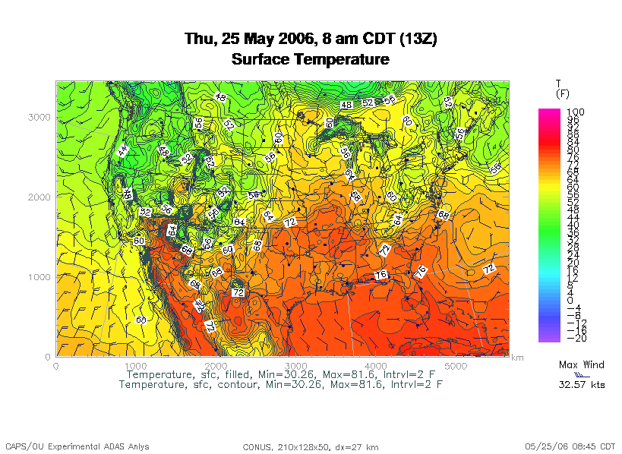
A Discrete Mesh of Data
Data live here!

Slide 78
Finite Difference
A typical (though not the only) way of approximating the solution of a differential equation is through finite differencing: convert each dx (infinitely thin) into a Δx (has finite nonzero width).

Slide 79
Navier-Stokes Equation
Differential Equation
These are only here to frighten you ....
Finite Difference Equation
The Navier-Stokes equations governs the movement of fluids (water, air, etc).

Slide 80
Cartesian Coordinates
y
x

Slide 81
Structured Mesh
A structured mesh is like the mesh on the previous slide. It’s nice and regular and rectangular, and can be stored in a standard Fortran or C or C++ array of the appropriate dimension and shape.
REAL,DIMENSION(nx,ny,nz) :: u
float u[nx][ny][nz];

Slide 82
Flow in Structured Meshes
When calculating flow in a structured mesh, you typically use a finite difference equation, like so:
unew_{i,j} = F(Δt, uold_{i,j}, uold_{i-1,j}, uold_{i+1,j}, uold_{i,j-1}, uold_{i,j+1})
for some function F, where uold_{i,j} is at time t and unew_{i,j} is at time t + Δt.
In other words, you calculate the new value of u_{i,j}, based on its old value as well as the old values of its immediate neighbors.
Actually, it may use neighbors a few farther away.

Slide 83
Ghost Boundary Zones

Slide 84
Ghost Boundary Zones
We want to calculate values in the part of the mesh that we care about, but to do that, we need values on the boundaries.
For example, to calculate unew_{1,1}, you need uold_{0,1} and uold_{1,0}.
Ghost boundary zones are mesh zones that aren’t really part of the problem domain that we care about, but that hold boundary data for calculating the parts that we do care about.

Slide 85
Using Ghost Boundary Zones (C)
A good basic algorithm for flow that uses ghost boundary zones is:
for (timestep = 0;
timestep < number_of_timesteps;
timestep++) {
fill_ghost_boundary(…);
advance_to_new_from_old(…);
}
This approach generally works great on a serial code.

Slide 86
Using Ghost Boundary Zones (F90)
A good basic algorithm for flow that uses ghost boundary zones is:
DO timestep = 1, number_of_timesteps
CALL fill_ghost_boundary(…)
CALL advance_to_new_from_old(…)
END DO
This approach generally works great on a serial code.

Slide 87
Ghost Boundary Zones in MPI
What if you want to parallelize a Cartesian flow code in MPI?
You’ll need to:
decompose the mesh into submeshes;
figure out how each submesh talks to its neighbors.

Slide 88
Data Decomposition

Slide 89
Data Decomposition
We want to split the data into chunks of equal size, and give each chunk to a processor to work on.
Then, each processor can work independently of all of the others, except when it’s exchanging boundary data with its neighbors.

Slide 90
MPI_Cart_*
MPI supports exactly this kind of calculation, with a set of functions MPI_Cart_*:
MPI_Cart_create
MPI_Cart_coords
MPI_Cart_shift
These routines create and describe a new communicator, one that replaces MPI_COMM_WORLD in your code.

Slide 91
MPI_Sendrecv
MPI_Sendrecv is just like an MPI_Send followed by an MPI_Recv, except that it’s much better than that.
With MPI_Send and MPI_Recv, these are your choices:
Everyone calls MPI_Recv, and then everyone calls MPI_Send.
Everyone calls MPI_Send, and then everyone calls MPI_Recv.
Some call MPI_Send while others call MPI_Recv, and then they swap roles.

Slide 92
Why not Recv then Send?
Suppose that everyone calls MPI_Recv, and then everyone calls MPI_Send.
MPI_Recv(incoming_data, ...);
MPI_Send(outgoing_data, ...);
Well, these routines are blocking, meaning that the communication has to complete before the process can continue on farther into the program.
That means that, when everyone calls MPI_Recv, they’re waiting for someone else to call MPI_Send.
We call this deadlock.
Officially, the MPI standard guarantees that THIS APPROACH WILL ALWAYS FAIL.

Slide 93
Why not Send then Recv?
Suppose that everyone calls MPI_Send, and then everyone calls MPI_Recv:
MPI_Send(outgoing_data, ...);
MPI_Recv(incoming_data, ...);
Well, this will only work if there’s enough buffer space available to hold everyone’s messages until after everyone is done sending.
Sometimes, there isn’t enough buffer space.
Officially, the MPI standard allows MPI implementers to support this, but it isn’t part of the official MPI standard; that is, a particular MPI implementation doesn’t have to allow it, so THIS WILL SOMETIMES FAIL.

Slide 94
Alternate Send and Recv?
Suppose that some processors call MPI_Send while others call MPI_Recv, and then they swap roles:
if ((my_rank % 2) == 0) {
MPI_Send(outgoing_data, ...);
MPI_Recv(incoming_data, ...);
}
else {
MPI_Recv(incoming_data, ...);
MPI_Send(outgoing_data, ...);
}
This will work, and is sometimes used, but it can be painful to manage – especially if you have an odd number of processors.

Slide 95
MPI_Sendrecv
MPI_Sendrecv allows each processor to simultaneously send to one processor and receive from another.
For example, P₁ could send to P₀ while simultaneously receiving from P₂ .
(Note that the send and receive don’t have to literally be simultaneous, but we can treat them as so in writing the code.)
This is exactly what we need in Cartesian flow: we want the boundary data to come in from the east while we send boundary data out to the west, and then vice versa.
These are called shifts.

Slide 96
MPI_Sendrecv
mpi_error_code =
MPI_Sendrecv(
westward_send_buffer,
westward_send_size, MPI_REAL,
west_neighbor_process, westward_tag,
westward_recv_buffer,
westward_recv_size, MPI_REAL,
east_neighbor_process, westward_tag,
cartesian_communicator, mpi_status);
This call sends to west_neighbor_process the data in westward_send_buffer, and at the same time receives from east_neighbor_process a bunch of data that end up in westward_recv_buffer.

Slide 97
Why MPI_Sendrecv?
The advantage of MPI_Sendrecv is that it allows us the luxury of no longer having to worry about who should send when and who should receive when.
This is exactly what we need in Cartesian flow: we want the boundary information to come in from the east while we send boundary information out to the west – without us having to worry about deciding who should do what to who when.

Slide 98
MPI_Sendrecv
Concept
in Principle
Concept
in practice

Slide 99
MPI_Sendrecv
Concept
in practice
Actual
Implementation
westward_send_buffer
westward_recv_buffer

Slide 100
What About Edges and Corners?
If your numerical method involves faces, edges and/or corners, don’t despair.
It turns out that, if you do the following, you’ll handle those correctly:
When you send, send the entire ghost boundary’s worth, including the ghost boundary of the part you’re sending.
Do in this order:
  all east-west;
  all north-south;
  all up-down.
At the end, everything will be in the correct place.

Slide 101
OK Supercomputing Symposium 2013
2003 Keynote:
Peter Freeman
NSF
Computer & Information
Science & Engineering
Assistant Director
2004 Keynote:
Sangtae Kim
NSF Shared
Cyberinfrastructure
Division Director
2005 Keynote:
Walt Brooks
NASA Advanced
Supercomputing
Division Director
2006 Keynote:
Dan Atkins
Head of NSF’s
Office of
Cyberinfrastructure
2007 Keynote:
Jay Boisseau
Director
Texas Advanced
Computing Center
U. Texas Austin
2008 Keynote: José Munoz Deputy Office Director/ Senior Scientific Advisor NSF Office of Cyberinfrastructure
2013 Keynote to be announced!
2009 Keynote: Douglass Post Chief Scientist US Dept of Defense HPC Modernization Program
2010 Keynote: Horst Simon Deputy Director Lawrence Berkeley National Laboratory
FREE! Wed Oct 2 2013 @ OU
Over 235 registra2ons already!
Over 150 in the first day, over 200 in the first week, over 225 in the first month.
2011 Keynote: Barry Schneider Program Manager National Science Foundation
2012 Keynote: Thom Dunning Director National Center for Supercomputing Applications
http://symposium2013.oscer.ou.edu/
Reception/Poster Session
Tue Oct 1 2013 @ OU
Symposium Wed Oct 2 2013 @ OU

Slide 102
Thanks for your attention!
Questions? www.oscer.ou.edu

Slide 103
References
[1] http://en.wikipedia.org/wiki/Monte_carlo_simulation
[2] http://en.wikipedia.org/wiki/N-body_problem
[3] http://lostbiro.com/blog/wp-content/uploads/2007/10/Magritte-Pipe.jpg

