Slide 1


An Organic Electronic Platform for Ultra-low energy and
Brain- like Electronics
T. Venkatesan
Center for Quantum Research and Technology
Venky@ou.edu

Slide 2
OUTLINE
Rationale for Low Energy Switching and Brain- like electronics
Organic Approach to an ultra-low Energy Memory
Neuronal memory functions

Slide 3

1.6x 10¹¹ watts- Power consumed by
all humans thinking actively
4.16 x 10¹⁴ watts- Power consumed by data centers in 2016
20%- of global Power consumed by data centers in 2025
50%-Power consumed by Memory
Notes:
No. of transistors in a INTEL processor, 2017 figures
Power consumed by data centers in 2016
Percentage of world power in 2025 that will be consumed by data centers
Percentage of power consumed by memory and cpu

Slide 4
Current Status of Deep Learning
Neil Thompson et al, “Deep Learning’s Diminishing Returns”, IEEE Spectrum, 24 Sep. 2021
1958-Rosenblatt (Cornell), artificial neural network (ANN)
“As number of connection in network increases….the burden on a conventional computer becomes excessive”
Today Deep Learning leverages the 10M fold increase in computing capability, thanks to Moore’s law
Deep Learning provides enormous flexibility but at computational cost
To cut error rates by a factor of two, a nine-fold enhancement in computing power is needed.

Slide 5
Energy Cost of Deep Learning
Univ. of Amherst study on effect of a 5% error rate Deep Learning estimated:
Energy cost ~ $100B and carbon emission as much as
New York’s one month output!
At 1% error rate the results are considerably worse.
The rising economic and environmental costs are forcing deep learning community to make following changes:
Improvements in algorithms
or
Improvements in processors
Are there alternatives to CMOS more suited for Deep Learning?

Slide 6
OUTLINE
Rationale for Low Energy Switching and Brain- like electronics
Organic Approach to an ultra-low Energy Memory
Neuronal memory functions

Slide 7
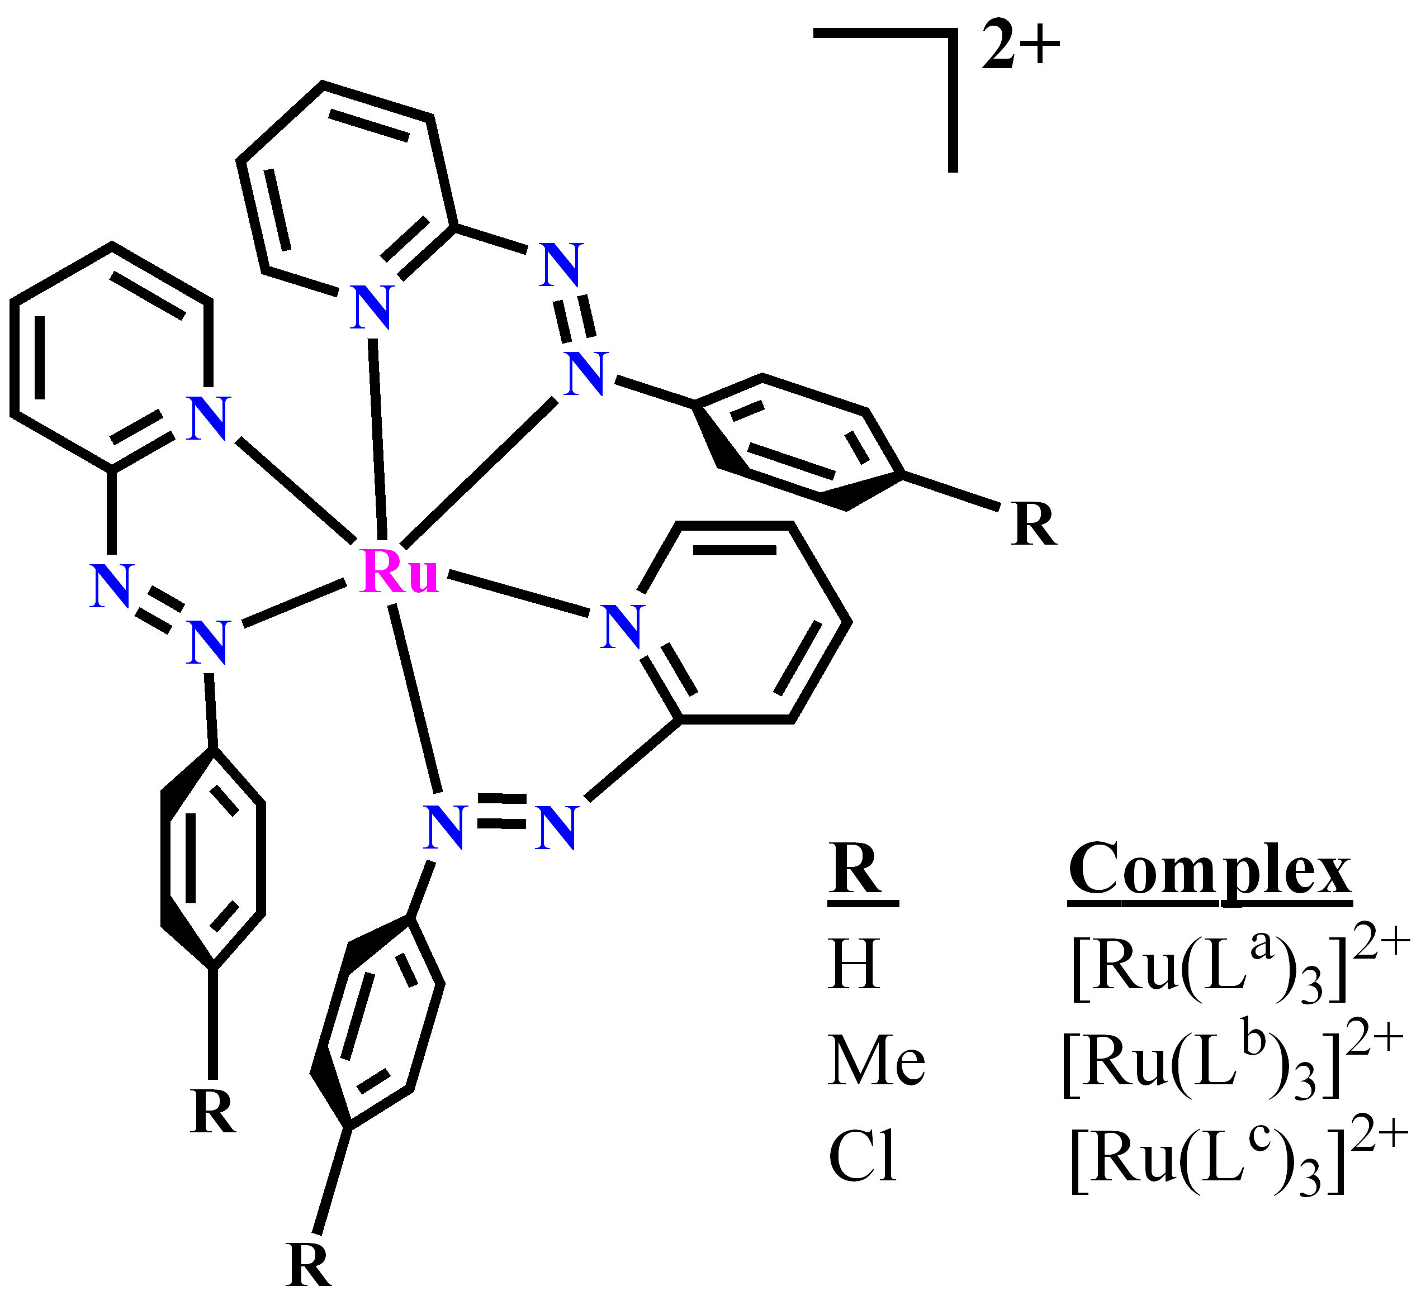
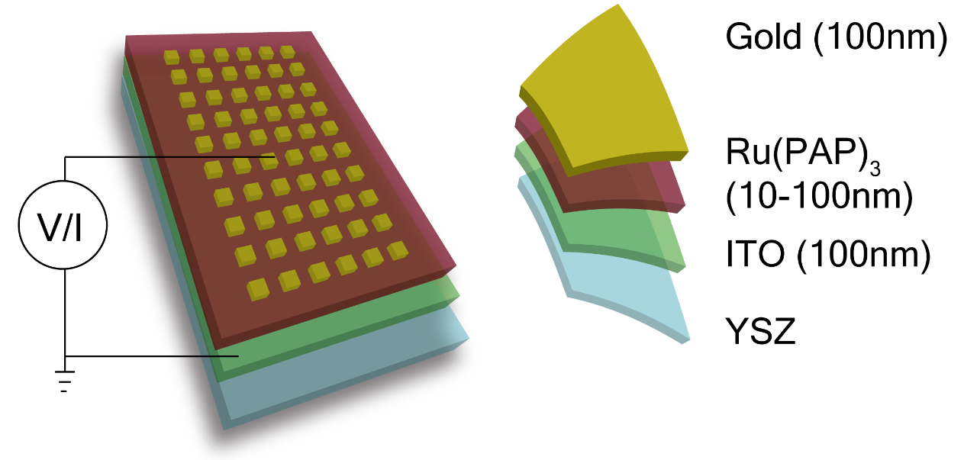
Our System
Goswami, Sreetosh, et al. Nature materials 16.12 (2017): 1216.

Slide 8
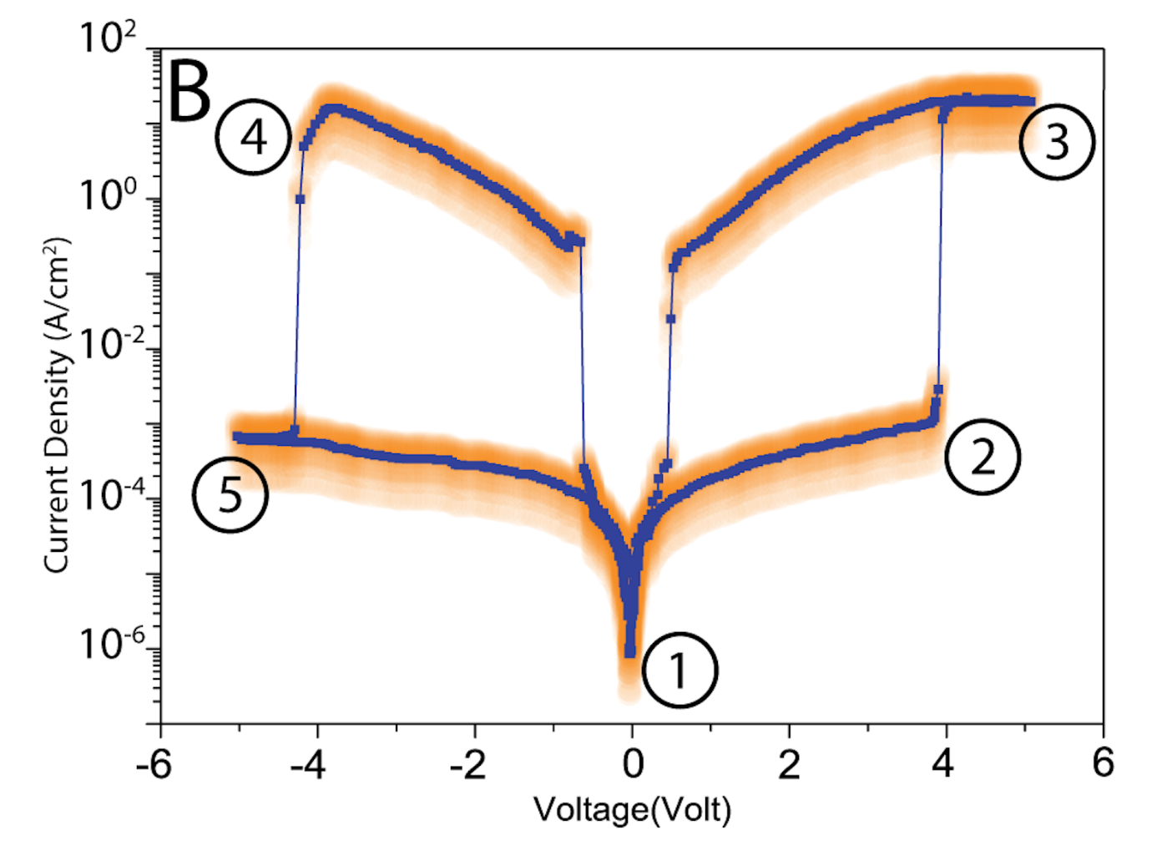
The MEMRISTIVE J(V)
# Devices | Top Electrode Size (um)
122 | 100
47 | 80
38 | 60
29 | 40
31 | 20
26 | 10
28 | 1
Total- 321
Goswami, Sreetosh, et al. Nature materials 16.12 (2017): 1216.

Slide 9
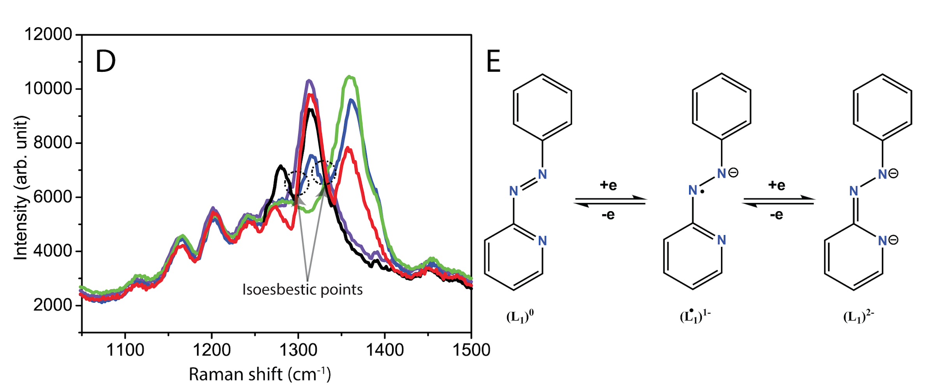
Ligand Redox States
Mode-1
State-0
State-1
State-2
Mode-0
Mode-2
Goswami, Sreetosh, et al. Nature materials 16.12 (2017): 1216.
Notes:
0, 1, 2

Slide 10
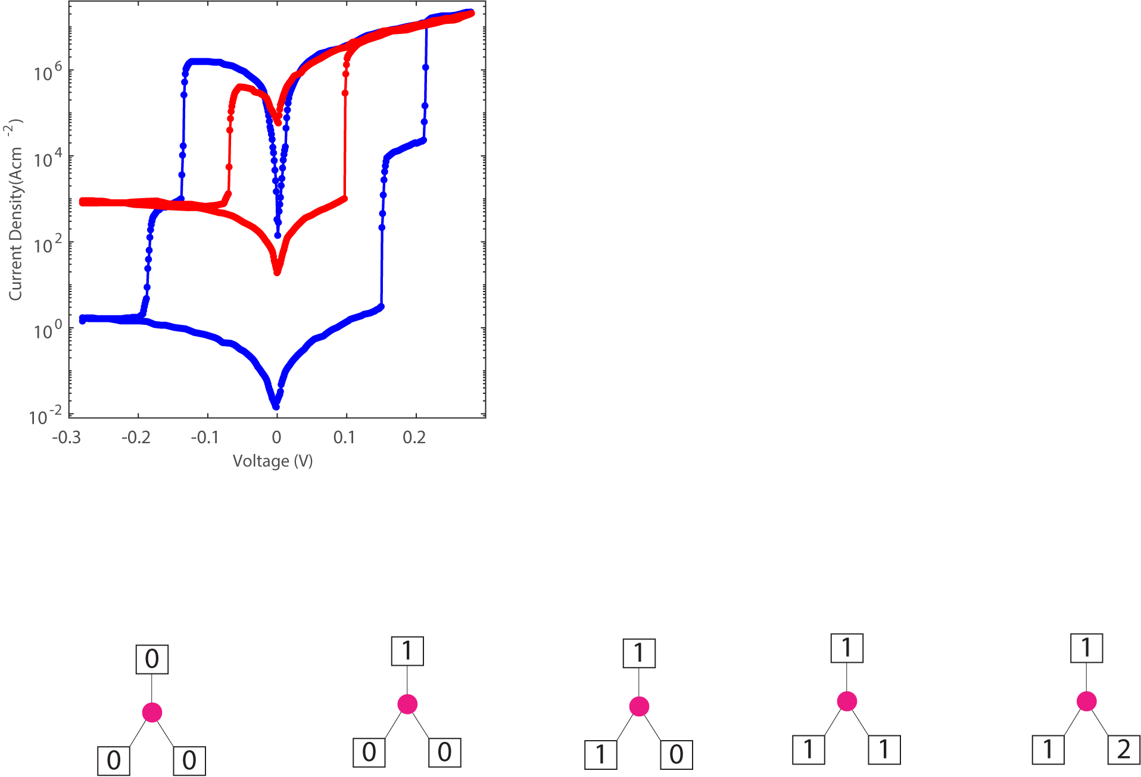
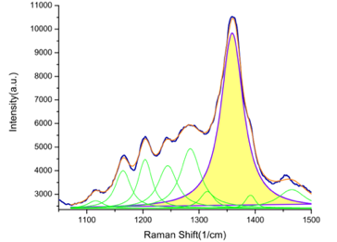
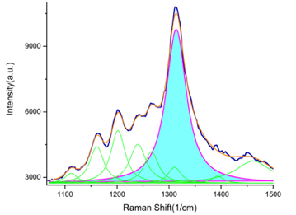

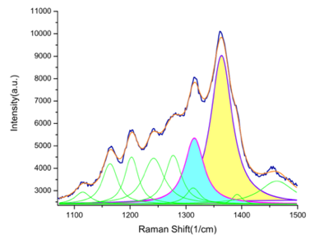
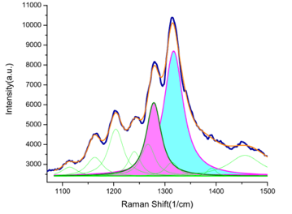
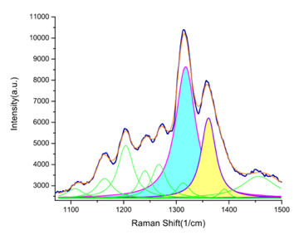
In-situ Raman
Origin of the hysteresis?
ON (3)
ON (4)
3
4
OFF (5)
OFF (1)
OFF (2)
5
1
2
Goswami, Sreetosh, et al. Nature materials 16.12 (2017): 1216.
Goswami, Sreetosh, et al. Nature materials 16.12 (2017): 1216.

Slide 11
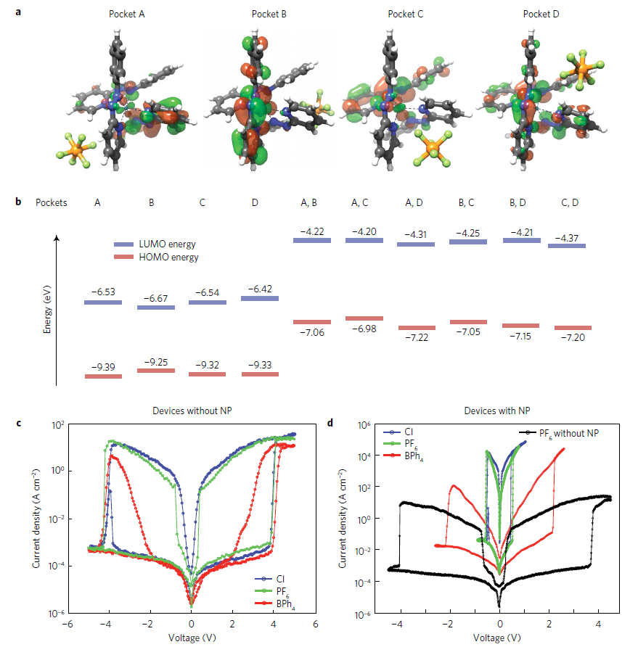
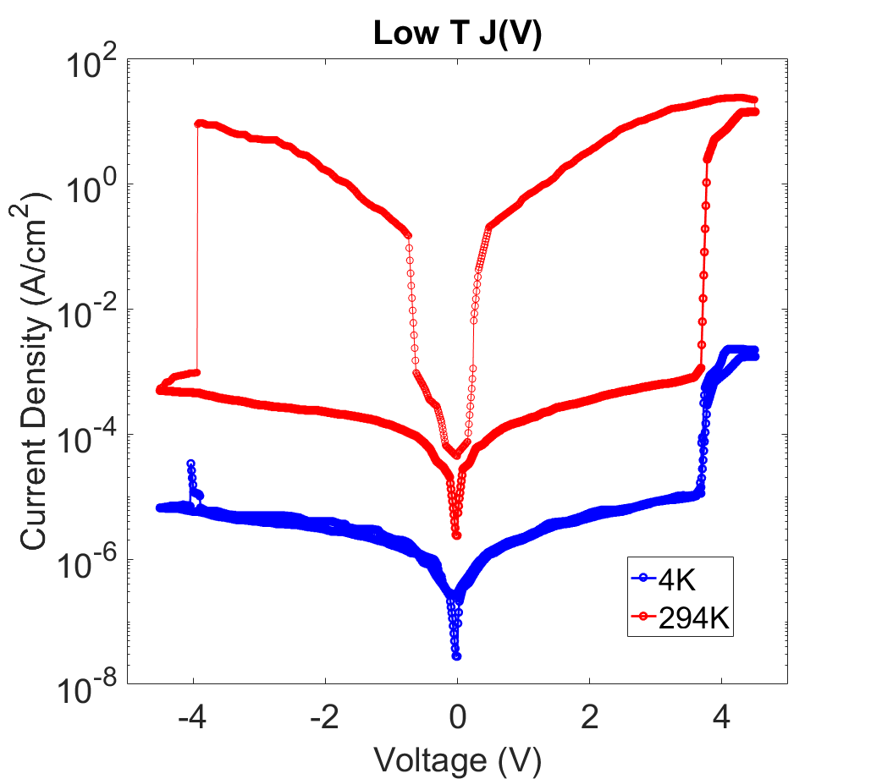
Hysteresis driven by counterions
Goswami, Sreetosh, et al. Nature materials 16.12 (2017): 1216.

Slide 12
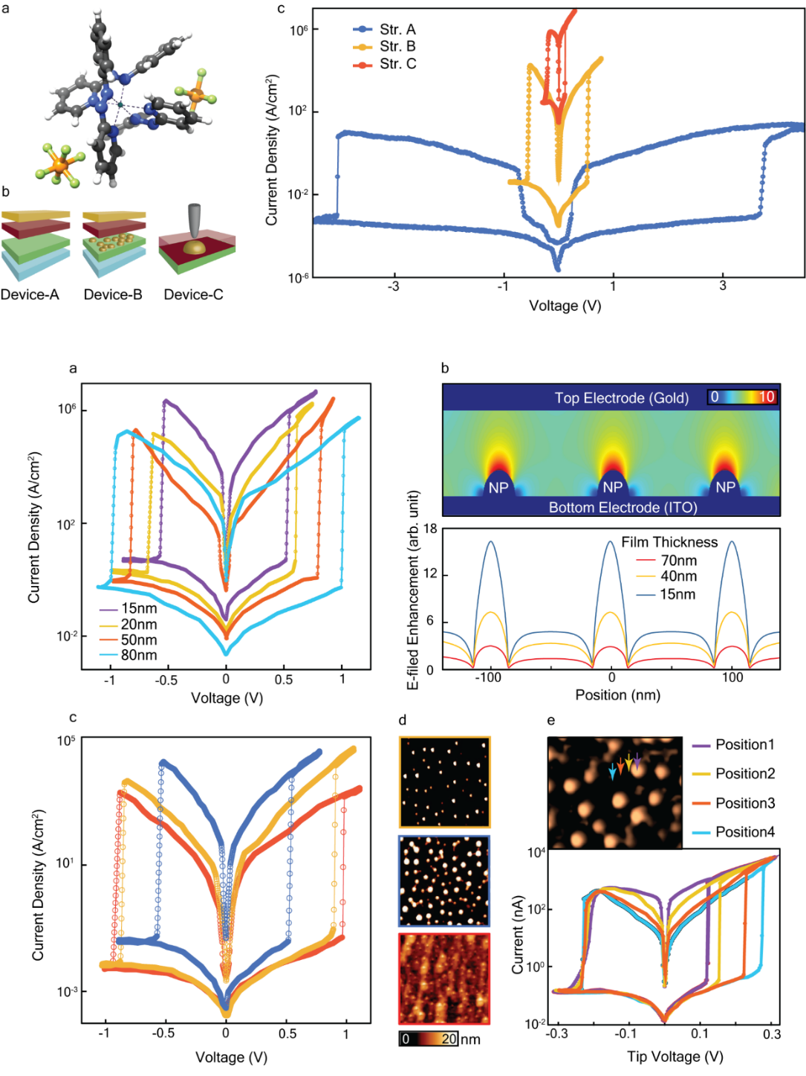
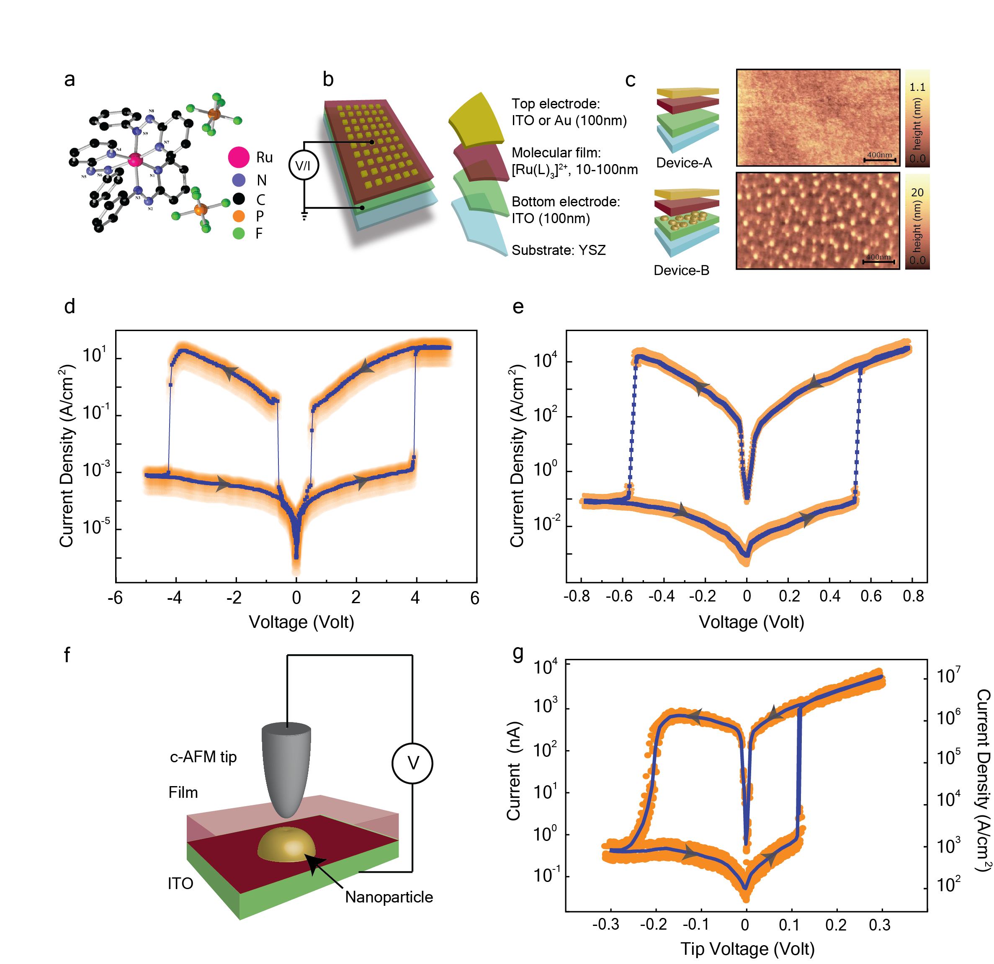

Effect of Electric Field Enhancement
Str-A
Str-B
Str-C
Goswami, Sreetosh, et al. Nature materials 16.12 (2017): 1216.

Slide 13
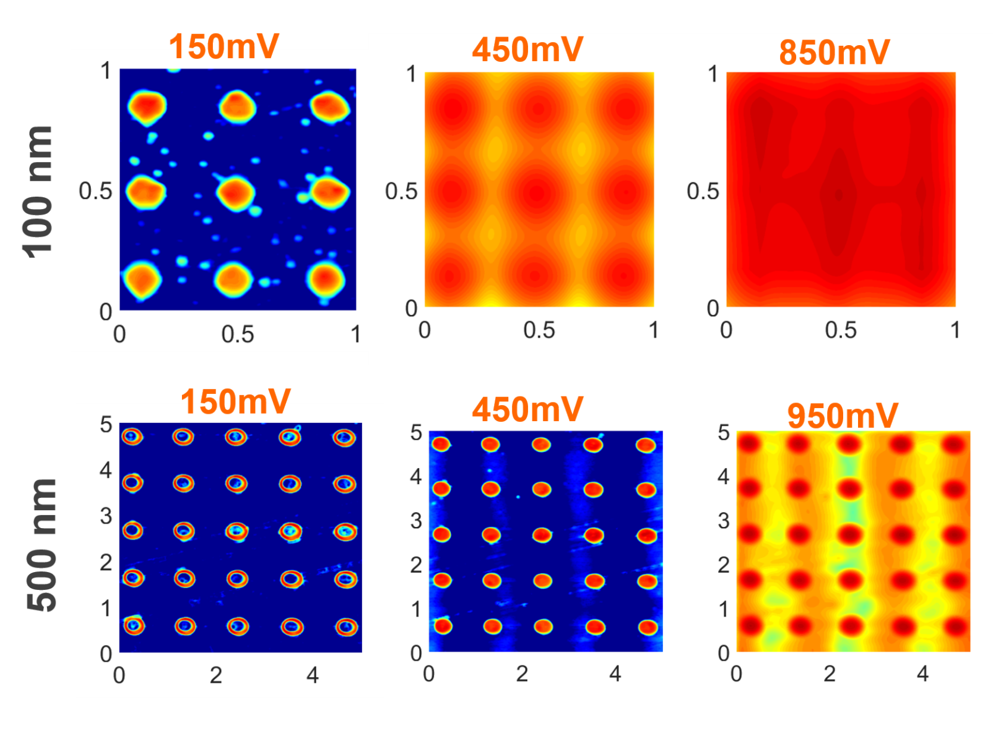
Current Evolution in Patterned Electrodes

Slide 14
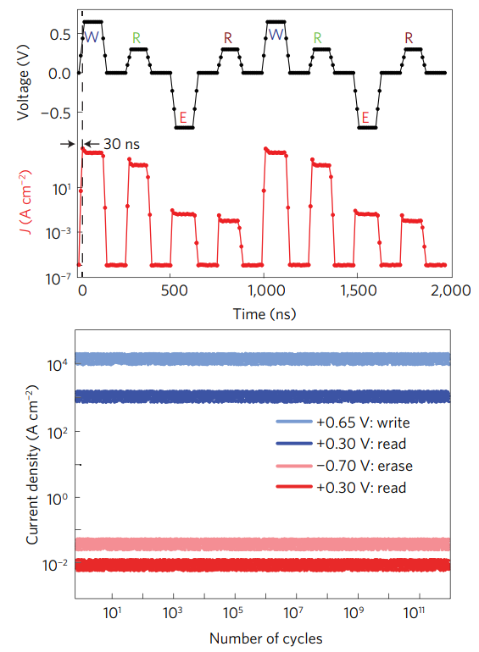
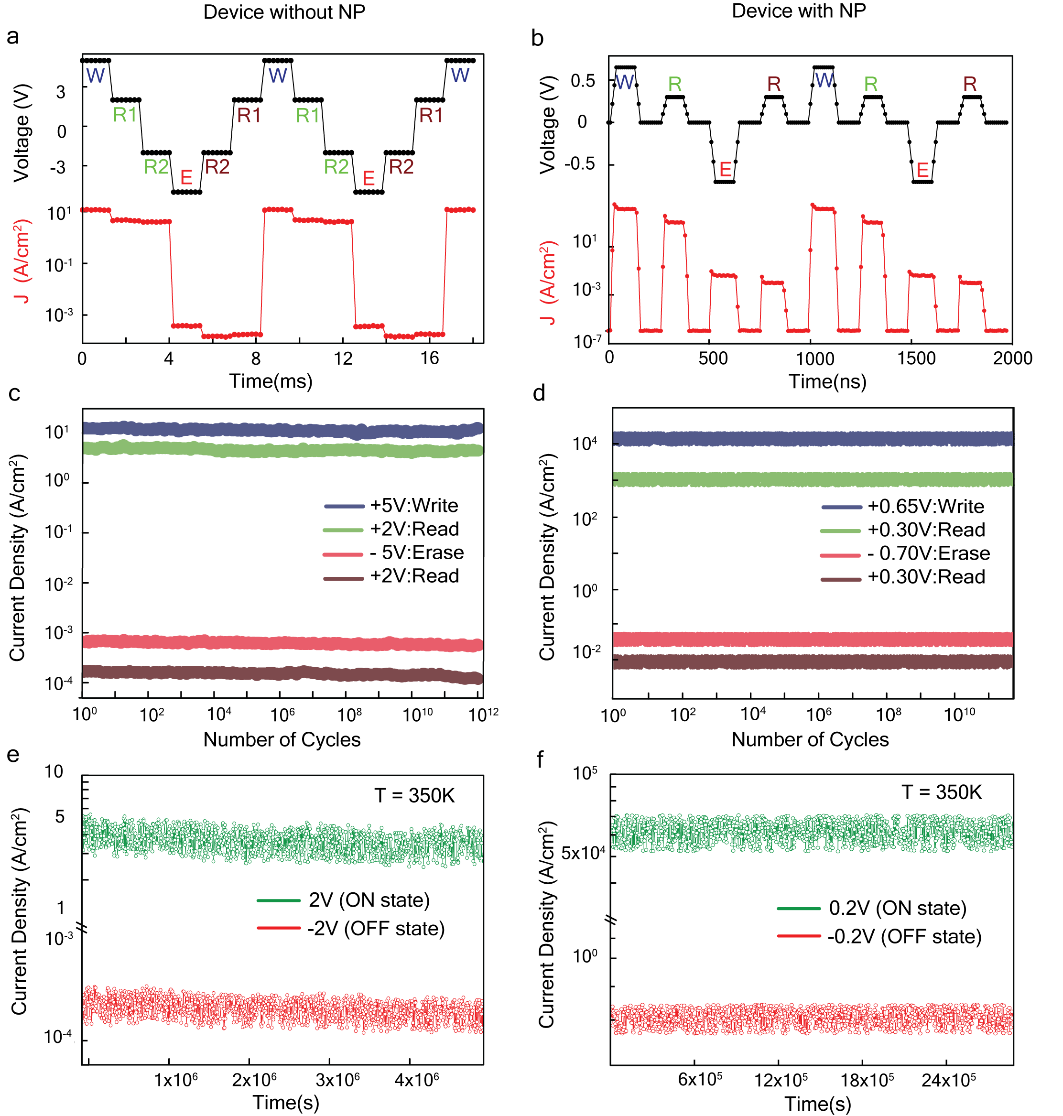
Dynamics and Endurance
Goswami, Sreetosh, et al. Nature materials 16.12 (2017): 1216

Slide 15
…and it beats all metrics
ITRS Road-map 2015
Parameter | ITRS Projection | Achieved Values | Next best Organic Device
Read Current | >10nA | 1μA | 200 fA at 400nm²
W/E time | ~ns | <30ns | ms
Write Cycles | >10¹⁰ | >10¹² | 10⁴
Write Voltage | <0.6V | 0.15V | 1.5V
Read Voltage | <0.2V | <.05V | .1V
Write energy | <1pJ | 1 aJ (area 50 nm²) Assuming 5 ns, 3 nΑ | Not reported
The devices work without degradation between -40C to 80C

Slide 16
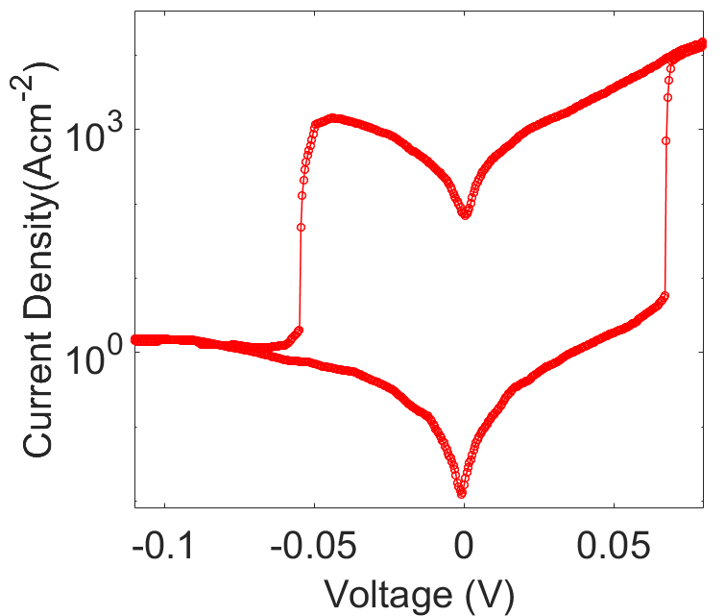
The Optimized Device
Switching energy
I_{ON} x V_{ON} x t_{switching}
(3x10⁻⁹A) x 0.07V x (5x10⁻⁹s)
=1aJ !!

Slide 17
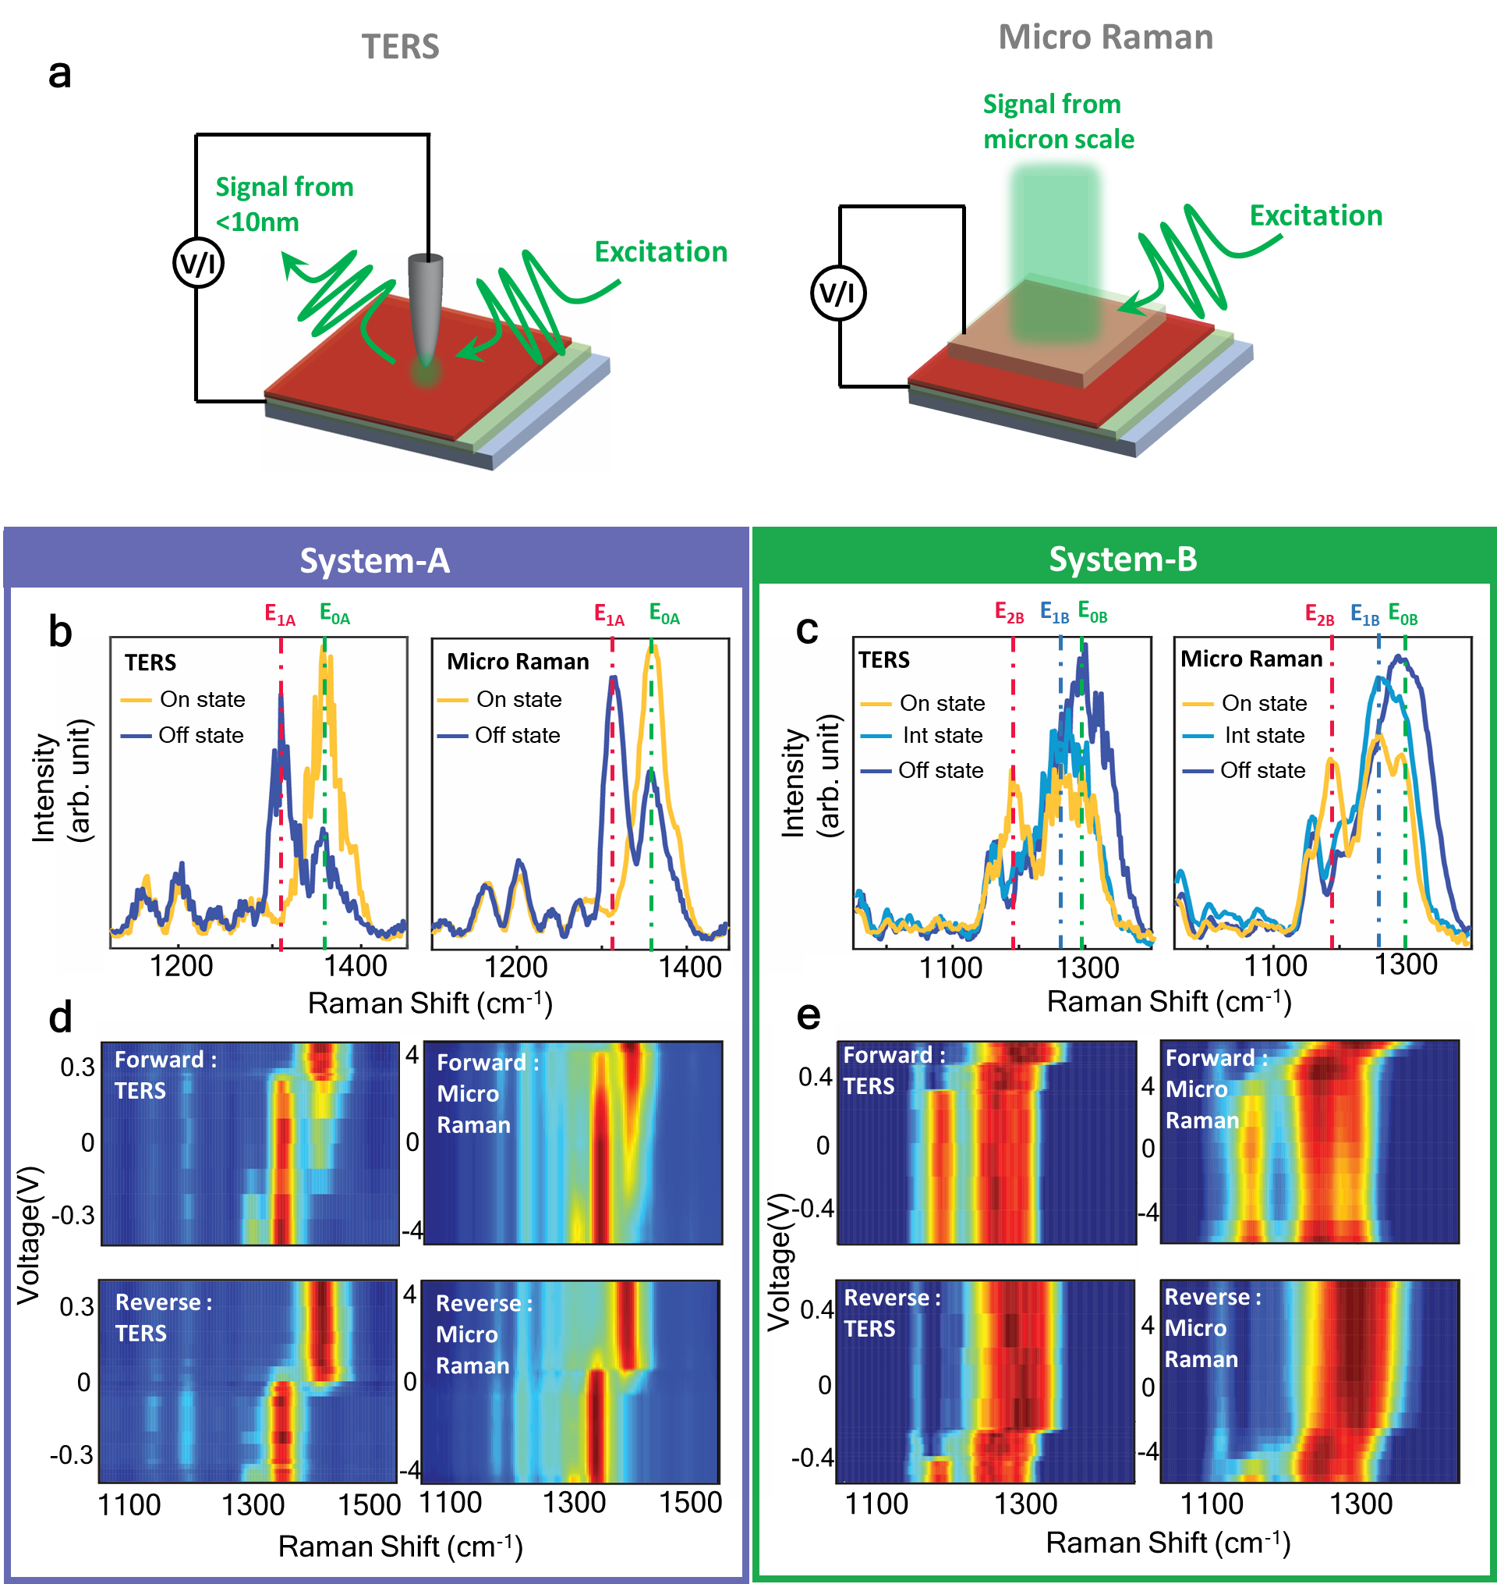
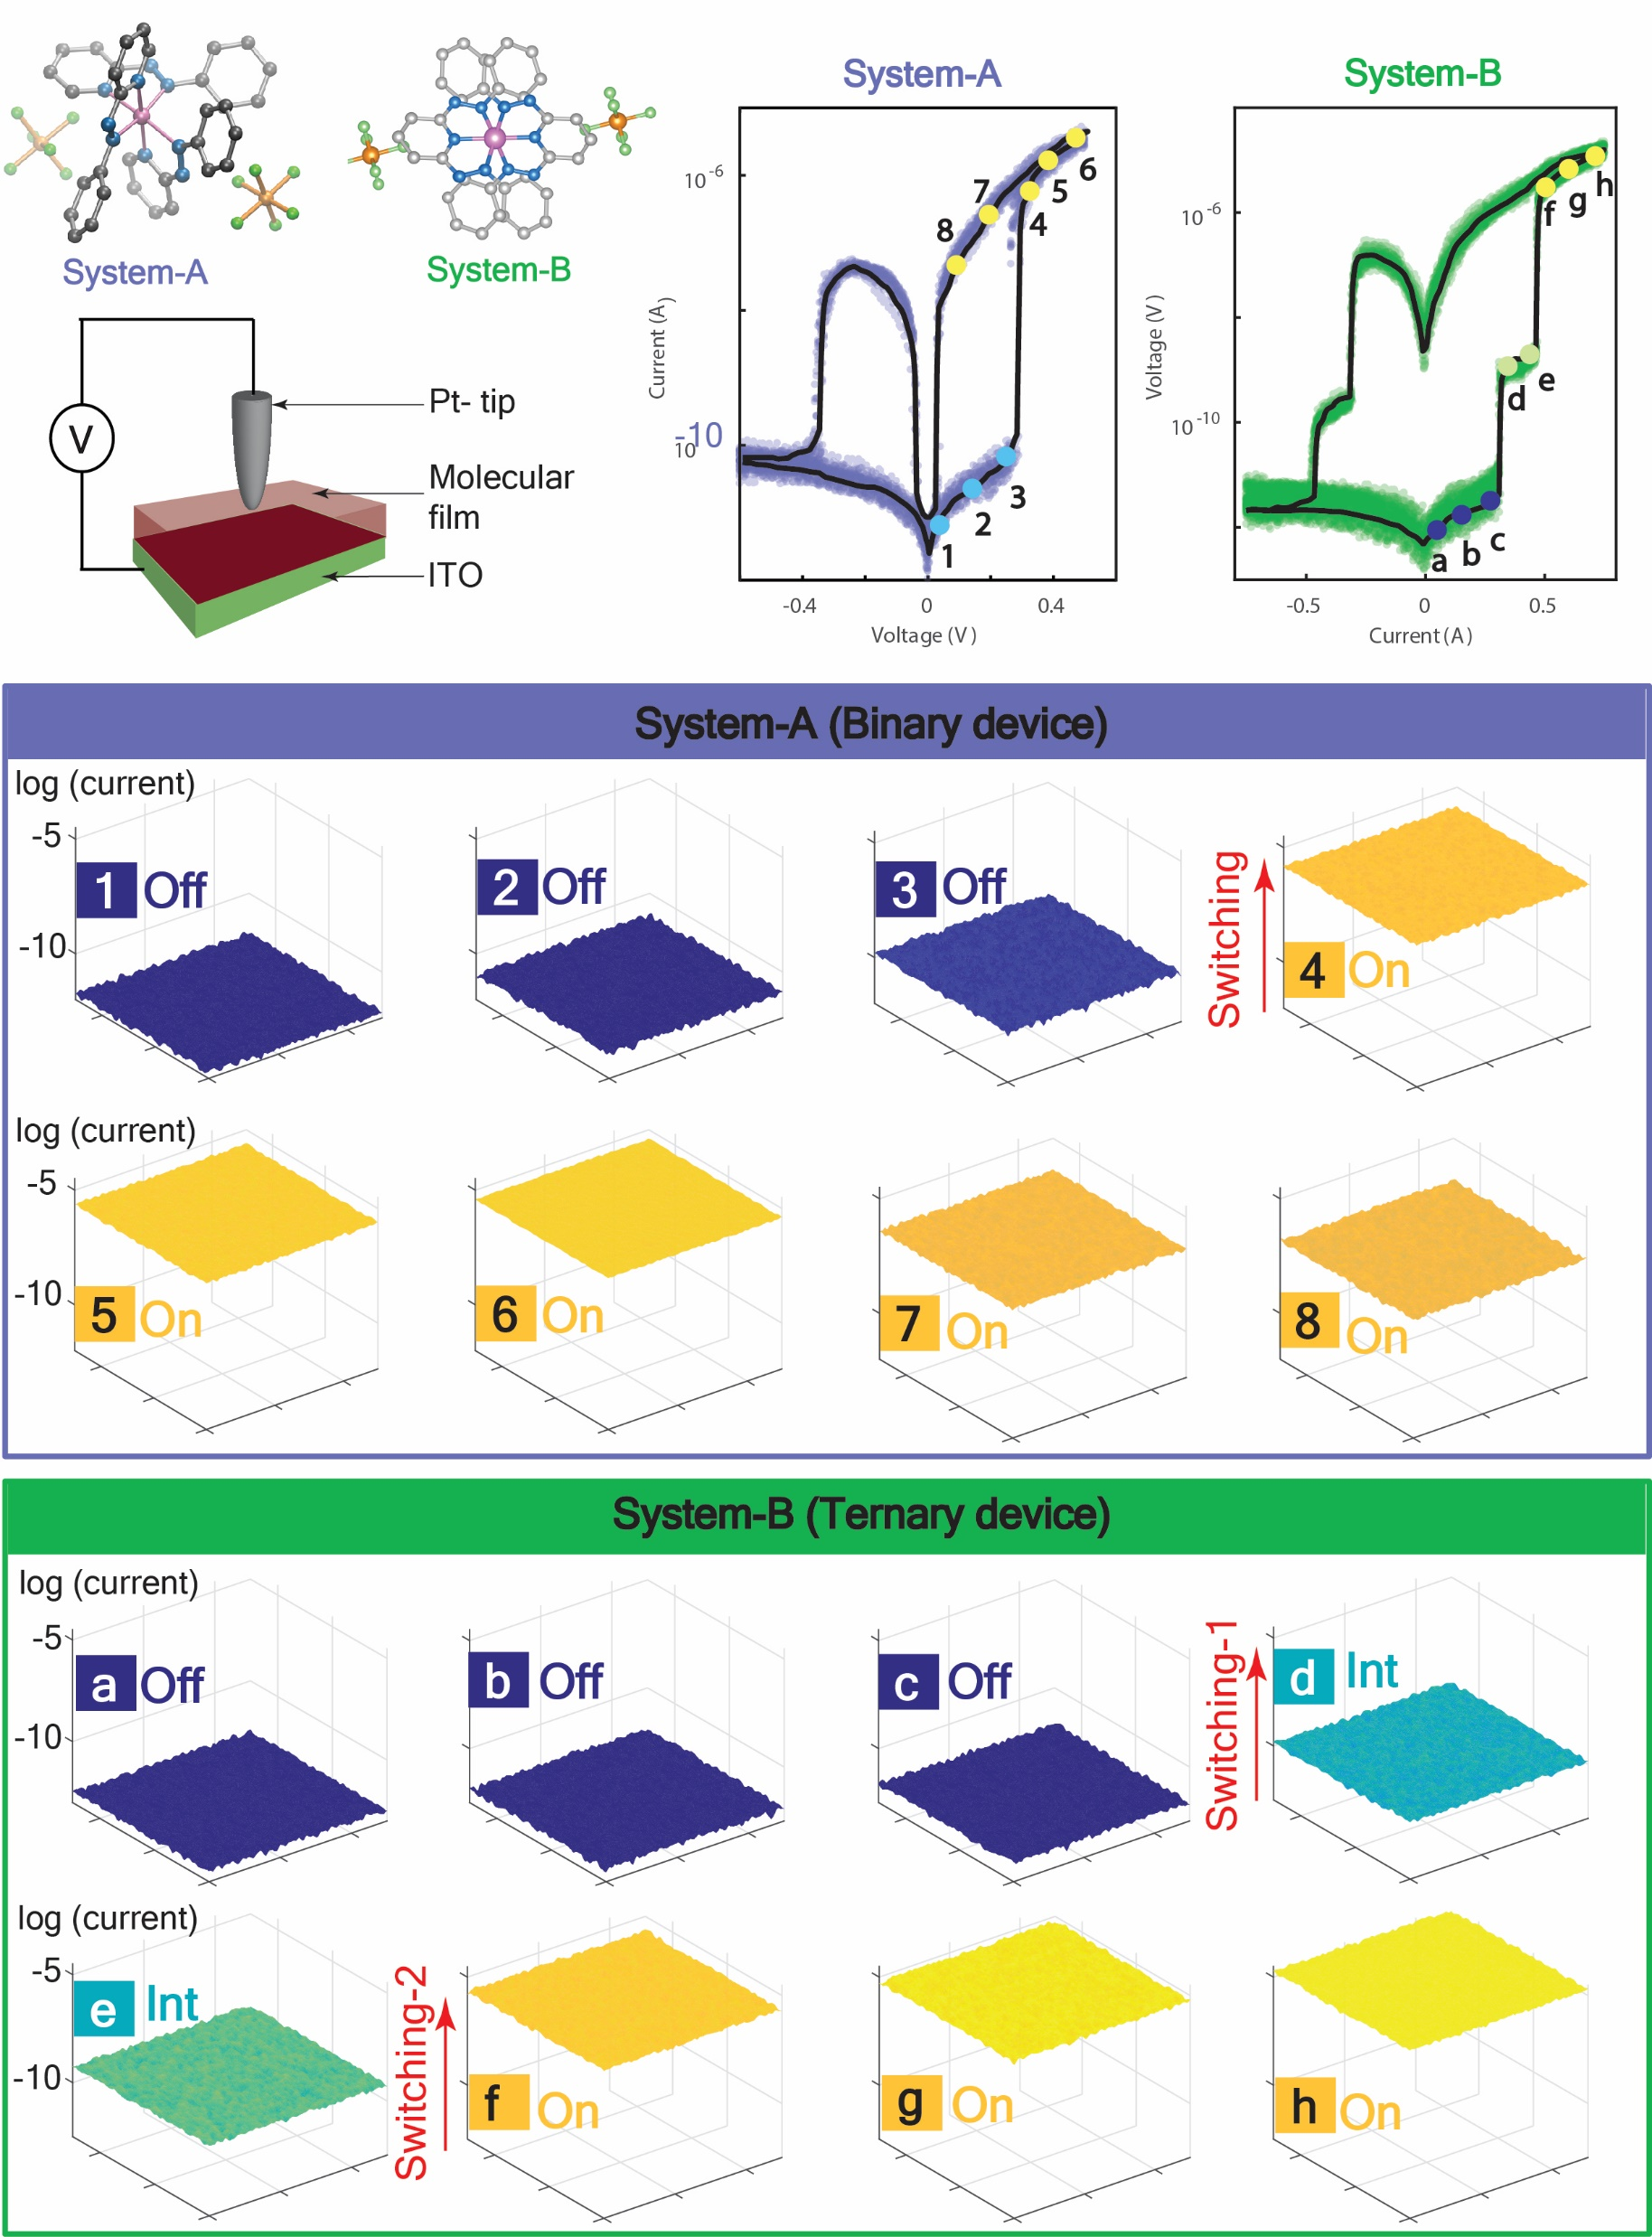
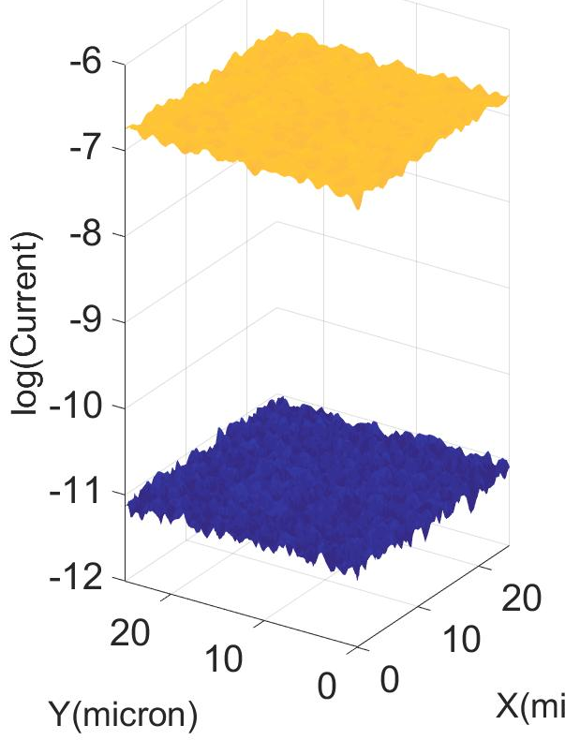
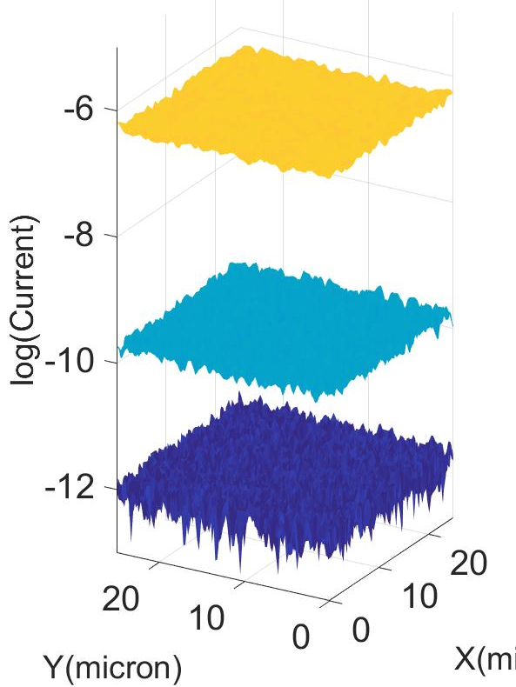
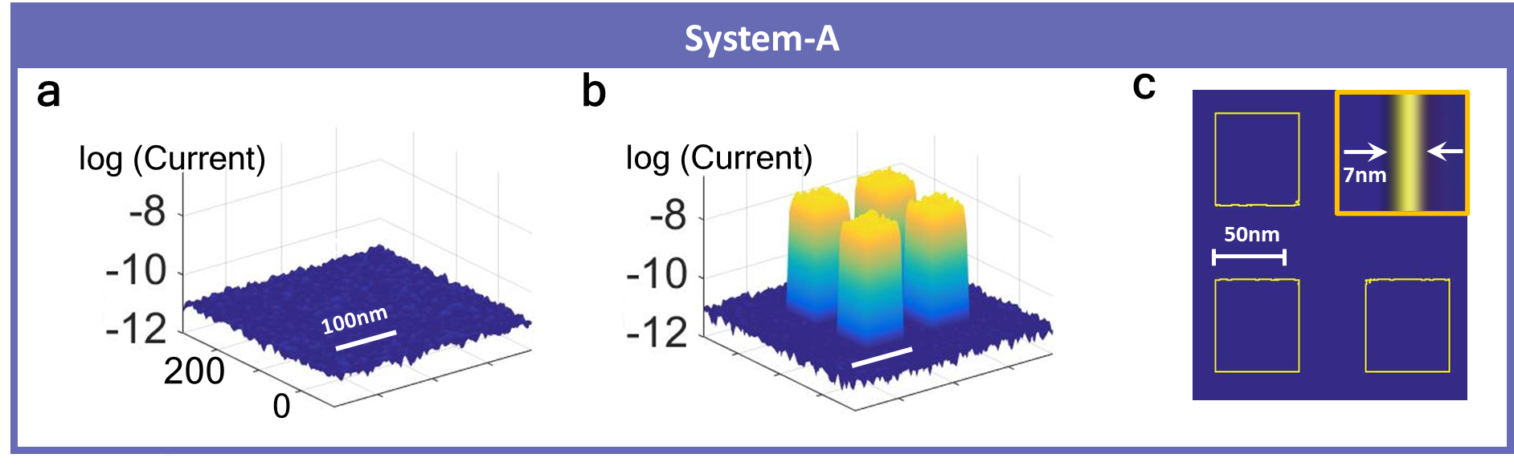
100% Spatially Uniform Switching
Switching Uniformity
System-A
System-B
Goswami, Sreetosh, et al. Advanced Materials (2020): 2004370.

Slide 18
OUTLINE
Rationale for Low Energy Switching and Brain- like electronics
Organic Approach to an ultra-low Energy Memory
Neuronal memory functions

Slide 19
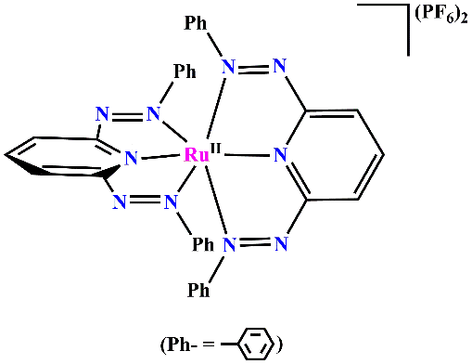
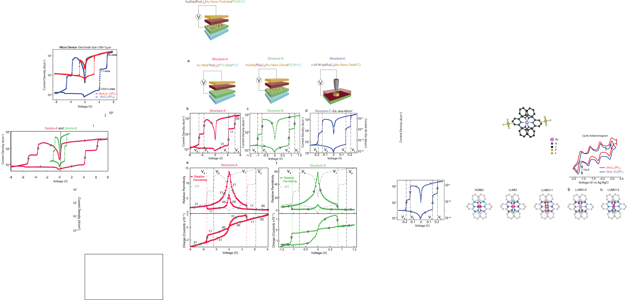
A Ternary memory
S. Goswami et al., Nature Nanotechnology, 4/3/2020
Notes:
Molecule
Sandwiched structure
Ternary memristor
Three discrete states with non-volatility is unique and has implications – don’t have time to talk

Slide 20
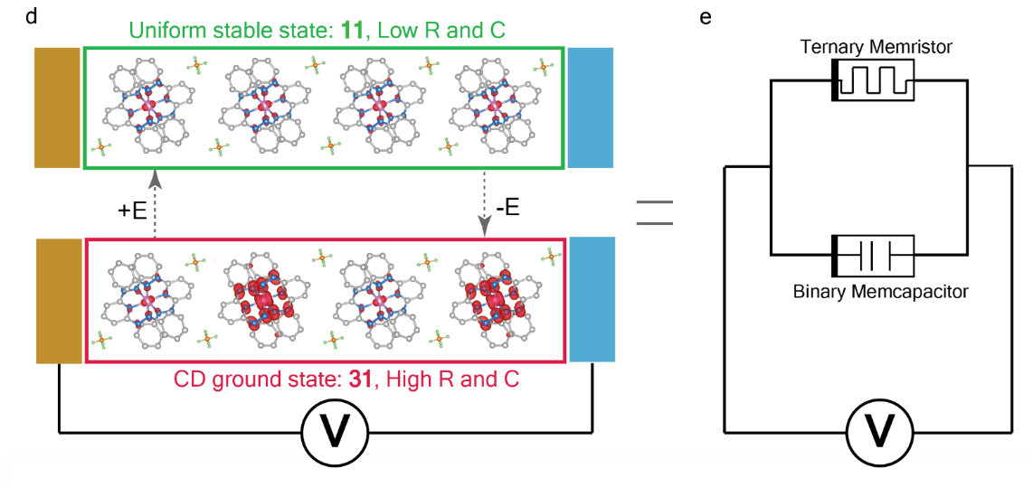
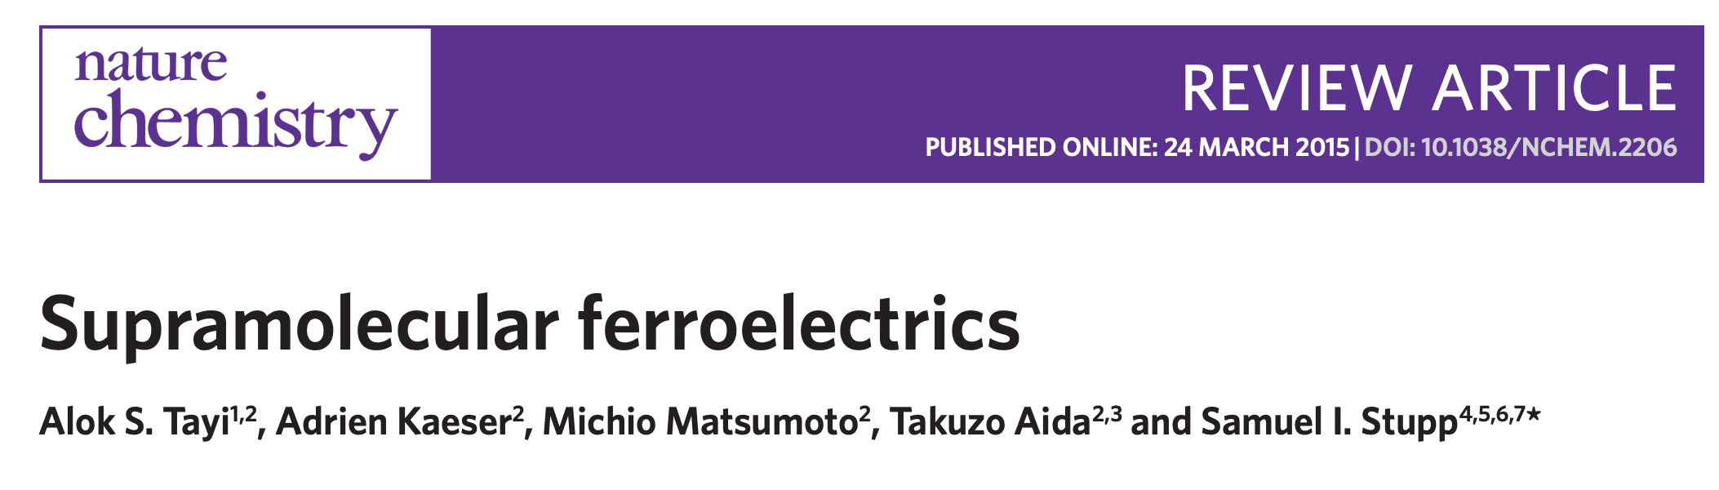
The CD State
S. Goswami et al., Nature Nanotechnology, 4/3/2020
Notes:
Capacitance should change by forming supramolecular dipoles

Slide 21
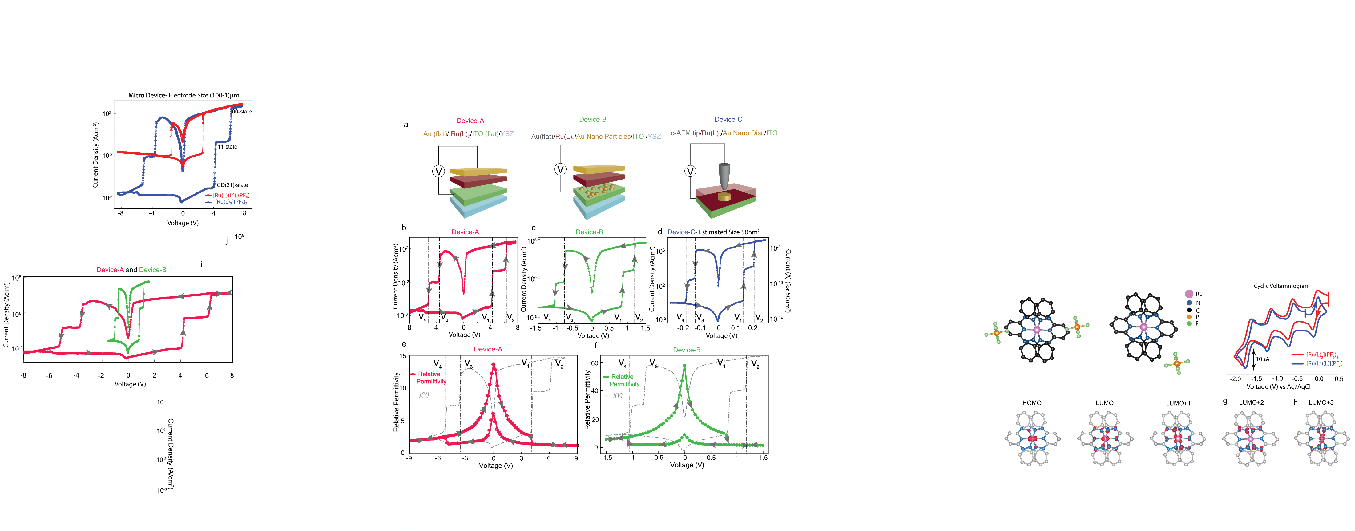
Memcapacitor
Notes:
Here you go – memcapacitor
Parallel to memristor
Only during CD – not the other transition

Slide 22
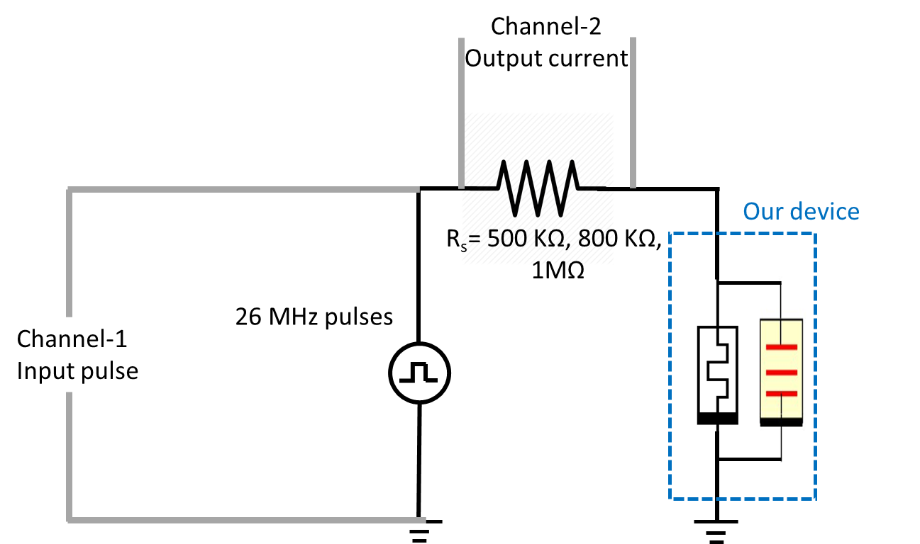
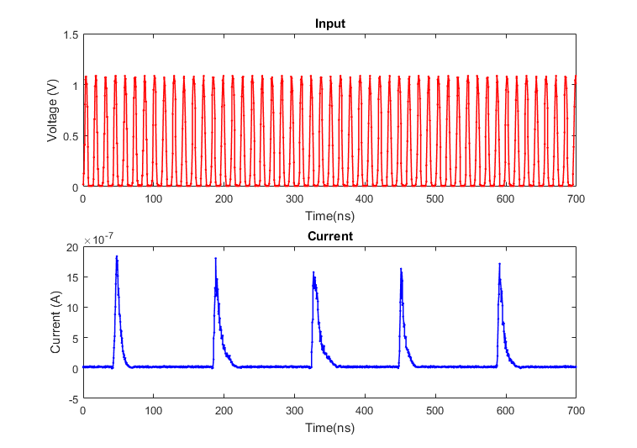
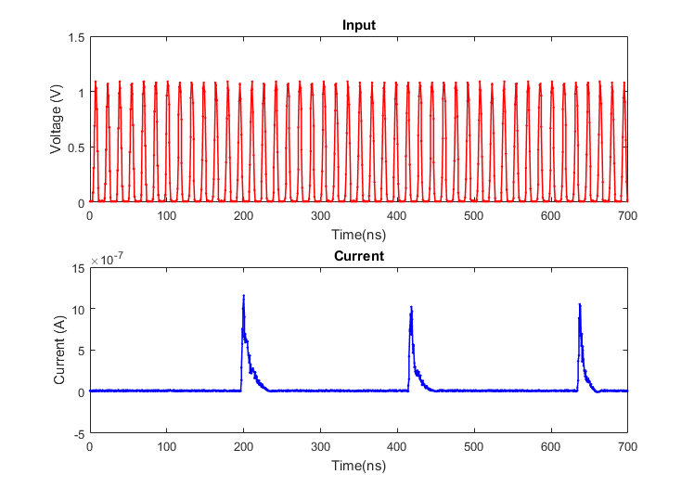
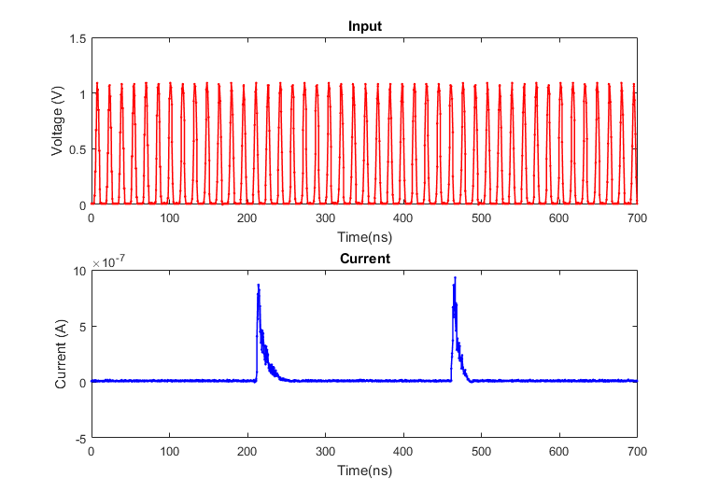
Integrate and fire – volatile regime
135 ns
230 ns
270 ns

Slide 23
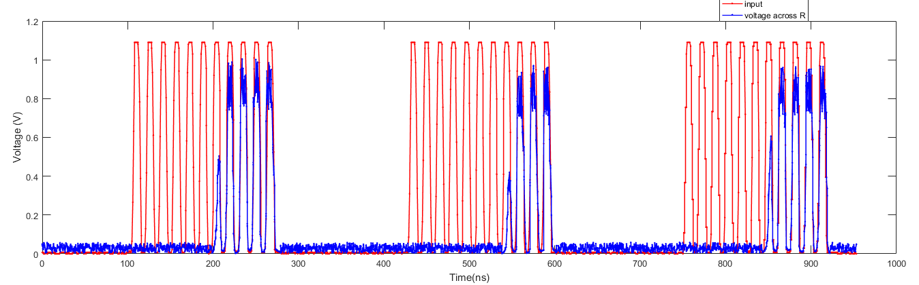
Potentiation

Slide 24
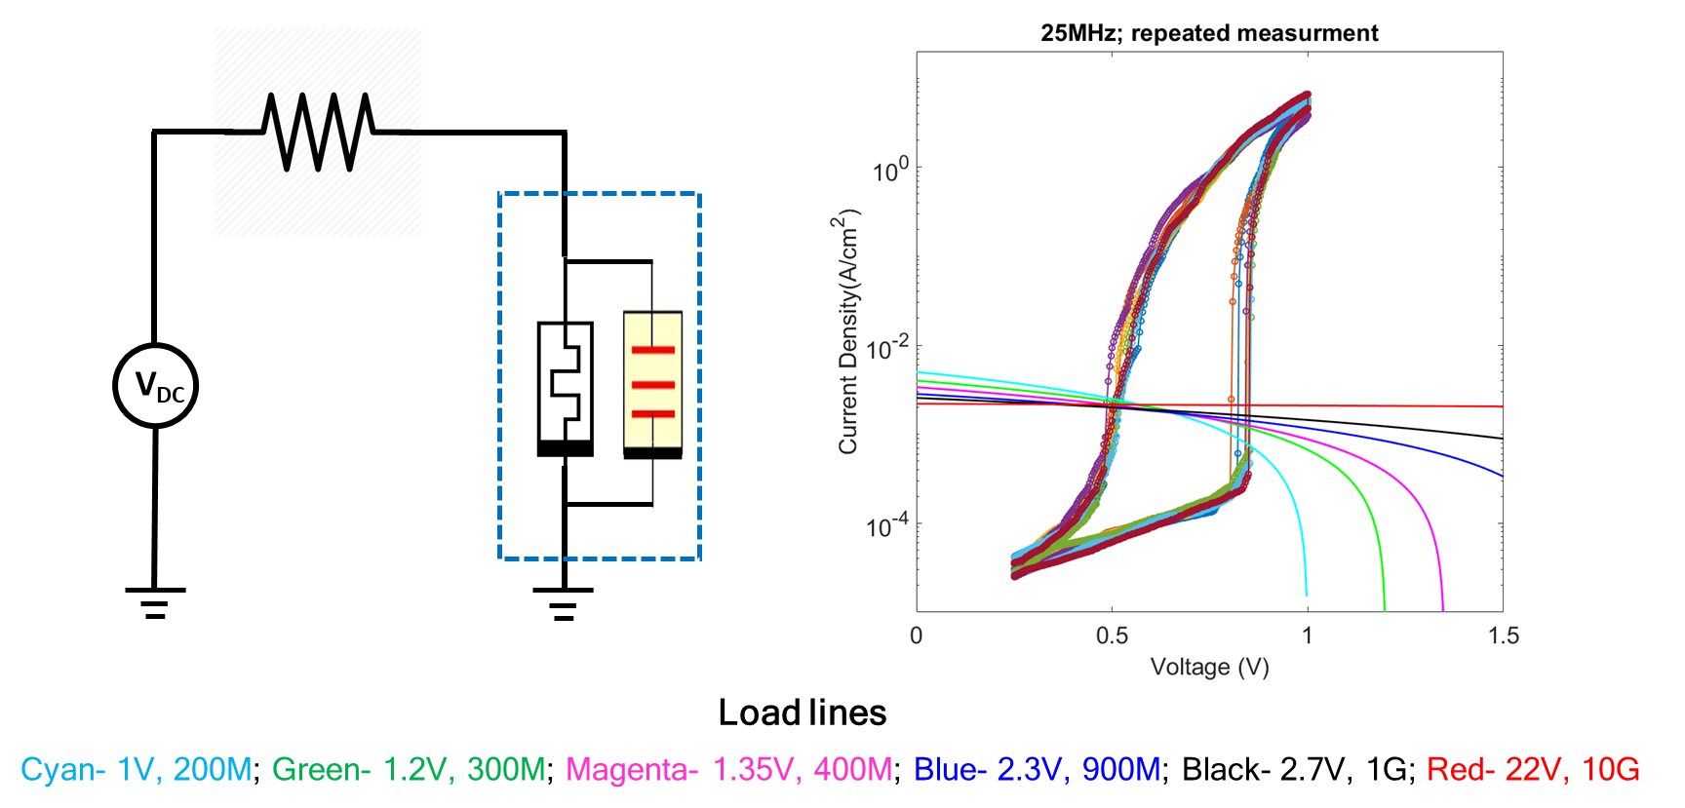
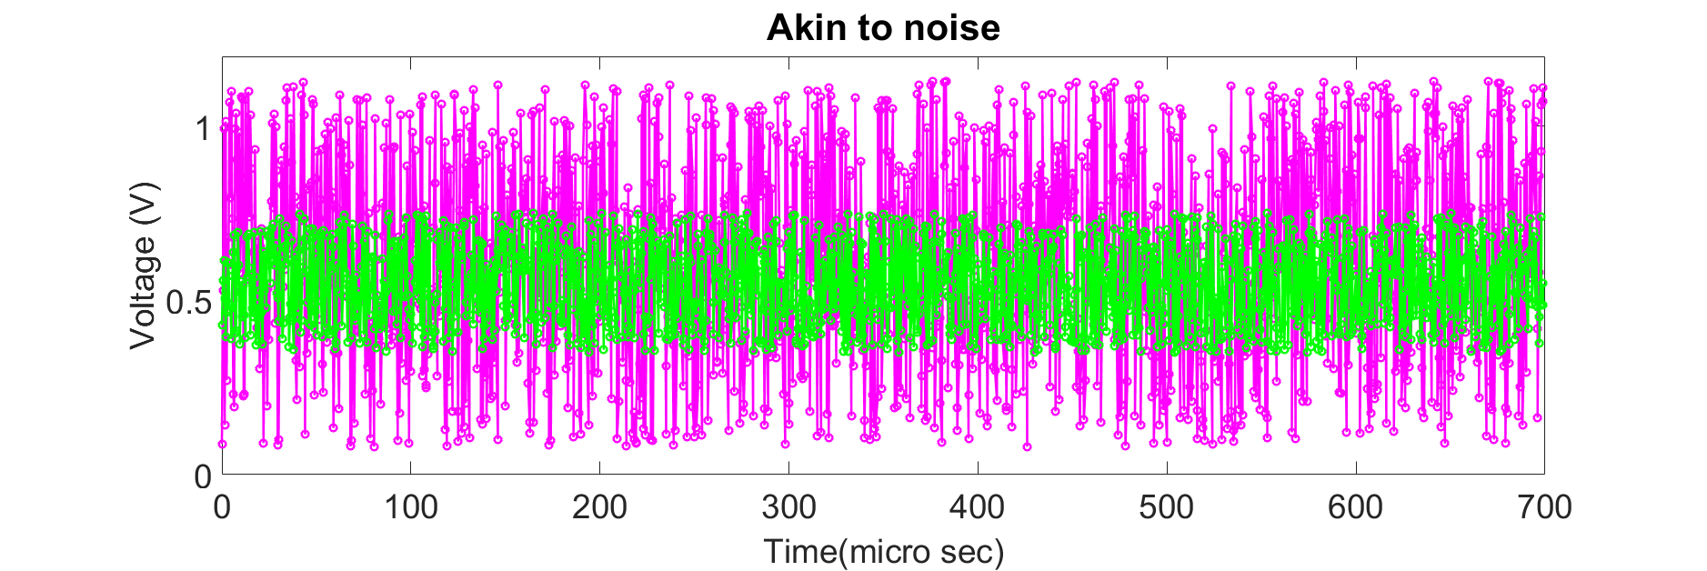
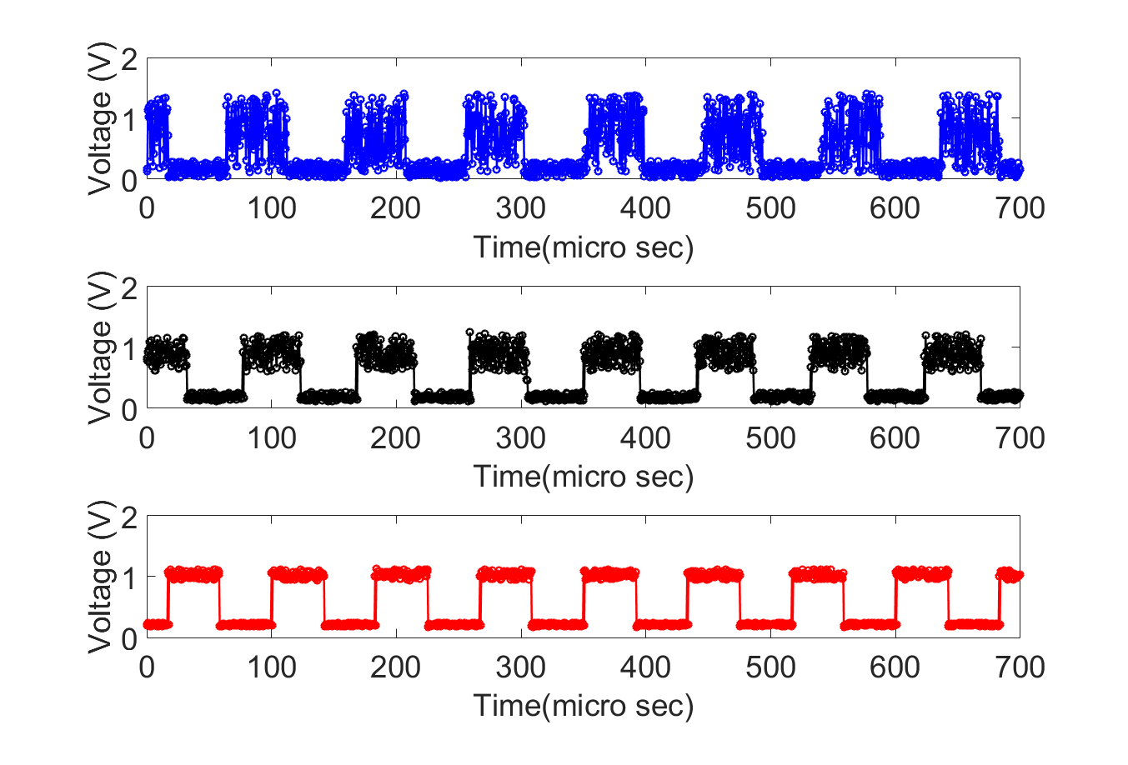
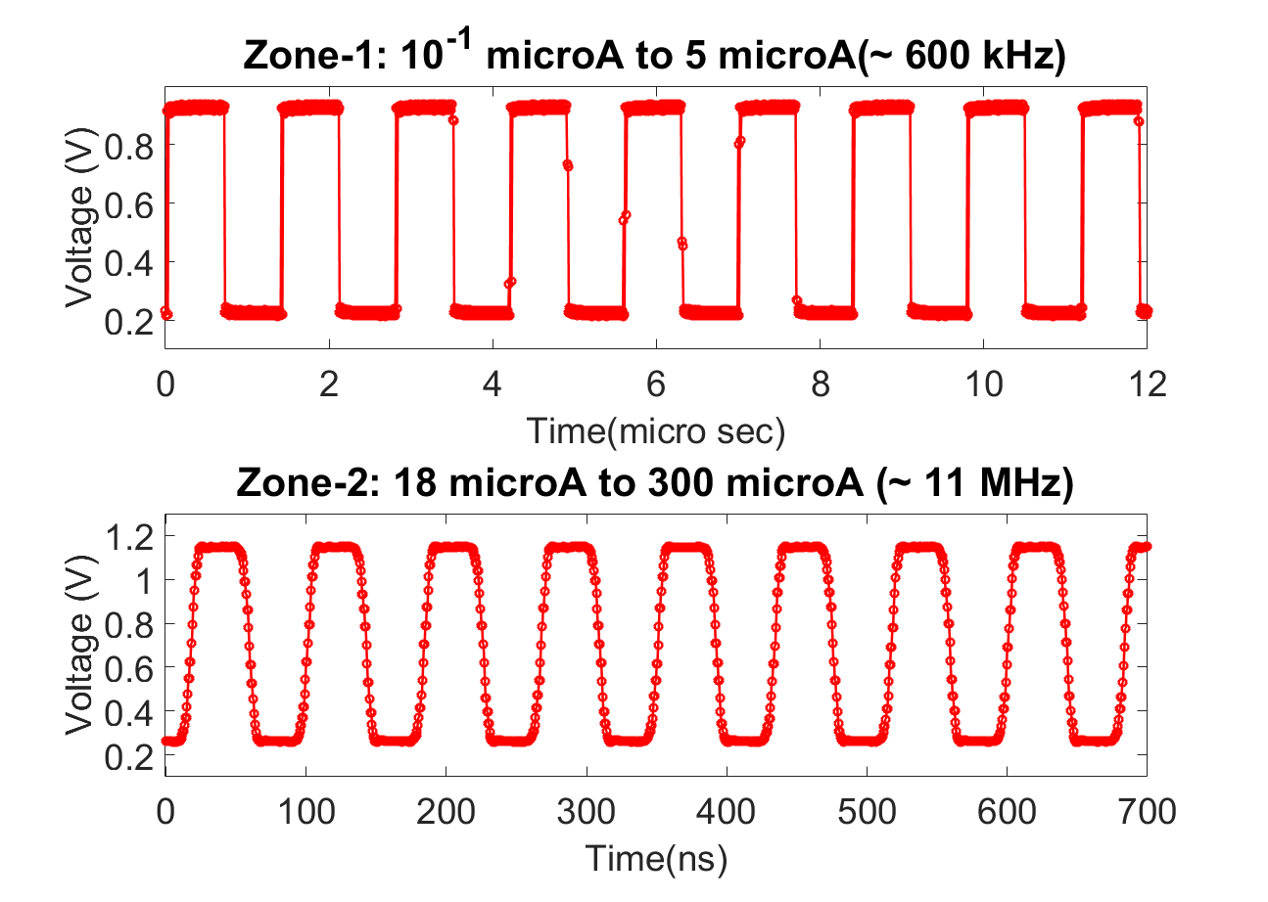
An oscillator – on the verge of instability

Slide 25
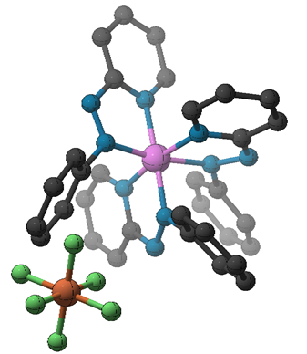
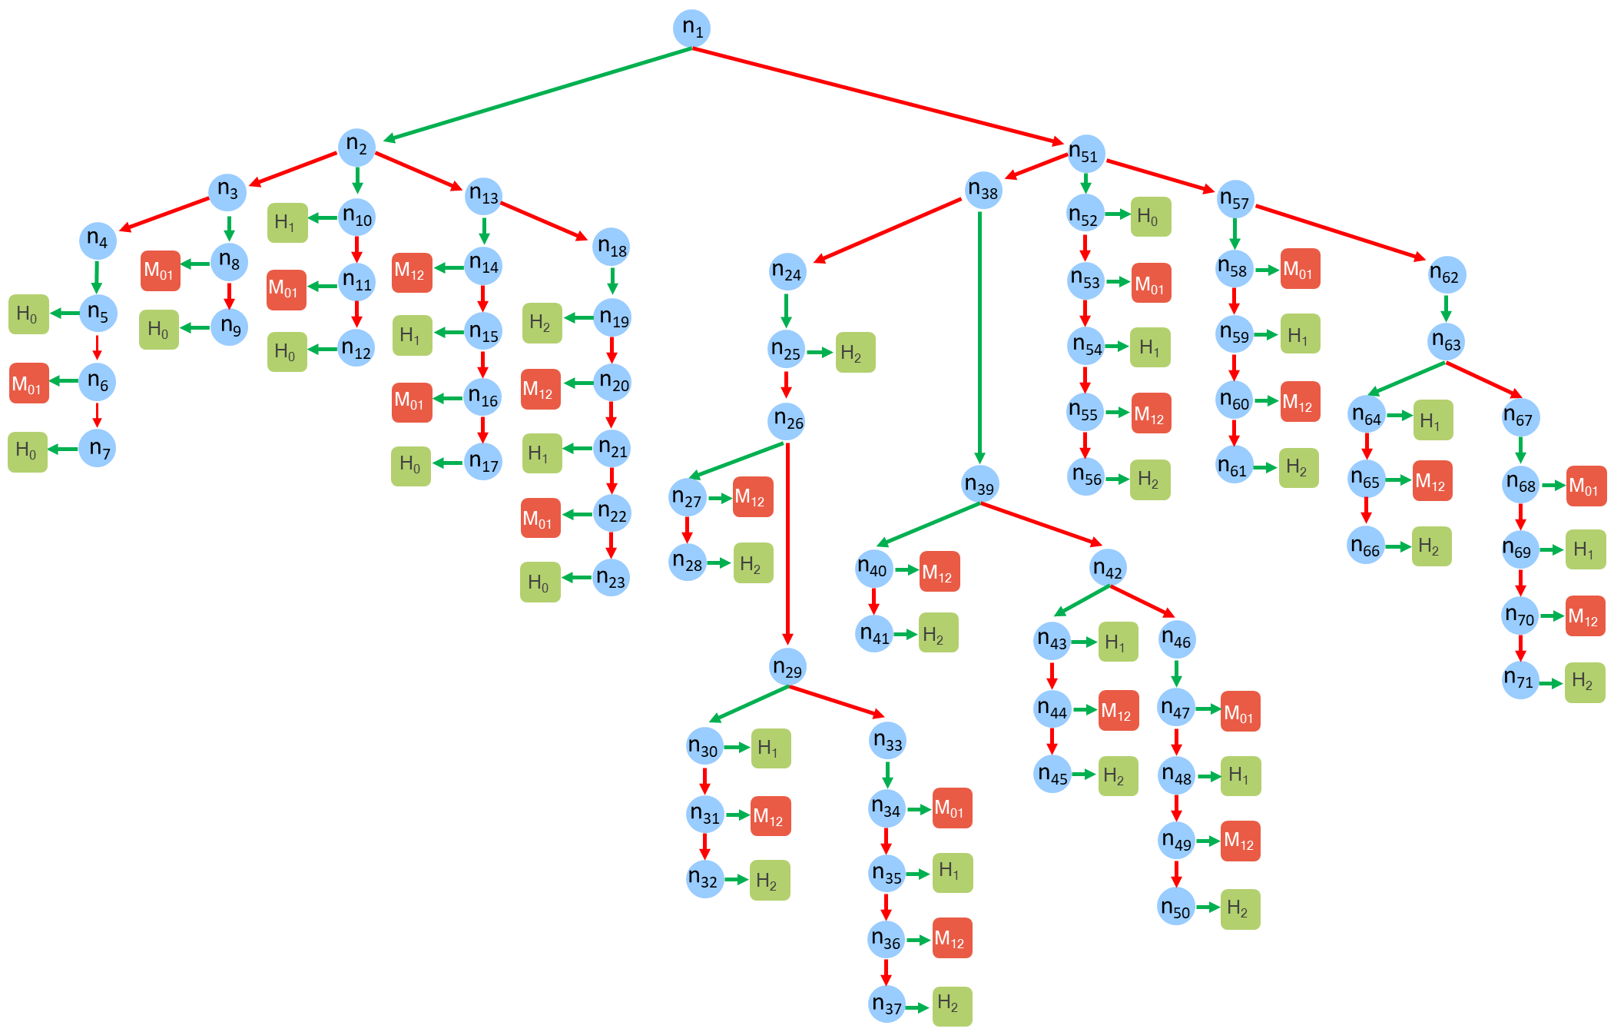
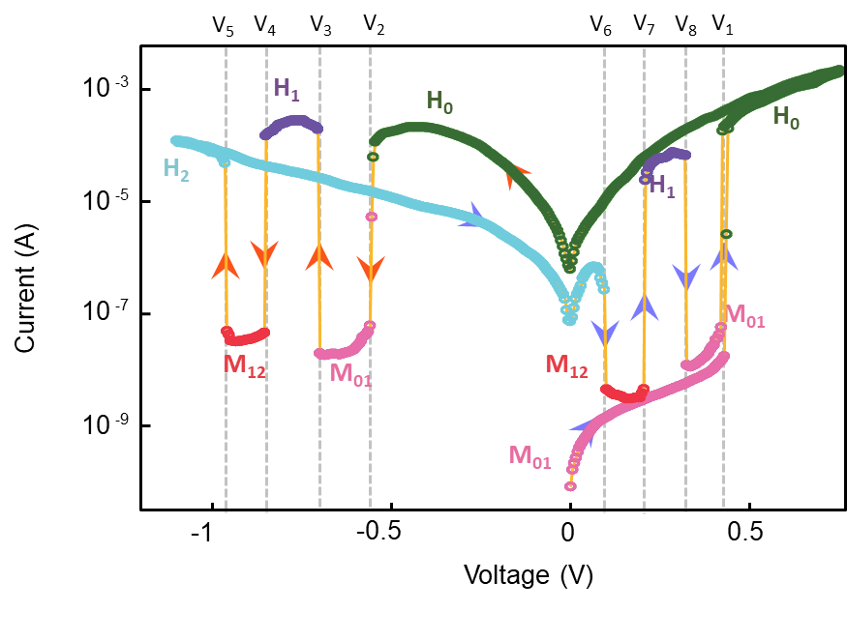
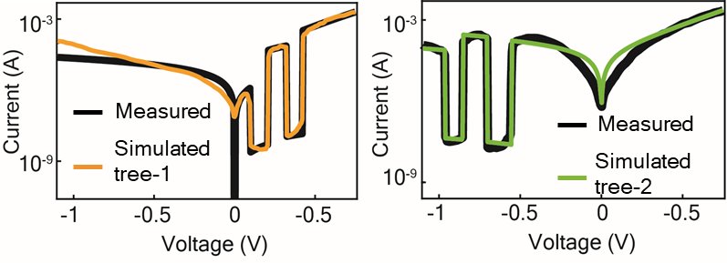
Decision Trees Within a Molecular Memristor
Sreetosh Goswami et al, Nature, Sep. 3, 2021

Slide 26
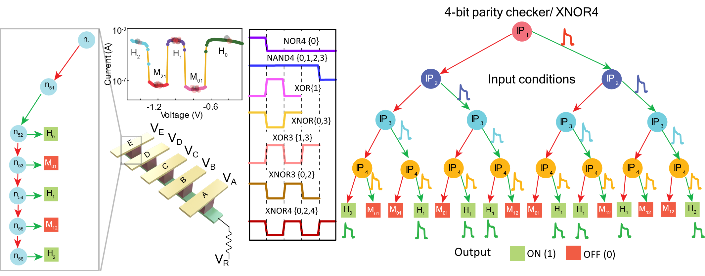
Single Stepped Decision Making
Sreetosh Goswami et al, Nature, Sep. 3, 2021

Slide 27
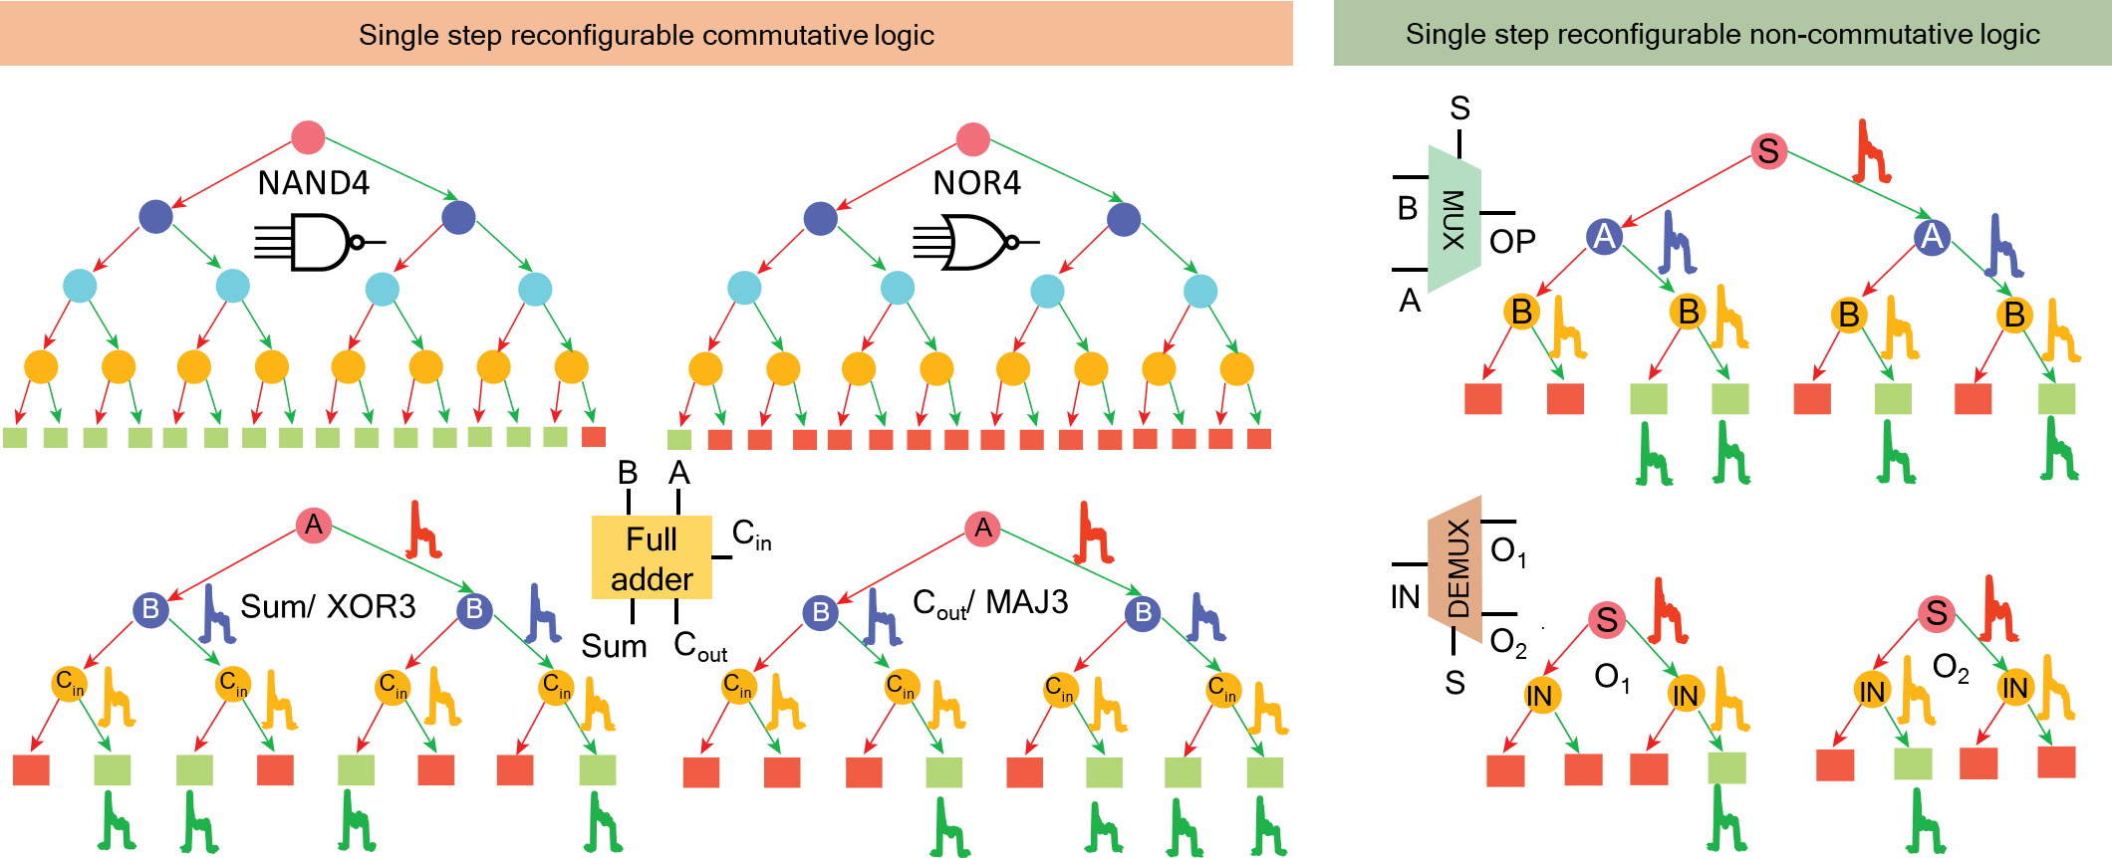
Reconfigurability
Sreetosh Goswami et al, Nature, Sep. 3, 2021

Slide 28





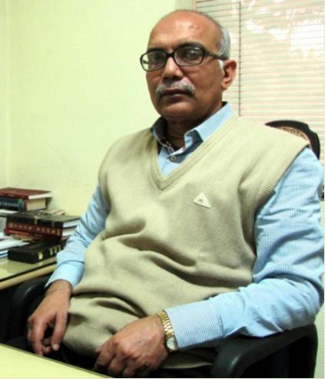
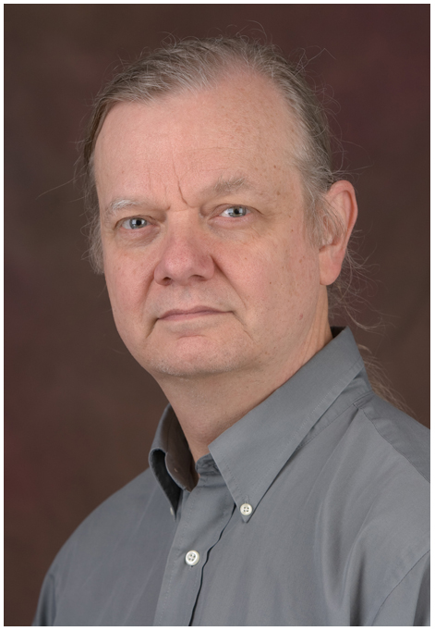
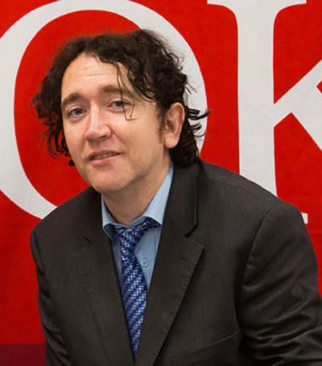

Acknowledgement
Dr. Sreetosh Goswami
NUSNNI
Professor S. Goswami
IACS, Kolkata
Professor R Stanley Williams
Texas A&M University
Professor D. Thompson
University of Limerick
Funding Support

Slide 29
Publications
1. Goswami, S.* et.al. Charge disproportionate molecular redox for discrete memristive and memcapacitive switching, Nature Nanotechnology, 15, 380 (2020)
2. Goswami, S. et. al. Valence Symmetry Breaking: From Textbook to Computing, Nature Device Materials and Engineering (blog highlight)
3. Goswami, S.* et.al. Nanometer-Scale Uniform Conductance Switching in Molecular Memristors, Advanced Materials (accepted for publication) (selected as VIP paper and cover page)
4. Sengupta, D., et al. Size-selective Pt siderophores based on redox-active π-acceptor ligands, Chemical Science (accepted for publication)
5. Goswami, S.* et.al. (2020). Colossal current and voltage tunability in an organic memristor via electrode engineering. Applied Materials Today, 19, 100626
6. Goswami, S.* et.al. (2020) An Organic Approach to Low Energy Memory and Brain Inspired Electronics, Applied Physics Review, 7, 021303 (2020) Invited review
7. Valov, I. et.al., 2017. Organic memristors come of age. Nature Materials, 16(12), 1170-1172 (news and views covering our work)
8. Goswami, S et.al. Robust Resistive Memory Devices Using Solution-Processable Metal-Coordinated Azo-aromatics. Nature materials 16, 1216 (2017) (as the first author)
9. Sreetosh Goswami et al, Decision Trees within a Molecular Memristor, Nature, Sep. 3 (2021).

Slide 30

Thanks
T. Venky Venkatesan
Venky@ou.edu

