Slide 1

Cloud-based Service
Dr. Neal N. Xiong
Southwestern Oklahoma State University

Slide 2
Outline
Myself
Cloud-based Trust Computing
Cloud-based Machine Learning for Medical Data
Cloud-based Tele-health
4
Notes:
At the end of this course, you should be able to:
Understand the characteristics and operation of WiFi networks (IEEE 802.11 WLANs)
…and MANETs as well as Bluetooth PANs
Deploy WLAN Hotspots
Use basic wireless network monitoring and analysis tools to troubleshoot and assess performance of WLANs
Tools
Tools
Utilize network modeling and simulation tools to plan WLAN networks
Understand possible attacks against WLANs, classify attacks and threats on Bluetooth PANs, and be able to properly secure WLANs(802.1x port-based authentication)

Slide 3
Outline
Myself
Cloud-based Trust Computing
Cloud-based Machine Learning for Medical Data
Cloud-based Tele-health
4
Notes:
At the end of this course, you should be able to:
Understand the characteristics and operation of WiFi networks (IEEE 802.11 WLANs)
…and MANETs as well as Bluetooth PANs
Deploy WLAN Hotspots
Use basic wireless network monitoring and analysis tools to troubleshoot and assess performance of WLANs
Tools
Tools
Utilize network modeling and simulation tools to plan WLAN networks
Understand possible attacks against WLANs, classify attacks and threats on Bluetooth PANs, and be able to properly secure WLANs(802.1x port-based authentication)

Slide 4


Slide 5
Myself
Research - Publication
Journal papers:
  Quality: Top 2
  IEEE JSAC (3.413-4.8), IEEE TPDS, IEEE SMC,
  ACM TAAS, IEEE TSC, IEEE THMS, IEEE/ACM J.
  Quantity: Journal 100+, over 20 IEEE/ACM J.
Conference papers:
  Quality: Rank 1
  INFOCOM, ICDCS, Sigcomm workshop, IPDPS
  ICPP, ICC, LCN, Cloud Computing…
  Quantity of Rank 1: about 20

Slide 6
Research - Service
Associate Editor,
IEEE Tran. on Systems, Man & Cybernetics, Systems (2.2,Top 15)
Information Sciences (Impact Factor 3.8-4.2, Top 20)
Chair, Trusted Cloud Computing Task Force,
IEEE Computational Intelligence Society (CIS)
Editor-in-Chief, Journal of Parallel & Cloud Computing (PCC),
http://www.j-pcc.org/editorialBoard.aspx
IEEE Senior member, IEEE Computer Society

Slide 7
Outline
Myself
Cloud-based Trust Computing
Cloud-based Machine Learning for Medical Data
Cloud-based Tele-health
4
Notes:
At the end of this course, you should be able to:
Understand the characteristics and operation of WiFi networks (IEEE 802.11 WLANs)
…and MANETs as well as Bluetooth PANs
Deploy WLAN Hotspots
Use basic wireless network monitoring and analysis tools to troubleshoot and assess performance of WLANs
Tools
Tools
Utilize network modeling and simulation tools to plan WLAN networks
Understand possible attacks against WLANs, classify attacks and threats on Bluetooth PANs, and be able to properly secure WLANs(802.1x port-based authentication)

Slide 8
Tech. I
Dynamic Cloud-based network model
IBM Cloud cover USA,
Almost of World!
Security, Dependability
Notes:
在超级计算系统的容错技术研究中取得重大突破，产生巨大国际影响，成果被广泛引用并进入包括 乔治理工 在内的世界著名研究型大学的研究生课堂。并被IBM认可，近来它们希望推广我的技术到IBM云平台中去。
未来百亿亿次超级计算机所包含的计算核心数目预计将接近一亿。超算系统的故障率随着系统规模增大呈直线上升趋势。复杂庞大的百亿亿次超算系统的可靠性问题将严重威胁其运行性能。容错技术对百亿亿次超算系统将必不可少

Slide 9
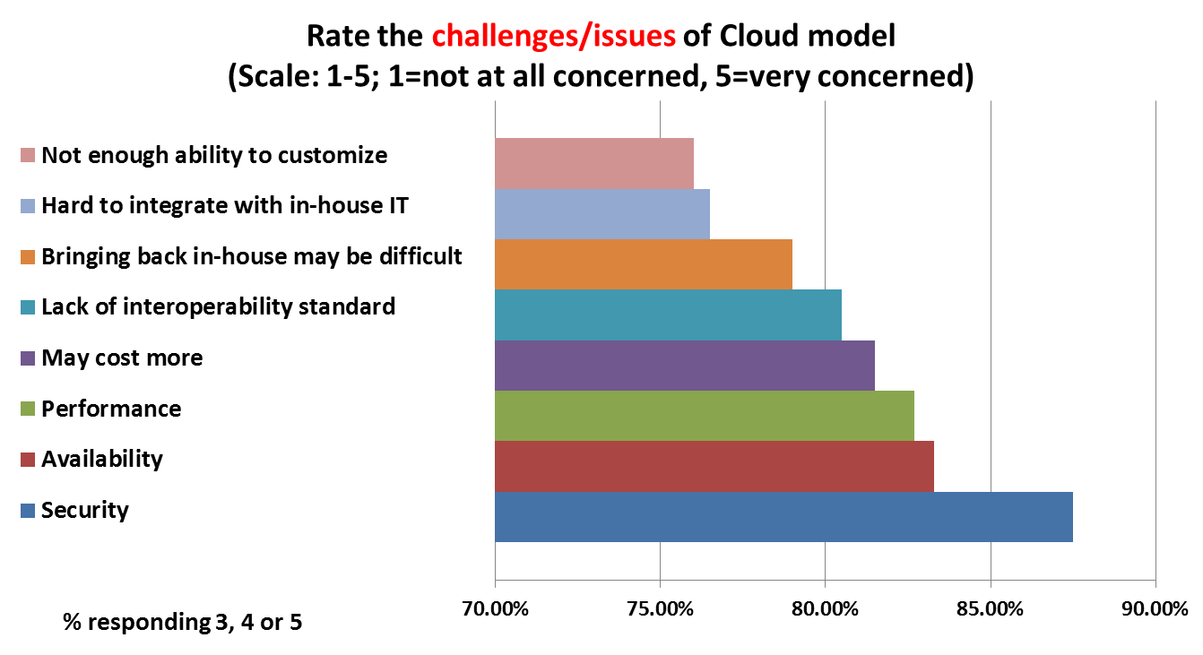
Cloud Challenges
There are lots of issues
for Clould Telehealth,
our group focus on
security/QoS gurantee

Slide 10
How to ensure effective service?
How to let limited server resources serve more users
(high utilization for server resources)?
How to deliver fair services for the server load?
How to process the uses’ jobs in servers faster or in time?
How to predict the performance of Servers?
Notes:
10

Slide 11
Possible Methods
Method: Use Failure Detector to get current states to dynamically adjust new assignments to the servers (Support by IBM/NSF)
Failure Detector
gets current states
Proper jobs:
Process fast,
high utilization
Servers
Patient/data
Management/
Medical center
Notes:
11
Then many efforts have been focused on the network congestion.
Congestion results in long delays,
wasted resources due to dropping packets,
and the possibility of a congestion collapse [1].
In the router congestion control schemes, the Active Queue Management (AQM) is an effective method in Internet routers
to enhance congestion control, and
to achieve tradeoff between link utilization and delay.
Method: The de facto standard, Random Early Detection (RED) AQM scheme, and most of its variants use queue length as congestion indicator to trigger packet dropping. Such as: RED, PDRED, PIRED, Adaptive RED, and so on.

Slide 12
Failure Detectors (FDs): Outline
Problems, Model, QoS of Failure Detectors
Existing Failure Detectors
1. Tuning adaptive margin FD (TAM FD): JSAC
Constant safety margin of Chen FD [30]
2. Exponential distribution FD (ED FD): ToN
Normal Distribution in Phi FD [18-19]
3. Self-tuning FD (S FD): IPDPS12, ToN
Self-tunes its parameters
m_{i}
A
B
d_{i}
Notes:
Multicast based on

Slide 13
Outline of failure detectors
1 Tuning adaptive margin FD (TAM FD)
2 Exponential distribution FD (ED FD):
Normal Distribution in Phi FD [18-19]
3 Self-tuning FD (S FD): Self-tunes its parameters
N. Xiong, A. V. Vasilakos, Comparative analysis of quality of service and memory usage for adaptive failure detectors in healthcare systems. IEEE Journal on Selected Areas in Communications, 27(4): 495-509, 2009. Impact Factor：4.8
Notes:
Multicast based on

Slide 14
1. Our TAM-FD Motivation
Basic Chen-FD scheme [1]:
Probabilistic behavior;
Constant safety margin problem;
m_{i}
[1] W. Chen, S. Toueg, and M. K. Aguilera. On the quality of service
of failure detectors. IEEE Trans. on Comp., 51(5):561-580, 2002.
A
B
d_{i}
Tuning adaptive margin FD is presented:
How to design or predict the adaptive margin
Bertier FD:
Jacobson’s estimation
Variables: : predictive delay; , : a variable;
: a constant, EA_{i+1}: theoretical arrival
∆t
Notes:
Problem:
(1)Chen relying on a probabilistic behavior of the system.
(2) However, it uses a constant safety margin.
(3) We know, the network environment is dynamic and unpredictable, heartbeats have quite different delay to arrive receivers. So the constant safety margin is not applicable the actual network
environments to obtain good QoS for users.
(4) How to design the FD to descript the network dynamic.

Slide 15
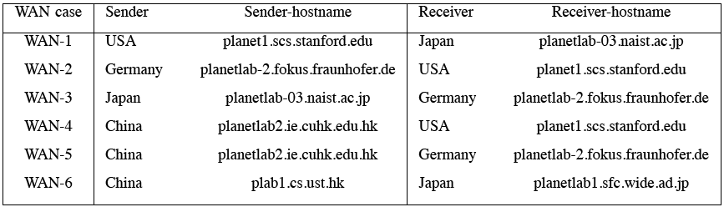
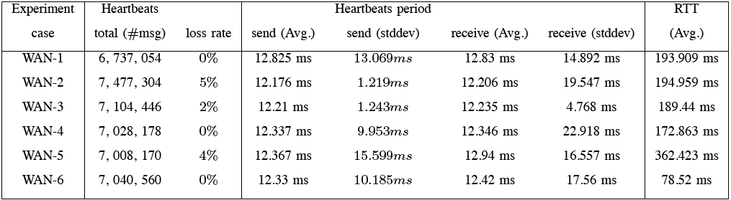
Extensive Experiments
Cluster, LAN, WIFI, WAN:

Slide 16
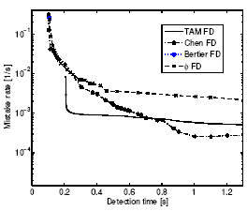
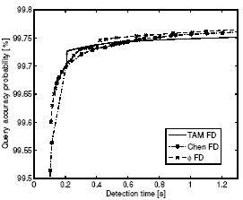
1. TAM-FD Exp. WAN
Bertier FD
TAM FD
Chen FD
Phi FD
Phi FD
TAM FD
Chen FD
Target QoS
MR and QAP comparison of FDs in WAN:
WS=1000 (logarithmic, aggressive, conservative).
Notes:
Left figure shows mistake rate comparison of FDs; In this figure , the vertical axis is on a log scale.
And best values are located toward the lower left corner, for it means that this FD provides a short detection time and has a low mistake rate.
(2) Right figure shows query accuracy probability comparison of FDs; In this fig, the vertical axis is on a linear scale. And best values are located toward the higher and left corner, for it means that the FD provides a short detection time and has a high query accuracy probability.
(3) In left fig, when TD < 735:3 ms, TAM FD obtains the lowest mistake rate among the four FDs.
When TD > 735:3 ms, Chen FD has the lowest mistake rate, compared with the other three FDs.
It is clear that TAM FD has a slightly lower mistake rate than FD in aggressive range.
(4) Bertier FD is still plotted as a single point, because there is no dynamic parameters in Bertier FD.

Slide 17
Outline of failure detectors
1 Tuning adaptive margin FD (TAM FD)
2 Exponential distribution FD (ED FD):
Normal Distribution in Phi FD [18-19]
3 Self-tuning FD (S FD): Self-tunes its parameters
N. Xiong, J. Wu, Y. Richard Yang, and Y. Pan, A Class of Practical Probability Distribution Failure Detection Schemes in Efficient and Reliable Transparent Computing Systems, IEEE Transactions on Computers.
Notes:
Multicast based on

Slide 18
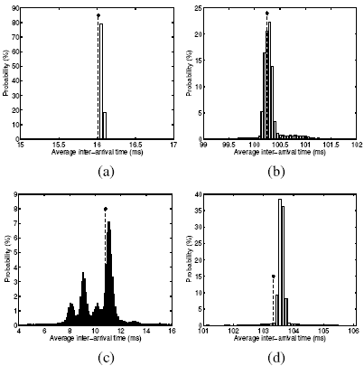
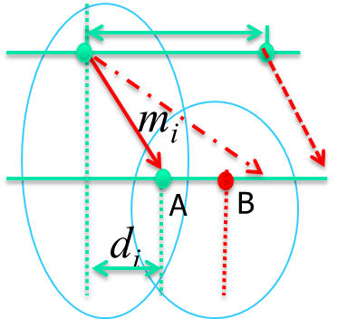
2. ED-FD Motivation 1/2
n1
n2
Min~Max:
50 µs~time unit
How to design probability distribution function to match it?
n₁, n₂, … ,n_{k}
P_{i}=n_{i} / N_{sum}
P_{i}~ i
Statistics: (a) Cluster; (b) WiFi; (c) Wired LAN; (d) WAN (N_{unit}/N_{all} ) f1+f2+f3+f4=graph; 4 single f for each part; nor F + tag F
Notes:
(1) from the minimum to the maximum, every 50 s as a unit, we can
get 9; 778 sample units,
(2) We can find the number is different in every statistic unit.
(3) the probability for each unit is the value
that the total sample data divided by the different number in every time unit.
(4) For the cluster, wireless, and WAN cases, we used the 50 us as a statistic unit,
except that the WAN case used 100 us as a statistic unit.
(5) most samples have an inter-arrival time that is near the average value;
(6) it is clear that the inter-arrival time with the maximum probability in the each experiment
is larger than the mean of all inter-arrival times.

Slide 19
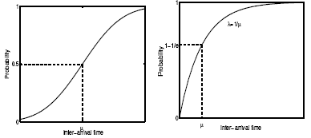
2. ED-FD Motivation 2/2
In sensitive range,
Exponential distrib.
can depict the
network heartbeat
clearer
Probability distribution vs. inter-arrival time: Phi FD [18]; ED FD
(Normal distribution~ Exponential distribution, slope)
Notes:
(1)Here u means the average inter-arrival time, left is for Normal distribution, right is for
Exponential distribution.
(2) We can find the range near u is sensitive, the Exponential distribution has a higher
Slope than that of Normal distribution. It means that in the sensitive range, Exponential
distribution can depict the network heartbeat clearer. Then it is a more aggressive scheme
than Phi FD.

Slide 20
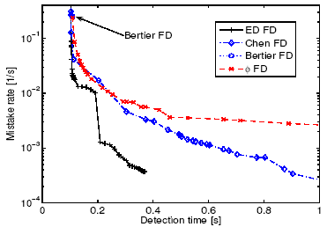
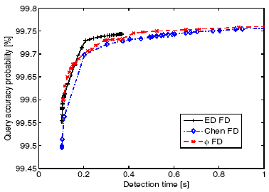
2. ED-FD Exp. WAN2
Experiment 2:
MR and QAP comparison of FDs in WAN.
Notes:
(2) In this experiment, we use the exactly same trace les from the paper about Phi FD [18].
(3) with the same detection time, ED FD obtains the
lowest mistake rate among the four FDs, except for several initial junctions of ED FD.
(4) when TD > 243 ms, Chen FD has the lower mistake rate compared with phi FD.
(5) It is obvious that the ED FD is more aggressive than Phi FD
Phi FD is more aggressive than Chen FD.
(6) In the four kinds of experiments, ED FD is an effective improvement over phi FD
in terms of short detection time, low mistake rate and high query accuracy probability.
(7) The ED-FD is stopped early, because the rounding error prevent the line
to the very conservative case. --- Rounding error prevent line

Slide 21
Outline of failure detectors
1 Tuning adaptive margin FD (TAM FD)
2 Exponential distribution FD (ED FD):
Normal Distribution in Phi FD [18-19]
3 Self-tuning FD (S FD): Self-tunes its parameters
N. Xiong, A. V. Vasilakos, J. Wu, Y. Richard Yang, A. Rindos, Y. Zhou, W. Song, Y. Pan, A Self-tuning Failure Detection Scheme for Cloud Computing Service. IEEE IPDPS 2012: 668-679.
Notes:
Multicast based on

Slide 22
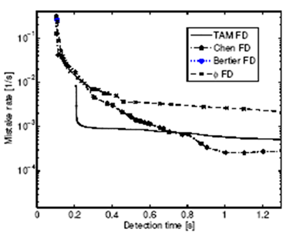
3. Self-tuning FD
Users give target QoS, How to provide corresponding QoS?
Chen FD [30]
Giving a list of QoS services for users -- different parameters
For certain QoS service -- match the QoS requirement
Choose the corresponding parameters -- by hand.
Problem: it is not applicable for
actual engineering applications.
target

Slide 23
3. Self-tuning FD
Output QoS of FD does not satisfy target, the feedback information is returned to FD；-- parameters
Eventually, FD can satisfy the target, if there is a certain field for FD, where FD can satisfy target
Otherwise, FD gives a response:
Output
How to design Self-tuning schemes to match it?

Slide 24
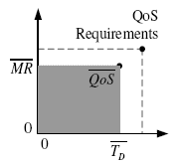
3. Self-tuning FD
Basic scheme:
=0;
>0;
<0;
Variables:
EA_{k+1}: theoretical arrival;
SM: safety margin;
τ_{k+1:} timeout delay;
α: a constant;
Margin

Slide 25
3. Self-tuning FD
SFD adjusts next freshness point to
get shorter MR, led to larger DT.
SFD adjusts next freshness point to get shorter TD, led to larger MR.
MR and QAP comparison of FDs (logarithmic).

Slide 26
Outline
Myself
Cloud-based Trust Computing
Cloud-based Machine Learning for Medical Data
Cloud-based Tele-health
4
Notes:
At the end of this course, you should be able to:
Understand the characteristics and operation of WiFi networks (IEEE 802.11 WLANs)
…and MANETs as well as Bluetooth PANs
Deploy WLAN Hotspots
Use basic wireless network monitoring and analysis tools to troubleshoot and assess performance of WLANs
Tools
Tools
Utilize network modeling and simulation tools to plan WLAN networks
Understand possible attacks against WLANs, classify attacks and threats on Bluetooth PANs, and be able to properly secure WLANs(802.1x port-based authentication)

Slide 27
Overview
Tech. II
1
Introduction
X. Wang, Y. Ren, Y. Yang, W. Zhang and Neal N. Xiong, A Weighted Discriminative Dictionary Learning Method for Depression Disorder Classification using fMRI Data, DBCloud 2016, Atlanta, GA, USA, Oct 20-23, 2016.
2
Methods
3
Experiments and Results
3
Summary

Slide 28

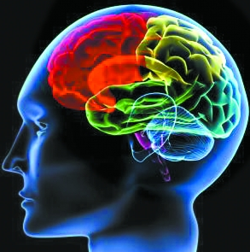
Introduction----Background
1.Depression will be the second cause of global disease burden by the year 2020.
2.The diagnosis of depression disorder is mainly dependent on clinical signs and symptoms.
There are evidences for altered fMRI activation patterns in patients with depression disorder.
Developing automatic depression disorder classification methods of fMRI data is of great importance.

Slide 29
Introduction----Problem
How to represent fMRI data?
How to classification fMRI data of patient class and healthy class?
Sparse representation based classification model can represent fMRI data and classification at the same time, such as SRC, DFDL, FDDL.
Drawback
These methods ignore the valuable relationship between the samples and dictionary atoms.

Slide 30
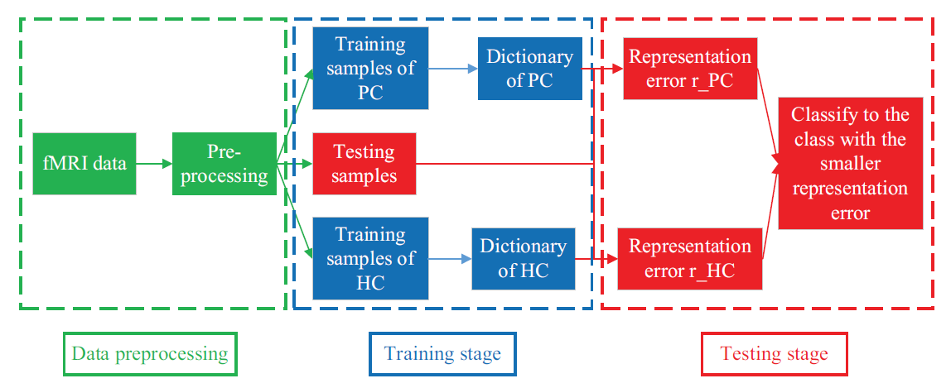
Methods----flow chart
Notes:
Our method include three steps: data preprocessing, training stage and testing stage. The preprocessing include leave out the first ten time points, slice timing, realignment, normalized, smooth, filtering and remove drifts. In the training stage, we train two dictionaries of the patient class (PC) and the healthy class (HC).
In the testing stage, a testing sample is classify to the class with the smaller representation error.

Slide 31
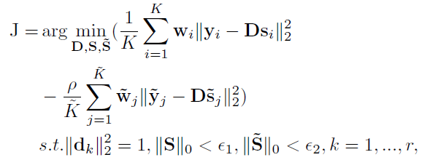


Methods----weighted discriminative dictionary learning(WDDL)
The aim of training stage is to learn dictionary for healthy class and dictionary ’ for patient class.
The objective function related to the healthy class of our WDDL method is formulated as follows. (The model of patient class can be solved in a similar way)
Notes:
Each sample y is represented by dictionary D as s.The first term of the objective function requires intra-class differences to be small, while the second term emphasizes inter-class differences. Namely, the dictionary D related to the healthy class can represent the samples of the healthy class well, but it can not represent the samples of the patient class well.
The aim of w:
Distance between a sample and the mean of dictionary atoms can measure the similarity between the sample and the dictionary atoms. If the distance between a sample and dictionary atoms is small, the weight would be large, making the representation error small enough to satisfy the convergence condition. In other words, the aim of adding the weighting scheme is to learn a dictionary which can better represent the samples similar to it. The better representation can further enhance the classification performance.

Slide 32
Experiments and Results----Experiments
Data
29 patients with depression (14 females, 15 males)
29 age-, sex- and education-matched healthy controls (15 females,14 males)
Evaluation
we employ leave-one-out cross-validation to classifiers. each of the subjects is treated as testing sample in turn, and the rest of subjects are treated as training samples.

Slide 33
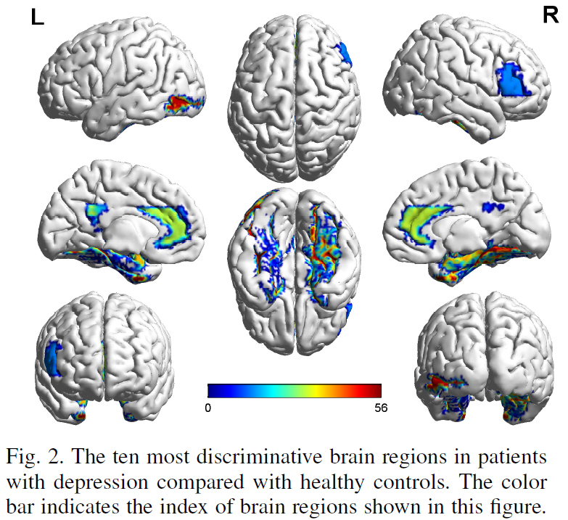
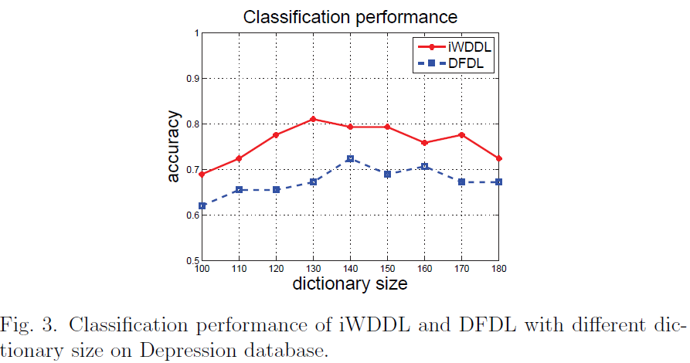
Experimental Results
Notes:
The discriminative brain regions of depression disorder detected by our method, shown in Fig. 2, are consistent with previous studies. We find that the discriminative brain regions are mainly involved in the limbic-cortical networks, such as hippocampus, parahippocampal gyrus, anterior cingulate cortex, posterior cingulate cortex, middle frontal gyrus and amygdala.

Slide 34
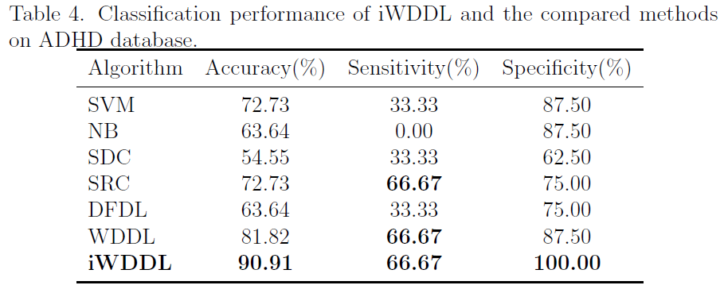
Experimental Results
Notes:
The discriminative brain regions of depression disorder detected by our method, shown in Fig. 2, are consistent with previous studies. We find that the discriminative brain regions are mainly involved in the limbic-cortical networks, such as hippocampus, parahippocampal gyrus, anterior cingulate cortex, posterior cingulate cortex, middle frontal gyrus and amygdala.

Slide 35
Experimental Results
Notes:
The discriminative brain regions of depression disorder detected by our method, shown in Fig. 2, are consistent with previous studies. We find that the discriminative brain regions are mainly involved in the limbic-cortical networks, such as hippocampus, parahippocampal gyrus, anterior cingulate cortex, posterior cingulate cortex, middle frontal gyrus and amygdala.

Slide 36
Summary
In this paper, we proposed a depression disorder classification method named WDDL, in which classification is based on representation error.
Weighting scheme was introduced into the representation model to improve classification performance.
Experimental results demonstrated the effectiveness and improved classification performance of WDDL.

Slide 37
Outline
Tech. III
Myself
Cloud-based Trust Computing
Cloud-based Machine Learning for Medical Data
Cloud-based Tele-health
4
Notes:
At the end of this course, you should be able to:
Understand the characteristics and operation of WiFi networks (IEEE 802.11 WLANs)
…and MANETs as well as Bluetooth PANs
Deploy WLAN Hotspots
Use basic wireless network monitoring and analysis tools to troubleshoot and assess performance of WLANs
Tools
Tools
Utilize network modeling and simulation tools to plan WLAN networks
Understand possible attacks against WLANs, classify attacks and threats on Bluetooth PANs, and be able to properly secure WLANs(802.1x port-based authentication)

Slide 38



Telehealth
Increasing Demands
Doctors/patients have more new demands for Telehealth.
Lower cost
Faster response
Smarter
More powerful
Broader applicable
More reliable
More accurate
Notes:
Then many efforts have been focused on the network congestion.
Congestion results in long delays,
wasted resources due to dropping packets,
and the possibility of a congestion collapse [1].
In the router congestion control schemes, the Active Queue Management (AQM) is an effective method in Internet routers
to enhance congestion control, and
to achieve tradeoff between link utilization and delay.
Method: The de facto standard, Random Early Detection (RED) AQM scheme, and most of its variants use queue length as congestion indicator to trigger packet dropping. Such as: RED, PDRED, PIRED, Adaptive RED, and so on.

Slide 39


Solution
Solution: use Cloud Telehealth.
This is where Cloud Telehealth comes in.
Notes:
Then many efforts have been focused on the network congestion.
Congestion results in long delays,
wasted resources due to dropping packets,
and the possibility of a congestion collapse [1].
In the router congestion control schemes, the Active Queue Management (AQM) is an effective method in Internet routers
to enhance congestion control, and
to achieve tradeoff between link utilization and delay.
Method: The de facto standard, Random Early Detection (RED) AQM scheme, and most of its variants use queue length as congestion indicator to trigger packet dropping. Such as: RED, PDRED, PIRED, Adaptive RED, and so on.

Slide 40


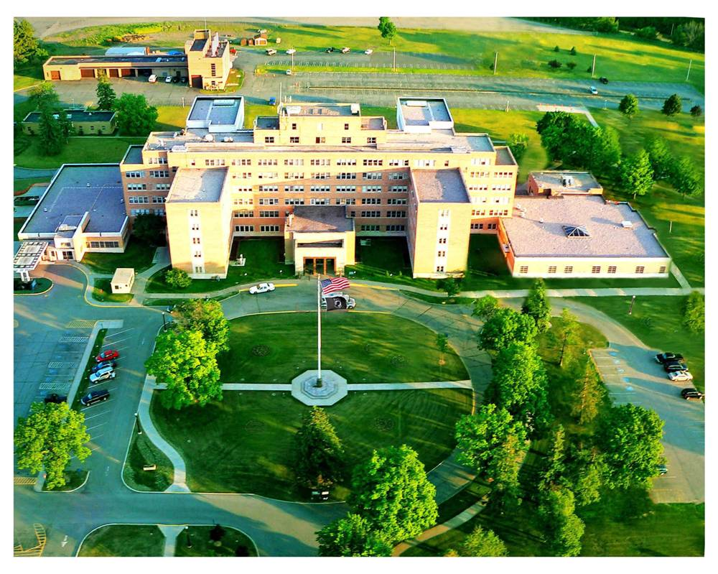



Cloud Telehealth Model
Patient/Sensor Data
Medical Center &
Management nodes
Patient
Doc
Manager/Gateway
Data center
Servers
Servers & Data Center
Notes:
40
If we know the sensors case, then In this area, the sensing area covers
This part. And we find that area is not covered by sensor, then we should
Use plane to monitor that area, or drop more sensors to that area
2) fire-cracker, airplane-bomber, tank, soldier, missile, satellite
Talk about characteristic of network: sensor is deployed from airplane month ago,
may die. Unattended. No battery replacement,..

Slide 41
Cloud Telehealth
3 key points of Cloud Telehealth
  Speed: is a race against time and death, people expect highly on the speed.
  Accuracy: take a long time if we want to get high accuracy results with complex algorithms. simple and rough methods, fast response -- unreliable results
  Reliability: sometimes, keep the interactions between patients and doctors continuously even if the host server is busy, especially telesurgecy.
Notes:
Speed. In the medical field, the demand for speed never lets up. This is a race against time and death. So people has expected highly on the speed of information transmission, characteristic data comparison.
Accuracy. The results of the comparison should be accurate. But, it would take a long time if we want to get high accuracy results with complex algorithms. Inversely, based on simple and rough methods, fast response will produce unreliable results. In this situation, both doctors and patients put forward high requests to task allocation and rational utilization of Cloud resources.
Reliability. We should keep the interactions between patients and doctors continuously even if the host server is busy. For example, during the telesurgery. Or we can just make predictions and avoid the busy path, busy servers or dead servers.
For the tele-surgery, servers support the service to the Doc, and this session should be stable.
If this server is not stable, this session is at risk. Then the manager can monitor these servers, and predict the service performance. If this service is not good enough, manager can find a backup server for this session.

Slide 42
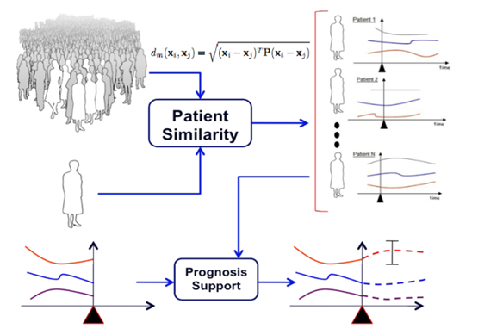
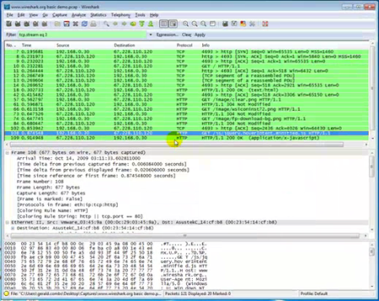

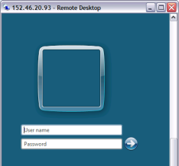

Cloud Telehealth: Case 1
Manager looks for proper servers, servers check big data in distributed centers to compare patient info. with historical big data in time.
Tasks of comparing big data should be assigned to multiple Servers. Guarantee each server finish its own tasks in time.
How to do?
HB (lead to large flow and use too many bandwidth resources) or FD…
Submit jobs
Assign jobs
Return to users
Manager node
Return results
Patients
Servers
Medical Cen. & Manager
Notes:
Then many efforts have been focused on the network congestion.
Congestion results in long delays,
wasted resources due to dropping packets,
and the possibility of a congestion collapse [1].
In the router congestion control schemes, the Active Queue Management (AQM) is an effective method in Internet routers
to enhance congestion control, and
to achieve tradeoff between link utilization and delay.
Method: The de facto standard, Random Early Detection (RED) AQM scheme, and most of its variants use queue length as congestion indicator to trigger packet dropping. Such as: RED, PDRED, PIRED, Adaptive RED, and so on.

Slide 43

Cloud Telehealth: Case 2
For the telesurgery, Server supports the service for Doctor, and this session should be stable.
If Server is not stable, this session/patient is at risk. Manager should choose/monitor these servers, and predict the service performance.
If this service is not good enough, manager can find a backup server.
Guarantee Servers support Doctor with Info (images) by Manager continuously.
Manager
Patients
Servers
Medical Cen./Doctor
Notes:
Then many efforts have been focused on the network congestion.
Congestion results in long delays,
wasted resources due to dropping packets,
and the possibility of a congestion collapse [1].
In the router congestion control schemes, the Active Queue Management (AQM) is an effective method in Internet routers
to enhance congestion control, and
to achieve tradeoff between link utilization and delay.
Method: The de facto standard, Random Early Detection (RED) AQM scheme, and most of its variants use queue length as congestion indicator to trigger packet dropping. Such as: RED, PDRED, PIRED, Adaptive RED, and so on.

Slide 44
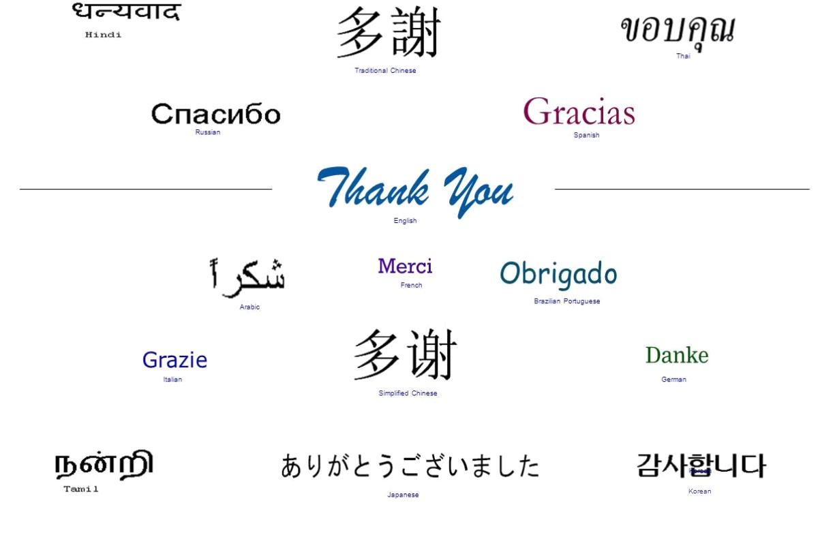
Questions?

Slide 45


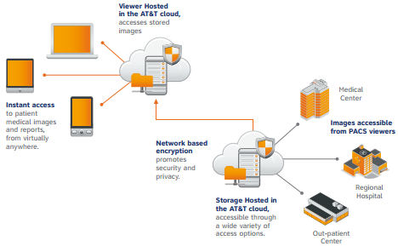



Cloud Telehealth Applications
AT&T Medical Imaging
IBM Smarter Healthcare
IBM Healthcare Solutions for Cities
Notes:
Then many efforts have been focused on the network congestion.
Congestion results in long delays,
wasted resources due to dropping packets,
and the possibility of a congestion collapse [1].
In the router congestion control schemes, the Active Queue Management (AQM) is an effective method in Internet routers
to enhance congestion control, and
to achieve tradeoff between link utilization and delay.
Method: The de facto standard, Random Early Detection (RED) AQM scheme, and most of its variants use queue length as congestion indicator to trigger packet dropping. Such as: RED, PDRED, PIRED, Adaptive RED, and so on.

Slide 46
Cloud Telehealth vs Traditional Telehealth
Advantages
  Has the medical center + massive amounts of medical data in widely located servers:
  Get more reliable results by comparing and analyzing huge database, Has immense computing power and nearly limitless storage.
  Doctors can make more accurate diagnosis effectively, and get more assistance.
  For doctors and hospitals, can broaden scope of their services and reduce cost. the vulnerable group may benefit from Telehealth.
  Also can enhance their medical capabilities.
Notes:
Then many efforts have been focused on the network congestion.
Congestion results in long delays,
wasted resources due to dropping packets,
and the possibility of a congestion collapse [1].
In the router congestion control schemes, the Active Queue Management (AQM) is an effective method in Internet routers
to enhance congestion control, and
to achieve tradeoff between link utilization and delay.
Method: The de facto standard, Random Early Detection (RED) AQM scheme, and most of its variants use queue length as congestion indicator to trigger packet dropping. Such as: RED, PDRED, PIRED, Adaptive RED, and so on.

Slide 47
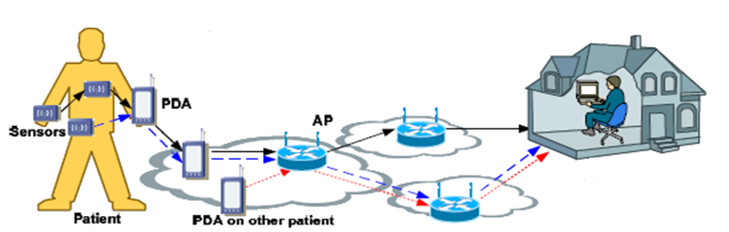
Telehealth
What is Traditional Telehealth?
  Telehealth is delivery of health-related services via telecommunications technologies, it is a service based on advanced technologies solution for both doctors and patients.
  For patients, get necessary assistance in emergency
  For doctors, Telehealth can help them to make a diagnosis
Notes:
Then many efforts have been focused on the network congestion.
Congestion results in long delays,
wasted resources due to dropping packets,
and the possibility of a congestion collapse [1].
In the router congestion control schemes, the Active Queue Management (AQM) is an effective method in Internet routers
to enhance congestion control, and
to achieve tradeoff between link utilization and delay.
Method: The de facto standard, Random Early Detection (RED) AQM scheme, and most of its variants use queue length as congestion indicator to trigger packet dropping. Such as: RED, PDRED, PIRED, Adaptive RED, and so on.

Slide 48
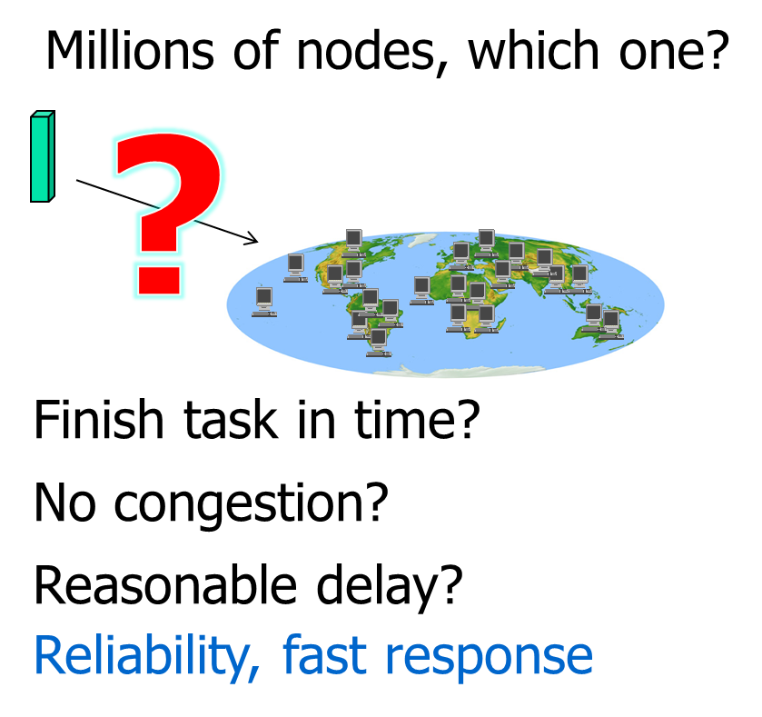
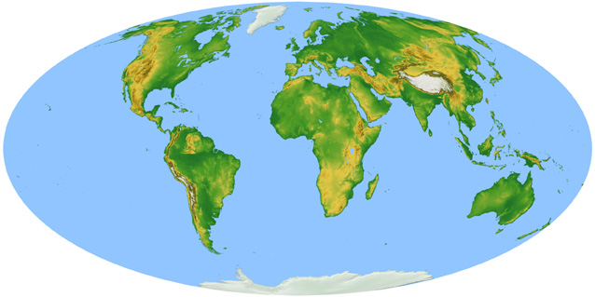
Challenge: Case 1
Input
Historical big data is distributed and split into lots of smaller independent runs
Servers around the world request those work units
Each server compares related historical big data with this patient info. and get its result.
Merge all results into statistic result for Doctor.
Output

