Slide 1
Another Year, Another Petabyte
A Look Into the Laureate Institute for Brain Research’s CephFS Deployment

Slide 2
Research At LIBR
Neuroscience-based, clinical and developmental research:
  To develop neuroscience-based individually predictive assessments.
  To develop novel brain-body based interventions
    Focus: mood, anxiety, addiction, or eating disorders.
  To use experimental systems to quickly test assessments and interventions.

Slide 3
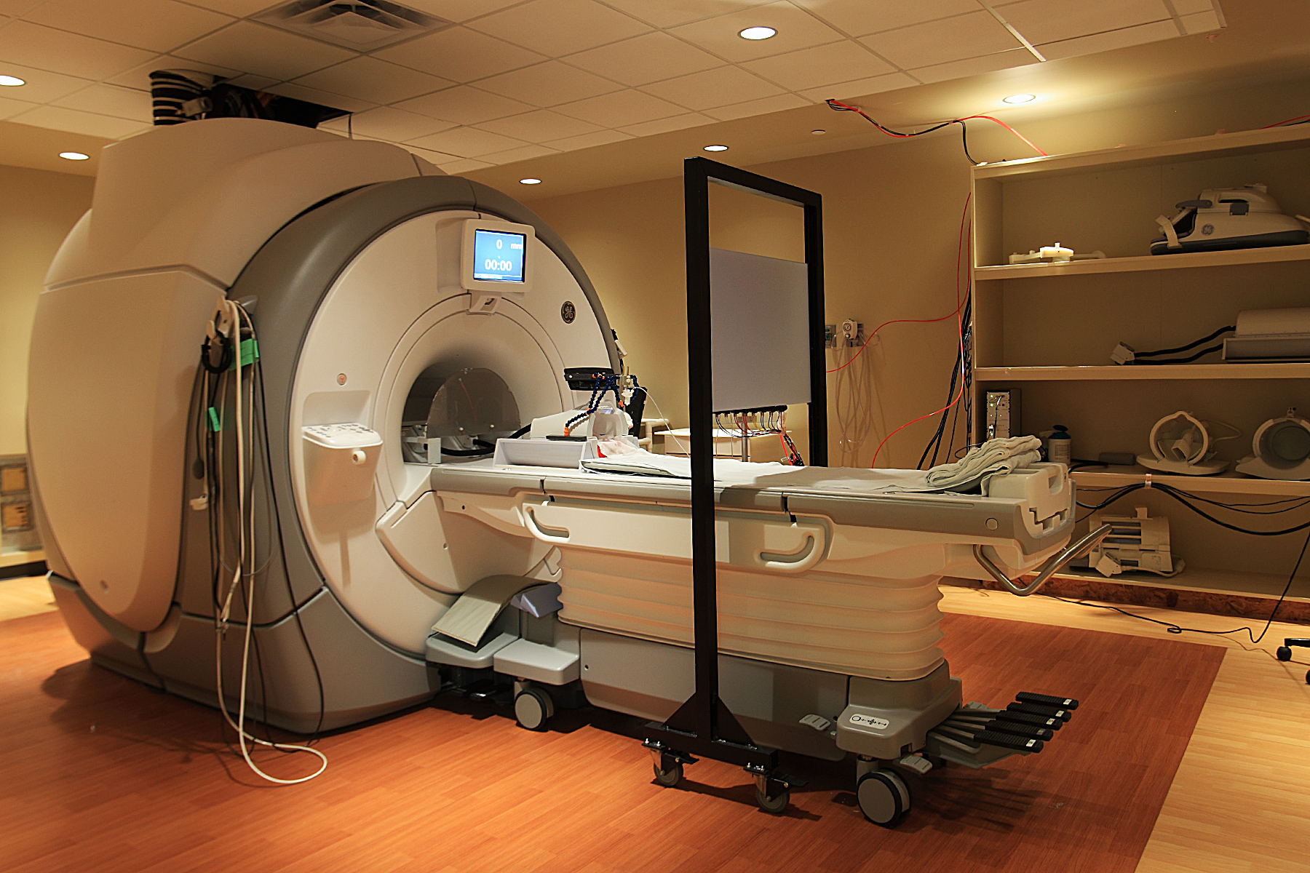
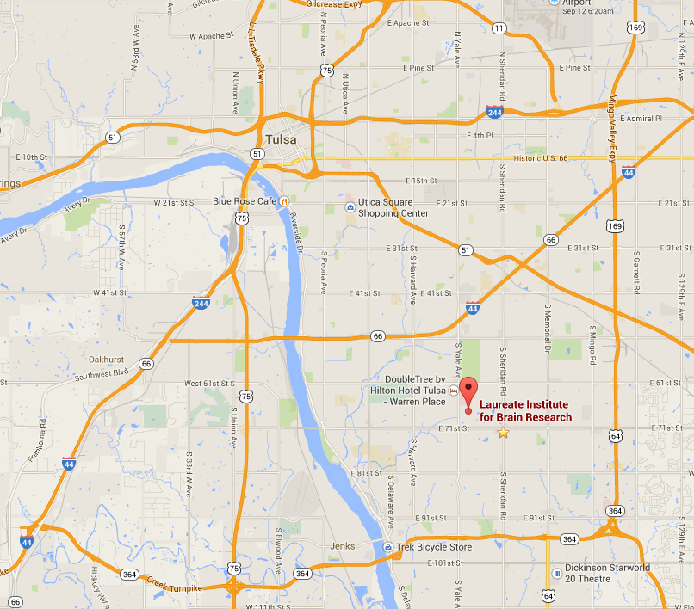

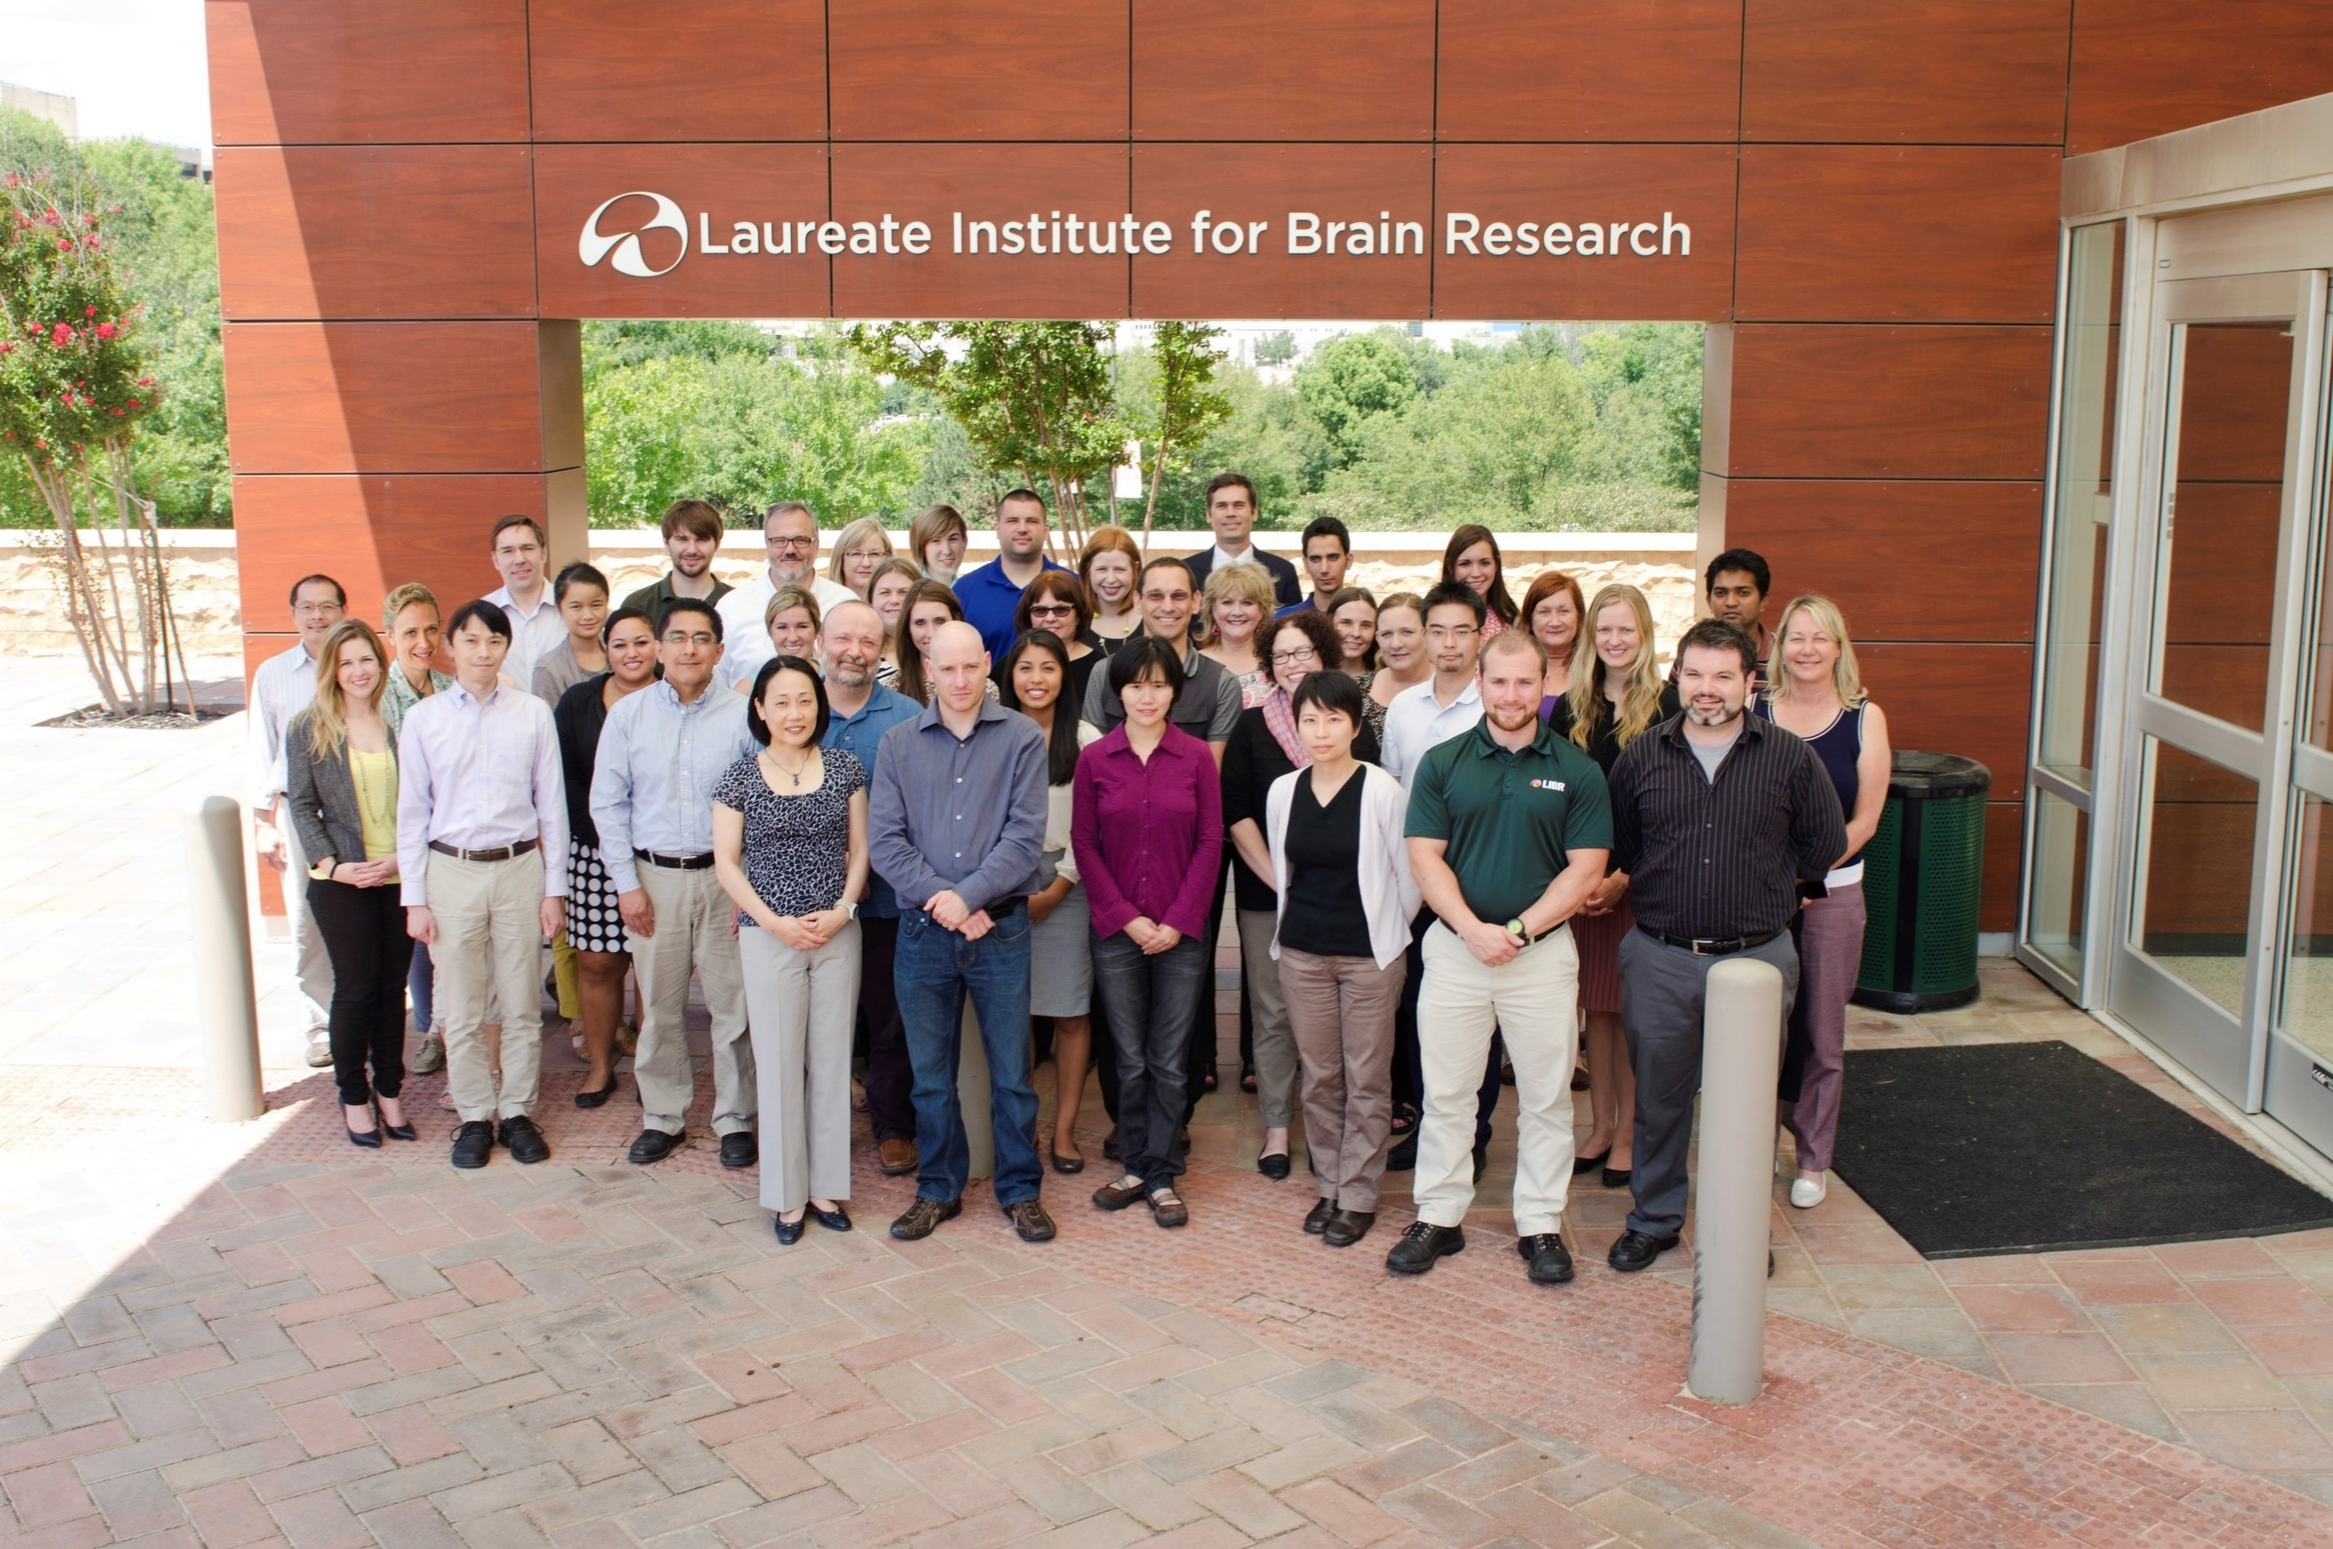
The LIBR Facilities
Notes:
-2x 3 tesla MRI machines with 128 channel head coils
-approximately 70 full and part-time employees
-located in Tulsa (Main St. Francis Complex)

Slide 4
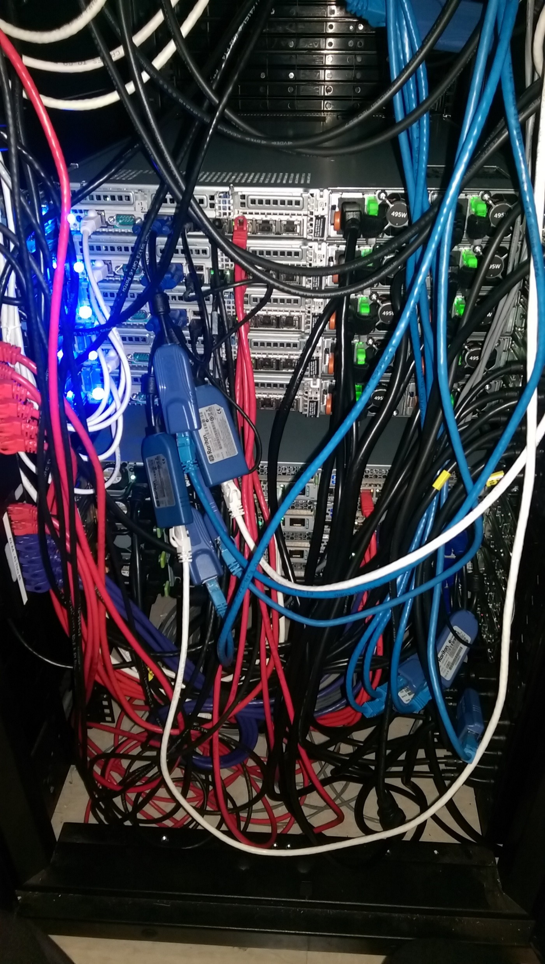
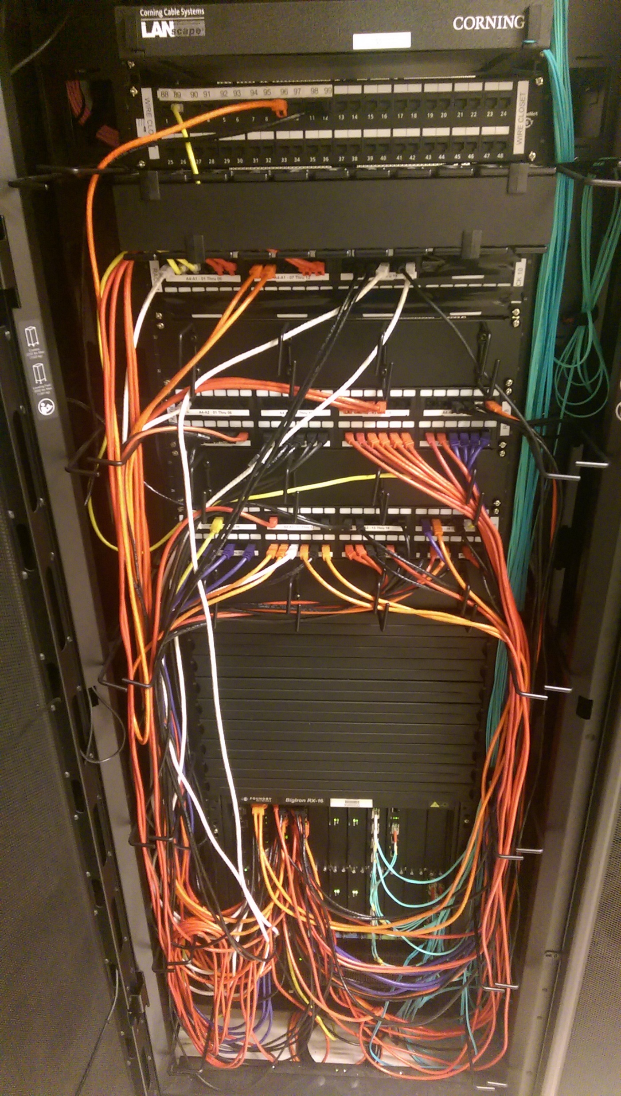
My Inheritance
November 2015
Foundry Big Iron RX-16
EMC Isilon
Oracle ZFS Appliance
Spectra Logic Black Pearl
Zmanda
Spectra Logic T950e
Notes:
-Network Core RX-16 purchased in 2008
-Isilon (2012) 128TB raw
-Oracle (2008) 400TB raw
-Tape archive (2014) wasn’t being used
-Zmanda (2014) backups
-t950 (2014) 920 tapes (9x LTO-6 drives)

Slide 5

The Problem
Depletion of compute/storage resources
Neglected infrastructure
$$$
Inadequate performance
Unreliable
Notes:
-90% used in tier 2
-80% used in tier 1
-aging infrastructure not being replaced
-network design lacked redundancy and was 1gig nearly everywhere
--including to hypervisors and compute nodes
-no formal cap ex IT budget
-the oracle storage would throw random “file not found” errors

Slide 6
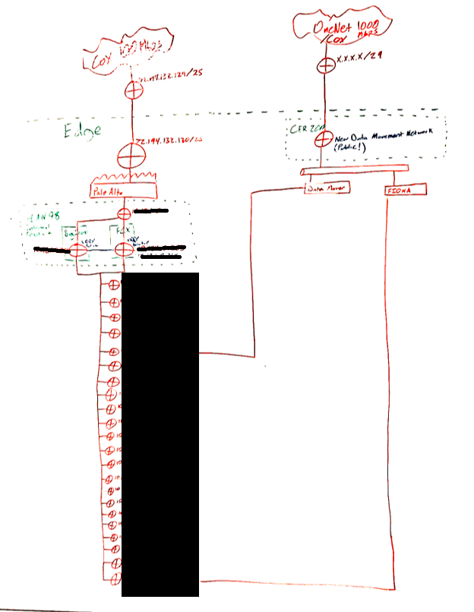
Network Diagram
Notes:
-Roughly 30 networks
-Existence and purpose completely undocumented

Slide 7
Options Presented to Stakeholders
January 2016
Scale existing Isilon with used hardware ($1.3M)
Panasas ($630k)
Oracle ZFS ($450k)
DiY scale-out + Network Refresh ($450k)
  Lustre
  Gluster
  Ceph
  OrangeFS
Notes:
Each project was quoted out to provide 500TB of usable space by the end of 2017.

Slide 8
Slow Progress
February – Approval to develop pilot
June – pilot approval
July – Pilot Equipment arrival
July – CEO approval to proceed
Notes:
February
-Following too many meetings management was convinced that I wasn’t completely insane.
-Make the smallest possible hardware purchase necessary to get a real world look at a Ceph
-The hardware purchased would be able to be adapted to fit into a full cluster if we moved forward
-Before purchasing, I’d have to have a backup plan in case Ceph failed. This meant having a design for adapting our Ceph cluster to either Lustre or Gluster.
May
-I’m ready to move forward
July
-This was annoying
-Had to wait for meetings with CEO who doesn’t work fulltime with the organization

Slide 9
Board of Directors Approval
August 2016
Placed Order
Brings configuration to:
  8x OSD (24 disk + 2 journal NVMe per node)
    1.1PB raw
  3x MON
  2x MDS

Slide 10
Ceph Design
8x OSD nodes
  256 GB RAM
  2x Intel S3610 for OS
  24x 6TB Enterprise SATA (24 slot chassis)
  2x Intel P3700
  2x Xeon 2660 V4
    28x2.0GHz
  Dual 40GB Ethernet Adapter (Mellanox ConnectX-4)
Notes:
-more ram more better
-roughly 10GB RAM per disk
--plenty of capacity for caching and non-normal ceph operations
-little more than 1 physical core per osd process
-1x nvme for filesystem journal per 12 disks
-we’ll talk about the network decision later

Slide 11
Ceph Design (Cont…)
2x MDS + 3x MON node
  128 GB RAM
  2x Intel S3610 for OS
  2x Xeon 2643 V4
    12x3.4GHz
  Dual 40GB Ethernet Adapter (Mellanox ConnectX-4)
Notes:
-original thought was to build monitor and mds nodes same for easy provisioning
-probably going to scale back ram on the monitor nodes and add it to the mds, though it isn’t necessary at the moment
-went with fewer faster cores because mds processes aren’t very parallel

Slide 12
Other Hardware and Software
Brocade VDX
Spectra Logic
Zabbix
ELK
Nfs-ganesha
Samba
Notes:
-Ethernet vs infiniband decision
-Spectra Logic T950 + Black Pearl for backup and archive
--facilitated by Ceph’s extended attributes

Slide 13
Blocksize | MB/sec Read | MB/sec Write
4kB | 6.845013 | 3.221325
16kB | 27.43865 | 13.15497
64kB | 103.5336 | 51.65482
256kB | 424.7271 | 193.5268
1MB | 1576.252 | 782.4383
4MB | 2619.374 | 3095.016

Slide 14
Blocksize | MB/sec Read | MB/sec Write
4kB | 3.806028 | 3.780054
16kB | 16.70582 | 13.7856
64kB | 78.28159 | 57.00872
256kB | 449.4757 | 203.128
1MB | 1790.493 | 791.1742
4MB | 6158.911 | 3112.754

Slide 15
Blocksize | MB/sec Read | MB/sec Write
4kB | 3.873204 | 1.331676
16kB | 14.99433 | 4.84942
64kB | 60.45827 | 20.30537
256kB | 233.5852 | 81.27407
1MB | 771.8829 | 327.8226
4MB | 1773.824 | 1301.71

Slide 16
Blocksize | MB/sec Read | MB/sec Write
4kB | 3.082823 | 1.739016
16kB | 12.86438 | 5.733841
64kB | 56.4047 | 23.77207
256kB | 280.6739 | 81.68536
1MB | 820.0511 | 320.4626
4MB | 2427.747 | 1260.187

Slide 17
Current Status
The Good
  Power users and their projects migrated
    No more “file not found” errors
    Computation > 100% faster
  Backups running and performing nicely
  Everybody is fairly happy
  Very resilient to many types of failure
The Bad
  Snapshots

