Slide 1
High Performance and long term retention that doesn’t break the bank
Neal Wingenbach – RSM for HPC
Seth Ingram – RSM, Tom Yenny – RSM QSS (Disk)
Notes:
It’s likely that the audience has a preconceived notion of Quantum from our rich history. I would encourage you not to change this title, as it emphasizes our broader scope and sets the stage for a broader conversation

Slide 2
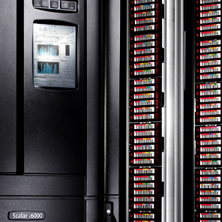
The Demanding Markets We Serve
ENTERPRISE BACKUP
CYBERSECURITY
OIL & GAS
GENOMICS
FEDERAL
ENTERPRISE ARCHIVE
SURVEILLANCE
GEOSPATIAL
UNIVERSITIES
CORPORATE VIDEO
Notes:
This is about emphasizing our heritage and our specialized focus. It can also be a great spot to tell a couple brief customer stories that are relevant for the particular meeting (see the customer story module).

Slide 3
Applying The Right Technology At The Right Time
HPC
Workflow
ACQUIRE
ANALYZE
RETAIN
STORNEXT 5 DATA MANAGEMENT LAYER
PRIMARY
SECONDARY
ARCHIVE
CLOUD
Tiers and Sites
Notes:
At the core is our approach to aligning storage tiers with the right stage of workflow across the data lifecycle.
It’s about applying the right technology at the right time, guided by the workflow

Slide 4
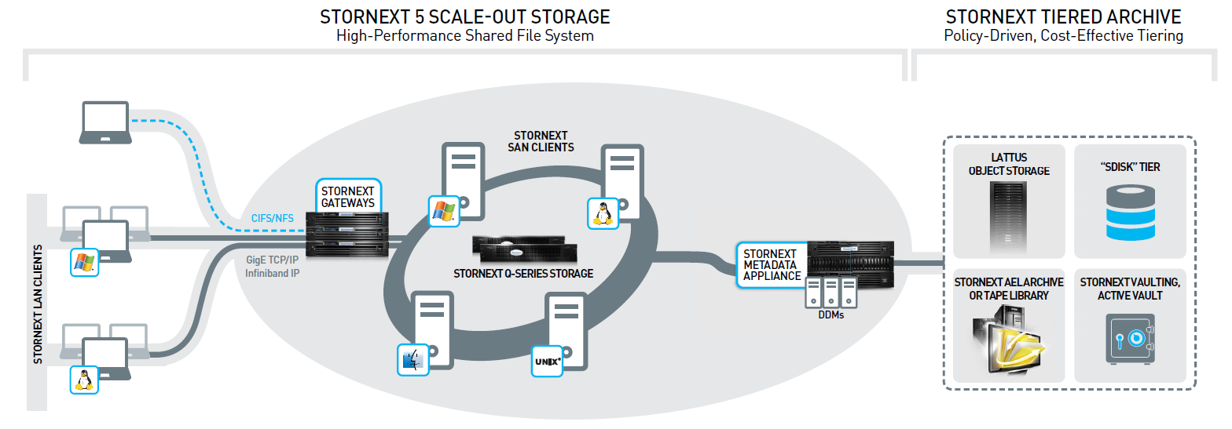
File System, Tape, and Nearline Disk: StorNext
Q-CLOUD
Enable comprehensive workflow sharing
Leverage technology tiers of choice

Slide 5
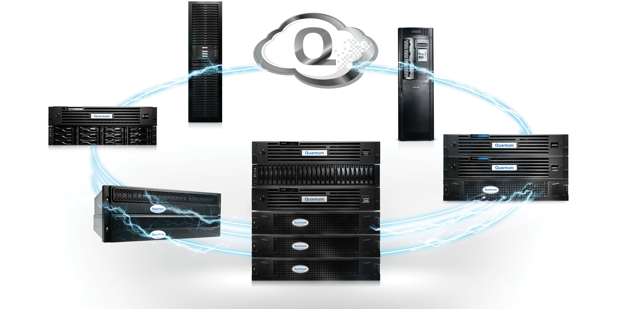
Quantum Tiered Storage Portfolio
Lattus Object Storage
Scalar LTO Libraries
Q-Cloud Services
DXi Deduplication
Artico NAS Archive
StorNext Scale-out Storage
QXS Hybrid Storage
End-to-end storage portfolio that powers your strategic applications
Notes:
The result is a complete end-to-end storage portfolio, including
A complete scale-out storage portfolio for workflows from M&E to Surveillance to HPC.
A complete archive portfolio, including our latest innovation called Artico, a NAS archive system
To industry-leading tape, where Quantum has been recognized as the market share leader for many years running
To a new DXi deduplication portfolio with industry-leading performance
To a set of cloud services for data protection and archiving
To a set of primary storage offerings with great price-performance value

Slide 6
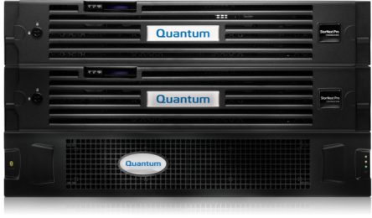
ARTICO – Intelligent NAS Archive
Tiering policies deliver the best TCO for sharing, storing, and protecting data
Comprehensive choice of archive targets
Scales from small environments to petabytes
Primary Storage
Artico NAS Appliance
NAS
Lattus
Object Storage
Q-Cloud Archive
Scalar Tape
Library
Add intelligent data movement from existing primary storage

Slide 7
HYBRID Storage

Slide 8
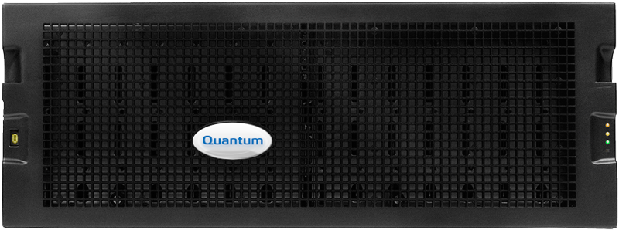
Quantum QXS Hybrid Storage Family
QXS-3 Series
Arrays optimized for virtualized IT workloads
Up to
40,000 iops
Entry
QXS-4 Series
Storage targeting vertical markets: Telco, M&E, Big Data Analytics,
High-Performance Computing
Up to
100,000 iops
Optimized
Performance
QXS-6 Series
High-Performance Computing
Up to
200,000 iops
High
Performance
Real-time, autonomic data placement (tiering) for balancing performance and costs are critical
Capacity HDD
Performance HDD
SSD

Slide 9
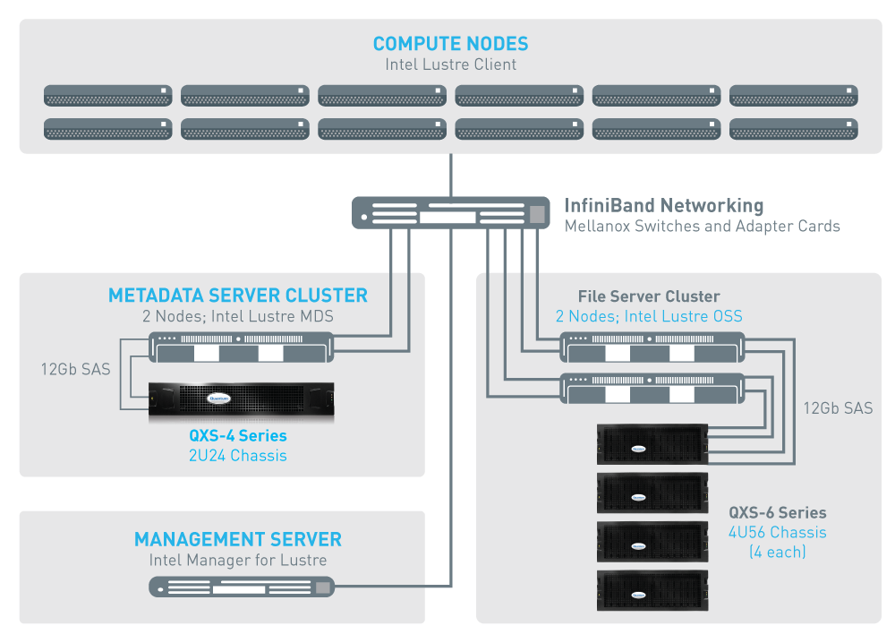
Customer Example: HPC Customer
SITUATION / PROBLEM
New HPC customer, wanting to avoid Panasas and EMC/Isilon lock-in. Needs 1PB with tremendous read, good write throughput and ability to expand. Concerned with Lustre ramp.
CUSTOMER SOLUTION
QXS-656 with 224x6TB LFF drives, Linear Configuration, 22 Object Storage Targets + QXS-456 with 8x900GB LFF HDDs
BUSINESS BENEFITS
Extreme read performance of 12GBps
Trusted partner with Intel IEEL™
Simple setup and management

Slide 10
Quantum Tiered Storage Portfolio
Lattus Object Storage
Scalar LTO Libraries
Q-Cloud Services
DXi Deduplication
Artico NAS Archive
StorNext Scale-out Storage
QXS Hybrid Storage
End-to-end storage portfolio that powers your strategic applications
Notes:
The result is a complete end-to-end storage portfolio, including
A complete scale-out storage portfolio for workflows from M&E to Surveillance to HPC.
A complete archive portfolio, including our latest innovation called Artico, a NAS archive system
To industry-leading tape, where Quantum has been recognized as the market share leader for many years running
To a new DXi deduplication portfolio with industry-leading performance
To a set of cloud services for data protection and archiving
To a set of primary storage offerings with great price-performance value

