Slide 1

XSEDE’s Campus Bridging Project
Jim Ferguson
National Institute for Computational Sciences
jwf@utk.edu

Slide 2
What is XSEDE?
eXtreme Science and Engineering Discovery Environment
$121M project funded by NSF to fund all the “non-infrastructure” things needed to support users and their science on NSF-funded hardware awards. Computational science support, Training, Helpdesk, Education, Allocations, Accounting, etc.

Slide 3
Campus Bridging
Mission: Facilitate the use of national cyberinfrastructure in aggregate
What’s this mean?
  Tools to facilitate management of data and jobs between campuses and national CI
  Sharing best practices from XSEDE
  Documentation, consulting, site visits

Slide 4
More on Campus Bridging
The goal of campus bridging is virtual proximity
The biggest problems:
  Not enough CI resources available to most researchers
  When you go from your campus to the national cyberinfrastructure it can feel like you are falling off a cliff! That’s why you need bridging….
Campus bridging is a major priority within XSEDE

Slide 5
XSEDE Campus Bridging Initiatives
Software for Clusters
  Repository of XSEDE software packages
  Rocks Roll including XSEDE software packages for new cluster installations
Tools for data and job management
  Globus Transfer
  Unicore 6 workflow manager

Slide 6
Campus Bridging services today
XSEDE Compatible Basic Cluster https://portal.xsede.org/web/xup/knowledge-base/-/kb/document/bdpe
XSEDE National Integration Toolkit (XNIT) https://portal.xsede.org/knowledge-base/-/kb/document/bdwx
Globus Online – File transfer utility, approved for use on XSEDE resources. Globus Connect Server also through engineering process.
UNICORE – https://portal.xsede.org/software/unicore

Slide 7
Rocks XCBC
Tools to allow cluster administrators to create a XCBC: the “XSEDE-compatible basic cluster”
Make your cluster more XSEDE-like
  Eases later transition to larger CI
  Saves investment on development and updates
  Allows researchers to benefit from XSEDE-wide training
  Teaches students interested in HPC to operate within a context similar to XSEDE

Slide 8
XCBC notes
Maintained and updated by XSEDE Campus Bridging
New cluster? Rocks ISOs can automate much of the work of setting up a basic XSEDE-like cluster

Slide 9
XNIT: XSEDE National Integration Toolkit
For those with an existing cluster you like
Install YUM Repo locally, manage XSEDE packages as if they were part of the OS
a collection of recommended Red Hat Package Manager (RPM) packages
packages included in the repository are specific versions and builds of scientific, mathematical, and visualization applications

Slide 10
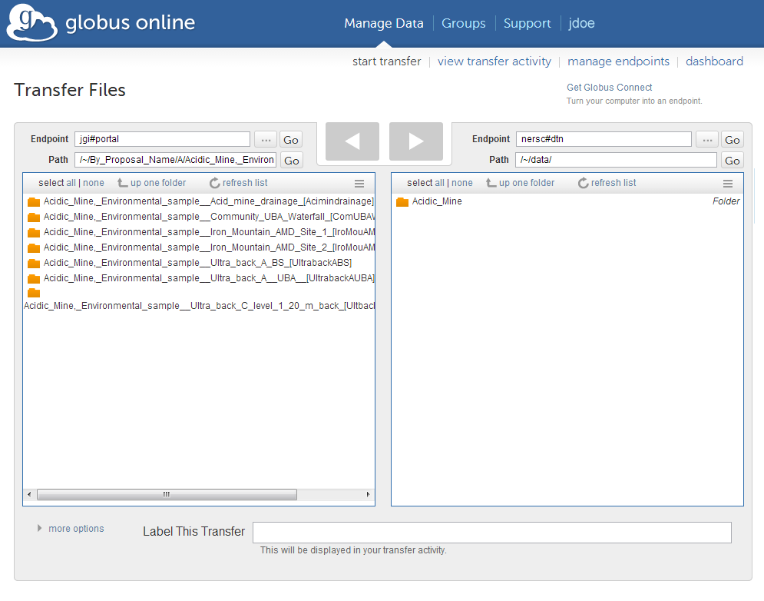
GlobusOnline
Simple, Dropbox-like interface for moving files back and forth
Can be configured to connect between multiple computers and larger resources to transfer data
      Screenshot courtesy of http://genome.jgi.doe.gov/pages/portal_apps.jsf

Slide 11
Globus Online (cont.)
Set a transfer and start it, walk away, and get a notification when the transfer is complete
During Q3 2013, GlobusOnline allowed researchers to move over 630TB of data onto the XSEDE network
  That’s just ONE direction!

Slide 12
UNICORE
Production CI suite
Installation instructions at https://portal.xsede.org/software/unicore
Server and Client software available, web interface under development
Under continued development at Forschungszentrum Jülich in Germany, one developer on XSEDE team.

Slide 13
Summary
Campus bridging aims to create virtual proximity between researchers and resources
Streamlining and easing the analysis part of research
Ways we are working to bridge research computing:
  XSEDE-compatible basic cluster stack (XCBC)
  XSEDE National Integration Tookit (XNIT)
  Full-time dedicated support and consulting
  GlobusOnline
  UNICORE

Slide 14
For more information…
https://www.xsede.org/campus-bridging
http://cb-repo.iu.xsede.org/xsederepo/
https://www.xsede.org/globus-online
campusbridging@xsede.org
+1 (812) 318-2872 (M-F, 9a-5p Eastern)

Slide 15


