Slide 1

Supporting Collaborative Cyberinfrastructure for Ground-breaking Research
Oklahoma Supercomputing Symposium -2014
Irene M. Qualters
Division Director, Advanced Cyberinfrastructure
National Science foundation
September 24, 2014

Slide 2
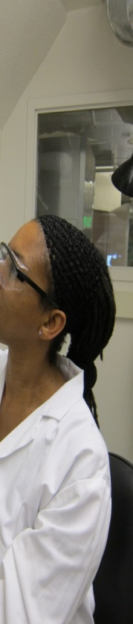

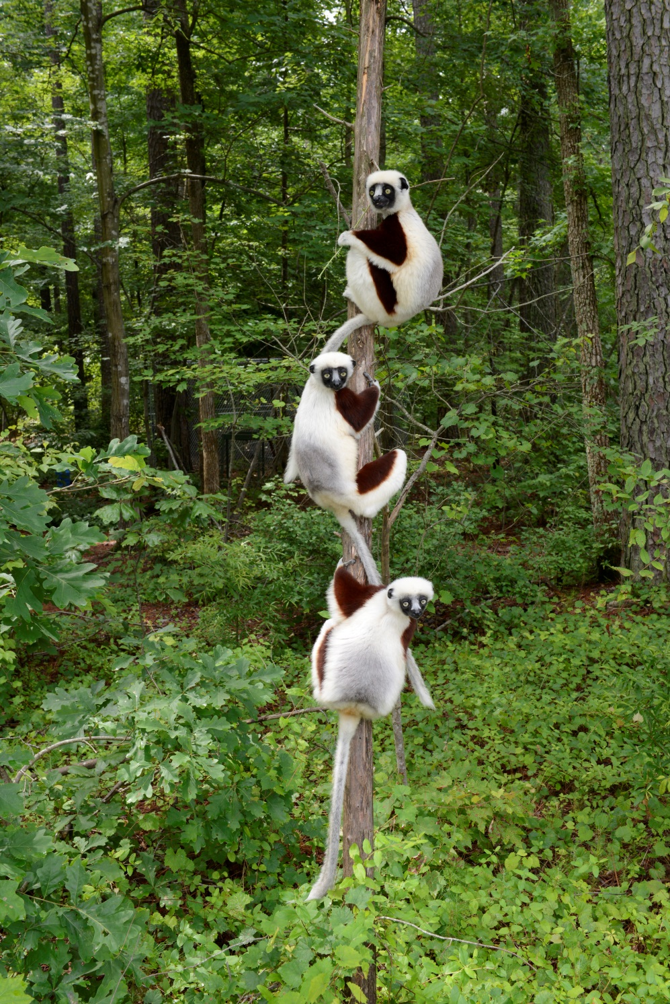
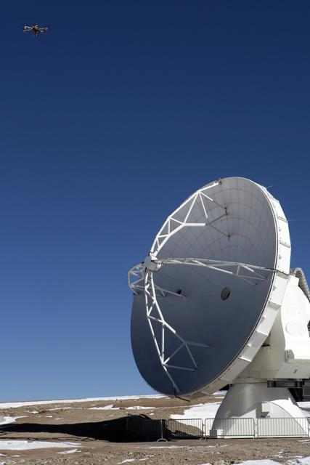

NSF Core Mission: Fundamental Research
Fundamental Research
$7.1
billion FY 2014 research budget
11,000
awards funded
94%
funds research, education and related activities
2,000
NSF-funded institutions
50,000
proposals
300,000
NSF-supported
researchers
Notes:
Planet: http://www.nsf.gov/news/news_summ.jsp?cntn_id=129831&org=MPS&from=news

Slide 3
NSF Embraces an Expansive View of Cyberinfrastructure Motivated by Research Priorities and the Scientific Process
Organizations
Universities, schools
Government labs, agencies
Research and Medical Centers
Libraries, Museums
Virtual Organizations
Communities
Expertise
Research and Scholarship
Education
Learning and Workforce Development
Interoperability and operations
Cyberscience
Scientific Instruments
Large Facilities, MREFCs,,telescopes
Colliders, shake Tables
Sensor Arrays
- Ocean, environment, weather,
buildings, climate. etc
Discovery
Collaboration
Education
Data
Databases, Data repositories
Collections and Libraries
Data Access; storage, navigation
management, mining tools,
curation, privacy
Computational Resources
Supercomputers
Clouds, Grids, Clusters
Visualization
Compute services
Data Centers
Networking
Campus, national, international networks
Research and experimental networks
End-to-end throughput
Cybersecurity
Software
Applications, middleware
Software development and support
Cybersecurity: access,
authorization, authentication
Notes:
ACI through its engagement with CLG, with directorates, has developed visions, initiatives, plans and activities within its four key thrust areas.
Individually clusters have taken on the issues of sustainability, LWD, point to point activities (e.g. LIGO and computing, International collaborations in data and software, security for facilities.
ACI has demonstrated the ability to work effectively in a multidisciplinary fashion with other directorates.
It should not move to advance the collaborative capabilities of cohesiveness of NSF’s CI.

Slide 4
NSF Cyberinfrastructure (ACI) is part of the CISE Directorate and responsible for NSF-wide CI coordination and support
Computer and Information Science and Engineering (CISE)
Division of
Advanced Cyberinfrastructure (ACI)
Division of
Computing and Communications Foundations (CCF)
Division of
Computer and Network Systems (CNS)
Division of
Information and Intelligent Systems (IIS)
Data
Algorithmic
Foundations
Computer Systems Research
Cyber-Human Systems
High Performance Computing
Communication and Information Foundations
Networking Technology and Systems
Information Integration and Informatics
Core
Research
Programs
Networking/ Cybersecurity
Software and Hardware Foundations
Robust Intelligence
Software

Slide 5
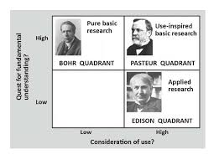
ACI Mission: To support advanced cyberinfrastructure to accelerate discovery and innovation across all disciplines
Coordination role across NSF
Interagency & international partnerships
Supports Use-inspired Cyberinfrastructure
  Research and Education
  Science and Engineering
Inherently multidisciplinary with strong ties to all disciplines/directorates
Biological Sciences Directorate
Mathematical & Physical Sciences
Directorate
Computer and Information Science and Engineering Directorate
Social, Behavioral & Economic
Sciences Directorate
Education & Human Resources Directorate
Geosciences Directorate
Engineering Directorate

Slide 6
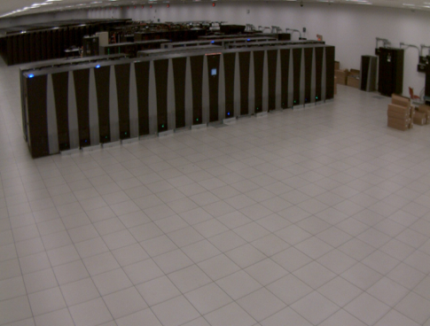
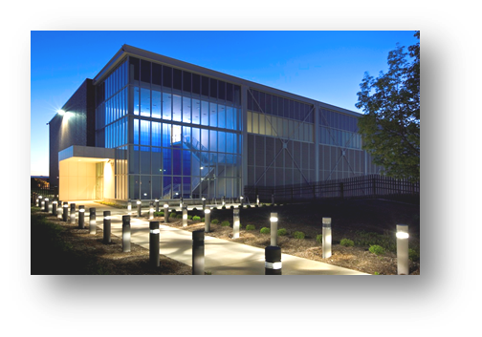
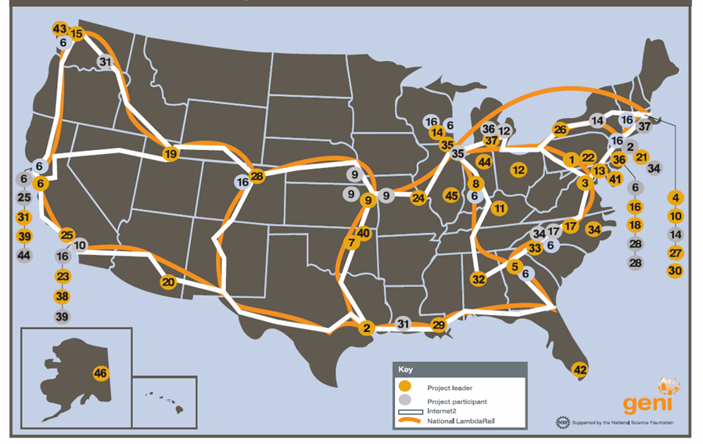
Advanced Cyberinfrastructure
(ACI)
Supports the research, development, acquisition and provision of state-of-the-art CI resources, tools, and services:
Advanced Computing: Provide open-science community with state-of-the-art computational systems ranging from loosely coupled clusters to large scale HPC instruments; develop a collaborative and innovative scientific computational environment.
Data: Support scientific communities in the use, sharing and archiving of data by creating building blocks to address community needs in data infrastructure.
Networking and Cybersecurity: Invest in campus network improvements and re-engineering to support computational and data science. Support transition of cybersecurity research to practice.
Software: Transform innovations in research and education into sustained software resources (shared tools and services) that are an integral part of cyberinfrastructure.
Notes:
Advanced cyberinfrastructure will accelerate the pace of discovery and innovation in all areas of inquiry.
Cross- and inter-disciplinary research is pushed by advances in IT and pulled by the expanding complexity, scope, and scale of global priorities.

Slide 7
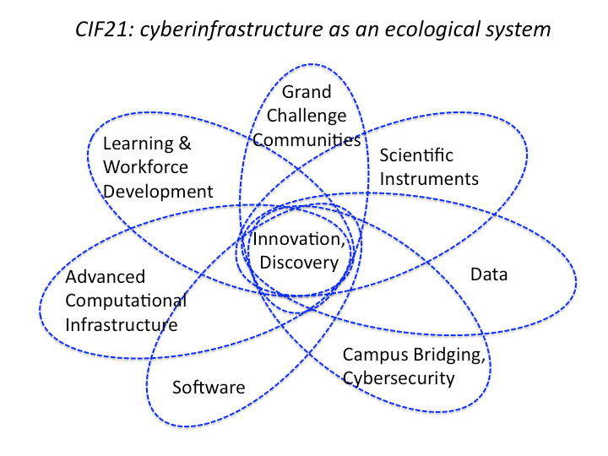
ACI FY2013 investments reflect a balance across Cyberinfrastructure categories consistent with
NSF’s CI strategy (CIF21)
Total ACI FY 2013 funding = $210,772,572

Slide 8

Ubiquity in mobile devices, social networks, sensors, advanced computing and instruments have created a complex data-rich environment ripe for new scientific and engineering advances
Credit: Christine Daniloff/MIT
An artist's conception of the National Ecological Observatory Network (NEON) depicting its distributed sensor networks, experiments and aerial and satellite remote sensing capabilities, all linked via cyberinfrastructure into a single, scalable, integrated research platform for conducting continental-scale ecological research. NEON is one of several National Science Foundation Earth-observing systems.
Credit: Nicolle Rager Fuller, National Science Foundation

Slide 9
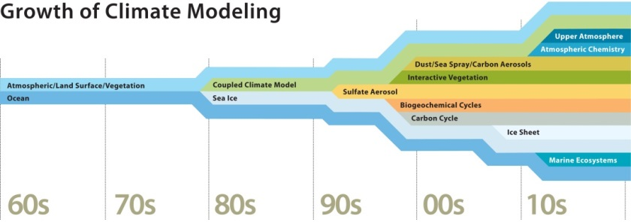
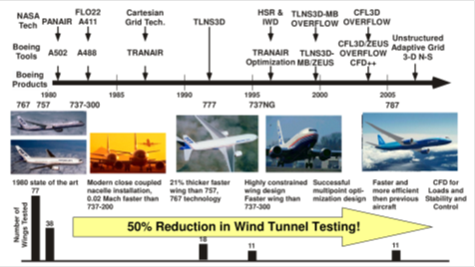
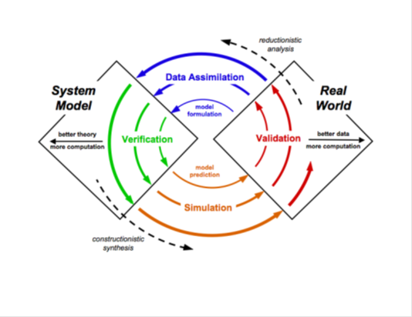
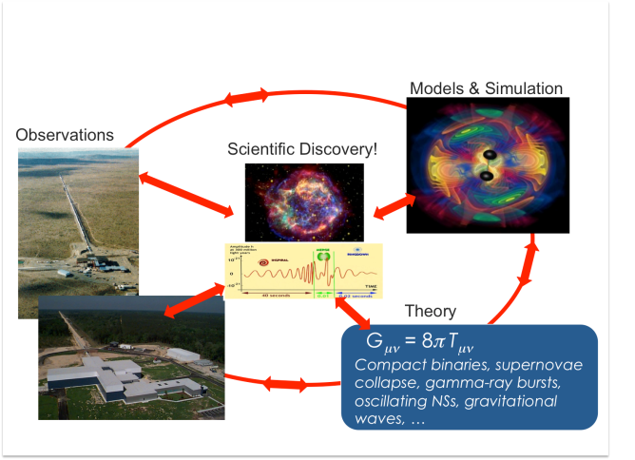
As models and workflows become more complex and data-rich, collaborative and capable CI is transformative to results and conduct of science
Computational Fluid Dynamics
Copyright: University Corporation for Atmospheric Research
This work by ©UCAR is licensed under a Creative Commons Attribution-NonCommercial 3.0 Unported License
Gravitational Wave Astrophysics
Interplay of Big Data & Big Simulation
Across many disciplines:
Molecular Dynamics
Cosmology & Astronomy
Plasma Physics
Quantum Chromo Dynamics
Seismic Hazards
Gene Sequence Analysis
Materials Science
Iterative, computationally intense process of model formulation and verification in earthquake forecasting
Notes:
New opportunities to:
Increase synergies between data-producing instruments and simulations in real-time
Grow existing infrastructure and introduce novel capabilities directly responding to the emerging grand challenge needs derived from new and existing communities
Develop a more holistic ecosystem of data, computation, networking and learning workflows
Create new, large-scale, next-generation data resources and relevant analytic techniques
Document Title: Growth of climate modeling (DI02411)
Description: The complexity of global climate models has increased enormously over the last four decades, as shown in this graphic. The most powerful models, such as the Community Earth System Model (developed by scientists at the Department of Energy and NCAR with colleagues at other organizations), now have the capability of simulating a broad range of atmospheric processes, such as the impact of marine ecosystems on the atmosphere.

Slide 10
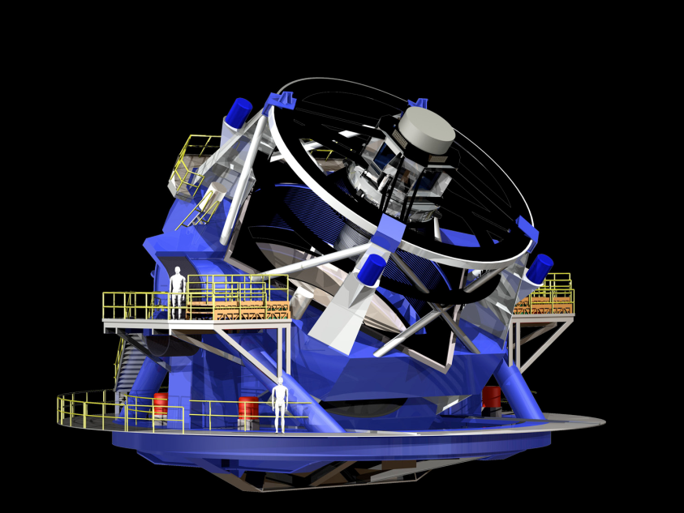
  LSST: A Deep, Wide, Fast, Optical Sky Survey
  8.4m telescope optical (ugrizy) 0.5-1% photometry (sys)
  3.2Gpix camera 2 x 15sec exp / 2sec read
  Location: Cerro Pachon, Chile Construction Start: July 2014 First Light: May 2019 Operations: May 2022

Slide 11
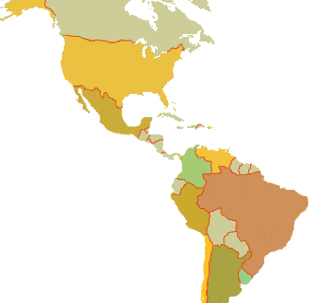
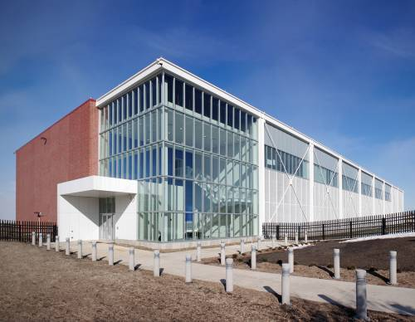

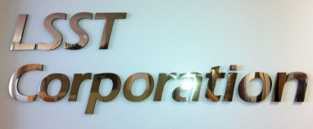
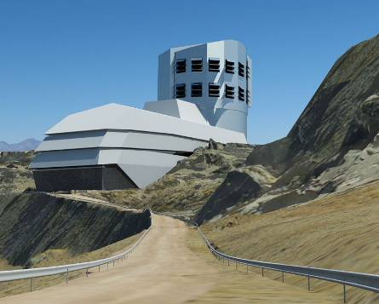
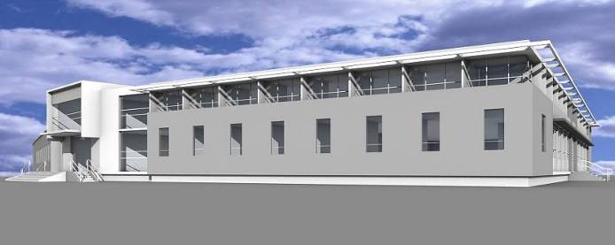
LSST Cyberinfrastructure for Data Capture
French Site
Processing Center
  Data Release Production
HQ Site
  HQ Facility
  Observatory Management
  Science Operations
  Education and Public Outreach
Archive Site
Archive Center
  Alert Production
  Data Release Production
  Calibration Products Production
  EPO Infrastructure
  Long-term Storage (copy 2)
Data Access Center
  Data Access and User Services
Summit Site
Summit Facility
Telescope and Camera
Data Acquisition
Crosstalk Correction
Base Site
Base Facility
Long-term storage (copy 1)
Data Access Center
  Data Access and User Services
Document LDM-129

Slide 12
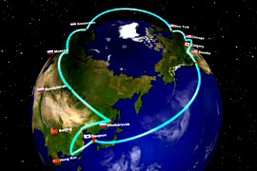
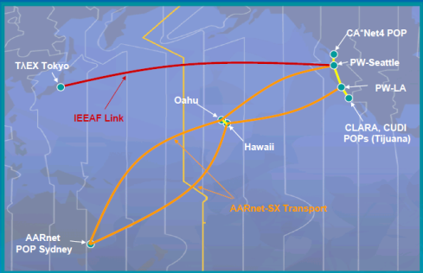
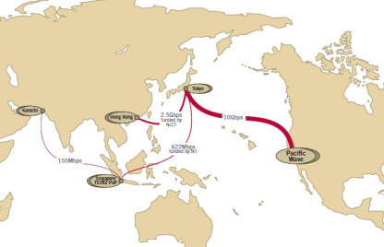
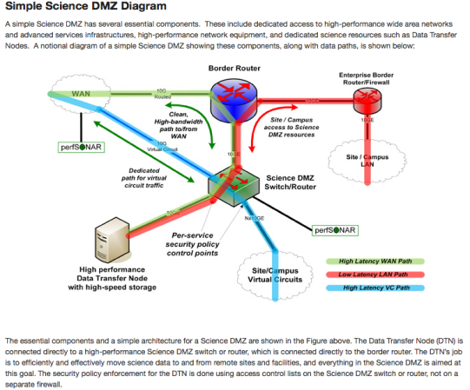
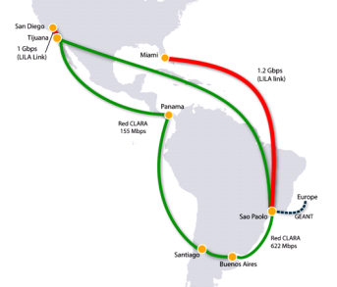
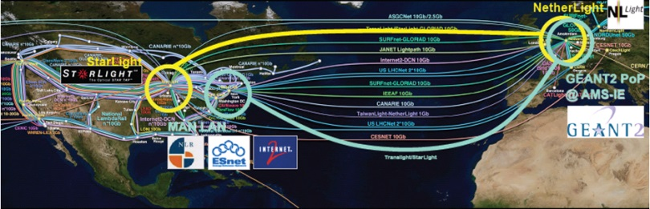
Networking Programs in CISE/ACI
Fundamental enabling layer and CI underpinning
CC-NIE (Campus Cyberinfrastructure – Network Infrastructure and Engineering): joint with CNS
  Campus networking upgrades (10/100Gbps), re-architecting and innovation
  Directly responsive to ACCI 2011 Task Force report
IRNC – International R&E Network Connections: joint with OIA/ISE
  Scientific discovery as a global collaborative endeavor
  Provide network connections linking U.S. research with peer networks in other parts of the world
  Stimulate the deployment and operational understanding of emerging network technology and standards in an international context

Slide 13
Networking/Cybersecurity -ACI
  Program Directors: Kevin Thompson, Anita Nikolich
  Campus Networking (CC-NIE/CC*IIE programs)
    Campus Cyberinfrastructure – Infrastructure, Innnovation and Engineering (CC*IIE) – campus network upgrades (10/100Gbps), re-architecting
    Continue re-forming campus (inter/intra) networking (entering year 4)
    Address needs of smaller schools, regional coordination, science VO’s
  International networking (IRNC program) NSF 14-544
    Scientific discovery as a global endeavor
    Stimulate deployment of emerging network technology and standards in an international context
  Secure and Trustworthy Cyberspace (SaTC) NSF 14-599
    .ACI provides funding for transition to practice (TTP) projects (7 awards in FY2014)
  Emerging Cybersecurity Topics
    Secure and Trustworthy Software
    Data Provenance and Privacy
    Coherent Cybersecurity for national CI
      Center for Trustworthy Scientific Infrastructure: PI, Von Welch; Indiana University

Slide 14
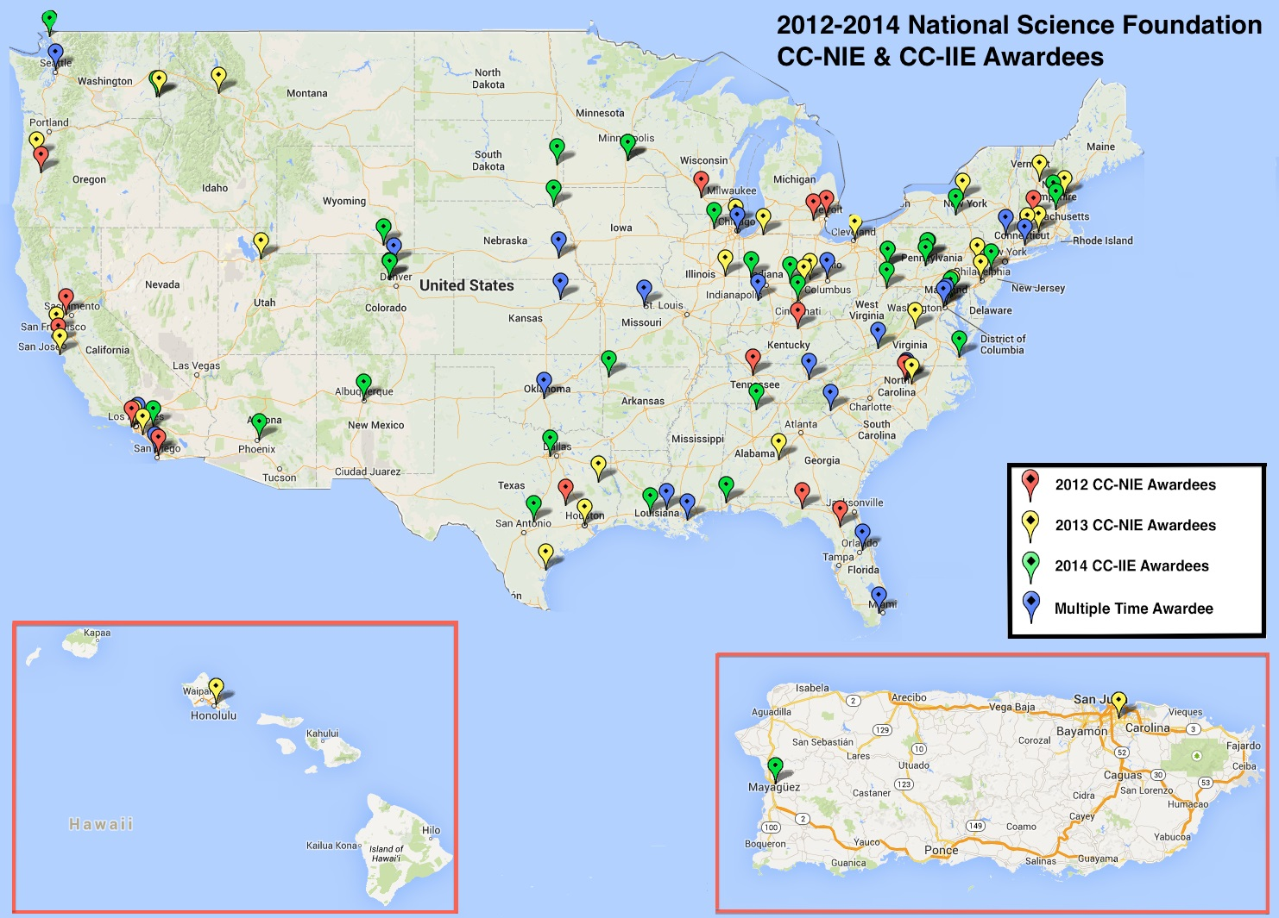
Transforming the national CI foundation to increase capacity and innovative capability

Slide 15

Overall Data Investment Framework
Policy
Foundational Research in algorithms and technologies to store, access, manage and derive knowledge from large, distributed and diverse data sets
Collaborative cyberinfrastructure to curate, analyze, archive and access high value research data
Advance education and workforce development
Promote interdisciplinary collaboration and community building

Slide 16
ACI data focused CI - “A view towards the horizon”
Program Directors: Bob Chadduck, Amy Walton; Irene Lombardo
Catalyze transformative , interdisciplinary science, & engineering, research & education through robust, shared, resources, services, & collaborations across diverse communities;
Advance capabilities for robust shared resources to capture, manage, curate, analyze, interpret, archive & share data at unprecedented scales & complexities enabling discoveries in all areas of inquiry and from all facilities, ranging from the campus to the national level;
Ensure data focused research cyberinfrastructure remains aligned with research priorities and at the forefront of technologies necessary to advance fundamental science and engineering;
Ensure that the future workforce of scientists, engineers & educators are equipped with skills to make use of, and build the next generation of data focused cyberinfrastructure
Contribute to advances in comprehensive policies for data, software, publications & other digital outputs
Notes:
derived from “Goals for Data in Science and Engineering”
https://www.nsf.gov/cise/aci/cif21/DataVision2012.pdf

Slide 17
FY13 data awards - towards an integrated portfolio for science, engineering, research & education
HPC Acquisition Data Resource -TACC “Wrangler” – PI: Dan Stanzione; Novel data intensive CI resource advancing open science communities;
DIBBS – Data Information Building Blocks
  NCSA “Brown Dog” – PI: Kenton McHenry; CI enabled tools & capabilities advancing integration of large unstructured, heterogeneous data collections as resources in science;
  Purdue “Geospatial data Analysis Building Blocks” (GABBs)– PI: Carol Song; Novel HUBzero CI capabilities enabling creation & sharing of geospatial data & modeling tools;
  JHU “SciServer” (formerly “SkyServer”) – PI: Alex Szalay; Novel data focused CI responsive to interests in multiple large scientific data sets serving broad science communities;
  PSC “Exacell” - PI: Mike Levine – Novel data focused CI building blocks & hardware supporting large scale analytics enabling data intensive scientific research;
Research Collaboration Network – RPI “Research Data Alliance” – PI: Fran Berman; data focused CI pilots, tools and capabilities developments responsive to global communities’ interests to share & access data catalyzing science advances;
Big Data - UChicago “Open Flow Enabled Hadoop over Local & Wide Area Clusters” PI: Bob Grossman – integration of OpenFlow enabled switches with Hadoop to handle more efficiently large data flows arising in data intensive computing

Slide 18
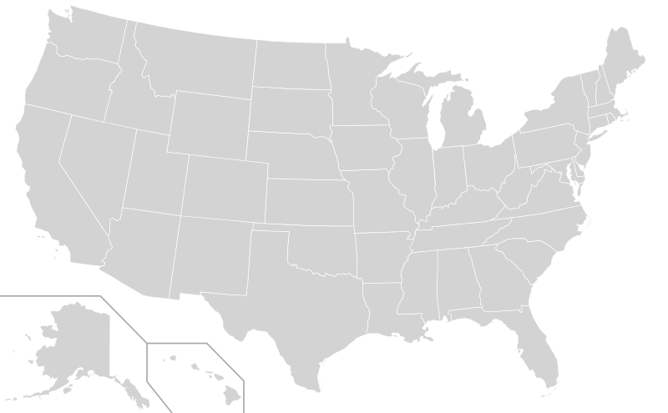
Data Infrastructure Building Block (DIBBs)
2014 Awards:
2013 Awards:
Pilot Demonstration
Conceptualization
Early Implementation
Implementation

Slide 19
DataONE (Observation Network for Earth) Award
William Michener, University of New Mexico
DataONE has interacted with almost 20,000 users; has 462,00 objects, 150,000 datasets and about 200,000 metadata records. It is a large and diverse community with 55 partnering projects and 300 plus collaborators with 170 plus persons that are active in the DataONE Users Groups as well as many and varied training workshops.
DataONE has been actively involved with federal, local government agencies, as well as industry (such as Microsoft), contributed to OSTP lead safety data challenge to improve public preparedness & emergency response, advised OSTP on Big Data challenges, advised the Federal Reserve Bank regarding data focused cyberinfrastructure topics.
Notes:
The DataONE Data (Observation Network for Earth) award was made in 2009 for five years as a cooperative agreement. The main goals of the program were to:
Address the growing environmental, social, and technological challenges facing the world, scientists, educators, librarians, resource managers, and the public need for open, persistent, robust, and secure access to well-described and easily discovered Earth observational data.
DataONE was designed to provide the distributed framework, sound management, and reliable technologies which enable the long-term preservation of diverse and complex multi-scale, multi-discipline, and multi-national science data.
DataONE would initially emphasize multi-disciplinary observational data collected by biological (genome to ecosystem) and environmental (atmospheric, ecological, hydrological, and oceanographic) scientists, national and international research networks, and environmental observatories.
However, the DataONE structure was not domain-specific, and would be extended to serve a broader range of science domains both directly and through interoperability with other DataNet deployments.

Slide 20
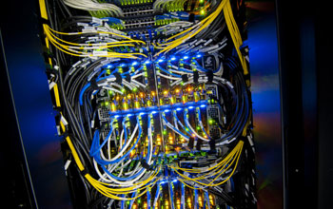
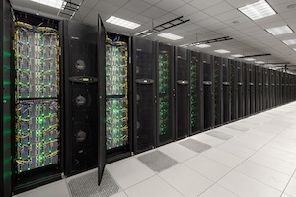

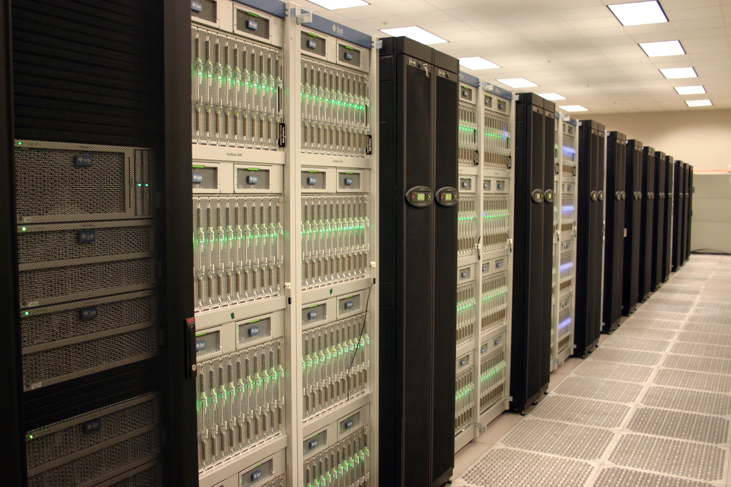
Advanced Computational Infrastructure
Program Directors: Rudi Eigenmann, Bob Chadduck; (Tom Russell, Irene Lombardo)
Anticipate and invest in diverse and innovative national scale shared resources, outreach and education complementing campus and other national investments
Leverage and invest in collaborative flexible “fabrics” dynamically connecting scientific communities with computational resources and services at all scales (campus, regional, national, international)
Gordon
Image Credit: UC San Diego Publications/Erik Jepsen
Blue Waters
Stampede
Image Credit: TACC
Ranger
Image Credit: NCSA/University of Illinois
Image Credit: TACC, The University of Texas at Austin
Notes:
These investments of course complement NSF’s existing investments in computational resources at all scales - campus, regional, national, international…
Blue Waters at UIUC: National resource offering large allocations for a small number of diverse and significant research projects across the U.S. In particular, provides access to Highly Scalable Heterogeneous System to enable investigations of computationally challenging problems that require sustained PetaFlops (10¹⁵) performance and/or large data and large memory
Stampede/UT at Austin: Expands the range of data intensive computationally-challenging science and engineering applications that can be tackled with current national resources
Introduces new heterogeneous architecture based on Intel MIC to science and engineering research communities
Stampede will accommodate larger simulations (both in fidelity and number of ensemble members) producing more accurate forecasts, and permit more research groups during critical response efforts
Stampede will also enable genetic relationships (phylogeny) to be determined for all green plant species (~500,000) on Earth to gain insights into the origins of drought resistance or nitrogen efficiency in plants, which could then be bred into future food crops
XSEDE: Enables campus, regional and national resources and communities to interact transparently
Flexibly adds diverse, distributed, heterogeneous sets of digital resources (computers, data, instruments) that change over time
Provides ACI support (management and user), education and outreach to science community
Develops computational science and education expertise and capabilities across a broad set of disciplines

Slide 21
In 2012 NSF published its Advanced Computing Infrastructure Vision and Strategy (12-051)
Vision: Position and support the entire spectrum of NSF-funded communities at the cutting edge of advanced computing technologies, hard, and software
Strategies
  Foundational research to full exploit parallelism and concurrency
  Application research and development in use of high-end computing resources
  Building, testing and deploying resources into a collaborative ecosystem
  Development of comprehensive education and workforce programs
  Development of transformational and grand challenge communities

Slide 22
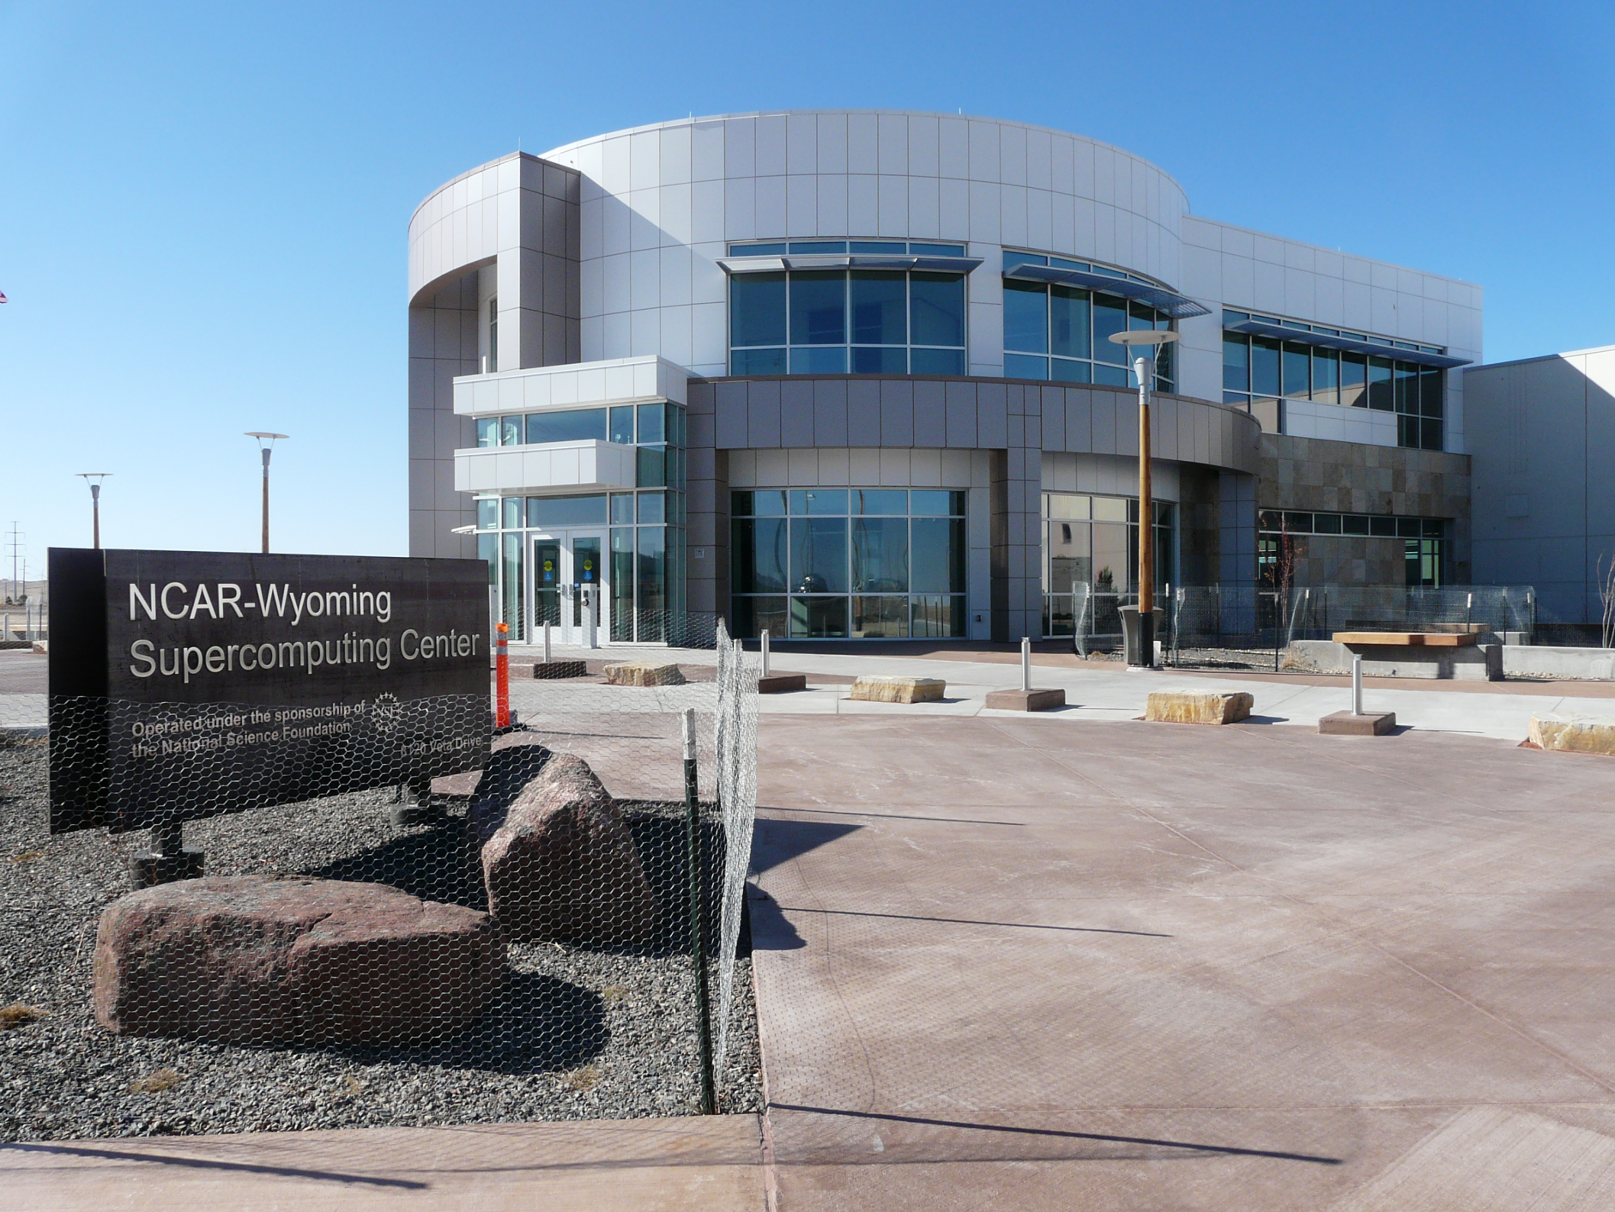
In 2013 Major Computing NSF Computing Infrastructure deployed
Image Credits: NCSA/University of Illinois
Blue Waters, UIUC
Image Credit: TACC
Stampede, UT Austin
NCAR/ Wyoming Supercomputing Center
Notes:
Blue Waters, UIUC
A national resource offering large allocations for a small number of diverse and significant research projects across the U.S. In particular, provides access to Highly Scalable Heterogeneous System to enable investigations of computationally challenging problems that require sustained PetaFlops (10¹⁵) performance and/or large data and large memory.
Stampede, UT at Austin
Empowers America's scientists and engineers to interactively share advanced computational resources, data and expertise to further research across scientific disciplines. Expands the range of data intensive computationally-challenging science and engineering applications that can be tackled with current national resources.
Introduces new heterogeneous architecture based on Intel MIC to science and engineering research communities.
Stampede will accommodate larger simulations (both in fidelity and number of ensemble members) producing more accurate forecasts, and permit more research groups during critical response efforts.
Stampede will also enable genetic relationships (phylogeny) to be determined for all green plant species (~500,000) on Earth to gain insights into the origins of drought resistance or nitrogen efficiency in plants, which could then be bred into future food crops
NCAR-Wyoming “Yellowstone” Supercomputing Center
Provides advanced computing services (through Yellowstone) to Earth systems scientists nationwide.
Features a massive data archiving system (Globally Accessible Data Environment, GLADE) that will enable the storage of historical climate records and other scientific datasets.

Slide 23
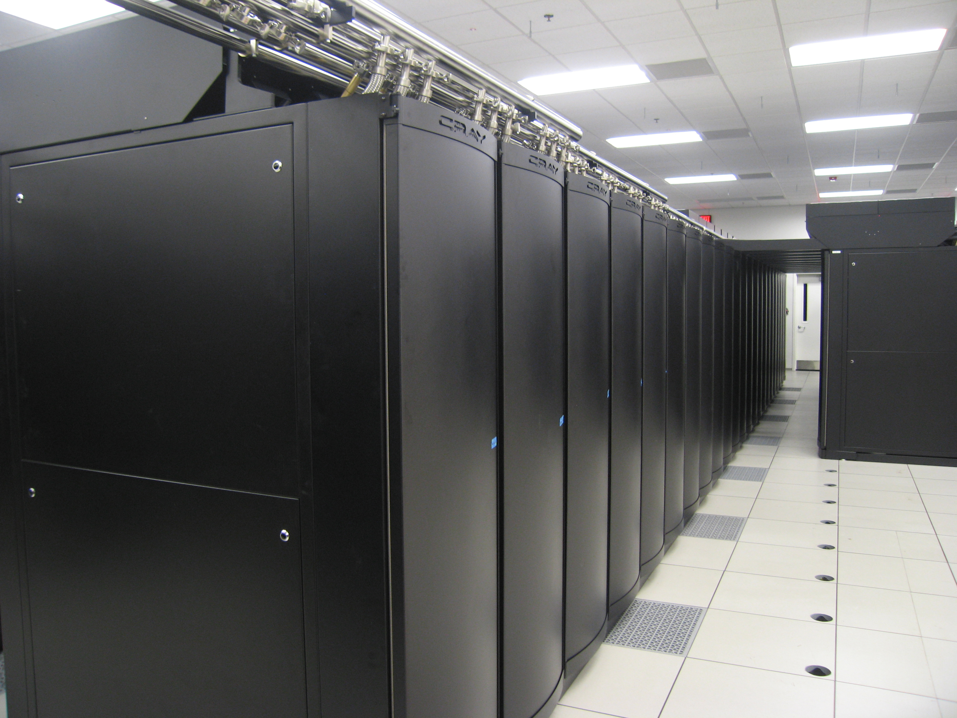
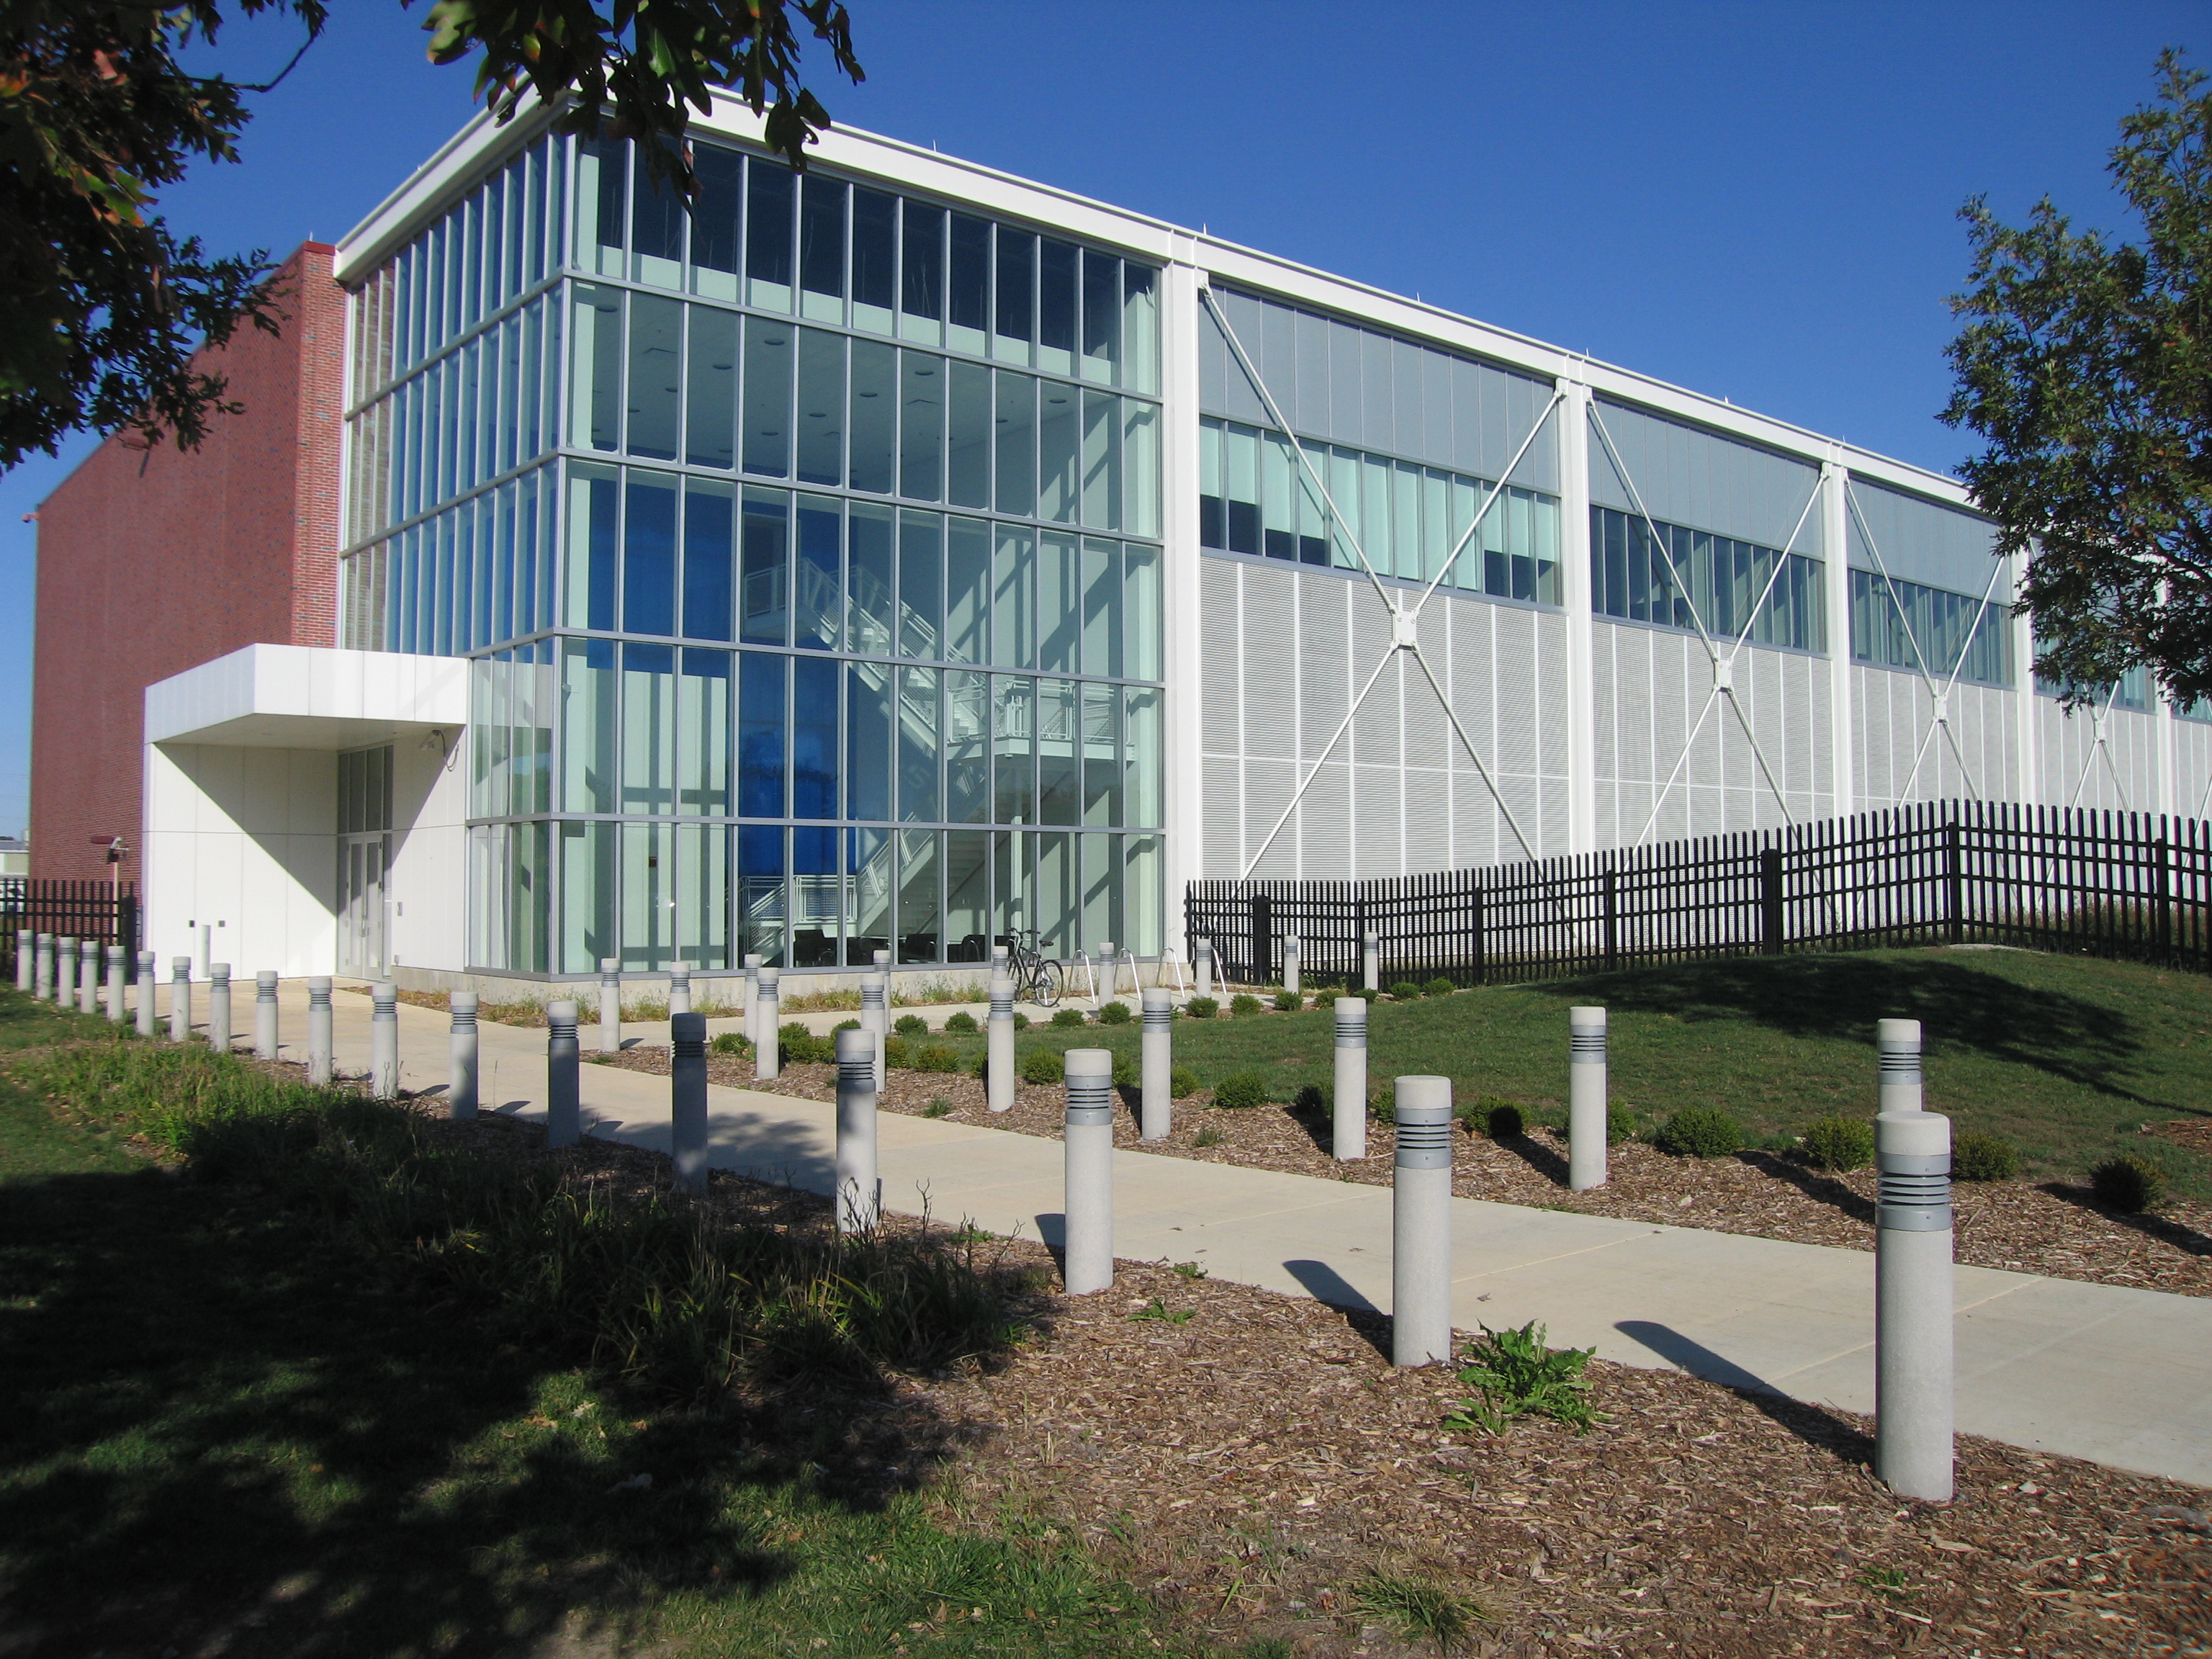

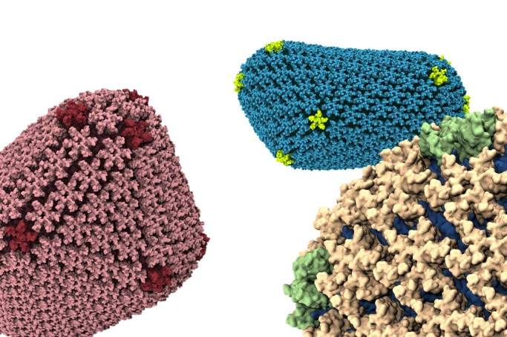
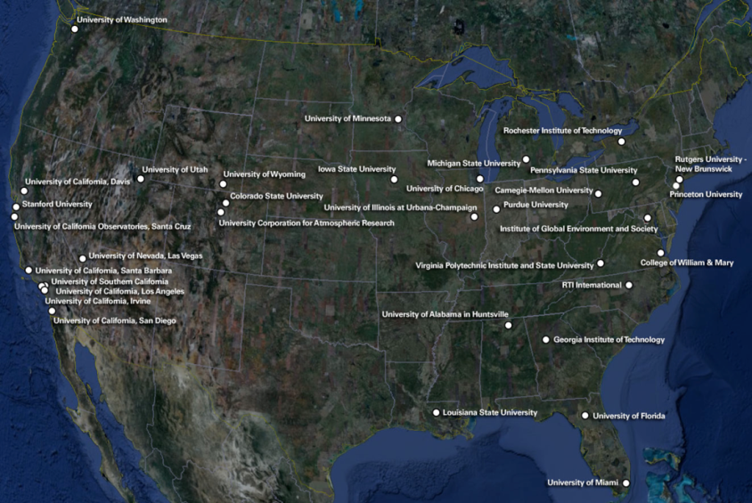
Blue Waters: Grand Challenge Computational Science/ Engineering through Sustained Petascale Performance
Cray XE6/XK7 accepted December, 2012
UIUC Data Center
Petascale Application Projects
May, 2013
Credit: Theoretical and Computational Biophysics Group (www.ks.uiuc.edu), Beckman Institute for Advanced Science and Technology, UIUC
Notes:
Blue Waters is the result of a community vision to advance large scale computational science to solve some of the most challenging problems in discovery, broad foundational development for the next generation of multiphysics, multiscale models and modelers, transition learnings to industry. It built upon the popular cross directorate PetaApps program .
Five years of collaborative activities: buildings, network infrastructure, data infrastructure, application team competitions, leading to….discovery, education and industry impacts. Almost exactly one year ago, Dr. Marrett addressed the audience at its dedication too almost exactly one year ago. Initial results are beginning – discovery, education, economic impact. Four more years are planned.
To date there is strong evidence of discovery impacts, the Blue Waters Fellowships have had >100 proposals, the UIUC software development to increase the size of the archival that could be robustly managed by IBM’s HPSS software have recently been selected by NOAA for its ability to handle the scale and robustness of a large archive, and Blue Waters has recently received more than 100 proposals for its Blue Waters Fellowship Program, and Chicago won a recent bidding war for a digital lab for manufacturing based on Blue Waters.
But this is not about being the advocate general for Blue Waters but more the internal story about NSF’s role in computational infrastructure.

Slide 24
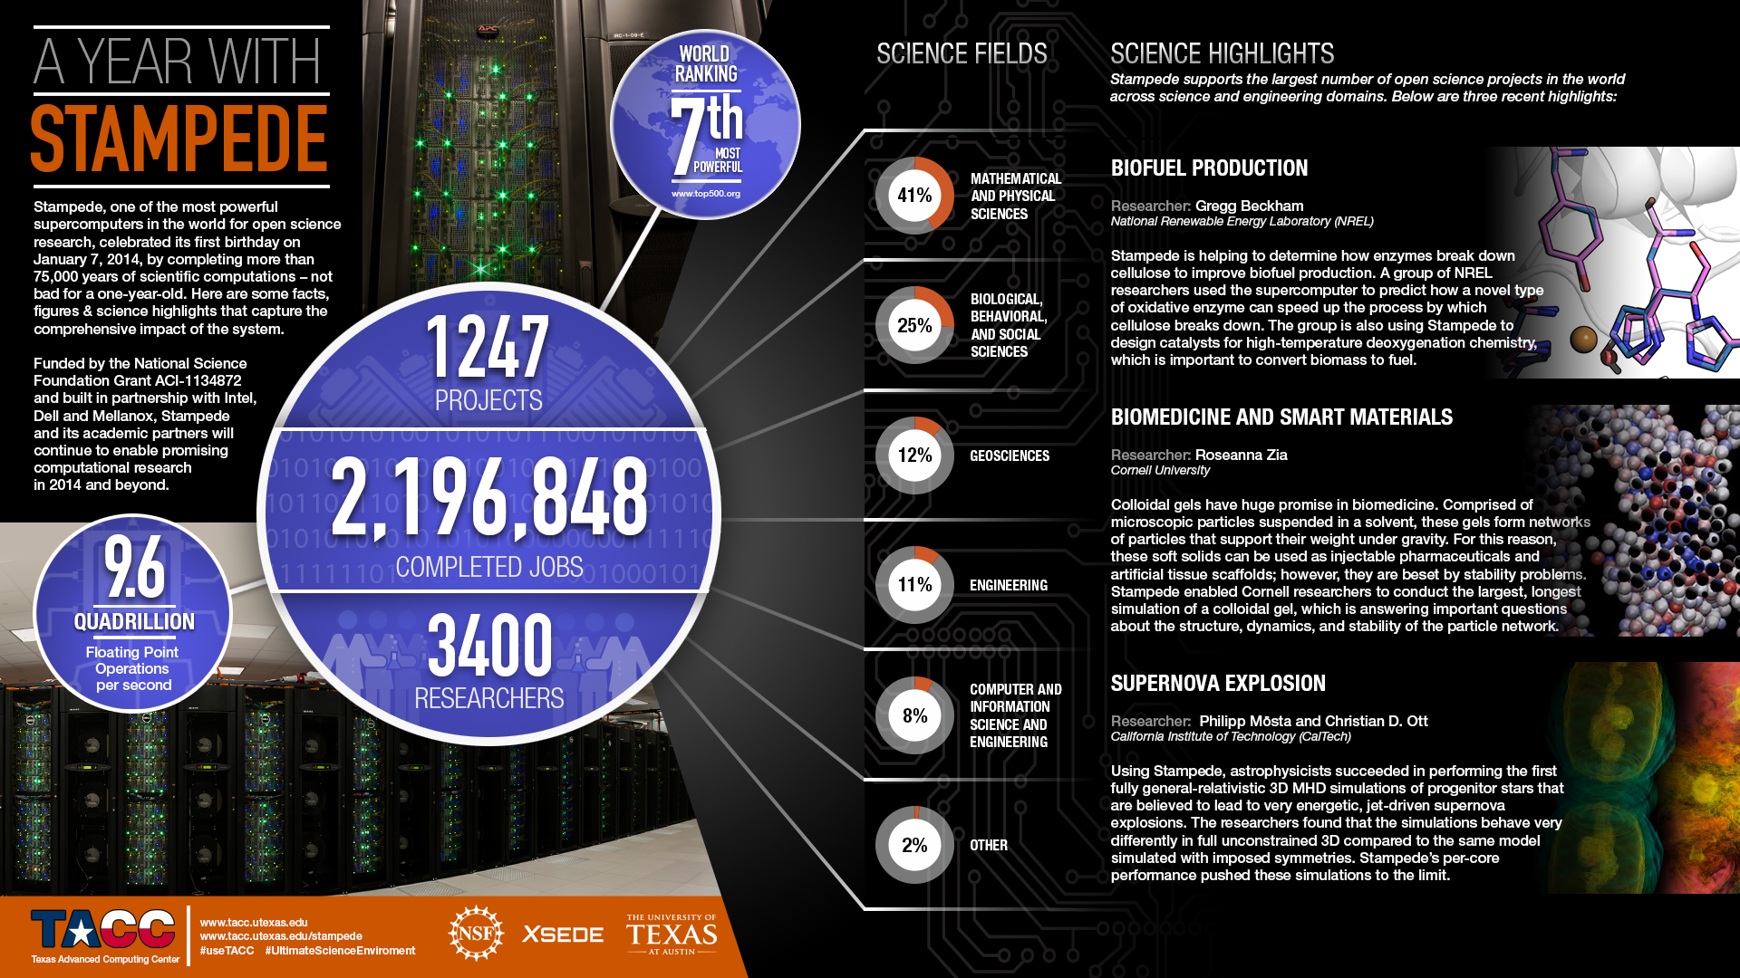
Stampede is both innovative and highly capable, doubling the resource pool for XRAC/XSEDE allocations
Notes:
In the same fiscal year in which Blue Waters and Yellowstone/NCAR are deployed, Stampede is accepted. It, too, is completing its first year. While Yellowstone is designed to serves a specific community, Stampede’s heterogeneous architecture is designed to support multiple communities, over a thousand projects annually.

Slide 25
National Academies Study launched in 2013: Future Directions for NSF Advanced Computing Infrastructure to support US Science in 2017-2022
Bill Gropp/University of Illionois at Urbana-Champaign
Robert Harrison/Stony Brook University
Mark Abbott/Oregon State University
David Arnett/University of Arizona
Robert Grossman/University of Chicago
Peter Kogge/University of Notre Dame
Padma Raghavan/Penn State University
Dan Reed/University of Iowa
Valerie Taylor/Texas A&M
Kathy Yelick/UC Berkeley
http://sites.nationalacademies.org/CSTB/CurrentProjects/CSTB_087924

Slide 26
Goals for this Study- Final Report
  By Summer, 2015, the final report will yield insights such as:
  The contribution of high end computing to U.S. leadership and competitiveness in basic science and engineering, the roles that NSF can play in sustaining this leadership, and how leadership can be measured, benchmarked, and monitored.
  Expected future national-scale computing needs across the full range of basic science and engineering research supported by NSF.
  Tradeoffs among investments in computing, software, data, and networking infrastructure and between those that advance the computational frontiers vs. those that focus on delivering more aggregate computing capacity.
  The roles of different models for advanced computing infrastructure, including NSF centers and consortia, campus-based infrastructure, and the commercial marketplace.
  Technical challenges to delivering needed computing capabilities, and what research and development may be needed to deliver expected future capabilities.

Slide 27
Goals for the Study – Interim Report
By Summer, 2014, the interim report will focus on the 2017-2020 timeframe and yield insights on key issues such as:
    Characterization of the trajectory and relevance of large scale simulation’s impact on foundational advances in science and engineering.
  Identification of scientific research grand challenges that will be substantially advanced by large scale data analytics and data mining not currently possible in research infrastructures.
  Based on the response to the previous two bullets, identify categories for research cyberinfrastructure investments (e.g. emergent technologies and algorithms, balance between experimental and “production”, education and workforce development, community software) required to support sustained advances in U.S. science
  Challenges and responses by research infrastructures at all scales (e.g. campus, regional, national; problem focused or multipurpose) to the items above, identifying those which can be most positively impacted by NSF. These should encompass economic, cross agency and international considerations.

Slide 28
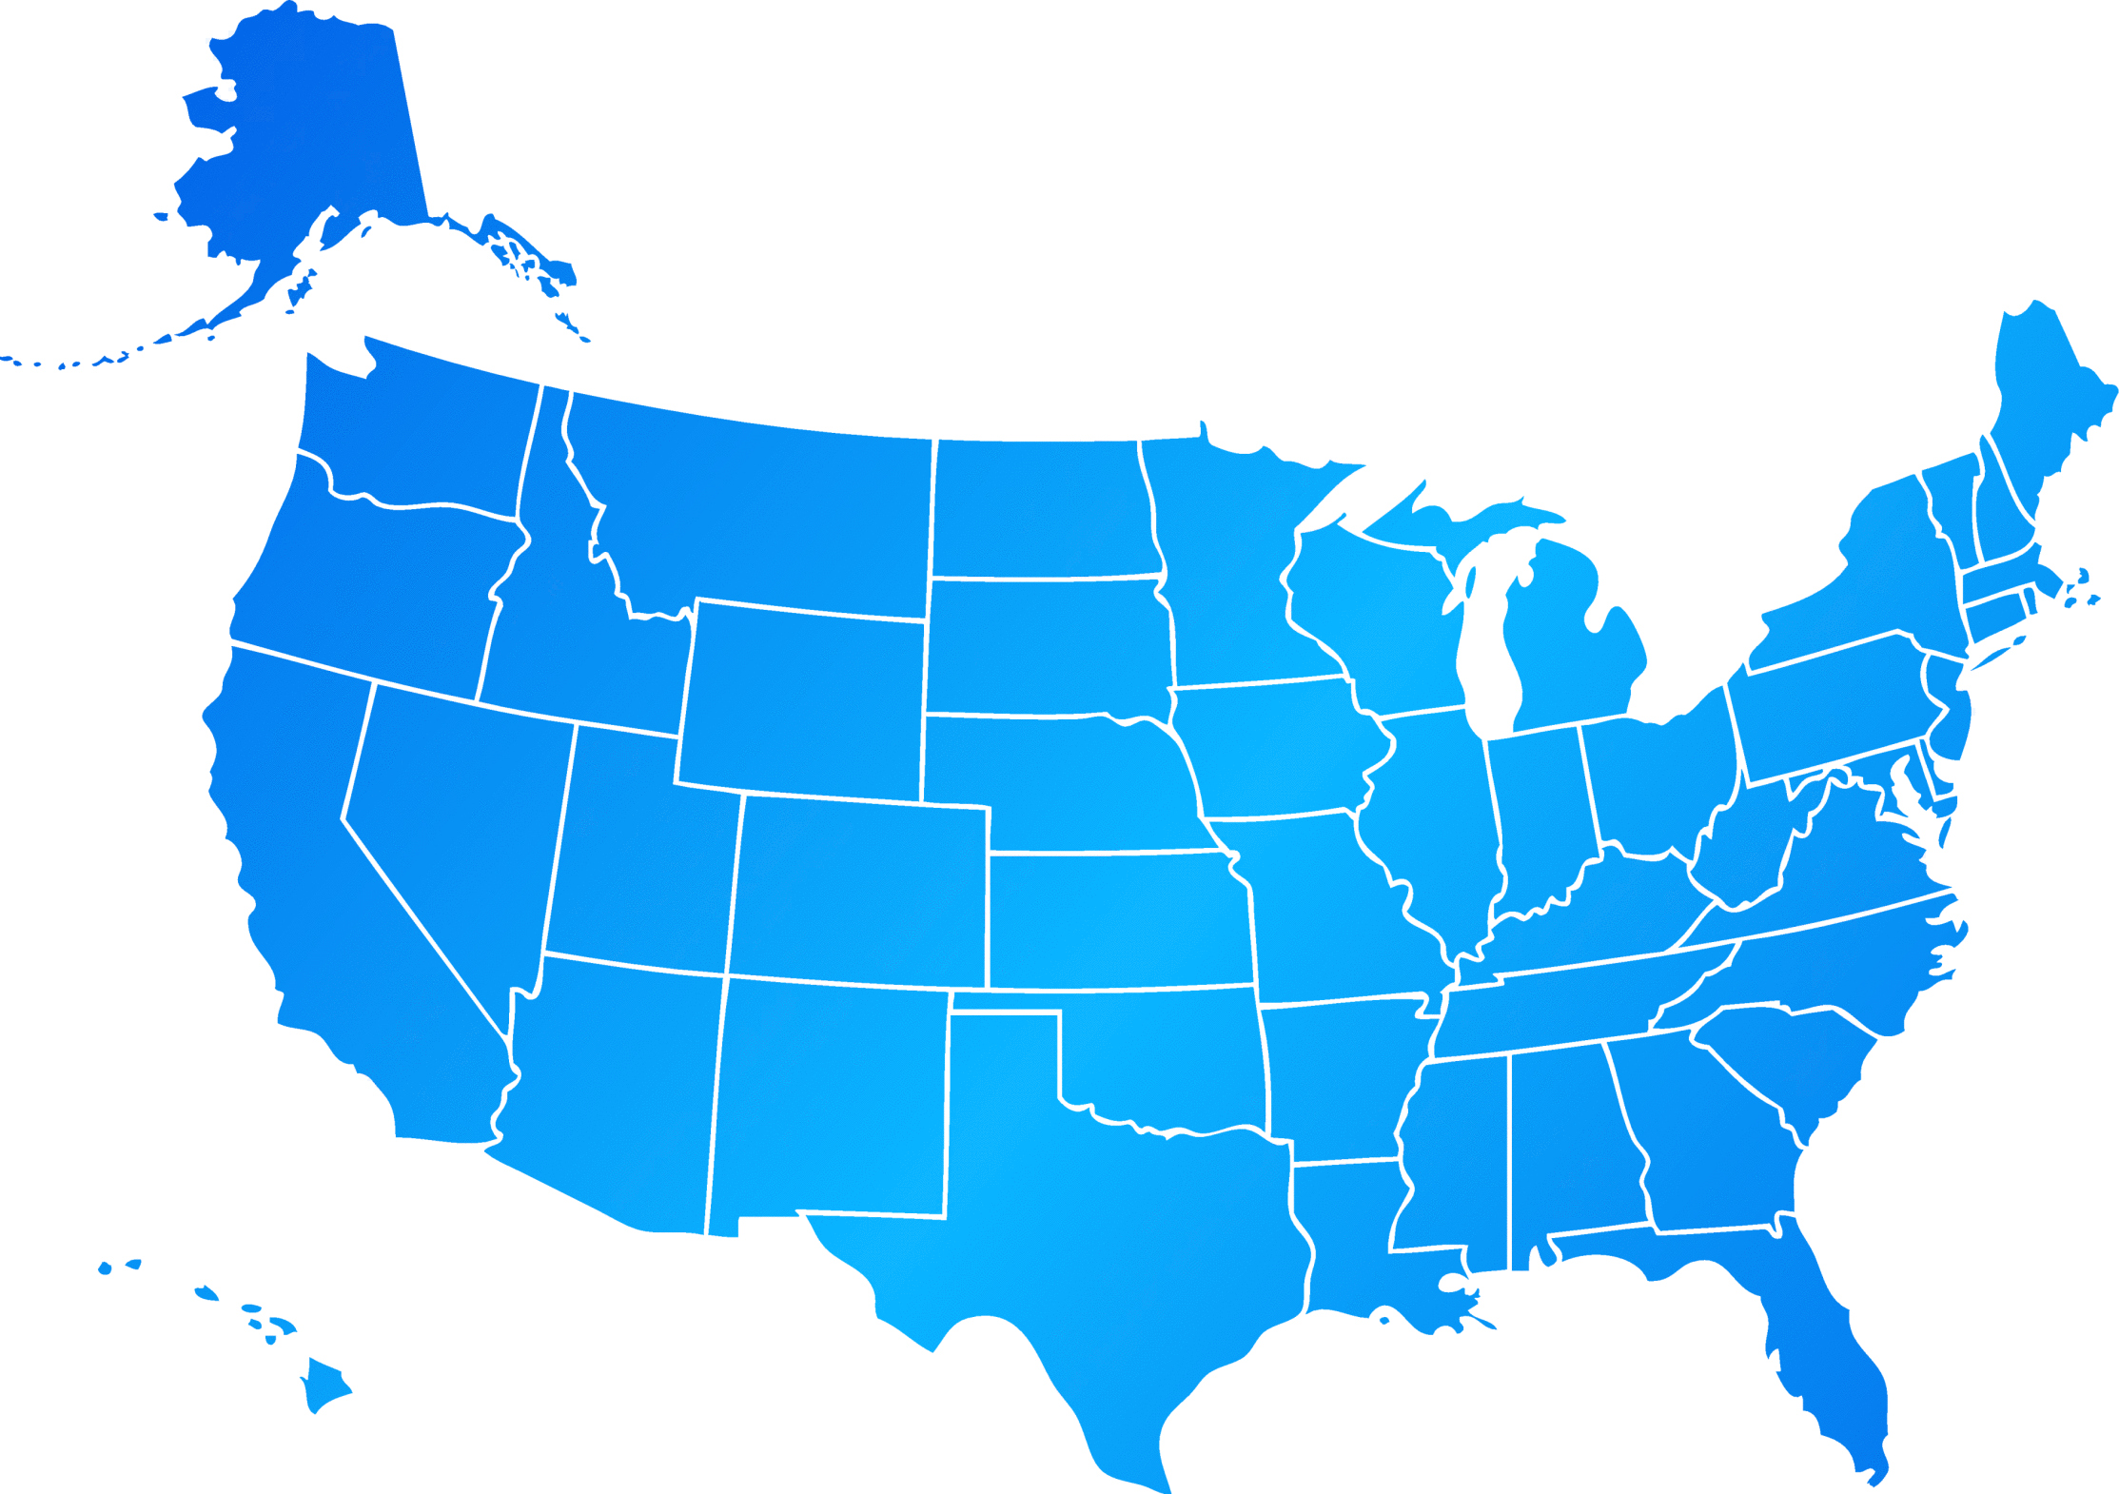
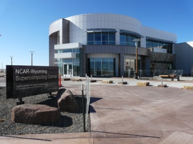

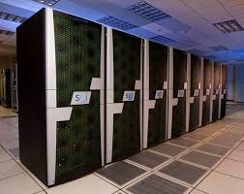
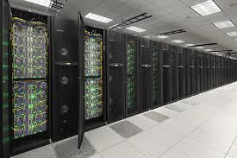
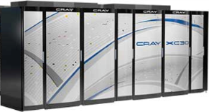
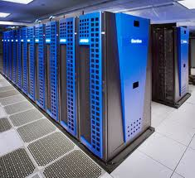
NSF Supported National Resources are increasingly diverse and collaborative
Open Science Grid
High throughput
Blacklight
Shared Memory
4k Xeon cores
Blue Waters
Leadership Class
Trestles
IO-intensive
10k cores
160 GB SSD/Flash
Gordon
Data intensive
64 TB memory
300 TB Flash Mem
FutureGrid*
CS testbed
Yellowstone
Geosciences
Darter
24k cores
Nautilus
Visualization
Data Analytics
Keeneland
CPU/GPGPU
Wrangler
Date Analytics
Stampede
460K cores
w. Xeon Phi
>1000 users
Upgrade in 2015
Maverick
Visualization
Data Analytics
Lonestar*
Large memory
Comet
“Long Tail Science”
47k cores/2 PF
High throughput
SuperMIC
380 nodes – 1PF
(Ivy bridge, Xeon Phi, GPU)
XSEDE integration
To be deployed in FY2015 with XSEDE integration and user services
* To be retired in 2014

Slide 29



Recent ACI supported acquisitions
& deployments are complementary
Xeon Upgrade
Renewal?
Long-tail/high throughput
Data Analytics
Wrangler
2013
2015
2016
2017
2014
NSF 14-536
TBA

Slide 30
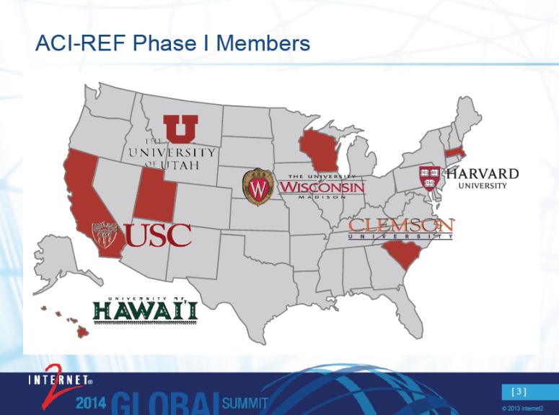

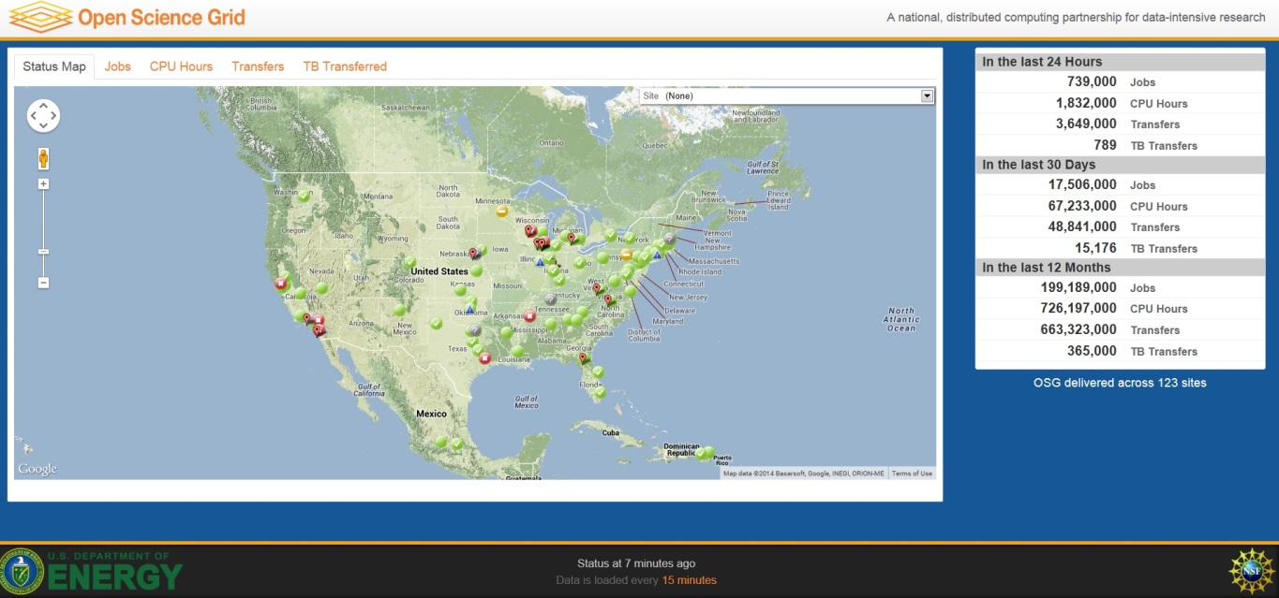

Continued investment in evolving and new models for collaborative CI to advances science frontiers
Extend
the impact of cyberinfrastructure
Prepare the current and next generation
Promote an open, robust, collaborative, and innovative ecosystem
Collaborate with other CI groups and projects
Adopt, create and disseminate knowledge
Provide technical expertise and support services

Slide 31
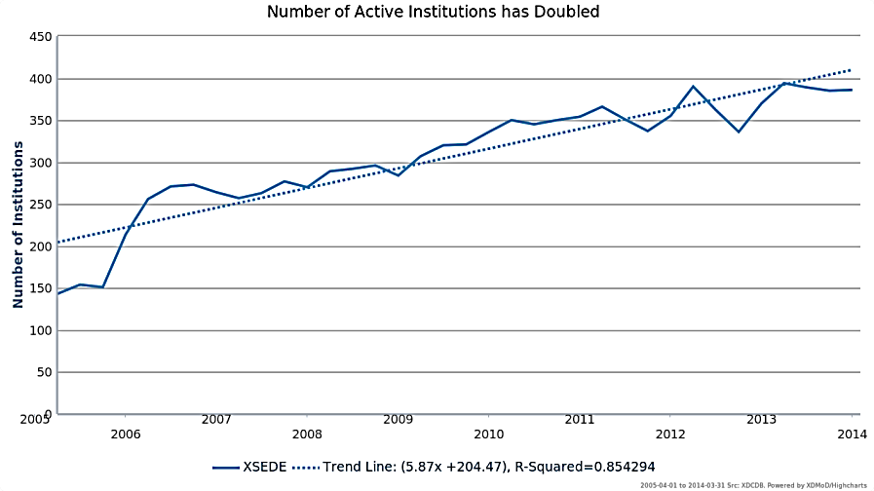
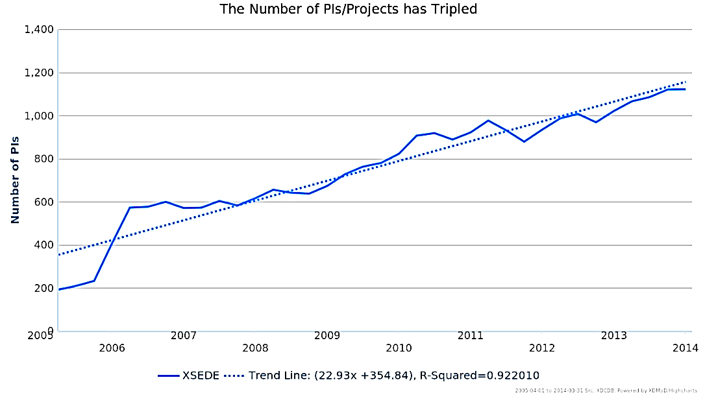
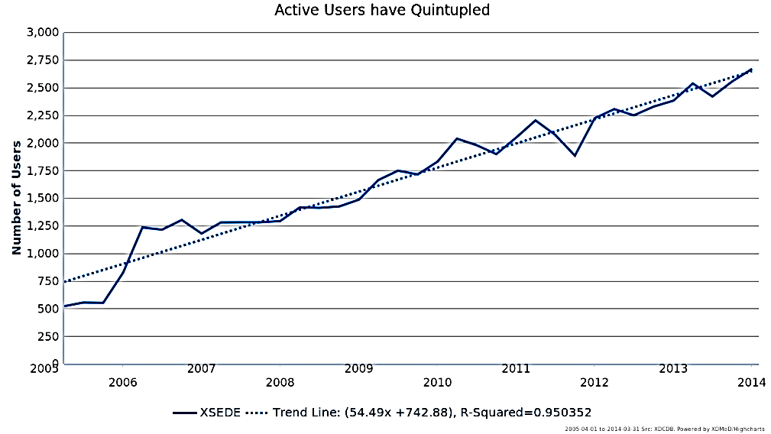
Quantitative Trends: the Number of Research Projects, Institutions and Users have increased
Notes:
This does not include NCAR or Bluewaters.
The number of active users is cumulative quarterly, if one looks at it annually, the number of annual active users increases to 5,000.

Slide 32
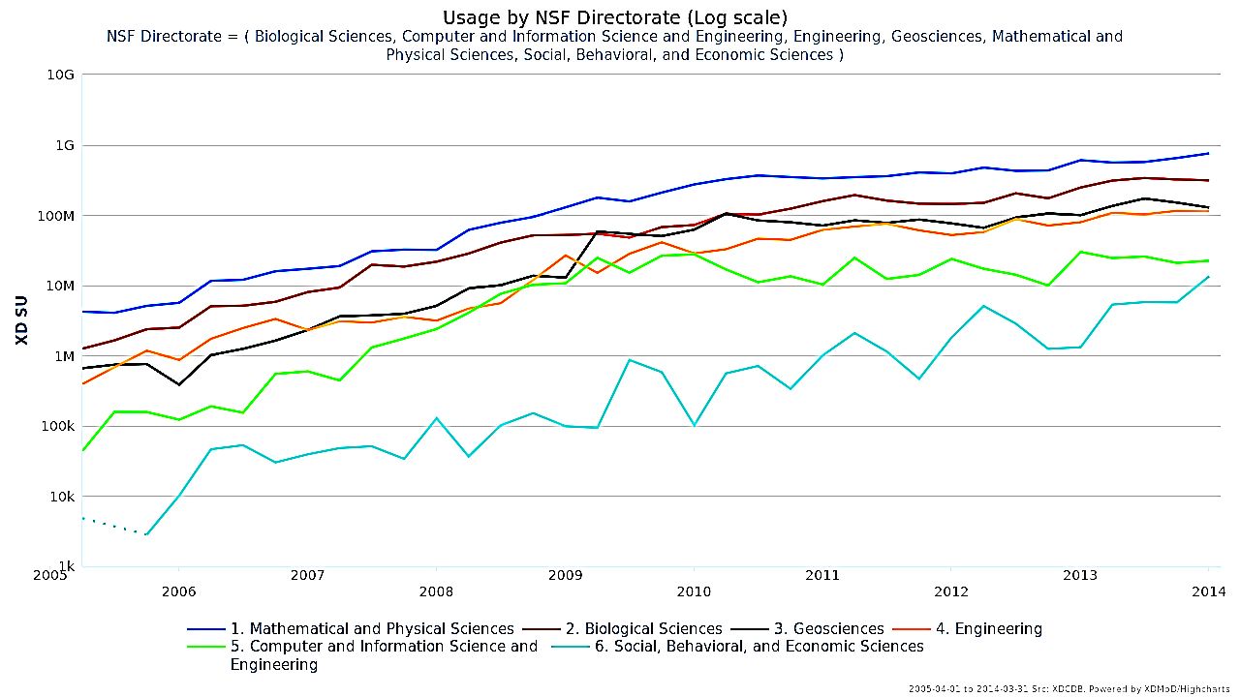
All Scientific Disciplines have increased use of national resources
Notes:
Note the log scale

Slide 33
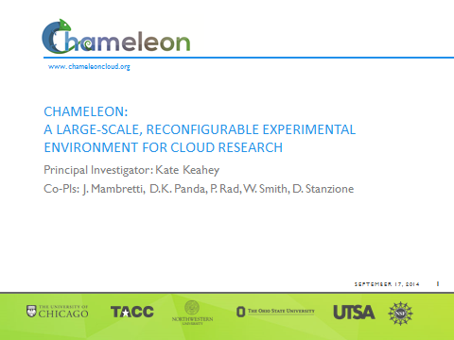
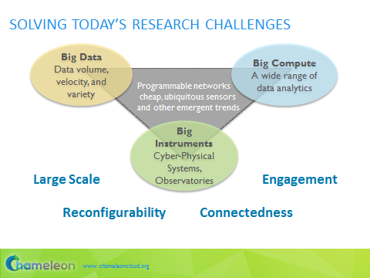
2014 NSF Cloud Awards:
Multi-institutional CI Research

Slide 34
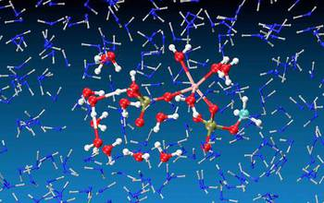



Computational science takes the Nobel stage
The molecular dynamics methods that Karplus, Warshel, and Levitt pioneered using NSF supported HPC systems have evolved into the standard approach to investigate complex chemical and biochemical processes and the behavior of materials.
Snapshots from extensive simulations of a step in the free energy perturbation study of phosphate hydrolysis in water. The simulations involve a QM/MM surface with a description of the phosphate (red and white) from first principle and an MM description of the water molecules (blue).
Credit: Arieh Warshel
Michael Levitt, 2013 Nobel Laureate in Chemistry
Credit: Alexander Mahmoud. Copyright Nobel Foundation 2013
Arieh Warshel, 2013 Nobel Laureate in Chemistry
Credit: Alexander Mahmoud. Copyright Nobel Foundation 2013
Martin Karplus, 2013 Nobel Laureate in Chemistry
Credit: Alexander Mahmoud. Copyright Nobel Foundation 2013

Slide 35





NSF Software Infrastructure Projects
5 rounds of funding, 65 SSEs
4 rounds of funding, 35 SSIs
2 rounds of funding,
14 S2I2 conceptualizations
See http://bit.ly/sw-ci for current projects
SSE & SSI – NSF 14-520: Cross-NSF, all Directorates participating
Next SSEs due Feb 2015; Next SSIs due June 2015

Slide 36
Software as Infrastructure- Role & Lifecycle
Create and maintain a software ecosystem providing new capabilities that advance and accelerate scientific inquiry at unprecedented complexity and scale
Enable transformative, interdisciplinary, collaborative, science and engineering research and education through the use of advanced software and services
Support the foundational research necessary to continue to efficiently advance scientific software
Transform practice through new policies for software, addressing challenges of academic culture, open dissemination and use, reproducibility and trust, curation, sustainability, governance, citation, stewardship, and attribution of software authorship
Develop a next generation diverse workforce of scientists and engineers equipped with essential skills to use and develop software, with software and services used in both the research and education process

Slide 37
Working Towards Sustainable Software for Science: Practice and Experiences
https://sites.google.com/site/si2pimeeting2014/agenda
http://wssspe.researchcomputing.org.uk
First Workshop on Sustainable Software for Science: Practice and Experiences (WSSSPE1), @ SC13, 17 November 2013, Denver
  2 keynotes, 54 accepted papers
  Discussion sessions: Developing software; Policy; Communities
  Cross-cutting (emergent) topics: Defining sustainability; Career paths
  Post-workshop paper: http://arxiv.org/abs/1404.7414
  WSSSPE1.1, @ SciPy2014, Austin
  WSSSPE2, @ SC14, 16 November 2014, New Orleans
    29 accepted papers
    Keynotes/sessions being planned

Slide 38
Advanced Cyberinfrastructure
Supports the research, development, acquisition, and provision of state-of-the-art CI resources, tools, and services:
High Performance Computing: Enable petascale computing; provide open-science community with state-of-the-art HPC assets ranging from loosely coupled clusters to large scale instruments; develop an integrated scientific HPC environment.
Data: Support scientific communities in the use, sharing and archiving of data by creating building blocks to address community needs in data infrastructure.
Networking and Cybersecurity: Invest in campus network improvements and re-engineering to support a range of activities in modern computational science. Support transition of cybersecurity research to practice.
Software: Transform innovations in research and education into sustained software resources that are an integral part of cyberinfrastructure.
PEOPLE

Slide 39



Learning and Workforce Development
Workforce as Cyberinfrastructure
CI-focused
Cyber Scientists
to develop, pilot and deliver
new capabilities
Computational Scientists
Data Scientists
Architects/Designers
Software Engineers
System Management
CI-enabled
Domain Scientists
To explore and exploit
new capabilities
CI

Slide 40


CAREER: Sharing Deep Cosmic Microwave Background (CMB) Maps for Cosmological Discovery
John M. Kovac, Harvard University
supported by MPS/AST, MPS/PHY, CISE/ACI, GEO/PLR
Project aims supported by CISE/ACI:
Share ultra-deep CMB polarization maps from SPUD, BICEP2, BICEP1, and DASI
Develop and disseminate complete data products and software tools that broaden the use and impact of path finding surveys while setting what are expected to be useful standards for others to do the same
The actual B-mode pattern observed with the BICEP2 telescope, with the line segments showing the polarization from different spots on the sky. The red and blue shading shows the degree of clockwise and anti-clockwise twisting of this B-mode pattern. Credit: BICEP2 Collaboration
Derive needed portable data products and software tools, test them in key joint analyses of overlapping maps with external collaborators
Share data products and software tools with the full astrophysics community
Encourage independent reanalysis of findings
The sun sets behind BICEP2 and the South Pole Telescope at NSF's Amundsen-Scott South Pole Station. Credit: Steffen Richter, BICEP
Notes:
On 17 March, John Kovac announced to the world that he and his team of radio astronomers had found the imprint of gravitational waves from the Big Bang. They did so by looking at the cosmic microwave background (CMB), sometimes called the 'afterglow' of the Big Bang, using BICEP2, a telescope experiment based at the South Pole.

Slide 41


Vetria L. Byrd
REU Site: Undergraduate Research in
Collaborative Data Visualization Applications
Clemson University
Clemson, South Carolina
vlbyrd@clemson.edu
Research areas of this site: Visualization, Computer Science, Genetics and Biochemistry, Geophysics, Sociology, Molecular Modeling and Simulation, Inorganic Chemistry, Social Media, Parks Recreation Tourism Management, Biological Sciences and Digital Humanities
Unique Feature in 2014
The program identifies research collaborators with visualization needs and assigns each student to a REU team. Each REU Team consists of a research/science collaborator, a visualization mentor and a visualization REU student. This arrangement fosters further collaboration among team members, an appreciation of the visualization process and an understanding of the role visualization plays in discovery and analysis. REU students participate in activities as a member of their REU Team, their Research Lab, and their REU cohort thereby creating a rich, multidisciplinary research experience.
Figure 1: REU Team.
CISE REU Site PI Meeting, Washington, D.C., March 2014
Notes:
This REU Site was funded in FY14.

Slide 42
ACI LWD
Name of Program | Solicitation Number
CAREER | NSF 11-960
REU Sites | NSF 13-542
EXTREEMS-QED | NSF 12-606
STEM-C Partnerships | NSF 14-522
Cyberlearning | NSF 14-526
NRT (formerly CIF21 IGERT) | NSF 14-548

Slide 43
Current Research Context
Changing practice of science: interdisciplinary, team-oriented, global, data intensive, complex work and data flows increasingly integrated with technology
The power and challenges of technology: instrumenting everything; computational and data learning and workforce development; ubiquitous connectivity
Shifting funding landscape and role for foundational research in the face of escalating global challenges
Changing demographics: diversity, increased need for more computational and data scientists

Slide 44
Research Cyberinfrastructure Response
Cooperating campus, national and global cyberinfrastructure at all scales
Sustainability Model Development, especially for burgeoning CI areas of software and data
Ubiquitous, capable, secure and facile CI access for more researchers, educators, institutions and communities
Integrated Learning and Workforce Development (LWD) for both CI creators and users

Slide 45

Advanced Cyberinfrastructure
Transformative CDS&E to enhance discovery & learning
Provisioning to create, deploy, and operate advanced CI
Research and Exploration of future CI environments for science and engineering
Notes:
Advances in computing, information and communication technologies continue to transform scientific and engineering research and practice. Cyberinfrastructure has increasingly become a critical component of the R&D ecosystem.
Advanced cyberinfrastructure will accelerate the pace of discovery and innovation in all areas of inquiry and enables a platform on which cross- and inter-disciplinary research thrives.
As a result, the deployment and use of cyberinfrastructure across the entire spectrum of science, engineering, and education continues to expand each year.
Achieving the NSF vision for advanced CI requires synergy among 3 types of activities:
R&D to enhance technical and social effectiveness of future CI environments
Transformative Application to enhance discovery & learning
Provisioning to create, deploy, and operate advanced CI
Borromean Ring: The three rings taken together are inseparable, but remove any one ring and the other two fall apart.

Slide 46
Thank you!
Contact Information:
iqualter@nsf.gov
+1 703 292 2339

