Slide 1
ISE@FHSU
Houssain Kettani, Ph.D.
Professor & Director
Computer Science & Information Systems Engineering
ISE
Information Systems Engineering

Slide 2
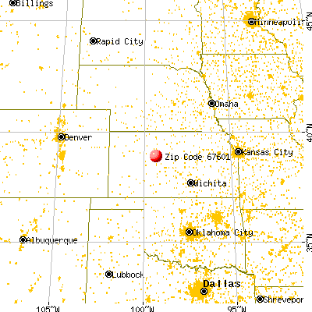
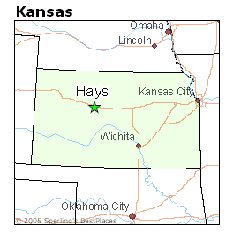
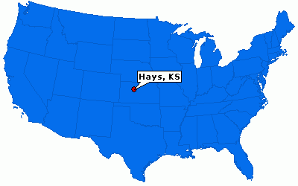
Hays, KS

Slide 3
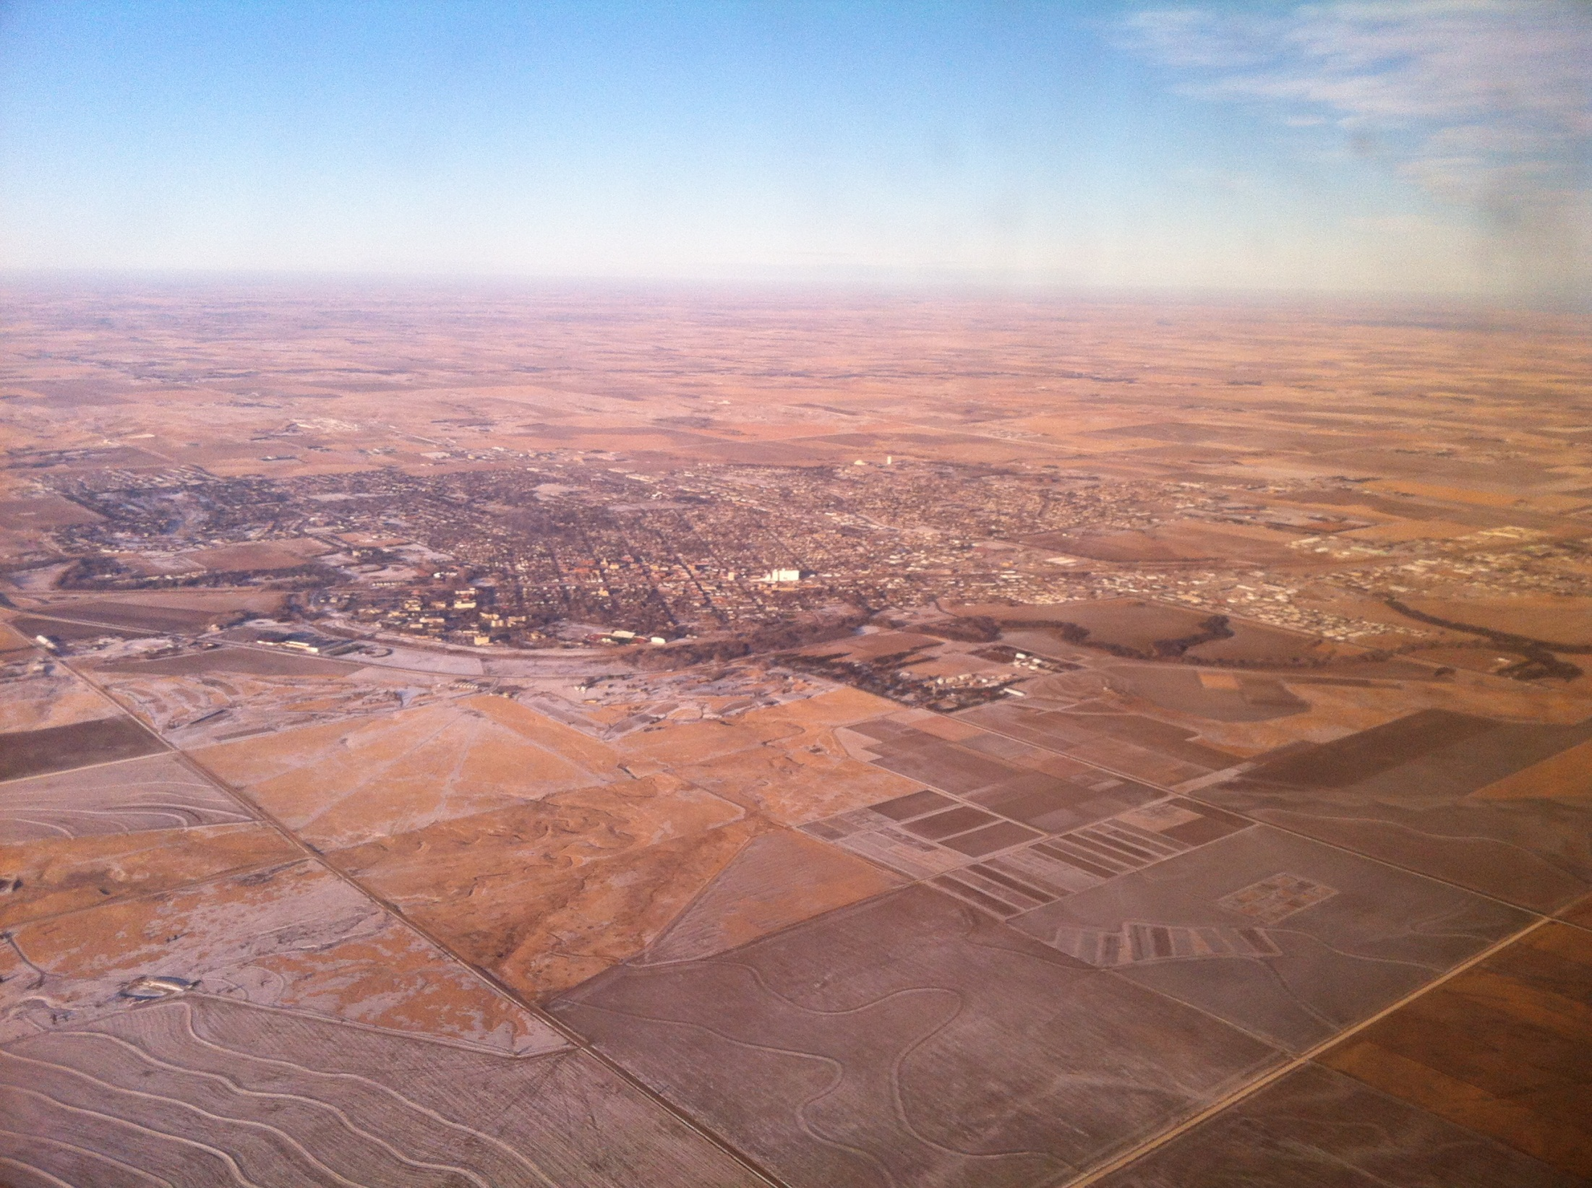

Slide 4
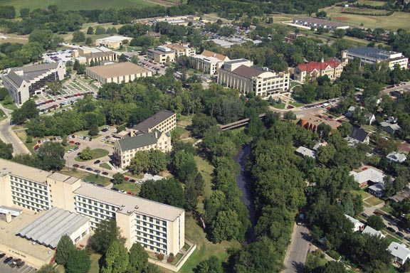

Slide 5
Est. 1902
14,000+ students
NSA/DHS CAE/IAE
Attractive transfer deals and 2+2’s
http://bigcat.fhsu.edu/~kettani/ise.html
http://www.fhsu.edu/csise/

Slide 6
Data vs. Information
Data: recorded facts and figures
Collection
Storage
Management
Retrieval
Analysis
Information: knowledge derived from data

Slide 7
Information Systems
IS: Collection of hardware, software, data, people and procedures that work together to produce quality information.
ISE: the effective use or engineering of IS for a better understanding of data to optimize decision making.

Slide 8
New Degree
BS: FHSU, JCSU
MS: JHU, Harrisburg U.,
PhD: U. Michigan – Dearborn, TSU

Slide 9
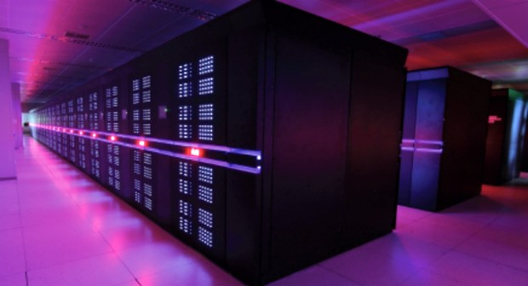
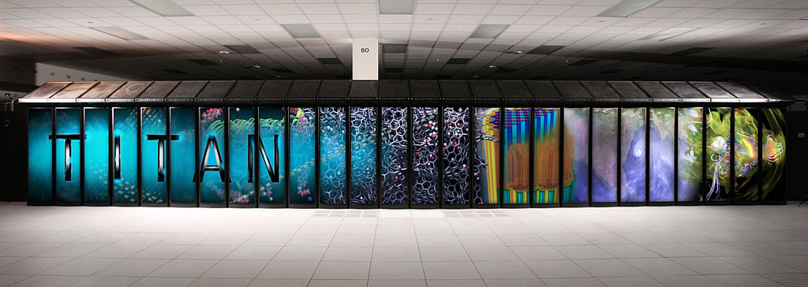
Supercomputers

Slide 10
Supercomputers
Fastest: Tianhe in China (1), Titan at ORNL (2)
Performs 34 (18) Pflop/s
Petaflop/s or quadrillion (10¹⁵)calculations per second
Has ~ 3 (1/2) million processors
Exaflop computing (quintillion - 10¹⁸) by 2018
Gf in 1985, Tf in 1996, Pf in 2008
Power: 18 (8) MW
http://top500.org/

Slide 11
SC vs. PC
PC achieves about 10 Gigaflop/s (Gflop/s or 10¹⁰)
Titan is 2,000,000 times faster!
1 sec in Titan = 2,000,000 sec in PC
or 565 hours
or 24 days
1 hr in Titan = 232 yrs in PC!
http://whohasthefastestcomputer.com/flopsmeter/

Slide 12
Info Retrieval
t₂
q
min θ ⇔ max α
c_{i}
θ_{i}
0 t₁

Slide 13
ISE Curriculum 1/2
Fall 1 Courses | CH
COMM100 Fundamentals of Oral Communication [FSU] | 3
ENG101 English Composition I [FSU] | 3
HHP200 Personal Wellness [FSU] | 3
IDS001 The First Year Seminar [FS] | 1
MIS101 Introduction to Computer Information Sys [FSU] | 3
PHYS100 Introduction to Engineering Science [F] | 3
Total | 16
Spring 1 Courses | CH
ENG102 English Composition II [FSU] | 3
INT250 Introduction to Web Development [FS] | 3
MATH234 Analytic Geometry & Calculus [FS] | 5
PHYS211 Physics for Scientists & Engineers I & Lab [FS] | 5
Total | 16
Fall 2 Courses | CH
CSCI261 Computer Science I [F] | 3
INT291 Internetworking I [FSU] | 3
MATH235 Analytic Geometry & Calculus II [FS] | 5
PHYS212 Physics for Scientists & Engineers II & Lab [FS] | 5
Total | 16
Spring 2 Courses | CH
ECFI205 Theory & Practice of Personal Finance [FSU] (or other SBS) | 3
MATH236 Analytic Geometry & Calculus III [FS] | 3
MATH240 Linear Algebra [S] | 3
MATH250 Elements of Statistics [FSU] | 3
PHIL100 General Logic [FSU] (or other Humanities) | 3
Total | 15

Slide 14
ISE Curriculum 2/2
Fall 3 Courses | CH
CSCI466 Software Engineering I [F] | 3
ISE300 Foundations of Info Systems Engineering [FSU] | 3
ISE310 Random Signal Analysis [S] | 3
MATH646 Discrete Structures [F] | 3
PHYS332 Analog & Digital Electronics [F] | 3
PSY100 General Psychology [FSU] (or other SBS) | 3
Total | 18
Spring 3 Courses | CH
CSCI463 Data Structures & Algorithm Design [S] | 3
HIST111 Modern World Civilization (or IS) [FSU] | 3
ISE320 Information Management [S] | 3
ISE330 Signals and Systems [S] | 3
SOC140 Introduction to Sociology [FSU] (or other SBS) | 3
Total | 15
Summer 3: ISE400 Internship in Information Systems Engineering [S] | 1
Fall 4 Courses | CH
GSCI110 World Geography (or other IS) [FSU] | 3
INT430 Leadership in INT [FU] | 3
INT650 Interactive System Design [FSU] | 3
INT684 Foundations of Information Systems Security [F] | 3
ISE440 Communication Systems [F] | 3
Total | 15
Spring 4 Courses | CH
CSCI663 Introduction to Cryptography [S] | 3
COMM318 Intro to Organizational Communication [FSU] (or other Humanities) | 3
IDS390 Technology in Society [FSU] (or other UDI) | 3
ISE450 Information Theory [S] | 3
ISE490 Capstone Seminar in Info Systems Eng. [FS] | 3
PHIL340 Ethics [FSU] (or other Humanities) | 3
Total | 18

Slide 15
Opportunities
Grad schools
ODNI’s federal intelligence agencies
National Laboratories
Private companies
….
The choice is yours, we are here to help!

Slide 16
