Slide 1

Getting HPC into Regional University Curricula with Few Resources
Karl Frinkle - Mike Morris

Slide 2
Getting HPC into Regional University Curricula with Few Resources
(Doing big things with little $$$)
Karl Frinkle - Mike Morris

Slide 3
Some of our goals . . .
Include parallel computing in our curriculum
Follow ACM accreditation guidelines
Allow early-CS and non-CS students to participate
Develop permanent courses
Exploit limited resources
Notes:
I thought it might be appropriate to translate the title of our paper and explain wht the whole exercise is about.
1. That’s why we’re here!
2. We researched the latest ACM accreditation guidelines and found that parallel computing is suggested in multiple areas of the CS curricula.
3. That is what we meant by interdisciplinary.
4.
5. Small liberal arts colleges are notorious for not showering money on the sciences.

Slide 4
Our Resources . . .
Uhhhh . . .
Notes:
I thought it might be appropriate to translate the title of our paper and explain wht the whole exercise is about.
1. That’s why we’re here!
2. We researched the latest ACM accreditation guidelines and found that parallel computing is suggested in multiple areas of the CS curricula.
3. That is what we meant by interdisciplinary.
4.
5. Small liberal arts colleges are notorious for not showering money on the sciences.

Slide 5



3 courses seemed essential . . .
Notes:
This is where the 3-semester part came in.
Course 1: We needed a crash course in C that was tailored to parallel thinking, so we tweaked a standard introductory C course.
Course 2: After some MPI success it seemed like a good idea to introduce CUDA.
Course 3: After a year of fairly intense programming, we felt like students could use some validation as to why we do this in the first place. We just happened to have a real research-level math problem at hand.

Slide 6
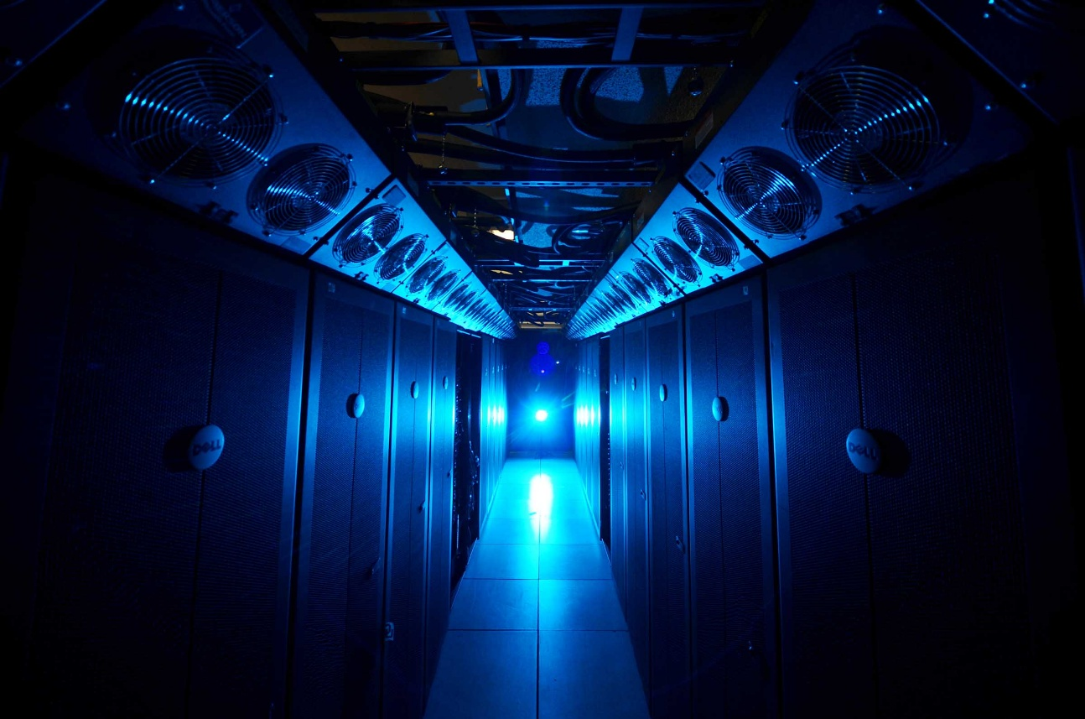
First we needed hardware.
Cluster
Notes:
This is the Oklahoma Supercomputing Center for Research and Education’s old supercomputer, Sooner. It’s been replaced by Boomer . . .

Slide 7

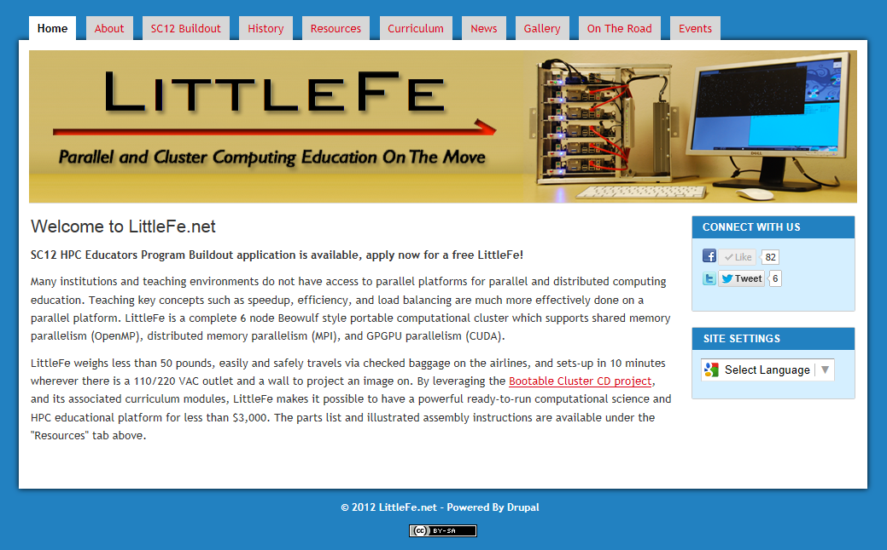
http://littlefe.net

Slide 8

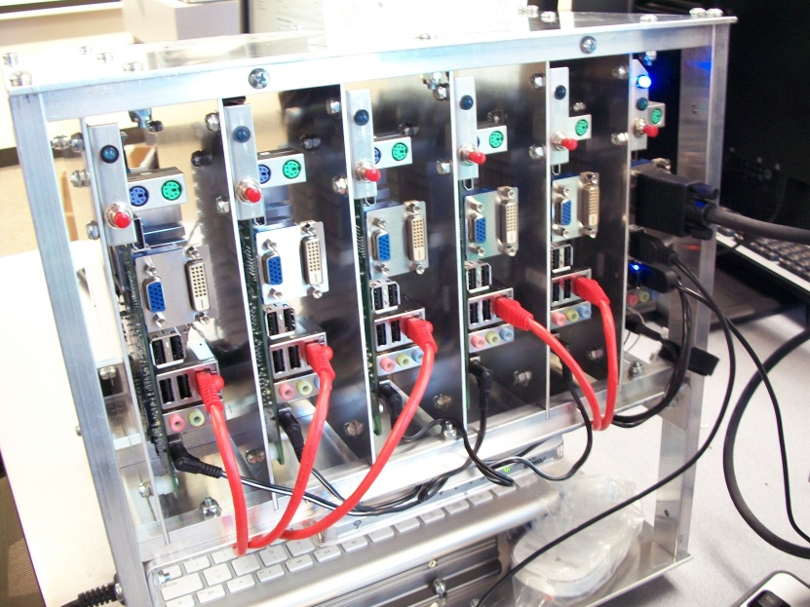
What is a LittleFe?
BigFe
LittleFe
Remember, Fe = Iron

Slide 9
Then we needed software.
Some sort of Linux.
We used BCCD,
(Bootable Cluster CD),
an incarnation of Debian.

Slide 10
Getting a course approved . . .

Slide 11
Special Seminars fit our bill.
CS4970 – Special Seminar
CS4980 – Special Studies
Immediate approval
Upper level a concern
. . . etc.

Slide 12
Back to the courses . . .

Slide 13
C with MPI
We threw caution to the winds and assumed a “Hello World” was the extent of students’ skills.
C & MPI
Course 1

Slide 14
C with MPI
We threw caution to the winds and assumed a “Hello World” was the extent of students’ skills.
We delivered a crash course in C, emphasizing array structures, memory management, binary storage and other fundamentals.
C & MPI
Course 1

Slide 15
C with MPI
We threw caution to the winds and assumed a “Hello World” was the extent of students’ skills.
We did not emphasize things like formatted i/o and loop syntax – we gave them examples and let them run with these types of things.
C & MPI
Course 1

Slide 16
C with MPI
As an introduction to parallel programming, we took a parallel “Hello World” using MPI that Charlie Peck gave us and studied it extensively.
C & MPI
Course 1

Slide 17
C with MPI
The main parallel project topic of the first course was
matrix multiplication.
C & MPI
Course 1

Slide 18
C with MPI
The main parallel project topic of the first course was
matrix multiplication.
Make no mistake – there is plenty of material in this seemingly simple problem for a plethora of programs.
C & MPI
Course 1

Slide 19
matrix multiplication
3 4 2 6 7 8
8 0 9 6 5 4
6 1 2 3 0 8
4 8 9 5 7 6
0 5 4 0 0 9
8 6 1 1 0 7
6 7 5 4 3 0
2 8 0 9 5 4
2 4 7 6 5 4
9 0 5 0 0 1
4 2 8 6 7 5
5 0 9 1 2 6
- - - - - -
- - - - - -
- - - - * -
- - - - - -
- - - - - -
- - - - - -
x
=
Each cell of a product matrix is calculated independently of others,
so the problem screams, “Parallelize me!”

Slide 20
C with MPI
C fundamentals and the matrix problems were more than enough for a first course.
We were pleasantly surprised at how naturally students seemed to accept the parallel models.
C & MPI
Course 1

Slide 21
CUDA
CUDA
Course 2
CUDA is the computing engine developed by Nvidia for high speed graphics rendering and physics calculations.
CUDA allows languages such as C/C++ to take advantage of high-speed GPUs in computationally intensive programs.
Compute
Unified Device Architecture

Slide 22
CUDA
We made the second course project based, and carefully chose a list of problems that would lend themselves to CUDA processing.
CUDA
Course 2

Slide 23
CUDA
We made the second course project based, and carefully chose a list of problems that would lend themselves to CUDA processing.
But like in the first course, we started with a CUDA version of “Hello World” which worked quite well.
CUDA
Course 2

Slide 24
CUDA
We made the second course project based, and carefully chose a list of problems that would lend themselves to CUDA processing.
CUDA
Course 2
For example:
- More matrix multiplication
- Large number multiplication
- Prime number checking
- Password cracking

Slide 25
more matrix multiplication
3 4 2 6 7 8
8 0 9 6 5 4
6 1 2 3 0 8
4 8 9 5 7 6
0 5 4 0 0 9
8 6 1 1 0 7
6 7 5 4 3 0
2 8 0 9 5 4
2 4 7 6 5 4
9 0 5 0 0 1
4 2 8 6 7 5
5 0 9 1 2 6
- - - - - -
- - - - - -
- - - - * -
- - - - - -
- - - - - -
- - - - - -
x
=
* = 6 x 3 + 1 x 5 + 2 x 5 + 3 x 0 + 0 x 7 + 8 x 2
Each cell’s required data is sent to a processor with MPI code.
That processor sends out all multiplications to the GPUs
by using CUDA code. [Blue font color represents CUDA calculations.]
Notes:
The “red” calculations were still done with MPI while the individual “blue” multiplications were done on the GPUs with CUDA code.

Slide 26
CUDA
Basing all projects on a shell obtained from our Hello World was a great method of generating programs.
The projects were more than enough for a semester of work for the students.
CUDA
Course 2

Slide 27
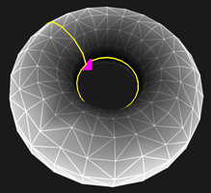
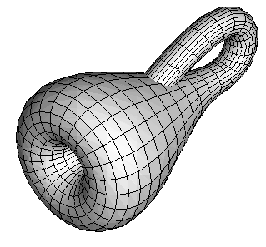
High Performance Computing
After getting a year of parallel programming under our belts, we decided to tackle a research-level math problem and make it the class project for an entire course.
HPC
Course 3
Notes:
The once punctured torus on the left and the Klein bottle on the right are famous topological shapes that mathematicians love to study.

Slide 28
High Performance Computing
A colleague co-authored a mathematical paper studying the behavior of a particular class of functions as they traversed a path along a once-punctured torus.
All values were complex numbers, and paths were integrated in the complex field, so computation was intensive.
HPC
Course 3
Notes:
This problem centered on behaviors of complex functions defined on once-punctured tori.

Slide 29
High Performance Computing
The problem was based upon a construction of a ternary tree based upon certain convergence criteria, and computations once again begged for parallelization.
It worked!
HPC
Course 3
Notes:
Enhance this as you see fit.

Slide 30
High Performance Computing
We got lots of help from the Oklahoma Supercomputer Center for Education and Research (OSCER).
After we “perfected” our programs, we ran them on OU’s supercomputer, using up to 2,000 processors per run, racking up several CPU-years of run time.
HPC
Course 3

Slide 31
Observations . . .
We used “Special Seminars” so we didn’t have to go through Curriculum Committees, etc.
Students adapted quickly to the parallel concept, even those of limited experience.
The association with Oklahoma University’s supercomputer people was invaluable.

Slide 32
Newest Course . . .
We are injecting a hardware component into the first course.
We have procured about 40 retired office computers and the students will build several clusters.
We’re not looking for speed, but we are demonstrating HPC techniques.

Slide 33
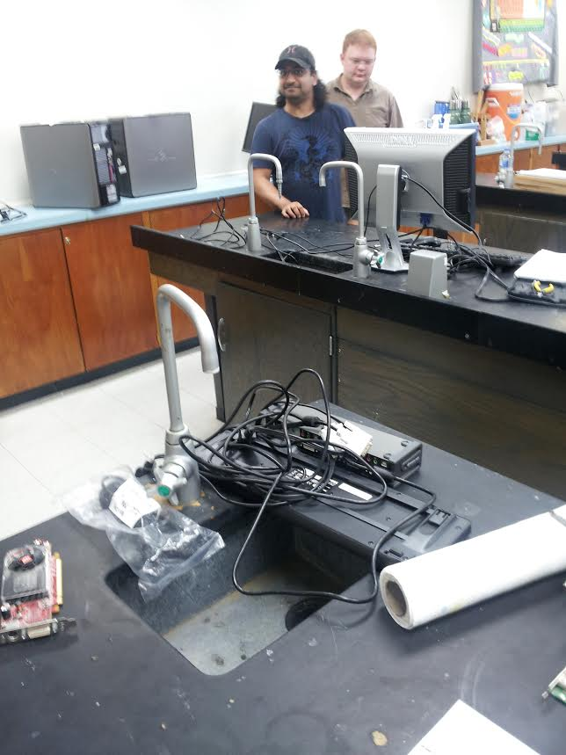
Up-to-the-minute activities . . .
We commandeered an old science lab!

Slide 34
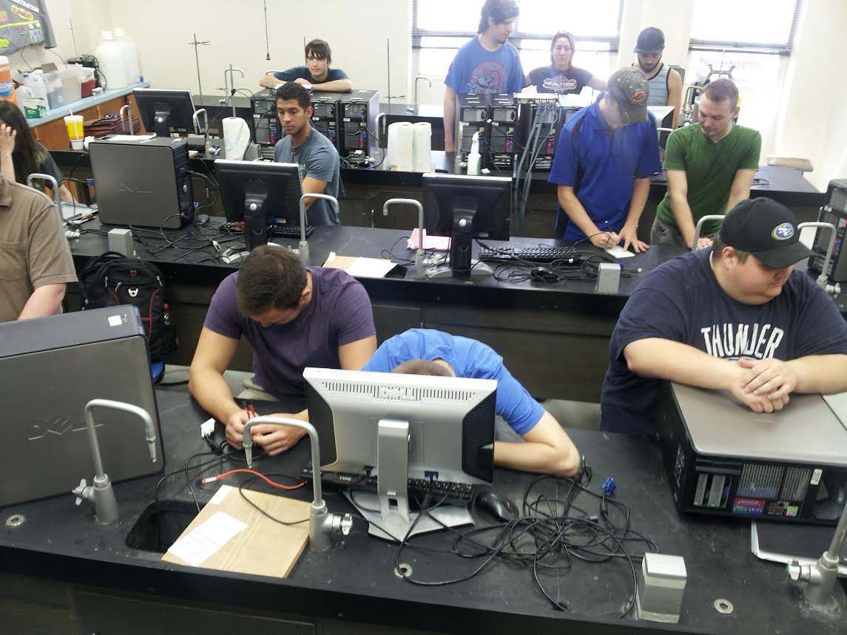
Up-to-the-minute activities . . .
Everyone has a sink!
We catalogued and “fixed” the cast off computers.

Slide 35
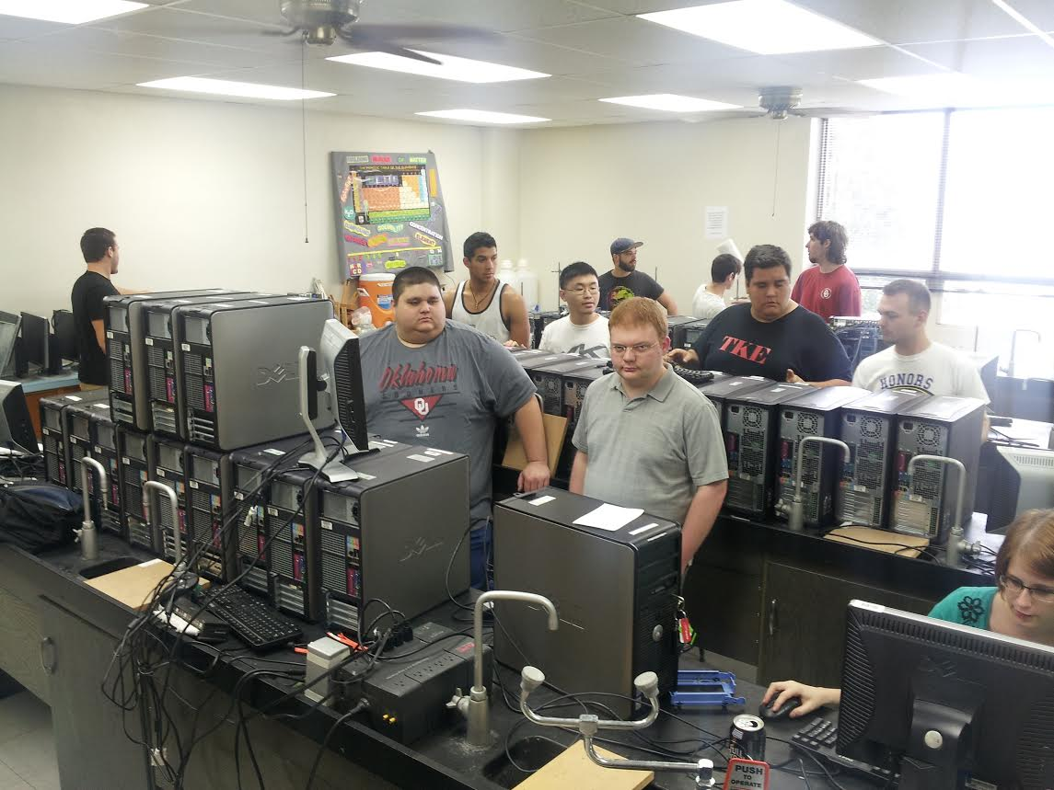
Up-to-the-minute activities . . .
We broke into 3 teams, each to build their own super computer!

Slide 36
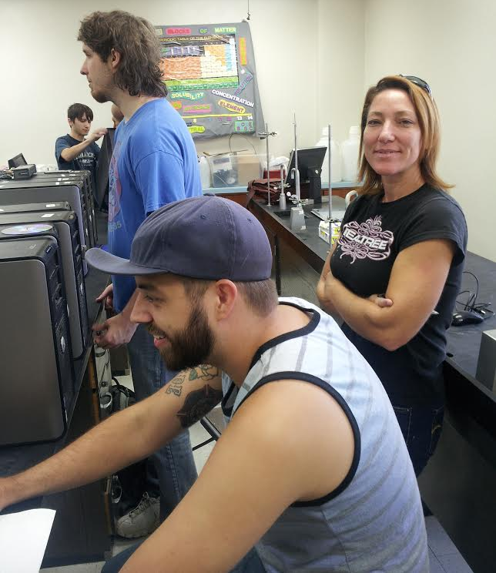
Up-to-the-minute activities . . .
Students love the format –
per the latest
pedagogy, we
have a high
entertainment value in the class.

Slide 37
Goals Accomplished
- We’ve spent almost nothing.
- We’ve delivered 4 separate HPC courses.
- We’ve generated interest in permanent courses.
- We’ve reached across disciplines.
- We’ve stayed in accreditation guidelines.
- We’re on the cutting edge of CS.

Slide 38
Thank You!
We especially thank Henry Neeman, Charlie Peck, Tom Murphy, Bob Panoff and everyone else associated with OU IT, the LittleFe project, the SOSU IT guys and all of our colleagues and friends in the educational community involved with HPC, for all the help we have received.
Karl Frinkle
Mike Morris

