Slide 1
The Evolution of Programming Models in Response to Energy Efficiency Constraints
John Shalf
Department Head: Computer Science and Data Sciences (CSDS)
CTO: National Energy Research Scientific Computing Center (NERSC)
Oklahoma Supercomputing Symposium 2013
October 2, 2013

Slide 2





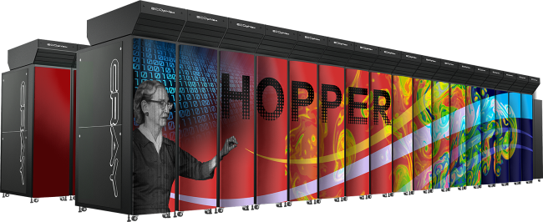

National Energy Research Scientific
Computing Center (NERSC)
Located at Berkeley Lab
Provides computing for a broad science
community:
5000 users, 700 research projects
48 states; 65% from universities
Hundreds of users each day
~1500 publications per year
Systems designed for science:
1.3PF Hopper + .5 PF clusters
With services for consulting, data analysis and more

Slide 3








NERSC’s 40 Year History of
Production High Performance Computing
NERSC-9 1 Exa
  Growth Rate: 10x every 4 years
  Goal: application performance
Moving Science Community through a Computing Revolution

Slide 4
30 Years of Exponential
Performance Improvement
1 Eflop/s
162 PFlop/s
100 Pflop/s
17.6 PFlop/s
10 Pflop/s
1 Pflop/s
SUM
76.5 TFlop/s
100 Tflop/s
10 Tflop/s
N=1
1 Tflop/s
1.17 TFlop/s
100 Gflop/s
10 Gflop/s
59.7 GFlop/s
N=500
1 Gflop/s
100 Mflop/s
400 MFlop/s
Source: TOP500 November 2012

Slide 5
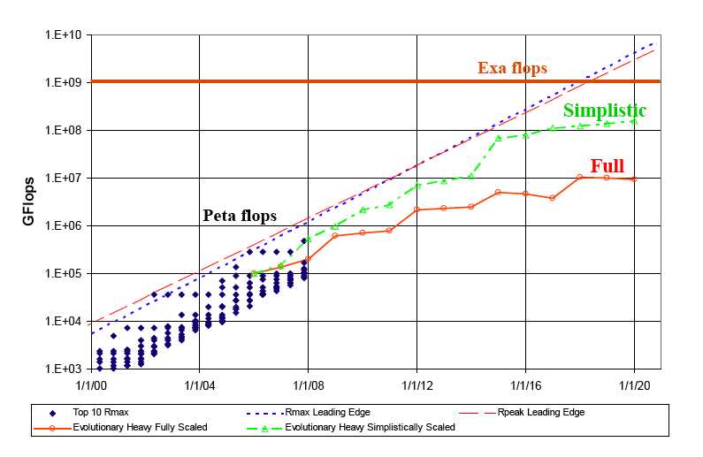
But Its Going to Be Very Hard to Continue!
(Requires a Laboratory-Wide Strategy for Next Decade)
From Peter Kogge, DARPA Exascale Study
Current Technology Roadmaps will Depart from Historical Performance Gains
Without major changes, computing cannot continue
historical trends of performance improvement

Slide 6
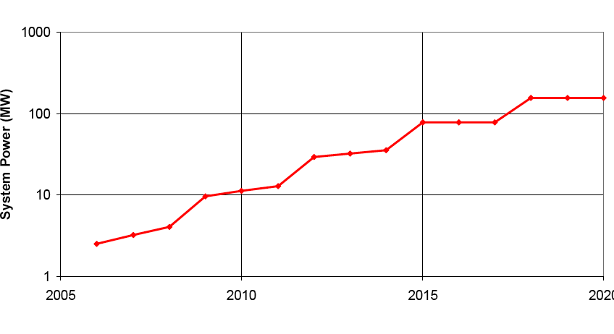
… and the power costs will still be staggering
From Peter Kogge, DARPA Exascale Study
$1M per megawatt per year! (with CHEAP power)

Slide 7
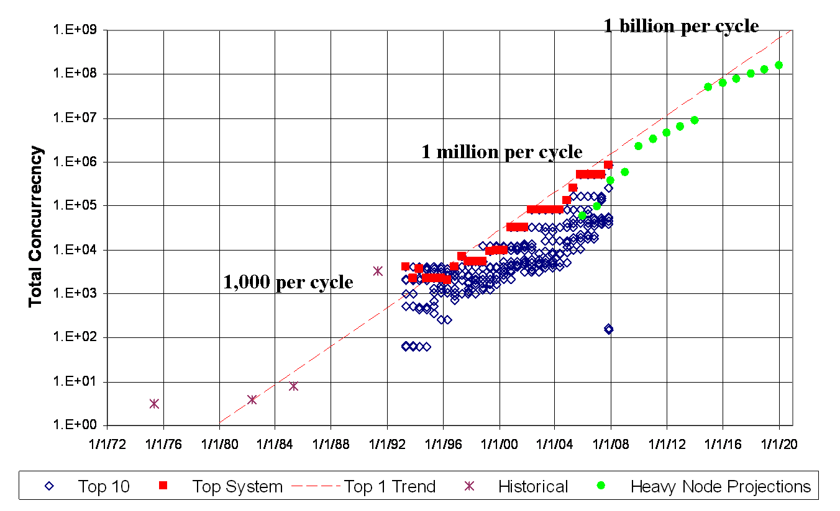
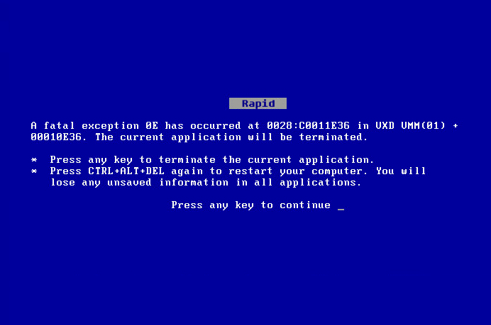
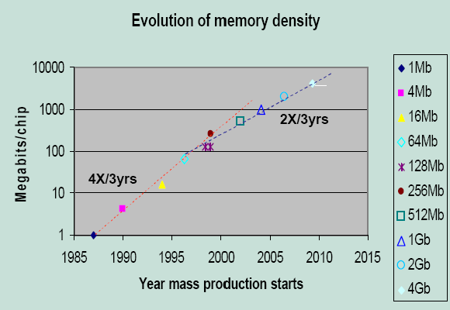
Technology Challenges for the Next Decade
Power is leading constraint for future performance growth
Parallelism is growing at exponential rate
Reliability going down for large-scale systems, but also to get more energy efficiency for small systems
Memory Technology improvements are slowing down
By 2018, cost of a FLOP will be less than cost of moving 5mm across the chip’s surface (locality will really matter)

Slide 8
These Trends Affect ALL users at ALL SCALES
(this is NOT just about exascale)
The disruptions are primarily within the node
Only resilience and interconnect scaling are exclusively HPC
Exponential growth of parallelism, power, and memory trends have pervasive impact on computing for the coming decade
Worse yet, the changes are already underway!
There is no need point in waiting for the “ExaFLOP computer”.
These trends are happening NOW!
The Challenge of our Decade: Performance growth in fixed power budget
The challenge is as dramatic as transition from vector to MPP
This transition affects all computing for science from smallest to the largest scale
Fundamentally breaks our software infrastructure (need to re-architect)

Slide 9
Top 10 Systems in November 2012
# | Site | Manufacturer | Computer | Country | Cores | Rmax [Pflops] | Power [MW]
1 | Oak Ridge National Laboratory | Cray | Titan Cray XK7, Opteron 16C 2.2GHz, Gemini, NVIDIA K20x | USA | 560,640 | 17.6 | 8.21
2 | Lawrence Livermore National Laboratory | IBM | Sequoia BlueGene/Q, Power BQC 16C 1.6GHz, Custom | USA | 1,572,864 | 16.3 | 7.89
3 | RIKEN Advanced Institute for Computational Science | Fujitsu | K Computer SPARC64 VIIIfx 2.0GHz, Tofu Interconnect | Japan | 795,024 | 10.5 | 12.66
4 | Argonne National Laboratory | IBM | Mira BlueGene/Q, Power BQC 16C 1.6GHz, Custom | USA | 786,432 | 8.16 | 3.95
5 | Forschungszentrum Juelich (FZJ) | IBM | JuQUEEN BlueGene/Q, Power BQC 16C 1.6GHz, Custom | Germany | 393,216 | 4.14 | 1.97
6 | Leibniz Rechenzentrum | IBM | SuperMUC iDataPlex DX360M4, Xeon E5 8C 2.7GHz, Infiniband FDR | Germany | 147,456 | 2.90 | 3.52
7 | Texas Advanced Computing Center/UT | Dell | Stampede PowerEdge C8220, Xeon E5 8C 2.7GHz, Intel Xeon Phi | USA | 204,900 | 2.66
8 | National SuperComputer Center in Tianjin | NUDT | Tianhe-1A NUDT TH MPP, Xeon 6C, NVidia, FT-1000 8C | China | 186,368 | 2.57 | 4.04
9 | CINECA | IBM | Fermi BlueGene/Q, Power BQC 16C 1.6GHz, Custom | Italy | 163,840 | 1.73 | 0.82
10 | IBM | IBM | DARPA Trial Subset Power 775, Power7 8C 3.84GHz, Custom | USA | 63,360 | 1.52 | 3.57

Slide 10
Potential System Architectures
What is Possible
Systems | 2009 | 2015 +1/-0 | 2018 +1/-0
System peak | 2 Peta | 100-300 Peta | 1 Exa
Power | 6 MW | ~15 MW | ~20 MW
System memory | 0.3 PB | 5 PB | 64 PB (+)
Node performance | 125 GF | 0.5 TF or 7 TF | 2 TF or 10TF
Node memory BW | 25 GB/s | 0.2TB/s or 0.5TB/s | 0.4TB/s or 1TB/s
Node concurrency | 12 | O(100) | O(1k) or 10k
Total Node Interconnect BW | 3.5 GB/s | 100-200 GB/s 10:1 vs memory bandwidth 2:1 alternative | 200-400GB/s (1:4 or 1:8 from memory BW)
System size (nodes) | 18,700 | 50,000 or 500,000 | O(100,000) or O(1M)
Total concurrency | 225,000 | O(100,000,000) *O(10)-O(50) to hide latency | O(billion) * O(10) to O(100) for latency hiding
Storage | 15 PB | 150 PB | 500-1000 PB (>10x system memory is min)
IO | 0.2 TB | 10 TB/s | 60 TB/s (how long to drain the machine)
MTTI | days | O(1day) | O(1 day)
Notes:
I’m not going to be able to program the machine the way I do today! (NO DUH!!!)
Rewriting your code is a cataclysmic event. You know that some day you may need to do that, but if so, you only want to do that once!
Missing Latencies
Message injection rates
Flops/watt cost money and bytes/flop that costs money
Joule/op in 2009, 2015 and 2018:
2015: 100 pj/op
Capacity doesn’t cost as much power as bandwidth
how many joules to move a bit
2 picojoule/bit
75pj/bit for accessing DRAM
32 Petabytes: with system memory at same fraction of system
Need $ number
Best machine for 20MW and best machine for $200M
Memory op is 64 bit word of memory
75 picojoule bit for (multiply by 64) (DDR 3 spec)
50 pj/ for an entire 64 bit op
Memory technology in 5pj/bit by 2015 if we invest soon
Anything more aggressive than 4pj/bit is close to the limit (will not sign up for 2pj/bit)
2015 10 pj/flop
5pj/flop in 2018
So we are talking 30:1 ratio of memory reference per flop
10pj/operation to bring a byte in
8 terabits * 1pj -> 8 watts
JEDEC is fundamentally broken (DDR4 is the end)
Low swing differential
insertion of known technology
20GB/s per component to 1 order of magnitude more
10-12 Gigabits/second per wire
16-64 using courant limited scaling of hydro codes
Cost per DRAM in that timeframe and how much to spend
# outstanding memory references per cycle-→ bandwidth * latency
above based on memory reference size
memory concurrency
200 cycles from DRAM (2GHz) is 100ns (40ns for memory alone). With queues will be 100ns
O(1000) references per node to memory
O(10k) for 64 byte cache lines?
Need to add system bisection:
2015: whatever local node bandwidth: factor of 4-8 or 2-4 against per-node interconnect bandwidth
2018:
Occupancy vs latency:
zero occupancy (1 slot for message launch)
5ns per
2-4 in 2015
2-4 in 2018
10^4 vs 10^9th

Slide 11
Why can’t we keep doing what we’ve been doing?
Optimization target for hardware has evolved to new direction
(but pmodels have not kept up)
Old Constraints
New Constraints
Peak clock frequency as primary limiter for performance improvement
Cost: FLOPs are biggest cost for system: optimize for compute
Concurrency: Modest growth of parallelism by adding nodes
Memory scaling: maintain byte per flop capacity and bandwidth
Locality: MPI+X model (uniform costs within node & between nodes)
Uniformity: Assume uniform system performance
Reliability: It’s the hardware’s problem
Power is primary design constraint for future HPC system design
Cost: Data movement dominates: optimize to minimize data movement
Concurrency: Exponential growth of parallelism within chips
Memory Scaling: Compute growing 2x faster than capacity or bandwidth
Locality: must reason about data locality and possibly topology
Heterogeneity: Architectural and performance non-uniformity increase
Reliability: Cannot count on hardware protection alone
Fundamentally breaks our current programming paradigm and computing ecosystem

Slide 12
Effect of Hardware on Programming Models
Programming Models are a Reflection of the Underlying Machine Architecture
  Express what is important for performance
  Hide complexity that is not consequential to performance
Programming Models are Increasingly Mismatched with Underlying Hardware Architecture
  Changes in computer architecture trends/costs
  Performance and programmability consequences
Recommendations on where to Reformulate Programming Models for the Future of HPC
  Emphasis on Performance Portability
  What to virtualize
  What to make more expressive/visible
  What to ignore

Slide 13
The Programming Model is a Reflection of the Underlying Abstract Machine Model
Equal cost SMP/PRAM model
  No notion of non-local access
  int [nx][ny][nz];
Cluster: Distributed memory model
  No unified memory
  int [localNX][localNY][localNZ];
PGAS for horizontal locality
  Data is LOCAL or REMOTE
  shared [Horizontal] int [nx][ny][nz];
HPGAS for vertical data movement
  Depth of hierarchy also matters now
  shared [Vertical][Horizontal] int [x][y][z];?
Notes:
GridLab saying “Just one more layer”
Is that the same for HPGAS? Is adding layers sensible?

Slide 14
Abstract Machine Models
Definition: An Abstract Machine model represents the machine attributes that will be important to reasoning about code performance
Enables us to reason about how to map algorithm onto underlying machine architecture
Enables us to reason about power/performance trade-offs for different algorithm or execution model choices
Want model to be as simple as possible, but not neglect any aspects of the machine that are important for performance

Slide 15
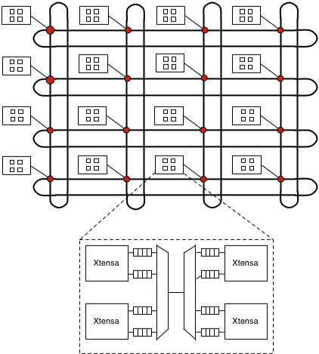
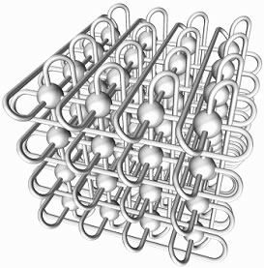
Notional Multi-Scale Machine Model
(what do we need to reason about when designing a new code?)
Cores
  How Many
  Heterogeneous
  SIMD Width
Network on Chip (NoC)
  Are they equidistant or
  Constrained Topology (2D)
On-Chip Memory Hierarchy
  Automatic or Scratchpad?
  Memory coherency method?
Node Topology
  NUMA or Flat?
  Topology may be important
  Or perhaps just distance
Memory
  Nonvolatile / multi-tiered?
  Intelligence in memory (or not)
Fault Model for Node
  FIT rates, Kinds of faults
  Granularity of faults/recovery
Interconnect
  Bandwidth/Latency/Overhead
  Topology
Primitives for data movement/sync
  Global Address Space or messaging?
  Synchronization primitives/Fences

Slide 16
Notional Multi-Scale Abstract Machine Model
(what do we need to reason about when designing a new code?)
For each parameterized machine attribute, can
Ignore it: If ignoring it has no serious power/performance consequences
Abstract it (virtualize): If it is well enough understood to support an automated mechanism to optimize layout or schedule
  This makes programmers life easier (one less thing to worry about)
Expose it (unvirtualize): If there is not a clear automated way of make decisions
  Must involve the human/programmer in the process (make pmodel more expressive)
  Directives to control data movement or layout (for example)
Want model to be as simple as possible, but not neglect any aspects of the machine that are important for performance

Slide 17
Data Movement

Slide 18
The Problem with Wires:
Energy to move data proportional to distance
Cost to move a bit on copper wire:
  power= bitrate * Length / cross-section area
Wire data capacity constant as feature size shrinks
Cost to move bit proportional to distance
~1TByte/sec max feasible off-chip BW (10GHz/pin)
Photonics reduces distance-dependence of bandwidth
Photonics requires no redrive and passive switch little power
Copper requires to signal amplification
even for on-chip connections

Slide 19
The Cost of Data Movement
MPI
pico joules / bit

Slide 20
The Cost of Data Movement
MPI
CMP
Cost of a FLOP
pico joules / bit

Slide 21
The Cost of Data Movement in 2018
FLOPs will cost less than on-chip data movement! (NUMA)
Data Movement
FLOPs
pico joules / bit

Slide 22
Data Movement Costs
Energy Efficiency will require careful management of data locality
Important to know when you are on-chip and when data is off-chip!

Slide 23
Consequences for Algorithm Design
Current Algorithms are designed to minimize FLOPs
  Often at the expense of data movement
But if data movement costs more than FLOPs, we are using the wrong metric for optimizing algorithms!
Future of algorithm design
  Incorporate data movement costs as a metric for “algorithm complexity”
  Consume additional flops to AVOID data movement (Communication Avoiding Algorithms)
  And make communication “locality aware” (will talk more about that)
  Even communication topology may be important

Slide 24
Future of On-Chip Architecture
(Nov 2009 DOE arch workshop)
~1000-10k simple cores
4-8 wide SIMD or VLIW bundles
Either 4 or 50+ HW threads
On-chip communication Fabric
  Low-degree topology for on-chip communication (torus or mesh)
  Can we scale cache-coherence?
  HW msg. passing
  Global (possibly nonCC memory)
  Shared register file (clusters)
Off-chip communication fabric
  Integrated directly on an SoC
  Reduced component counts
  Coherent with TLB (no pinning)
Scale-out for Planar geometry

Slide 25
Cost of Data Movement
(towards “coherence domains” on chip)
Cost of moving long-distances on chip motivates clustering on-chip
  1mm costs ~6pj (today & 2018)
  20mm costs ~120 pj (today & 2018)
  FLOP costs ~100pj today
  FLOP costs ~25pj in 2018
Different Architectural Directions
  GPU: WARPs of hardware threads clustered around shared register file
  CMP: limited area cache-coherence
  CMT: hardware multithreading clusters

Slide 26
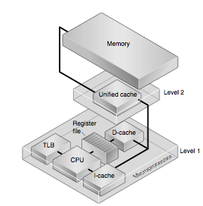
Data Locality Management
Vertical Locality Management
(spatio-temporal optimization)
Horizontal Locality Management
(topology optimization)
Sun Microsystems

Slide 27
Algorithm Complexity Related to FLOPs or Ops
Old Mental Model -- Reduce FLOPs
  FLOPS used to be the most expensive (conserve what is expensive)
  Concern about sustained-to-peak performance (% of peak flop rate)
Technology Trends
  Cost of data movement rising faster than cost of a flop. (IKEA FLOPs)
  New costs center around vertical and horizontal data movement
New Models / Approaches
  Communication Avoiding Algorithms
  Average Communication Distance Model
  More expressive type-systems to express data layouts
    Enables compilers and runtimes info to reason about data layout
  Functional Semantics
    Make data volume and movement trivial to identify and compute
    Make tedious CUDA_copy and ACC data movement directives go away

Slide 28
Software Mechanisms for Expressing Locality

Slide 29
Problems with Existing Abstractions for Expressing Locality
Our current programming models assume all communicating elements are equidistant (PRAM)
  OpenMP, and MPI each assume flat machine at their level of parallelism
But the machine is not flat!!!
  Lose performance because expectation and reality are mismatched
  Pmodel does not match underlying machine model!!
What is wrong with Flat MPI?
  10x higher bandwidth between cores on chip
  10x lower latency between cores on chip
  If you pretend that every core is a peer (each is just a generic MPI rank) you are leaving a lot of performance on the table
  You cannot domain-decompose things forever

Slide 30
Two-level Parallelism? (MPI+X?)
Hybrid Model (MPI+X)
  Recognizes biggest cost delta is when you go off-chip
  This is not the same as old SMPs
    10x-100x higher bandwidth between cores on chip and 10x-100x lower latency
  Failure to exploit hierarchical machine architecture will drastically inhibit ability to efficiently exploit concurrency! (requires code structure changes)
If this abstraction is sufficient to capture performance (within factor of 2x) then why make things more complicated by having hierarchical abstraction?
Notes:
System programmers of serial applications write enough bugs into the code as it is. Now there is another dimension of mistakes that can be made involving incorrect reasoning about data-flow hazards. What we need is a mechanism that fails by inhibiting performance in response to incorrect reasoning rather than getting the wrong answer (and doing so inconsistently). Transactions try to deliver this… if you fail to identify a dataflow hazard (which would normally result in changed answer), then the transaction will roll back and performance collapses to the serial case. Any way that we can degrade performance in response to an error in reasoning rather than outright failing is a benefit.

Slide 31
Current Practices (2-level Parallelism)
Hybrid Model improves 3D FFT communication performance
  Enables node to send larger messages between nodes
  Substantial improvements in communications efficiency
Good News!
Benefits of expressing
Two-levels of locality

Slide 32
Current Practices (2-level Parallelism) NUMA Effects Ignored (with huge consequence)
MPI+OMP Hybrid
  Reduces memory footprint
  Increases performance up to NUMA-node limit
  Then programmer responsible for matching up computation with data layout!! (UGH!)
  Makes library writing difficult and Makes AMR nearly impossible!
It’s the Revenge of the SGI Origin2000
Bad News!
Notes:
How could we let it get this bad!???

Slide 33
Partitioned Global Address Space (PGAS) better expression of data locality
Implicitly binds compute location to data layout
Data Layout in PGAS understands two categories of data access performance
    Local
    Not local
Enables powerful locality aware looping constructs
    Can write loop in conventional form, while typesystem determines data layout
    UPC_FORALL() will execute iterations where data is local (affine renumbering of loop iterations)
      this is HUGE because totally abstracts/virtualizes # cores
      It also implicitly binds execution locality to data layout
This is better than flat model, but . . .

Slide 34
PGAS 1D partitions May Be Insufficient for
Expressing hierarchical energy and locality cost
Hierarchical Energy Costs
  FP Op: 100pj
  Register: 3.5pj
  1mm on chip: 6pj
  20mm on chip: 120pj
  Off-chip (SMP): 250pj
  Off-chip (DRAM): 2000pj
  Off-chip (neighboring node): ~2500pj
  Off-chip (cross-system): ~3000pj

Slide 35
Example from UPC
1D Decomp
  Shared [blocksize] int [nx][ny][nz]
3D Decomp
  Struct gridcell_s { int cell[cellsize] }
  Shared [blocksize] gridcell_t cellgrids[nthreads];
  #define grids(gridno,z,y,z) cell_grids[gridno][((z)/DIMZ) *NO_ROWS*NO_COLS+ etc…..

Slide 36
Multidimensional Blocking?
  Shared [coreblock][nodeblock] int x[nx][ny];
Our target abstract machine
0,0
1,0
2,0
m,0
0,1
1,1
2,1
M,1
0,2
1,2
2,2
M,2
coreblock
0,3
1,3
2,3
M,3
0,n
1,n
2,N
PN
Doesn’t really match our target machine
Nodeblock

Slide 37
Expressing Hierarchical Layout
Hierarchical layout statements
    Express mapping of “natural” enumeration of an array to the unnatural system memory hierarchy
    Maintain unified “global” index space for arrays (A[x][y][z])
    Support mapping to complex address spaces
    Convenient for programmers
Iteration expressions more powerful when they bind to data locality instead of threadnumber
    instead of upc_forall(;;;<threadnumber>)
    Use upc_forall(;;;<implicitly where Array A is local>)
  upc_forall(i=0;i<NX;i++;A)
  C[j]+=A[j]*B[i][j]);

Slide 38
Hierarchical Layout Statements
Building up a hierarchical layout
    Layout block coreblk {blockx,blocky};
    Layout block nodeblk {nnx,nny,nnz};
    Layout hierarchy myheirarchy {coreblk,nodeblk};
    Shared myhierarchy double a[nx][ny][nz];
Then use data-localized parallel loop
  doall_at(i=0;i<nx;i++;a){
    doall_at(j=0;j<ny;j++;a){
    doall_at(k=0;k<nz;k++;a){
    a[i][j][k]=C*a[i+1]…>
And if layout changes, this loop remains the same
Satisfies the request of the application developers
(minimize the amount of code that changes)

Slide 39
Conclusions on Data Layout
Failure to express data locality has substantial cost in application performance
  Compiler and runtime cannot figure this out on its own given limited information current languages and programming models provide
Hierarchical data layout statements offer better expressiveness
  Must be hierarchical
  Must be multidimensional
  Support composable build-up of layout description
Data-centric parallel expressions offer better virtualization of # processors/threads
  Don’t execute based on “thread number”
  Parallelize & execute based on data locality
  Enables layout to be specified in machine-dependent manner without changing execution

Slide 40
Interconnects
Technology Trends and Effects on Application Performance

Slide 41
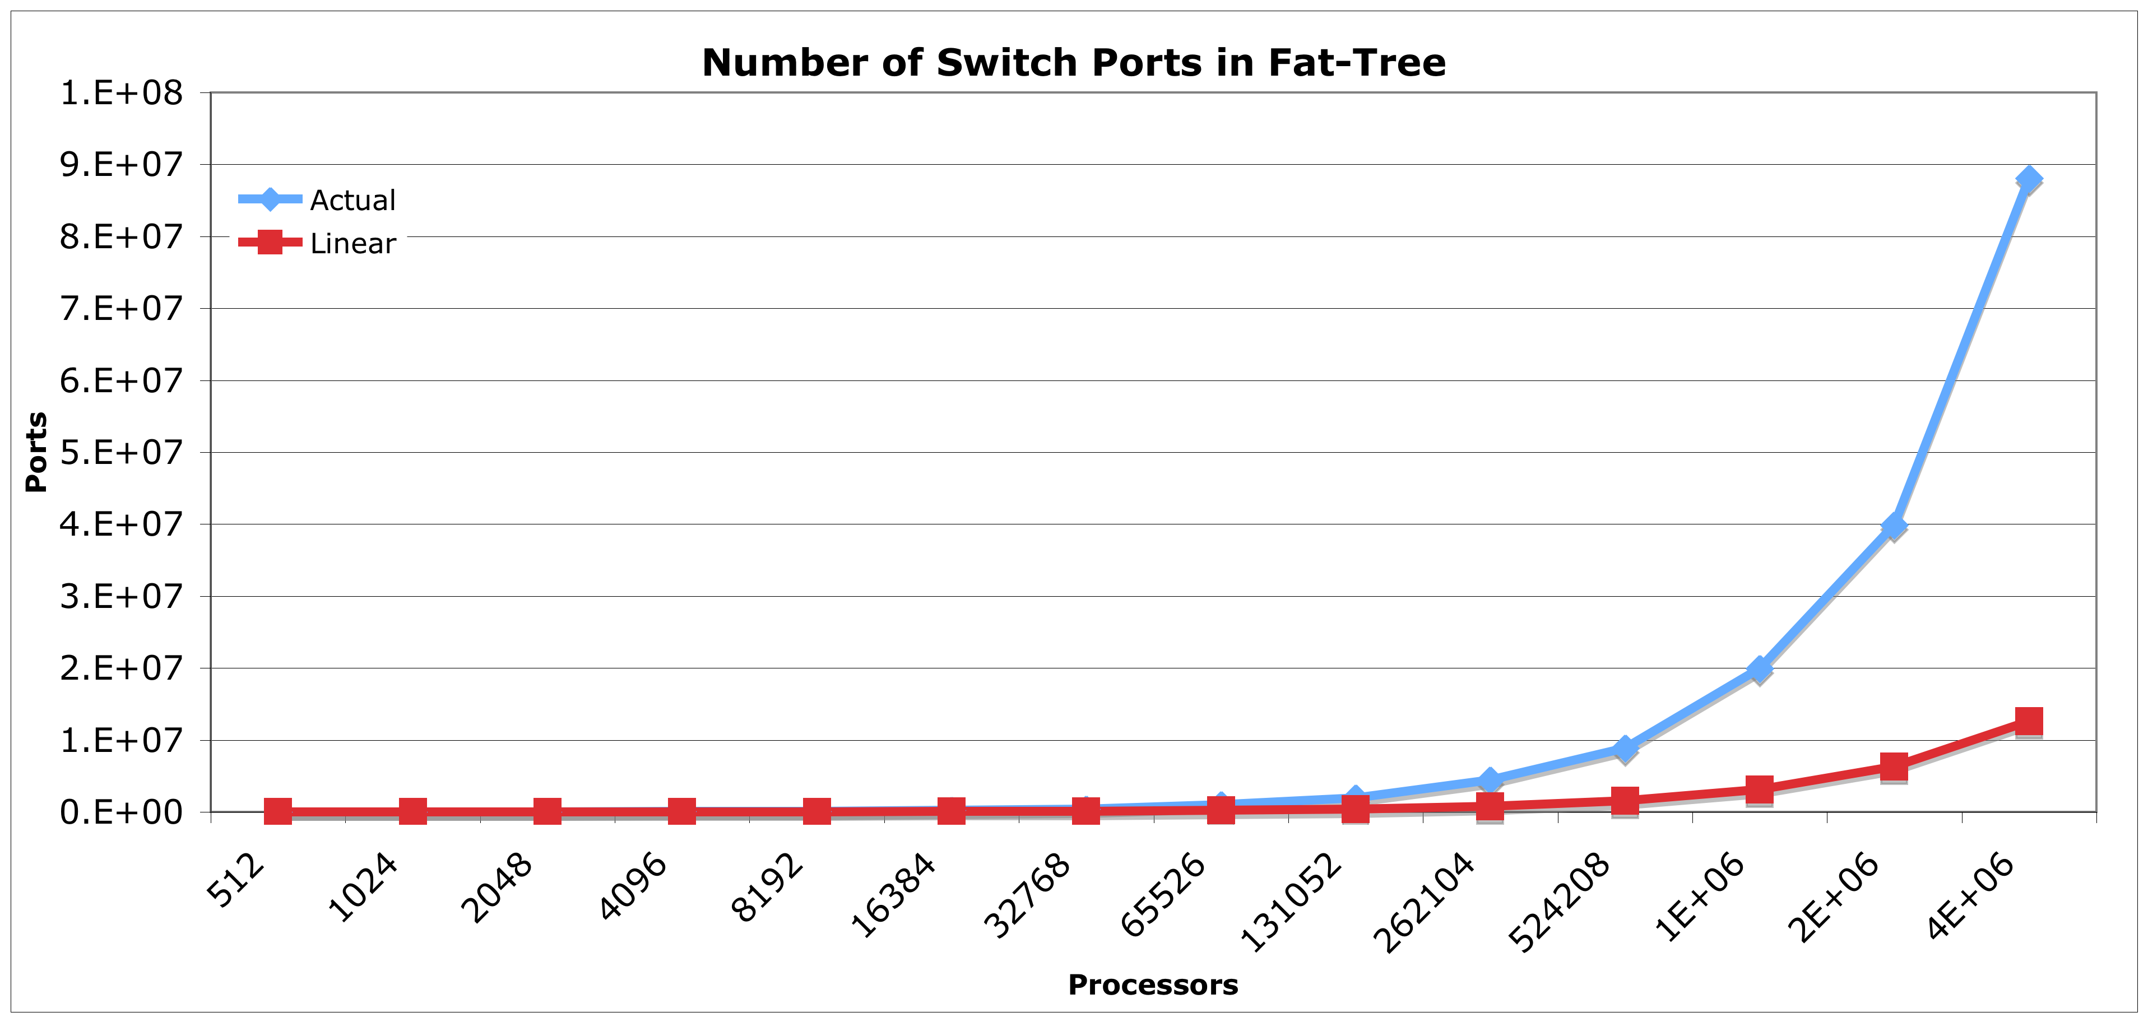
Scalable Interconnects
Can’t afford to continue with Fat-trees or other Fully-Connected Networks (FCNs)
But will Ultrascale applications perform well on lower degree networks like meshes, hypercubes or torii. Or high-radix routers/tapered dragonfly?
How can we wire up a custom interconnect topology for each application?

Slide 42
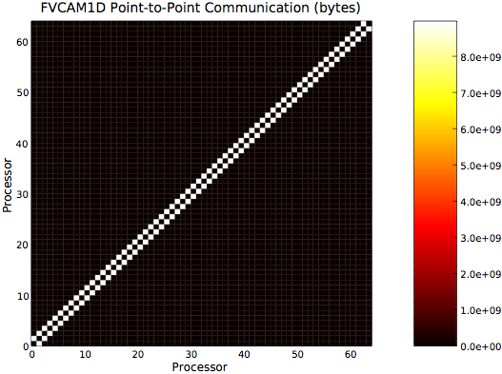
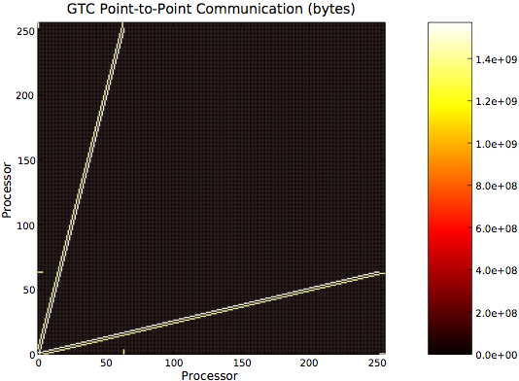
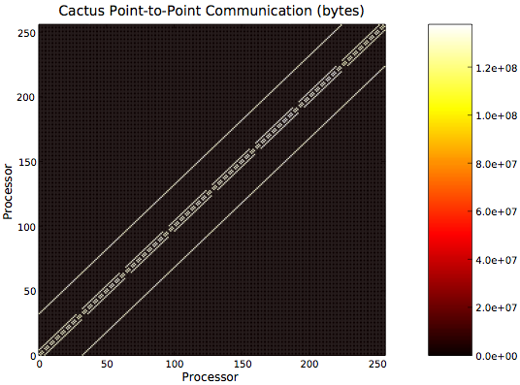

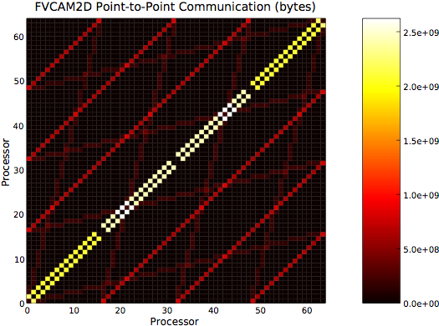
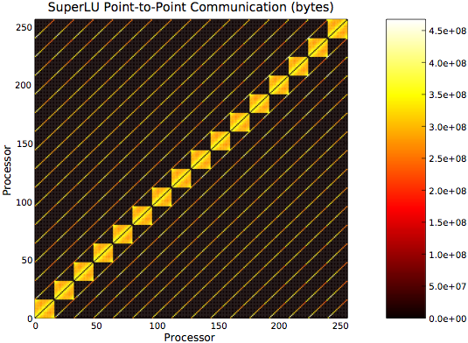
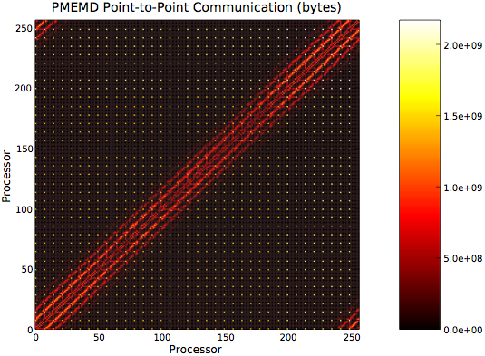
Interconnect Design Considerations for Message Passing Applications
Application studies provide insight to requirements for Interconnects (both on-chip and off-chip)
  On-chip interconnect is 2D planar (crossbar won’t scale!)
  Sparse connectivity for most apps.; crossbar is overkill
  No single best topology
  Most point-to-point message exhibit sparse topology + often bandwidth bound
  Collectives tiny and primarily latency bound
Ultimately, need to be aware of the on-chip interconnect topology in addition to the off-chip topology
  Adaptive topology interconnects (HFAST)
  Intelligent task migration?

Slide 43
Interconnect Design Considerations for Message Passing Applications
Application studies provide insight to requirements for Interconnects (both on-chip and off-chip)
  On-chip interconnect is 2D planar (crossbar won’t scale!)
  Sparse connectivity for most apps.; crossbar is overkill
  No single best topology
  Most point-to-point message exhibit sparse topology + often bandwidth bound
  Collectives tiny and primarily latency bound
Ultimately, need to be aware of the on-chip interconnect topology in addition to the off-chip topology
  Adaptive topology interconnects (HFAST)
  Intelligent task migration?
Opportunity

Slide 44
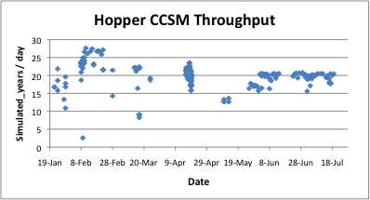
CCSM Performance Variability
(trials of embedding communication topologies)
Result of 311 runs of the coupled climate model showing model throughput as a function of completion date.
COV ~9%
Data from Harvey Wasserman

Slide 45
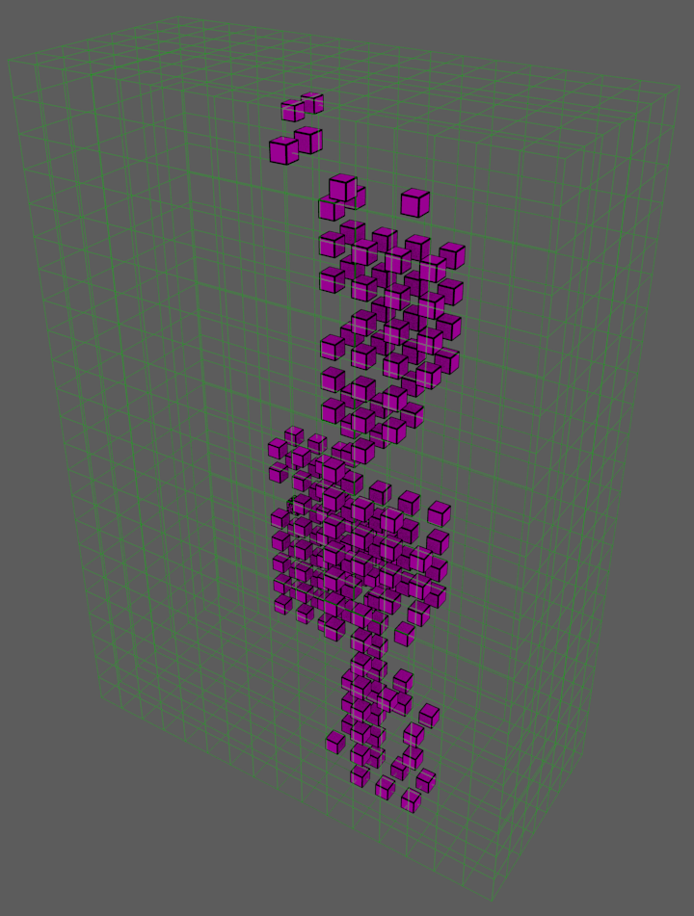
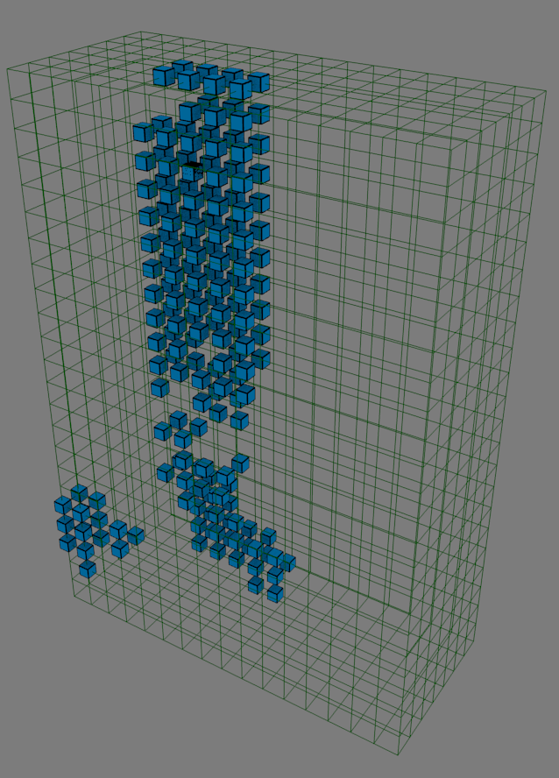
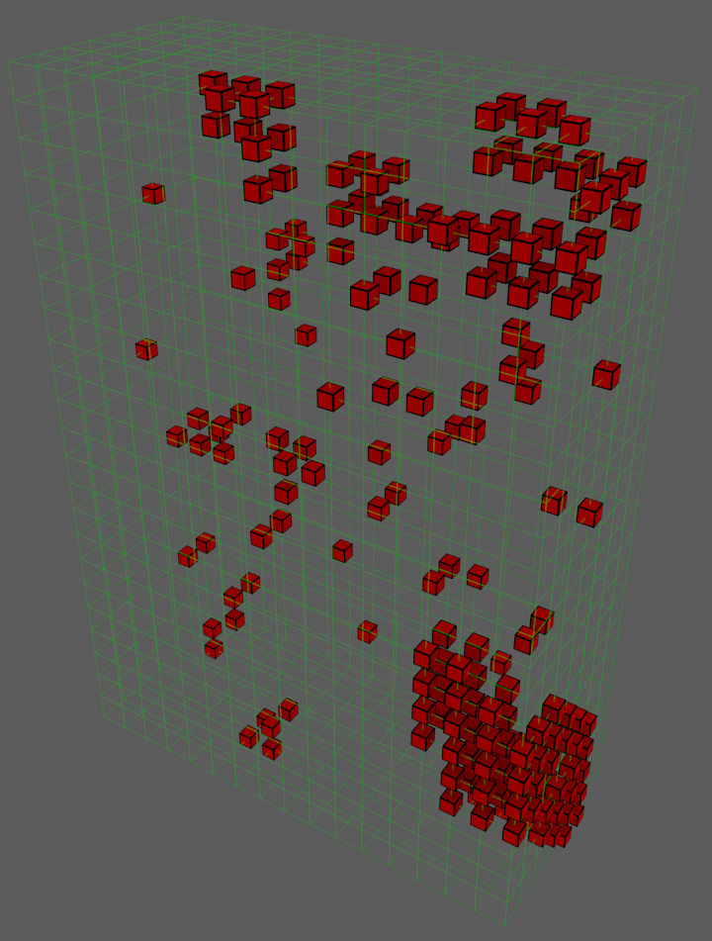
Node placement of a fast, average and slow run
from Katie Antypas
Y=8
Z=24
X=17
Fast run: 940 seconds
Average run: 1100 seconds
Slow run: 2462 seconds

Slide 46
Node placement of a fast, average and slow run
from Katie Antypas
Y=8
Failure to exploit opportunity
(when virtualization of topology goes wrong)
Z=24
X=17
Fast run: 940 seconds
Average run: 1100 seconds
Slow run: 2462 seconds

Slide 47
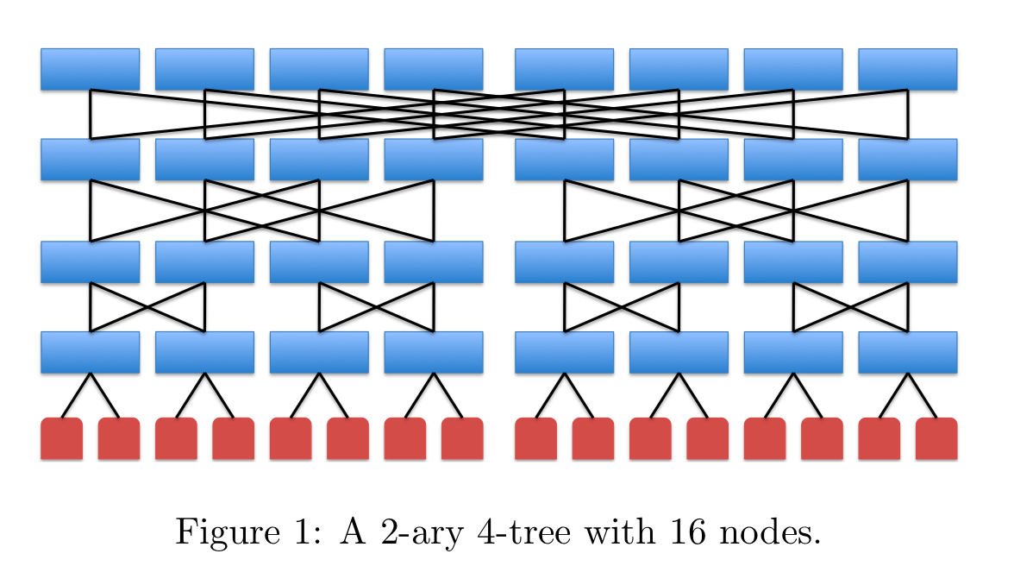
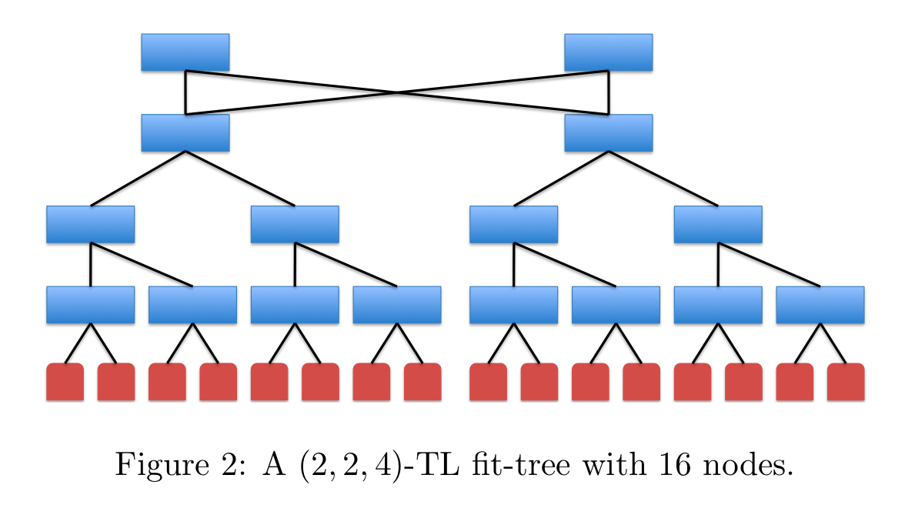
Topology Optimization
(turning Fat-trees into Fit-trees)
A Fit-tree uses OCS to prune unused (or infrequently used) connections in a Fat-Tree
Tailor the interconnect bandwidth taper to match application data flows

Slide 48
Conclusions on Interconnect
Huge opportunity for communication topology optimization to improve performance
    Runtime information gathering for active task migration, circuit switching
    Use intelligent runtime to remap for locality or to use circuit switching to optimize switch topology
Current Programming Models do not provide facility to express topology
    OpenMP topology un-aware
    MPI has topology directives (tedious, and rarely implemented or used)
    Results in substantial measurable losses in performance (within node/OpenMP and inter-node/MPI)
Need to provide the compiler, runtime & resource manager more information about topology

Slide 49
Heterogeneity / Inhomogeneity
The case for asynchronous runtime systems
(aka “execution models”)

Slide 50
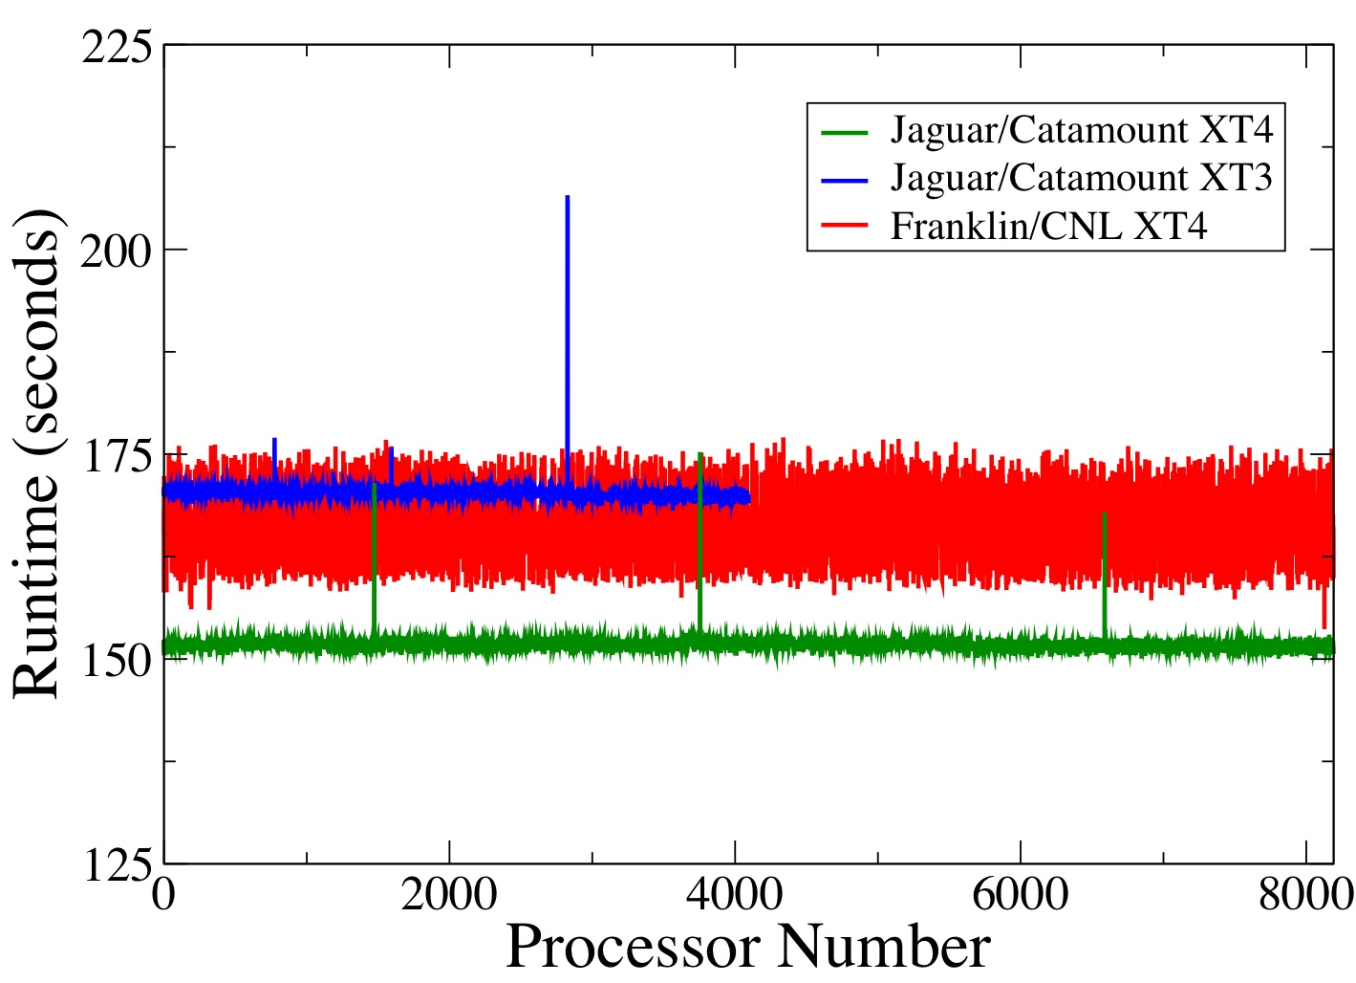
Assumptions of Uniformity is Breaking
(many new sources of heterogeneity)
Heterogeneous compute engines (hybrid/GPU computing)
Irregular algorithms
Fine grained power mgmt. makes homogeneous cores look heterogeneous
    thermal throttling on Sandybridge – no longer guarantee deterministic clock rate
Nonuniformities in process technology creates non-uniform operating characteristics for cores on a CMP
Fault resilience introduces inhomogeneity in execution rates
    error correction is not instantaneous
    And this will get WAY worse if we move towards software-based resilience
Notes:
David Wessel: fired if you miss a beat.

Slide 51
Conclusions on Heterogeneity
Sources of performance heterogeneity increasing
  Heterogeneous architectures (accelerator)
  Thermal throttling
  Performance heterogeneity due to transient error recovery
Current Bulk Synchronous Model not up to task
  Current focus is on removing sources of performance variation (jitter), is increasingly impractical
  Huge costs in power/complexity/performance to extend the life of a purely bulk synchronous model
Embrace performance heterogeneity: Study use of asynchronous computational models (e.g. SWARM, HPX, and other concepts from 1980s)

Slide 52
Why Wait for Exascale everything is breaking NOW!

Slide 53
The Power and Clock Inflection Point in 2004
Source: Kogge and Shalf, IEEE CISE

Slide 54
It’s the End of the World as We Know It!
Summary Trends
Source: Kogge and Shalf, IEEE CISE

Slide 55
Why Wait for Exascale Machine?
The changes we are concerned about are underway NOW
Specifics of exascale machine are not as important as the design TRENDS
Focus on the first derivative of change rather than the target point design
  If you focus on target design, then it will create a brittle non-performance-portable solution
  Performance portability SHOULD be the right metric (how little code to change between generations of machines)
  Architectural Simulation helps us with sensitivity analysis and extrapolation
To this end, we should concentrate on what hardware abstractions correctly minimize the impact of these design trends
  How do I make # cores seemingly go away? (or scale without intervention)
  How do I express communication costs in a way that makes it easier to reason about data placement/locality without being pinned down to the specifics of one machine

Slide 56
Remember the Abstract Machine Model
Programming model IS, and SHOULD BE a proper reflection of the underlying machine architecture
Machine attributes are parameterized
  Changes with each generation of machine and between different vendor implementations
  Pmodel should target the parameterized attributes
For each parameterized machine attribute
Ignore it: If ignoring it has no serious power/performance consequences
Abstract it (virtualize): If it is well enough understood to support an automated mechanism to optimize layout or schedule
Expose it (unvirtualize): If there is not a clear automated way of make decisions

Slide 57
Conclusions
Data layout (currently, make it more expressive)
  Need to support hierarchical data layout that closer matches architecture
  Automated method to select optimal layout is elusive, but type-system can support minimally invasive user selection of layout
Horizontal locality management (virtualize)
  Flexibly use message queues and global address space
  Give intelligent runtime tools to dynamically compute cost of data movement
Vertical data locality management (make more expressive)
  Need good abstraction for software managed memory
  Malleable memories (allow us to sit on fence while awaiting good abstraction)
Heterogeneity (virtualize)
  Its going to be there whether you want it or not
  Pushes us towards async model for computation (post-SPMD)
Parallelism (virtualize)
  Need abstraction to virtualize # processors (but must be cognizant of layout)
  For synchronous model (or sections of code) locality-aware iterators or loops enable implicit binding of work to local data.
  For async codes, need to go to functional model to get implicit parallelism
    Helps with scheduling
    Does not solve data layout problem

