Slide 1
The Stampede is Coming: A New Petascale Resource for the Open Science Community
Dan Stanzione
Deputy Director
Texas Advanced Computing Center
dan@tacc.utexas.edu

Slide 2
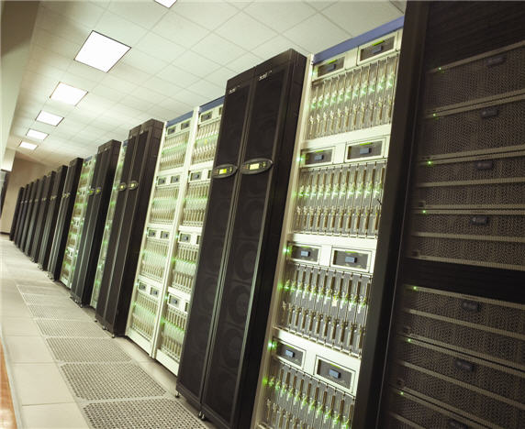
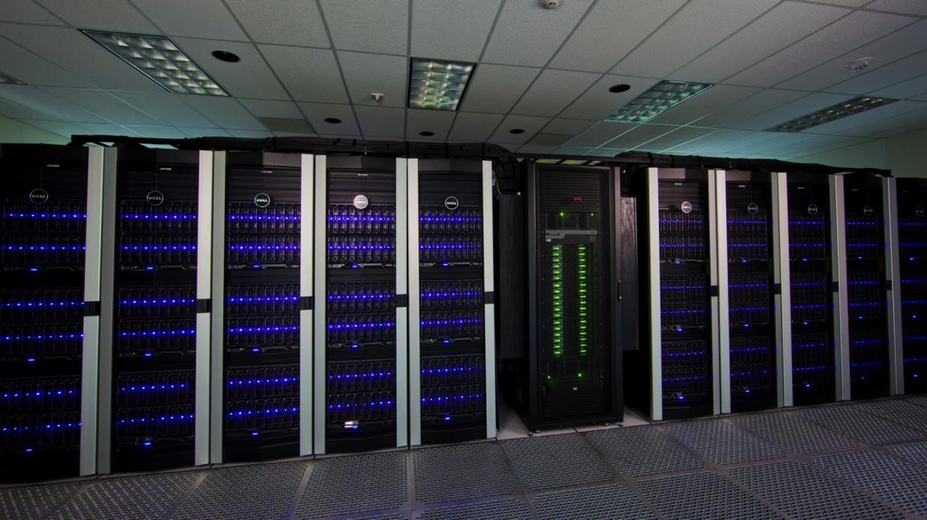
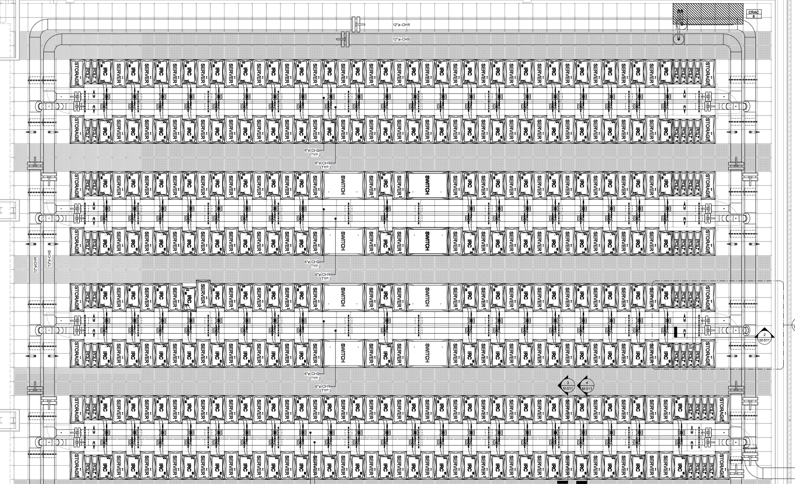
The Texas Advanced Computing Center:
A Leader in High Performance Computing
1,000,000x performance increase in computing capability in 10 years.
Ranger: 62,976 Processor Cores, 123TB RAM, 579 TeraFlops, Fastest Open Science Machine in the World, 2008
Lonestar: 23,000 processors, 44TB RAM, Shared Mem and GPU subsystems, #25 in the world 2011
Stampede: Coming soon…

Slide 3
Stampede
A new NSF-funded XSEDE resource at TACC
Funded two components of a new system:
  Two+ petaflop, 100,000+ core Xeon E5 based Dell cluster to be the new workhorse of the NSF open science community (>3x Ranger)
  Up to eight additional petaflops of Intel Many-Integrated-Core (MIC) Xeon Phi processors to provide a revolutionary innovative capability: a new generation of supercomputing.
  Change the power/performance curves of supercomputing without changing the programming model (terribly much).

Slide 4
Stampede - Headlines
Up to 10PF Peak performance in initial system (Early 2013)
  100,000+ conventional Intel processor cores
  Almost 500,000 total cores with Intel Xeon Phi
Upgrade with “Future Knight’s” in 2015
14PB+ disk
272TB+ RAM
56Gb FDR InfiniBand interconnect
Nearly 200 racks of compute hardware (10,000 sq ft)
>SIX MEGAWATTS total power

Slide 5
The Stampede Project
A Complete Advanced Computing Ecosystem:
  HPC Compute, storage, interconnect
  Visualization subsystem (144 high end GPUs)
  Large memory support (16 1TB nodes)
  Integration with archive, and (coming soon) TACC global work filesystem and other data systems
  People, training, and documentation to support computational science
Hosted at an expanded building in TACC; massive power upgrades
  12MW new total datacenter power
  Thermal energy storage to reduce operating costs

Slide 6
Contrast with Blue Waters
Stampede is tasked with the “broad” instead of “deep” mission.
  We estimate more than 1,000 projects will be supported on Stampede.
  Blue Waters will handle a few of the very largest problems.
  Stampede will run big problems too, but also lots and lots of small and midsize jobs.
Smaller budget, shorter timescale.
Stampede will be part of XSEDE

Slide 7

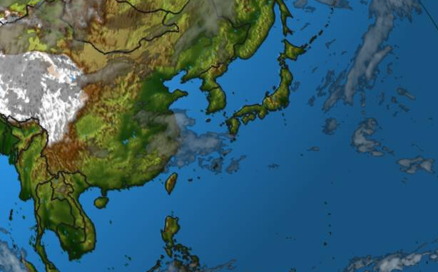
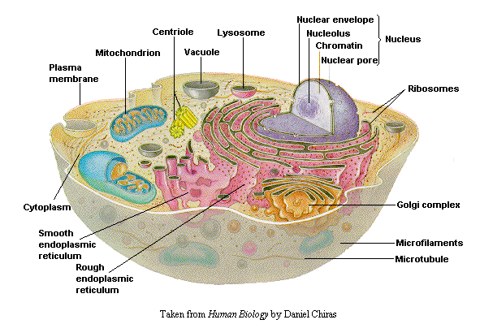
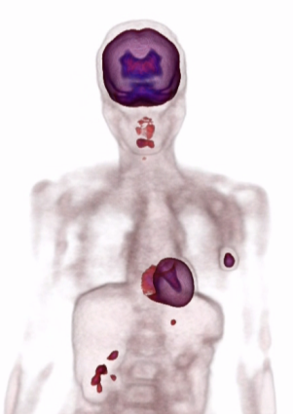
HPC Needs Decades of Moore’s Law
Weather Prediction
1 ZFlops
100 EFlops
10 EFlops
Genomics Research
1 EFlops
100 PFlops
10 PFlops
Medical Imaging
1 PFlops
100 TFlops
10 TFlops
1 TFlops
100 GFlops
10 GFlops
1 GFlops
100 MFlops
1993
1999
2005
2011
2017
2023
2029
Data Source: www.top500.org (Courtesy Intel)
Notes:
7
7

Slide 8
An Inflection point (or two) in High Performance Computing
Relatively “boring”, but rapidly improving architectures for the last 15 years.
Performance rising much faster than Moore’s Law…
  But power rising faster
  And concurrency rising faster than that, with serial performance decreasing.
Something had to give

Slide 9
Consider this Example
Homogeneous v. Heterogeneous
  Acquisition costs and power consumption
Homogeneous system: K computer in Japan
  10 PF unaccelerated
  Rumored ~$1 billion acquisition costs
  Large power bill (13MW) and foot print (800 racks)
Heterogeneous system: Stampede at TACC
  Near 10PF (2 SNB + up to 8 MIC)
  Modest footprint: 8,000 ft², 5MW, 180 racks.
  $27.5 million
Notes:
Don’t get your hopes up
Only somebody like Jay call pull off such a deal

Slide 10
Accelerated Computing for Exascale
Exascale systems, predicted for 2018, would have required 500MW on the “old” curves.
Something new was clearly needed.
The “accelerated computing” movement was reborn (this happens periodically, starting with 387 math coprocessors).

Slide 11
Key aspects of acceleration
We have lots of transistors… Moore’s law is holding; this isn’t necessarily the problem.
We don’t really need lower power per transistor, we need lower power per *operation*.
How to do this?

Slide 12
The GPU Approach
Don’t repeat the past mistakes of failed accelerators (i.e. have another market to drive volume and development).
Streaming model
Simpler processors, lots of concurrency (work by compilers or programmers doesn’t cost power at runtime).
Very large die (tolerate failures to get yield).

Slide 13
More accelerators
nVidia leads this charge in GPU, but there are many similar competing ideas:
  ARM (Marvell/Calxeda) (simple cores, lots per die, low power per operation).
  AMD Fusion (AMD cores plus GPU cores on same die).
  FPGA (large arrays, lower power by special purpose circuit per application

Slide 14
Intel’s MIC approach
Since the days of RISC vs. CISC, Intel has mastered the art of figuring out what is important about a new processing technology, and saying “why can’t we do this in x86?”
The Intel Many Integrated Core (MIC) architecture is about large die, simpler circuit, much more parallelism, in the x86 line.

Slide 15
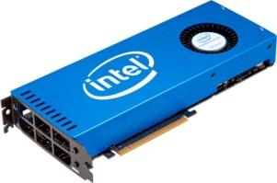
What is MIC?
Basic Design Ideas
  Leverage x86 architecture (CPU with many cores)
    x86 cores that are simpler, but allow for more compute throughput
  Leverage (Intel’s) existing x86 programming models
  Dedicate much of the silicon to floating point ops., keep some cache(s)
  Keep cache-coherency protocol
  Increase floating-point throughput per core
  Implement as a separate device
  Strip expensive features (out-of-order execution, branch prediction, etc.)
  Widen SIMD registers for more throughput
  Fast (GDDR5) memory on card

Slide 16
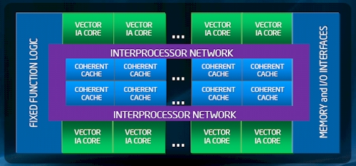
MIC Architecture
Many cores on the die
L1 and L2 cache
Bidirectional ring network
Memory and PCIe connection
Knights Ferry –SW Dev Platform
Up to 32 cores
1-2 GB of GDDR5 RAM
512-bit wide SIMD registers
L1/L2 caches
Multiple threads (up to 4) per core
Slow operation in double precision
Xeon PHI (was Knights Corner)
First product
Used in Stampede
50+ cores
Increased amount of RAM
Details are under NDA
22 nm technology
MIC (KNF) architecture block diagram

Slide 17
Stampede: Programming Models
A ~2PF Xeon-only system (MPI, OpenMP)
A ~8PF MIC-only system (MPI, OpenMP)
A ~10PF heterogeneous system (MPI, OpenMP)
  Run separate MPI tasks on Xeon vs. MIC, or use OpenMP extensions for offload for hybrid programs.

Slide 18
Stampede
Base Cluster:
  Intel Sandy Bridge processors
  Dell dual-socket nodes w/32GB RAM
  More than 6,000 nodes
  More than 100,000 cores
Co-Processors:
  Intel “MIC” Many Integrated Core processors
  Special release of “Knight’s Corner” (>50 cores)
  “Knight’s Ferry” development platforms at TACC now
Total Concurrency approaching 500,000 cores

Slide 19
Power/Physical
Stampede will physically use 182 48U cabinets.
Power density (after upgrade in 2015) will exceed 40kW per rack.
Estimated 2015 peak power is 6.2MW.

Slide 20
Key Datacenter Features
Thermal energy storage to reduce peak power charges
Hot aisle containment to boost efficiency (and simply provide enough cooling).
Total IT power to 9.5MW, total power ~12MW.
Expand experiments in mineral oil cooling.

Slide 21
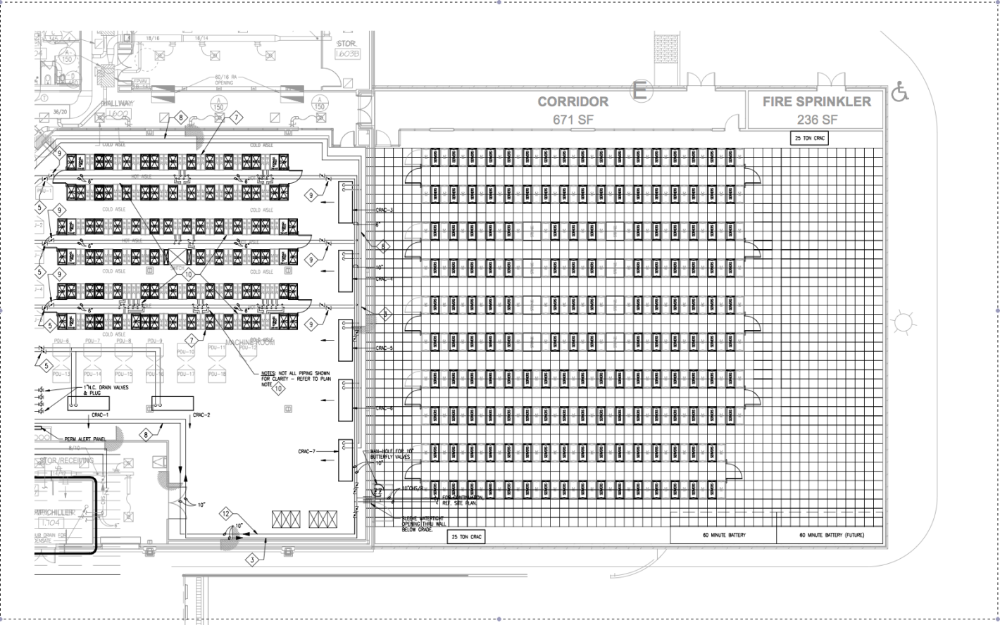
Datacenter Expansion
Ranger: 3000 ft²
Stampede: 8000 ft²

Slide 23
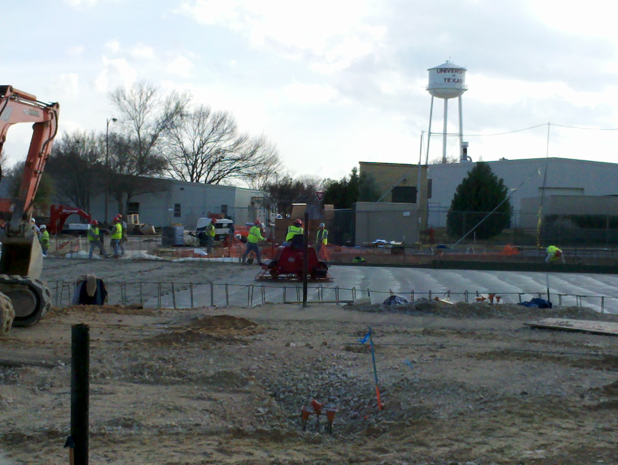
Stampede Datacenter –February 20th

Slide 24
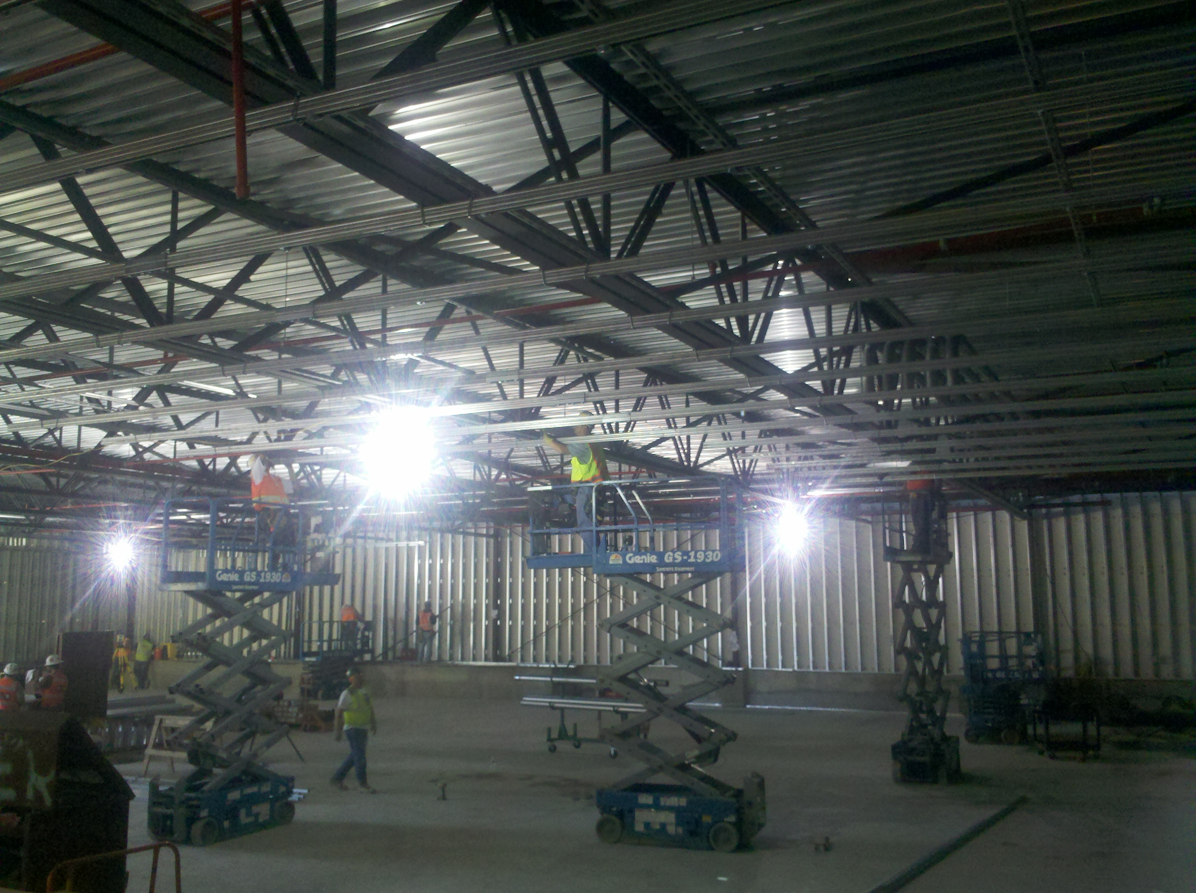
Stampede Datacenter – March 22nd

Slide 25
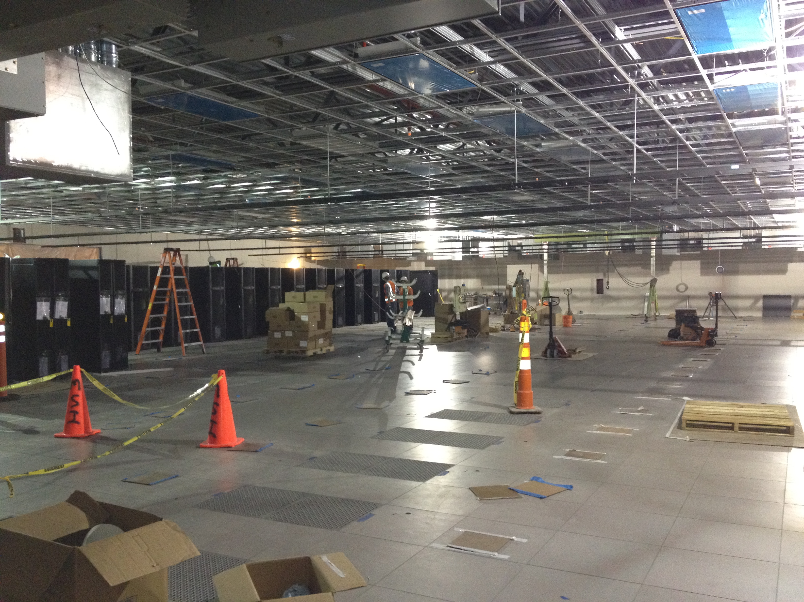
Stampede Datacenter – May 16th

Slide 26
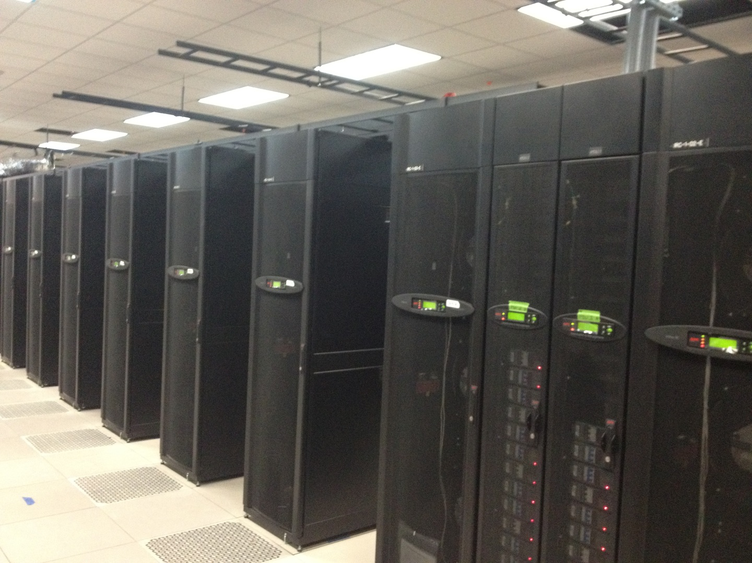
Stampede Datacenter – June 20th

Slide 27
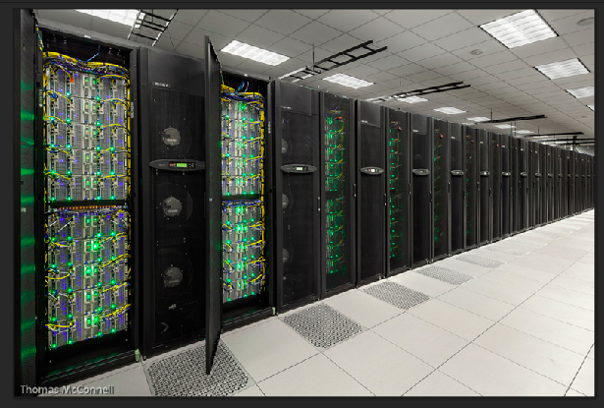
Stampede Datacenter, ~September 10th

Slide 28
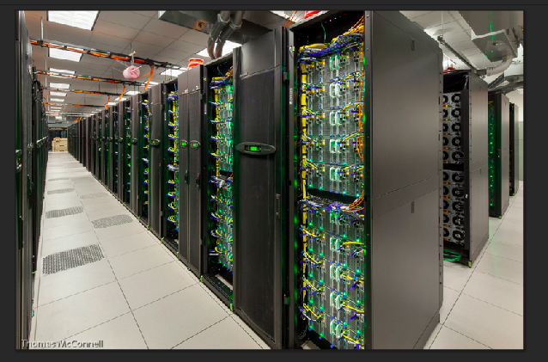
Stampede Datacenter, ~September 10th

Slide 29
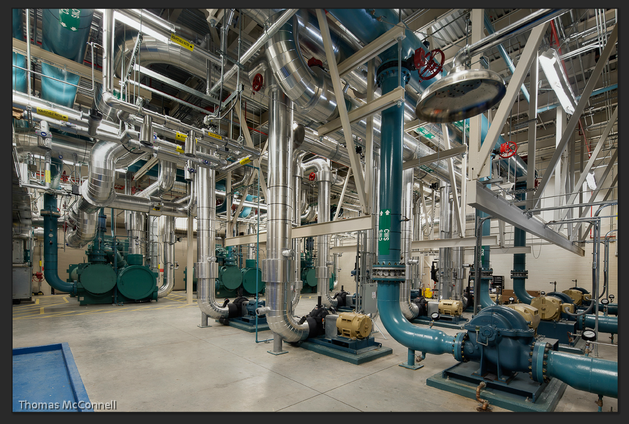
Some utilities are involved

Slide 30
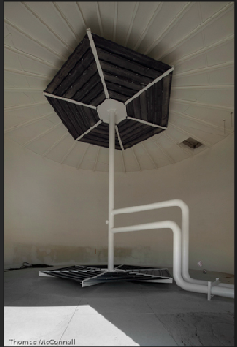
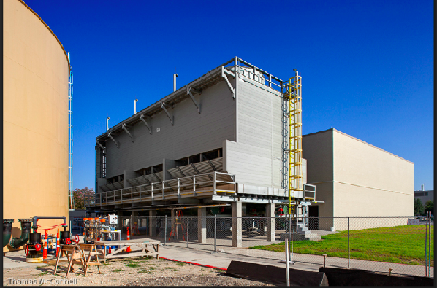
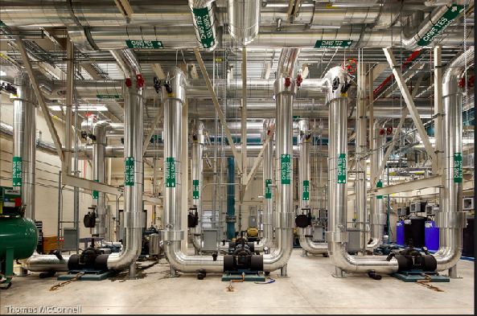
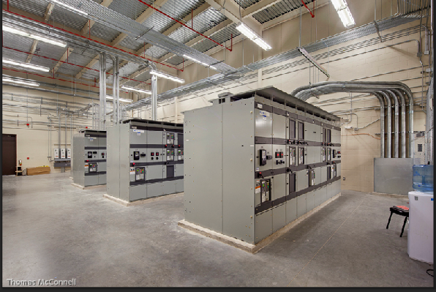
Actually, way more utility space than machine space
Turns out the utilities for the datacenter costs more, takes more time and more space than the computing systems

Slide 31
New Technologies/Milestones in the Stampede Project
Density: surpasses 40KW/Cabinet
  New Dell node designs to support multiple 300W expansion cards in single node ~1U
Total system power past 5 *megawatts*
  Thermal storage technology incorporated.
Breakthrough price/performance and power/performance.
  Inclusion of Intel MIC; but we must program it.
Application concurrency past 1 *million* threads per application

Slide 32
What we at TACC like about MIC
Intel’s MIC is based on x86 technology
  x86 cores w/ caches and cache coherency
  SIMD instruction set
Programming for MIC is similar to programming for CPUs
  Familiar languages: C/C++ and Fortran
  Familiar parallel programming models: OpenMP & MPI
  MPI on host and on the coprocessor
  Any code can run on MIC, not just kernels
Optimizing for MIC is similar to optimizing for CPUs
  “Optimize once, run anywhere”
  Our early MIC porting efforts for codes “in the field” are frequently doubling performance on Sandy Bridge.

Slide 33
Will My Code Run on MIC?
Yes
That’s the wrong question, it’s:
  Will your code run *best* on MIC?, or
  Will you get great MIC performance without additional work?

Slide 34
Early MIC Programming Experiences at TACC
Codes port easily
  Minutes to days depending mostly on library dependencies
Performance can require real work
  While the sw environment continues to evolve
  Getting codes to run *at all* is almost too easy; really need to put in the effort to get what you expect
Scalability is pretty good
  Multiple threads per core *really important*
  Getting your code to vectorize *really important*

Slide 35
Adapting and Optimizing Code for MIC
Hybrid Programming
  MPI + Threads (OpenMP, etc.)
Optimize for higher thread performance
  Minimize serial sections and synchronization
Test different execution models
  Symmetric vs. Offloaded
Optimize for L1/L2 caches
Test performance on MIC
Optimize for specific architecture
Start production
Today “Any” resource
Today/Soon Knights Ferry
Stampede MIC 2013+
Notes:
Engineering product not for public

Slide 36
Stampede Programming
Five Possible Models
Host-only
Offload
Symmetric
Reverse Offload
MIC Native

Slide 41
Programming Models
Ready to use on day one
TBB’s will be available to C++ programmers
MKL will be available
  Automatic offloading by compiler for some MKL features
  (probably most transparent mode)
Cilk Plus
  Useful for task-parallel programing (add-on to OpenMP)
  May become available for Fortran users as well
OpenMP
  TACC expects that OpenMP will be the most interesting programming model for our HPC users

Slide 42
MIC Programming with OpenMP
MIC specific pragma precedes OpenMP pragma
  Fortran: !dir$ omp offload target(mic) <…>
  C: #pragma offload target(mic) <…>
All data transfer is handled by the compiler
(optional keywords provide user control)
Options for:
  Automatic data management
  Manual data management
  I/O from within offloaded region
    Data can “stream” through the MIC; no need to leave MIC to fetch new data
    Also very helpful when debugging (print statements)
  Offloading a subroutine and using MKL

Slide 43
The Stampede is Coming
Stampede has a *lot* of new technologies, and as such has a certain element of risk.
However, as of now, we expect the early user/science period to begin in December.
Full production by January 7th (Base system at least).
You might hear some more about this machine at SC12 in November ☺.
Thank to NSF, Intel, Dell

Slide 44
Roadmap
What comes next?
How to get prepared?
Many HPC applications are pure-MPI codes
Start thinking about upgrading to a hybrid scheme
Adding OpenMP is a larger effort than adding MIC directives
Special MIC/OpenMP considerations
  Many more threads will be needed: 50+ cores (Production KNC) ➞ 50+/100+/200+ threads
  Good OpenMP scaling will be (much) more important
  Vectorize, vectorize, vectorize
  There is no unified last-level cache (LLC): Cache shared among cores, several MB on CPUs
Stay tuned
The coming years will be exciting …

Slide 45
Can I use Stampede?
Yes!
We expect to have 5,000-10,000 academic users next year.
See Jeff’s talk about XSEDE later today.
Every academic researcher can apply for a startup account, and eventually larger.

Slide 46
At this point, there is a very slight chance I’ve left time for questions.
(Certainly, I’ve created enough confusion for them)
Thanks for listening!
dan@tacc.utexas.edu

