Slide 1
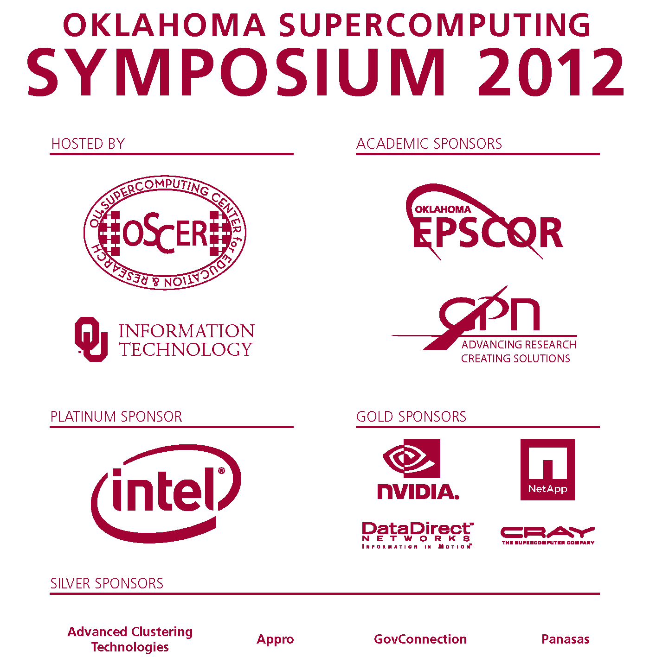
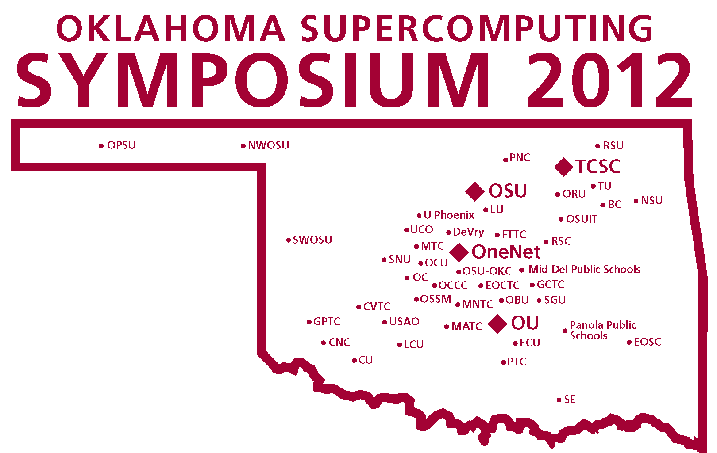

Welcome to the

Slide 2





OSCER
State of the Center
Henry Neeman, OSCER Director
hneeman@ou.edu
OU Supercomputing Center for Education & Research
A Division of OU Information Technology
Wednesday October 3 2012
University of Oklahoma

Slide 3
Preregistration Profile 2012
Organizations: 67 preregistered
  Academic: preregistered 26 institutions in 9 states (AR,GA,IL,KS,LA,MI,NC,OK,TX)
    Includes 19 institutions in 4 EPSCoR states (AR,KS,LA,OK)
  Industry: preregistered 28 firms
  Government: preregistered 9 agencies (federal, state)
  Non-governmental: preregistered 4 organizations
Demographics (241 preregistered)
  35% OU, 65% non-OU
  72% Oklahoma, 28% non-Oklahoma
  81% from EPSCoR states, 19% non-EPSCoR
  74% academic, 26% non-academic

Slide 4
Attendee Profile 2002-2012
Over 2500 attendees at 11 Symposia
  69 in 2002, 225-325 per year thereafter
Organizations: 251
  Academic: from 98 institutions in 27 US states & territories
    60+ institutions in 14 EPSCoR jurisdictions
    28 institutions in Oklahoma
      PhD-granting, masters-granting, bachelors-granting, community college, career tech, high school
      Historically Black University, Tribal College
      public, private, for-profit
  Industry: attendees from 107 firms
  Government: attendees from 32 agencies (federal, state, municipal, foreign)
  Non-governmental: attendees from 14 organizations

Slide 5
Symposium 2012 Sponsors
Academic sponsors
  Oklahoma EPSCoR
  Great Plains Network
Industry sponsors
  Platinum: Intel
  Gold: Cray, Dell, DataDirect Networks, NetApp, NVIDIA
  Silver: Advanced Clustering Technologies, Appro, GovConnection, Panasas
  Bronze: Avere, Gnodal, Oracle
Thank you all! Without you, the Symposium couldn’t happen.
Over the past 11 Symposia, we’ve had a total of 64 companies as sponsors.

Slide 6
Some Accomplishments
Submitting OK’s NSF EPSCoR RII Track-1 proposal today!
  The most ambitious – yet very achievable – CI plan in Oklahoma history!
Over 500,000 batch jobs run already on Boomer (opened to users in May).
“Supercomputing in Plain English” overview talk has reached every public university and every private university with relevant degree programs except one.
  If anyone has a contact at OK Wesleyan U, let me know ....
“A Day in the Life of an IT Professional” talks: so far
53 visits to over 1000 students, faculty, staff and guests at 27 institutions.

Slide 7
Outline
OU
  Resources
  Accomplishments
OCII

Slide 8
Resources

Slide 9
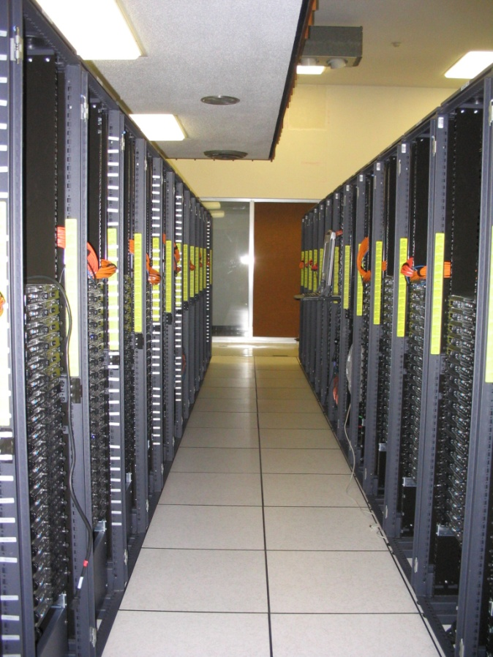
Dell Intel Xeon Linux Cluster
1,076 Intel Xeon CPU chips/4288 cores
528 dual socket/quad core Harpertown 2.0 GHz, 16 GB each
3 dual socket/quad core Harpertown 2.66 GHz, 16 GB each
3 dual socket/quad core Clovertown 2.33 GHz, 16 GB each
2 x quad socket/quad core Tigerton, 2.4 GHz, 128 GB each
8,800 GB RAM
~130 TB globally accessible disk
QLogic Infiniband
Force10 Networks Gigabit Ethernet
Red Hat Enterprise Linux 5
Peak speed: 34.5 TFLOPs*
*TFLOPs: trillion calculations per second
sooner.oscer.ou.edu

Slide 10
Dell Intel Xeon Linux Cluster
1,076 Intel Xeon CPU chips/4288 cores
528 dual socket/quad core Harpertown 2.0 GHz, 16 GB each
3 dual socket/quad core Harpertown 2.66 GHz, 16 GB each
3 dual socket/quad core Clovertown 2.33 GHz, 16 GB each
2 x quad socket/quad core Tigerton, 2.4 GHz, 128 GB each
8,800 GB RAM
~130 TB globally accessible disk
QLogic Infiniband
Force10 Networks Gigabit Ethernet
Red Hat Enterprise Linux 5
Peak speed: 34.5 TFLOPs*
*TFLOPs: trillion calculations per second
DEAD
sooner.oscer.ou.edu

Slide 11

Dead Supercomputer Club
http://www.cp-tel.net/pasqualy/kingmole/242F.jpg

Slide 12
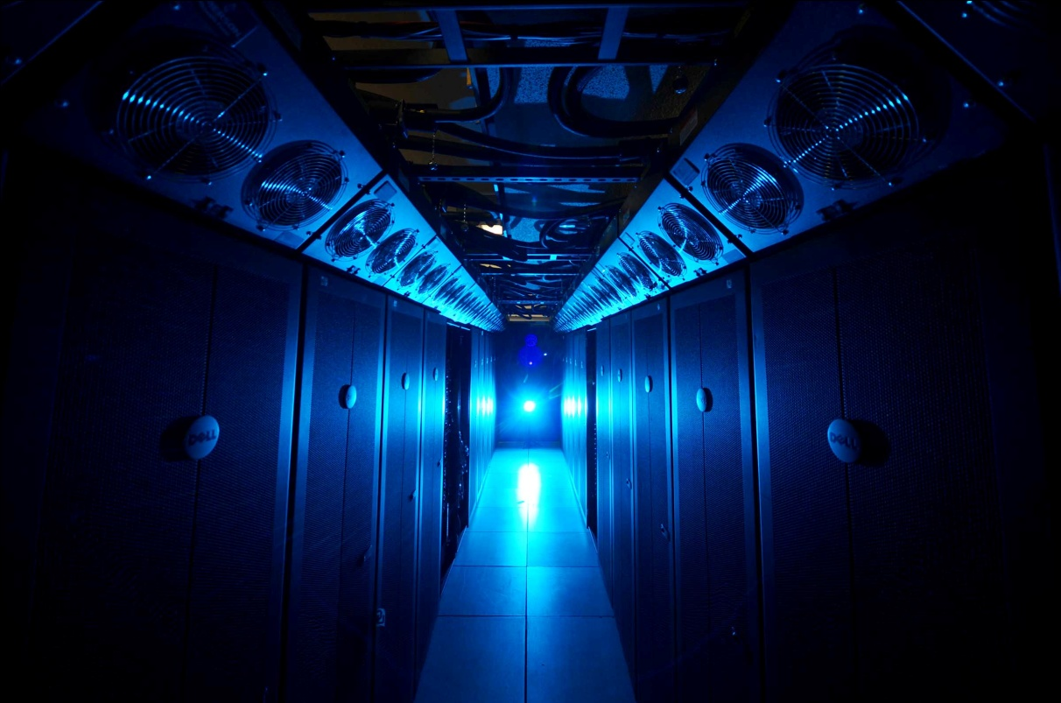
NEW SUPERCOMPUTER!
874 Intel Xeon CPU chips/6992 cores
412 dual socket/oct core Sandy Bridge 2.0 GHz, 32 GB
23 dual socket/oct core Sandy Bridge 2.0 GHz, 64 GB
1 quad socket/oct core Westmere, 2.13 GHz, 1 TB
15,680 GB RAM
~360 TB global disk
QLogic Infiniband
(16.67 Gbps, ~1 microsec latency)
Dell Force10 Gigabit/10G Ethernet
Red Hat Enterprise Linux 6
Peak speed: 111.6 TFLOPs*
*TFLOPs: trillion calculations per second
Just over 3x (300%) as fast as our 2008-12 supercomputer.
Just over 100x (10,000%) as fast as our first cluster supercomputer in 2002.
Photo: Jawanza Bassue
boomer.oscer.ou.edu

Slide 13
NEW SUPERCOMPUTER!
874 Intel Xeon CPU chips/6992 cores
412 dual socket/oct core Sandy Bridge 2.0 GHz, 32 GB
23 dual socket/oct core Sandy Bridge 2.0 GHz, 64 GB
1 quad socket/oct core Westmere, 2.13 GHz, 1 TB
15,680 GB RAM
~360 TB global disk
QLogic Infiniband
(16.67 Gbps, ~1 microsec latency)
Dell Force10 Gigabit/10G Ethernet
Red Hat Enterprise Linux 6
Peak speed: 111.6 TFLOPs*
*TFLOPs: trillion calculations per second
19% of the nodes are
“condominium” (owned by individual
research teams): ~4x as many as all OSCER’s
previouos clusters combined.
Photo: Jawanza Bassue
boomer.oscer.ou.edu

Slide 14
Improvement in OSCER Hardware
GFLOPs: 2012 = 103 x 2002
RAM: 2012 = 57 x 2002
CPU cores: 2012 = 28 x 2002
Moore’s Law: 2012 = 32 x 2002

Slide 15
OU Research IT Personnel
OSCER
  Director: Henry Neeman
  Associate Director for Remote & Heterogeneous Computing: Horst Severini
  Manager of Operations: Brandon George
  Senior System Administrator: David Akin
  Senior System Administrator: Brett Zimmerman
  HPC Application Software Specialist: Josh Alexander
  Administrative Specialist: Debi Gentis
  Petascale Storage Administrator: Patrick Calhoun
  NEW! Deputy Director Brian Cremeans

Slide 16
OU Research IT Personnel
Informatics
  Brian Cremeans
  Jonah Duckles
  Mark Stacy

Slide 17
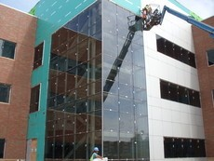
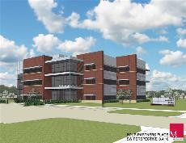
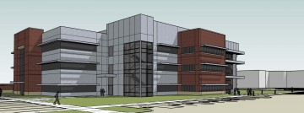
New Building!
Four Partners Place: just past SRTC, where we were last night
We’ll be moving in very soon.

Slide 18
Accomplishments

Slide 19
External Research Grants
I.Y. Akkutlu, J. Callard, C. Rai, C. Sondergeld, “OU Shale Gas and Unconventional Reservoir Research Cooperative,” $2.8M per year
J. P. Shaffer, T. Pfau, “A Rydberg Atom Electric Field Sensor,” DARPA-ARO, $1.18M (total),$1.06M (OU)
Y. Luo, “Data Synthesis and Data Assimilation at Global Change Experiments and Fluxnet toward Improving Land Process Models,” DOE, $1.05M
F. Kong, M. Xue, K. Brewster, “Establishment of an Improved Numerical Weather Forecasting System for Chongqing Meteorological Service,” Chongqing Institute of Green and Intelligent Technology, China, $852K
G. Zhang, M. Xue, B. L. Cheong, T. J. Schurr, “Advanced Study of Precipitation Microphysics with Multi-Frequency Polarimetric Radar Observations and Data Assimilation,” NSF, $637K
J. P. Shaffer, “A Quantum Hybrid System for Linking Rydberg Atom Quantum Gates. NSF, $465K
J. P. Shaffer, “Rydberg Atom Interactions and Collective Behavior,” NSF, $436K
J. P. Shaffer, “Interactions in Cold Rydberg Gases,” NSF, $422K
J. Cruz, “CIF: Small: Two-Dimensional Channel Modeling, Detection and Coding for Shingled Magnetic Recording,” NSF, $418K
M. Yuan, “Supplement to Developing and Evaluating the Effectiveness of the Location-based Offender Monitoring System for Offender Supervision,” National Institute of Justice, $396K
X. Wang, M. Xue, F. Kong, “Optimal Design of Multi-scale Ensemble Systems for Convective-Scale Probabalistic Forecasting,” NSF, $359K
F. Kong, M. Xue, “Further Development of the Storm-Scale Numerical Weather Prediction Capability for Shenzhen Meteorological Bureau,” Shenzhen Institute of Advanced Technology, China, $251K
J. Snow & F. Fondjo Fotou (Langston U), “MRI: Acquisition of a High Performance Computing Cluster for Research and Education,” NSF, $250K
M. Xue, K. Brewster, Y. Jung, “Advanced Data Assimilation and Prediction Research for Convective-Scale Warn-on-Forecast,” NOAA, $243K
I.Y. Akkutlu, “Multi-scale Characterization of Transport Phenomena in Shales for Improved Gas Recovery,” Devon Energy, $200K
OSCER-RELATED FUNDING TO DATE:
$206M total, $116M to OU
E
E
E
E

Slide 20
External Research Grants (cont’d)
R. Voronov, “Intra-Thrombus Chemo-Transport and Local Stress Mechanics under Flow,” American Heart Association Postdoctoral Fellowship, $150K
X. Wang, M. Xue, “Improving High Resolution Tropical Cyclone Prediction using GSI-based Hybrid Ensemble-Variational Data Assimilation System for HWRF,” NOAA, $150K
I. Y. Akkutlu, “Molecular Theory of Capillarity in Kerogen - A Multi-component Approach to Predict Shale Gas/Liquid In-place and Transport in Nanopores,” Devon Energy, $150K
S. Dhall, L. Gruenwald, “Autonomous Database Partitioning using Data Mining for High End Computing,” NSF, $150K
M. Xue, K. Brewster, F. Kong, “Ensemble Simulation of GOES-R Proxy Radiance Data from CONUS Storm-Scale Ensemble Forecasts, Product Demonstration and Assessment at the Hazardous Weather Testbed GOES-R Proving Ground,” NOAA, $126K
M. Xue, K. Brewster, F. Kong, “Ensemble Simulation of GOES-R Proxy Radiance Data from CONUS Storm-Scale Ensemble Forecasts, Product Demonstration and Assessment at the Hazardous Weather Testbed GOES-R Proving Ground,” NOAA, $94K
K. Brewster, M. Xue, “High Resolution Data Assimilation for Trajectory Improvement,” DOD-Air Force, $79K
F. Kong, “CAPS support to the WRF Lightning Forecast Algorithm for the NOAA R3 effort,” NOAA GOES-R/Universities Space Research Assn, $48K
R. McPherson, M. Shafer, Y. Hong, “Utilization of Regional Climate Science Programs in Reservoir and Watershed Impact Assessments,” OSU Water Resources Responses to Climate Change: Pilot Study, $43K
P. Attar, “Numerical Simulation of a Membrane Micro Air Vehicle in a Gust Field, Ohio Aerospace Institute, $35K
J.R. Cruz, “Signal Processing for Magnetic Recording Channels,” Hitachi Global Storage Technologies, Inc., Director, $30K
J.R. Cruz, “Equalization, Detection, and Coding Algorithms for Bit Patterned Media Recording,” Advanced Storage Technology Consortium, $17K
L. Sells, J. Goulden, H. Aboudja, “LittleFe grant,” LittleFe project, $2.5K
L. Sells, J. Goulden, “Early Adopter Grant,” NSF/TCPP, $2.5K
OSCER-RELATED FUNDING TO DATE:
$206M total, $116M to OU
E
E
E
E

Slide 21
External Research Grants (cont’d)
B. Moore III et al, “Department of the Interior South-Central Regional Climate Science Center,” US Dept of the Interior, $3.5M (total), $1.4M (OU)
A. Striolo, D. Resasco et al, “Center for Application of Single-Walled Carbon Nanotubes,” DOE, $1M
J. K. Shen, “CAREER: Electrostatic Mechanisms in Protein Stability and Folding, NSF, $773K
Y. Kogan, “Parameterization of cumulus convective cloud systems in mesoscale forecast models,” ONR, $594K
X. Wang, M. Xue, F. Kong, “Optimal Design of Multi-scale Ensemble Systems for Convective-Scale Probabilistic Forecasting,” NSF, $395K
R. D. Palmer, T.-Y. Yu, “NMQ and WDSS-II for the KMA radar network: Real-time, effective, and integrated weather products,” Space Environment Laboratory, Inc., $361K
B. Grady, A. Striolo, “Novel Supramolecular Structures of Laterally Confined Amphiphilic Molecules,” NSF, $335K
D. Resasco, D. Papavassiliou et al, “Interfacially active SWNT/silica nanohybrids,” Advanced Energy Consortium, $331K
C. Y. Tang , R. Ramakumar, N. Jiang , “Control and Operation of Large-Scale Wind Farms in the Power System”, NSF, $231K
J. Shen, “Electrostatic Modulationof Protein Stability and Folding,” NIH, $1.4M
Y. Wang, “Theoretical Tools for Measuring Dark Energy from Galaxy Clustering,” DOE, $230K
F. Kong, M. Xue, “Further Enhancement to the Hourly Assimilation and Prediction System (HAPS) for Shenzhen Meteorological Bureau.” Shenzhen Institute of Advanced Technology, Chinese Academy of Science, $228K
P. Attar, P. Vedula, “Multi-fidelity Modeling and Simulation (M&S) Tool for Nonlinear Aeroelasticity,” Advanced Dynamics, $160K
B. Eskridge, “CDI-TYPE I: RUI: Emergent Hierarchies of Leaders in Multi-Robot Systems,” NSF, $159K
A. Striolo, “Mixed-Volatile Fluids Relevant to Subsurface Energy Systems,” DOE, $120K
P. Skubic, M. Strauss, “OU Contribution to the ATLAS Southwest Tier 2 Computing Center (Supplement),” NSF, $110K
P. Attar, “High-Fidelity Computational Aeroelastic Solver Research,” Ohio Aerospace Institute, $53K
P. Skubic, M. Strauss, “OU Contribution to the ATLAS Southwest Tier 2 Computing Center (Supplement),” NSF, $50K
OSCER-RELATED FUNDING TO DATE:
$206M total, $116M to OU
E
E
E
E

Slide 22
External Research Grants (cont’d)
P. Skubic, M. Strauss, “University of Oklahoma Contribution to OSG Software Development,” Brookhaven National Laboratory, $50K.
P. Attar, “Computational Model Development and Experimental Validation Measurements for Membrane-Batten Wing,” Ohio Aerospace Institute, $43K
A. Striolo, “Reduced Carbon in Earth’s Crust and Mantle I,” Alfred P. Sloan Foundation, $39K.
J. Gao, “Advancing Research on Realtime Weather-Adaptive 3DVAR Analyses with Automatic Storm Positioning and On-demand Capability,” NOAA, $36K
M. Xue, “Probabilistic Forecasting for Aviation Decision Aid Applications,” Impact Technologies,$20K
P. Attar, P. Vedula, “Towards Better Modeling and Simulation of Nonlinear Aeroelasticity On and Beyond Transonic Regimes,” Advanced Dynamics, $20K
P. Attar, P. Vedula, “High-Fidelity Computational Aeroelastic Models in Support of Certification Airworthiness of Control Surfaces with Freeplay and Other Nonlinear Features,” Advanced Dynamics, $9K
OSCER-RELATED FUNDING TO DATE:
$206M total, $116M to OU
E
E
E
E

Slide 23
External Research Grants (cont’d)
H. Neeman, D. Brunson (OSU), J. Deaton (OneNet), J. He (Noble Foundation), D. Schoenefeld (TU), J. Snow (Langston U), M. Strauss (OU), X. Xiao (OU), M. Xue (OU), “Oklahoma Optical Initiative,” NSF, $1.17M
H. Neeman, M. Jensen, M. Strauss, X. Xiao, M. Xue, E. Baron, K. Dresback, R. Kolar, A. McGovern, R. Palmer, D. Papavassiliou, H. Severini, P. Skubic, T. Trafalis, M. Wenger, R. Wheeler (Duquesne U), “MRI: Acquisition of Extensible Petascale Storage for Data Intensive Research,” NSF, $793K
D. Resasco, J. Harwell, F. Jentoft, K. Gasem, S. Wang, “Center for Interfacial Reaction Engineering (CIRE),” DOE EPSCoR, $2.4M ($1.97M OU)
P. Skubic, M. Strauss, B. Abbott, P. Gutierrez, “Experimental Physics Investigations Using Colliding Beam Detectors at Fermilab and the Large Hadron Collider (LHC) (TASK A) 2010-2013 Renewal,” DOE, $2.8M
R. Palmer, Y. Zhang, G. Zhang, T. Yu, M. Yeary, Y. Hong, J. Crain, P. Chilson, “Next Generation Phased Array,” NSSL, $2M
P. Skubic, M. Strauss, B. Abbott, P. Gutierrez, “Experimental Physics Investigations Using Colliding Beam Detectors at Fermilab and the Large Hadron Collider (LHC) (TASK A) 2010-2013 Renewal-Revision,” DOE, $1.52M
D. Cole, Alberto Striolo, “Structure and Dynamics of Earth Materials, Interfaces and Reactions,” DOE, $1.5M ($90K OU)
R. Sigal, F. Civan, D. Devegowda, “Simulation of Shale Gas Reservoirs Incorporating the Correct Physics of Capillarity and Fluid Transport,” Research Partnership to Secure Energy for America (RPSEA), $1.05M
M. Biggerstaff , J. Straka, L. Wicker, Zrnic, Zahari, “MRI Development of C-Band Mobile Polarimetric Weather Radars,” NSF, $989K ($439K OU)
D. Resasco, D. Papavassiliou et al, “Carbon Nanotube Technology Center,” DOE, $925K
M. Saha, D. Papavassiliou, A. Striolo, K. Mullen, B. Grady, C. Altan, D. Resasco, “Experimental and theoretical studies of carbon nanotube hierarchical structures in multifunctional polymer composites,” DoD-EPSCoR, $897K
E. Mansell , J. Straka, C. Ziegler, D. MacGorman, “Numerical modeling studies of storm electrification and lightning,” NSF, $817K
E. Rasmussen, J. Straka, K. Kanak, “Collaborative Research: Challenges in understanding tornadogenesis and associated phenomena, $755K ($489K OU)
J. Straka, K. Kanak, “Challenges in tornadogenesis and associated phenomena,” NSF, $584K
OSCER-RELATED FUNDING TO DATE:
$206M total, $116M to OU
E
E
E
E

Slide 24
External Research Grants (cont’d)
M. Xue, F. Kong, “Advanced Multi-Moment Microphysics for Precipitation and Tropical Cyclone Forecast Improvement with COAMPS,” ONR, $592K
J. Straka, K. Kanak, “Collaborative Research: Challenges in Understanding Tornadogenesis and Associated Phenomena,” NSF, $515K
D. MacGorman, E. Mansell, C. Ziegler, A. Fierro, M. Xue, “Techniques for Assimilating Geostationary Lightening Mapper Data and Assessment of the Resulting Impact on Forecasts,” NOAA, $415K
M. Xue, F. Kong, K. Brewster, X. Wang, “A Partnership to Develop, Conduct, and Evaluate Realtime High-Resolution Ensemble and Deterministic Forecasts for Convective-scale Hazardous Weather: Moving to the Next Level,” NOAA CSTAR, $375K
M. Xue, K. Brewster, J. Gao, X. Wang, “Advanced Data Assimilation and Prediction Research for Convective-Scale ‘Warn-on-Forecast,’” $500K, NOAA
X. Wang, “Improving satellite radiance data assimilation using a hybrid ensemble-Gridpoint Statistical Interpolation (GSI) method for global numerical weather prediction,” NASA, $276K
X. Wang, M. Xue, “Improving NOAA operational global numerical weather prediction using a hybrid-ensemble Kalman filter data assimilation and ensemble forecast system,” NOAA, $207K
D. Resasco, D. Papavassiliou et al, “Interfacially active SWNT/silica nanohybrids,” Advanced Energy Consortium (AEC), $333K
D. Oliver, “Data analysis and inversion for mobile nanosensors,” AEC, $320K
R. Palmer, T. Yu, G. Zhang, M. Yeary, P. Chilson, Y. Zhang, J. Crain, “Advancements in Phased Array Weather Radar Research at OU,” NOAA National Severe Storms Laboratory (NSSL), $270K
A. Striolo, “The Emergent Behavior of Solid Nanoparticles at Oil-Water Interfaces: A Multi-Scale Thermodynamic Approach to Enable Bio-Oil Upgrade,” NSF, $238K
M. Xue, K. Brewster, F. Kong, “Development of a Short-Range Realtime Analysis and Forecasting System based on the ARPS for Taiwan Region,” NOAA, $200K
J. Straka, K. Kanak, “Formative dynamics of the mammatus clouds in thunderstorm cirrus,” NSF, $318K
M. Yeary, C. Tang, “Computationally Efficient Linear Transforms for Remote Sensing Systems,” NSF, $299K
A. Striolo, “Probing regular solution theory for mixed amphoteric/ionic surfactant systems by molecular dynamics simulations,” ACS, $100K
OSCER-RELATED FUNDING TO DATE:
$206M total, $116M to OU
E
E
E
E

Slide 25
External Research Grants (cont’d)
K. Brewster, M. Xue, F. Kong, meteorology project, $211K
M. Xue, meteorology project, $120K
A. McGovern, “Learning to guide search in large state spaces,” IBM DARPA, $95K
J. Straka, K. Kanak, “Supplement: Challenges in tornadogenesis and associated phenomena (VORTEX2),” NSF, $87K
F. Kong, M. Xue, “Establishment of an Experimental Real-Time Short-Term Storm Prediction System for Shenzhen Meteorological Bureau,” $58K
J. Straka, “Improved Understanding/Prediction of Severe Convective Storms and Attendant Phenomena through Advanced Numerical Simulation,” NSF, $58K
M. Xue, “Assimilation of NEXRAD Radial Winds in a Regional Mesoscale Model,” Miss State U, $79K
J. Cruz, R. Todd, “Medium-Density Parity-Check Codes for Tape Systems,” INSIC, $36K
M. Xue, D. Stensrud, J. Gao, “Advancing Warn on Forecast – Storm-scale Analysis of Vortex 2 Thunderstorms,” NSSL, $70K
P. Attar, “High-Fidelity Computational Aeroelastic Solver Research,” Ohio Aerospace Institute, $60K
J. Straka, K. Kanak, “Development of Unmanned Aircraft System for Research in a Severe Storm Environment and Deployment within the VORTEX 2,” NSF, $44K
J. Cruz, “Equalization, Detection, and Coding Algorithms for Bit Patterned Media Recording Channels,” International Storage Industry Consortium (INSIC), $35K
J. Cruz, R. Todd, “Signal Processing for Magnetic Recording Channels,” private company, $30K
P. Attar, P. Vedula, “Deterministic and Statistical Characterization of the Impact of Control Surface Freeplay on Flutter and Limit-Cycle Oscillation (LCO) using Efficient Computational Modeling,” Advanced Dynamics, $30K
P. Attar, P. Vedula, “Novel Reduced Order in time Models for Problems in Nonlinear Aeroelasticity,” Advanced Dynamics, $29K
F. Carr, J. Straka, “Severe storm research,” Jonathon Merage Foundation, $21K
F. Carr, J. Straka, “Severe storm research,” Jonathon Merage Foundation, $20K
OSCER-RELATED FUNDING TO DATE:
$206M total, $116M to OU
E
E
E
E

Slide 26
External Research Grants (cont’d)
A. Striolo, “Electrolytes at Solid-Water Interfaces: Theoretical Studies for Practical Applications,” DOE EPSCoR, $450K
A. Striolo, Saha, “Experimental and Theoretical Studies of Carbon Nanotube Hierarchical Structures in Multifunctional Polymer Composites,” DOD EPSCoR, $450K
D. Cole (ORNL), A. Striolo, “Structure and Dynamics of Earth Materials, Interfaces and Reactions,” DOE, $1.5M ($75K OU)
D. Papavassiliou, A. Striolo, “Effects of Hydrophobicity-Induced Wall Slip on Turbulence Drag and Turbulence Structure,” NSF, $230K
A. Striolo, D. Resasco, U. Nollert, “Understanding the Interactions between Carbon Nanotubes and Cellular Membranes,” NSF, $380K
M. Xue, Y. Hong, X. Hu (GSU), “Integrated Weather and Wildfire Simulation and Optimization for Wildfire Management,” NSF, $997K ($483K OU)
Y. Hong, “Next Generation QPE: Toward a Multi-Sensor Approach for Integration of Radar, Satellite, and Surface Observations to Produce Very High-resolution Precipitation Data,” NOAA/OAR/NSSL via CIMMS, $83K
R. Palmer, Y. Hong, “Phased Array Technology for Weather Radar Applications,” NOAA/OAR/NSSL via CIMMS, $426K
Y. Hong, Baski (OSU), “Proactive approach to transportation resource allocation under severe winter weather emergencies,” OK-DOT/OTC, $261K ($101K OU)
R. Palmer, Y. Hong, “Atmospheric Observations using PhasedArray Technology,” $340K
Y. Hong, “Toward Improved Flood Prediction and Risk Mitigation: Capacity Building for Africa,” NASA, $87K
Y. Hong, “Improving NASA Global Hazard System and Implementing SERVIR-Africa,” NASA, $272K
Y. Hong, “Link SERVIR-Africa Work to NASA Land Information System: Workshop Training and Data Assimilation of GRACE to NASA-OU Hydrologic Model,” NASA, $10K
R. Adler (NASA), Y. Hong, “Global Hazard (Flood-Landslide) Decision-Support System,” NASA, $900K
S. Schroeder, “CAREER: Advancing Viral RNA Structure Prediction,” NSF, $750K
OSCER-RELATED FUNDING TO DATE:
$206M total, $116M to OU
E
E
E
E

Slide 27
External Research Grants (cont’d)
P. Attar, “High Fidelity Computational Aeroelastic Analysis of a Flexible Membrane Airfoil Undergoing Dynamic Motion,” Ohio Aerospace Institute, $35K
P. Attar, “Computational Model Development and Experimental Validation Measurements for Membrane-Batten Wing” Flexible Membrane Airfoil Undergoing Dynamic Motion,” Ohio Aerospace Institute, $43K
K. Droegemeier, F. Kong, P. Attar, “A Partnership to Develop, Conduct, and Evaluate Realtime High-Resolution Ensemble and Deterministic Forecasts for Convective-scale Hazardous Weather,” NOAA, $375K
M. Xue, G. Zhang, K. Brewster, F. Kong, “Prediction and Predictability of Tropical Cyclones over Oceanic and Coastal Regions and Advanced Assimilation of Radar and Satellite Data for the Navy Coupled Ocean-Atmosphere Mesoscale Prediction System,” ONR/DOD EPSCoR, $476K; OK Board of Regents $100K
S. Ahalt, A. Apon, D. Lifka, H. Neeman, “NSF Workshop High Performance Computing Center Sustainability,” NSF, $49K ($0 OU)
Y. Luo, S. Lakshmivarahan, “Development of a Data Assimilation Capability towards Ecological Forecasting in a Data-Rich Era,” NSF, $1.08M
Y. Luo, D. Schimmel (NEON), J. Clark (Duke U.), Kiona Ogle (U. Wyoming), S. LaDeau (Cary Institute of Ecosystem Study), “RCN: Forecasts Of Resource and Environmental Changes: Data Assimilation Science and Technology (FORECAST),” NSF, $500K
J. Straka, K. Kanak, Davies-Jones, H. Neeman, “Challenges in understanding tornadogenesis and associated phenomena,” NSF, $854K
P. Risser et al, “A cyberCommons for Ecological Forecasting,” NSF, $6M ($2.78M OU)
M. Xue, X. Wang, X. Li (OSU), R. Barnes, S. Sanielevici (PSC), H. Neeman, “Enabling Petascale Ensemble-Based Data Assimilation for the Numerical Analysis and Prediction of High-Impact Weather,” NSF, $1.2M ($902K OU)
P. Skubic, B. Abbott, P. Gutierrez, M. Strauss, “ATLAS Southwest Tier 2 Computing Center,” NSF, $600K/year ($60K/year OU)
Y. Hong, “Evaluation of NASA Global Hazard System,” NASA, $45K
OSCER-RELATED FUNDING TO DATE:
$206M total, $116M to OU
E
E
E
E

Slide 28
External Research Grants (cont’d)
J Wicksted, F. Waxman et al, “Building Oklahoma's Leadership Role in Cellulosic Bioenergy,” NSF EPSCoR, $15M ($5.7M OU)
D.S. Oliver, software, $16.7M
K.K. Muraleetharan, G. Miller, and A. Cerato, “Understanding and Improving the Seismic Behavior of Pile Foundations in Soft Clays,” NSF, $1.15M ($500K OU)
K. Droegemeier, F. Kong, “Multisensor Studies of Precipitation for Model Verification and Data Assimilation,” U Minn, ($7K OU)
K. Droegemeier, M. Xue, F. Kong, “Observing System Simulation Experiments for Airborne Weather Sensors,” HRL, ($33K OU)
M. Nollert, Scholarship, FD-OMRF, $12K
R. Sigal, R. Philp, C. Rai,, S. Shah, R. Slatt, C. Sondergeld, D. Zhang, energy company, $1.9M
B. Grady, D. Schmidtke, A. Striolo, A. Cheville, D. Teeters, “Polymer Nanostructures on Solid Surfaces,”$208K ($125K OU)
T. Conway, “E. coli Model Organism Resource,” UN-Purdue, ($685K OU)
R. Kolar, “Storm Surge Modeling in SE Liousiana - 2006,” ARCADIS, ($37K OU)
D. Cole (ORNL), A. Striolo, “Rates and Mechanisms of Mineral-Fluid Interactions at the Nanoscale,” DOE, $1.65M (total), ($55K OU)
R. Kolar, “A Prototype Operational Modeling System for Waves, Coastal Currents, Inundation and Hydrologic Flooding for Eastern North Carolina,” UN-UNC-CH, ($209K OU)
R. Kolar, “A Coupled Regional-Coastal Ocean Model: HYCOM/CG-ADCIRC,” DOD-NRL, ($333K OU)
M. Xue, “Contribution to WRF Model Development by the Center for Analysis and Prediction of Storms,” DOC-NOAA, $821K
K. Marfurt, “Improving Geologic and Engineering Models of Midcontinent Fracture and Karst Modified Reservoirs Using 3-D Seismic Attributes,” UKCRINC, ($61K OU)
P. Attar, P. Vedula, “Novel, Optimal, Physics-based Reduced Order Models for Nonlinear Aeroelasticity,” Advanced Dynamics, $49K
S. Dhall, “Autonomous Data Partitioning using Data Mining for High Performance Computing,” NSF, ($125K OU)
OSCER-RELATED FUNDING TO DATE:
$206M total, $116M to OU
E
E
E
E

Slide 29
External Research Grants (cont’d)
M. Xue, K. Brewster, J. Gao, “Ensemble-based Data Assimilation for Tropical Storms, and Realtime 3DVAR Analysis for Initial Proof of 'Warn-on-Forecast‘ Concept: Collaborative Research between CAPS and NSSL,” DOC-NOAA, $100,000
M. Xue, “Contribution to Model Development and Enhancement Research Team by the Center for Analysis and Prediction of Storms,” DOC-NOAA, $620K
M. Xue, K. Brewster, “Ensemble-based Data Assimilation for Convective Storms and Hurricanes,” DOC-NOAA, $100,000
S. Schroeder, "Discovering Satellite Tobacco Mosaic Virus Structure,“ OCAST, $85K
S. Schroeder, "Computational Advacnes Toward Predicting Encapsidated Viral RNA Structure,“ Pharmaceutical Research and Manufactuerer's Association of America, $60K
R. Kolar, "Outer Boundary Forcing for Texas Coastal Models,“ Texas Water Development Board, $20K
K. Milton, "Collaborative Research: Quantum Vacuum Energy", NSF, $250K
A. McGovern, "Developing Spatiotemporal Relational Models to Anticipate Tornado Formation,“ NSF, $500K
Y. Kogan, "Midlatitude Aerosol-Cloud-Radiation Feedbacks in Marine Boundary Layer Clouds", ONR, $638K
J. Straka, K. Kanak, Davies-Jones, “Challenges in understanding tornadogenesis and associated phenomena,” NSF, $854K (total), $584K (OU)
Y. Hong, "Improvement of the NASA Global Hazard System and Implement Server-Africa,“ NASA, $272K
J. Antonio, S. Lakshmivarahan, H. Neeman, "Predictions of Atmospheric Dispersion of Chemical and Biological Contaminants in the Urban Canopy.“ Subcontract No. 1334/0974-01, Prime Agency DOD-ARO, Subcontract through Texas Tech University, Lubbock, TX, Sep. 29, 2000 to Nov. 3, 2001, $75K
A. Striolo, "Electrolytes at Solid-Water Interfaces: Theoretical Studies for Practical Applications,“ OSRHE Nanotechnology, $15K
D. Papavassiliou, “Turbulent transport in non-homogeneous turbulence, ” NSF, $320K
OSCER-RELATED FUNDING TO DATE:
$206M total, $116M to OU
E
E
E
E

Slide 30
External Research Grants (cont’d)
K. Droegemeier et al., “Engineering Research Center for Collaborative Adaptive Sensing of the Atmosphere,” NSF, $17M (total), $5.6M (OU)
K. Droegemeier et al., “Linked Environments for Atmospheric Discovery (LEAD),” NSF, $11.25M (total), $2.5M (OU)
M. Strauss, P. Skubic et al., “Oklahoma Center for High Energy Physics”, DOE EPSCoR, $3.4M (total), $1.6M (OU)
M. Richman, A. White, V. Lakshmanan, V. DeBrunner, P. Skubic, “Real Time Mining of Integrated Weather Data,” NSF, $950K
D. Weber, K. Droegemeier, H. Neeman, “Modeling Environment for Atmospheric Discovery,” NCSA, $435K
H. Neeman, K. Droegemeier, K. Mish, D. Papavassiliou, P. Skubic, “Acquisition of an Itanium Cluster for Grid Computing,” NSF, $340K
J. Levit, D. Ebert (Purdue), C. Hansen (U Utah), “Advanced Weather Data Visualization,” NSF, $300K
D. Papavassiliou, “Turbulent Transport in Wall Turbulence,” NSF, $165K
L. Lee, J. Mullen (Worcester Polytechnic), H. Neeman, G.K. Newman, “Integration of High Performance Computing in Nanotechnology,” NSF, $400K
R. Wheeler, “Principal mode analysis and its application to polypeptide vibrations,” NSF, $385K
R. Kolar, J. Antonio, S. Dhall, S. Lakshmivarahan, “A Parallel, Baroclinic 3D Shallow Water Model,” DoD - DEPSCoR (via ONR), $312K
R. Luettich (UNC), R. Kolar, B. Vieux, J. Gourley, “The Center for Natural Disasters, Coastal Infrastructure, and Emergency Management,” DHS, $699K
D. Papavassiliou, M. Zaman, H. Neeman, “Integrated, Scalable MBS for Flow Through Porous Media,” NSF, $150K
Y. Wang, P. Mukherjee, “Wavelet based analysis of WMAP data,” NASA, $150K
E. Mansell, C. L. Ziegler, J. M. Straka, D. R. MacGorman, “Numerical modeling studies of storm electrification and lightning,” $605K
OSCER-RELATED FUNDING TO DATE:
$206M total, $116M to OU
E
E
E
E

Slide 31
External Research Grants (cont’d)
K. Brewster, J. Gao, F. Carr, W. Lapenta, G. Jedlovec, “Impact of the Assimilation of AIRS Soundings and AMSR-E Rainfall on Short Term Forecasts of Mesoscale Weather,” NASA, $458K
R. Wheeler, T. Click, “National Institutes of Health/Predoctoral Fellowships for Students with Disabilties,” NIH/NIGMS, $80K
K. Pathasarathy, D. Papavassiliou, L. Lee, G. Newman, “Drag reduction using surface-attached polymer chains and nanotubes,” ONR, $730K
D. Papavassiliou, “Turbulent transport in non-homogeneous turbulence, ” NSF, $320K
C. Doswell, D. Weber, H. Neeman, “A Study of Moist Deep Convection: Generation of Multiple Updrafts in Association with Mesoscale Forcing,” NSF, $430K
D. Papavassiliou, “Melt-Blowing: Advance modeling and experimental verification,” NSF, $321K
R. Kol,ar et al., “A Coupled Hydrodynamic/Hydrologic Model with Adaptive Gridding,” ONR, $595K
D. Papavassiliou, “Scalar Transport in Porous Media,” ACS-PRF, $80K
M. Xue, F. Carr, A. Shapiro, K. Brewster, J. Gao, “Research on Optimal Utilization and Impact of Water Vapor and Other High Resolution Observations in Storm-Scale QPF,” NSF, $880K.
J. Gao, K. Droegemeier, M. Xue, “On the Optimal Use of WSR-88D Doppler Radar Data for Variational Storm-Scale Data Assimilation,” NSF, $600K.
K. Mish, K. Muraleetharan, “Computational Modeling of Blast Loading on Bridges,” OTC, $125K
V. DeBrunner, L. DeBrunner, D. Baldwin, K. Mish, “Intelligent Bridge System,” FHWA, $3M
D. Papavassiliou, “Scalar Transport in Porous Media,” ACS-PRF, $80K
Y. Wang, P. Mukherjee, “Wavelet based analysis of WMAP data,” NASA, $150K
R. Wheeler et al., “Testing new methods for structure prediction and free energy calculations (Predoctoral Fellowship for Students with Disabilities),” NIH/NIGMS, $24K
L. White et al., “Modeling Studies in the Duke Forest Free-Air CO2 Enrichment (FACE) Program,” DOE, $730K
OSCER-RELATED FUNDING TO DATE:
$206M total, $116M to OU
E
E
E
E

Slide 32
External Research Grants (cont’d)
Neeman, Severini, “Cyberinfrastructure for Distributed Rapid Response to National Emergencies”, NSF, $132K
Neeman, Roe, Severini, Wu et al., “Cyberinfrastructure Education for Bioinformatics and Beyond,” NSF, $250K
K. Milton, C. Kao, “Non-perturbative Quantum Field Theory and Particle Theory Beyond the Standard Model,” DOE, $150K
J. Snow, "Oklahoma Center for High Energy Physics", DOE EPSCoR, $3.4M (total), $169K (LU)
M. Xue, F. Kong, “OSSE Experiments for airborne weather sensors,” Boeing, $90K
M. Xue, K. Brewster, J. Gao, A. Shapiro, “Storm-Scale Quantitative Precipitation Forecasting Using Advanced Data Assimilation Techniques: Methods, Impacts and Sensitivities,” NSF, $835K
Y. Kogan, D. Mechem, “Improvement in the cloud physics formulation in the U.S. Navy Coupled Ocean-Atmosphere Mesoscale Prediction System,” ONR, $889K
G. Zhang, M. Xue, P. Chilson, T. Schuur, “Improving Microphysics Parameterizations and Quantitative Precipitation Forecast through Optimal Use of Video Disdrometer, Profiler and Polarimetric Radar Observations,” NSF, $464K
T. Yu, M. Xue, M. Yeay, R. Palmer, S. Torres, M. Biggerstaff, “Meteorological Studies with the Phased Array Weather Radar and Data Assimilation using the Ensemble Kalman Filter,” ONR/Defense EPSCOR/OK State Regents, $560K
B. Wanner, T. Conway, et al., “Development of the www.EcoliCommunity.org Information Resource,” NIH, $1.5M (total), $150K (OU)
T. Ibrahim et al., “A Demonstration of Low-Cost Reliable Wireless Sensor for Health Monitoring of a Precast Prestressed Concrete Bridge Girder,” OK Transportation Center, $80K
T. Ibrahim et al., “Micro-Neural Interface,” OCAST, $135K
J. Snow, “Langston University High Energy Physics,” $155K (LU)
OSCER-RELATED FUNDING TO DATE:
$206M total, $116M to OU
E
E
E
E

Slide 33
External Research Grants (cont’d)
L.M. Leslie, M.B. Richman, C. Doswell, “Detecting Synoptic-Scale Precursors Tornado Outbreaks,” NSF, $548K
L.M. Leslie, M.B. Richman, “Use of Kernel Methods in Data Selection and Thinning for Satellite Data Assimilation in NWP Models,” NOAA, $342K
J. Gao, K. Brewster, M. Xue, K. Droegemeier, "Assimilating Doppler Radar Data for Storm-Scale Numerical Prediction Using an Ensemble-based Variational Method,“ NSF, $200K
E. Chesnokov, “Fracture Prediction Methodology Based On Surface Seismic Data,” Devon Energy, $1M
E. Chesnokov, “Scenario of Fracture Event Development in the Barnett Shale (Laboratory Measurements and Theoretical Investigation),” Devon Energy, $1.3M
M. Xue, K. Brewster, J. Gao, "Study of Tornado and Tornadic Thunderstorm Dynamics and Predictability through High-Resolution Simulation, Prediction and Advanced Data Assimilation,“ NSF, $780K
A. Striolo, “Heat Transfer in Graphene-Oil Nanocomposites: A Molecular Understanding to Overcome Practical Barriers.” ACS Petroleum Research Fund, $40K
D.V. Papavassiliou, “Turbulent Transport in Anisotropic Velocity Fields,” NSF, $292.5K
D. Oliver, software license grant, $1.5M
R. Broughton et al, “Assembling the Eutelost Tree of Life – Addressing the Major Unresolved Problem in Vertebrate Phylogeny,” NSF, $3M ($654K to OU)
A. Fagg, “Development of a Bidirectional CNS Interface or Robotic Control,” NIH, $600K
M. Xue, J. Gao, "An Investigation on the Importance of Environmental Variability to Storm-scale Radar Data Assimilation,“ NSSL, $72K
JV. Sikavistsas and D.V. Papavassiliou , “Flow Effects on Porous Scaffolds for Tissue Regeneration,” NSF, $400K
P. Skubic, M. Strauss, et al., “Experimental Physics Investigations Using Colliding Beam Detectors at Fermilab and the LHC,” DOE, $503K
OSCER-RELATED FUNDING TO DATE:
$206M total, $116M to OU
E
E
E
E

Slide 34
External Funding Summary
External research funding facilitated by OSCER (Fall 2001- Fall 2012): $206M total, $116M to OU
Funded projects: 217
111 OU faculty and staff in 19 academic departments and 2 other non-academic organizations
Comparison: Fiscal Year 2002-12 (July 2001 – June 2012): OU Norman externally funded research expenditure: $793M
Since being founded in fall of 2001, OSCER has enabled research projects comprising more than 1 / 7 of OU Norman's total externally funded research expenditure, with a 7-to-1 return on investment.

Slide 35
Publications Facilitated by Research IT
Publications facilitated by Research IT resources
  2012: 119 (so far)
  2011: 115
  2010: 122
  2009: 107
  2008: 105
  2007: 73
  2006: 93
  2005: 65
  2004: 27
  2003: 9
  2002: 8
  2001: 3
Includes: 25 MS theses, 23 PhD dissertations
TOTAL SO FAR:
846 publications
http://www.oscer.ou.edu/papers_from_rounds.php

Slide 36
Blue Ribbon Panel
In early August, OU hosted a Blue Ribbon panel of experts from across the US, mostly academic but also industry, to help us understand how to strategize for the coming decade.
Non-panelist participants included:
  several dozen from OU;
  about a dozen other Oklahoma institutions;
  about a dozen institutions in 10 other EPSCoR jurisdictions;
  about a dozen from institutions in non-EPSCoR jurisdictions.
Major realization: collaboration!
  with researchers, instead of only providing service;
  among OU’s CIO, VPR and Dean of Libraries.

Slide 37
Oklahoma

Slide 38
OK Cyberinfrastructure Initiative
All academic institutions in Oklahoma are eligible to sign up for free use of OU’s and OSU’s centrally-owned CI resources.
Other kinds of institutions (government, NGO, commercial) are eligible to use, though not necessarily for free.
Everyone can participate in our CI education initiative.
The Oklahoma Supercomputing Symposium, our annual conference, continues to be offered to all.

Slide 39
OCII Goals
Reach institutions outside the mainstream of advanced computing.
Serve every higher education institution in Oklahoma that has relevant curricula.
Educate Oklahomans about advanced computing.
Attract underrepresented populations and institution types into advanced computing.

Slide 40
OCII Service Methodologies Part 1
Access (A): to supercomputers and related technologies (20 academic institutions to date).
Dissemination (D): Oklahoma Supercomputing Symposium – annual advanced computing conference at OU (25 Oklahoma academic institutions to date).
Education (E): “Supercomputing in Plain English” (SiPE) workshop series: 11 talks about advanced computing, taught with stories, analogies and play rather than deep technical jargon. Have reached 166 institutions (academic, government, industry, nonprofit) in 42 US states and territories and 5 other countries (14 academic institutions in OK to date) – coming again in Spring 2013!

Slide 41
OCII Service Methodologies Part 2
Faculty Development (F): Workshops held at OU and OSU on advanced computing and computational science topics, sponsored by the National Computational Science Institute, the SC supercomputing conference series, the Linux Clusters Institute, the Virtual School for Computational Science & Engineering. Oklahoma is the only state to have hosted multiple events sponsored by each of these (18).
Outreach (O): “Supercomputing in Plain English” (SiPE) overview talk (24 OK academic).
Proposal Support (P): Letters of commitment for access to OCII resources; collaborations with OCII lead institutions (4 OK academic, 1 nongovernmental).

Slide 42
OCII Service Methodologies Part 3
Technology (T): Got or helped get technology (e.g., network upgrade, mini-supercomputer, hi def video camera for telepresence) for that institution (14 OK academic).
Workforce Development (W) – (27 OK academic)
  Oklahoma Information Technology Mentorship Program (OITMP)
  “A Day in the Life of an IT Professional” presentations to courses across the full spectrum of higher education.
  Job shadowing opportunities and direct mentoring of individual students.
  Institution Types: career techs, community colleges, regional universities, PhD-granting universities.
Special effort to reach underrepresented populations:
underrepresented minorities, non-PhD-granting, rural

Slide 43
OCII Institution Profile
To date, OCII has served 92 Oklahoma institutions, agencies and organizations:
45 OK academic
47 OK non-academic

Slide 44
OCII Institution Profile
To date, OCII has served:
45 OK academic
  Universities & Colleges: 3 PhD-granting, 21 regional
  Community Colleges: 9
  Career techs: 8
  High schools: 2
  Public school systems: 2
47 OK non-academic

Slide 45
OCII Institution Profile
To date, OCII has served:
45 OK academic
  8 Minority Serving Institutions:
    Oklahoma’s only Historically Black University: Langston U
    Native American Serving Non-tribal Institutions
      East Central U (Ada)
      Northeastern State U (Tahlequah)
      Southeastern Oklahoma State U (Durant)
    Tribal Colleges
      College of the Muscogee Nation (Okmulgee)
      Comanche Nation College (Lawton)
      Pawnee Nation College (Pawnee)
    Other MSI
      Bacone College (Muskogee)
47 OK non-academic

Slide 46
OCII Institution Profile
To date, OCII has served:
45 OK academic institutions
47 OK non-academic organizations
  17 commercial
  20 government (including 2 military)
  10 non-governmental

Slide 47
OCII Academic Institutions
Bacone College (MSI, 30.9% AI, 24.0% AA): T
Cameron U (8.1% AI, 15.4% AA): A, D, E, F, O, T, W
Teaching advanced computing course using OSCER’s supercomputer.
Canadian Valley Technology Center: W
College of the Muscogee Nation (Tribal): O, T
Comanche Nation College (Tribal): D, O, T
DeVry U Oklahoma City: D, F, O
East Central U (NASNI, rural, 20.4% AI): A, D, E, F, O, P, T, W
Taught advanced computing course using OSCER’s supercomputer.
Eastern Oklahoma State College (24.5% AI): W
Average: ~3 (mean 3.4, median 3, mode 1)
Eastern Oklahoma County Tech Center (10.4% AI): W
Francis Tuttle Technology Center: D
Gordon Cooper Technology Center (18.5% AI): D, O, W
Great Plains Tech Center (11.7% AI): T, W
Langston U (HBCU, 82.8% AA): A, D, E, F, O, P, T, W
NSF Major Research Instrumentation grant for supercomputer awarded in 2012.
Note: Langston U (HBCU) and East Central U (NASNI) are the only two non-PhD-granting institutions to have benefited from every category of service that OCII provides.
AA = African American (7.4% OK population, 12.6% US population)
AI = American Indian (8.6% OK, 0.9% US)
H = Hispanic (8.9% OK, 16.3% US)
ALL = 24.9% OK, 29.8% US
HBCU: Historically Black College or University
NASNI = Native American Serving Non-Tribal Institution
MSI = Minority Serving Institution

Slide 48
OCII Academic (cont’d)
Lawton Christian School (high school): W
Metro Technology Centers (30.6% AA): D
Mid-America Technology Center (23.5% AI): D, T, W
Mid-Del Public Schools: D
Moore Norman Technology Center: D
Northeastern State U (NASNI, 28.3% AI): A, D, E, F, O, T, W
Taught computational chemistry course using OSCER’s supercomputer.
Northwestern Oklahoma State U: A, F, O
Oklahoma Baptist U (nonmetro): A, D, E, F, O
Oklahoma Christian U: W
Average: ~3 (mean 3.4, median 3, mode 1)
Oklahoma City U: A, D, E, F, O, T, W
Educational Alliance for a Parallel Future mini-supercomputer proposal funded in 2011.
Teaching advanced computing course using OSCER’s supercomputer (several times).
Oklahoma City Community College: W
Oklahoma Panhandle State U (rural, 15.4% H): A, D, O, W
Oklahoma School of Science & Mathematics (high school): A, D, E, O, W
Oklahoma State U (PhD, 8.3% AI): A, D, E, F, O, T, W
NSF Major Research Instrumentation proposal for supercomputer funded in 2011.
Oklahoma State U Institute of Technology (Comm College, 24.2% AI): W
AA = African American (7.4% OK population, 12.6% US population)
AI = American Indian (8.6% OK, 0.9% US)
H = Hispanic (8.9% OK, 16.3% US)
ALL = 24.9% OK, 29.8% US
HBCU: Historically Black College or University
NASNI = Native American Serving Non-Tribal Institution
MSI = Minority Serving Institution

Slide 49
OCII Academic (cont’d)
Oklahoma State U Oklahoma City (Comm College): O, W
Oral Roberts U: A, F, O, W
Panola Public Schools: D
Pawnee Nation College (Tribal): T
Pontotoc Technology Center (30.4% AI): W
Rogers State U (13.9% AI): A, D, F, O
Rose State College (17.4% AA): W
St. Gregory’s U: A, D, E, F, O
Southeastern Oklahoma State U (NASNI, 29.6% AI): A, D, E, F, O, T, W
Educational Alliance for a Parallel Future mini-supercomputer grant funded in 2011.
Southern Nazarene U: A, D, F, O, P, T, W
Teaching computational chemistry course using OSCER’s supercomputer.
Southwestern Oklahoma State U (rural): A, D, E, F, O
Tulsa Community College: W
U Central Oklahoma: A, D, E, F, O, W
NSF Major Research Instrumentation proposal for supercomputer submitted in 2011-12.
U Oklahoma (PhD): A, D, E, F, O, P, T, W
NSF Major Research Instrumentation proposal for large scale storage funded in 2010.
U Phoenix: D
U of Science & Arts of Oklahoma (14.1% AI): A, O
U Tulsa (PhD): A, D, E, F, O
Taught bioinformatics course using OSCER’s supercomputer.
Average: ~3 (mean 3.4, median 3, mode 1)
AA = African American (7.4% OK population, 12.6% US population)
AI = American Indian (8.6% OK, 0.9% US)
H = Hispanic (8.9% OK, 16.3% US)
ALL = 24.9% OK, 29.8% US
HBCU: Historically Black College or University
NASNI = Native American Serving Non-Tribal Institution
MSI = Minority Serving Institution

Slide 50
OCII Non-academic
Commercial (17)
  Andon Corp : D, F
  Chesapeake Energy Corp : D
  Creative Consultants : D
  Fusion Geophysical: D
  Indus Corp: D, E
  Information Techknologic: D
  KANresearch: D
  KeyBridge Technologies: D
  Lumenate: D
  OGE Energy Corp: D
  Perfect Order (now defunct): D
  PowerJam Production Inc: D
  Versatile: D
  Visage Production Inc: D, E
  Weather Decision Technologies Inc : A
  Weathernews Americas Inc.: A, D
  Zeus Analytics (now defunct): A
Government (18)
  City of Duncan: D
  City of Edmond: D
  City of Nichols Hills: D
  NOAA National Severe Storms Laboratory: A, D, E, F
  NOAA Storm Prediction Center: D
  NOAA National Weather Service: D
  NOAA Radar Operations Center: D
  OK Climatological Survey: D
  OK Department of Health: D, E
  OK Department of Human Services: D, E
  OK Department of Libraries: D
  OK Department of Mental Health and Substance Abuse Services: D
  OK Office of State Finance: D
  Oklahoma State Chamber of Commerce: D
  OK State Regents for Higher Education: A, D
  OK State Supreme Court: D
  OK Tax Commission: D
  Tulsa County Court Services: D

Slide 51
OCII Non-academic (cont’d)
Military (2)
  Fort Sill Army Base: E
  Tinker Air Force Base: A, D, E, F, O
Non-governmental/non-profit (10)
  American Society of Mechanical Engineers, Oklahoma City chapter: O
  Lions Club of Norman OK: O
  Lions Club of Shawnee OK: O
  Norman Science Café: O
  Oklahoma EPSCoR: D
  Oklahoma Historical Society: D
  Oklahoma Innovation Institute: D
  Oklahoma Medical Research Foundation: A, D, P
  Oklahoma Nanotechnology Initiative: D
  Samuel Noble Roberts Foundation (rural): A, D, E, F, T

Slide 52
OCII Outcomes: Teaching
Teaching: 7 + 1 institutions including 2 MSIs
Teaching/taught parallel computing using OSCER resources:
  Cameron U
  East Central U (NASNI)
  Oklahoma City U
Taught parallel computing via LittleFe baby supercomputer:
  Southeastern Oklahoma State U (NASNI, breakout talk)
Taught computational chemistry using OSCER resources:
  Northeastern State U (NASNI)
  Southern Nazarene U
  Rogers State U is about to.

Slide 53
OCII Outcomes: Resources
6 institutions including 2 MSIs, plus C2 institutions
NSF Major Research Instrumentation grants
  OU: Oklahoma PetaStore, $792,925 (in production)
  Oklahoma State U: Cowboy cluster, $908,812 (deployed)
  Langston U: cluster, $250,000 (to be acquired)
LittleFe baby supercomputer grants
  OU: Ron Barnes
  Oklahoma City U: Larry Sells & John Goulden
  Southeastern Oklahoma State U: Mike Morris & Karl Frinkle
Networking: C2 grant

Slide 54
NSF EPSCoR RII C2 Grant
The National Science Foundation in 2010 created a new program under EPSCoR (the Experimental Program to Stimulate Competitive Research), known as Intra- and Inter-campus Cyber Connectivity (C2).
Oklahoma’s C2 grant focuses on providing resources to both research-intensive institutions and minority serving institutions.

Slide 55
NSF EPSCoR C2 Upgrades
Statewide ring: replaced routed mux/demuxes a 3 ring sites with optical components at 5 ring sites.
  Suddenly, adding more 10G circuits is cheap and simple.
Institutional upgrades
  OU, OSU: to 10 Gbps from 1 Gbps
  U Tulsa: to 1 Gbps from 200 Mbps
  Samuel Roberts Noble Foundation: research 1 Gbps, commodity Internet 100 Mbps, both from 45 Mbps
  Langston U: High Energy Physics and new MRI cluster to 10 Gbps from 100 Mbps
  Tribal Colleges and Tribal mission

Slide 56
NSF EPSCoR C2 Tribal Colleges
Institutional upgrades: Tribal Colleges and Tribal mission
  Tribal Colleges
    College of the Muscogee Nation: networking equipment for their residence hall
    Comanche Nation College: distance learning
    Pawnee Nation College: online radio station and tv station
  Tribal-serving mission
    Bacone College: campus backbone upgrade to 100 Mbps

Slide 57
NSF EPSCoR C2 Unanticipated
OU/OU+OSU Shared Services initiative
  Without the C2, Shared Services would have had to buy a C2’s worth of equipment.
Bandwidth increase for OU via either multiple 10G connections or 1 40G connection.
  OU’s Center for Analysis & Prediction of Storms can consume an aggregate of 12 Gbps during spring storm season.
  OU’s High Energy Physics can consume around 5 – 10 Gbps, plus whatever Langston U will be able to consume.

Slide 58
OK IT Mentorship Program
The Oklahoma Information Technology Mentorship Program is sending networking professionals to universities, colleges, career techs and even a high school statewide.
These professionals will give talks on the practicalities of being a networking professional – what that career choice means day by day.
We also provide both live and virtual job shadowing opportunities – students can follow networking professionals around to see what their work looks like, either in person or via Twitter and Facebook.

Slide 59
OK IT Mentorship Program
Completed 53 visits to and from 27 institutions
Comprehensive Universities (PhD-granting)
Oklahoma State U (Stillwater campus)
U Oklahoma (Norman and Tulsa campuses)
U Tulsa (private)
Regional Colleges and Universities (masters- and bachelors-granting)
Cameron U (Lawton)
East Central U (Ada)
Native American Serving Non-tribal Institution
Langston U (Langston)
Historically Black University
Northeastern State U (Tahlequah)
Native American Serving Non-tribal Institution
Oklahoma Christian U (Oklahoma City, private)
Oklahoma City U (private)
Oklahoma Panhandle State University (Goodwell)
Oral Roberts U (Tulsa, masters-granting, private)
Southeastern Oklahoma State U (Durant) Native American Serving Non-tribal Institution
Southern Nazarene U (Bethany, private)
U Central Oklahoma (Edmond)
Community Colleges
Eastern Oklahoma State College (Wilburton)
Oklahoma City Community College
Oklahoma State U - Oklahoma City
Oklahoma State U Institute of Technology (Okmulgee)
Rose State College (Midwest City)
Tulsa Community College
Career Techs
Canadian Valley Technology Center (Chickasha)
Eastern Oklahoma County Technology Center (Choctaw)
Gordon Cooper Technology Center (Shawnee)
Great Plains Technology Center (Lawton)
Mid-America Technology Center (Wayne)
Pontotoc Technology Center (Ada)
K – 12
Lawton Christian School (pre-K - 12, private) -- at OU only, not visited
Oklahoma School of Science & Mathematics (Oklahoma City, high school)

Slide 60
What a Bargain!
When you hand in a completed EVALUATION FORM, you’ll get the following amazing swag:
A lovely t-shirt!
A capacious coffee mug!
A plastic bag!
What a bargain!

Slide 61
Thanks!
Academic sponsors
  Oklahoma EPSCoR
  Great Plains Network
Industry sponsors
  Platinum: Intel
  Gold: Cray, Dell, DataDirect Networks, NetApp, NVIDIA
  Silver: Advanced Clustering Technologies, Appro, GovConnection, Panasas
  Bronze: Avere, Gnodal, Oracle
Thank you all! Without you, the Symposium couldn’t happen.

Slide 62
Thanks!
OU IT
  OU CIO/VPIT Loretta Early
  Symposium commmittee: Josh Alexander (OU), Dana Brunson (OSU), Debi Gentis (OU), Jeff Pummill (U Ark)
  Symposium coordinator: Debi Gentis
  Sponsorship coordinator: Chance Grubb
  OSCER Operations Team: Brandon George, Dave Akin, Brett Zimmerman, Josh Alexander, Patrick Calhoun
  All of the OU IT folks who helped put this together
CCE Forum
  Kristin Livingston, Deborah Haddock
  The whole Forum crew who helped put this together

Slide 63
Thanks!
Keynote Speaker
  Thom Dunning, NCSA
Plenary Speakers
  Bob Panoff
  Stephen Wheat, Intel
  Dan Stanzione, TACC
Gold Sponsor Speakers
  Greg Clifford, Cray
  Bob Crovella, NVIDIA
  Dave Ellis, NetApp
  Jan Jitze Krol, DataDirect Networks
Breakout speakers
  Accelerating Science Group, Louisiana School for Math, Science, and the Arts
  Kate Adams, Great Plains Network
  Dan Andresen, Kansas State U
  Dana Brunson, Oklahoma State U
  Larry Fisher, Creative Consultants
  Karl Frinkle & Mike Morris, Southeastern Oklahoma State U
  Erin M. Hodgess, U Houston-Downtown
  Jeff Pummill, U Arkansas
  Dan Weber & James Stevens, Tinker Air Force Base
  Eva Yi, OU

Slide 64
Thanks!
To all of your for participating, and to those many of you who’ve shown us so much loyalty over the past 11 years.

Slide 65
To Learn More About OSCER
http://www.oscer.ou.edu/

Slide 66
Thanks for your attention!
Questions?

