Slide 1
Object storage in Cloud Computing and Embedded Processing
Jan Jitze Krol
Systems Engineer

Slide 2
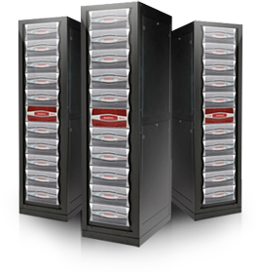






DDN | We Accelerate Information Insight
DDN is a Leader in Massively Scalable Platforms and Solutions for Big Data and Cloud Applications
Established: 1998
Revenue: $226M (2011) – Profitable, Fast Growth
Main Office: Sunnyvale, California, USA
Employees: 600+ Worldwide
Worldwide Presence: 16 Countries
Installed Base: 1,000+ End Customers; 50+ Countries
Go To Market: Global Partners, Resellers, Direct
World-Renowned & Award-Winning

Slide 3
Fact: amount of data is growing, fast
Notes:
If all the words spoke since the dawn of mankind would be stored in ASCII format then it would take up about 5 to 6 Exa Bytes
In 2007 94% of the data produced and stored was digital.

Slide 4
Disk drives grow bigger, not faster or better
Disk drives haven’t changed that much over the last decade
They just store more, ~40GB in 2002, 4000 GB in 2012
Access times are about the same, ~ 5 – 10 ms
Write/read speeds are about the same ~ 50 -100MB/s
Read error rate is about the same 1 error per 10^14 bits read, or one guaranteed read error per 12 TB read.

Slide 5
Agenda
Highlight two of DDN’s initiatives to deal with large repositories of data:
The Web Object Scaler, WOS
Embedded data processing, aka in-storage processing

Slide 6
Challenges of ExaByte scale storage
Exponential growth of data
The expectation that all data will be available everywhere on the planet.
Management of this tidal wave of data becomes increasingly difficult with regular NAS :
    Introduced in the 90’s (when ExaByte was a tape drive vendor)
        With 16TB file system sizes that many still have
    Management intensive
        LUNs, Volumes, Aggregates,…
        Heroically management intensive at scale
    Antiquated resiliency techniques that don’t scale
        RAID ( disk is a unit in RAID, whereas drive vendors consider a sector a unit)
        Cluster failover, “standby” replication, backup
        File Allocation Tables, Extent Lists
    Focused on structured data transactions (IOPS)
        File locking overhead adds cost and complexity

Slide 7
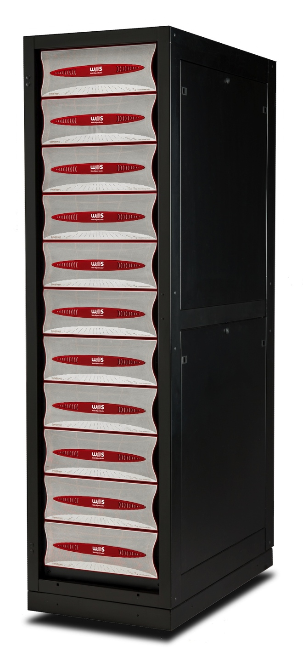


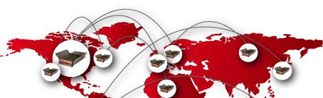
Hyperscale Storage | Web Object Scaler
NoFS
Hyperscale Distributed Collaboration

Slide 8
What is WOS
A data store for immutable data
  That means we don’t need to worry about locking
  No two systems will write to the same object
Data is stored in objects
  Written with policies
  Policies drive replication
Objects live in ‘zones’
Data protection is achieved by replication or erasure coding
  Replicate within a zone or between zones
  Data is available from every WOS node in the cluster
Only three operations possible, PUT, GET and DELETE
Notes:
Can handle ExaByte scale of data and beyond
Easy to install, upgrade and manage
Replication is part of the design
A cluster of WOS nodes can be split in zones
Replication within a zones or between zones
Move data to where it will be used
No RAID
Protection through replication or
Erasure coding or
Both
Loss of a sector not a disaster
Self healing
Simple, simple, keep it simple

Slide 9


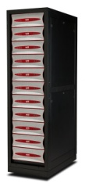
Universal Access to Support a Variety of Applications
C++, Python, Java, PHP,
HTTP, REST interfaces
PUT, GET, DELETE
S3 & WebDAV APIs
Secure File Sharing
Multi-tenancy
NFS, CIFS
LDAP,AD
HA
Rules Engine
Rich Metadata
Automation
WOS Native Object Interface
WOS Cloud
WOS Access
iRODS
WOS Hyperscale Geo-Distributed Storage Cloud

Slide 10
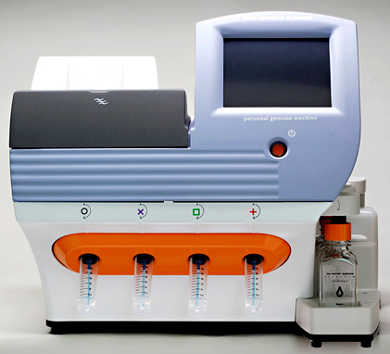
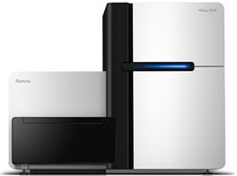

What can you build with this?
IonTorrent PGM
Illumina Hi-Seq
Remote site 1
Note: multiple name spaces
Multiple storage protocols
But…
ONE shared storage system
iRODS
CIFS 1
NFS 1
iRODS
CIFS 1
CIFS 1
Sequencer center
NFS 1
CIFS 2
CIFS 2
Remote site 2
CIFS 2
iRODS
iRODS
Library
Remote site 3

Slide 11
Storing ExaBytes, ZettaBytes or JottaBytes of data is only part of the story. The data needs to be processed too, which means as fast as possible access.
Notes:
The time it takes to read the data is lost time from the application’s perspective.

Slide 12
What is ‘Embedded Processing’?
And why ?
Do data intensive processing as ‘close’ to the storage as possible.
  Bring computing to the data instead of bring data to computing
HADOOP is an example of this approach.
Why Embedded Processing?
Moving data is a lot of work
A lot of infrastructure needed
So how do we do that?
Client sends a request to storage (red ball)
Client
But what we really want is :
Storage
Storage responds with data (blue ball)

Slide 13
Storage Fusion Architecture (SFA)
8 x IB QDR or 16 x FC8 Host Ports
Interface Virtualization
Interface Virtualization
Interface processor
Interface processor
Interface processor
Interface processor
Interface processor
Interface processor
Interface processor
Interface processor
System memory
System memory
RAID Processors
RAID Processors
High-Speed Cache
Cache Link
High-Speed Cache
Internal SAS Switching
Internal SAS Switching
1
2
3
4
5
6
7
8
P
RAID 5,6
Q
RAID 6
1
2
3
4
P
RAID 5,6
Q
RAID 6
Up to 1,200 disks in an SFA 10K
Or 1,680 disks in an SFA 12K
1
1^{m}

Slide 14
Repurposing Interface Processors
In the block based SFA10K platform, the IF processors are responsible for mapping Virtual Disks to LUNs on FC or IB
In the SFA10KE platform the IF processors are running Virtual Machines
RAID processors place data (or use data) directly in (or from) the VM’s memory
One hop from disk to VM’s memory
Now the storage is no longer a block device
It is a storage appliance with processing capabilities

Slide 15
One SFA-10KE controller
8 x IB QDR/10GbE Host Ports (No Fibre Channel)
Interface Virtualization
Virtual
Machine
Virtual
Machine
Virtual
Machine
Virtual
Machine
System memory
RAID Processors
High-Speed Cache
Cache Link
Internal SAS Switching

Slide 16
Example configuration
Now we can put iRODS inside the RAID controllers
  This give iRODS the fastest access to the storage because it doesn’t have to go onto the network to access a fileserver. It lives inside the fileserver.
We can put the iRODS catalogue, iCAT, on a separate VM with lots of memory and SSDs for DataBase storage
The following example is a mix of iRODS with GPFS
  The same filesystem is also visible from an external compute cluster via GPFS running on the remaining VMs
This is only one controller, there are 4 more VMs in the other controller need some work too
  They see the same storage and can access it at the same speed.
On the SFA-12K we will have 16 VM’s available running on Intel Sandy Bridge processors. (available Q3 2012)

Slide 17

Example configuration
8x 10GbE Host Ports
Interface Virtualization
Virtual
Machine
Linux
Linux
Linux
Virtual
Machine
Virtual
Machine
Linux
Virtual
Machine
iCAT
GPFS
GPFS
GPFS
SFA Driver
SFA Driver
SFA Driver
SFA Driver
System memory
16 GB memory allocated
8 GB memory allocated
8GB memory allocated
8GB memory allocated
RAID Processors
High-Speed Cache
Cache Link
Internal SAS Switching
RAID sets with 2TB SSD
RAID sets with 300TB SATA
RAID sets with 30TB SAS

Slide 18
Running Micro Services inside the controller
Since iRODS runs inside the controller we now can run iRODS MicroServices right on top of the storage.
The storage has become an iRODS appliance ‘speaking’ iRODS natively.
We could create ‘hot’ directories that kick off processing depending on the type of incoming data.

Slide 19
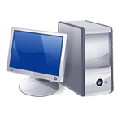
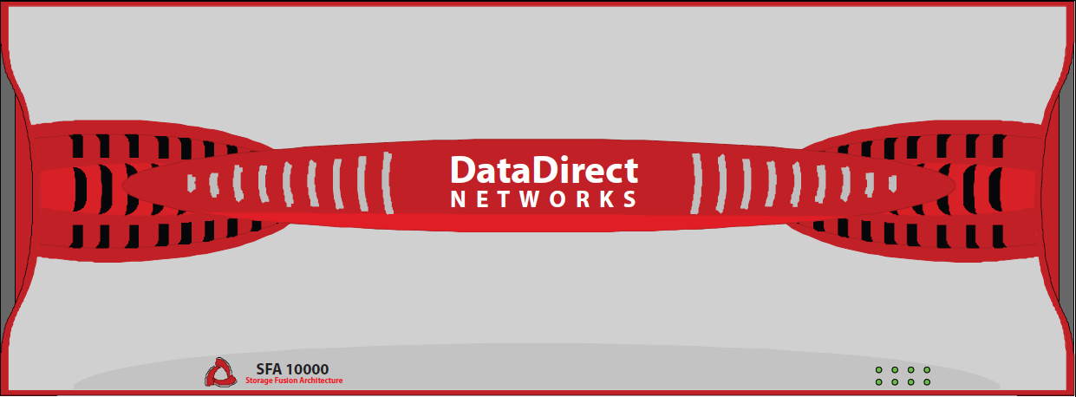
DDN | SFA10KE™
With iRODS and GridScaler parallel filesystem
Reading data via parallel paths with
DDN | GRIDScaler embedded in the system.
Faster access->faster processing->faster results
An iRODS rule requires that
a copy of the data is sent to
a remote iRODS server
iRODS
clients
Writing the result of the processing
Remote iRODS
server
Clients are sending data to the built-in
iRODS server.
Compute
cluster
Computing
All of this happened because of a few rules in iRODS that triggered on the incoming data.
In other words, the incoming data drives the processing.
Start processing
DDN
GRIDScaler
NSD
DDN
GRIDScaler
NSD
DDN
GRIDScaler
NSD
iRODS/iCAT
server
After the conversion another MicroService
submits a processing job on the cluster to
process the uploaded and pre-processed data
DDN
GRIDScaler
Client
iRODS was configured with a rule to
convert the orange ball into a purple one.
Note that this is done on the storage itself
Here is a configuration with iRODS for datamanagement
and GridScaler for fast scratch space. Data can come in
from clients or devices such as sequencers.
(click to continue)
Virtual Machine 5
Virtual Machine 6
Virtual Machine 7
Virtual Machine 8
Virtual Machine 1
Virtual Machine 2
Virtual Machine 3
Virtual Machine 4
Meta
data
Massive throughput to backend storage
Registering the data with iRODS

Slide 20
Thank You

Slide 21

Backup slides

Slide 22
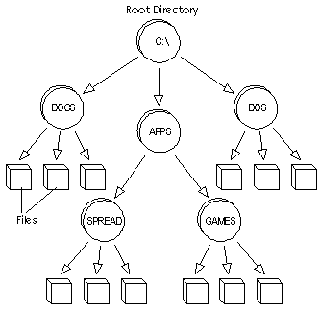
Object Storage Explained
  Object storage stores data into containers, called objects
  Each object has both data and user defined and system defined metadata (a set of attributes describing the object)
File Systems
Objects
File Systems were designed to run individual computers, then limited shared concurrent access, not to store billions of files globally
Flat Namespace
Metadata
Metadata
Metadata
Data
Data
Data
  Objects are stored in an infinitely large flat address space that can contain billions of files without file system complexity
Notes:
Traditional hierarchical file systems organize data into “trees” consisting
of directories, folders, subfolders and files. Files are a logical representation
of blocks of data associated with an application and are the most
familiar means of working with data. Network file system interfaces like
NFS and CIFS are well-understood, standardized methods of conveying
the logical groups of blocks from a storage repository to an application.
A problem arises, however, when a traditional file system, which has
a theoretically limited number of files it can address in a single directory
and tracks only simple metadata, runs
into massive repositories of similar files.
“File systems make less sense over
time as the amount of data grows,”
StorageMojo’s Harris said. “Architecturally,
it makes more sense for each
file to have a unique 128-bit ID and use
an Internet-like system for locating that
file; a URL points to an address and
there are files at that address, and
object-based storage interfaces are
essentially operating on the same
principle.”

Slide 23



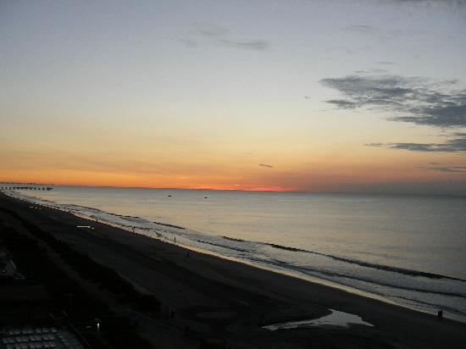
Intelligent WOS Objects
Sample Object ID (OID):
ACuoBKmWW3Uw1W2TmVYthA
Signature
A random 64-bit key to prevent unauthorized access to WOS objects
Policy
Eg. Replicate Twice; Zone 1 & 3
Checksum
Robust 64 bit checksum to verify data integrity during every read
User Metadata
Key Value or Binary
Object = Photo
Tag = Beach
thumbnails
Full File or
Sub-Object

Slide 24
WOS Performance Metrics
Network | Performance Per Node |  |  |  | Maximum System Performance (256 Nodes)
 | Large Objects |  | Small Objects (~20KB) |  | Small Objects (~20KB)
 | Write MB/s | Read MB/s | Object Writes/s | Object Reads/s | Object Writes/Day | Object Reads/Day
1 GbE | 200 | 300 | 1200 | 2400 | 25,214,976,000 | 50,429,952,000
10 GbE | 250 | 500 | 1200 | 2400 | 25,214,976,000 | 50,429,952,000
Benefits
  Greater data ingest capabilities
  Faster application response
  Fewer nodes to obtain
  equivalent performance

Slide 25



WOS – Architected for Big Data
Hyper-Scale
Global Reach & Data Locality
  256 billion objects per cluster
  5 TB max object size
Scales to 23PB
  Network & storage efficient
  64 zones and 64 policies
Up to 4 way replication
Global collaboration
Access closest data
No risk of data loss
Resiliency with Near Zero Administration
Universal Access
NAS Protocol
Cloud Platform
iRODS
Store
Native Object
(
S3 compatibility
interface
Store interface
Self healing
All drives fully utilized
50% faster recovery than traditional RAID
Reduce or eliminate service calls
NFS, CIFS)
WOS Access
Cloud Store Platform
IRODS
Native Object Store
•
NFS, CIFS protocols
•
S3
•
C++, Python, Java,
-
Compatible &
•
Custom rules
WebDAV
APIs
–
a
PHP, HTTP REST
•
Scalable
rule for every need
interfaces
•
Multi
-
•
HA & DR Protected
tenancy
•
Rich metadata
•
Simple interface
•
Federation
•
Reporting & Billing
•
Personal storage
Notes:
This slide can be used to summarize WOS if you have limited time
Hyperscale quadrant
WOS nodes are self-contained appliances configured with disk storage and CPU and memory resources. Each node is pre-configured with the WOS software and Gigabit Ethernet network interfaces. A cloud can be created out of any nodes that have Internet Protocol (IP) connectivity to each other, regardless of their physical location
WOS Nodes are available in two versions,
WOS 1600 – a 3U 16 drive node that provides up to 48TB (3T Drives) of SAS/SATA storage per tray
WOS 6000 – a 4U 60 drive 2-node tray that provides up to 180TB of SAS/SATA storage per tray
A rack containing 11 WOS 600o trays contains 2PB of storage per rack,
WOS 2.0 limits – will be extended in each release - 128 Billion objects per cluster, scales to 23 PB per cluster.
Easy to extend, grow brick by brick.
Efficiency is key, from a density, power, disk utilization, and I/O perspective
Global Reach & Data Locality quadrant
WOS is architected from the ground up to be distributed across multiple sites. Data is replicated across up to 4 sites (extended in upcoming releases) based on policy. While replication is typically used for data protection & DR, with WOS, it enables something even more powerful.. Data locality and global collaboration. WOS maintains intelligence regarding the location of objects so Users at each replica site always access data closest to them (latency). Users can collaborate (ingest, access & update data) at local speeds across multiple locations. WOS is uniquely architected to enable local data access and global collaboration
Resiliency with Near Zero Administration
WOS Self healing provides completely automated data protection and reduces or eliminates service calls. WOS resiliency and administration is superior to competitive approaches in severa1 ways:
All drives fully utilized – Any free capacity on any drive is part of the spare pool
50% shorter re-balance times – Only actual data is copied
Faster recovery times increase overall performance and reduce risk of data loss
Drive failures decrease overall capacity only by the size of the failed drives
Total capacity may be restored by replacing drives during scheduled maintenance
All combined, WOS administrative simplicity, self healing capabilities, ease of provisioning & deployment provide the lowest TCO in the industry.
Universal Access
WOS provides a NAS, cloud, and Native API interfaces to enable WOS benefits to be available to a wide range of applications.
NAS Protocol Gateway
Used for internal POSIX apps that want to utilize internal cloud storage
Efficiently utilizes WOS cloud storage with easy provisioning/de-provisioning
Federates across multiple sites and provides collaboration & data locality services
Cloud Storage Platform
Targeted at cloud service providers or private clouds
Enables S3-enabled apps to use WOS storage at a fraction of the price
Supports full multi-tenancy, bill-back, geo-replication, encryption, and per-tenant reporting
Native Object interface
WOS quickly integrates in to existing and new environments using the simple but powerful WOS native storage interface.
Available API Commands include: PUT object, GET object, DELETE object, RESERVE Object ID
Access WOS via standard tools including REST, Java, PHP, Python and C++.

