Slide 1

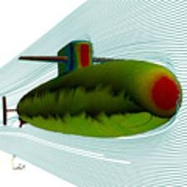
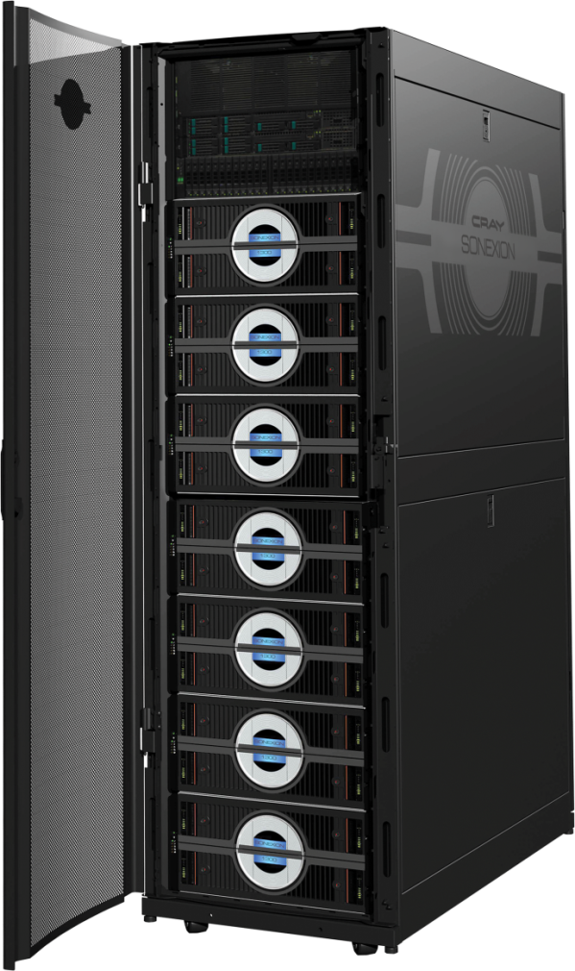
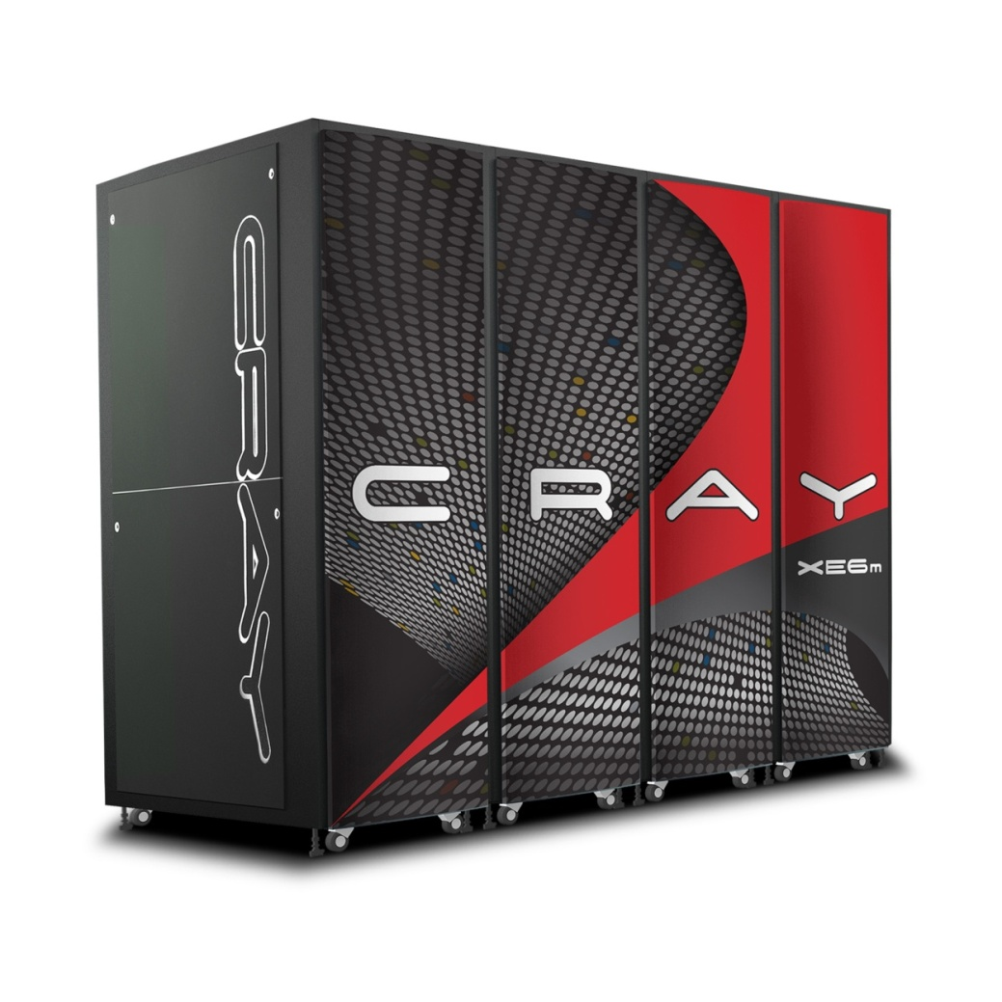
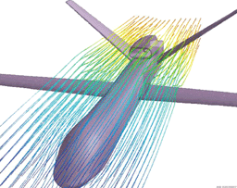
Extreme scalability
in CAE ISV Applications
Greg Clifford
Manufacturing Segment Manager
clifford@cray.com
1

Slide 2
Introduction
ISV codes dominate the CAE commercial workload
Many large manufacturing companies have >>10,000 cores HPC systems
Even for large organizations very few jobs use more than 128 MPI ranks
There is a huge discrepancy between the scalability in production at large HPC centers and the commercial CAE environment
  Can ISV applications efficiently scale to 1000’s of MPI ranks?
Spoiler alert: the answer is YES!
2

Slide 3
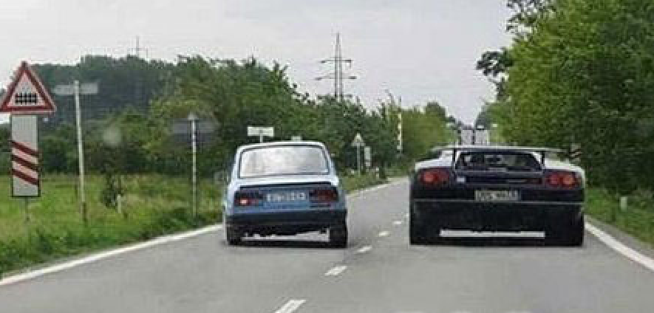
Often the full power available is not being leveraged

Slide 4
Is there a business case for scalable CAE applications?
4

Slide 5
Seismic processing Compute requirements
petaFLOPS
Seismic Algorithm complexity
1000
Visco elastic FWI
Petro-elastic inversion
100
10
Elastic FWI
Visco elastic modeling
1
One petaflop
Isotropic/anisotropic FWI
Elastic modeling/RTM
0,5
Isotropic/anisotropic RTM
Isotropic/anisotropic modeling
0,1
Paraxial isotropic/anisotropic imaging
Asymptotic approximation imaging
1995
2000
2005
2010
2015
2020
A petaflop scale system is required to deliver the capability to move to a new level of seismic imaging.
5

Slide 6
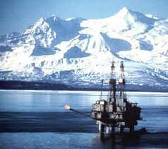


Breaking News: April 18, 2012
ExxonMobil and Rosneft…could invest over $500 billion in a joint venture to explore for and produce oil in the Arctic and the Black Sea…
…recoverable hydrocarbon reserves at the three key Arctic fields are estimated at 85 billion barrels
by the Associate Press

Slide 7
Petascale Seismic Processing: A Business Case
Compute & data requirements for seismic processing are huge
Wide demands on processing from data acquisition to seismic to res sim
Petabytes of capacity and terabytes of bandwidth from I/O
An accurate seismic image has huge returns
A single deep water well can cost >$100M…and getting deeper
“Restating” a reserve has serious business implications
When requirements & return are huge –
the demand for “getting it right” goes up
This is the class of simulation that drives real petascale capability computing
You can do capacity on capability systems but not vice versa – risk mitigation
Petaflop scale systems required for state-of the art processing
  The Oil & Gas industry has typically led the way on new HPC hardware technology in the commercial sector
Notes:
It is also important to highlight the business case associated with Seismic processing. The importance of the projects in DoE and DoD is clear, but very different. The mission critical nature of HPC simulations in Oil & Gas is also clear. These are problems where the term “good enough” does not apply
Slide 9: deep water wells are indeed expensive and the water is just getting deeper too – there was an article this week in the WSJ that the Mexican oil company is exploring in 11,000 ft of water – so it would be interesting to know the cost as a function of depth.

Slide 8
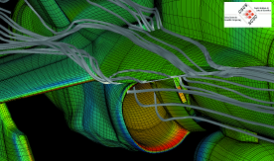
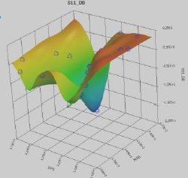

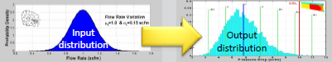
CAE trends driving HPC requirements
“Extreme Fidelity”*
  Enhanced physics and larger models,
  e.g. 1 Billion cell models
  Large models scale better across compute cores
Design optimization methods
  Many simulations required to explore the design space
  Multiple runs can require 100x compute power
Robust design
  Looking for the “best solution”
“Future performance depends on highly scalable parallel software”
* ref: ANSYS CFD presentation
8

Slide 9

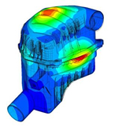
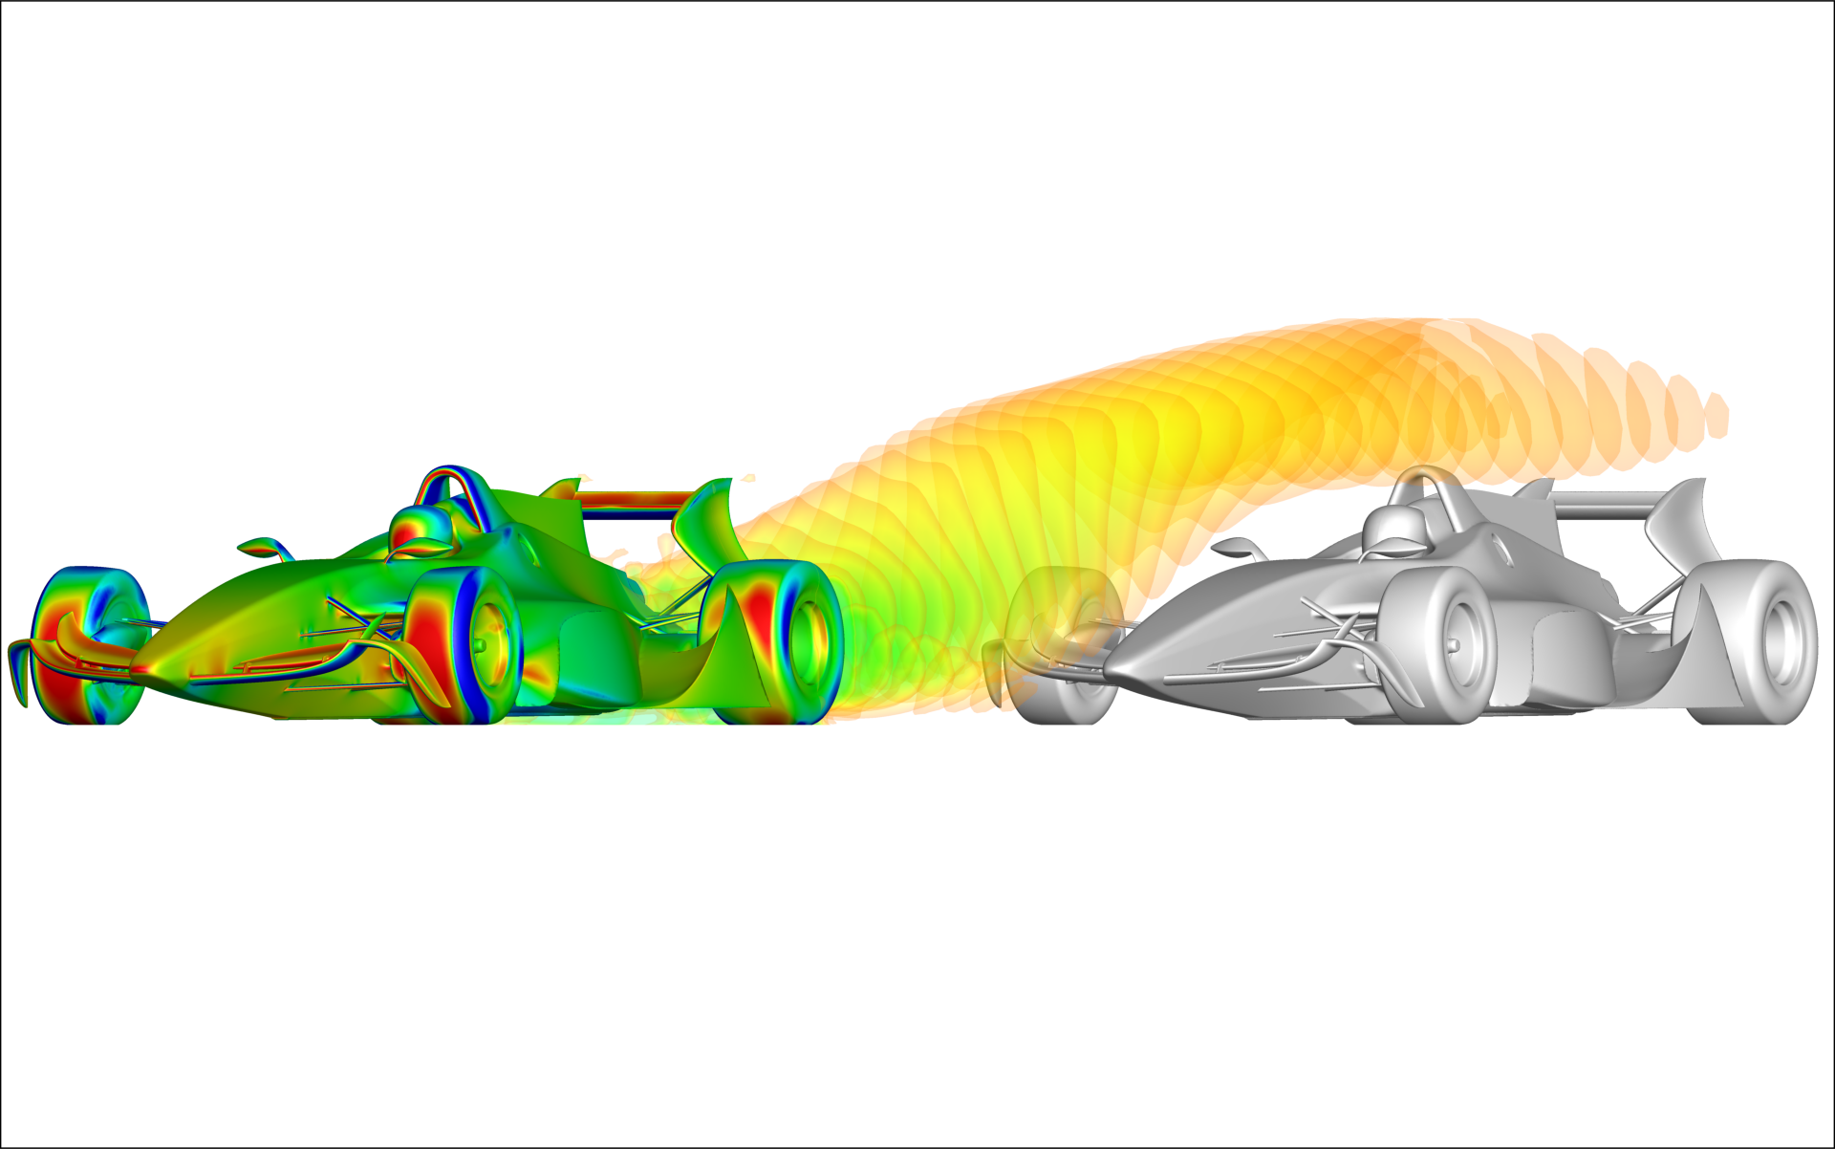
Compute requirements in CAE
“Simulation allows engineers to know, not guess – but only if IT can deliver dramatically scaled up infrastructure for mega simulations….
1000’s of cores per mega simulation”
Robust
Design
Design
Optimization
Departmental cluster
100 cores
Central Compute
Cluster
1000 cores
Design
Exploration
Supercomputing
Environment
>2000 cores
Desktop
16 cores
Multiple
runs
Single run
Simulation Fidelity
9

Slide 10
CAE Application Workload
Basically the same ISV codes used across all industries
Impact/Crash Apps
  ABAQUS explicit
  LS-DYNA
  PAM-CRASH
  RADIOSS
CFD Apps
  CFD++
  ANSYS Fluent
  PowerFLOW
  STAR-CCM+
  “in-house”
Structures Apps
  ABAQUS implicit
  ANSYS Mechanical
  MSC.Nastran
Electromagnetic Apps
  “in-house” (classified)
  ANSYS HFSS
Vast majority of large simulations are MPI parallel

Slide 11
Is the extreme scaling technology ready for production CAE environments?
11

Slide 12
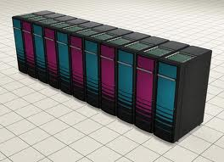
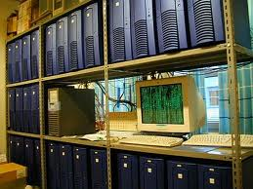
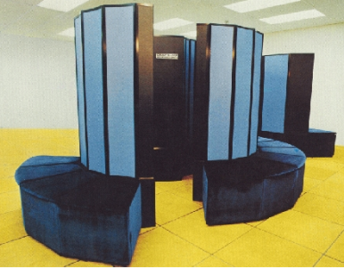
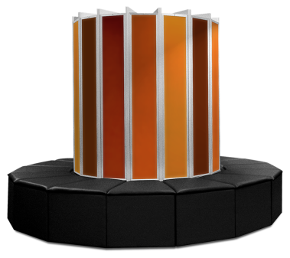
Brief history of HPC technology in high end environments
c. 2007, extreme scalability
Proprietary interconnect
1000’s cores
Requires “end-to-end parallel”
c. 1998, low density, slow interconnect
“Linux cluster”, MPI Parallel
100’s of “cores”
Major code restructuring
c. 1983
Cray X-MP, SMP parallel
8 Processors
Compiler directives for key kernels
c.1978
Cray-1, Vector processing
1 Processor
Automated vectorization in the compiler

Slide 13
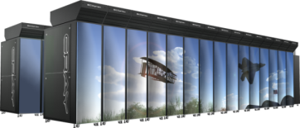
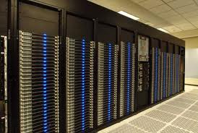
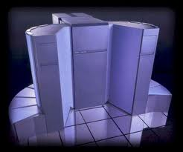
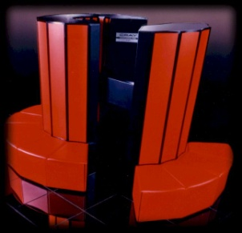
Propagation of HPC to commercial CAE
Early adoption
Common in Industry
c. 2007, Extreme scalability
Proprietary interconnect
1000’s cores
Requires “end-to-end parallel”
c. 2013
Cray XE6
driving apps:
CFD, CEM, ???
c. 1998,
MPI Parallel
“Linux cluster”,
low density, slow interconnect
~100 MPI ranks
c. 2003,
high density,
fast interconnect
Crash & CFD
c. 1983
Cray X-MP, SMP
2-4 cores
c. 1988, Cray Y-MP, SGI
Crash
c.1978
Cray-1, Vector processing
Serial
c. 1983, Cray X-MP, Convex
MSC/NASTRAN

Slide 14
Do CAE algorithms scale?
14

Slide 15
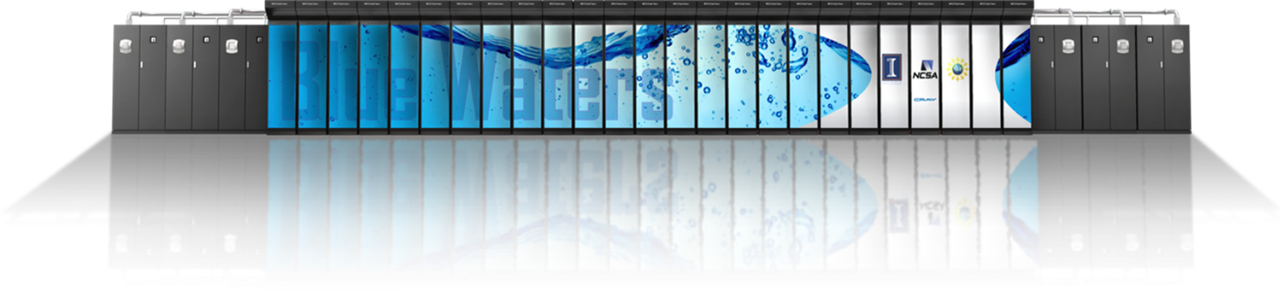
WRF Results on Blue Waters (preliminary)
WRF V3.3.1
1km, 1 billion cell, case
30 minute forecast, cold start
WSM5 (mp_physics=4) microphysics
Results on XE6 96 cabinet system (2.3GHz IL16 sockets)
The system will scale to 10,000’s of cores
Integer Cores | total nodes | average timestep (seconds) | sustained performance (GFLOPS/sec) | Speedup
2048 | 64 | 3.995 | 2181 | 1.0
8192 | 256 | 1.065 | 8182 | 3.8
32768 | 1024 | 0.286 | 30480 | 15.6
131072 | 4096 | 0.142 | 61485 | 28.1
262144 | 8192 | 0.053 | 166332 | 75.4
15

Slide 16
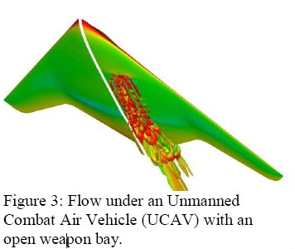
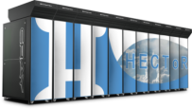
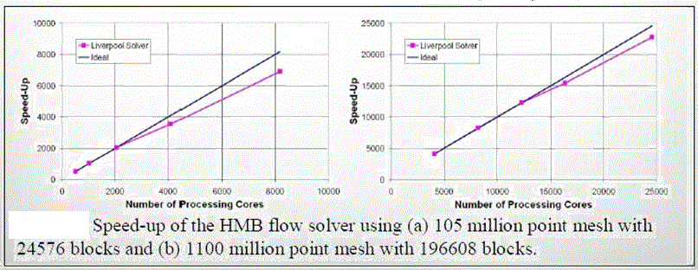
Cavity Flow Studies using HECToR (Cray XE6)
S. Lawson, et.al. University of Liverpool
  1.1 Billion grid point model
  Scaling to 24,000 cores
  Good agreement between experiments and CFD
  * Ref: http://www.hector.ac.uk/casestudies/ucav.php

Slide 17
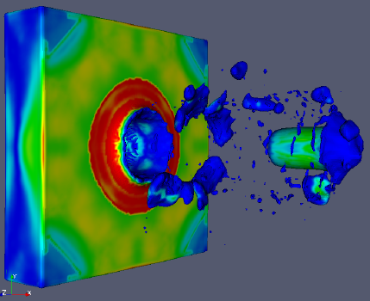
CTH Shock Physics
CTH is a multi-material, large deformation, strong shock wave, solid mechanics code and is one of the most heavily used computational structural mechanics codes on DoD HPC platforms.
“For large models CTH will show linear scaling to over 10,000 cores. We have not seen a limit to the scalability of the CTH application”
“A single parametric study can easily consume all of the Jaguar resources”
CTH developer

Slide 18





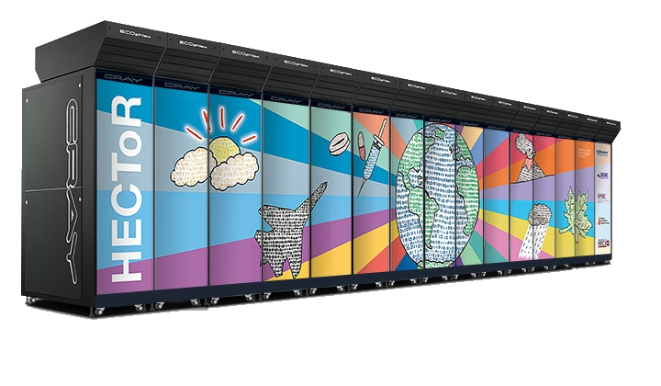

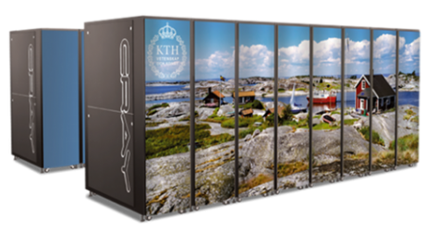

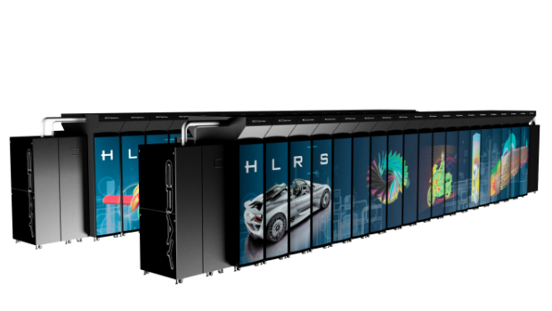



Large Cray systems running ISV applications
Several of the largest Cray systems are running CAE applications
  CAE codes scaling to over 10,000 cores
Both In-house and ISV applications
Commercial companies are using Cray systems at the HPC centers
Notes:
I like the next slide better but we need all the systems
XT Family:
Indiana University
MERCK
SAHA
HLRS
FMI
RTRI
NCAR
CPTECH
PDC/KTH
Univ of Duisburg-Essen
ISM
XE6 Customers:
KMA
NERSC6
CIELO/Sandia
TI-10/AFRL (ERDC & ARSC already had XTs)
ORNL/NOAA

Slide 19
Are scalable systems applicable to commercial environments?
19

Slide 20
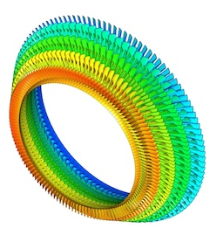

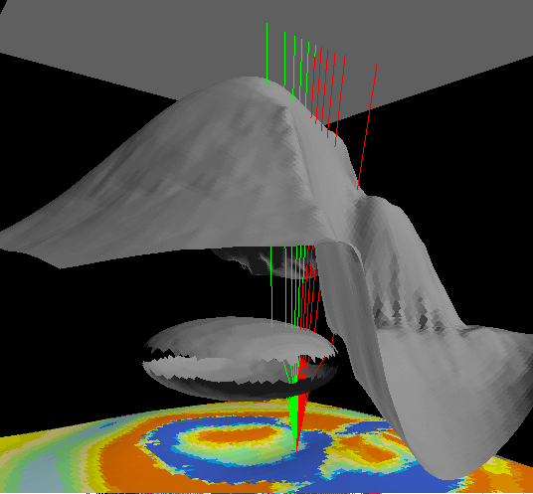
Two Cray Commercial Customers
GE Global Research
  Became aware of the capability of Cray systems through a grant at ORNL
  Using Jaguar and their in-house code, modeled the “time-resolved unsteady flows in the moving blades”
      Ref. Digital Manufacturing Report, June 2012
Major Oil Company
  Recently installed and accepted a Cray XE6 system
  System used to scale key in-house code
The common thread here is that both of these organizations had important codes that would not scale on their internal clusters
Notes:
There are two commercial customers that recently bought gemini-based systems.
Both customers have plenty of QDR IB clusters, but they simply do not work on their application codes past 200 nodes or so.
Either the scaling stops, the application fails to run to completion, or the behavior is at best erratic.
One note is that such organizations as GE and ExxonMobil are not bound by the procurement rules of most publicly funded procurements – they simply buy what they believe is the best technology.

Slide 21
Are ISV applications extremely scalable ?
For many simulation areas…YES!
21

Slide 22
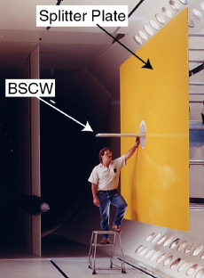
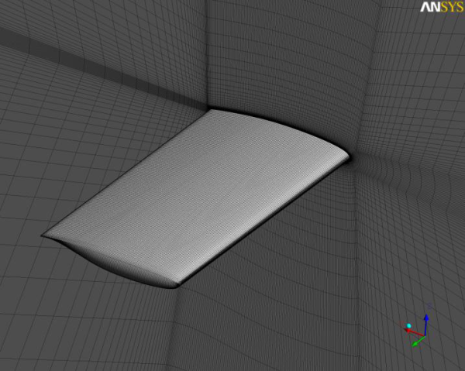
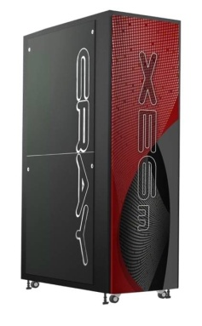

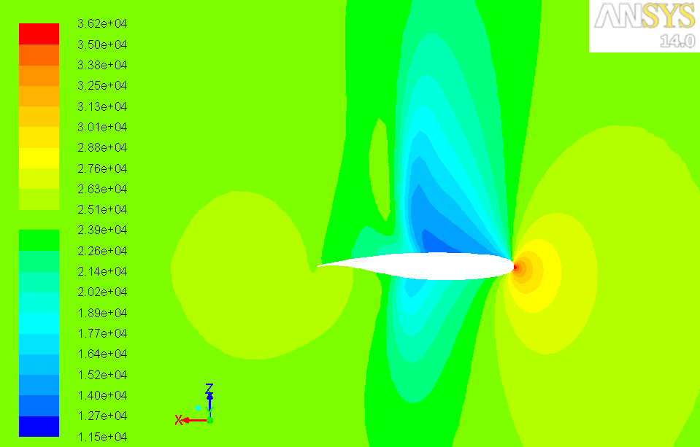
ANSYS Fluent scaling to >3000 cores on XE6
Aeroelastic Simulation, “Supercritical Wing”
In support of AIAA Aeroelastic Prediction Workshop
Higher is better
0 32 64 96
Number of nodes

Slide 23
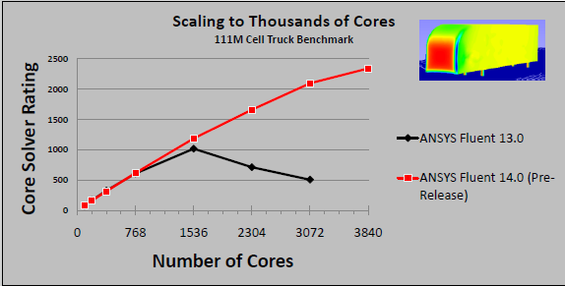
ANSYS Fluent scaling to >4000 cores on Cray XE6
Performance testing of Fluent has shown scalability to over 3000 cores even with this modest size model
Fluent external aerodynamics simulation: truck_111m
Higher is better

Slide 24
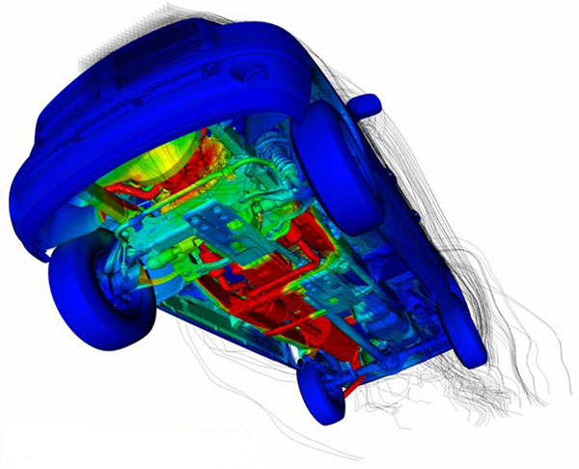


Cray XE6: Extreme Scalability with EXA PowerFLOW
Cray XE6: “ Scaling to a larger number of cores than any other platform”
Scaling to over 3000 cores
3X the total performance of any other systems
* ref: EXA press release Oct 2011
24

Slide 25
STAR-CCM+ benchmark
100M cell automotive aerodynamics
Cores/MPI Ranks | Cray XE6, “Interlagos“ 8 “core pairs”, 2.1 GHz Star-CCM+ | Speedup
72 | 24.0 4.5 nodes | 1.0
144 | 12.1 9 nodes | 2.0
288 | 6.0 18 nodes | 4.0
576 | 3.3 36 nodes | 7.3
1152 | 2.0 72 nodes | 12.0
2304 | 1.1 144 nodes | 21.2
Performance: Seconds per iteration
Number of Nodes
used in that run

Slide 26
LS-DYNA benchmark
Two car crash simulation, 2.4M elements
Hybrid parallel
Total number of cores | Cray XE6 MC-12, 2.1 GHz Hybrid parallel | Speedup
144 | 21,193 6 nodes | 1.0
288 | 12,274 12 nodes | 1.7
576 | 7,643 24 nodes | 2.8
1152 | 5,258 48 nodes | 4.0
Performance: Elapsed time (sec)
Number of Nodes
used in that run

Slide 27
Status of select ISV applications
ISV Application | Primary segment | Demonstrated scalability *
ANSYS Fluent | Commercial CFD | >4000 cores
LS-DYNA** | Impact/crash analysis | >4000 cores
CFD++ | Aero CFD | >2000 cores
STAR-CCM+ | Commercial CFD | >3000 cores
PowerFLOW | External CFD | >4000 cores
RADIOSS | Impact/Crash analysis | >1000 cores
Abaqus | Structural analysis | >64 cores
* Demonstrated scalability typically limited by the simulation model available
** Currently working on a 10M element crash simulation model which should scale much higher
27

Slide 28
If a model scales to 1000 cores will a similar size model also scale that high?
Not necessarily
28

Slide 29
Obstacles to extreme scalability using ISV CAE codes
Most CAE environments are configured for capacity computing
  Difficult to schedule 1000‘s of cores
  Simulation size and complexity driven by available compute resource
  This will change as compute environments evolve
Applications must deliver “end-to-end” scalability
  “Amdahl’s Law” requires vast majority of the code to be parallel
  This includes all of the features in a general purpose ISV code
  This is an active area of development for CAE ISVs
Application license fees are an issue
  Application cost can be 2-5 times the hardware costs
  ISVs are encouraging scalable computing and are adjusting their licensing models
29

Slide 30

External Aerodynamics
118M cells
unsteady solution, 1350 time steps
moving mesh, rotating boundary condition (tires)
384 cores
350 Hours of elapsed time
Actions:
Work with Swift Eng. and CFD++ ISV to demonstrate real CFD model scaling to 1000 cores using CFD++ (in progress)
Terabytes of data
Cray XE6 with Lustre file system
30

Slide 31
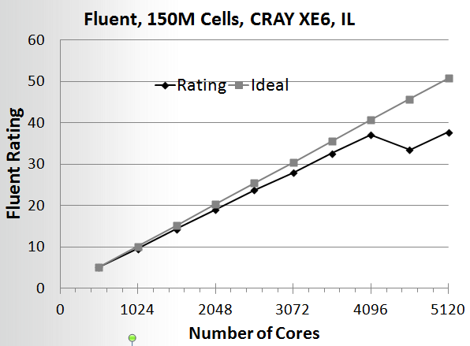
ANSYS Fluent Scaling on complex industrial model
Pressure based, coupled solver
Compressible, LES
Scaling to 4096 cores with 91% efficiency
Something happens at about 4500 cores but this will be addressed as the project to improve scaling progresses
It is this type of cooperative work between application users, ISVs and Cray, that will lead to extreme scaling for the vast majority of simulations.

Slide 32
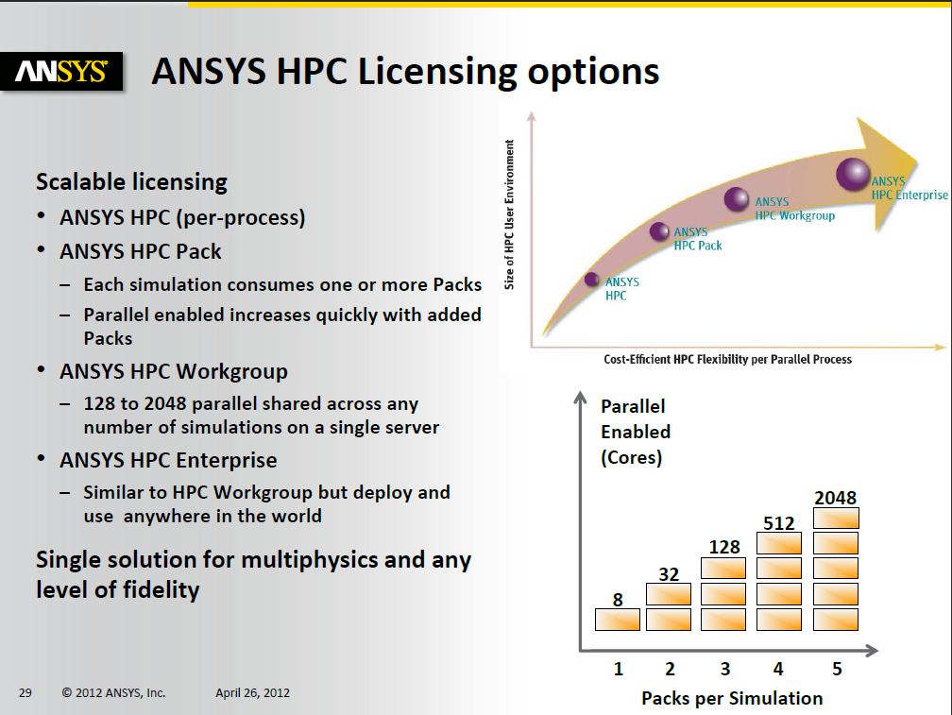
ANSYS presentation at 2012 Cray User Group (CUG)

Slide 33
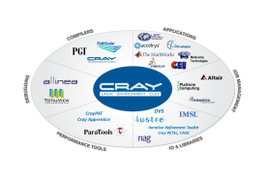
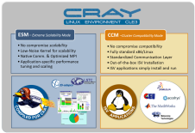
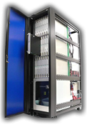

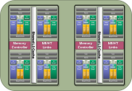
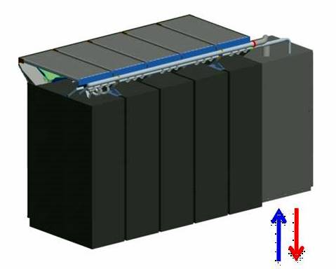
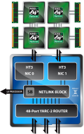
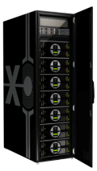
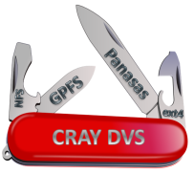
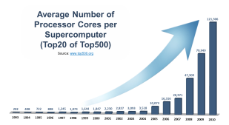
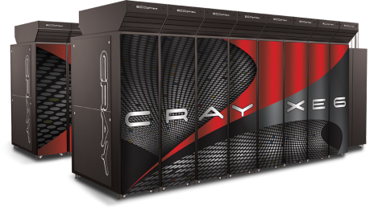
Summary: Well-balanced Scalable Supercomputer
Gemini Interconnector
Packaging & ECOphlex Liquid Cooling
Scalable Supercomputer
“Beyond Commodity” areas
Throughput: Scalable Storage Solution
State-of-the-art Processor
Compilers, Performance Tools and Libraries
O/S Technology

Slide 34
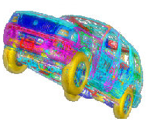
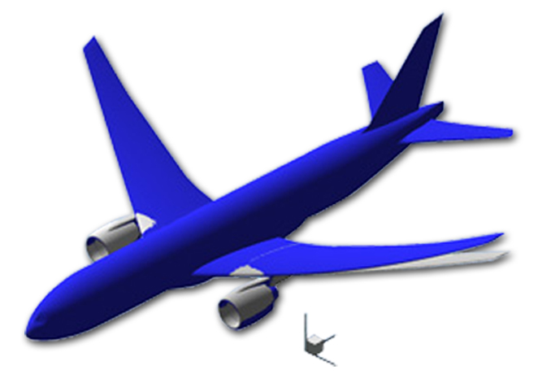

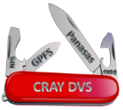



Summary: Well-balanced Scalable Applications Infrastructure
Scalable Compute Power
Extreme scalability for CAE simulation
Clear ROI for scalability: e.g. application costs
Scalable Data management
Scalable analysis tools: e.g. visualization
Large models
End-to-end simulation scalability

Slide 35


Backup Slides

Slide 36
Random Message MPI Benchmark Test Today
Gemini vs. QDR IB
Mbytes/sec per MPI Rank
30x
47x
74x
221x
Number of MPI Ranks
A Comparison of the Performance Characteristics of Capability and Capacity Class HPC Systems
By Douglas Doerfler, Mahesh Rajan, Marcus Epperson, Courtenay Vaughan, Kevin Pedretti, Richard Barrett, Brian Barrett , Sandia National Laboratories
Notes:
The same group of authors recently completed a similar study today with Gemini vs. QDR IB.
What has changed in the past couple of years?
Core count has increased per node by 4 to 8 times. This increases the stress on the NIC architecture
Bandwidth has increased in QDR by a sizeable amounts
This test shows that for the same NODE counts, the custom network advantage is still quite large, even at relative modest scale.
Custom advantage is growing, not shrinking.
Next slide shows effect when measured in the context of real applications.

