Slide 1
Cowboy Up
Dana Brunson
Oklahoma State University
High Performance Computing Center
http://hpc.it.okstate.edu
NSF MRI Award # 1126330
Notes:
Abstract: The OSU High Performance Computing Center is deploying Cowboy, the largest externally funded supercomputer in state history. This talk will present the highlights (and lowlights) of the NSF MRI proposal, data center expansion, cluster design and deployment, as well as how OSUHPCC is facilitating computational and data intensive research and education.

Slide 2
What is OSU HPCC?
Multidisciplinary Center to provide free cyberinfrastructure resources, expertise and education, not only at OSU but across OK.
Our mission is to help our users be successful in computational research, education and outreach.
We provide proposal support and collaboration – letters, facilities, data management, outreach, optimization etc.

Slide 3
Who is OSU HPCC?
Director: Dana Brunson (new title April 2012)
Manager of Operations: Jesse Schafer (new hire Feb 2012)
Undergraduate HPC guru: Will Flanery
Over 230 users in 24 departments in 6 Colleges as well as users from across the state.

Slide 4
Who are the users?
Over 230 users so far, including:
45 faculty
14 undergraduate students
150 graduate students
5 postdocs
6 staff
Plus collaborators and other researchers from around the state and more added weekly.

Slide 5
Who is OSU HPCC – Academic Depts.
Ag Econ
Animal Science
Biochemistry & Molecular Biology
Biosystems & Ag Engineering
Botany
Chemical Engineering
Chemistry
Civil & Env. Engineering
Computer Science
Elec. & Comp. Engineering
Entomology & Plant Pathology
Fire Protection
Industrial Eng. & Mgmt
Mechanical & Aerospace Eng.
Mgmt Science & Info. Systems
Mathematics
Microbiology & Molecular Genetics
Natural Resource Ecology & Mgmt
Nutritional Science
Physics
Physiological Sciences
Plant & Soil Science
Statistics
Zoology

Slide 6
Publications Facilitated by OSUHPCC
2009: 3 Master’s Reports
2010: 4 reported, including 1 dissertation
2011: 19 reported
2012: 18 reported so far, including 2 dissertations
We are getting better at collecting data.
See: http://hpcwiki.it.okstate.edu/index.php/Publications

Slide 7
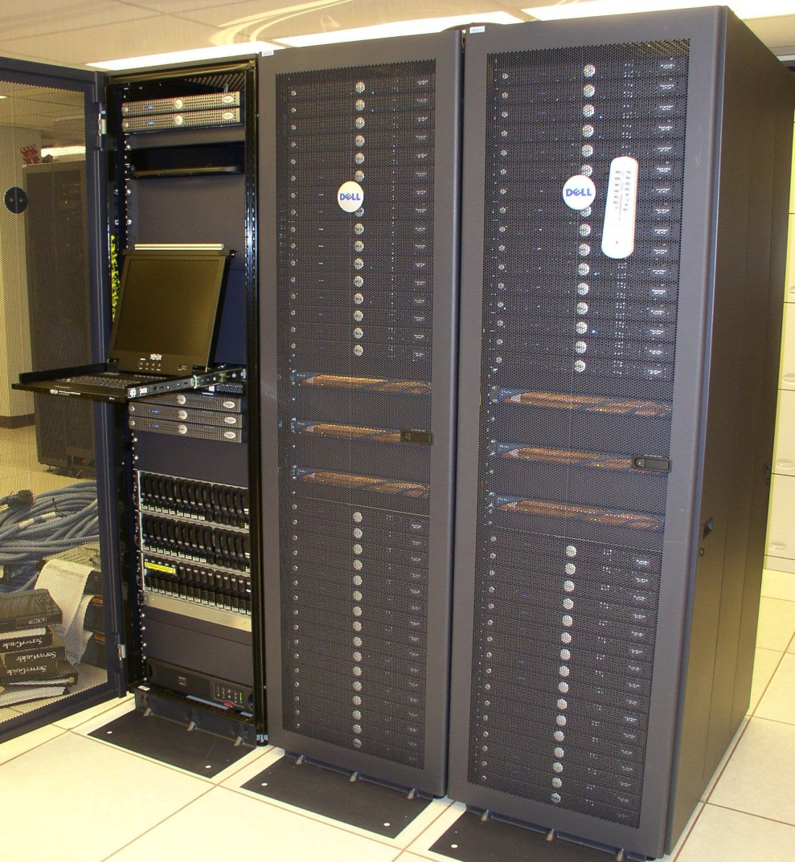
Background – prehistory
2005-6
Faculty plan for first centrally available cluster
Bullet: 64 nodes, 820 GFLOPs
Administered by one person in IT

Slide 8
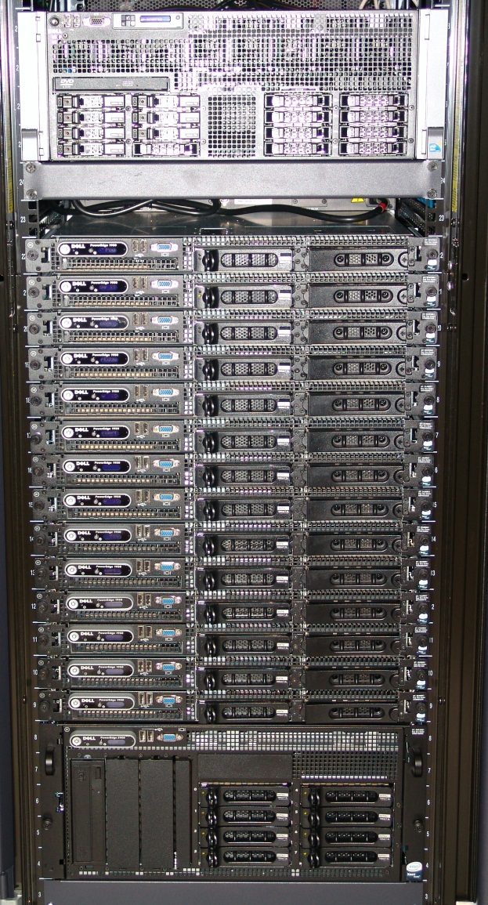
Background: 2007-8
November, 2007
  19 users
  Hired replacement person (yours truly.)
  Met Henry & Jeff
In 2008 added
  50 new users
  Spur: 128 GB RAM
  Cimarron: 14 nodes, 892 GFLOPs
  Student helper

Slide 9
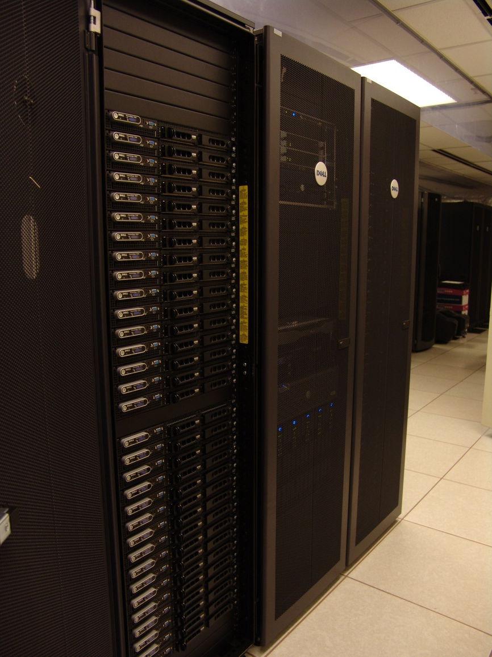
Background: 2009-10
In 2009 added
  20 new users
  Pistol Pete: 64 nodes, 5.4 TFLOPs
  EOT endeavors
In 2010, added 70 users and needed:
  More resources
  More staff

Slide 10
Finding solutions
The HPC community is very helpful!
Henry Neeman & Jeff Pummill are great teachers!
Solution: write NSF MRI proposal for hardware and use the cost share to hire a new person, with lots of help.

Slide 11
The proposal highlights
MRI research projects represented:
  44 faculty, 10 staff, 7 postdocs, 80 graduate students and 29 undergraduates
VP for Research & Technology Transfer (VPRTT) agreed to fund the cost share.
VPRTT & CIO committed to space, power & cooling and continued funding of new hire!
Broader Impacts: Oklahoma Cyberinfrastructure Initiative, diversity, dissemination, CI EOT efforts.

Slide 12
MRI Research Projects
Mechanical Behavior of Granular Materials and Molecular Dynamics (MD) Simulation. R. Komanduri, Mechanical & Aerospace Engineering
Discovery genes for Canine Hip Dysplasia. L. Zhu, Statistics
Improvements to performance per Watt (computing efficiency) of many-core systems. S. Sohoni, Electrical & Computer Engineering
Transcriptional Profiling of determination events in adult and embryonic murine stem cell lines. P. Hoyt, Biochemistry & Molecular Biology
Hoyt Collaborative Research: Muscle Adaptations Permitting Fatigue-Resistant Exercise. M. Davis, Physiological Sciences
Hoyt Collaborative Research: Using comparative transcriptome and immunological analyses to “connect the dots” for bats affected by White-Nose Syndrome. R. Van Den Bussche, Dean, Arts & Sciences:

Slide 13
MRI Research Projects (cont’d)
Genomic, metagenomic and proteomic approaches to decipher host-pathogen interactions, complex carbohydrate metabolism and cellulosic bioenergy. Patricia Ayoubi-Canaan, Biochemistry & Molecular Biology
Partial Differential Equations Modeling Geophysical Fluids. J. Wu, Mathematics
Computational Chemistry. N. Materer, Chemistry
Electronic Structure Simulations of Nanostructured Materials. J. W. Mintmire, Physics
Dynamics and Scalable Atomistic Monte Carlo Simulation of the Growth of Carbon Nanotubes and Other Nano-Scale Structures. S. Bukkapatnam, Industrial Engineering & Management
Methods and Applications on Modeling and Simulating Gas-Phase and Condensed-Phase Materials. Y. Guo, Physics

Slide 14
MRI Research Projects (cont’d)
Imaging Complex Geology Using High-Performance Computational Seismology. P. Jaiswal, Geology
Computational Optimization. B. Balasundaram, Industrial Engineering & Management
Optimal error-control coding and compressive sensing techniques for applications such as efficient data acquisition and reliable data transmissions in communication networks. N. Rahnavard, Electrical & Computer Engineering
Charge, Spin and Heat Transport in Low-Dimensional Systems. X. Xie, Physics
Molecular phylogeny of the Asteraceae. L. Watson, Botany
Evolutionary genetics of morphological diversification and domestication in grasses (Poaceae) and mustards (Brassicaceae). A. Doust, Botany

Slide 15
MRI Research Projects (cont’d)
Robust Electromagnetic Field Testing and Simulation Laboratory. J. West, Electrical & Computer Engineering
Phylogenomic analyses of the extremophile red alga Galdieria sulphuraria. G. Schoenknecht, Botany
Integrating Data in Evolving Social Networks. S. Kak, Computer Science
Computational and combinatorial methods in commutative algebra. C. Francisco, Mathematics
Characterization of environmental microbes associated with non-cultivated and cultivated plants. U. Melcher, Biochemistry and Molecular Biology
Application of ensemble based- simulated annealing algorithms(EBSA) to radio-biologically-based Intensity-Modulated Radiation Therapy (RB IMRT) planning. F. Fondjo, Chair, Technology, Langston U
Phylogenomics of milkweeds (Asclepias, Apocynaceae). M. Fishbein, Botany

Slide 16
OK Cyberinfrastructure Initiative
Triggered by Oklahoma’s current NSF EPSCoR Track-1 grant.
Memorandum of Understanding between OU and OSU.
All academic institutions in Oklahoma are eligible to sign up for free use of OU’s and OSU’s centrally-owned CI resources.
Other kinds of institutions (government, NGO, commercial) are eligible to use, though not necessarily for free.
Everyone can participate in our CI education initiative.
The Oklahoma Supercomputing Symposium, our annual conference, continues to be offered to all.
Plus new things coming soon!

Slide 17
And we got the grant!
Next steps:
Hire new Manager of Operations
  Jesse started Feb. 6, 2012
Evaluate the evolving needs of researchers
Go out for bid for the new cluster
Expand the data center (unexpected!)

Slide 18
HPC to meet our needs
Potential of Sandy Bridge, worth waiting?
Variety of core counts per node, memory per node?
Large shared memory nodes?
Disk storage, fast/slow?
GPUs?
Network?
RFP went out in January, PO went out late Feb

Slide 19
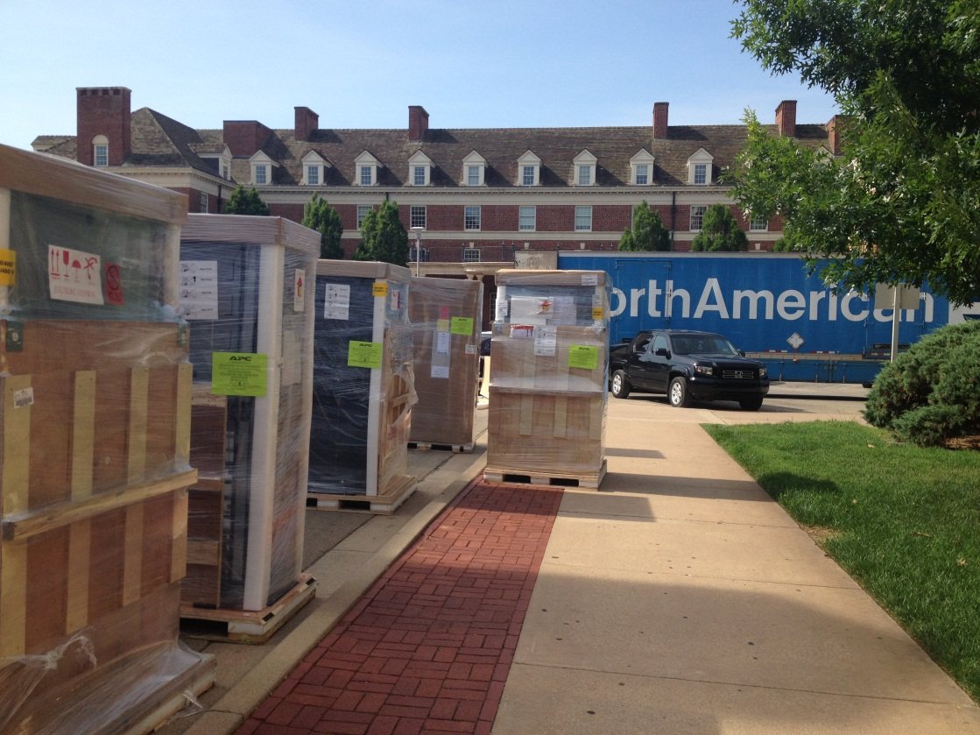
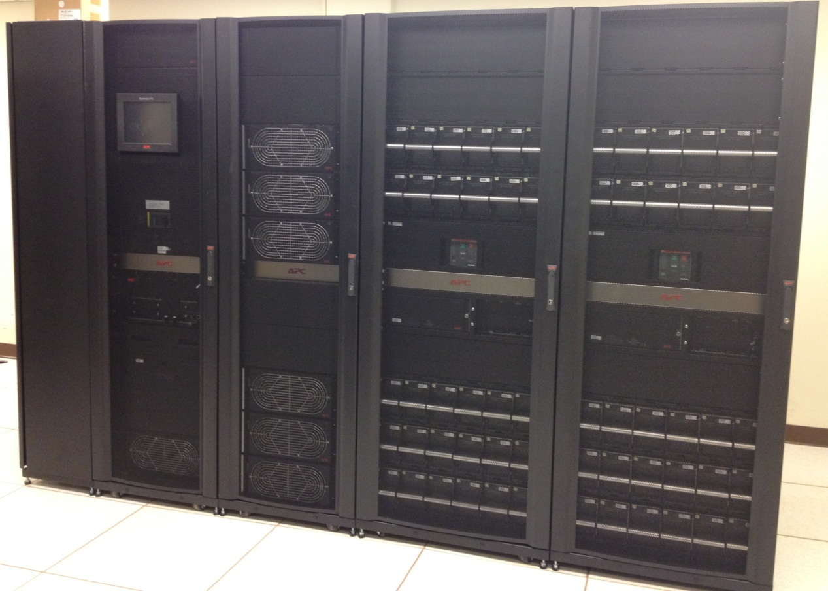
The UPS arrived June 5, 2012

Slide 20
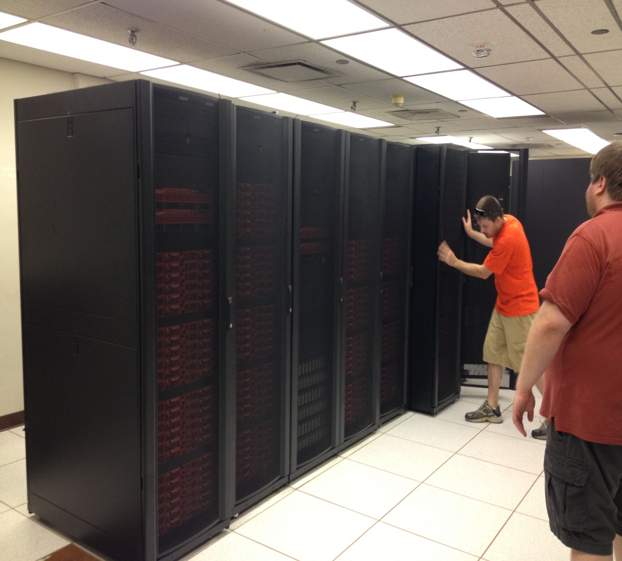
Cowboy arrived June 19, 2012
Cowboy is funded by NSF grant for $908,812.
Cost share funded new full-time position.
Cowboy is the largest externally funded supercomputer in state history!
9x the capacity of the current cluster Pistol Pete

Slide 21
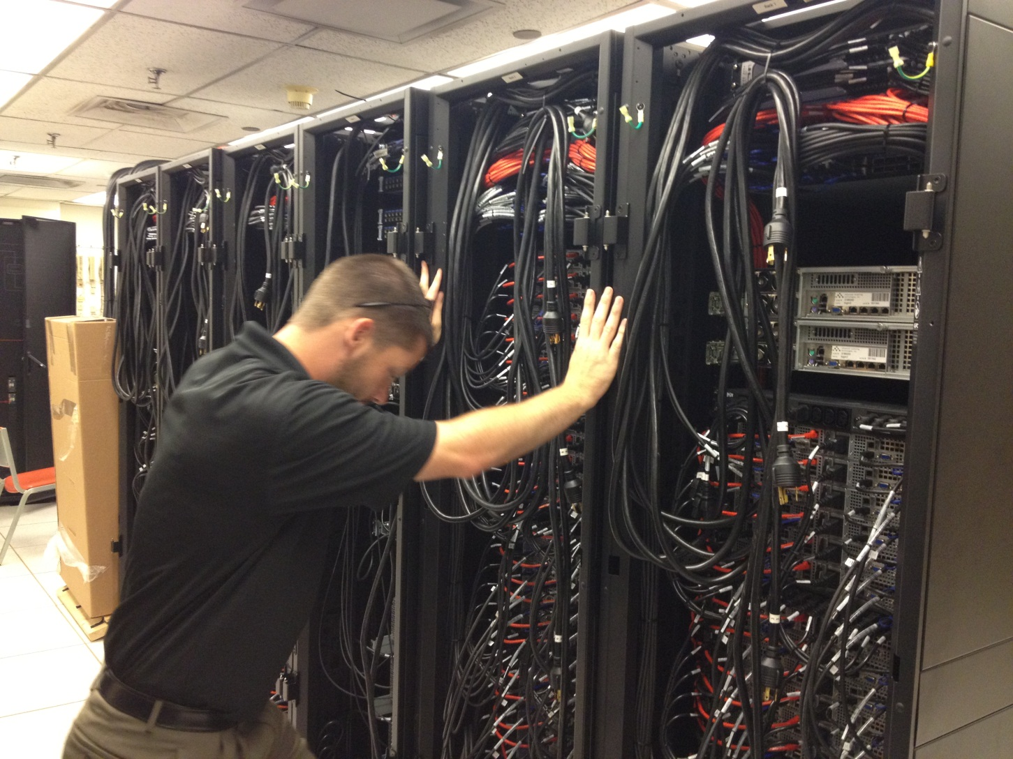
Jesse lining up the racks

Slide 22
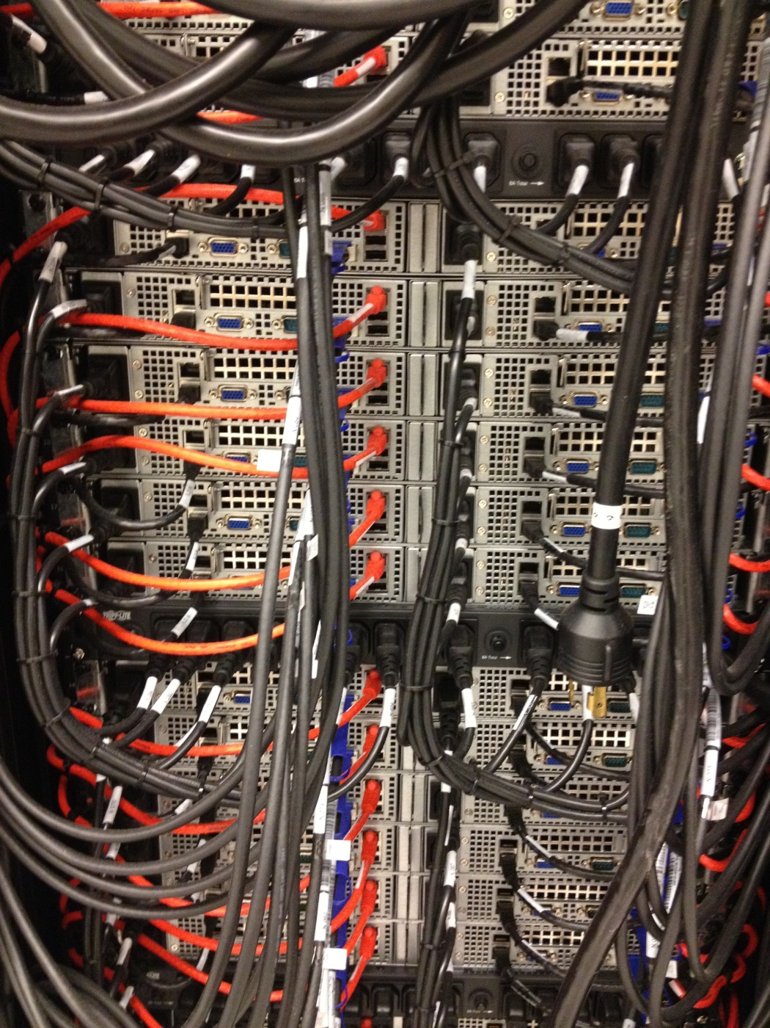
Cowboy’s parts
252 compute nodes with dual 6-core CPUs and 32 GB RAM
2 “fat” nodes with 256 GB RAM and GPU cards
120 TB very fast disk storage
QDR infiniband (high speed, low latency interconnect)
10G connectivity to Internet2
2 management and 2 login servers
Over 48 TFLOPs

Slide 23
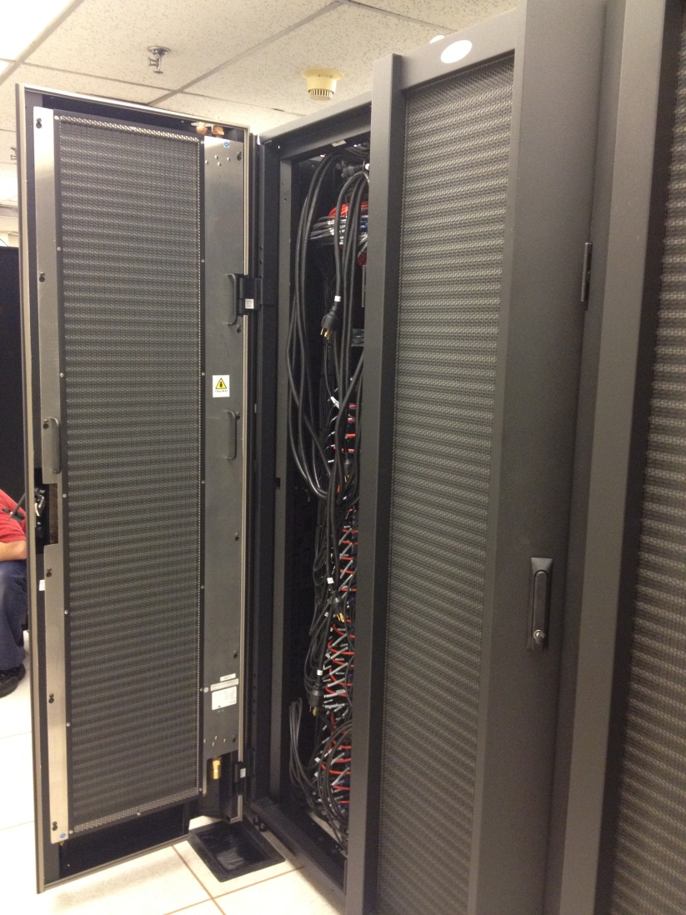
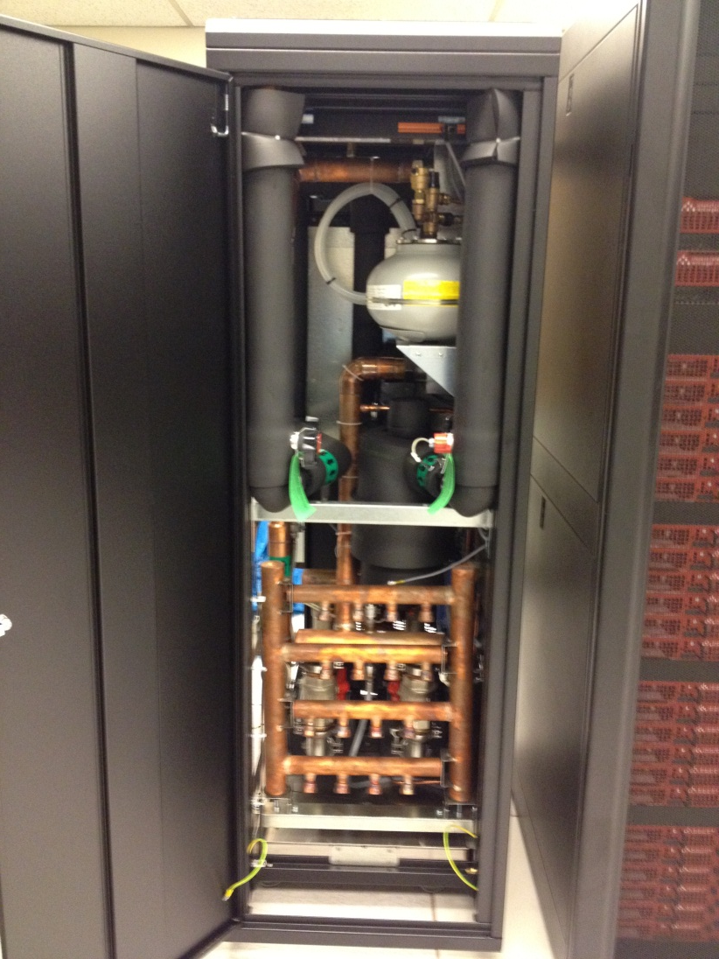
Cooling – rear door heat exchangers

Slide 24
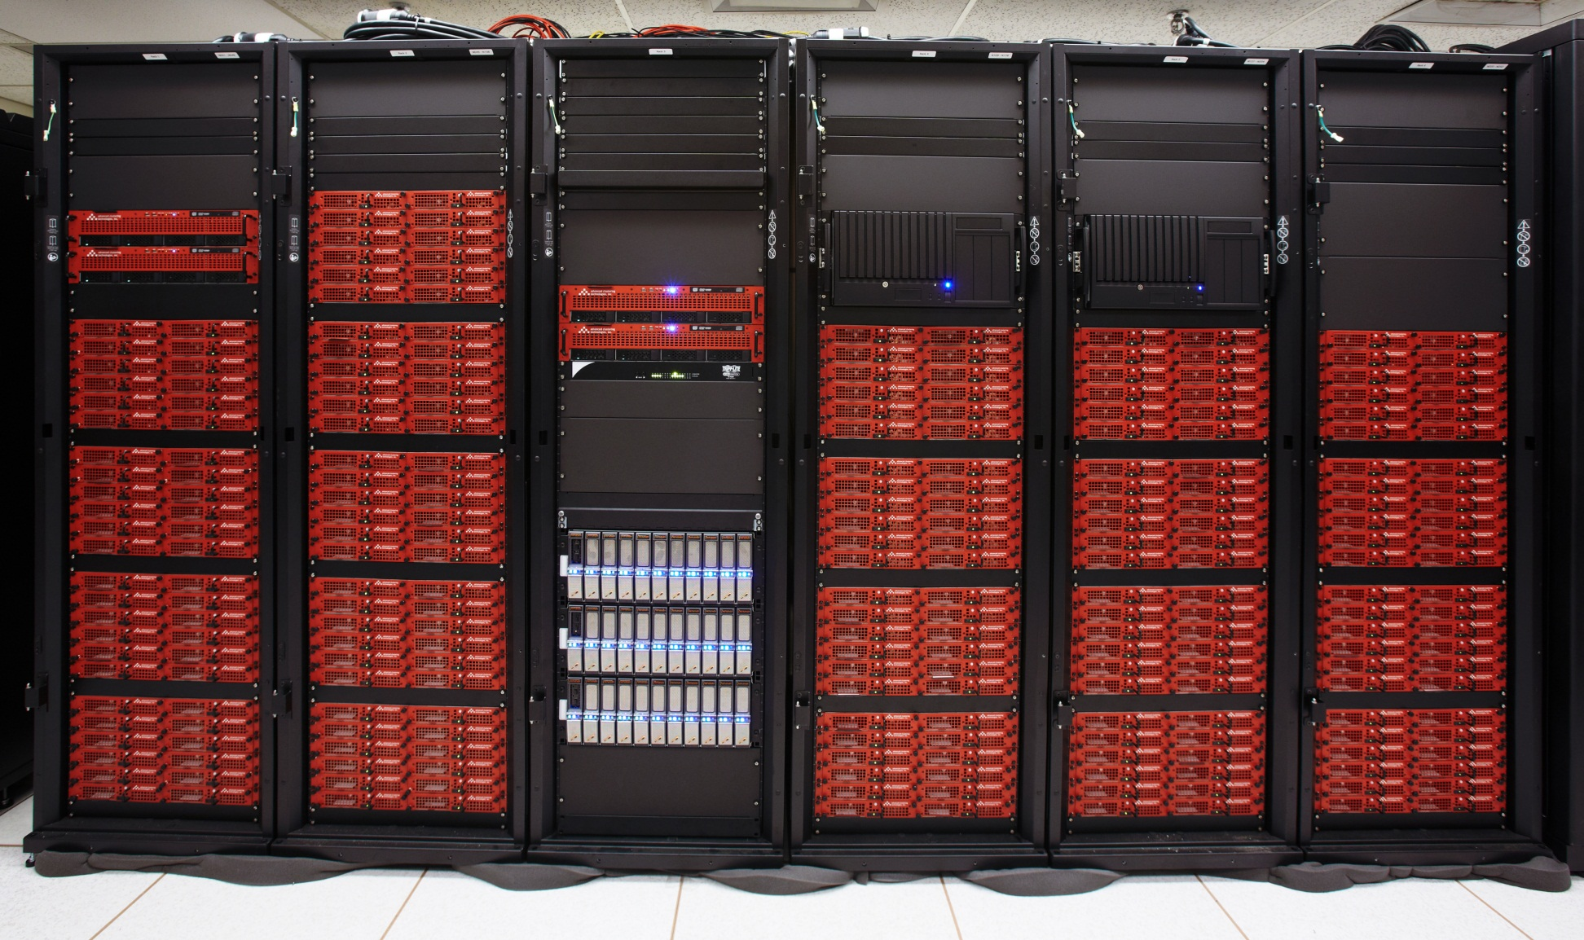
Cowboy UP!

Slide 25
Making users happy (or not)
Making max walltimes shorter
  Some codes have unpredictable walltimes, need reliable checkpoint/restart system
  Short walltimes make system maintenance less intrusive
  Short walltimes make the queue move faster
Environment modules
  Dynamic modification of user’s env. Variables.
  Can also log usage of applications

Slide 26
In progress
Early user phase
Migrating users – slowly to minimize disruption of their work
Installing user applications
Help sessions, new user training sessions
Wiki
Workshops

Slide 27
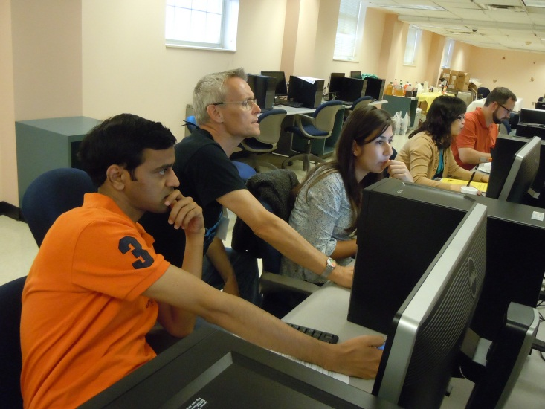
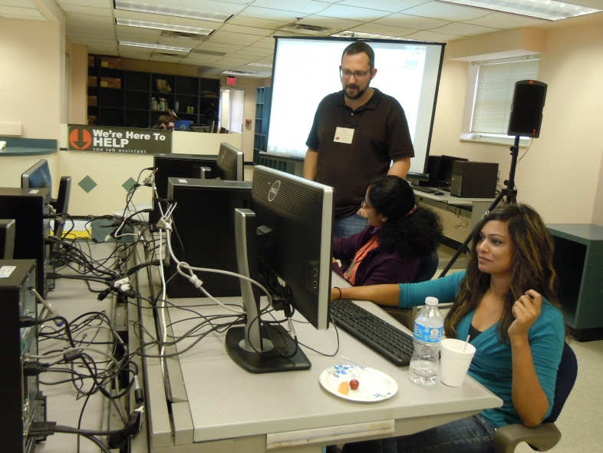
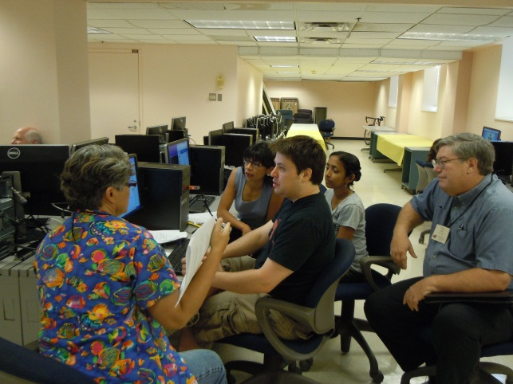
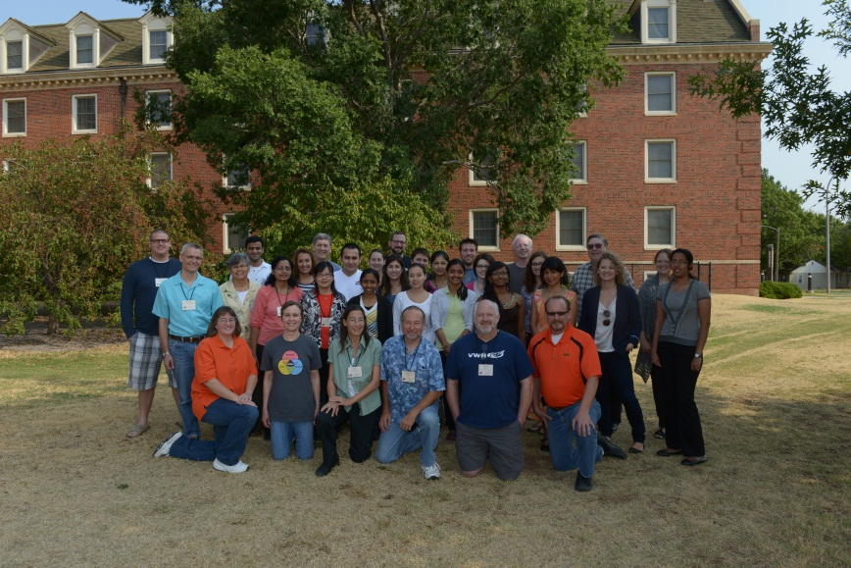
Workshops
2012: Bioinformatics of Entangled Genomes
2009, 2011: Computational Chemistry

Slide 28
What’s next?
Plan for next expansion
Sustainability for both hardware and support personnel
Condor pool
Provide more education, outreach and training

Slide 29
Thanks!
Questions?
Dana Brunson
dana.brunson@okstate.edu
OSU High Performance Computing Center
http://hpc.it.okstate.edu

