Slide 1
iRODS and
Large-Scale
Data
Management
Leesa Brieger

Slide 2
Renaissance Computing Institute
(RENCI)
A research unit of UNC Chapel Hill
Current Director: Stan Ahalt, formerly from the Ohio Supercomputer Center
State-supported
Governed by the Triangle universities:
  UNC Chapel Hill
  NC State University
  Duke University

Slide 3
Data Intensive Cyber Environments
(DICE Group)
Directed by Reagan Moore
Developed SRB, the Storage Resource Broker
Began at SDSC, the San Diego Supercomputer Center
Most of the group migrated to UNC Chapel Hill in 2008
  Joint appointments in SILS and RENCI
  The group is bi-coastal: DICE-UNC, DICE-UCSD
SRB migrated to iRODS, the integrated Rule-Oriented Data System in 2009

Slide 4
iRODS Evolution
Based on decade-long SRB development experience for managing distributed data
Community-driven
iRODS picked up where SRB left off
Modular, extensible, customizable
Open source (BSD license – Berkeley Software Distribution)
Supported by RENCI at UNC: iRODS@RENCI

Slide 5
iRODS Unified Virtual Collection
iRODS View of Distributed Data
User Client
User sees a single collection
My Data:
disk, tape, database, filesystem...
My Data:
disk, tape, database, filesystem...
Partner’s Data
remote disk, tape, filesystem...
  iRODS installs over heterogeneous data resources
  Users share & manage distributed data as a single collection
Notes:
DICE: Data Intensive Cyber Environments

Slide 6
iRODS as a Data Grid
Sharing data across:
  geographic and institutional boundaries
  heterogeneous resources (hardware/software)
Virtual collections of distributed data
Global name spaces
  data/files
  users: single sign on
  storage: virtual resources
Metadata catalogue (iCAT) manages mappings between logical and physical name spaces
Beyond a single-site repository model
Notes:
Users:
single sign-on to reach data distributed among many sites
no requirement to hold unix accounts at each site to access data (the data grid manages its users’ authorization)

Slide 7
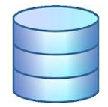
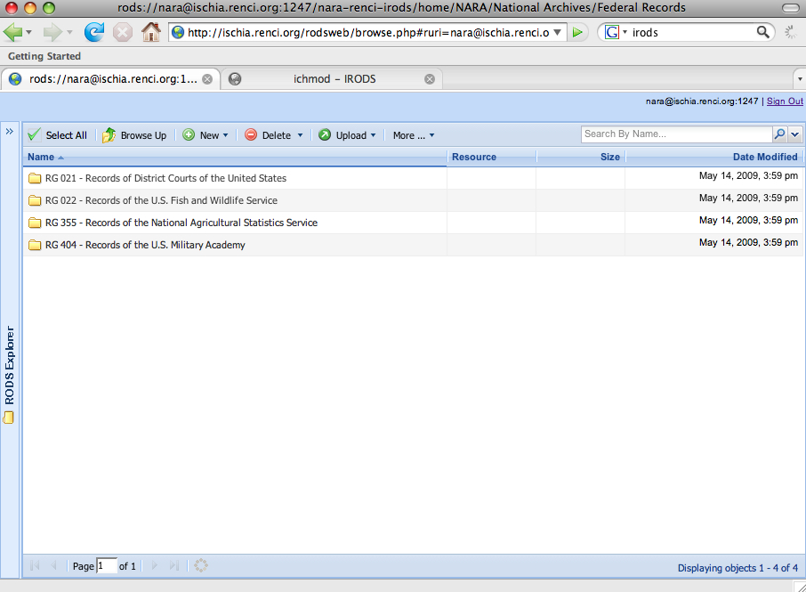
A RENCI Data Grid
Duke
NCSU
iRODS Server
iRODS Server
ECU
UNC-A
UNC-CH
RENCI, Europa Center
iRODS Server
iRODS Server
Metadata Catalog (iCAT)
iRODS Server
iRODS Server
Client asks for data – request goes to an iRODS server
Server contacts the iCAT-enabled server
Information (location, access rights, etc) is
retrieved from the iCAT
Server containing data is signaled to send data to
authorized client

Slide 8




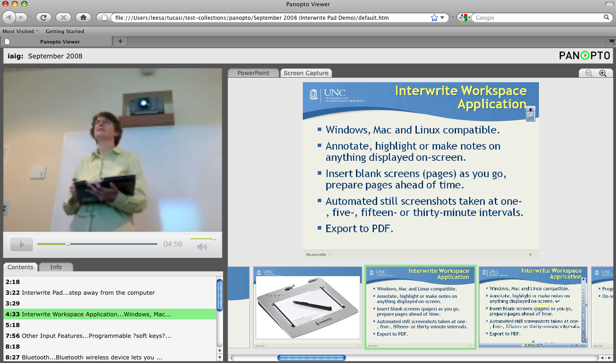

TUCASI Infrastructure Project (TIP)
Federated Data Grids

Slide 9

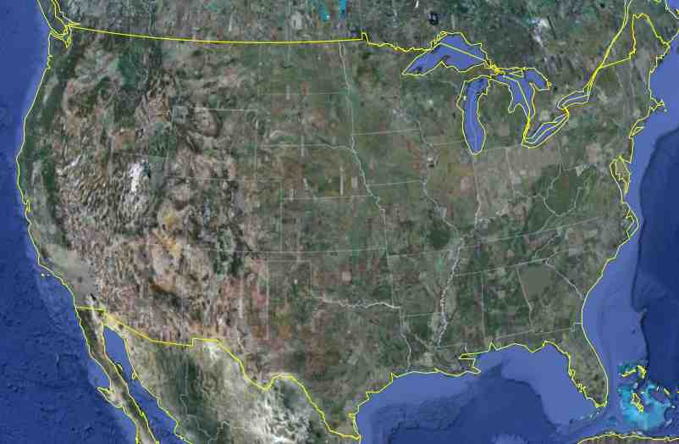












UNC iRODS Data Grids, Federations,
and Collaborations
NARA CIBER------------------- TACC----------------------
NCDC (NOAA)--------------- eLegacy---------------------
NCCS (NASA)---------------- DCAPE------------------------
MotifNet---------------------- CDR---------------------------
CineGrid----------------------- NC B-Prepared--------------
TDLC
UNC ITS
DataNetShare
SILS educational grid
RENCI VO Statewide Grid
UNC Health Science Grid
TUCASI (Duke, NCSU, UNC)
VidArch

Slide 10
The Data Issues - Examples
Genome centers
  petabytes of data
  researchers sharing data
  derived data products from workflows
  requirements for traceability and reproducibility (provenance and metadata management)
NOAA’s National Climate Data Center (NCDC)
  repository management
  publishing public data
  delivery of services with the data (to the public and to researchers)
  support for climate modeling (at ORNL, …)

Slide 11
How much is that?
1 kilobyte (kB) = 1000 bytes
1 megabyte (MB) = 1000 KB
1 gigabyte (GB) = 1000 MB
1 terabyte (TB) = 1000 GB
1 petabyte (PB) = 1000 TB
1 byte = 8 bits
1 kB = a joke (very short story)
2 kB = 1 typewritten page
1 MB = 4 books
2 MB = 1 high-resolution photo
5 MB = complete works of Shakespeare
500 MB = a CD-ROM
1 GB = ~ 900,000 pages of plaintext (enough typewritten pages to fill
the bed of a pickup)
2 GB = 20 yards of books on a shelf
1 TB = 900+ million pages of plaintext( 4.5 million books); ~230 DVD movies
20 TB = entire printed collection of Library of Congress
1 PB = 4.7 billion books; 13.3 years of HD-TV video
1.5PB = 10 billion photos on Facebook
50 PB = entire written works of mankind from the beginning of recorded history, in all languages

Slide 12
The Issues – More Examples
Streamline/automate data movement (HPC, data analysis)
  data to distributed jobs
  services provided on distributed data
  collect data to a central location for sharing/post-processing
  archive data output
National/agency repositories
  publish data from a multitude of disparate sources
  manage collections independently:
    some public collections
    some shared collections
    varying life spans
    some privacy-protected data (legal issues)
    different requirements of integrity, versioning, provenance, etc [legal issues]
Notes:
Manage collections independently:
1.) different institutions manage their data differently
2.) collections are independent from each other

Slide 13
Data Life Cycle
Creation
Active Use
Publication & Sharing
Local Policy
Reference Collection
Service/Use
Policy
Distribution
Policy
Archival Collection/Deletion
Description and
Re-purposing
Policy
Retention/
Preservation
Policy
Policy evolution across the stages of the data life cycle.
s ds
Notes:
FRAN are this and previous slide trying to say same thing? If so, this one is clearer

Slide 14
Policy-Based Data Environments
Assembled/Distributed Collections
Properties - attributes that ensure the purpose of the collections
Policies - methodologies for enforcing desired properties
Procedures - functions that implement the policies
implemented as computer actionable rules/workflows
Persistent state information - results of applying the procedures
contained in system metadata
Assessment criteria - validation that state information conforms to the desired purpose
mapped to periodically executed policies

Slide 15
Policy-Oriented Data Infrastructure
Implement management policies
  Each community defines their own policies
Automate administrative tasks
  Data administrator (not system administrator) manages data collections
Validate assessment criteria
  Verify policy compliance
    Point-in-time through queries on metadata catalog
    Compliance over time through parsing audit trails

Slide 16
Additional iRODS Design Goals
Virtualize distributed collections (data grid)
  Collection management independent of remote storage locations
  Infrastructure independence
Abstract out the data management
  Policy-based data management
  Separate policy enforcement from storage administration
Scalability and extensibility
  Enable versioning of policies and procedures and data
  Support differentiated services (storage, metadata, messaging, workflow, scheduling)

Slide 17
iRODS Policy Implementation
Microservices and Rules
Microservice – functional unit of work (C programs)
Rules – workflows of microservices (and rules)
Provide server-side (data-side) services
Modular
New libraries of microservices can be developed without touching the core code
Allows customization of data grid for community-specific policy
Event-triggered rule execution

Slide 18
Data Virtualization
Map from the actions requested by the client to multiple policy enforcement points.
Map from policy to standard micro-services.
Map from micro-services to standard Posix I/O operations.
Map standard I/O operations to the protocol supported by the storage system
Access Interface
Policy Enforcement Points
Standard Micro-services
Standard I/O Operations
Storage Protocol
Storage System
Asdfadsfasd
afsdfasdfsdf

Slide 19
iRODS Extensible Infrastructure
Some extensions handled by user groups
  Clients
  Policies
  Procedures
iRODS (extensible) core infrastructure:
  Network transport
  Authentication/Authorization
  Distributed storage access
  Remote/Data-side execution of services
  Metadata management
  Messaging
  Rule engine

Slide 20
An iRODS Overview

Slide 21



Large-Scale Data with iRODS
NASA
Broad Institute
Sanger Institute

Slide 22

NASA Center for Climate Simulation
NCCS: simulation tools and supercomputing resources for NASA missions and future scientific discoveries…
http://www.nccs.nasa.gov/
Part of NASA’s High End Computing Program
Data Management System (DMS) Project: applied R&D aimed at moving iRODS data grid technology into practical use in the NCCS. It’s about:
Technology Readiness, Operational Transfer, and Cultural Change ...
Asfsdfas
asdfsdf

Slide 23
NCCS Mandates
Major clients:
  NASA's Global Modeling and Assimilation Office (GMAO)
  Goddard Institute for Space Studies (GISS)
Data management services and analytical tools in support of the Intergovernmental Panel on Climate Change (IPCC) Fifth Assessment Report (AR5), due between 2013 and 2014
The tie between NASA modeling efforts and satellite missions: working to integrate model outputs and observational data
NCCS keeping pace with increasing heterogeneity and distributed nature of Earth Science data

Slide 24


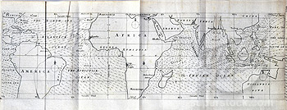
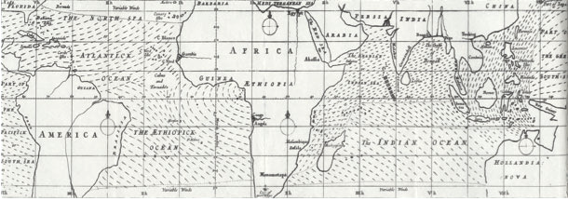

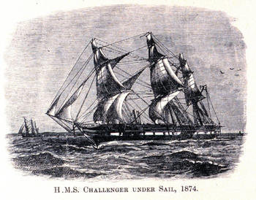

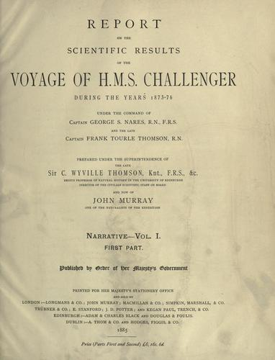
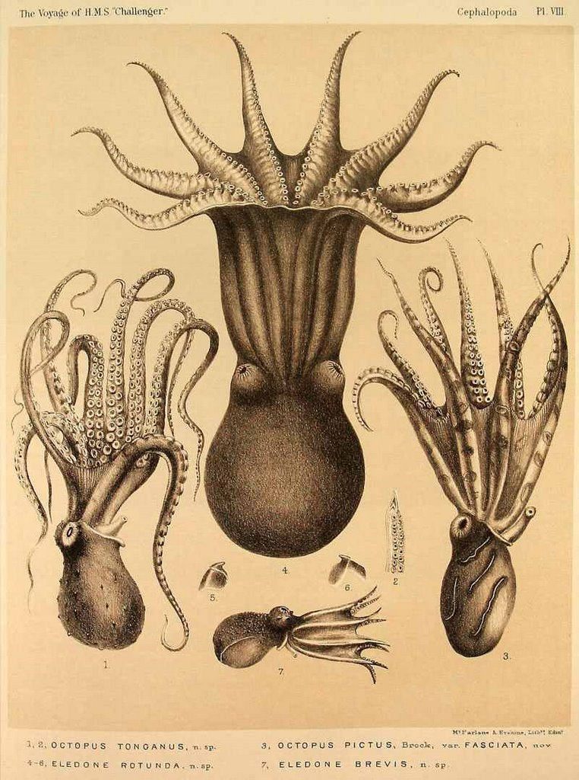
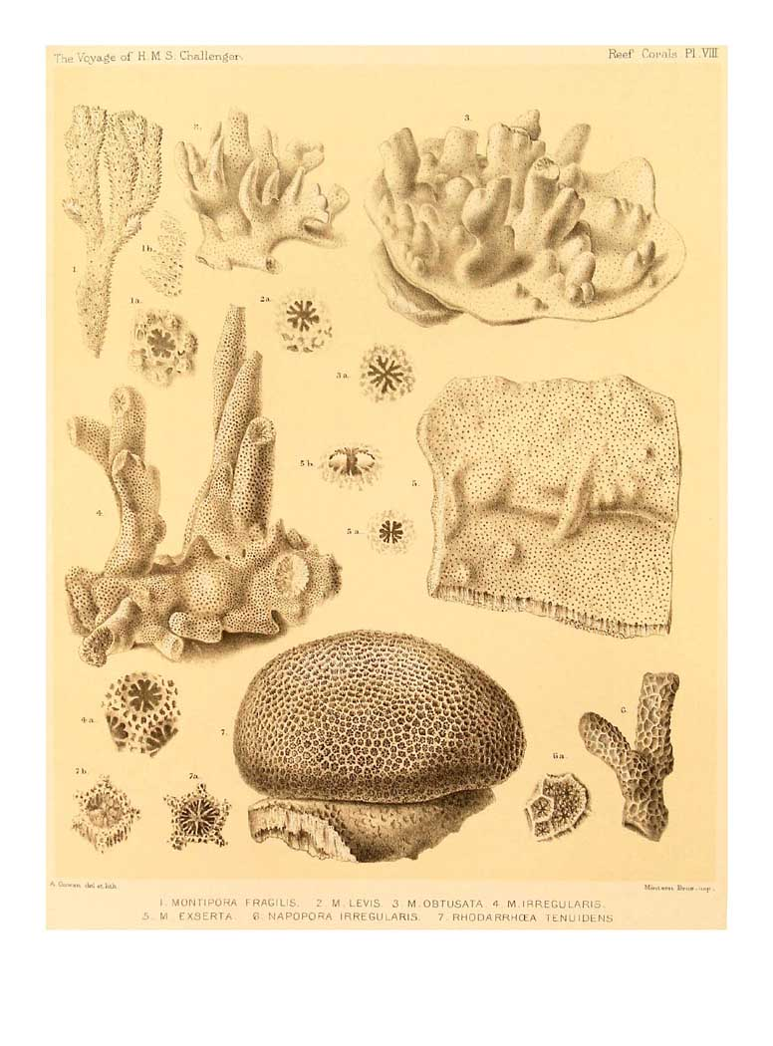
Climate Data Services
The story of climate data
It’s old, global in scale, and all of it is relevant.
It’s one of the largest and fastest growing classes of scientific data.
The types and sources of climate data are becoming increasingly diverse.
Climate research is becoming increasingly data centric.
Data services as a core NCCS mission
Climate data services represent an effort to respond to the story of climate data.
The concept is being defined.
At the very least, we know that it will require:
a new view of data stewardship,
new organizational processes, and
new data technologies.
Edmund Halley’s Wind Map (1686)
The DMS Project has been focused here ...
Asfsdfas
asdfsdf

Slide 25
iRODS Capabilities
Global persistent identifiers for naming digital objects. A unique identifier is used for each object stored in iRODS. Replicas and versions of the same object share the same global identifier but differ in replication and version metadata. Support for metadata to identify system-level physical properties of the stored data object. The properties that are stored include physical resource location, path names (or canned SQL queries in the case of database resources), owner, creation time, modification time, expiration times, file types, access controls, file size, location of replicas, aggregation in a container, etc. Support for descriptive metadata to enable discovery through simple query mechanisms. iRODS supports metadata in terms of attribute-value-unit triplets. Any number of such associations can be added for each digital object. Standard access mechanisms. Interfaces include Web browsers, Unix shell commands, Python load libraries, Java, C library calls, FUSE-based file interface, WebDav, Kepler and Taverna workflow, etc. Storage repository abstraction. Files may be stored in multiple types of storage systems including tape systems, disk systems, databases, and, now, cloud storage. Inter-realm authentication. The authentication system provides secure access to remote storage systems including secure passwords and certificate-based authentication such as Grid Security Infrastructure (GSI). Support for replication and synchronization of files between resource sites. Support for caching copies of files onto a local storage system and support for accessing files in an archive using compound resource methodology. This includes the concept of multiple replicas of an object with distinct usage models. Archives are used as “safe” copies and caches are used for immediate access. Support for physically aggregating files into tar-files to optimize management of large numbers of small files.
Access controls and audit trails to control and track data usage. Support for execution of remote operations for data sub-setting, metadata extraction, indexing, remote data movement, etc., using micro-services and rules. Support for rich I/O models for file ingestion and access including in situ registration of files into the system, inline transfer of small files, and parallel transfer for large files. Support for federation of data grids. Two independently managed persistent archives can establish a defined level of trust for the exchange of materials and access in one or both directions. This concept is very useful for developing a full-fledged preservation environment with dark and light archives.
Asfsdfas
asdfsdf

Slide 26
NASA iRODS Zones
modis_Zone: MODIS Earth Observational Data
  use iRODS to provide access to Moderate Resolution Imaging Spectroradiometer (MODIS) atmosphere data products (satellite data)
  iRODS in the setting of a production, flight mission observational data system
  22 iRODS data servers, 54 million files, 300 million metadata attributes, 630 TB
merra_Zone: MERRA Climate Simulation Data
  use iRODS to provide access to Modern Era Retrospective-Analysis for Research and Applications (MERRA) model output data.
  managing GMAO model output (simulation) data products.
yotc_Zone: YOTC Climate Simulation Data
  Production access to Year of Tropical Convection (YOTC) data (model output data)
isds_Zone: Invasive Species Data Service (ISDS) Earth Observational Data
  deliver custom data products
  personal- or laboratory-scale data management, which could participate in an extended federation of iRODS resources

Slide 27

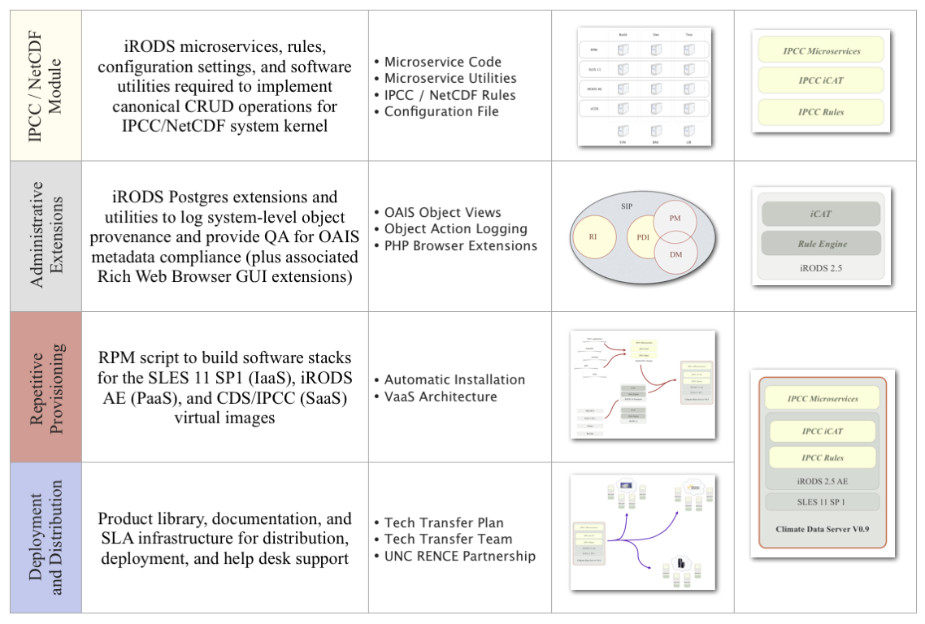

Climate Data Server (CDS) Anatomy
Our approach has been to build a core suite of general purpose scientific kits – such as NetCDF, HDF, and GeoTIF – that sit in the vertical stack above iRODS and below application-specific climate kits such as IPCC, MERRA, and SMOS ...
IPCC-Specific
Software Stack
CDS Core Components
IPCC-specific microservices
Canonical archive ops, particularly the mechanisms required to ingest OAIS-compliant Submission Information Package (SIP) metadata for IPCC NetCDF objects ...
IPCC-specific metadata
OAIS-compliant constitutive (application-independent) Representation Information (RI) and Preservation Description Information (PDI) metadata for IPCC NetCDF objects ...
IPCC-specific rules
IPCC NetCDF triggers and workflows ...
A specific release of iRODS
iRODS 2.5 w/ Administrative Extensions (AE)
A specific operating system
SLES 11 SP 1
IPCC Microservices
IPCC iCAT
General
Configuration
IPCC Rules
iCAT
iRODS 2.5 AE
Rule Engine
SLES 11 SP 1
iRODS Data Server
Climate Data Server V0.9
OS
Disk, Tape, etc.
Storage Resources
IPCC AR5 Data
Asfsdfas
asdfsdf

Slide 28

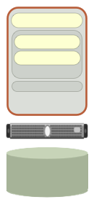
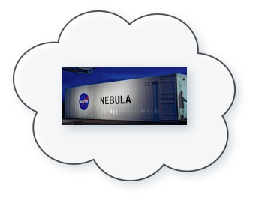
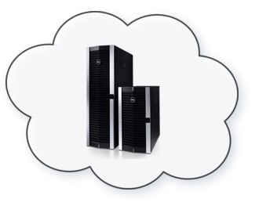
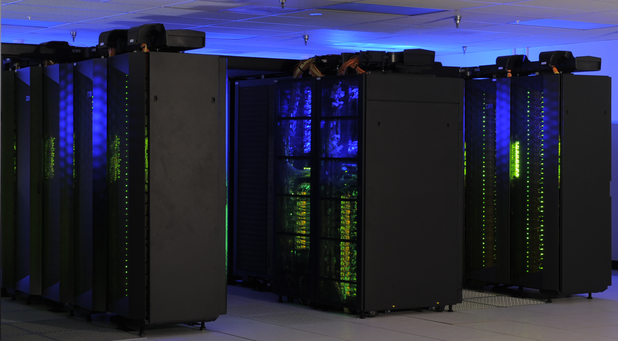
Public Cloud
Virtual Climate Data Server
Provisioning Paths
Hybrid Cloud
IPCC Microservices
Community Cloud
NetCDF iCAT
NetCDF Rules
Federation Paths
Migration Paths
iRODS 3.0 EE
VME
SLES 11 SP 1
Private Cloud
vCDS V0.9
Provisioning Paths
Hybrid Cloud
Zcxvzcxvz
sdfgsdfgs
Data Center
NCCS

Slide 29

The Sanger Institute
Large-scale genomic research
Sequenced 1/3 of the human genome
(largest single contributor).
Active cancer, malaria, pathogen and
genomic variation/human health studies.
All data is made publicly available: websites, ftp, direct database access, programmatic APIs.
Most-cited in the UK (Science Watch, 2008)
Funded by WellcomeTrust: 2nd largest research charity in the world.
More than 800 employees.
Based in WellcomeTrust Genome Campus, Hinxton, Cambridge, UK. (share with EBI)
Asfsdfas
asdfsdf
Notes:
Sanger:

Slide 30
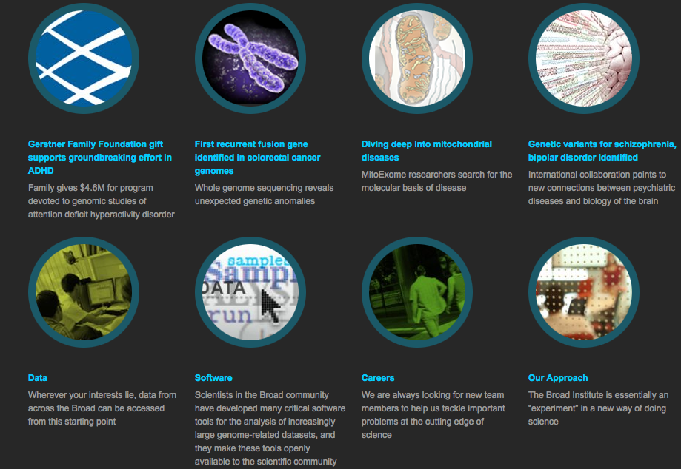
The Broad Institute at MIT and Harvard
Large-scale genomic research
Launched in 2004: Eli and Edyth Broad,
Harvard and affiliated hospitals, MIT
Seek to:
  Uncover the molecular basis of major inherited
  diseases
  Unearth all the mutations that underlie different cancer types
  Discover the molecular basis of major infectious diseases
  Change therapeutic approaches
Data contributed to NIH’s NCBI (National Center for Biotechnology
Information)
Human Genome Project
Zcxvzcxvz
sdfgsdfgs

Slide 31
Sequencing Data
2001: capillary sequencing - one sequencer produced about 115 kbp (kilobase pairs) per day (500-600 base pairs per reaction, 96 reactions per run, 2+ runs per day)
Currently: 3000 Gbases/week (16 Gbytes/Gbase) – capillary sequencing (48TB/week, almost 10 TB/day)
Small, affordable machines => many per lab (Sanger will have 20)
New data analysis pipelines required for new sequencing techniques
Data management is becoming extremely
complicated and important.

Slide 32
Data Growth and Management
Sanger: Storage/compute doubles every 12 months; 2009: ~7 PB raw data
Broad: generating 10TB of data/day
Very good at data management for the sequencing pipeline:
  Strict metadata controls (wet-lab doesn’t begin until investigator fulfills data privacy and archiving info)
  Automated analysis pipeline – bar codes, tracking, archiving
But research begins after this point
No idea what researchers have been doing with their data

Slide 33
Accidents waiting to happen...
Borrowed from Guy Coates, Sanger
From: <User A> (who left 12 months ago)
I find the <project> directory is removed . The original directory is "/scratch/<User B> (who left 6 months ago)”
..where is the directory?
If this problem cannot be solved, I am afraid that <project> cannot be released.
Need a file tracking system for unstructured data !!
Want an institute wide, standardised system.
  Invest in people to maintain/develop it.
Adsfsdf
Adsfdsf adf

Slide 34
iRODS in Large-Scale Sequencing
Broad:
  Cancer genome analysis pipeline – archival data automatically stored in iRODS
  High-performance storage for a fee; iRODS archival storage in exchange for tagging the data
  Integration of OS authorization

Slide 35
iRODS in Large-Scale Sequencing
Sanger:
  Define a resource group, replicate data automatically to all resources in the group
  Delayed and periodic rules to check replication and repair holes in case of interruption (which always comes, sooner or later!)
  Authentication mechanisms – Kerberos, Shibboleth
Broad and Sanger will be working
on a pilot iRODS federation.

Slide 36
iRODS Enterprise Version: iRODS-E
IRODS@RENCI
RENCI’s support for long-term iRODS sustainability
Target new funding models – move beyond traditional public research funds
0.9 Release due out early next year
RedHat Fedora model:
  Community code (DICE) releases every 4 months
  Enterprise code (RENCI) releases every 18 months
  Product lines, service agreements based on iRODS-E

Slide 37
iRODS Enterprise Version: iRODS-E
IRODS@RENCI
Properties of Enterprise Software: scalability, reliability, security, accessibility
Achieved through:
  Continuous Integration
  Automated Testing
  Code Hardening: static analysis, code review, refactoring, application of software engineering best practices
  Documentation & Packaging: system-specific binary packages, user documentation, cookbook guides

