Slide 1





Parallel Programming & Cluster Computing
GPGPU: Number Crunching in Your Graphics Card
Henry Neeman, University of Oklahoma
Charlie Peck, Earlham College
Tuesday October 11 2011

Slide 2
Outline
What is GPGPU?
GPU Programming
Digging Deeper: CUDA on NVIDIA
CUDA Thread Hierarchy and Memory Hierarchy
CUDA Example: Matrix-Matrix Multiply

Slide 3
What is GPGPU?

Slide 4

Accelerators
No, not this ....
http://gizmodo.com/5032891/nissans-eco-gas-pedal-fights-back-to-help-you-save-gas

Slide 5
Accelerators
In HPC, an accelerator is hardware component whose role is to speed up some aspect of the computing workload.
In the olden days (1980s), supercomputers sometimes had array processors, which did vector operations on arrays, and PCs sometimes had floating point accelerators: little chips that did the floating point calculations in hardware rather than software.
More recently, Field Programmable Gate Arrays (FPGAs) allow reprogramming deep into the hardware.

Slide 6
Why Accelerators are Good
Accelerators are good because:
they make your code run faster.

Slide 7
Why Accelerators are Bad
Accelerators are bad because:
they’re expensive;
they’re hard to program;
your code on them may not be portable to other accelerators, so the labor you invest in programming them has a very short half-life.

Slide 8
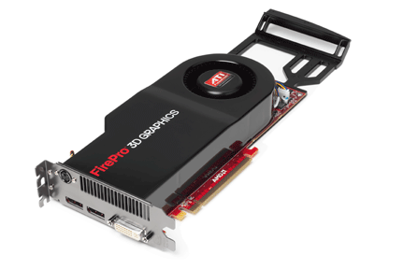
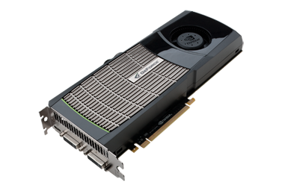
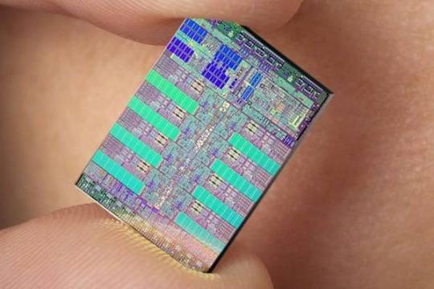
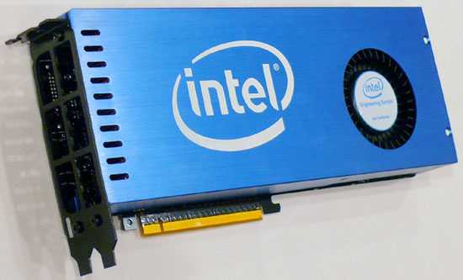
The King of the Accelerators
The undisputed champion of accelerators is:
the graphics processing unit.
http://www.amd.com/us-en/assets/content_type/DigitalMedia/46928a_01_ATI-FirePro_V8700_angled_low_res.gif
http://images.nvidia.com/products/quadro_fx_5800/Quadro_FX5800_low_3qtr.png
http://www.overclockers.ua/news/cpu/106612-Knights-Ferry.jpg
http://www.gamecyte.com/wp-content/uploads/2009/01/ibm-sony-toshiba-cell.jpg

Slide 9
Why GPU?
Graphics Processing Units (GPUs) were originally designed to accelerate graphics tasks like image rendering.
They became very very popular with videogamers, because they’ve produced better and better images, and lightning fast.
And, prices have been extremely good, ranging from three figures at the low end to four figures at the high end.

Slide 10
GPUs are Popular
Chips are expensive to design (hundreds of millions of $$$), expensive to build the factory for (billions of $$$), but cheap to produce.
For example, in 2006 – 2007, GPUs sold at a rate of about 80 million cards per year, generating about $20 billion per year in revenue.
  http://www.xbitlabs.com/news/video/display/20080404234228_Shipments_of_Discrete_Graphics_Cards_on_the_Rise_but_Prices_Down_Jon_Peddie_Research.html
This means that the GPU companies have been able to recoup the huge fixed costs.

Slide 11
GPU Do Arithmetic
GPUs mostly do stuff like rendering images.
This is done through mostly floating point arithmetic – the same stuff people use supercomputing for!

Slide 12
GPU Programming

Slide 13
Hard to Program?
In the olden days – that is, until just the last few years – programming GPUs meant either:
  using a graphics standard like OpenGL (which is mostly meant for rendering), or
  getting fairly deep into the graphics rendering pipeline.
To use a GPU to do general purpose number crunching, you had to make your number crunching pretend to be graphics.
This was hard. So most people didn’t bother.

Slide 14
Easy to Program?
More recently, GPU manufacturers have worked hard to make GPUs easier to use for general purpose computing.
This is known as General Purpose Graphics Processing Units.

Slide 15
How to Program a GPU
Proprietary programming language or extensions
  NVIDIA: CUDA (C/C++)
  AMD/ATI: StreamSDK/Brook+ (C/C++) – seems to be defunct
OpenCL (Open Computing Language): an industry standard for doing number crunching on GPUs.
Portland Group Inc (PGI) Fortran and C compilers with accelerator directives; PGI CUDA Fortran (Fortran 90 equivalent of NVIDIA’s CUDA C).
OpenMP version 4.0 may include directives for accelerators.
HMPP: directive-based like PGI and OpenMP4 but creates intermediate CUDA or OpenCL code (so portable).
Others are popping up or in development now ….

Slide 16
NVIDIA CUDA
NVIDIA proprietary
Formerly known as “Compute Unified Device Architecture”
Extensions to C to allow better control of GPU capabilities
Modest extensions but major rewriting of the code
Portland Group Inc (PGI) has released a Fortran implementation of CUDA available in their Fortran compiler.

Slide 17
CUDA Example Part 1
// example1.cpp : Defines the entry point for the console application.
//
#include "stdafx.h"
#include <stdio.h>
#include <cuda.h>
// Kernel that executes on the CUDA device
__global__ void square_array(float *a, int N)
{
int idx = blockIdx.x * blockDim.x + threadIdx.x;
if (idx<N) a[idx] = a[idx] * a[idx];
}
http://llpanorama.wordpress.com/2008/05/21/my-first-cuda-program/

Slide 18
CUDA Example Part 2
// main routine that executes on the host
int main(void)
{
float *a_h, *a_d; // Pointer to host & device arrays
const int N = 10; // Number of elements in arrays
size_t size = N * sizeof(float);
a_h = (float *)malloc(size); // Allocate array on host
cudaMalloc((void **) &a_d, size); // Allocate array on device
// Initialize host array and copy it to CUDA device
for (int i=0; i<N; i++) a_h[i] = (float)i;
cudaMemcpy(a_d, a_h, size, cudaMemcpyHostToDevice);
// Do calculation on device:
int block_size = 4;
int n_blocks = N/block_size + (N%block_size == 0 ? 0:1);
square_array <<< n_blocks, block_size >>> (a_d, N);
// Retrieve result from device and store it in host array
cudaMemcpy(a_h, a_d, sizeof(float)*N, cudaMemcpyDeviceToHost);
// Print results
for (int i=0; i<N; i++) printf("%d %f\n", i, a_h[i]);
// Cleanup
free(a_h); cudaFree(a_d);
}

Slide 19
AMD/ATI Brook+
AMD/ATI proprietary
Formerly known as “Close to Metal” (CTM)
Extensions to C to allow better control of GPU capabilities
No Fortran version available

Slide 20
Brook+ Example Part 1
float4 matmult_kernel (int y, int x, int k,
float4 M0[], float4 M1[])
{
float4 total = 0;
for (int c = 0; c < k / 4; c++)
{
total += M0[y][c] * M1[x][c];
}
return total;
}
http://developer.amd.com/gpu_assets/Stream_Computing_Overview.pdf

Slide 21
Brook+ Example Part 2
void matmult (float4 A[], float4 B’[], float4 C[])
{
for (int i = 0; i < n; i++)
{
for (j = 0; j < m / 4; j+)
{
launch_thread{
C[i][j] =
matmult_kernel(j, i, k, A, B’);}
}
}
sync_threads{}
}

Slide 22
OpenCL
Open Computing Language
Open standard developed by the Khronos Group, which is a consortium of many companies (including NVIDIA, AMD and Intel, but also lots of others)
Initial version of OpenCL standard released in Dec 2008.
Many companies are creating their own implementations.
Apple was first to market, with an OpenCL implementation included in Mac OS X v10.6 (“Snow Leopard”) in 2009.

Slide 23
OpenCL Example Part 1
// create a compute context with GPU device
context =
clCreateContextFromType(NULL, CL_DEVICE_TYPE_GPU, NULL, NULL, NULL);
// create a command queue
queue = clCreateCommandQueue(context, NULL, 0, NULL);
// allocate the buffer memory objects
memobjs[0] = clCreateBuffer(context,
CL_MEM_READ_ONLY | CL_MEM_COPY_HOST_PTR,
sizeof(float)*2*num_entries, srcA, NULL);
memobjs[1] = clCreateBuffer(context,
CL_MEM_READ_WRITE,
sizeof(float)*2*num_entries, NULL, NULL);
// create the compute program
program = clCreateProgramWithSource(context, 1, &fft1D_1024_kernel_src,
NULL, NULL);
http://en.wikipedia.org/wiki/OpenCL

Slide 24
OpenCL Example Part 2
// build the compute program executable
clBuildProgram(program, 0, NULL, NULL, NULL, NULL);
// create the compute kernel
kernel = clCreateKernel(program, "fft1D_1024", NULL);
// set the args values
clSetKernelArg(kernel, 0, sizeof(cl_mem), (void *)&memobjs[0]);
clSetKernelArg(kernel, 1, sizeof(cl_mem), (void *)&memobjs[1]);
clSetKernelArg(kernel, 2, sizeof(float)*(local_work_size[0]+1)*16, NULL);
clSetKernelArg(kernel, 3, sizeof(float)*(local_work_size[0]+1)*16, NULL);
// create N-D range object with work-item dimensions and execute kernel
global_work_size[0] = num_entries; local_work_size[0] = 64;
clEnqueueNDRangeKernel(queue, kernel, 1, NULL,
global_work_size, local_work_size, 0, NULL, NULL);

Slide 25
OpenCL Example Part 3
// This kernel computes FFT of length 1024. The 1024 length FFT is
// decomposed into calls to a radix 16 function, another radix 16
// function and then a radix 4 function
__kernel void fft1D_1024 (__global float2 *in, __global float2 *out,
__local float *sMemx, __local float *sMemy) {
int tid = get_local_id(0);
int blockIdx = get_group_id(0) * 1024 + tid;
float2 data[16];
// starting index of data to/from global memory
in = in + blockIdx;
out = out + blockIdx;
globalLoads(data, in, 64); // coalesced global reads
fftRadix16Pass(data); // in-place radix-16 pass
twiddleFactorMul(data, tid, 1024, 0);

Slide 26
OpenCL Example Part 4
// local shuffle using local memory
localShuffle(data, sMemx, sMemy, tid, (((tid & 15) * 65) + (tid >> 4)));
fftRadix16Pass(data); // in-place radix-16 pass
twiddleFactorMul(data, tid, 64, 4); // twiddle factor multiplication
localShuffle(data, sMemx, sMemy, tid, (((tid >> 4) * 64) + (tid & 15)));
// four radix-4 function calls
fftRadix4Pass(data); // radix-4 function number 1
fftRadix4Pass(data + 4); // radix-4 function number 2
fftRadix4Pass(data + 8); // radix-4 function number 3
fftRadix4Pass(data + 12); // radix-4 function number 4
// coalesced global writes
globalStores(data, out, 64);
}

Slide 27
Portland Group Accelerator Directives
Proprietary directives in Fortran and C
Similar to OpenMP in structure
If the compiler doesn’t understand these directives, it ignores them, so the same code can work with an accelerator or without, and with the PGI compilers or other compilers.
In principle, this will be able to work on a variety of accelerators, but the first instance is NVIDIA; PGI recently announced a deal with AMD/ATI.
The directives tell the compiler what parts of the code happen in the accelerator; the rest happens in the regular hardware.

Slide 28
PGI Accelerator Example
!$acc region
do k = 1,n1
do i = 1,n3
c(i,k) = 0.0
do j = 1,n2
c(i,k) = c(i,k) +
& a(i,j) * b(j,k)
enddo
enddo
enddo
!$acc end region
http://www.pgroup.com/resources/accel.htm

Slide 29
OpenMP 4.0 Accelerator Directives
OpenMP’s 4.0 standard is very much in discussion (and flux).
It may end up with accelerator directives.
It’s too soon to say what the details will be, if it happens at all.
But, if it happens, then codes amenable to accelerator directives will be able to get substantial speedups with very modest coding effort.

Slide 30
OpenMP 4.0 Accelerator Example
!$omp acc_region
do k = 1,n1
do i = 1,n3
c(i,k) = 0.0
do j = 1,n2
c(i,k) = c(i,k) +
& a(i,j) * b(j,k)
enddo
enddo
enddo
!$omp end acc_region
http://www.pgroup.com/resources/accel.htm
http://www.cse.scitech.ac.uk/events/GPU_2010/12_Hart.pdf

Slide 31
Digging Deeper:
CUDA on NVIDIA

Slide 32
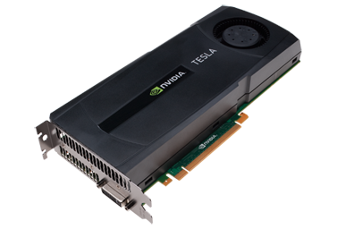
NVIDIA Tesla
NVIDIA now offers a GPU platform named Tesla.
It consists essentially of their highest end graphics card, minus the video out connector.
http://images.nvidia.com/products/geforce_gtx_480/geforce_gtx_480_3qtr_low.png
http://images.nvidia.com/products/tesla_C2050_C2070/Tesla_C2050_C2070_3qtr_low_new.png

Slide 33
NVIDIA Tesla C2050 Card Specs
448 GPU cores
1.15 GHz
Single precision floating point performance: 1030.4 GFLOPs (2 single precision flops per clock per core)
Double precision floating point performance: 515.2 GFLOPs (1 double precision flop per clock per core)
Internal RAM: 3 GB DDR5
Internal RAM speed: 144 GB/sec (compared 21-25 GB/sec for regular RAM)
Has to be plugged into a PCIe slot (at most 8 GB/sec per GPU card)

Slide 34
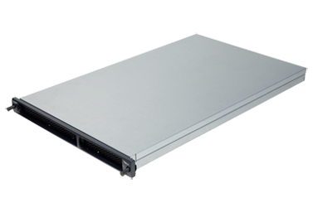
NVIDIA Tesla S2050 Server Specs
4 C2050 cards inside a 1U server (looks like a Sooner node)
1.15 GHz
Single Precision (SP) floating point performance: 4121.6 GFLOPs
Double Precision (DP) floating point performance: 2060.8 GFLOPs
Internal RAM: 12 GB total (3 GB per GPU card)
Internal RAM speed: 576 GB/sec aggregate
Has to be plugged into two PCIe slots (at most 16 GB/sec for 4 GPU cards)

Slide 35
Compare x86 vs S2050
Let’s compare the best dual socket x86 server today vs S2050.
 | Dual socket, AMD 2.3 GHz 12-core | NVIDIA Tesla S2050
Peak DP FLOPs | 220.8 GFLOPs DP | 2060.8 GFLOPs DP (9.3x)
Peak SP FLOPS | 441.6 GFLOPs SP | 4121.6 GFLOPs SP (9.3x)
Peak RAM BW | 25 GB/sec | 576 GB/sec (23x)
Peak PCIe BW | N/A | 16 GB/sec
Needs x86 server to attach to? | No | Yes
Power/Heat | ~450 W | ~900 W + ~400 W (~2.9x)
Code portable? | Yes | No (CUDA) Yes (PGI, OpenCL)

Slide 36
Compare x86 vs S2050
Here are some interesting measures:
 | Dual socket, AMD 2.3 GHz 12-core | NVIDIA Tesla S2050
DP GFLOPs/Watt | ~0.5 GFLOPs/Watt | ~1.6 GFLOPs/Watt (~3x)
SP GFLOPS/Watt | ~1 GFLOPs/Watt | ~3.2 GFLOPs/Watt (~3x)
DP GFLOPs/sq ft | ~590 GFLOPs/sq ft | ~2750 GFLOPs/sq ft (4.7x)
SP GFLOPs/sq ft | ~1180 GFLOPs/sq ft | ~5500 GFLOPs/sq ft (4.7x)
Racks per PFLOP DP | 142 racks/PFLOP DP | 32 racks/PFLOP DP (23%)
Racks per PFLOP SP | 71 racks/PFLOP SP | 16 racks/PFLOP SP (23%)

Slide 37
Kepler and Maxwell
NVIDIA’s 20-series is also known by the codename “Fermi.” It runs at about 0.5 TFLOPs per GPU card (peak).
The next generation, to be released in 2011, is codenamed “Kepler” and will be capable of something like 1.4 TFLOPs double precision per GPU card.
After “Kepler” will come “Maxwell” in 2013, capable of something like 4 TFLOPs double precision per GPU card.
So, the increase in performance is likely to be roughly 2.5x – 3x per generation, roughly every two years.
http://www.vizworld.com/2010/09/thoughts-nvidias-kepler-maxwell-gpus/

Slide 38
What Are the Downsides?
You have to rewrite your code into CUDA or OpenCL or PGI accelerator directives (or someday maybe OpenMP).
  CUDA: Proprietary, but maybe portable soon
  OpenCL: portable but cumbersome
  PGI accelerator directives: not clear whether you can have most of the code live inside the GPUs.
BUT: Many groups are coming out with GPGPU code development tools that may help a lot, such as:
  Fortran-to-CUDA-C converter (NCAR)
  CUDA C automatic optimizer (memory, threading etc)
  OpenMP-to-CUDA converter
  CUDA-to-x86 converter (CUDA code on non-CUDA system)

Slide 39
Programming for Performance
The biggest single performance bottleneck on GPU cards today is the PCIe slot:
PCIe 2.0 x16: 8 GB/sec
1600 MHz Front Side Bus: 25 GB/sec
GDDR5 GPU card RAM: 144 GB/sec per card
Your goal:
At startup, move the data from x86 server RAM into GPU RAM.
Do almost all the work inside the GPU.
Use the x86 server only for I/O and message passing, to minimize the amount of data moved through the PCIe slot.

Slide 40
Does CUDA Help?
http://www.nvidia.com/object/IO_43499.html

Slide 41
CUDA
Thread Hierarchy and Memory Hierarchy
Some of these slides provided by Paul Gray, University of Northern Iowa

Slide 42
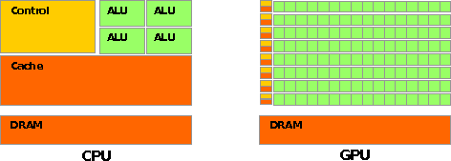
CPU vs GPU Layout
Source: NVIDIA CUDA Programming Guide

Slide 43
Buzzword: Kernel
In CUDA, a kernel is code (typically a function) that can be run inside the GPU.
Typically, the kernel code operates in lock-step on the stream processors inside the GPU.

Slide 44
Buzzword: Thread
In CUDA, a thread is an execution of a kernel with a given index.
Each thread uses its index to access a specific subset of the elements of a target array, such that the collection of all threads cooperatively processes the entire data set.
So these are very much like threads in the OpenMP or pthreads sense – they even have shared variables and private variables.

Slide 45
Buzzword: Block
In CUDA, a block is a group of threads.
Just like OpenMP threads, these could execute concurrently or independently, and in no particular order.
Threads can be coordinated somewhat, using the _syncthreads() function as a barrier, making all threads stop at a certain point in the kernel before moving on en mass. (This is like what happens at the end of an OpenMP loop.)

Slide 46
Buzzword: Grid
In CUDA, a grid is a group of (thread) blocks, with no synchronization at all among the blocks.

Slide 47
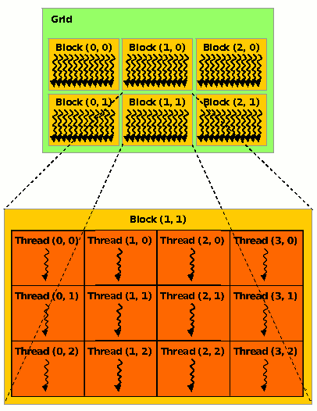
NVIDIA GPU Hierarchy
Grids map to GPUs
Blocks map to the MultiProcessors (MP)‏
  Blocks are never split across MPs, but an MP can have multiple blocks
Threads map to Stream Processors (SP)‏
Warps are groups of (32) threads that execute simultaneously
Image Source:
NVIDIA CUDA Programming Guide

Slide 48
CUDA Built-in Variables
blockIdx.x, blockIdx.y, blockIdx.z are built-in variables that returns the block ID in the x-axis, y-axis and z-axis of the block that is executing the given block of code.
threadIdx.x, threadIdx.y, threadidx.z are built-in variables that return the thread ID in the x-axis, y-axis and z-axis of the thread that is being executed by this stream processor in this particular block.
So, you can express your collection of blocks, and your collection of threads within a block, as a 1D array, a 2D array or a 3D array.
These can be helpful when thinking of your data as 2D or 3D.

Slide 49
__global__ Keyword
In CUDA, if a function is declared with the __global__ keyword, that means that it’s intended to be executed inside a GPU.
In CUDA, the term for the GPU is device, and the term for the x86 server is host.
So, a kernel runs on a device, while the main function, and so on, run on the host.
Note that a host can play host to multiple devices; for example, an S2050 server contains 4 C2050 GPU cards, and if a single host has two PCIe slots, then both of the PCIe plugs of the S2050 can be plugged into that same host.

Slide 50
Copying Data from Host to Device
If data need to move from the host (where presumably the data are initially input or generated), then a copy has to exist in both places.
Typically, what’s copied are arrays, though of course you can also copy a scalar (the address of which is treated as an array of length 1).

Slide 51
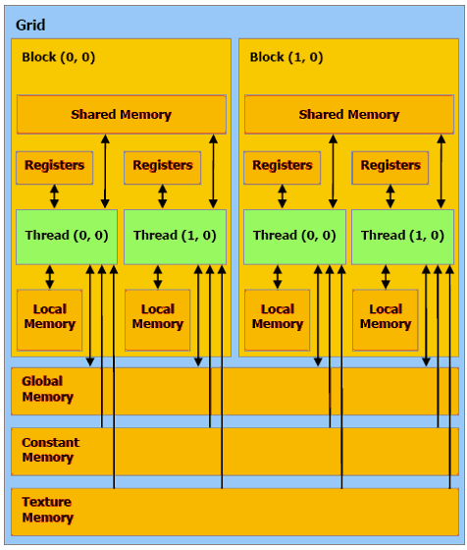
CUDA Memory Hierarchy #1
CUDA has a hierarchy of several kinds of memory:
Host memory (x86 server)
Device memory (GPU)
  Global: visible to all threads in all blocks – largest, slowest
  Shared: visible to all threads in a particular block – medium size, medium speed
  Local: visible only to a particular thread – smallest, fastest

Slide 52
CUDA Memory Hierarchy #2
CUDA has a hierarchy of several kinds of memory:
Host memory (x86 server)
Device memory (GPU)
  Constant: visible to all threads in all blocks; read only
  Texture: visible to all threads in all blocks; read only

Slide 53
CUDA Example:
Matrix-Matrix Multiply
http://developer.download.nvidia.com/compute/cuda/sdk/website/Linear_Algebra.html#matrixMul

Slide 54
Matrix-Matrix Multiply Main Part 1
float* host_A;
float* host_B;
float* host_B;
float* device_A;
float* device_B;
float* device_C;
host_A = (float*) malloc(mem_size_A);
host_B = (float*) malloc(mem_size_B);
host_C = (float*) malloc(mem_size_C);
cudaMalloc((void**) &device_A, mem_size_A);
cudaMalloc((void**) &device_B, mem_size_B);
cudamalloc((void**) &device_C, mem_size_C);
// Set up the initial values of A and B here.
// Henry says: I’ve oversimplified this a bit from
// the original example code.

Slide 55
Matrix-Matrix Multiply Main Part 2
// copy host memory to device
cudaMemcpy(device_A, host_A, mem_size_A,
cudaMemcpyHostToDevice);
cudaMemcpy(device_B, host_B, mem_size_B,
cudaMemcpyHostToDevice);
// setup execution parameters
dim3 threads(BLOCK_SIZE, BLOCK_SIZE);
dim3 grid(WC / threads.x, HC / threads.y);
// execute the kernel
matrixMul<<< grid, threads >>>(device_C,
device_A, device_B, WA, WB);
// copy result from device to host
cudaMemcpy(host_C, device_C, mem_size_C,
cudaMemcpyDeviceToHost);

Slide 56
Matrix Matrix Multiply Kernel Part 1
__global__ void matrixMul( float* C, float* A, float* B, int wA, int wB)
{
// Block index
int bx = blockIdx.x;
int by = blockIdx.y;
// Thread index
int tx = threadIdx.x;
int ty = threadIdx.y;
// Index of the first sub-matrix of A processed by the block
int aBegin = wA * BLOCK_SIZE * by;
// Index of the last sub-matrix of A processed by the block
int aEnd = aBegin + wA - 1;
// Step size used to iterate through the sub-matrices of A
int aStep = BLOCK_SIZE;
// Index of the first sub-matrix of B processed by the block
int bBegin = BLOCK_SIZE * bx;
// Step size used to iterate through the sub-matrices of B
int bStep = BLOCK_SIZE * wB;
// Csub is used to store the element of the block sub-matrix
// that is computed by the thread
float Csub = 0;

Slide 57
Matrix Matrix Multiply Kernel Part 2
// Loop over all the sub-matrices of A and B
// required to compute the block sub-matrix
for (int a = aBegin, b = bBegin;
a <= aEnd;
a += aStep, b += bStep) {
// Declaration of the shared memory array As used to
// store the sub-matrix of A
__shared__ float As[BLOCK_SIZE][BLOCK_SIZE];
// Declaration of the shared memory array Bs used to
// store the sub-matrix of B
__shared__ float Bs[BLOCK_SIZE][BLOCK_SIZE];
// Load the matrices from device memory
// to shared memory; each thread loads
// one element of each matrix
AS(ty, tx) = A[a + wA * ty + tx];
BS(ty, tx) = B[b + wB * ty + tx];
// Synchronize to make sure the matrices are loaded
__syncthreads();

Slide 58
Matrix Matrix Multiply Kernel Part 3
// Multiply the two matrices together;
// each thread computes one element
// of the block sub-matrix
for (int k = 0; k < BLOCK_SIZE; ++k)
Csub += AS(ty, k) * BS(k, tx);
// Synchronize to make sure that the preceding
// computation is done before loading two new
// sub-matrices of A and B in the next iteration
__syncthreads();
}
// Write the block sub-matrix to device memory;
// each thread writes one element
int c = wB * BLOCK_SIZE * by + BLOCK_SIZE * bx;
C[c + wB * ty + tx] = Csub;
}

Slide 59
Would We Really Do It This Way?
We wouldn’t really do matrix-matrix multiply this way.
NVIDIA has developed a CUDA implementation of the BLAS libraries, which include a highly tuned matrix-matrix multiply routine.
(We’ll learn about BLAS next time.)
There’s also a CUDA FFT library, if your code needs Fast Fourier Transforms.

Slide 60
Thanks for your attention!
Questions?

