Slide 1


Exascale Challenges for the Computational Science Community
Horst Simon
Lawrence Berkeley National Laboratory
and UC Berkeley
Oklahoma Supercomputing Symposium 2010
October 6, 2010
Notes:
1

Slide 2
Key Message
The transition from petascale to exascale will be characterized by significant and dramatics changes in hardware and architecture.
This transition will be disruptive, but create unprecedented opportunities for computational science.

Slide 3
Overview
From 1999 to 2009: evolution from Teraflops to Petaflops computing
From 2010 to 2020: key technology changes towards Exaflops computing
Impact on Computational Science
Notes:
This view of capability is not always shared by others. Sometimes only focus on large number of processors

Slide 4
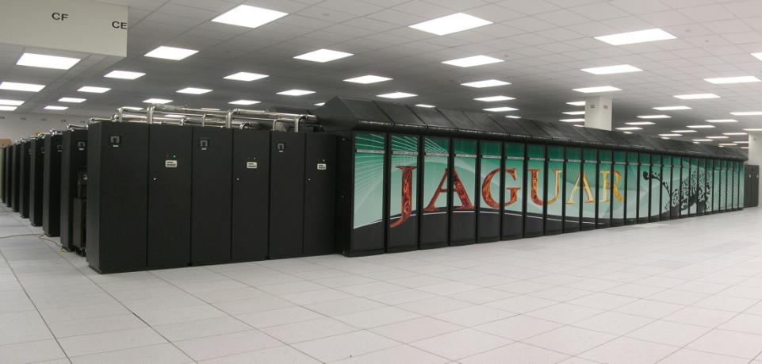

Jaguar: World’s most powerful computer since 2009
Peak performance | 2.332 PF
System memory | 300 TB
Disk space | 10 PB
Processors | 224K
Power | 6.95 MW
#1 Nov. 2009

Slide 5
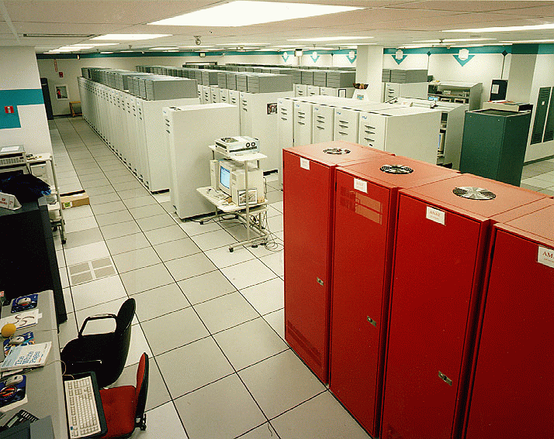
ASCI Red: World’s Most Powerful Computer in 1999
#1 Nov. 1999
Peak performance | 3.154 TF
System memory | 1.212 TB
Disk space | 12.5 TB
Processors | 9298
Power | 850 kW

Slide 6
Comparison
Jaguar (2009) vs. ASCI Red (1999)
739x performance (LINPACK)
267x memory
800x disk
24x processors/cores
8.2x power
Parallelism and faster processors made about equal contributions to performance increase
Significant increase in operations cost
Essentially the same architecture and software environment

Slide 7
Overview
From 1999 to 2009: evolution from Teraflops to Petaflops computing
From 2010 to 2020: key technology changes towards Exaflops computing
Impact on Computational Science
Notes:
This view of capability is not always shared by others. Sometimes only focus on large number of processors

Slide 8
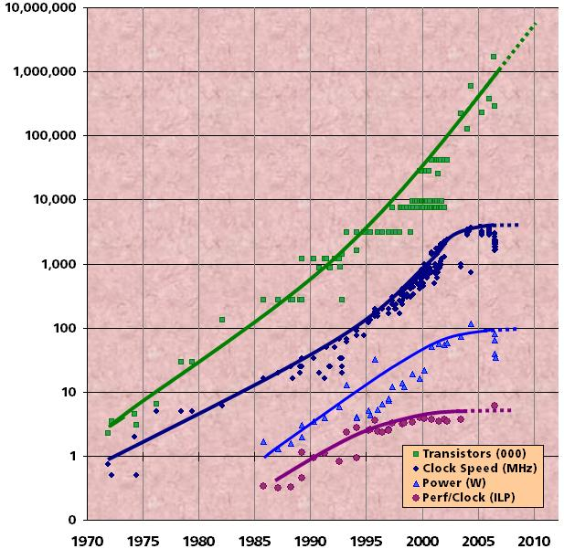
Traditional Sources of Performance Improvement are Flat-Lining (2004)
New Constraints
  15 years of exponential clock rate growth has ended
Moore’s Law reinterpreted:
  How do we use all of those transistors to keep performance increasing at historical rates?
  Industry Response: #cores per chip doubles every 18 months instead of clock frequency!
Figure courtesy of Kunle Olukotun, Lance Hammond, Herb Sutter, and Burton Smith

Slide 9
Performance Development
100 Pflop/s
32.4 PFlop/s
10 Pflop/s
1.75 PFlop/s
1 Pflop/s
100 Tflop/s
SUM
24.67 TFlop/s
10 Tflop/s
1 Tflop/s
N=1
1.17 TFlop/s
100 Gflop/s
59.7 GFlop/s
10 Gflop/s
N=500
1 Gflop/s
400 MFlop/s
100 Mflop/s

Slide 10
Projected Performance Development
100 Pflop/s
10 Pflop/s
SUM
1 Pflop/s
100 Tflop/s
N=1
10 Tflop/s
1 Tflop/s
N=500
100 Gflop/s
10 Gflop/s
1 Gflop/s
100 Mflop/s

Slide 11
Concurrency Levels
Jack‘s Notebook
Notes:
Almost 1/3 of processors are in 24 (5%) of systems: BG/L
June 07 dip for min is SX8R in France

Slide 12
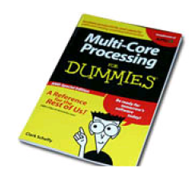
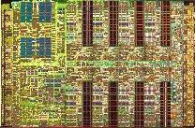
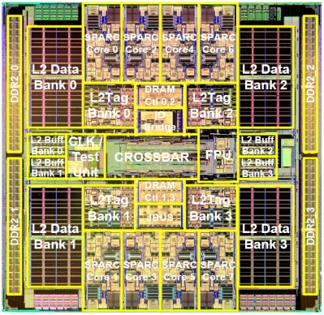
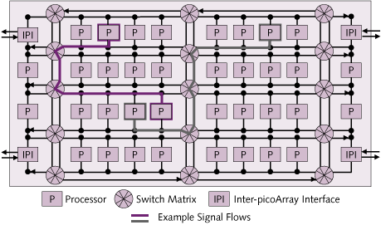
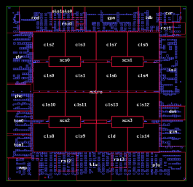
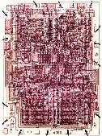
Multicore comes in a wide variety
  Multiple parallel general-purpose processors (GPPs)
  Multiple application-specific processors (ASPs)
Intel Network Processor
1 GPP Core
16 ASPs (128 threads)
IBM Cell
1 GPP (2 threads)
8 ASPs
18
18
18
IXP2800
Picochip DSP
1 GPP core
248 ASPs
Stripe
RDRAM
1
RDRAM
2
RDRAM
3
MEv2
1
MEv2
2
MEv2
3
MEv2
4
Rbuf
64 @ 128B
S
P
I
4
or
C
S
I
X
16b
PCI
(64b)
66 MHz
Intel®
XScale™
Core
32K IC
32K DC
G
A
S
K
E
T
MEv2
8
MEv2
7
MEv2
6
MEv2
5
64b
MEv2
9
MEv2
10
MEv2
11
MEv2
12
Tbuf
64 @ 128B
16b
Hash
48/64/128
Cisco CRS-1
188 Tensilica GPPs
QDR
SRAM
1
QDR
SRAM
2
QDR
SRAM
3
QDR
SRAM
4
MEv2
16
MEv2
15
MEv2
14
MEv2
13
Scratch
16KB
Sun Niagara
8 GPP cores (32 threads)
CSRs
-Fast_wr -UART
-Timers -GPIO
-BootROM/SlowPort
E/D Q
E/D Q
E/D Q
E/D Q
18
18
18
18
18
18
18
18
Intel 4004 (1971): 4-bit processor,
2312 transistors, ~100 KIPS,
10 micron PMOS, 11 mm² chip
1000s of processor cores per die
“The Processor is the new Transistor” [Rowen]

Slide 13
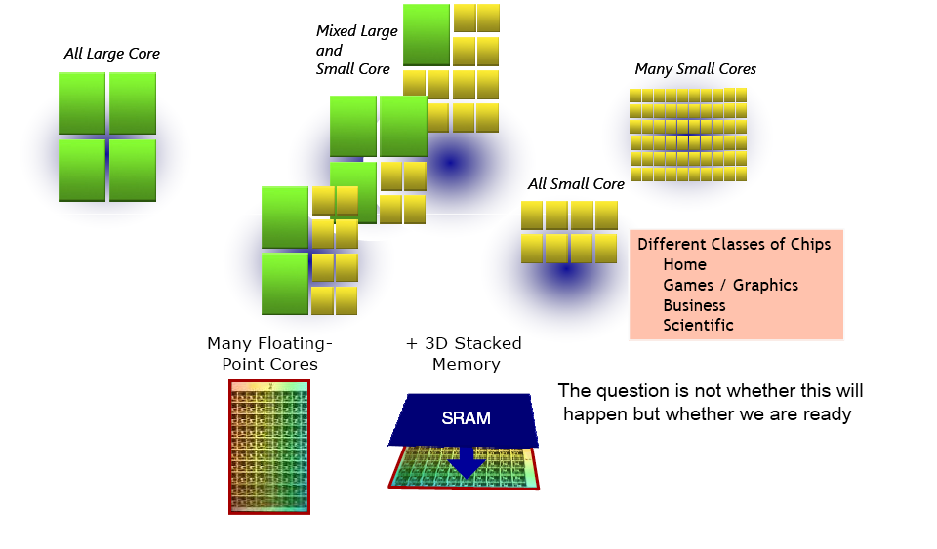
What’s Next?
Source: Jack Dongarra, ISC 2008

Slide 14
Moore’s Law reinterpreted
Number of cores per chip will double every two years
Clock speed will not increase (possibly decrease)
Need to deal with systems with millions of concurrent threads
Need to deal with inter-chip parallelism as well as intra-chip parallelism

Slide 15
Countries / System Share

Slide 16
Performance Development
100 Pflop/s
32.4 PFlop/s
10 Pflop/s
1.75 PFlop/s
1 Pflop/s
100 Tflop/s
SUM
24.67 TFlop/s
10 Tflop/s
1 Tflop/s
N=1
1.17 TFlop/s
100 Gflop/s
59.7 GFlop/s
10 Gflop/s
N=500
1 Gflop/s
400 MFlop/s
100 Mflop/s

Slide 17
Annual Performance Increase of the
TOP500

Slide 18
Total Power Levels (kW) for TOP500 systems
Notes:
#50 is ASCI Purple

Slide 19
Power Efficiency (Mflops/Watt) for different Processor Generations

Slide 20
Power Efficiency (Mflops/Watt) related to Interconnects

Slide 21
Power Consumption

Slide 22
Power Efficiency

Slide 23
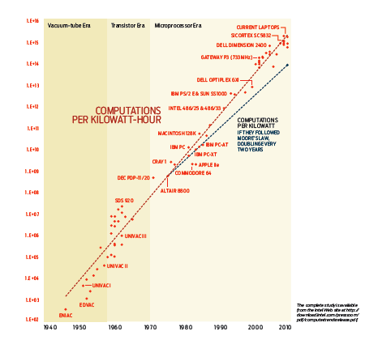
Koomey’s Law
Computations per kWh have improved by a factor about 1.5 per year
“Assessing Trends in Electrical Efficiency over Time”, see IEEE Spectrum, March 2010

Slide 24
Trend Analysis
Processors and Systems have become more energy efficient over time
  Koomey’s Law shows factor of 1.5 improvement in computations/kWh
Supercomputers have become more powerful over time
  TOP500 data show factor of 1.86 increase of computations/sec per system
Consequently power/system increases by about 1.24 per year
Based on these projections: 495 Pflop/s Linpack-Rmax system with 60 MW in 2020

Slide 25
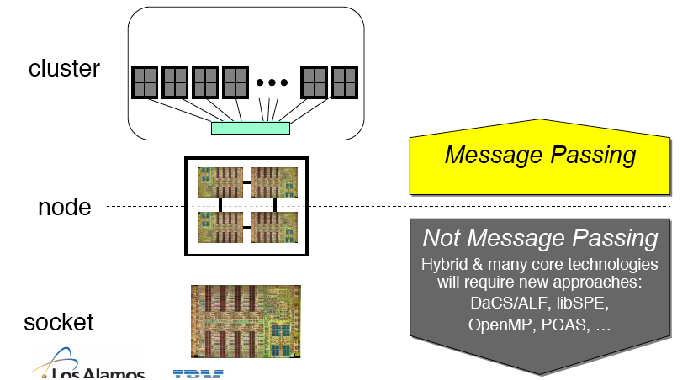
Roadrunner - A Likely Future Scenario
System: cluster + many core node
Programming model:
MPI+X
Not Message Passing
Hybrid & many core technologies
will require new approaches:
PGAS, auto tuning, ?
after Don Grice, IBM, Roadrunner Presentation, ISC 2008

Slide 26
Why MPI will persist
Obviously MPI will not disappear in five years
By 2014 there will be 20 years of legacy software in MPI
New systems are not sufficiently different to lead to new programming model

Slide 27
What will be the “X” in MPI+X
Likely candidates are
  PGAS languages
  OpenMP
  Autotuning
  CUDA, OpenCL
  A wildcard from commercial space

Slide 28
What’s Wrong with MPI Everywhere?

Slide 29
What’s Wrong with MPI Everywhere?
One MPI process per core is wasteful of intra-chip latency and bandwidth
Weak scaling: success model for the “cluster era”
  not enough memory per core
Heterogeneity: MPI per CUDA thread-block?

Slide 30
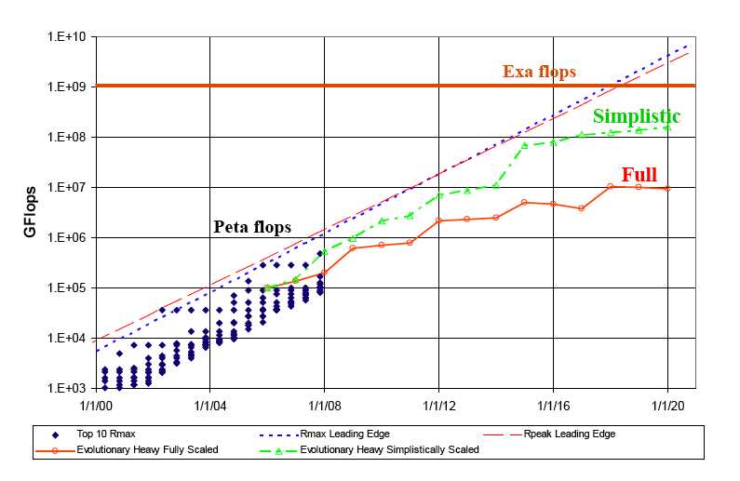
We won’t reach Exaflops with the current approach
From Peter Kogge, DARPA Exascale Study

Slide 31
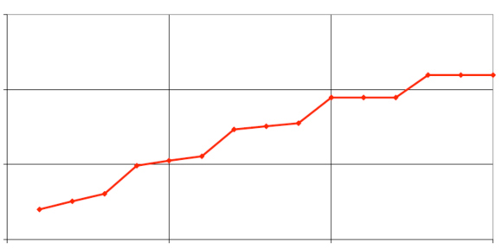
… and the power costs will still be staggering
1000
100
System Power (MW)
10
1
2005
2010
2015
2020
From Peter Kogge, DARPA Exascale Study

Slide 32
A decadal DOE plan for providing exascale applications and technologies for DOE mission needs
Rick Stevens and Andy White, co-chairs
  Pete Beckman, Ray Bair-ANL; Jim Hack, Jeff Nichols, Al Geist-ORNL; Horst Simon, Kathy Yelick, John Shalf-LBNL; Steve Ashby, Moe Khaleel-PNNL; Michel McCoy, Mark Seager, Brent Gorda-LLNL; John Morrison, Cheryl Wampler-LANL; James Peery, Sudip Dosanjh, Jim Ang-SNL; Jim Davenport, Tom Schlagel, BNL; Fred Johnson, Paul Messina, ex officio

Slide 33

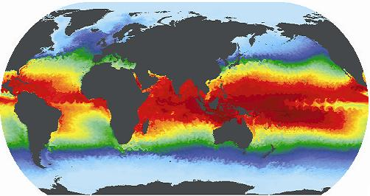





Process for identifying exascale applications and technology for DOE missions ensures broad community input
Town Hall Meetings April-June 2007
Scientific Grand Challenges Workshops Nov, 2008 – Oct, 2009
  Climate Science (11/08),
  High Energy Physics (12/08),
  Nuclear Physics (1/09),
  Fusion Energy (3/09),
  Nuclear Energy (5/09),
  Biology (8/09),
  Material Science and Chemistry (8/09),
  National Security (10/09)
  Cross-cutting technologies (2/10)
Exascale Steering Committee
  “Denver” vendor NDA visits 8/2009
  SC09 vendor feedback meetings
  Extreme Architecture and Technology Workshop 12/2009
International Exascale Software Project
  Santa Fe, NM 4/2009; Paris, France 6/2009; Tsukuba, Japan 10/2009
MISSION IMPERATIVES
FUNDAMENTAL SCIENCE

Slide 34


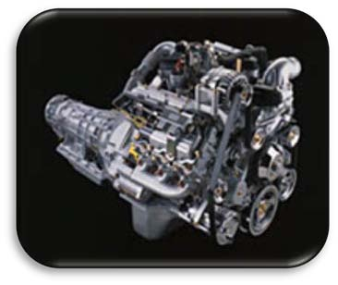

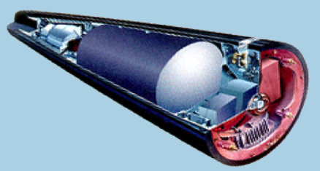
DOE mission imperatives require simulation and analysis for policy and decision making
Climate Change: Understanding, mitigating and adapting to the effects of global warming
  Sea level rise
  Severe weather
  Regional climate change
  Geologic carbon sequestration
Energy: Reducing U.S. reliance on foreign energy sources and reducing the carbon footprint of energy production
  Reducing time and cost of reactor design and deployment
  Improving the efficiency of combustion energy systems
National Nuclear Security: Maintaining a safe, secure and reliable nuclear stockpile
  Stockpile certification
  Predictive scientific challenges
  Real-time evaluation of urban nuclear detonation
Accomplishing these missions requires exascale resources.

Slide 35
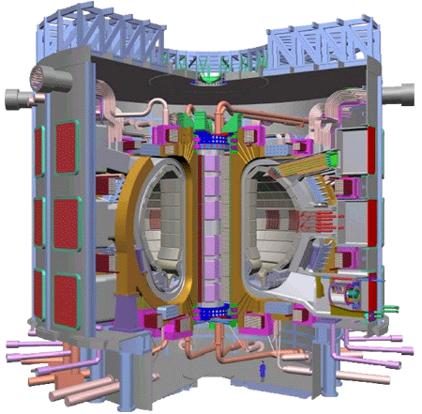

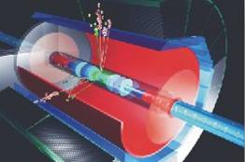
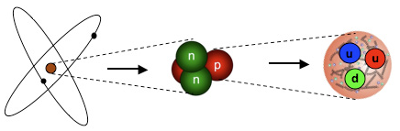

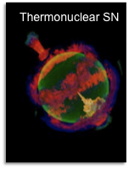
Exascale simulation will enable fundamental advances in basic science.
ITER
High Energy & Nuclear Physics
  Dark-energy and dark matter
  Fundamentals of fission fusion reactions
Facility and experimental design
  Effective design of accelerators
  Probes of dark energy and dark matter
  ITER shot planning and device control
Materials / Chemistry
  Predictive multi-scale materials modeling: observation to control
  Effective, commercial technologies in renewable energy, catalysts, batteries and combustion
Life Sciences
  Better biofuels
  Sequence to structure to function
ILC
Hubble image
of lensing
Structure of
nucleons
These breakthrough scientific discoveries and facilities require exascale applications and resources.

Slide 36
Potential System Architecture Targets
System attributes | 2010 | “2015” |  | “2018”
System peak | 2 Peta | 200 Petaflop/sec |  | 1 Exaflop/sec
Power | 6 MW | 15 MW |  | 20 MW
System memory | 0.3 PB | 5 PB |  | 32-64 PB
Node performance | 125 GF | 0.5 TF | 7 TF | 1 TF | 10 TF
Node memory BW | 25 GB/s | 0.1 TB/sec | 1 TB/sec | 0.4 TB/sec | 4 TB/sec
Node concurrency | 12 | O(100) | O(1,000) | O(1,000) | O(10,000)
System size (nodes) | 18,700 | 50,000 | 5,000 | 1,000,000 | 100,000
Total Node Interconnect BW | 1.5 GB/s | 20 GB/sec |  | 200 GB/sec
MTTI | days | O(1day) |  | O(1 day)
Notes:
Missing Latencies
Message injection rates
Flops/watt cost money and bytes/flop that costs money
Joule/op in 2009, 2015 and 2018:
2015: 100 pj/op
Capacity doesn’t cost as much power as bandwidth
how many joules to move a bit
2 picojoule/bit
75pj/bit for accessing DRAM
32 Petabytes: with system memory at same fraction of system
Need $ number
Best machine for 20MW and best machine for $200M
Memory op is 64 bit word of memory
75 picojoule bit for (multiply by 64) (DDR 3 spec)
50 pj/ for an entire 64 bit op
Memory technology in 5pj/bit by 2015 if we invest soon
Anything more aggressive than 4pj/bit is close to the limit (will not sign up for 2pj/bit)
2015 10 pj/flop
5pj/flop in 2018
So we are talking 30:1 ratio of memory reference per flop
10pj/operation to bring a byte in
8 terabits * 1pj -> 8 watts
JEDEC is fundamentally broken (DDR4 is the end)
Low swing differential
insertion of known technology
20GB/s per component to 1 order of magnitude more
10-12 Gigabits/second per wire
16-64 using courant limited scaling of hydro codes
Cost per DRAM in that timeframe and how much to spend
# outstanding memory references per cycle-→ bandwidth * latency
above based on memory reference size
memory concurrency
200 cycles from DRAM (2GHz) is 100ns (40ns for memory alone). With queues will be 100ns
O(1000) references per node to memory
O(10k) for 64 byte cache lines?
Need to add system bisection:
2015: whatever local node bandwidth: factor of 4-8 or 2-4 against per-node interconnect bandwidth
2018:
Occupancy vs latency:
zero occupancy (1 slot for message launch)
5ns per
2-4 in 2015
2-4 in 2018
10^4 vs 10^9th

Slide 37
Comparison
“2018” vs. Jaguar (2009)
500x performance (peak)
100x memory
5000x concurrency
3x power
All performance increase is based on more parallelism
Keep operating cost about the “same”
Significantly different architecture and software environment

Slide 38
DOE Exascale Technology Roadmap
Key Observations from DOE Exascale Architecture and Technology Workshop, San Diego, Dec. 2009,
http://extremecomputing.labworks.org/hardware/index.stm

Slide 39
Where do we get 1000x performance improvement for 10x power?
Processors
On-chip data movement
System-wide data movement
Memory Technology
Resilience Mechanisms

Slide 40
Processors: What are the problems?
(Lessons from the Berkeley View)
Current Hardware/Lithography Constraints
  Power limits leading edge chip designs
    Intel Tejas Pentium 4 cancelled due to power issues
  Yield on leading edge processes dropping dramatically
    IBM quotes yields of 10 – 20% on 8-processor Cell
  Design/validation leading edge chip is becoming unmanageable
    Verification teams > design teams on leading edge processors
Solution: Small Is Beautiful
  Simpler (5- to 9-stage pipelined) CPU cores
    Small cores not much slower than large cores
  Parallel is energy efficient path to performance:CV²F
    Lower threshold and supply voltages lowers energy per op
  Redundant processors can improve chip yield
    Cisco Metro 188 CPUs + 4 spares; Sun Niagara sells 6 or 8 CPUs
  Small, regular processing elements easier to verify
Notes:
¾ of the design cost is in verifying that the design is correct (used to be all design costs)
Can put more transistors on a chip now than we can afford to power without melting the chip (was traditionally limited by # transistors)
Autotuners is fine. I had a slightly longer list I was working on before seeing Krste's mail. PHiPAC: Dense linear algebra (Krste, Jim, Jeff Bilmes and others at UCB) PHiPAC = Portable High Performance Ansi C FFTW: Fastest Fourier Transforms in the West (from Matteo Frigo and Steve Johnson at MIT; Matteo is now at IBM) Atlas: Dense linear algebra now the "standard" for many BLAS implementations; used in Matlab, for example. (Jack Dongarra, Clint Whaley et al) Sparsity: Sparse linear algebra (Eun-Jin Im and Kathy at UCB) Spiral: DSP algorithms including FFTs and other transforms (Markus Pueschel, José M. F. Moura et al) OSKI: Sparse linear algebra (Rich Vuduc, Jim and Kathy, From the Bebop project at UCB) In addition there are groups at Rice, USC, UIUC, Cornell, UT Austin, UCB (Titanium), LLNL and others working on compilers that include an auto-tuning (Search-based) optimization phase. Both the Bebop group and the Atlas group have done work on automatic tuning of collective communication routines for supercomputers/clusters, but this is ongoing. I'll send a slide with an autotuning example later. Kathy

Slide 41
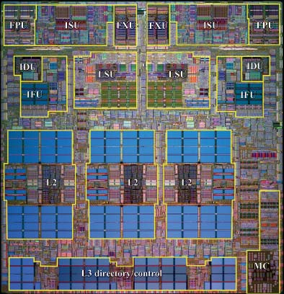
Low-Power Design Principles
Tensilica XTensa
Cubic power improvement with lower clock rate due to V²F
Slower clock rates enable use of simpler cores
Simpler cores use less area (lower leakage) and reduce cost
Tailor design to application to REDUCE WASTE
Intel Atom
Intel Core2
Power 5
This is how iPhones and MP3 players are designed to maximize battery life and minimize cost

Slide 42
Low-Power Design Principles
Power5 (server)
  120W@1900MHz
  Baseline
Intel Core2 sc (laptop) :
  15W@1000MHz
  4x more FLOPs/watt than baseline
Intel Atom (handhelds)
  0.625W@800MHz
  80x more
Tensilica XTensa DP (Moto Razor) :
  0.09W@600MHz
  400x more (80x-120x sustained)
Tensilica XTensa
Intel Atom
Intel Core2
Power 5

Slide 43
Low Power Design Principles
Power5 (server)
  120W@1900MHz
  Baseline
Intel Core2 sc (laptop) :
  15W@1000MHz
  4x more FLOPs/watt than baseline
Intel Atom (handhelds)
  0.625W@800MHz
  80x more
Tensilica XTensa DP (Moto Razor) :
  0.09W@600MHz
  400x more (80x-100x sustained)
Tensilica XTensa
Intel Core2
Power 5
Even if each simple core is 1/4th as computationally efficient as complex core, you can fit hundreds of them on a single chip and still be 100x more power efficient.

Slide 44
Future of On-Chip Architecture
(San Diego Meeting)
~1000-10k simple cores /Chip
  4-8 wide SIMD or VLIW bundles
  Either 4 or 50+ HW threads
On-chip communication Fabric
  Low-degree topology for on-chip communication (torus or mesh)
  Scale cache coherence?
  Global (nonCC memory)
  Shared register file (clusters)
Off-chip communication fabric
  Integrated directly on an SoC
  Reduced component counts
  Coherent with TLB (no pinning)
Scale-out for Planar geometry

Slide 45
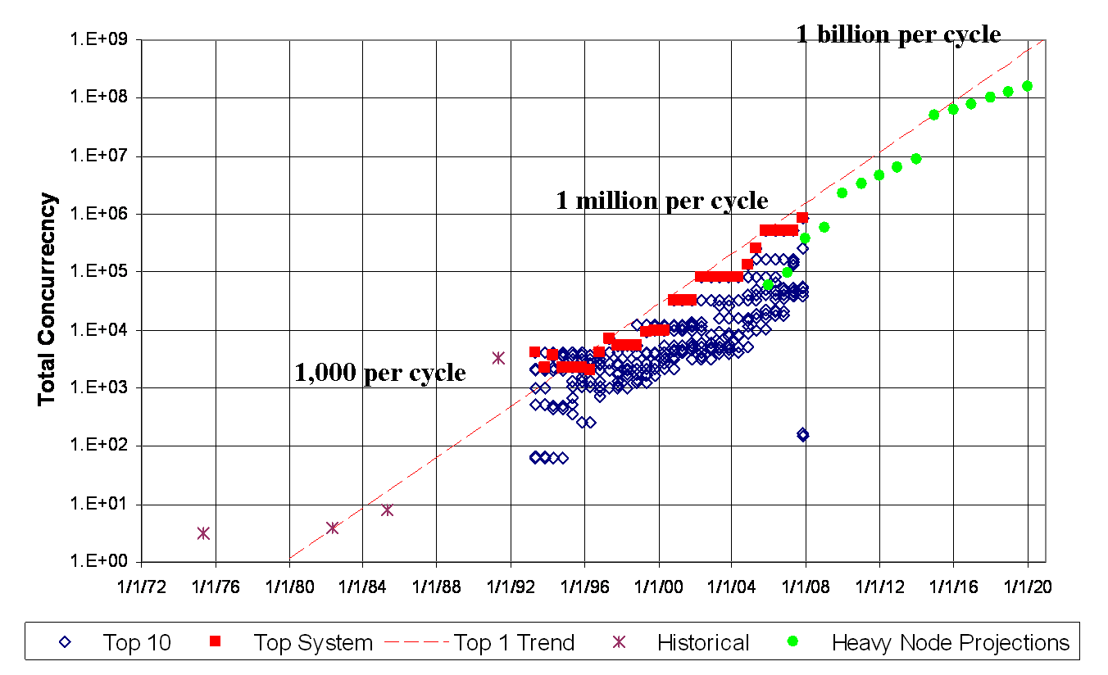
Projected Parallelism for Exascale
How much parallelism must be handled by the program?
From Peter Kogge (on behalf of Exascale Working Group), “Architectural Challenges at the Exascale Frontier”, June 20, 2008

Slide 46
Conclusion: Solving Logic Power Drives Move to Massive Parallelism
Future HPC must move to simpler power-efficient core designs
  Embedded/consumer electronics technology is central to the future of HPC
  Convergence inevitable because it optimizes both cost and power efficiency
How much parallelism must be handled by the program?
From Peter Kogge (on behalf of Exascale Working Group), “Architectural Challenges at the Exascale Frontier”, June 20, 2008
Consequence is massive on-chip parallelism
  A thousand cores on a chip by 2018
  1 Million to 1 Billion-way System Level Parallelism
  Must express massive parallelism in algorithms and pmodels
  Must manage massive parallelism in system software

Slide 47
The Cost of Data Movement
How do those cores talk to each other?

Slide 48
The problem with Wires:
Energy to move data proportional to distance
Cost to move a bit on copper wire:
  energy = bitrate * Length² / cross-section area
Wire data capacity constant as feature size shrinks
Cost to move bit proportional to distance
~1TByte/sec max feasible off-chip BW (10GHz/pin)
Photonics reduces distance-dependence of bandwidth
Photonics requires no redrive and passive switch little power
Copper requires to signal amplification
even for on-chip connections

Slide 49
The Cost of Data Movement
MPI

Slide 50
The Cost of Data Movement
MPI
CMP
Cost of a FLOP

Slide 51
The situation will not improve in 2018
Energy Efficiency will require careful management of data locality
Important to know when you are on-chip and when data is off-chip!

Slide 52
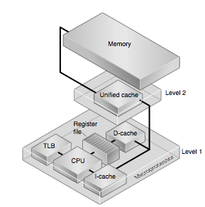
Locality Management is Key
Vertical Locality Management
Horizontal Locality Management
Sun Microsystems

Slide 53
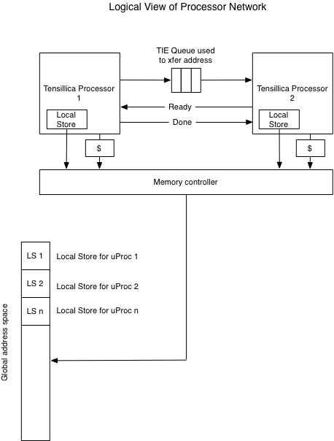
Locality Management is Key
Vertical Locality Management
Movement of data up and down cache hierarchy
  Cache virtualizes notion of on-chip off-chip
  Software managed memory (local store) is hard to program (cell)
Virtual Local store
  Use conventional cache for portability
  Only use SW managed memory only for performance critical code
  Repartition as needed
On-chip Network Fabric

Slide 54
The Problem with Caches
(why local-store will be increasingly prevalent)
Automatic cache virtualizes the notion of on-chip vs. off-chip memory
  Makes on-chip memory indistinguishable from off-chip to pmodel
  But energy cost is ~100x is data is off-chip
  But if you have explicit on-chip memory, then what does that mean for cache-coherence?
If you want performance, you really need to know the difference between on & off chip
  You can ignore it and be correct, but penalty is ~100x (reduces urgency from standpoint of applications)
This is why flat models for parallelism are NOT in the solution space
If local store is in solution space, then what does it mean to have cache-coherence between local stores?

Slide 55
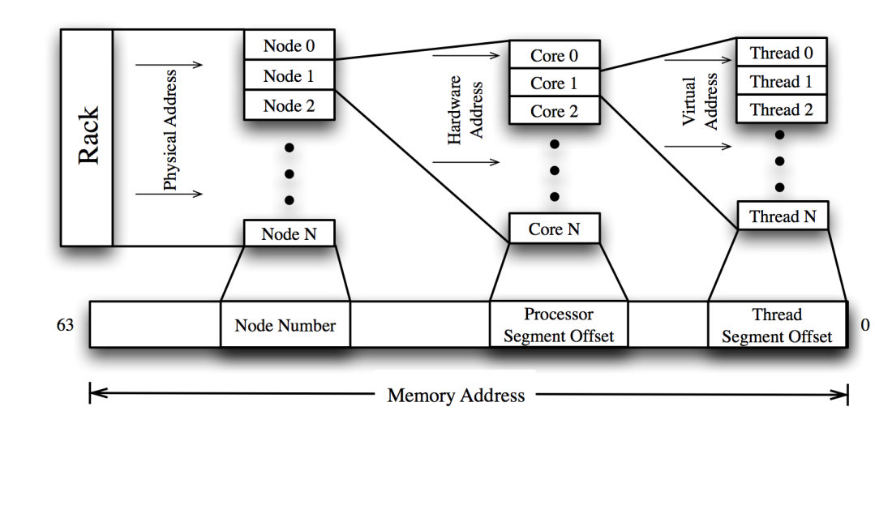
Locality Management is Key
Horizontal Locality Management
Movement of data between processors
  10x lower latency and 10x higher bandwidth on-chip
  Need to minimize distance of horizontal data movement
Encode Horizontal locality into memory address
  Hardware hierarchy where high-order bits encode cabinet and low-order bits encode chip-level distance

Slide 56
Locality Management is Key
Horizontal Locality Management
Movement of data between processors
  10x lower latency and 10x higher bandwidth on-chip
  Need to minimize distance of horizontal data movement
Encode Horizontal locality into memory address
  Hardware hierarchy where high-order bits encode cabinet and low-order bits encode chip-level distance
Map local-store into global address space
  Hierarchical Partitioned Global Address space

Slide 57
Locality Management is Key
Vertical Locality Management
Horizontal Locality Management
Movement of data up and down cache hierarchy
  Cache virtualizes notion of on-chip off-chip
  Software managed memory (local store) is hard to program (cell)
Virtual Local store
  Use conventional cache for portability
  Only use SW managed memory only for performance critical code
  Repartition as needed
Movement of data between processors
  10x lower latency and 10x higher bandwidth on-chip
  Need to minimize distance of horizontal data movement
Encode Horizontal locality into memory address
  Hardware hierarchy where high-order bits encode cabinet and low-order bits encode chip-level distance
Map local-store into global address space
  Hierarchical Partitioned Global Address space

Slide 58
Memory

Slide 59
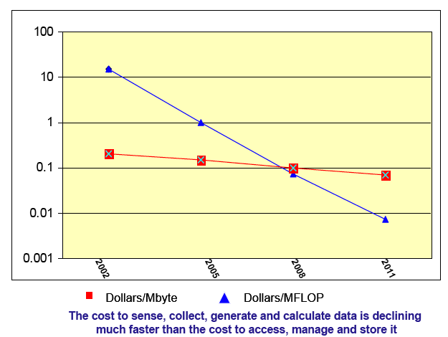
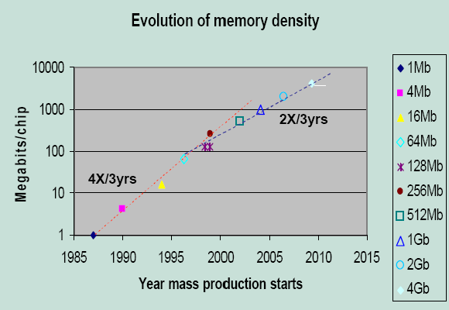
Projections of Memory Density Improvements
Memory density is doubling every three years; processor logic is every two
  Project 8Gigabit DIMMs in 2018
  16Gigabit if technology acceleration (or higher cost for early release)
Storage costs (dollars/Mbyte) are dropping gradually compared to logic costs
  Industry assumption: $1.80/memory chip is median commodity cost
Cost of Computation vs. Memory
Source: David Turek, IBM

Slide 60
Cost of Memory Capacity
2 different potential Memory Densities
Forces us to strong scaling
Forces us to memory conservative communication (GAS)

Slide 61
Exascale Memory Power Consumption
(San Diego Meeting)
Power consumption with standard technology roadmap
Power consumption with investment in advanced memory technology
70 MW total
20 MW total

Slide 62
Memory Technology
Bandwidth costs power

Slide 63
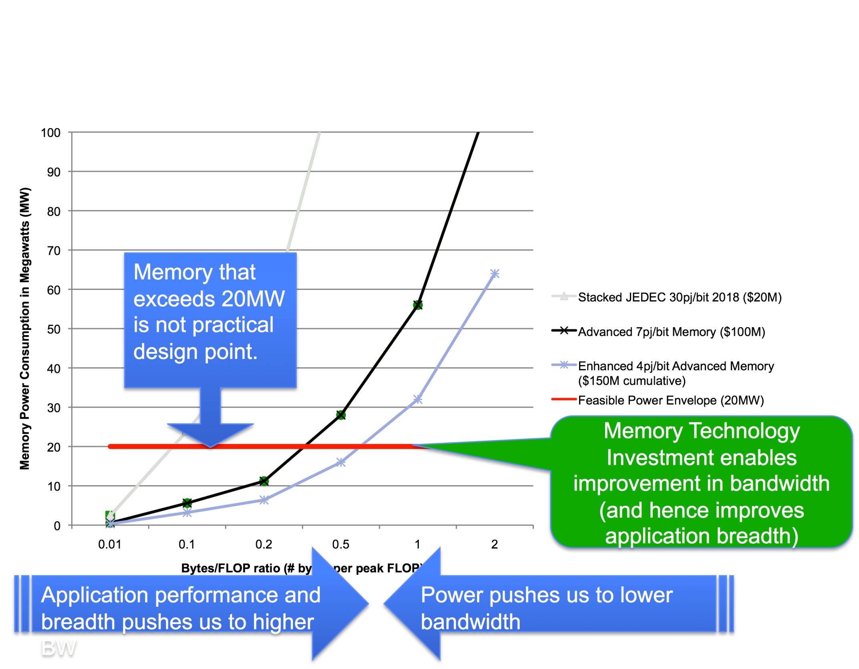
Limiting Memory Bandwidth Limits System Scope

Slide 64
1Gbit DDR3 Architecture
DDR
I/O
Power
Overfetch
Slide from Dean Klein (Micron Technology)

Slide 65
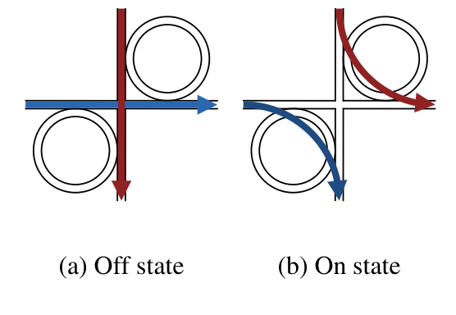
Optical Memory Interfaces
On chip:
  Optical interconnect enabled with Si photonic ring resonators
  Integrates with conventional CMOS
  Up to 27x power improvement
Off Chip:
  DDR interface power hungry
    Cu line capacitance
    Large voltage swing
  Optical link much more efficient
    Very small voltage modulation required
    50x reduction in interface power
Unified optical fabric to reduce optical / electrical conversion
Stacking to improve density
Wiring of a single channel DDR to the Memory controller (Intel)
Notes:
65

Slide 66


Looking Beyond DRAM
Resistive Change RAM (ReRAM)
  Nonvolatile - no refresh required!
  No high-voltage requirement
  Less energy / write (compared to FLASH)
  More robust than FLASH
    More cycles to cell wear out
  Lower read energy than DRAM
    < 1V read-out voltage
  Similar density to flash
    MLC capable
    2-4x DRAM
  Read / write speeds comparable (or better!) than DRAM
  Integrates very well with existing CMOS processes
  Overall 10x reduction in power with a 4x increase in density
Notes:
66

Slide 67
Conclusions
Memory technology requires major reorganization (if domestic industry stays alive)
  More ranks/banks, Less over-fetch, new drivers
  Chip stacking or optical memory interfaces
  New nonvolatile memory technologies
Failure to invest in memory technology means
  We will have to live with less memory (more emphasis on strong scaling)
  We will have lower memory bandwidth/computational performance (< 0.01 bytes/flop)

Slide 68
Power Considerations Drive Future Architectures in the Exascale Era
Massive parallelism with low power processors
Limited amount of memory, low memory/flop ratios (processing is free)
Cost of data movement, locality is becoming more important

Slide 69
What are critical exascale technology investments?
System power is a first class constraint on exascale system performance and effectiveness.
Memory is an important component of meeting exascale power and applications goals.
Programming model. Early investment in several efforts to decide in 2013 on exascale programming model, allowing exemplar applications effective access to 2015 system for both mission and science.
Investment in exascale processor design to achieve an exascale-like system in 2015.
Operating System strategy for exascale is critical for node performance at scale and for efficient support of new programming models and run time systems.
Reliability and resiliency are critical at this scale and require applications neutral movement of the file system (for check pointing, in particular) closer to the running apps.
HPC co-design strategy and implementation requires a set of a hierarchical performance models and simulators as well as commitment from apps, software and architecture communities.

Slide 70
Overview
From 1999 to 2009: evolution from Teraflops to Petaflops computing
From 2010 to 2020: key technology changes towards Exaflops computing
Impact on Computational Science
  Co-design

Slide 71
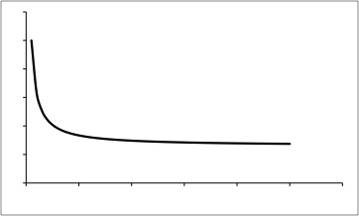
The trade space for exascale is very complex.
20 MW
power
envelope
bytes/core
envelope
$200M
cost
envelope
nodes
Exascale
Performance
envelope
feasible
systems
memory
Notes:
The trade space for exascale is very complex. For example, an interesting example is the distributed responsibility for reliability and resilience: many h/w venders see it placed squarely on the applications.

Slide 72
Co-design expands the feasible solution space to allow better solutions.
Application driven:
Find the best technology to run this code.
Sub-optimal
Application
Model
Algorithms
Code
Technology
Now, we must expand the co-design space to find better solutions:
new applications & algorithms,
better technology and performance.
Technology driven:
Fit your application to this technology.
Sub-optimal.
architecture
programming model
resilience
power
Notes:
a style of system design that considers whether specific system functions should be realized as software or as hardware, by analyzing trade-offs between design alternatives. [1994 National Technology Roadmap for Semiconductors]
# System Co-simulation
System level HW-SW Co-simulation is a way to give designers feedback on their design choices. These design choices include HW-SW partitioning, CPU selection, and scheduler selection. Fast timed co-simulation (up to millions of clock cycles per second on a workstation) is possible in POLIS thanks to the software synthesis and performance estimation techniques described below. We currently utilize PTOLEMY as a simulation engine, but we are not limited to PTOLEMY. VHDL code including all the co-simulation information is also an output of the system, so any commercial VHDL simulator can be adapted for this purpose.
# Design Partitioning
By design partitioning we mean making system-level design decisions such as HW-SW partitioning, target architecture selection, and scheduler selection. These decisions are based heavily on design experience and are very difficult to automate. We therefore provide the designer with an environment to quickly evaluate any such decision through various feedback mechanisms from either formal verification or system co-simulation.

Slide 73

A first step toward co-design was the last exascale workshop.
The approach will be to engage experts in computational science, applied mathematics and CS with the goal of
Producing a first cut at the characteristics of systems that (a) could be fielded by 2018 and (b) would meet applications' needs
Outlining the R&D needed for "co-design" of system architecture, system software and tools, programming frameworks, mathematical models and algorithms, and scientific application codes at the exascale, and
Exploring whether this anticipated phase change in technology (like parallel computing in 1990s) provides any opportunities for applications. That is, whether a requirement for revolutionary application design allows new methods, algorithms, and mathematical models to be brought to bear on mission and science questions.

Slide 74
Summary of some priority research directions (PRD)
Black – Crosscutting workshop report
Green – HDS interpretation
Investigate and develop new exascale programming paradigms to support ‘billion-way’ concurrency
  Think 10,000 times more parallel
  Expect MPI+X programming model
  Think of algorithms that can easily exploit the intra node parallelism, especially if CS researchers develop automatics tools for X

Slide 75
Summary of some priority research directions (PRD) -- cont.
Re-cast critical applied mathematics algorithms to reflect impact of anticipated macro architecture evolution, such as memory and communication constraints
  Live with less memory/thread and less bandwidth
Develop new mathematical models and formulations that effectively exploit anticipated exascale hardware architectures
  Add more physics and not just more refinement
Address numerical analysis questions associated with moving away from bulk-synchronous programs to multi-task approaches
  No more SPMD; think of mapping coarse grain data flow in frameworks

Slide 76
Summary of some priority research directions (PRD) – cont.
Adapt data analysis algorithms to exascale environments
Extract essential elements of critical science applications as “mini-applications” that hardware and system software designers can use to understand computational requirements
Develop tools to simulate emerging architectures for use in co-design
  Applied mathematicians/computer scientists should be ready to lead co-design teams

Slide 77
Summary
Major Challenges are ahead for extreme computing
  Power
  Parallelism
  … and many others not discussed here
We will need completely new approaches and technologies to reach the Exascale level
This opens up many new opportunities for computer scientists, applied mathematicians, and computational scientists

Slide 78
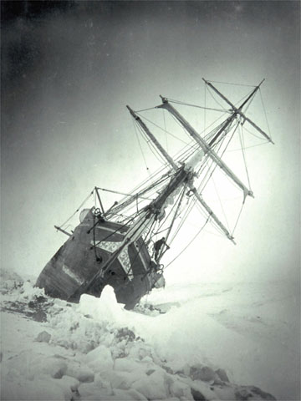
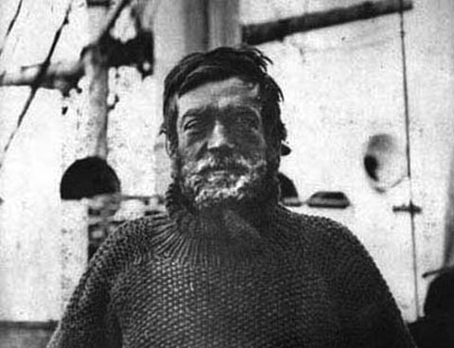
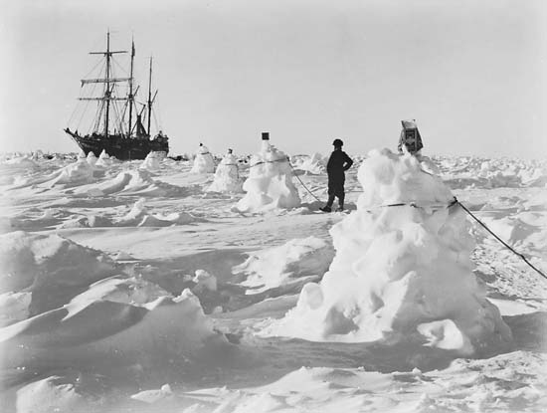
Shackleton’s Quote on Exascale
Ernest Shackleton’s 1907 ad in London’s Times, recruiting a crew to sail with him on his exploration of the South Pole
“Wanted. Men/women for hazardous architectures. Low wages. Bitter cold. Long hours of software development. Safe return doubtful. Honor and recognition in the event of success.”
Notes:
“Wanted. Men for hazardous journey. Low wages. Bitter cold. Long hours of complete darkness. Safe return doubtful. Honor and recognition in the event of success.”

