Slide 1

Stornext
Accelerate your business. Preserve your data.
06 October, 2010

Slide 2
Archival
Business challenges

Slide 3

Is Your Department...
Drowning in a sea of data?
Struggling to navigate through a demanding workflow?
Notes:
© 2007 Quantum Corporation Confidential
3
This slide represents the 2 major Business Issues that StorNext prospects will face.
Managing the rapid growth of Unstructured Data
Unstructured-data is outpacing Email and Database-driven data and this trend is only predicted to continue
IDC claims unstructured data is growing at CAGR of 62% compared with transactional-based data with a CAGR of 22%
IDC claims that upwards of 70% of all unstructured data in the enterprise will be “archival data”
Navigating through tumultuous waters of a demanding workflow….
Demanding Workflows required high-performance environments that enable fast file creation, dynamic file sharing, and intelligent storing so that projects can be completed on time and within budget.

Slide 4
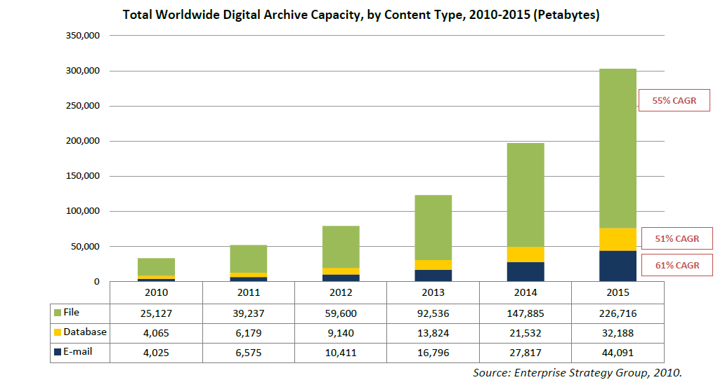
Unstructured FILE Data Growth
Over committing storage infrastructure & budget
Management nightmare
Notes:
This slide explains the Problems Associated with Managing Unstructured Data Growth
Note that according to ESG, file data is the largest data type impacting data centers
Over committing existing storage infrastructure
Consuming IT budget with expensive storage acquisitions
Straining IT SLAs
Discovery
Underutilized IT investment
Management nightmare
Storage silos
Moving, protecting, sharing data
Planning investment and growth

Slide 5
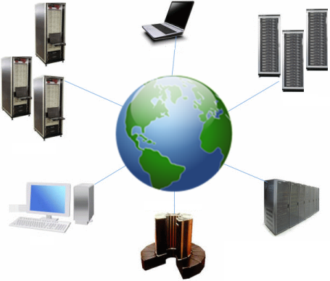
Demanding Workflows
Budget constraints
Long term data retention
Ballooning storage costs
Protection of data
It will only get worse – data will continue to grow !
Notes:
This slide explains the Problems Associated with Demanding Workflows
Performance constraints
Underperforming IT infrastructure
Sharing challenges across departments and globe
Inefficient copying and moving of data around the organization
Application integration concerns to easily adopt best of breed technologies
Inability to take advantage of technology advancements can be detrimental to success, even jeopardizing survival
Scalability limitations to grow with the business
Future-proof performance & capacity growth
Store for reuse or Throw away

Slide 6

Customer Pain-Points: Archiving
Data ownership – who owns what and their SLA?
Data retention – how long to keep it?
Compliance and regulations – what are my obligations?
Economical data storage – Storing important data without excessive cost - tangible and intangible
Data integrity and protection
Access from disparate teams - Cloud
Notes:
This is a good introductory slide to give the customer an idea of who we are. It’s relatively self explanatory, however a few points to really focus on;
Bullet 1 - Backup, recovery and archive is all we do! We don’t delve into other areas of infrastructure such as primary disk storage or backup software, allowing us to specialise in our field.
Bullet 3 - Highlight the number of employees locally in Australia, in particular the Rocksoft guys based in Adelaide who develop our patented de-duplication software.
Bullet 6 – Make special mention of the reinvestment of 10% of our annual revenue back into R&D, which is typically more than our competitors make in revenue annually.

Slide 7
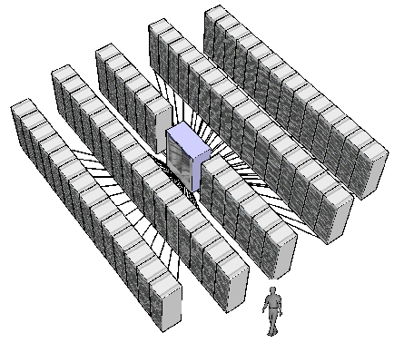
Customer Pain Point: Massive Scalability
Scalable architecture – unlimited storage capacity, no HW constraints
  Archives for years or decades?
Vendor agnostic – leverage new technologies and existing investment
Reducing technical refresh and or component replacement = very painful

Slide 8
Spinning verses Non-Spinning
Disk
Tape
Faster access time
Comfort
  User are comfortable with disk interfaces and I/O
Larger disks = ability to build large storage pools
Slower access time
Less comfort:
  Removable, requires automation and software
LTO-5 and LTFS extending the archival range of tape

Slide 9
Cooling and Power
Cooling
Power
HVAC impacting data centers
Faster and more processors consuming more cooling
Larger Storage systems require more HVAC
How to mange data growth without impacting HVAC capacity?
Large HPC systems consume loads of power
Large disk storage systems consumes power with or without data I/O
Can reduction in utility costs decreased overall budgets?

Slide 10
Long term technology refresh
Vendor lock-in
Ease of migration from one storage technology to another
Responding to regulatory or internal archival requirements
Difficulty in retiring old storage technology
  How to migrate 2PB off disk to new storage?
    Every 5-7 years

Slide 11
The Stornext Solution
Accelerate your business. Preserve your data.
06 October, 2010

Slide 12














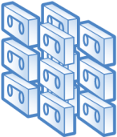
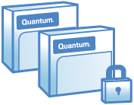


Workflow with Advanced Management
Policy-Based
Data Management
Local
Remote
High-Performance Shared
Workflow
DEDUPLICATION
Storage Area Network
(SAN)
Storage Area Network
(SAN)
SECONDARY TIER
TAPE LIBRARY ARCHIVE
VAULT
REPLICATION
Notes:
There are several options to locally manage, protect, and cost-effectively store the data within the file system namespace. We’ll go into each option in further detail, but they are:
Deduplication, reducing the amount of duplicate data that bogs down your storage infrastructure
Storage Tiering, transparently migrating data to a lower cost tier of disk storage
Online or Active Archiving, transparently migrating to tape for maximum cost savings to long term archival platform
In addition to these local management and data protection options, you can also protect or distribute data to remote office or facility, or data warehouse. Those options include:
Tape Vaulting, moving physical tapes out of the library and into a secure storage facility
Replication, migrating data to a remove office or data center for data protection, consolidation, or distribution
Let’s look at each of these advanced data management capabilities a little closer.
(move to next slide)

Slide 13
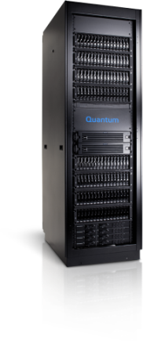
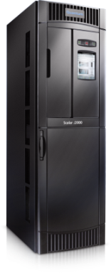
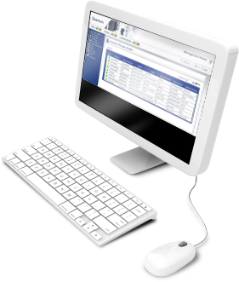
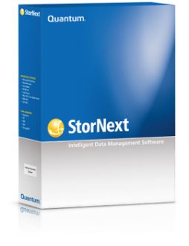
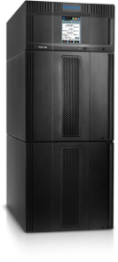
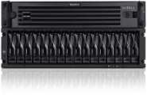
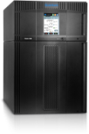

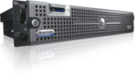

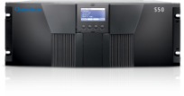

Quantum’s Comprehensive Portfolio
Quantum continues to invest and innovate across the portfolio
StorNext Software
DXi-Series
Scalar Series
w/iLayer
Vision Storage
Management Tools
Professional Services & Global Support
Shared File System
VTL, NAS, iSCSI
Disk
Tape
Key Management
Data deduplication
Replication
Encryption
Tiered Storage Policies
Proactive Diagnostics
Centralized Management
Notes:
Don’t spend to much time on this slide as this isn’t a corporate presentation. Make two quick points:
Quantum has a complete data management portfolio: software, disk and tape.
Quantum is investing heavily in it’s portfolio. There is not a single product in the portfolio that hasn’t been significantly enhanced or isn’t a completely new product.

Slide 14



Accelerate your business. Preserve your data.
www.Quantum.com
Steve Rovarino
www.quantum.com/StorNext
Steve.rovarino@Quantum.com

