Slide 1

Regional Cyberinfrastructure Planning
Great Plains Network
Greg Monaco, Ph.D.
Director for Research and Cyberinfrastructure Initiatives
greg@greatplains.net

Slide 2
GPN Milestones
Initially, funded via EPSCoR award
Formed by researchers
First regional connector to Internet2
First 2x10G connector to I2
CPS
Research/CI focus continues
  Annual Conference
  Communities of Interest (e.g., Collaborative CI)
  Workshops
  Facilitate collaborative research (GENI, Middleware)
Notes:
Annual Conference
Unique combination of research and IT/network attendees
Plenary session speakers from I2, NSF,NIH
Good access to federal funding program officers
Workshops/seminars
Multi-state collaborations
Grant support
Web site/wiki for information sharing/knowledge transfer

Slide 3
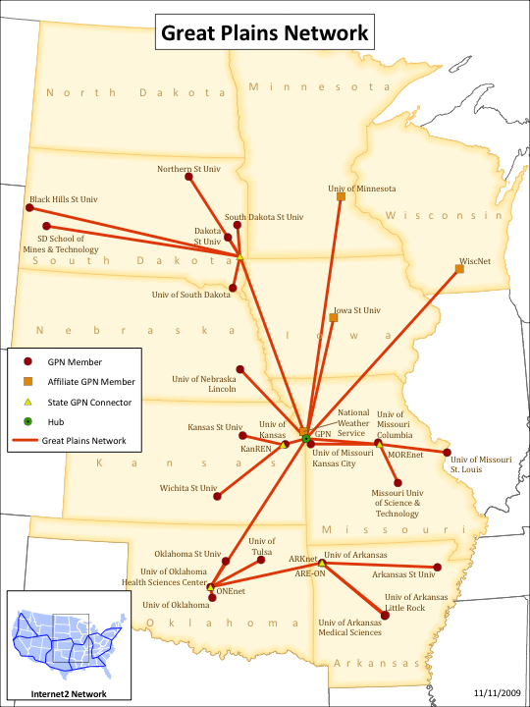

Slide 4
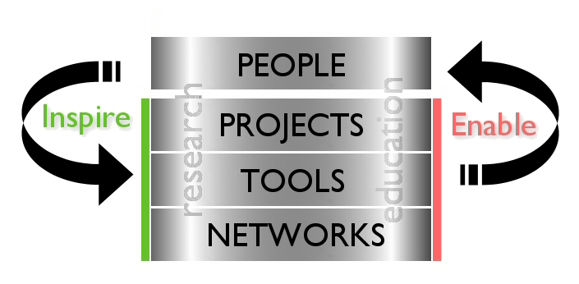
GPN Collaborative Framework

Slide 5
Mission & Strategic Directions
To support the research and education missions of our members through the use of advanced cyberinfrastructure.
Strategic Direction 1:
Provide leadership in advanced networking at the regional and national level on behalf of the membership.
(Managed by a Network Program Committee)
Strategic Direction 2:
Actively support the development of and provide support to research and education initiatives among the membership that extend or use cyberinfrastructure in novel or unique ways.
5

Slide 6
CI Advisory Committee
Purpose: To develop a plan to implement GPN goals in the area of CI
Members:
  Mike Abbiatti, AREON
  Gary Allen, University of Missouri System, MU, GPN Executive Council
  Guy Almes, Texas A & M,
  James Deaton, ONENET & GPN Executive Council
  Claude Garelik, SD Board of Regents & GPN Executive Council Chair
  Del Johnson, SDSU & GPN Representative Council
  Myron Lowe, UMN & GPN Representative Council
  Rick McMullen, KU (Chair)
  Henry Neeman, OU
  James Rice, SDSU, SD EPSCoR Director
  Ron Roeber, UNL
  Gordon Springer, MU
  David Swanson, UNL & Holland Computing Center

Slide 7
CI Planning Process
Two surveys
  Survey 1 to assess perceived CI needs.
  Survey 2 to identify CI service priorities that can be met on a regional basis.
  Participation: Faculty, staff & graduate students at GPN member institutions

Slide 8
Survey 1: Respondent Profile
Grouped by Campus HPC Use
HPC Campus Users* | 55%
HPC Campus Aware* | 25%
HPC Campus Not Aware | 20%
N | 410
Grouped by Regional/National HPC Use
HPC Regional/National Users* | 22%
HPC Regional/National Aware* | 35%
HPC Regional/National Not Aware | 42%
N | 410

Slide 9
Survey 1: High Priority Needs of CI-Knowledgeable Respondents
Inventory of CI resources available across my campus/organization.
Inventory of CI resources available regionally and nationally.
Searchable knowledgebase of CI expertise (people, tools, applications, resources) in my field.
Opportunities for collaboration.
Help in identifying possible revenue streams for my/my campus/my organization's CI efforts.
Help in identifying cost containment/avoidance strategies for my/my campus/my organization's CI efforts.

Slide 10
Survey 1: Open-ended Responses
Security
Bandwidth
Specialized CI tools for research
Specialized software
Specialized hardware (e.g., visualization)
Shared Data Resources
Shared computational resources

Slide 11
Survey 2: Highest Priority Services (1)
Service Group | Service
Computation | HPC facilities for research, education and training at a regional level (2) Assistance to access and use HPC at other institutions in the region (22)
Data storage services | Data storage facilities for research, education and training. (6) A way to store and catalogue my datasets (13) A way to access and use storage resources at institutions in the region. (20)
Networking services | High bandwidth connectivity and related services to other universities and other research institutions in the US. (1) High bandwidth connectivity and related services to other universities and other research institutions outside the US. (19)

Slide 12
Survey 2: High Priority Services (2)
Service Group | Service
Education & training | Workshops to learn about advanced tools for research. (3) Online demonstrations of emerging CI-related technologies. (15) Workshops to learn to develop and improve campus tools. (16) Annual meeting focusing on using advanced tools across the region. (21)
Communication | Monthly newsletter on technical advances/uses across GPN and nationally (5) Providing regular email, blog, twitter, etc. communication on the latest developments in CI. (7)
Collaboration | Searchable database of opportunities for collaboration. (11) Assistance in identifying potential research collaborators. (14) Facilitate grant requests across multiple campuses. (17) Help to make contacts with individuals with specific CI expertise (24)

Slide 13
Survey 2: High Priority Services (3)
Service Group | Service
Help | Online searchable help for CI tools. (4) Centralized help desk model of support for locating and using regional and national CI technology in your research. (12)
Expertise & resource referral | Searchable database of CI resources available across my campus or organization. (8) Searchable database of CI expertise (people, tools, applications, resources) in my field at the regional, national and international levels. (23)
Other | Help in identifying possible revenue streams for my/my campus/my organization's CI efforts. (9) Organizing and maintaining a software licensing/purchasing collaborative for GPN member institutions. (10) Providing collaborative tools that I can pick up and use (e.g., Adobe Connect, wikis, blogs) (18)

Slide 14
Next steps
Great Plains Network
  Executive Council (Board of Directors)
  Network Program Committee (responsible for managing issues related to networking)
  Create GPN CI Program Committee to manage regional service development & deployment

Slide 15
Thanks!
Greg Monaco
  greg@greatplains.net

