Slide 1

Cloud Computing
Roger Hall
MidSouth Bioinformatics Center
University of Arkansas at Little Rock
rahall2@ualr.edu

Slide 2

Notes:
DANGER: Clouds are amorphous. You may see what you wish to see.

Slide 3

Notes:
Vendors generally see Cloud Computing as shiny and distinct, and completely bounded by the features of their product.

Slide 4

Notes:
Today’s Goal: Illuminate the edges to Define the system

Slide 5
HPC

Slide 6
HTC

Slide 7
SAAS
PAAS
IAAS

Slide 8
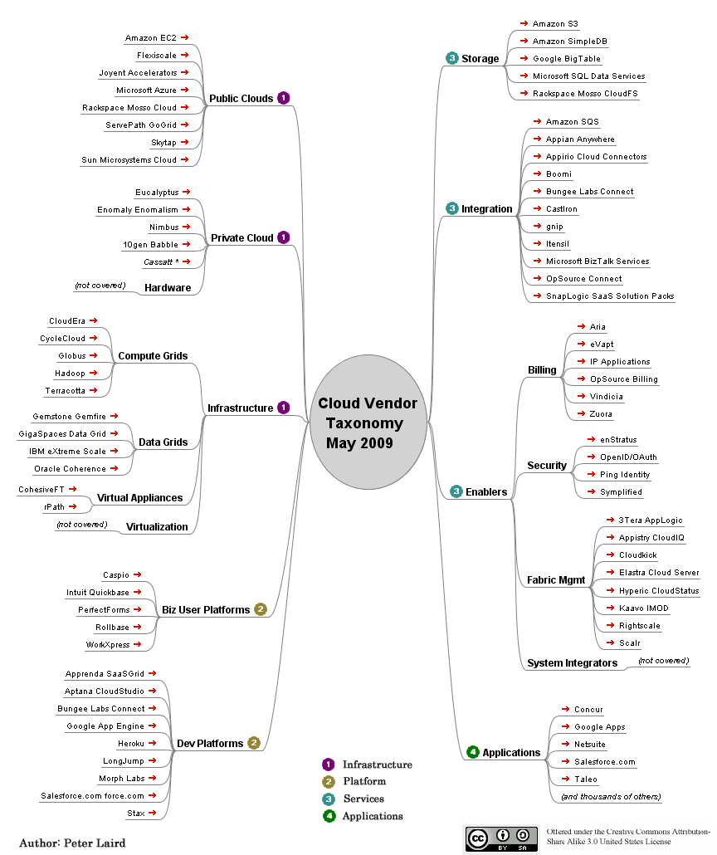

Slide 9


Slide 10
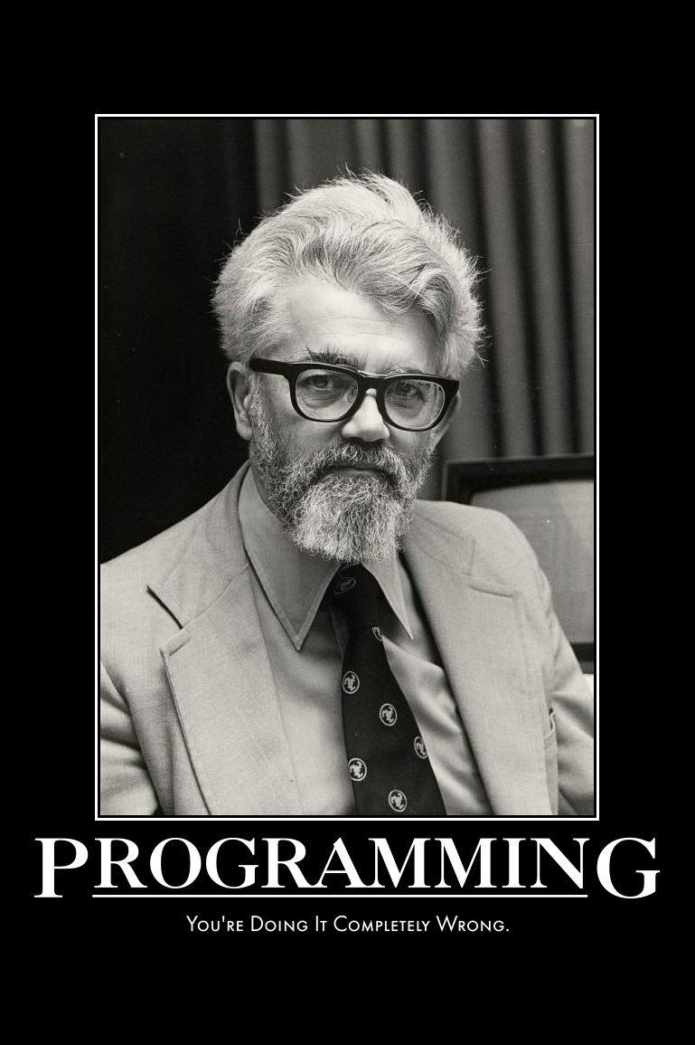

Slide 11
TIME
SHARING

Slide 12
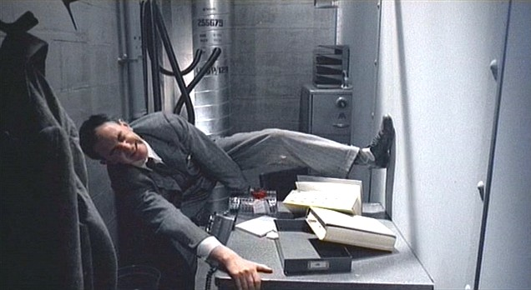

Slide 13


Slide 14
LOUDCLOUD

Slide 15
ASPs

Slide 16
DCOM
.NET

Slide 17


Slide 18
AUTONOMIC
COMPUTING

Slide 19
SAAS
PAAS
IAAS

Slide 20
P v I

Slide 21
GOOD
FAST
CHEAP
Notes:
Pick Two

Slide 22
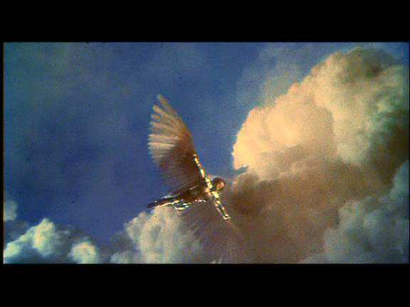

Slide 23
MACHINE
IMAGE

Slide 24
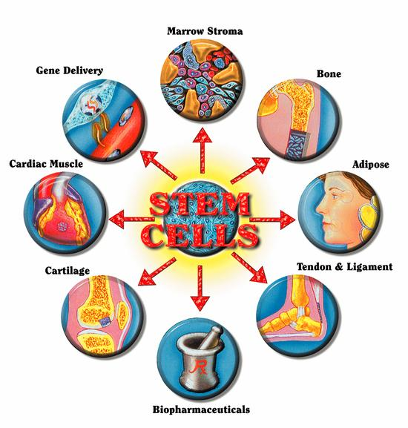
Notes:
A project Machine Image is like a Stem Cell. They can be copied and are differentiable.

Slide 25
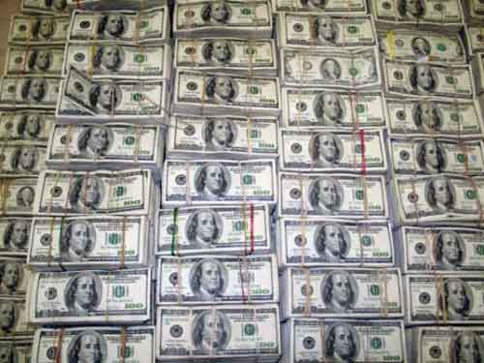

Slide 26
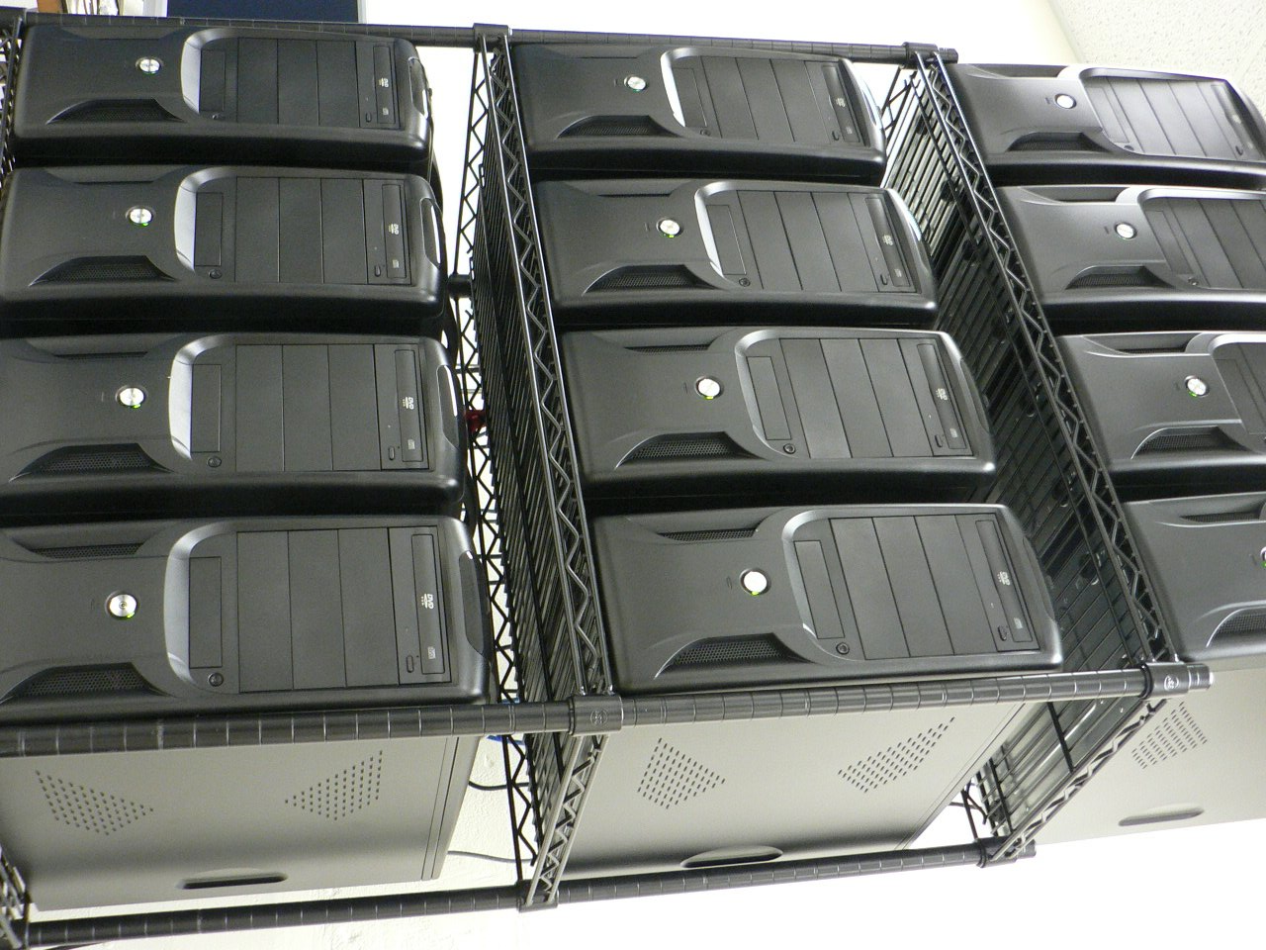

Slide 28
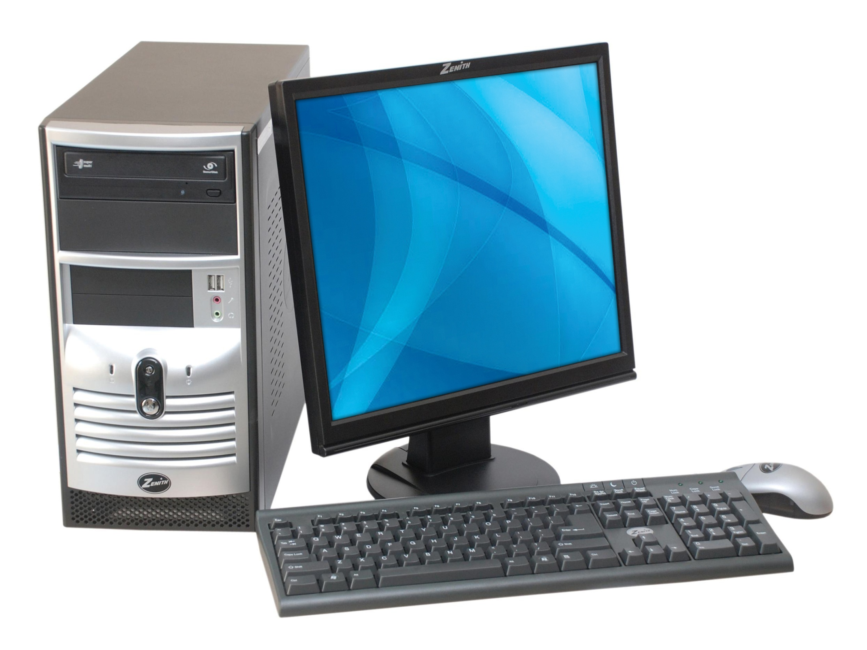

Slide 29


Slide 30
PEW
PEW

Slide 31
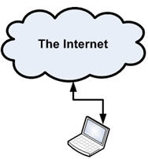
Notes:
Our First Cloud: It’s the Internet

Slide 32
OUT
THERE

Slide 33
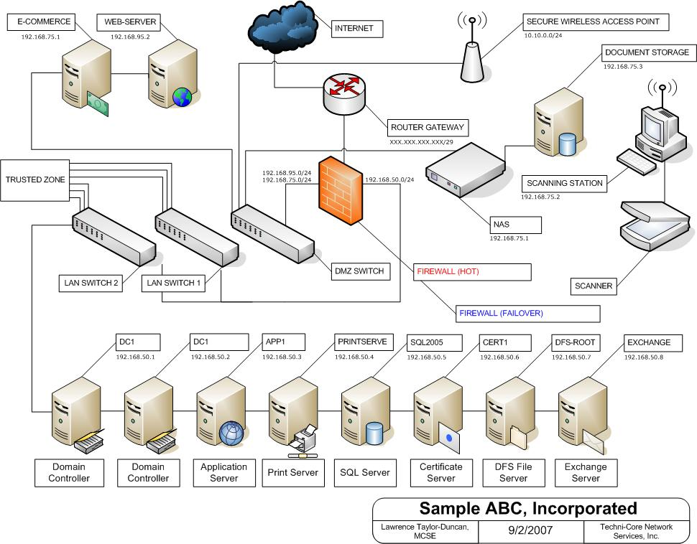
Notes:
Cloud capabilities with IAAS

Slide 34


Slide 35
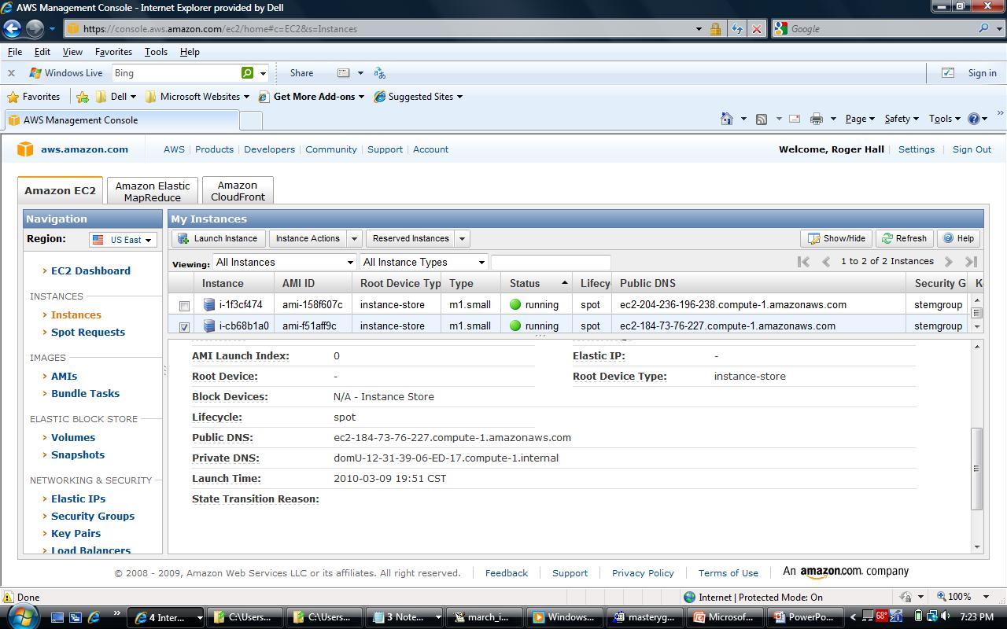
Notes:
Cloud capabilities with IAAS

Slide 36

Notes:
If you are considering getting into Cloud technology, remember that like any business Enterprise, there are three important things to remember:

Slide 37
LOCATION
LOCATION
LOCATION

Slide 38

Notes:
Privacy

Slide 39
SLA
Notes:
Service Level Agreement is the Terms of Service. Know what you are buying.

Slide 40
Notes:
Clouds can do many things, but the edges of BINF applications are Web Services, primarily defined by GET, REST, and SOAP, and implemented over HTTP.

Slide 41
Notes:
Web Services haven’t quite fit together as well as the gear imagery.

Slide 42
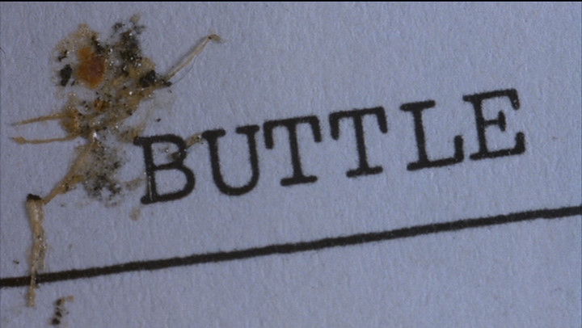
Notes:
Many issues the seem as simple as spelling errors are actually as complex as failure, and many criticisms lead to additional technologies, including Directory Services for Web Services.

Slide 43

Notes:
Directory Services provide …
BioMoby …

Slide 45

Notes:
Data type issues …

Slide 46
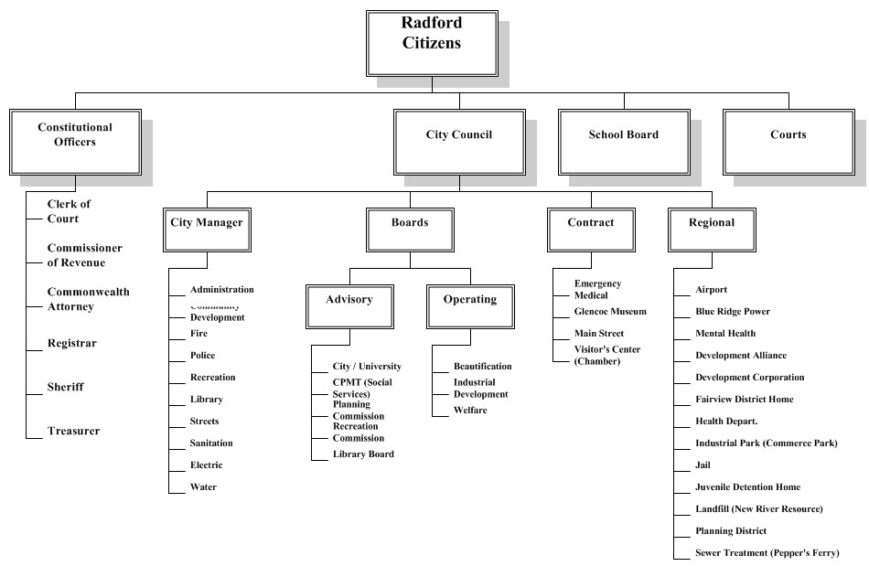
Notes:
Organize data type semantically and technically …

Slide 47
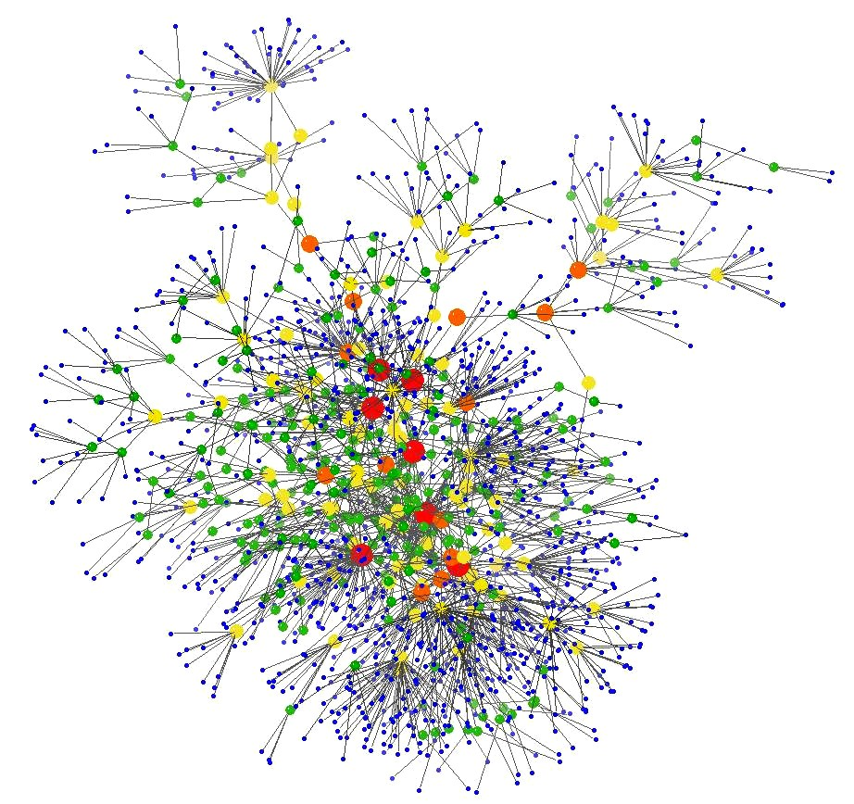
Notes:
Ontology looks more like this than any normal org chart

Slide 48
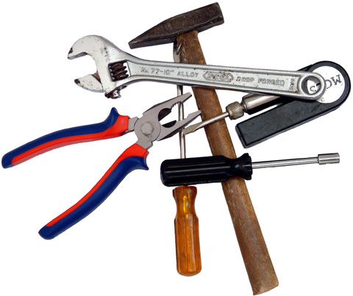
Notes:
But now we have the tools to do …

Slide 49
Notes:
… Web Services that are programmatically discoverable with negotiable execution.

Slide 50
COMMUNICATE
REASON
Notes:
Web Services can Communicate with clients and Reason over semantic ontologies.

Slide 51
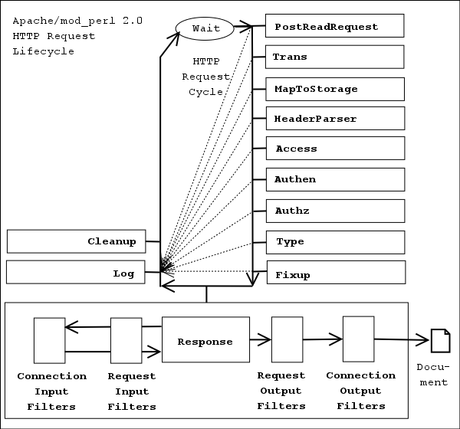

Slide 52
FAST
CHEAP

Slide 53
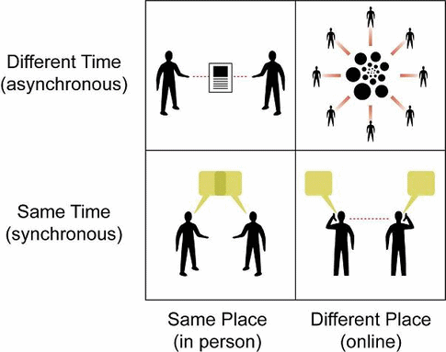

Slide 54


Slide 55
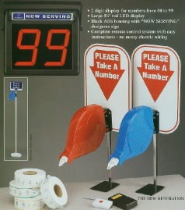

Slide 56
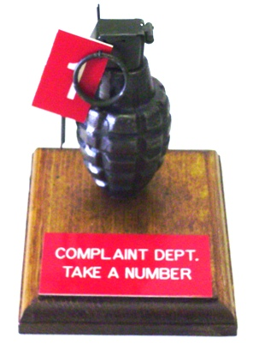

Slide 57
XMPP

Slide 58
IO Data

Slide 59
Notes:
… and the tools to communicate with other services and reason over a data content ontology.

Slide 60

Notes:
Here comes Agent “Synergy” …

Slide 61
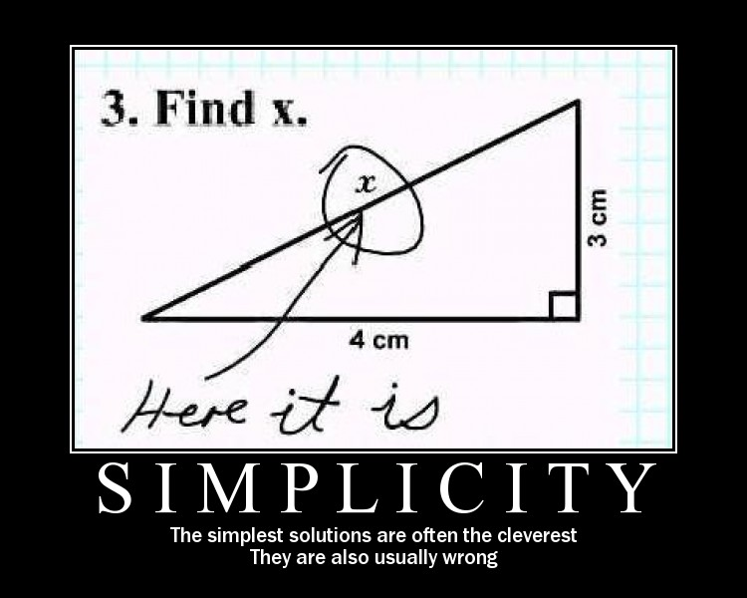

Slide 62

Notes:
Agents communicate

Slide 63
Notes:
We now have directory services for web services to locate other web services and negotiate their offerings ...

Slide 64
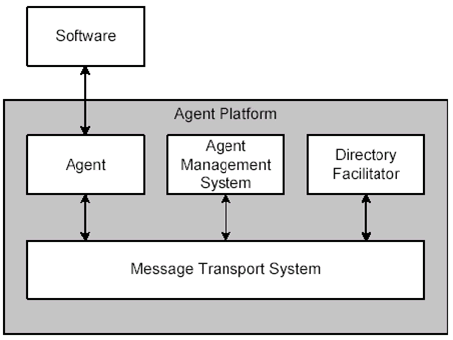
Notes:
We now have directory services for web services to locate other web services and negotiate their offerings ...

Slide 65
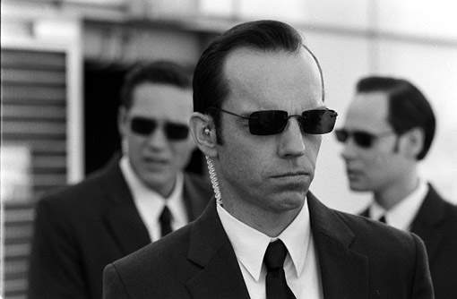

Slide 66
COMMUNICATE
REASON
Notes:
Pick Two

Slide 68
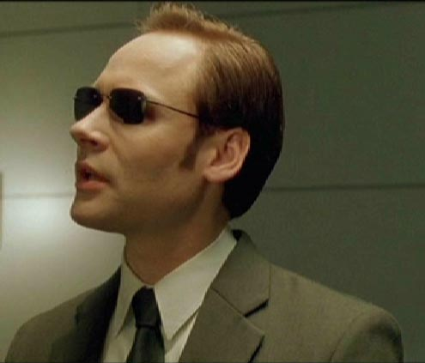

Slide 69


Slide 70
REACTIVE

Slide 71
PROACTIVE

Slide 72
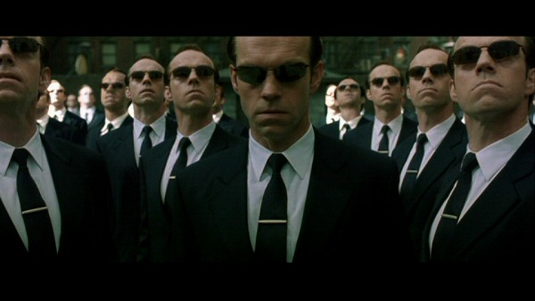

Slide 73
AUTONOMIC
COMPUTING

Slide 74
MACHINE
IMAGE

Slide 76
Notes:
Ontology looks more like this than any normal org chart

Slide 77
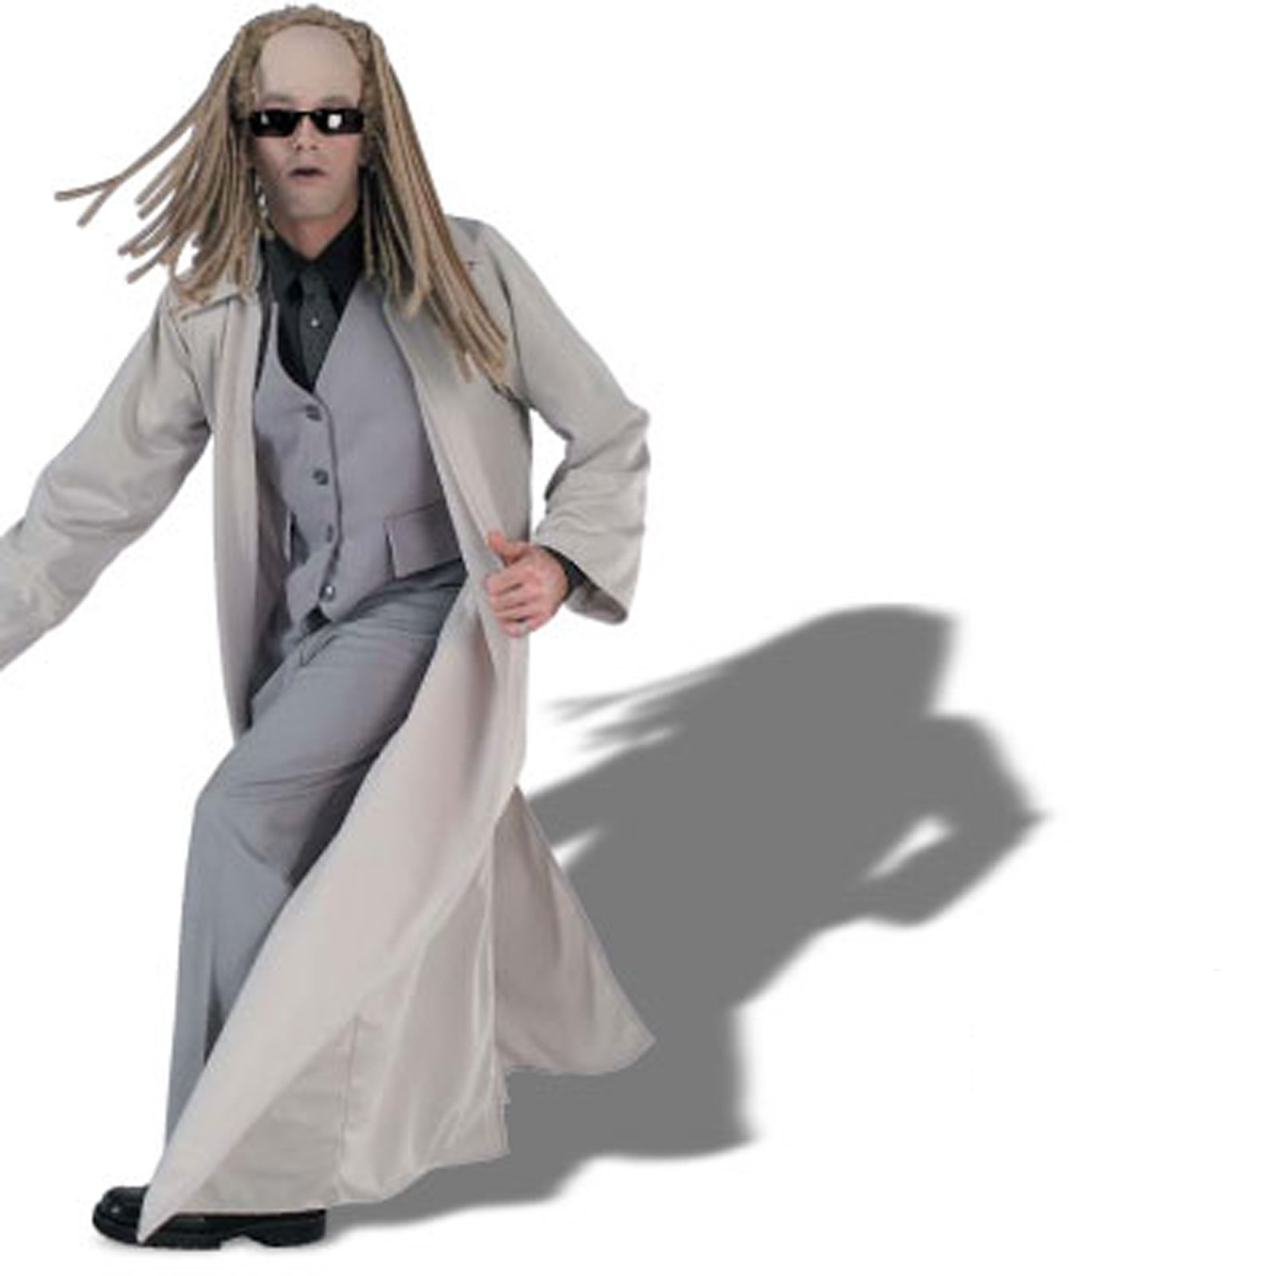
Notes:
Hackers over STD message-sets

Slide 78
GENEWEAVER

Slide 79
MACHINE
IMAGE

Slide 80
PROVENANCE

Slide 82

Notes:
Web Services with Agent Design give us individual assistants, built from common tools, each becoming their own specialized tool.

Slide 83

Notes:
Cloud Computing allows us to create a “stem cell” system for projects that can reconfigured on-the-fly. (déjà vu)

Slide 84
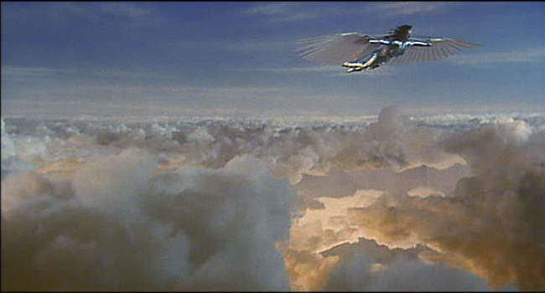
Notes:
Soar above the clouds!

