Slide 1
Building life earnings
Annette D. Colbert-Latham
CEO
Visage Production, Inc.

Slide 2
Introduction

Slide 3
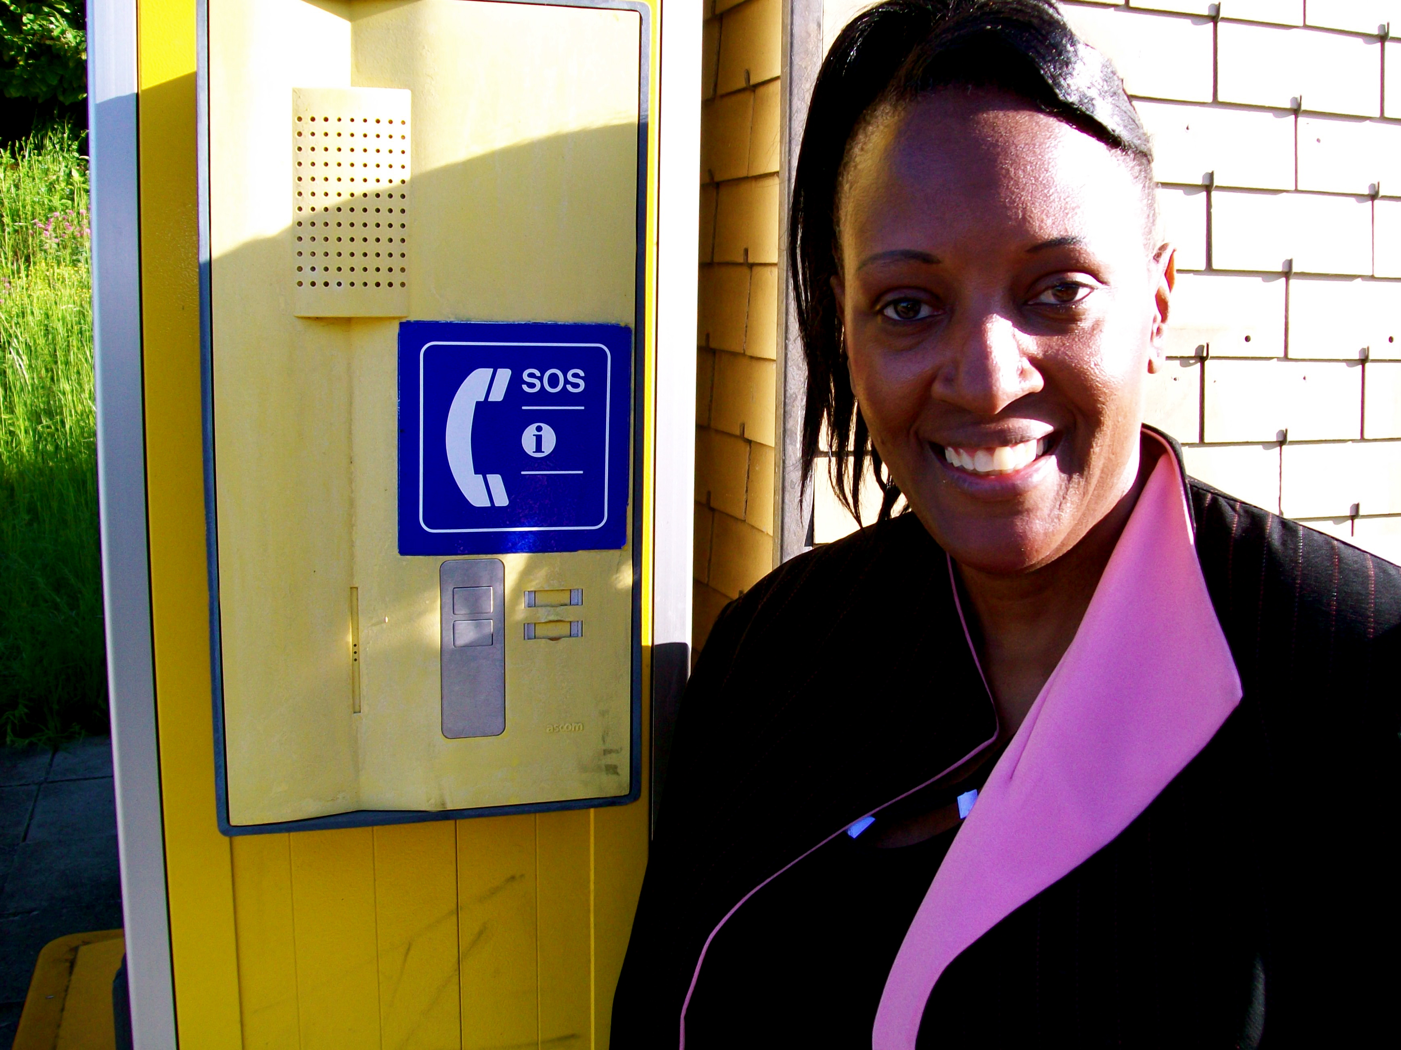
Who am I?
Independent Filmmaker
A perpetual student
BSEE – Electronic Engineer - DeVry University
Masters Arts in Art Business – Sotheby’s Institute 2011 – 2012
Documentaries
Feature Film
International Travel
Currencies

Slide 4

Business Finance - Royalties

Slide 5

Develop Computer applications

Slide 6

“Clearances are needed”
Copyright Filed
U S Library of Congress
http://www.copyright.gov
Patents/Trademark
http://www.uspto.gov

Slide 7

What requires protection? Software application

Slide 8
What do we copyright?
DVDs, CDs, Music, Books, Poetry, Writings, Notes, Plays, Films, or anything we can mass produce or manufacture

Slide 9


Licensing of work
When is it time for representation?
Distribution Channels

Slide 10
Where do we start?
Value Added Resellers!
IBM
Intel
Dell
Apple
Government Contractors/IT
State Contractors

Slide 11


Build a Team &
Develop A Board

Slide 12

Alternatives to For profit
Non-profit Ties-ins
Start at the University Level
OCAST – R & D funding
Medical or Science related

Slide 13

Pennies become dollars
Start small
There are many needs
Few will answer or meet the needs
Give from your well

Slide 14
Visage Prdocution, Inc
Continue to give and live!

Slide 15
Thank you, for coming…
Sound out – the world is watching!

