Slide 1
Using
Remote HPC Resources to Teach Local Courses
Oklahoma Supercomputing Symposium
10/06/10
Larry F. Sells, Oklahoma City University
Clay B. Carley III, East Central University
Chao (Charlie) Zhao, Cameron University

Slide 2
The Impact of OSCER on Software Engineering at Oklahoma City University
Larry F. Sells
Department of Computer Science
Oklahoma City University

Slide 3
Software Engineering at OCU
Same instructor for many years
SE concepts and team/project course
The last 4 semesters project focus has been on MPI and OpenMP

Slide 4
Instructor’s Training
OU Supercomputing Center for Education and Research (OSCER) resources
National Computational Science Institute (NCSI)/SC07-09 HPC summer Parallel Computing workshops 2005, 2007, 2009, 2010
Importance of NCSI summer 2010 Intermediate Parallel Computing workshop in pulling many things together

Slide 5
Course Objectives
Engage students in a first course in software engineering (Roger Pressman text)
Help students work in a UNIX, C, MPI environment
Help student teams create MPI project code along with SE documentation (requirements, design, test plan, user manual, final source code, executables, and report)

Slide 6
Software Engineering Fall 2010 - Prerequisites
2 years experience in C, C++, or Java
Knowledge of data structures
Basic background in Linux (UNIX) helpful
No previous study of parallel programming, HPC, or MPI
No previous knowledge of cryptology

Slide 7
Software Engineering Fall Project
Inspired by Simon Singh’s “Cipher Challenge”
Ciphers include: homophonic, Vigenere, Playfair, ADFGVX, DES, and RSA
Goal is to decipher Singh’s ciphertexts using MPI and C or C++ and to develop appropriate SE documentation

Slide 8
Dr. Henry Neeman, OSCER, and Sooner
OSCER operations team created Sooner accounts for SE students
Henry Neeman and Josh Alexander came to OCU to do an introduction to Sooner lab
Importance of Neeman’s 11 SiPE (Supercomputing in Plain English) presentations – especially #5 and #6
We are working to set up an OU Sooner tour – gives gut understanding of a cluster.

Slide 9
Relevant OSCER 2010 Workshop Ideas
Client/server, data parallelism, task parallelism, and pipeline parallel strategies
Comparing MPI output on Sooner and Earlham cluster
MPI debugging
Introduction to CUDA
Introduction to hybrid HPC – CUDA and MPI

Slide 10
Sooner is Better
Clay B. Carley III
Department of Computer Science
East Central University

Slide 11
Parallel Programming
The Future
High Performance Computing
The Cloud
Multicore Architectures
Equals => more pressure on future graduates to understand parallel programming
11

Slide 12
Parallel Programming Spring 2010 - Prerequisites
Experience in C
Linux (UNIX) experience
No previous study of parallel programming, HPC (High Performance Computing) or MPI (Message Passing Interface) before
No experience with batch processing
12

Slide 13
Course Objectives
Engage students in a first course in parallel programming (“Parallel Programming with MPI,” Pacheco)
Help students work in a C, MPI, batch environment
Help students understand the different parallel computing architectures
13

Slide 14
OSCER Resources
Priming the Pump with Dr. Henry Neeman's “Supercomputing in Plain English” slides
Hardware and Memory Issues
Workshop links
MPI – examples are available in C and FORTRAN
14

Slide 15
Priming the Pump
Starting from scratch
Getting an Instructor's account on Sooner
Online Resources
  Workshops
  PowerPoint Slides
  Exercises and Code Examples
15

Slide 16
Course Kickoff
Visit by Dr. Neeman and Josh Alexander
Connecting to Sooner for the first time
Guidance for first exercises
Q&A about supercomputing and supercomputers
16

Slide 17
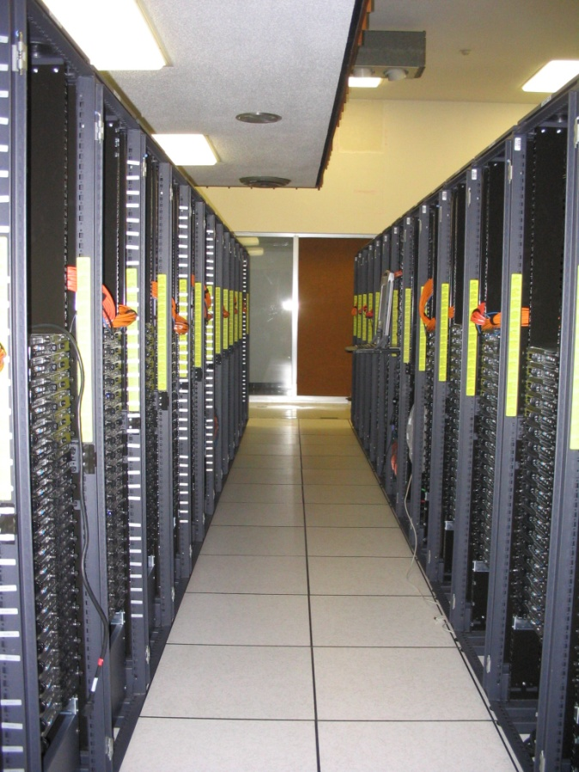
The Sooner Linux Cluster
1,072 Intel Xeon CPU chips/4288 cores
8,768 GB RAM
~105 TB globally accessible disk
QLogic Infiniband
Force10 Networks Gigabit Ethernet
Red Hat Enterprise Linux 5
Peak speed: 34.45 TFLOPs*
*TFLOPs: trillion calculations per second
sooner.oscer.ou.edu

Slide 18
Sooner Benefits for Course
“real supercomputer environment”
Ability to explore different options to see what impact they have on performance
  Increasing/decreasing number of cores
  Increasing/decreasing number of processes
  Increasing/decreasing granularity of the problem
18

Slide 19
Methods for Teaching
Some Basic Concepts of
Parallel Computing to Undergraduate CS Students at Cameron University
Chao Zhao
Associate Professor
Computing and Technology Department
Cameron University

Slide 20
Parallel Computing at Cameron
Cameron is a five year regional public university.
BS in Computer Science is offered in Computing and Technology Department.
CS 3813 Parallel Computing is a required course in CS curriculum (ACM 2000).
MPI is used as message passing library.
OSCER has been used as significant teaching resources.

Slide 21
Instructor’s Training and Cooperation with OSCER
OU HPC Summer Workshops (06, 07, 08, 09)
Inviting supercomputing expert to deliver speech to students (Dr. Neeman: Basic Parallel concepts and Logics)
Visiting OSCER Supercomputing Center
Using OSCER’s supercomputer to run students’ parallel programs:
  Dr. Neeman and Josh Alexander campus visits
  Sooner account for each student

Slide 22
Why Parallel Computing?
Take advantage of multiple core machines
Parallel approach may improve computing efficiency:
  Sp_{(n)} = Ts / Tp
  Ep = Ts / (Tp ∙ n ) or
  Ep = Sp / n
Solve some problems that CANNOT be solved by sequential approach
No speed limit in theory

Slide 23
Parallel Program Logical Structure
Main function
{
common part (variables declaration and initialization);
if ( myrank equal master)
{
code that will be executed by the master process;
}
else {
code that will be executed by slave processes;
}
program termination part;
}

Slide 24
Teaching Methods
Job Balance (Matrix Multiplication)
A (m, n) * B (m’, n’) = C (n, m’)
Master process does the following in order:
Broadcasting matrix B to all slave processes;
Sending a row of matrix A to each process.
Receiving a row of matrix C from a slave process.
Copying the received row into matrix C
If the number of sent rows is less than the number of rows in matrix A, send a row to an idle process that completed its task. Repeat C, D, and E until the job is done.
A Slave process does:
Receiving matrix B;
Receiving a row r of matrix A;
Multiplying row r to matrix B to produce a row of matrix C
Sending the resulted row back to the master process
Repeating B, C, and D until the completion notice is received.

Slide 25
Teaching Methods (continued)
Communicator Creation
Monte Carlo method to compute π
Master process generates a set of random number repeatedly until it is noticed to terminated.
Slave processes use the random numbers to generate points.
Master process and slave process belong to different communicators.

Slide 26
Conclusions
Instructor training is essential to offer a sound teaching to our students in parallel computing and Software Engineering.
OSCER is a very useful resource that can be used to improve teaching and learning quality.
Proper teaching methods provide instructors with a efficient way to deliver their teaching materials.
HPC has much to offer to the CS curriculum.
Thanks to OSCER and its excellent staff!

