Slide 1

Investment in High Performance Computing
A Predictor of Research Competitiveness in U.S. Academic Institutions
Really
Amy Apon, Ph.D.
Director, Arkansas High Performance Computing Center
Professor, CSCE, University of Arkansas
Stan Ahalt, Ph.D.
Director RENCI
Professor, Computer Science, UNC-CH
Work supported by the NSF through Grant #0946726
University of Arkansas and RENCI/UNC-CH
Notes:
I hope to convince you that this title is really true!

Slide 2
Collaborators
Amy Apon University of Arkansas | Stanley Ahalt RENCI, University of North Carolina | Vijay Dantuluri RENCI, University of North Carolina | Constantin Gurdgiev IBM
Moez Limayem University of Arkansas | Linh Ngo University of Arkansas | Michael Stealey RENCI, University of North Carolina

Slide 3
Research Study
Background and motivation
Research hypothesis
Data acquisition
Analysis and Results
Discussion

Slide 4
Research and Computing
Cyberinfrastructure Ecosystem Foundation
Computational and Data Driven Science
Nanotechnology
High Energy Physics
Health Sciences
Global Climate Modeling
…
Notes:
Great science is built on a great cyberinfrastructure foundation.

Slide 5
$
$
$
$
$
$
$
$
$
$
$
$
Credit: NSF OCI
Notes:
View from NSF OCI. View from the eyes of the VPR.

Slide 6
Conversation with a Chancellor
HPC guys, “This is a great investment! We think we can run the HPC center with only $1M/year in hardware and $1M/year in staffing.”
Chancellor, “Which 20 faculty do you want me to fire?”

Slide 7
HPC: High rePeating Cost
Computer equipment is usually treated as a capital expense, with costs for substantial clusters in the range of $1M+
Warranties on these generally last 3 years, or 5 years at most, after which repairs become prohibitive
Even without that, the pace of technology advances require refreshing every 3-5 years
Staffing is a long term repeating cost!

Slide 8
HPC: High rePeating Cost
Ranks of Top 500 Computers and Appearances in Succeeding Lists

Slide 9
Some Observations

Slide 10
What is the ROI?
Can I convince my VPR that the funds invested in HPC add value to the institution and create opportunity?
What if this is not true?

Slide 11
Hypothesis
Investment in high performance computing, as measured by entries on the Top 500 list, is a predictive factor in the research competitiveness of U.S. academic institutions.
We study Carnegie Foundation institutions with “Very High” and “High” research activity – about 200 institutions

Slide 12
Data Acquisition
Independent variables
Top 500 List count and rank of entries
  Mapped from “supercomputer site” to “institution”
  We note that entries are voluntary – the absence of an entry does not mean that an institution does not have HPC
Dependent variables
NSF and other federal funding summary and award information
Publication counts
U.S. News and World Report rankings

Slide 13
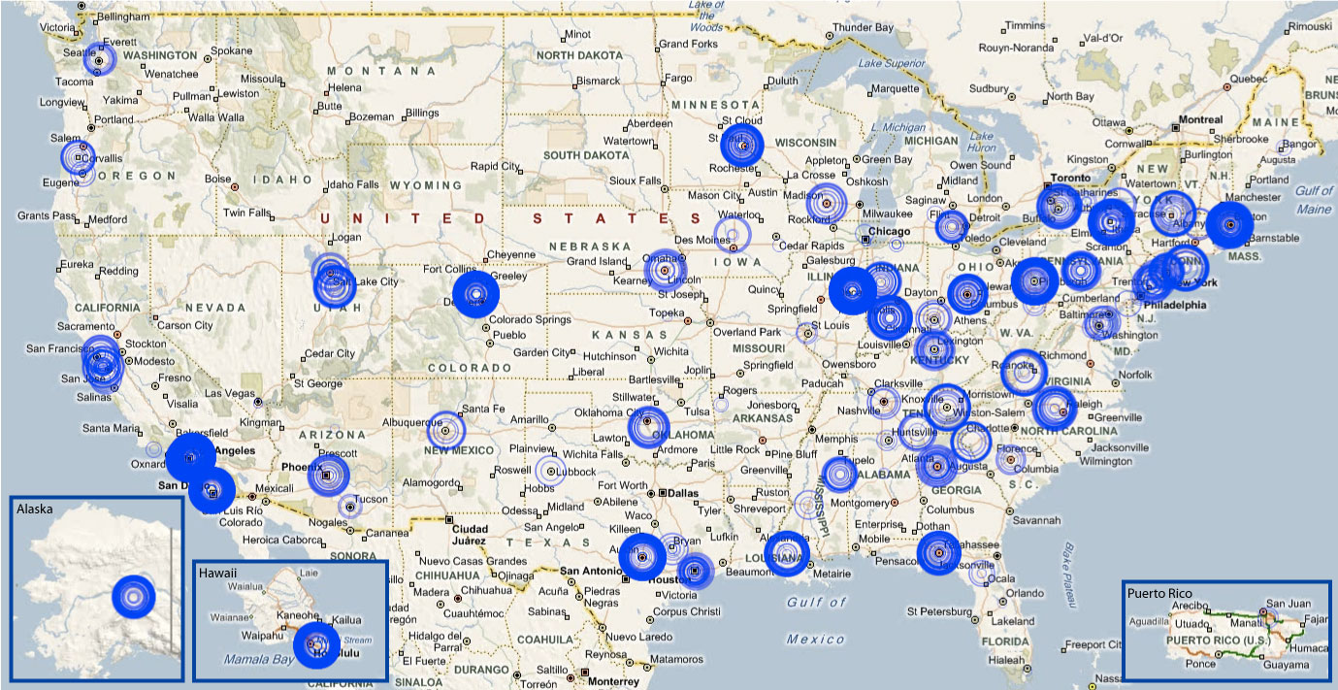
Data from the Top 500 List
An historical record without comparison of supercomputers

Slide 14
Data from the Top 500 List
About 100 U.S. institutions have appeared on a Top 500 List

Slide 15
Analysis
Examples
Correlation analysis
Regression analysis

Slide 16
Simple Example of ROI
Evidence based on 2006 NSF funding
With HPC
Without HPC
Average NSF funding: $30,354,000
Average NSF funding: $7,781,000
95 of Top NSF-funded Universities with HPC 98 of Top NSF-funded Universities w/out HPC

Slide 17
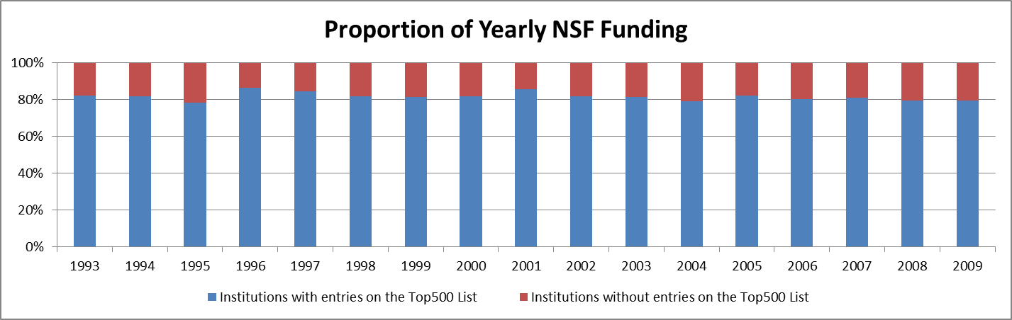
Longer Example of ROI
More evidence, 1993-2009 NSF funding

Slide 18
Correlation Analysis
 | Counts | NSF | Pubs | All Fed | DOE | DOD | NIH | USNews
dRankSum | 0.8198 | 0.6545 | 0.2643 | 0.2566 | 0.2339 | 0.1418 | 0.1194 | -0.243
Counts |  | 0.6746 | 0.4088 | 0.3601 | 0.3486 | 0.1931 | 0.2022 | -0.339
NSF |  |  | 0.7123 | 0.6542 | 0.5439 | 0.2685 | 0.4830 | -0.540
Pubs |  |  |  | 0.8665 | 0.4846 | 0.3960 | 0.8218 | -0.588
All Fed |  |  |  |  | 0.4695 | 0.6836 | 0.9149 | -0.543
DOE |  |  |  |  |  | 0.1959 | 0.3763 | -0.384
DOD |  |  |  |  |  |  | 0.4691 | -0.252
NIH |  |  |  |  |  |  |  | -0.500

Slide 19
Regression Analysis
Two Stage Least Squares (2SLS) regression is used to analyze the research-related returns to investment in HPC
We model two relationships
  Model 1: NSF Funding as a function of contemporaneous and lagged Appearance (APP) on the Top 500 List Count and Publication Count (PuC), and
  Model 2: Publication Count (PuC) as a function of contemporaneous and lagged Appearance on the Top 500 List Count (APP) and NSF Funding

Slide 20
Endogeneity
Funding allows an institution to acquire resources
Resources are used to perform research, which leads to more funding
Resources are also cited in the argument for research funding
NSF funding begats HPC resources which begats NSF funding …

Slide 21
Regression Analysis
Original tests revealed significant problems with endogeneity of Publication Counts (PuC) and NSF Funding.
To correct for this, we deployed a 2SLS estimation method, with number of undergraduate Student Enrollments (SN) acting as an instrumental variable in the first stage regression for PuC (Model 1) and NSF (Model 2).
In both cases, SN was found to be a suitable instrument for endogenous regressors.

Slide 22
First Result
A single HPC investment yields statistically significant immediate returns in terms of new NSF funding
An entry on a list results in an increase of yearly NSF funding of $2.4M
  Confidence level 95%
  Confidence interval $769K-$4M

Slide 23
Second Result
A single HPC investment yields statistically significant immediate returns in terms of increased academic publications
An entry results in an increase in yearly publications of 60
  Confidence level 95%
  Confidence interval 19-100

Slide 24
Third Result
Analysis on the rank of the system shows that rank has a positive impact to competiveness, but with reduced confidence.
We have not studied returns to other institutions of investments by resource providers, or returns to overall U.S. competitiveness.

Slide 25
Fourth Result
HPC investments suffer from fast depreciation over a 2 year horizon
Consistent investments in HPC, even at modest levels, are strongly correlated to research competitiveness.
Inconsistent investments have a significantly less positive ROI

Slide 26
Discussion
More study is needed to precisely determine the rate of depreciation of HPC investments
The publication counts include all publications, not just those related to HPC
More study is needed regarding how use of national systems, such as Teragrid, may impact research competitiveness

Slide 27
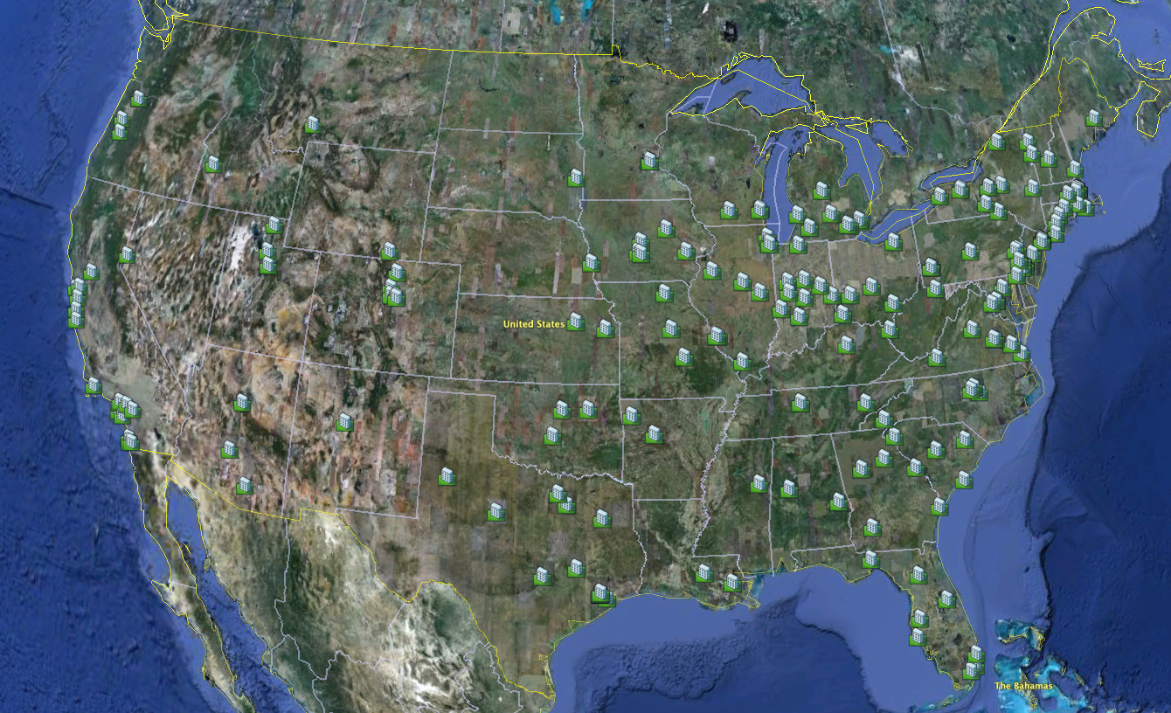
Data from Teragrid Usage

Slide 28
Questions?

