Slide 1






Parallel Programming & Cluster Computing
Overview:
What the Heck is Supercomputing?
Henry Neeman, Director
OU Supercomputing Center for Education & Research
University of Oklahoma Information Technology
Oklahoma Supercomputing Symposium, Tue Oct 5 2010

Slide 2
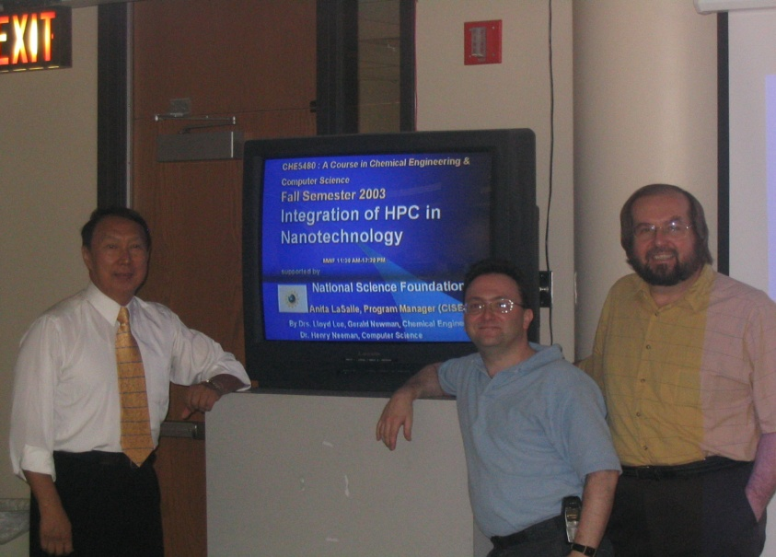
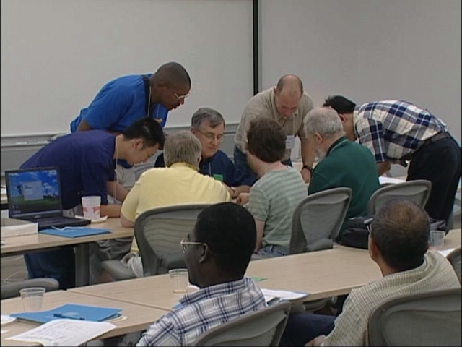
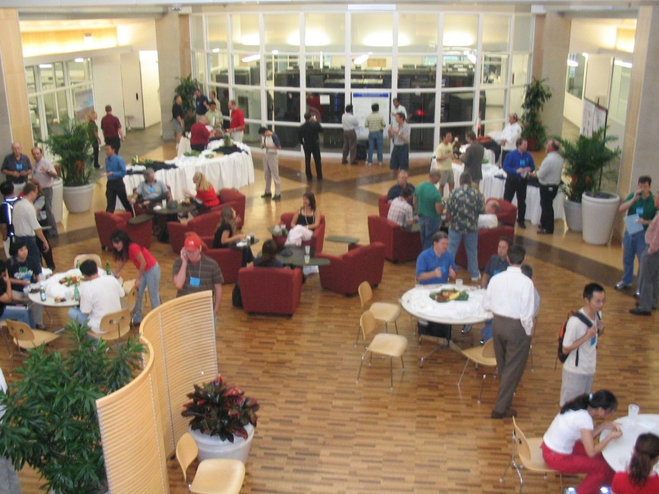
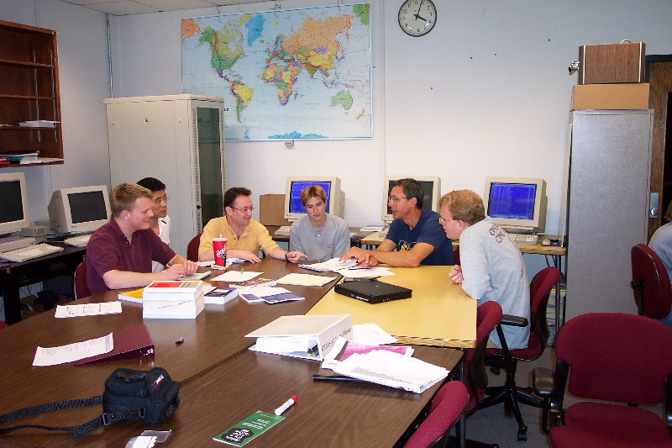
People

Slide 3
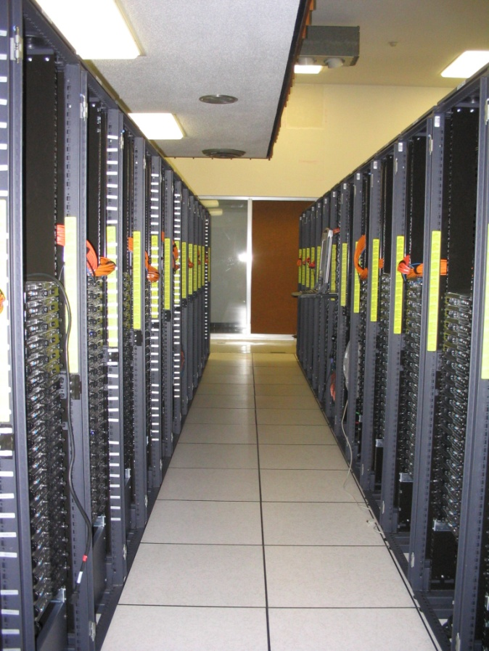
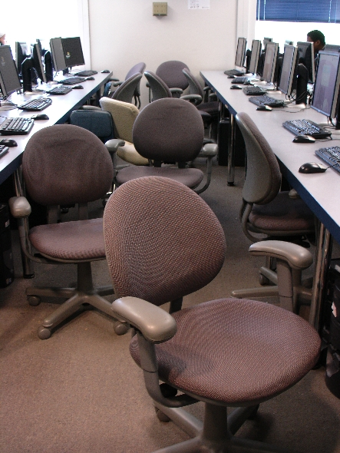
Things

Slide 4
Thanks for your attention!
Questions? www.oscer.ou.edu

Slide 5
What is Supercomputing?
Supercomputing is the biggest, fastest computing right this minute.
Likewise, a supercomputer is one of the biggest, fastest computers right this minute.
So, the definition of supercomputing is constantly changing.
Rule of Thumb: A supercomputer is typically at least 100 times as powerful as a PC.
Jargon: Supercomputing is also known as High Performance Computing (HPC) or High End Computing (HEC) or Cyberinfrastructure (CI).

Slide 6
Fastest Supercomputer vs. Moore
GFLOPs:
billions of calculations per second

Slide 7
What is Supercomputing About?
Size
Speed
Laptop

Slide 8
What is Supercomputing About?
Size: Many problems that are interesting to scientists and engineers can’t fit on a PC – usually because they need more than a few GB of RAM, or more than a few 100 GB of disk.
Speed: Many problems that are interesting to scientists and engineers would take a very very long time to run on a PC: months or even years. But a problem that would take a month on a PC might take only a few hours on a supercomputer.

Slide 9
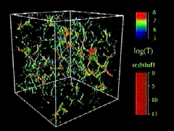
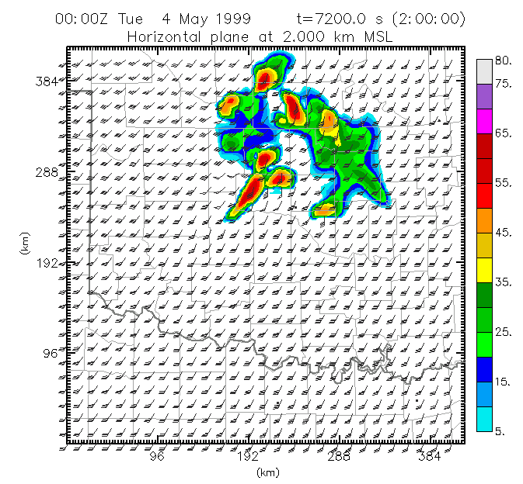
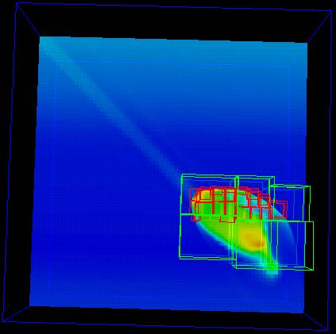
What Is HPC Used For?
Simulation of physical phenomena, such as
  Weather forecasting
  Galaxy formation
  Oil reservoir management
Data mining: finding needles of information in a haystack of data,
such as
  Gene sequencing
  Signal processing
  Detecting storms that might produce tornados
Visualization: turning a vast sea of data into pictures that a scientist can understand
^{[1]}
Moore, OK
Tornadic
Storm
May 3 1999^{[2]}
^{[3]}

Slide 10
Supercomputing Issues
The tyranny of the storage hierarchy
Parallelism: doing multiple things at the same time

Slide 11
OSCER

Slide 12

What is OSCER?
Multidisciplinary center
Division of OU Information Technology
Provides:
  Supercomputing education
  Supercomputing expertise
  Supercomputing resources: hardware, storage, software
For:
  Undergrad students
  Grad students
  Staff
  Faculty
  Their collaborators (including off campus)

Slide 13
Who is OSCER? Academic Depts
Aerospace & Mechanical Engr
Anthropology
Biochemistry & Molecular Biology
Biological Survey
Botany & Microbiology
Chemical, Biological & Materials Engr
Chemistry & Biochemistry
Civil Engr & Environmental Science
Computer Science
Economics
Electrical & Computer Engr
Finance
Health & Sport Sciences
History of Science
Industrial Engr
Geography
Geology & Geophysics
Library & Information Studies
Mathematics
Meteorology
Petroleum & Geological Engr
Physics & Astronomy
Psychology
Radiological Sciences
Surgery
Zoology
E
E
E
E
More than 150 faculty & staff in 26 depts in Colleges of Arts & Sciences, Atmospheric & Geographic Sciences, Business, Earth & Energy, Engineering, and Medicine – with more to come!

Slide 14
Who is OSCER? Groups
Advanced Center for Genome Technology
Center for Analysis & Prediction of Storms
Center for Aircraft & Systems/Support Infrastructure
Cooperative Institute for Mesoscale Meteorological Studies
Center for Engineering Optimization
Fears Structural Engineering Laboratory
Human Technology Interaction Center
Institute of Exploration & Development Geosciences
Instructional Development Program
Interaction, Discovery, Exploration, Adaptation Laboratory
Microarray Core Facility
OU Information Technology
OU Office of the VP for Research
Oklahoma Center for High Energy Physics
Robotics, Evolution, Adaptation, and Learning Laboratory
Sasaki Applied Meteorology Research Institute
Symbiotic Computing Laboratory
E
E
E
E

Slide 15
Who? External Collaborators
California State Polytechnic University Pomona (masters)
Colorado State University
Contra Costa College (CA, 2-year)
Delaware State University (EPSCoR, masters)
Earlham College (IN, bachelors)
East Central University (OK, EPSCoR, masters)
Emporia State University (KS, EPSCoR, masters)
Great Plains Network
Harvard University (MA)
Kansas State University (EPSCoR)
Langston University (OK, EPSCoR, masters)
Longwood University (VA, masters)
Marshall University (WV, EPSCoR, masters)
Navajo Technical College (NM, EPSCoR, 2-year)
NOAA National Severe Storms Laboratory (EPSCoR)
NOAA Storm Prediction Center (EPSCoR)
Oklahoma Baptist University (EPSCoR, bachelors)
Oklahoma City University (EPSCoR, masters)
Oklahoma Climatological Survey (EPSCoR)
Oklahoma Medical Research Foundation (EPSCoR)
Oklahoma School of Science & Mathematics (EPSCoR, high school)
Oklahoma State University (EPSCoR)
Purdue University (IN)
Riverside Community College (CA, 2-year)
St. Cloud State University (MN, masters)
St. Gregory’s University (OK, EPSCoR, bachelors)
Southwestern Oklahoma State University (EPSCoR, masters)
Syracuse University (NY)
Texas A&M University-Corpus Christi (masters)
University of Arkansas (EPSCoR)
University of Arkansas Little Rock (EPSCoR)
University of Central Oklahoma (EPSCoR)
University of Illinois at Urbana-Champaign
University of Kansas (EPSCoR)
University of Nebraska-Lincoln (EPSCoR)
University of North Dakota (EPSCoR)
University of Northern Iowa (masters)
E
E
E
E

Slide 16
Who Are the Users?
Over 700 users so far, including:
Roughly equal split between students vs faculty/staff (students are the bulk of the active users);
many off campus users (roughly 20%);
… more being added every month.
Comparison: TeraGrid, consisting of 11 resource provide sites across the US, has ~5000 unique users.

Slide 17


Biggest Consumers
Center for Analysis & Prediction of Storms: daily real time weather forecasting
Oklahoma Center for High Energy Physics: simulation and data analysis of banging tiny particles together at unbelievably high speeds
Chemical Engineering: lots and lots of molecular dynamics

Slide 18
Why OSCER?
Computational Science & Engineering has become sophisticated enough to take its place alongside experimentation and theory.
Most students – and most faculty and staff – don’t learn much CSE, because CSE is seen as needing too much computing background, and as needing HPC, which is seen as very hard to learn.
HPC can be hard to learn: few materials for novices; most documents written for experts as reference guides.
We need a new approach: HPC and CSE for computing novices – OSCER’s mandate!

Slide 19
Why Bother Teaching Novices?
Application scientists & engineers typically know their applications very well, much better than a collaborating computer scientist ever would.
Commercial software lags far behind the research community.
Many potential CSE users don’t need full time CSE and HPC staff, just some help.
One HPC expert can help dozens of research groups.
Today’s novices are tomorrow’s top researchers, especially because today’s top researchers will eventually retire.

Slide 20
What Does OSCER Do? Teaching
Science and engineering faculty from all over America learn
supercomputing at OU by playing with a jigsaw puzzle (NCSI @ OU 2004).

Slide 21
What Does OSCER Do? Rounds
OU undergrads, grad students, staff and faculty learn
how to use supercomputing in their specific research.

Slide 22
OSCER Resources

Slide 23
OK Cyberinfrastructure Initiative
All academic institutions in Oklahoma are eligible to sign up for free use of OU’s and OSU’s centrally-owned CI resources.
Other kinds of institutions (government, NGO, commercial) are eligible to use, though not necessarily for free.
Everyone can participate in our CI education initiative.
The Oklahoma Supercomputing Symposium, our annual conference, continues to be offered to all.

Slide 24
Dell Intel Xeon Linux Cluster
1,076 Intel Xeon CPU chips/4288 cores
528 dual socket/quad core Harpertown 2.0 GHz, 16 GB each
3 dual socket/quad core Harpertown 2.66 GHz, 16 GB each
3 dual socket/quad core Clovertown 2.33 GHz, 16 GB each
2 x quad socket/quad core Tigerton, 2.4 GHz, 128 GB each
8,800 GB RAM
~130 TB globally accessible disk
QLogic Infiniband
Force10 Networks Gigabit Ethernet
Red Hat Enterprise Linux 5
Peak speed: 34.5 TFLOPs*
*TFLOPs: trillion calculations per second
sooner.oscer.ou.edu

Slide 25
Dell Intel Xeon Linux Cluster
DEBUTED NOVEMBER 2008 AT:
#90 worldwide
#47 in the US
#14 among US academic
#10 among US academic excluding TeraGrid
#2 in the Big 12
#1 in the Big 12 excluding TeraGrid
sooner.oscer.ou.edu

Slide 26
Dell Intel Xeon Linux Cluster
Purchased mid-July 2008
First friendly user Aug 15 2008
Full production Oct 3 2008
Christmas Day 2008: >~75% of nodes and ~66% of cores were in use.
sooner.oscer.ou.edu

Slide 27

What is a Cluster?
“… [W]hat a ship is … It's not just a keel and hull and a deck and sails. That's what a ship needs. But what a ship is ... is freedom.”
– Captain Jack Sparrow
“Pirates of the Caribbean”

Slide 28
What a Cluster is ….
A cluster needs of a collection of small computers, called nodes, hooked together by an interconnection network (or interconnect for short).
It also needs software that allows the nodes to communicate over the interconnect.
But what a cluster is … is all of these components working together as if they’re one big computer ... a super computer.

Slide 29
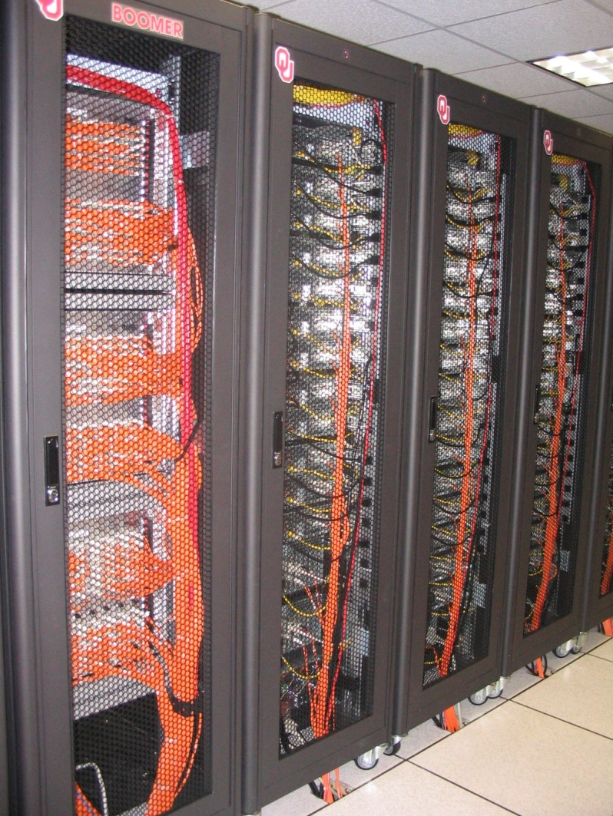
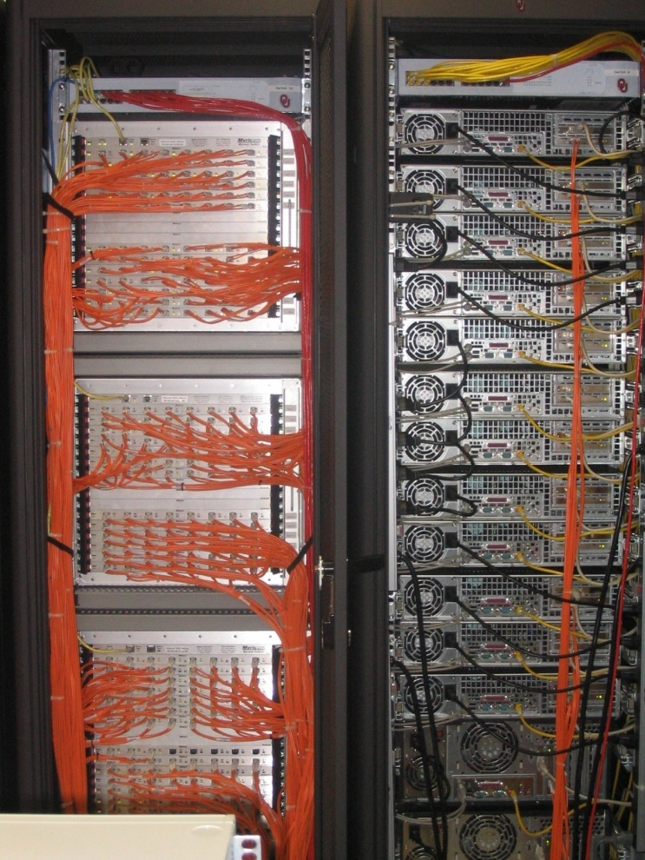
An Actual Cluster
Interconnect
Nodes

Slide 30
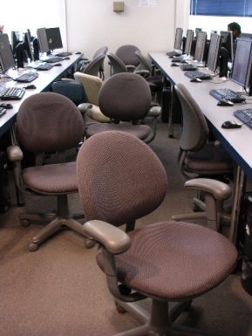
Condor Pool
Condor is a software technology that allows idle desktop PCs to be used for number crunching.
OU IT has deployed a large Condor pool (795 desktop PCs in IT student labs all over campus).
It provides a huge amount of additional computing power – more than was available in all of OSCER in 2005.
20+ TFLOPs peak compute speed.
And, the cost is very very low – almost literally free.
Also, we’ve been seeing empirically that Condor gets about 80% of each PC’s time.

Slide 31
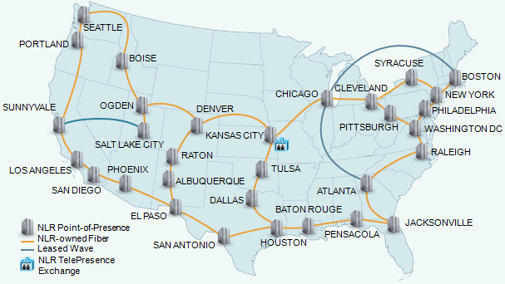
National Lambda Rail

Slide 32
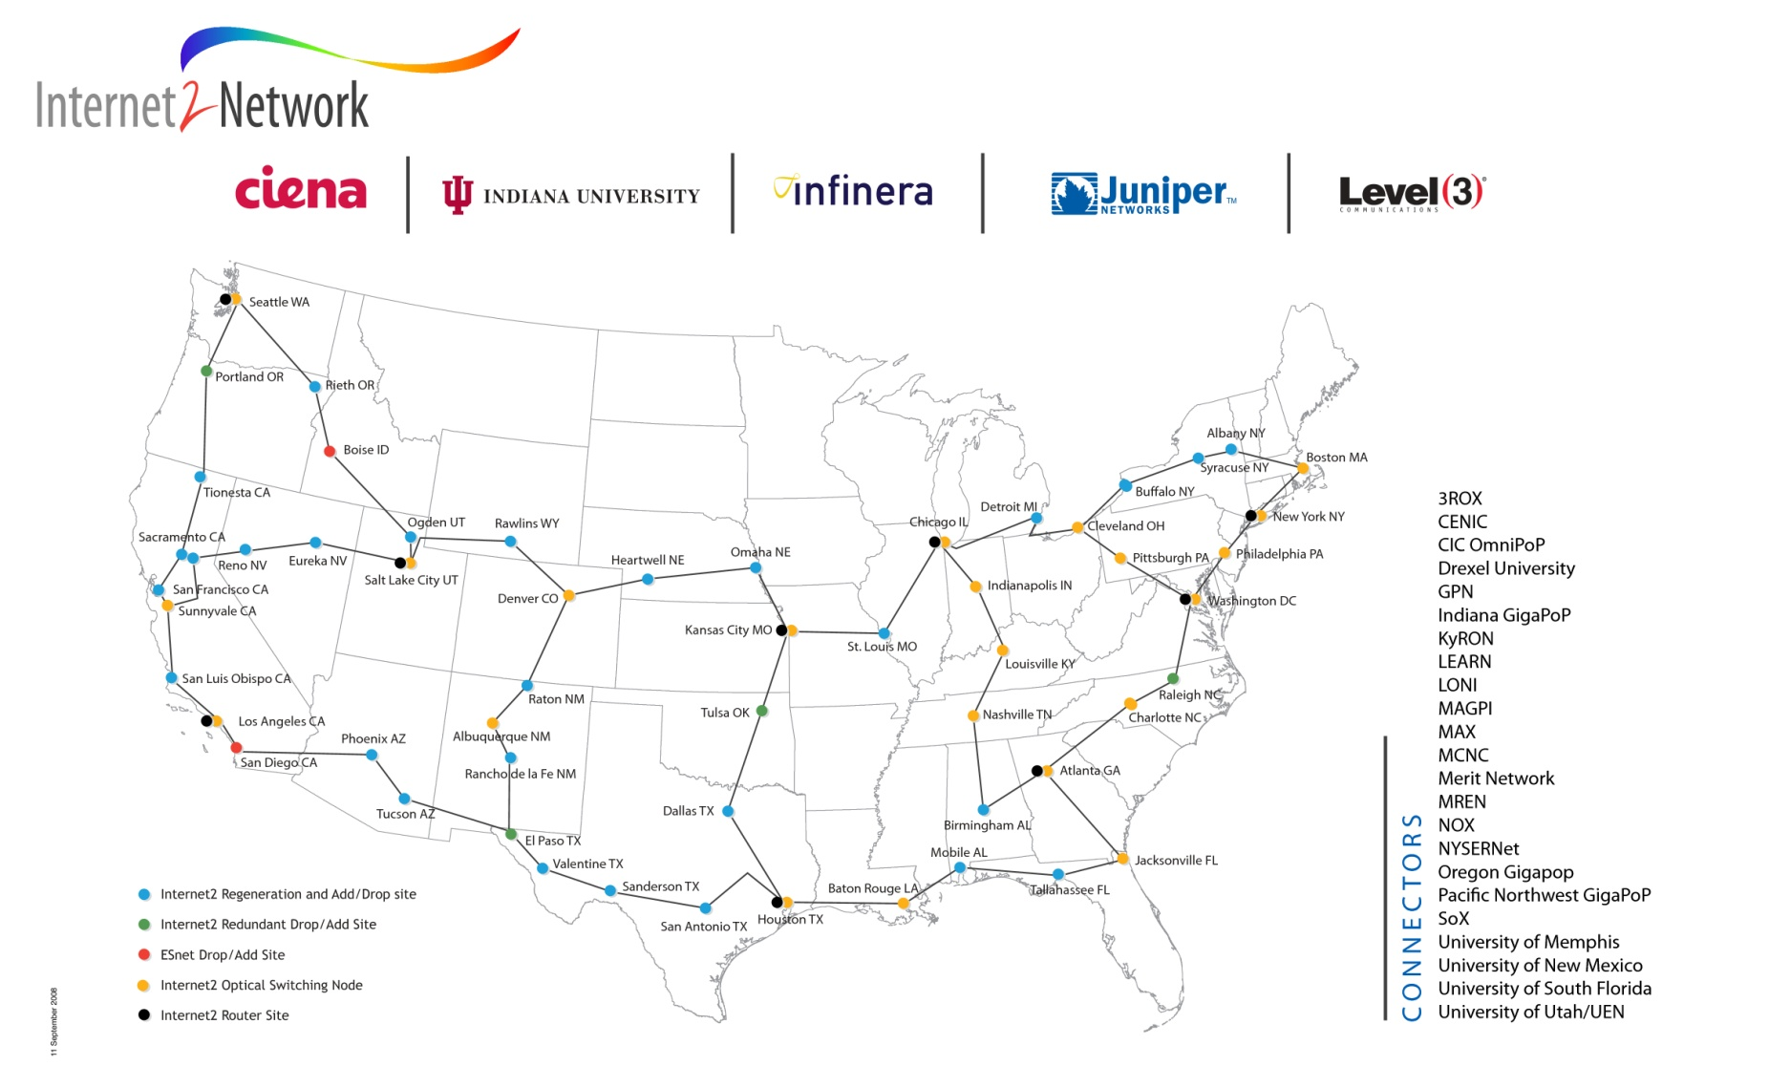
Internet2
www.internet2.edu

Slide 33
A Quick Primer on Hardware

Slide 34
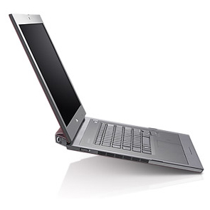
Henry’s Laptop
Dell Latitude Z600^{[4]}
Intel Core2 Duo SU9600 1.6 GHz w/3 MB L2 Cache
4 GB 1066 MHz DDR3 SDRAM
256 GB SSD Hard Drive
DVD+RW/CD-RW Drive (8x)
1 Gbps Ethernet Adapter

Slide 35
Typical Computer Hardware
Central Processing Unit
Primary storage
Secondary storage
Input devices
Output devices

Slide 36
Central Processing Unit
Also called CPU or processor: the “brain”
Components
Control Unit: figures out what to do next – for example, whether to load data from memory, or to add two values together, or to store data into memory, or to decide which of two possible actions to perform (branching)
Arithmetic/Logic Unit: performs calculations – for example, adding, multiplying, checking whether two values are equal
Registers: where data reside that are being used right now

Slide 37
Primary Storage
Main Memory
  Also called RAM (“Random Access Memory”)
  Where data reside when they’re being used by a program that’s currently running
Cache
  Small area of much faster memory
  Where data reside when they’re about to be used and/or have been used recently
Primary storage is volatile: values in primary storage disappear when the power is turned off.

Slide 38
Secondary Storage
Where data and programs reside that are going to be used in the future
Secondary storage is non-volatile: values don’t disappear when power is turned off.
Examples: hard disk, CD, DVD, Blu-ray, magnetic tape, floppy disk
Many are portable: can pop out the CD/DVD/tape/floppy and take it with you

Slide 39
Input/Output
Input devices – for example, keyboard, mouse, touchpad, joystick, scanner
Output devices – for example, monitor, printer, speakers

Slide 40
The Tyranny of the Storage Hierarchy

Slide 41
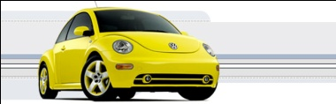
The Storage Hierarchy
Fast, expensive, few
Registers
Cache memory
Main memory (RAM)
Hard disk
Removable media (CD, DVD etc)
Internet
Slow, cheap, a lot
[5]

Slide 42
RAM is Slow
CPU
307 GB/sec^{[6]}
The speed of data transfer
between Main Memory and the
CPU is much slower than the
speed of calculating, so the CPU
spends most of its time waiting
for data to come in or go out.
Bottleneck
4.4 GB/sec^{[7]} (1.4%)

Slide 43
Why Have Cache?
CPU
Cache is much closer to the speed
of the CPU, so the CPU doesn’t
have to wait nearly as long for
stuff that’s already in cache:
it can do more
operations per second!
27 GB/sec (9%)^{[7]}
4.4 GB/sec^{[7]} (1%)

Slide 44
Henry’s Laptop
Dell Latitude Z600^{[4]}
Intel Core2 Duo SU9600 1.6 GHz w/3 MB L2 Cache
4 GB 1066 MHz DDR3 SDRAM
256 GB SSD Hard Drive
DVD+RW/CD-RW Drive (8x)
1 Gbps Ethernet Adapter

Slide 45
Storage Speed, Size, Cost
Henry’s Laptop | Registers (Intel Core2 Duo 1.6 GHz) | Cache Memory (L2) | Main Memory (1066MHz DDR3 SDRAM) | Hard Drive (SSD) | Ethernet (1000 Mbps) | DVD+R (16x) | Phone Modem (56 Kbps)
Speed (MB/sec) [peak] | 314,573^{[6]} (12,800 MFLOP/s*) | 27,276 ^{[7]} | 4500 ^{[7]} | 250 ^{[9]} | 125 | 22 ^{[10]} | 0.007
Size (MB) | 304 bytes** ^{[11]} | 3 | 4096 | 256,000 | unlimited | unlimited | unlimited
Cost ($/MB) | – | $285 ^{[12]} | $0.03 ^{[12]} | $0.002 ^{[12]} | charged per month (typically) | $0.00005 ^{[12]} | charged per month (typically)
* MFLOP/s: millions of floating point operations per second
** 8 32-bit integer registers, 8 80-bit floating point registers, 8 64-bit MMX integer registers,
8 128-bit floating point XMM registers

Slide 46
Parallelism

Slide 47
Parallelism
Parallelism means doing multiple things at the same time: you can get more work done in the same time.
Less fish …
More fish!

Slide 48
The Jigsaw Puzzle Analogy

Slide 49
Serial Computing
Suppose you want to do a jigsaw puzzle
that has, say, a thousand pieces.
We can imagine that it’ll take you a
certain amount of time. Let’s say
that you can put the puzzle together in
an hour.

Slide 50
Shared Memory Parallelism
If Scott sits across the table from you, then he can work on his half of the puzzle and you can work on yours. Once in a while, you’ll both reach into the pile of pieces at the same time (you’ll contend for the same resource), which will cause a little bit of slowdown. And from time to time you’ll have to work together (communicate) at the interface between his half and yours. The speedup will be nearly 2-to-1: y’all might take 35 minutes instead of 30.

Slide 51
The More the Merrier?
Now let’s put Paul and Charlie on the other two sides of the table. Each of you can work on a part of the puzzle, but there’ll be a lot more contention for the shared resource (the pile of puzzle pieces) and a lot more communication at the interfaces. So y’all will get noticeably less than a 4-to-1 speedup, but you’ll still have an improvement, maybe something like 3-to-1: the four of you can get it done in 20 minutes instead of an hour.

Slide 52
Diminishing Returns
If we now put Dave and Tom and Horst and Brandon on the corners of the table, there’s going to be a whole lot of contention for the shared resource, and a lot of communication at the many interfaces. So the speedup y’all get will be much less than we’d like; you’ll be lucky to get 5-to-1.
So we can see that adding more and more workers onto a shared resource is eventually going to have a diminishing return.

Slide 53
Distributed Parallelism
Now let’s try something a little different. Let’s set up two tables, and let’s put you at one of them and Scott at the other. Let’s put half of the puzzle pieces on your table and the other half of the pieces on Scott’s. Now y’all can work completely independently, without any contention for a shared resource. BUT, the cost per communication is MUCH higher (you have to scootch your tables together), and you need the ability to split up (decompose) the puzzle pieces reasonably evenly, which may be tricky to do for some puzzles.

Slide 54
More Distributed Processors
It’s a lot easier to add more processors in distributed parallelism. But, you always have to be aware of the need to decompose the problem and to communicate among the processors. Also, as you add more processors, it may be harder to load balance the amount of work that each processor gets.

Slide 55
Load Balancing
Load balancing means ensuring that everyone completes their workload at roughly the same time.
For example, if the jigsaw puzzle is half grass and half sky, then you can do the grass and Scott can do the sky, and then y’all only have to communicate at the horizon – and the amount of work that each of you does on your own is roughly equal. So you’ll get pretty good speedup.

Slide 56
Load Balancing
Load balancing can be easy, if the problem splits up into chunks of roughly equal size, with one chunk per processor. Or load balancing can be very hard.

Slide 57
Load Balancing
EASY
Load balancing can be easy, if the problem splits up into chunks of roughly equal size, with one chunk per processor. Or load balancing can be very hard.

Slide 58
Load Balancing
EASY
HARD
Load balancing can be easy, if the problem splits up into chunks of roughly equal size, with one chunk per processor. Or load balancing can be very hard.

Slide 59
Moore’s Law

Slide 60
Moore’s Law
In 1965, Gordon Moore was an engineer at Fairchild Semiconductor.
He noticed that the number of transistors that could be squeezed onto a chip was doubling about every 18 months.
It turns out that computer speed is roughly proportional to the number of transistors per unit area.
Moore wrote a paper about this concept, which became known as “Moore’s Law.”

Slide 61
Fastest Supercomputer vs. Moore
GFLOPs:
billions of calculations per second

Slide 62
Moore’s Law in Practice
CPU
log(Speed)
Year

Slide 63
Moore’s Law in Practice
Network Bandwidth
CPU
log(Speed)
Year

Slide 64
Moore’s Law in Practice
Network Bandwidth
CPU
log(Speed)
RAM
Year

Slide 65
Moore’s Law in Practice
Network Bandwidth
log(Speed)
CPU
RAM
1/Network Latency
Year

Slide 66
Moore’s Law in Practice
Network Bandwidth
CPU
log(Speed)
RAM
1/Network Latency
Software
Year

Slide 67
Why Bother?

Slide 68
Why Bother with HPC at All?
It’s clear that making effective use of HPC takes quite a bit of effort, both learning how and developing software.
That seems like a lot of trouble to go to just to get your code to run faster.
It’s nice to have a code that used to take a day, now run in an hour. But if you can afford to wait a day, what’s the point of HPC?
Why go to all that trouble just to get your code to run faster?

Slide 69
Why HPC is Worth the Bother
What HPC gives you that you won’t get elsewhere is the ability to do bigger, better, more exciting science. If your code can run faster, that means that you can tackle much bigger problems in the same amount of time that you used to need for smaller problems.
HPC is important not only for its own sake, but also because what happens in HPC today will be on your desktop in about 10 to 15 years: it puts you ahead of the curve.

Slide 70
The Future is Now
Historically, this has always been true:
Whatever happens in supercomputing today will be on your desktop in 10 – 15 years.
So, if you have experience with supercomputing, you’ll be ahead of the curve when things get to the desktop.

Slide 71
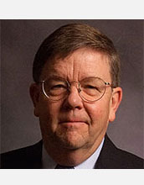

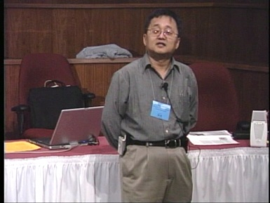
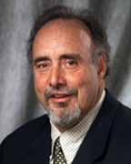
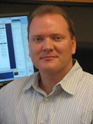
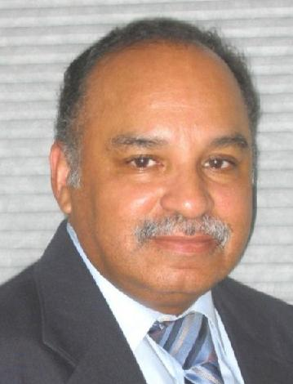
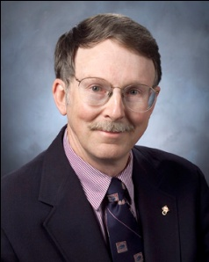
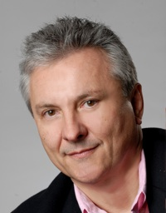
OK Supercomputing Symposium 2010
2003 Keynote:
Peter Freeman
NSF
Computer & Information
Science & Engineering
Assistant Director
2004 Keynote:
Sangtae Kim
NSF Shared
Cyberinfrastructure
Division Director
2005 Keynote:
Walt Brooks
NASA Advanced
Supercomputing
Division Director
2006 Keynote:
Dan Atkins
Head of NSF’s
Office of
Cyberinfrastructure
2007 Keynote:
Jay Boisseau
Director
Texas Advanced
Computing Center
U. Texas Austin
2008 Keynote: José Munoz Deputy Office Director/ Senior Scientific Advisor NSF Office of Cyberinfrastructure
2010 Keynote
Horst Simon, Director
National Energy Research Scientific Computing Center
FREE! Wed Oct 6 2010 @ OU
Over 235 registratons already!
Over 150 in the first day, over 200 in the first week, over 225 in the first month.
2009 Keynote: Douglass Post Chief Scientist US Dept of Defense HPC Modernization Program
http://symposium2010.oscer.ou.edu/

Slide 72
Thanks for your attention!
Questions? www.oscer.ou.edu

Slide 73
References
[1] Image by Greg Bryan, Columbia U.
[2] “Update on the Collaborative Radar Acquisition Field Test (CRAFT): Planning for the Next Steps.”
Presented to NWS Headquarters August 30 2001.
[3] See http://hneeman.oscer.ou.edu/hamr.html for details.
[4] http://www.dell.com/
[5] http://www.vw.com/newbeetle/
[6] Richard Gerber, The Software Optimization Cookbook: High-performance Recipes for the Intel Architecture. Intel Press, 2002, pp. 161-168.
[7] RightMark Memory Analyzer. http://cpu.rightmark.org/
[8] ftp://download.intel.com/design/Pentium4/papers/24943801.pdf
[9] http://www.samsungssd.com/meetssd/techspecs
[10] http://www.samsung.com/Products/OpticalDiscDrive/SlimDrive/OpticalDiscDrive_SlimDrive_SN_S082D.asp?page=Specifications
[11] ftp://download.intel.com/design/Pentium4/manuals/24896606.pdf
[12] http://www.pricewatch.com/

