Slide 1






Parallel Programming & Cluster Computing
High Throughput Computing
Henry Neeman, Director
OU Supercomputing Center for Education & Research
University of Oklahoma Information Technology
Oklahoma Supercomputing Symposium, Tue Oct 5 2010

Slide 2
Outline
What is High Throughput Computing?
Tightly Coupled vs Loosely Coupled
What is Opportunistic Computing?
Condor
Grid Computing

Slide 3
What is
High Throughput Computing?

Slide 4
High Throughput Computing
High Throughput Computing (HTC) means getting lots of work done per large time unit (for example, jobs per month).
This is different from High Performance Computing (HPC), which means getting a particular job done in less time (for example, calculations per second).

Slide 5
Throughput vs Performance
Throughput is a side effect of how much time your job takes from when you first submit it until it completes.
Performance is the factor that controls how much time your jobs takes from when it first starts running until it completes.
Example:
  You submit a very big job at 1:00am on January 1.
  It sits in the queue for a while.
  It starts running at 5:00pm on January 2.
  It finishes running at 6:00pm on January 2.
  Its performance is fast; its throughput is slow.

Slide 6
High Throughput on a Cluster?
Is it possible to get high throughput on a cluster?
Sure – it just has to be a cluster that no one else is trying to use!
Normally, a cluster that is shared by many users is fully loaded with jobs all the time. So your throughput depends on when you submit your jobs, and even how many jobs you submit at a time.
Depending on a variety of factors, a job you submit may wait in the queue for anywhere from seconds to days.

Slide 7
Tightly Coupled vs
Loosely Coupled

Slide 8
Tightly Coupled vs Loosely Coupled
Tightly coupled means that all of the parallel tasks have to advance forward in lockstep, so they have to communicate frequently.
Loosely coupled means that the parallel tasks can largely or completely ignore each other (little or no communication), and they can advance at different rates.

Slide 9
Tightly Coupled Example
Consider weather forecasting.
You take your simulation domain – for example, the continental United States – split it up into chunks, and give each chunk to an MPI process.
But, the weather in northern Oklahoma affects the weather in southern Kansas.
So, every single timestep, the process that contains northern Oklahoma has to communicate with the process that contains southern Kansas, so that the interface between the processes has the same weather at the same time.

Slide 10
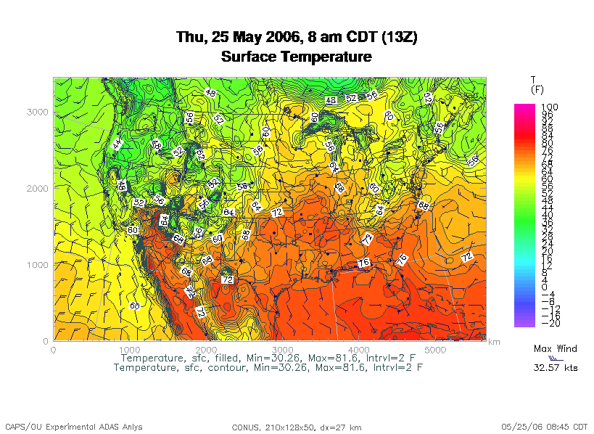
Tightly Coupled Example
OK/KS boundary
http://www.caps.ou.edu/wx/p/r/conus/fcst/

Slide 11
Loosely Coupled Example
An application is known as embarrassingly parallel, or loosely coupled, if its parallel implementation:
can straightforwardly be broken up into roughly equal amounts of work per processor, AND
has minimal parallel overhead (for example, communication among processors).
We love embarrassingly parallel applications, because they get near-perfect parallel speedup, sometimes with only modest programming effort.

Slide 12
Monte Carlo Methods
Monte Carlo is a city in the tiny European country Monaco.
People gamble there; that is, they play games of chance, which involve randomness.
Monte Carlo methods are ways of simulating (or otherwise calculating) physical phenomena based on randomness.
Monte Carlo simulations typically are embarrassingly parallel.

Slide 13
Monte Carlo Methods: Example
Suppose you have some physical phenomenon. For example, consider High Energy Physics, in which we bang tiny particles together at incredibly high speeds.
BANG!
We want to know, say, the average properties of this phenomenon.
There are infinitely many ways that two particles can be banged together.
So, we can’t possibly simulate all of them.

Slide 14
Monte Carlo Methods: Example
Suppose you have some physical phenomenon. For example, consider High Energy Physics, in which we bang tiny particles together at incredibly high speeds.
BANG!
We want to know, say, the average properties of this phenomenon.
There are infinitely many ways that two particles can be banged together.
So, we can’t possibly simulate all of them.
Instead, we can randomly choose a finite subset of these infinitely many ways and simulate only the subset.

Slide 15
Monte Carlo Methods: Example
Suppose you have some physical phenomenon. For example, consider High Energy Physics, in which we bang tiny particles together at incredibly high speeds.
BANG!
We want to know, say, the average properties of this phenomenon.
There are infinitely many ways that two particles can be banged together.
So, we can’t possibly simulate all of them.
The average of this subset will be close to the actual average.

Slide 16
Monte Carlo Methods
In a Monte Carlo method, you randomly generate a large number of example cases (realizations) of a phenomenon, and then take the average of the properties of these realizations.
When the realizations’ average converges (that is, doesn’t change substantially if new realizations are generated), then the Monte Carlo simulation stops.
This can also be implemented by picking a high enough number of realizations to be sure, mathematically, of convergence.

Slide 17
MC: Embarrassingly Parallel
Monte Carlo simulations are embarrassingly parallel, because each realization is completely independent of all of the other realizations.
That is, if you’re going to run a million realizations, then:
you can straightforwardly break up into roughly 1M / N_{p} chunks of realizations, one chunk for each of the N_{p} processes, AND
the only parallel overhead (for example, communication) comes from tracking the average properties, which doesn’t have to happen very often.

Slide 18
Serial Monte Carlo
Suppose you have an existing serial Monte Carlo simulation:
PROGRAM monte_carlo
CALL read_input(…)
DO realization = 1, number_of_realizations
CALL generate_random_realization(…)
CALL calculate_properties(…)
END DO
CALL calculate_average(…)
END PROGRAM monte_carlo
How would you parallelize this?

Slide 19
Parallel Monte Carlo: MPI
PROGRAM monte_carlo_mpi
[MPI startup]
IF (my_rank == server_rank) THEN
CALL read_input(…)
END IF
CALL MPI_Bcast(…)
number_of_realizations_per_process = &
& number_of_realizations / number_of_processes
DO realization = 1, number_of_realizations_per_process
CALL generate_random_realization(…)
CALL calculate_realization_properties(…)
CALL calculate_local_running_average(...)
END DO
IF (my_rank == server_rank) THEN
[collect properties]
ELSE
[send properties]
END IF
CALL calculate_global_average_from_local_averages(…)
CALL output_overall_average(...)
[MPI shutdown]
END PROGRAM monte_carlo_mpi

Slide 20
Parallel Monte Carlo: HTC
Suppose you have an existing serial Monte Carlo simulation:
PROGRAM monte_carlo
CALL read_input(…)
number_of_realizations_per_job = &
& number_of_realizations / number_of_jobs
DO realization = 1, number_of_realizations_per_job
CALL generate_random_realization(…)
CALL calculate_properties(…)
END DO
CALL calculate_average_for_this_job(…)
CALL output_average_for_this_job(…)
END PROGRAM monte_carlo
To parallelize this for HTC, simply submit number_of_jobs jobs, and then at the very end run a little program to calculate the overall average.

Slide 21
What is
Opportunistic Computing?

Slide 22
Desktop PCs Are Idle Half the Day
Desktop PCs tend to be active during the workday.
But at night, during most of the year, they’re idle. So we’re only getting half their value (or less).

Slide 23
Supercomputing at Night
A particular institution – say, OU – has lots of desktop PCs that are idle during the evening and during intersessions.
Wouldn’t it be great to put them to work on something useful to our institution?
That is: What if they could pretend to be a big supercomputer at night, when they’d otherwise be idle anyway?
This is sometimes known as opportunistic computing: When a desktop PC is otherwise idle, you have an opportunity to do number crunching on it.

Slide 24

Supercomputing at Night Example
SETI – the Search for Extra-Terrestrial Intelligence – is looking for evidence of green bug-eyed monsters on other planets, by mining radio telescope data.
SETI@home runs number crunching software as a screensaver on idle PCs around the world (2+ million PCs in 252 countries):
http://setiathome.berkeley.edu/
There are many similar projects:
folding@home (protein folding)
climateprediction.net
Einstein@Home (Laser Interferometer Gravitational wave Observatory)
Cosmology@home
…

Slide 25

BOINC
The projects listed on the previous page use a software package named BOINC (Berkeley Open Infrastructure for Network Computing), developed at the University of California, Berkeley:
http://boinc.berkeley.edu/
To use BOINC, you have to insert calls to various BOINC routines into your code. It looks a bit similar to MPI:
int main ()
{ /* main */
…
boinc_init();
…
boinc_finish(…);
} /* main */

Slide 26
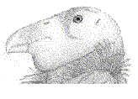
Condor

Slide 27
Condor is Like BOINC
Condor steals computing time on existing desktop PCs when they’re idle.
Condor runs in background when no one is sitting at the desk.
Condor allows an institution to get much more value out of the hardware that’s already purchased, because there’s little or no idle time on that hardware – all of the idle time is used for number crunching.

Slide 28
Condor is Different from BOINC
To use Condor, you don’t need to rewrite your software to add calls to special routines; in BOINC, you do.
Condor works great under Unix/Linux, but less well under Windows or MacOS (more on this presently); BOINC works well under all of them.
It’s non-trivial to install Condor on your own personal desktop PC; it’s straightforward to install a BOINC application such as SETI@home.

Slide 29
Useful Features of Condor
Opportunistic computing: Condor steals time on existing desktop PCs when they’re otherwise not in use.
Condor doesn’t require any changes to the software.
Condor can automatically checkpoint a running job: Every so often, Condor saves to disk the state of the job (the values of all the job’s variables, plus where the job is in the program).
Therefore, Condor can preempt running jobs if more important jobs come along, or if someone sits down at the desktop PC.
Likewise, Condor can migrate running jobs to other PCs, if someone sits at the PC or if the PC crashes.
And, Condor can do all of its I/O over the network, so that the job on the desktop PC doesn’t consume the desktop PCs local disk.

Slide 30
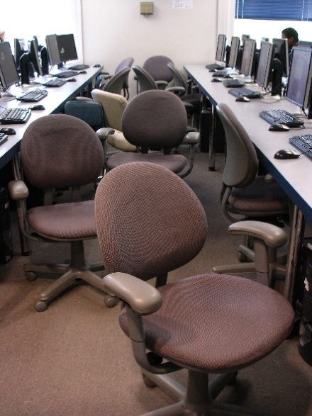
Condor Pool @ OU
OU IT has deployed a large Condor pool (795 desktop PCs in dozens of labs around campus).
OU’s Condor pool provides a huge amount of computing power – more than OSCER’s big cluster:
if OU were a state, we’d be the 19th largest state in the US;
if OU were a country, we’d be the 18th largest country in the world.
The hardware and software cost is zero, and the labor cost is modest.
Also, we’ve been seeing empirically that lab PCs are available for Condor jobs about 80% of the time.

Slide 31
Condor Limitations
The Unix/Linux version has more features than Windows or MacOS, which are referred to as “clipped.”
Your code shouldn’t be parallel to do opportunistic computing (MPI requires a fixed set of resources throughout the entire run), and it shouldn’t try to do any funky communication (for example, opening sockets).
For a Red Hat Linux Condor pool, you have to be able to compile your code with gcc, g++, g77 or NAG f95 (which is a Fortran90-to-C translator that then calls gcc).
Also, depending on the PCs that have Condor on them, you may have limitations on, for example, how big your jobs’ RAM footprint can be.

Slide 32
Running a Condor Job
Running a job on Condor pool is a lot like running a job on a cluster:
You compile your code using the compilers appropriate for that resource.
You submit a batch script to the Condor system, which decides when and where your job runs, magically and invisibly.

Slide 33
Sample Condor Batch Script
Universe = standard
Executable = /home/hneeman/NBody/nbody_compiled_for_condor
Notification = Error
Notify_User = hneeman@ou.edu
Arguments = 1000 100
Input = /home/hneeman/NBody/nbody_input.txt
Output = nbody_$(Cluster)_$(Process)_out.txt
Error = nbody_$(Cluster)_$(Process)_err.txt
Log = nbody_$(Cluster)_$(Process)_log.txt
InitialDir = /home/hneeman/NBody/Run001
Queue
The batch submission command is condor_submit, used like so:
condor_submit nbody.condor

Slide 34

Linux Condor on Windows PCs?
If OU’s Condor pool uses Linux, how can it be installed in OU IT PC labs? Don’t those run Windows?
Yes.
Our solution is to run Linux inside Windows, using a piece of software named coLinux (“Cooperative Linux”):
http://www.colinux.org/

Slide 35
Condor inside Linux inside Windows
Number Crunching Applications
Condor
Linux
Desktop Applications
coLinux
Windows

Slide 36
Advantages of Linux inside Windows
Condor is full featured rather than clipped.
Desktop users have a full Windows experience, without even being aware that coLinux exists.
A little kludge helps Condor watch the keyboard, mouse and CPU level of Windows, so that Condor jobs don’t run when the PC is otherwise in use.
Want to try it yourself?
http://www.oscer.ou.edu/CondorInstall/condor_colinux_howto.php

Slide 37
Grid Computing

Slide 38
What is Grid Computing?
The term grid computing is poorly defined, but the best definition I’ve seen so far is:
“a distributed, heterogeneous operating system.”
A grid can consist of:
compute resources;
storage resources;
networks;
data collections;
shared instruments;
sensor networks;
and so much more ....

Slide 39
Grid Computing is Like and Unlike ...
IBM’s website has a very good description of grid computing:
“Like the Web, grid computing keeps complexity hidden: multiple users enjoy a single, unified experience.
“Unlike the Web, which mainly enables communication, grid computing enables full collaboration toward common ... goals.
“Like peer-to-peer, grid computing allows users to share files.
“Unlike peer-to-peer, grid computing allows many-to-many sharing – not only files but other resources as well.
“Like clusters and distributed computing, grids bring computing resources together.
“Unlike clusters and distributed computing, which need physical proximity and operating homogeneity, grids can be geographically distributed and heterogeneous.
“Like virtualization technologies, grid computing enables the virtualization of IT resources.
“Unlike virtualization technologies, which virtualize a single system, grid computing enables the virtualization of vast and disparate IT resources.”
http://www.thocp.net/hardware/grid_computers.htm

Slide 40
Condor is Grid Computing
Condor creates a grid out of disparate desktop PCs.
(Actually, they don’t have to be desktop PCs; they don’t even have to be PCs. You can use Condor to schedule a cluster, or even on a big iron supercomputer.)
From a user’s perspective, all of the PCs are essentially invisible; the user just knows how to submit a job, and everything happens magically and invisibly, and at some point the job is done and a result appears.

Slide 41
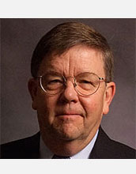
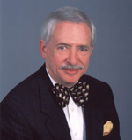
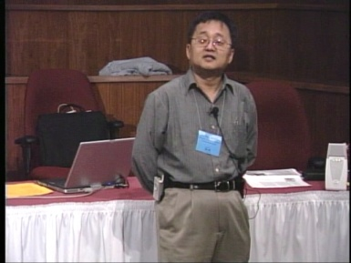
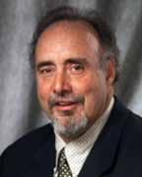
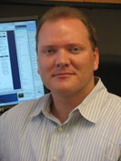
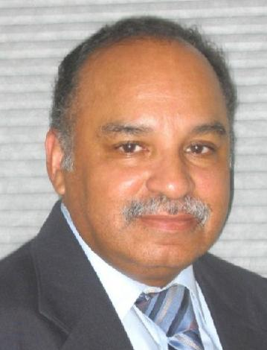
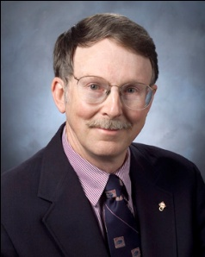
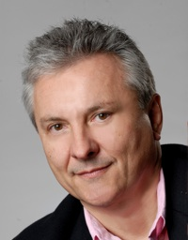
OK Supercomputing Symposium 2010
2003 Keynote:
Peter Freeman
NSF
Computer & Information
Science & Engineering
Assistant Director
2004 Keynote:
Sangtae Kim
NSF Shared
Cyberinfrastructure
Division Director
2005 Keynote:
Walt Brooks
NASA Advanced
Supercomputing
Division Director
2006 Keynote:
Dan Atkins
Head of NSF’s
Office of
Cyberinfrastructure
2007 Keynote:
Jay Boisseau
Director
Texas Advanced
Computing Center
U. Texas Austin
2008 Keynote: José Munoz Deputy Office Director/ Senior Scientific Advisor NSF Office of Cyberinfrastructure
2010 Keynote
Horst Simon, Director
National Energy Research Scientific Computing Center
FREE! Wed Oct 6 2010 @ OU
Over 235 registratons already!
Over 150 in the first day, over 200 in the first week, over 225 in the first month.
2009 Keynote: Douglass Post Chief Scientist US Dept of Defense HPC Modernization Program
http://symposium2010.oscer.ou.edu/

Slide 42
Thanks for your attention!
Questions? www.oscer.ou.edu

