Slide 1

Supercomputing at Croatian Hydrological and Meteorological Service
Antonio Stanesic

Slide 2
Outline
General information
Croatia supercomputers
Usage of DHMZ supercomputer Viking
OU – DHMZ collaboration

Slide 3
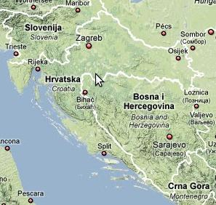
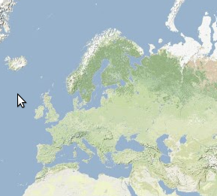
Croatia
56,542km²
4,5 million inhabitants

Slide 4
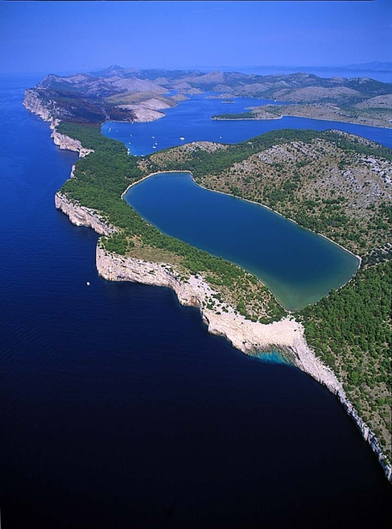
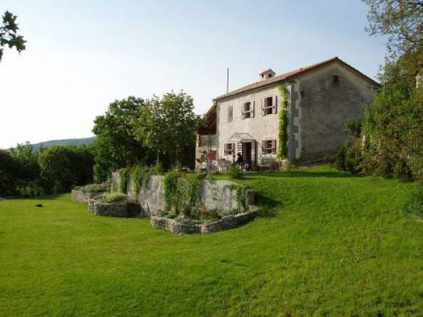
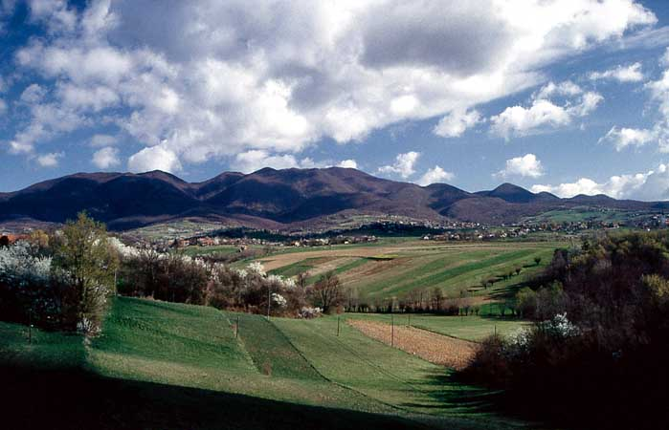
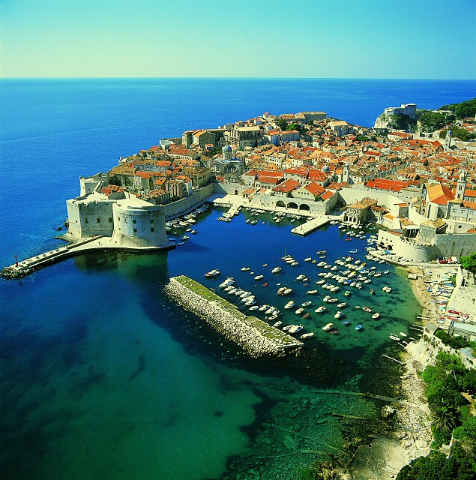
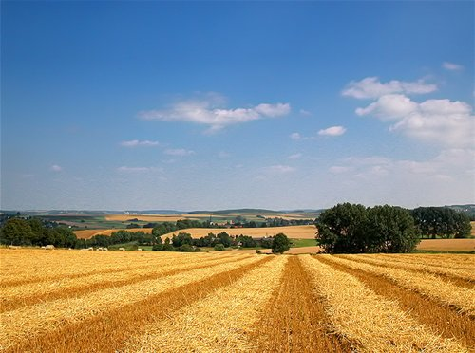
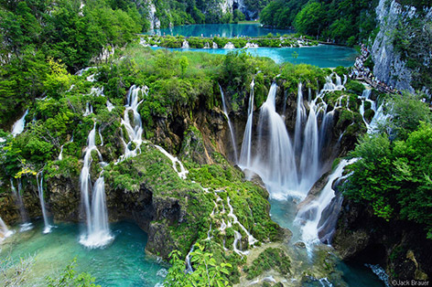
Croatia

Slide 5
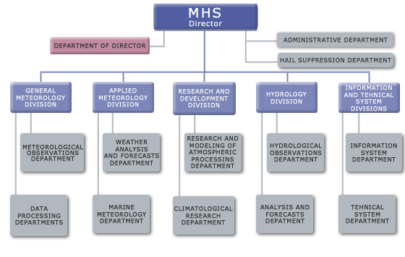
DHMZ
DHMZ – Croatian Hydrological and Meteorologica Service
  fundamental institution for meteorology and hydrology in Croatia
  founded by decree of Government of People’s Republic of Croatia (NRH) on 27th of August 1947
  the number of employees increased to reach a stuff of more than 440

Slide 6
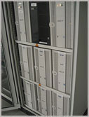
Croatia - supercomputers
Isabella – located at University Computing Centre (SRCE)
  100+2 servers
  352 CPU cores on compute nodes
  544 GB RAM memory
  8 TB local disk space
  additional disk space at main SRCE's disk space (SAN - Storage Area Network) with total capacity up to 40 TB

Slide 7
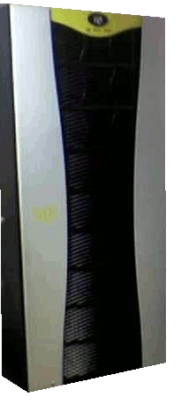
Croatia - supercomputers
Viking – located at DHMZ
  SGI Altix LSB-3700 BX2 Server
  48 Intel Itanium2 1.6GHz/6MB
  96 GB standard system memory, 2x146 GB/10Krpm SCSI disk drive
  OS SUSE Linux Enterprise Server 9 for IPF with SGI Package
  Intel Fortran & C++ compilers version 9.0.031
  Queuing system (PBS Pro)
  7 TB of storage place available and ongoing implementation of 30 TB of disk space

Slide 8
Supercomputing at DHMZ
Operational 72h forecast
Research activities:
  Data assimilation
  Case studies
  Climate model
  Chemical transport model
  Downscaling of ECMWF reanalysis

Slide 9
General information - NWP in Europe
At the moment there are 5+1 NWP Consortia in Europe:
  ALADIN- Aire Limitée Adaptation dynamique Développement InterNational (Algeria, Belgium, Bulgaria France, Morocco, Poland, Portugal, Tunisia, Turkey)
  COSMO- COnsortium for Small-scale Modeling (Germany, Switzerland, Italy, Greece, Poland, Romania)
  HIRLAM- HIgh Resolution Limited Area Model (Denmark, Estonia, Finland, Iceland, Ireland, The Netherlands, Norway, Spain, Sweden)
  UK Met Office
  ECMWF- European Consortium for global model
  RC-LACE- Regional Cooperation for Limited Area modeling in Central Europe (Austria, Croatia, Czech Republic, Hungary, Slovakia, Slovenia, Romania) => DHMZ (Croatia) is member of ALADIN and RC-LACE Consortiums
Notes:
RC-LACE is a part of ALADIN Consortium, status of RC-LACE is specific because significant part of the model development and research work are done bye scientists from RC‑LACE countries in Méteo-Francé or in home institutes.

Slide 10
About models in ALADIN World
ARPEGE – global spectral model
ALADIN – NH/H regional NWP model developed for scale ~ 10 km
Mezo-NH – NH mesoscale atmospheric model of the French research community
AROME – NH mesoscale NWP model with advanced physics for nowcasting and very short range forecasting. Dynamical kernel – NH ALADIN and physical parameterization package of the Meso-NH for ~2 km resolution
ALARO (is not a model) – improved version of ALADIN: new radiation scheme, horizontal diffusion, microphysics, TKE; mostly developed by RC-LACE

Slide 11
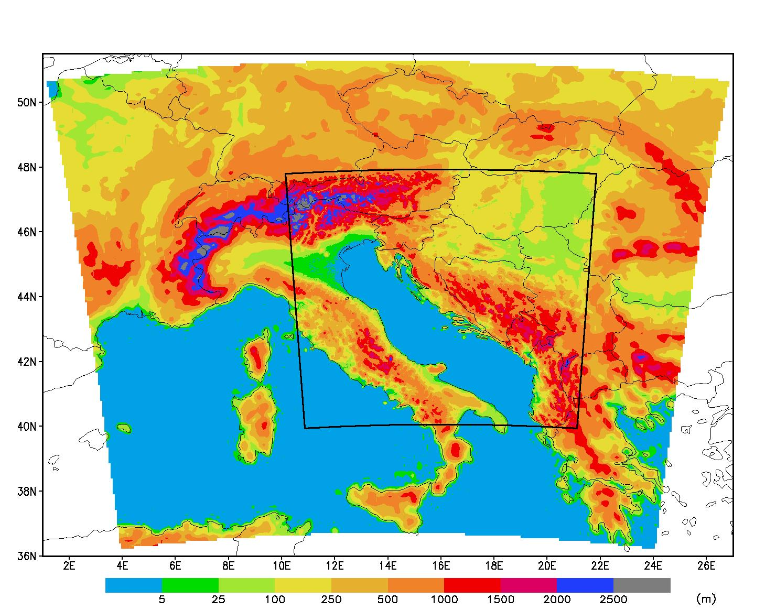
Operational forecast
LBC – ARPEGE (global model); runs at Meteo-France
ALARO – regional model
  8km horizontal resolution
  hydrostatic
  37 levels
  (229x205) 240x216 grid points
  72 hour forecast;1-3 hourly output
DADA – dynamical adaptation
  10m wind forecast, 450x450gp, 15 levels (lowest 17m) below 1km

Slide 12
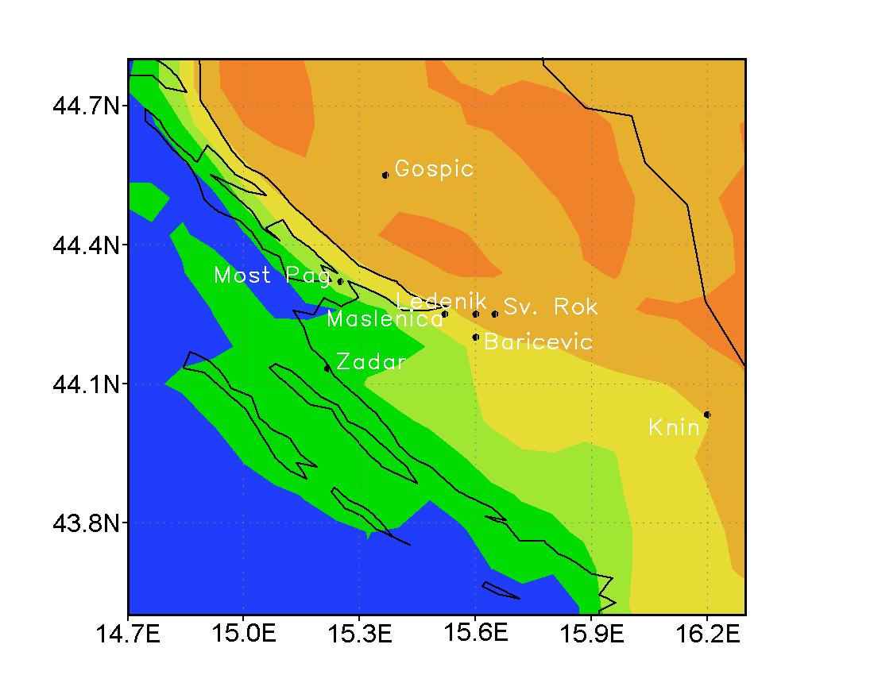
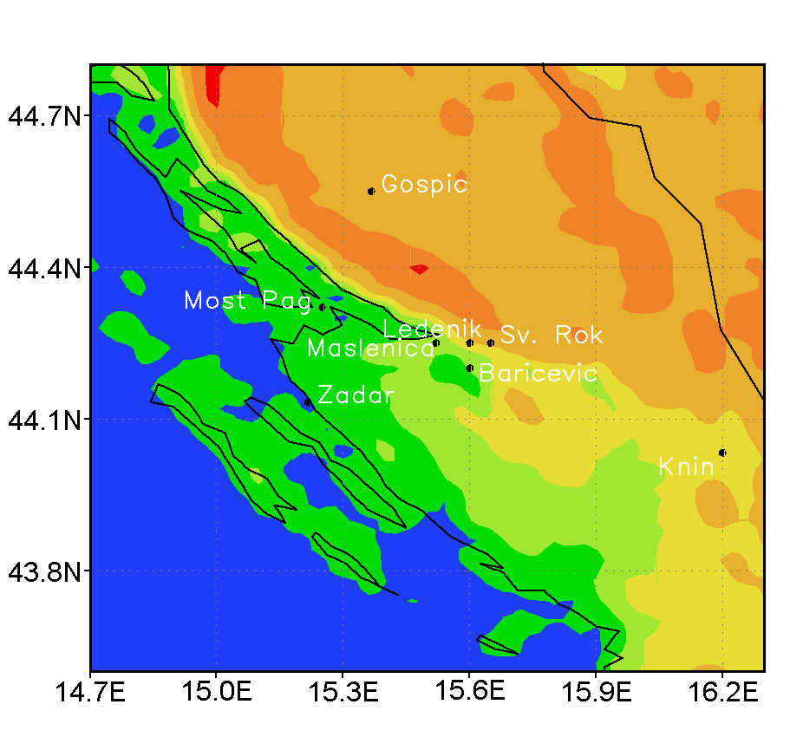
DADA
To make integration with smaller number of levels and only part of physical parameterizations (vertical diffusion and influence of gravity waves) to adjust flow to better orography until quasi stationary state
Notes:
Ako zelimo povecati horizontalnu razluciviost t(num stabilnost) reba smanjiti vremenski korak i treba povecati vertikalnu rezoluciju-s istom fizikom 8x dulje vrijeme integracije
Radi se do 30 timestepova unaprijed. Timestep je 1min. Operativno je 5-6 min.

Slide 13
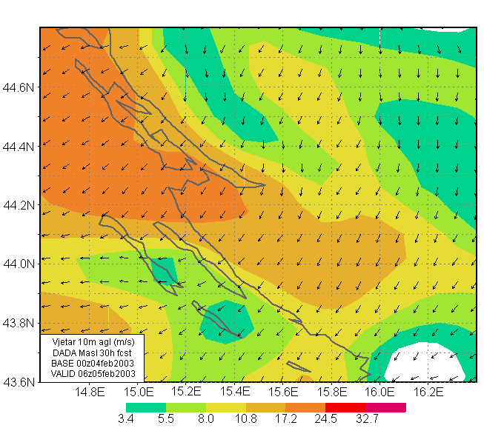
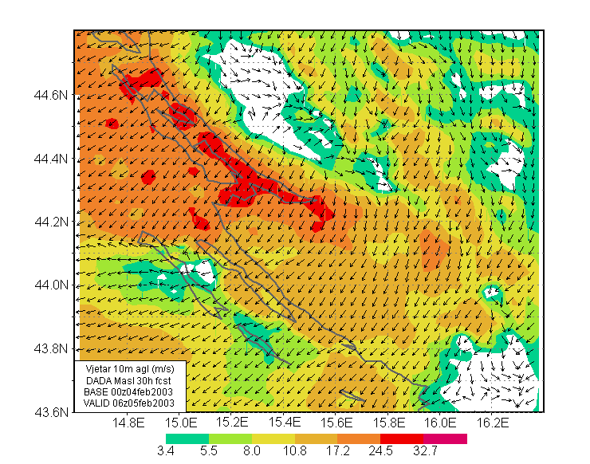
DADA
More details in flow (stronger flow behind mountain Velebit)

Slide 14
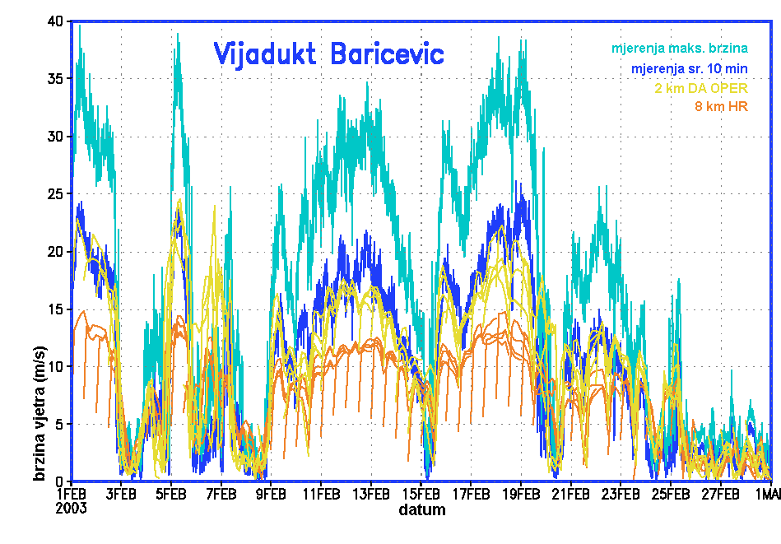
DADA
Comparison with measurements

Slide 15
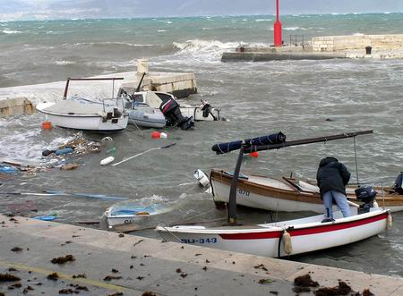
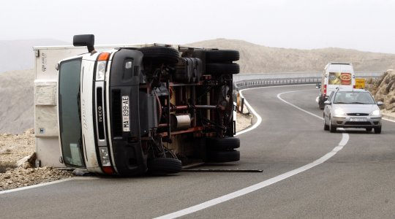
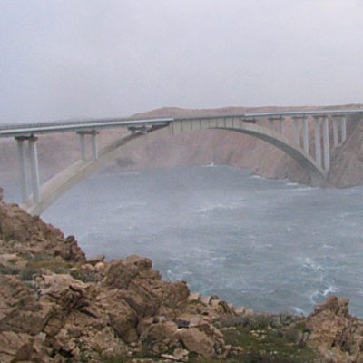
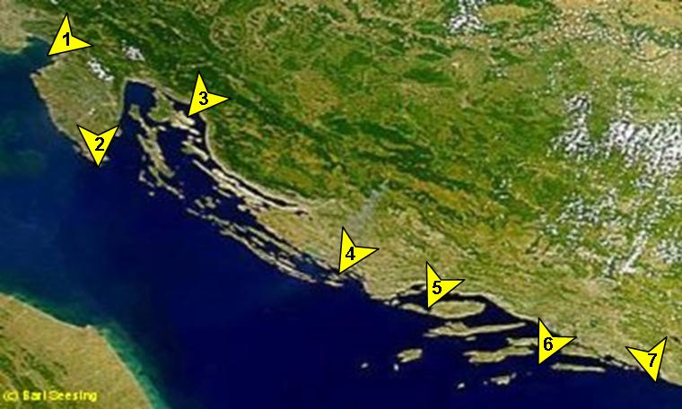
Bura

Slide 16
Operational forecast
Operational production (00 and 12 UTC):
  Downloading of LBC files (ARPEGE)
  Interpolation of fields to finer resolution
  ALARO Integration
  Visualization of meteorological fields: surface charts, pressure levels charts and vertical cross-sections (in time and space)
  Change of the resolution 8 to 2 km
  DADA - Adaptation of the wind field (Integration) at 2 km
  Visualization of the 2 km resolution wind field forecast

Slide 17
Operational forecast
Top time consuming applications on supercomputer Viking
  Downloading of the LBC files ~ 30 minutes (done at 03:25 and 15:00 UTC)
  Integration at 8 km (20 processors) ~ 40 minutes (done at 03:40 and 15:20 UTC),
  Dynamical Adaptation of the wind field (Integration) at 2 km with 3 hrs time resolution (20 processors) (done at 04:25 and 16:00 UTC)
  Continuation of the Dynamical adaptation for 1 hr time resolution (extra 1 hour done at 05:25 or 17:00)
  For operational usage most of the time less than 5 hours per day is sufficient.

Slide 18
ALARO
Most important public users
  Air traffic control – HKZP
  Military – MORH
  National Protection and Rescue Directorate -112- DUZS
  Forecast department in DHMZ
  Hail protection department in DHMZ
  Forest fire forecast for DHMZ
  Road authorities- HC wind fcst
  Electrical company- HEP
  Nuclear Safety Agency- DZNS
  TV’s- public & private
  Mobile phone providers
  Internet- free public forecasts

Slide 19
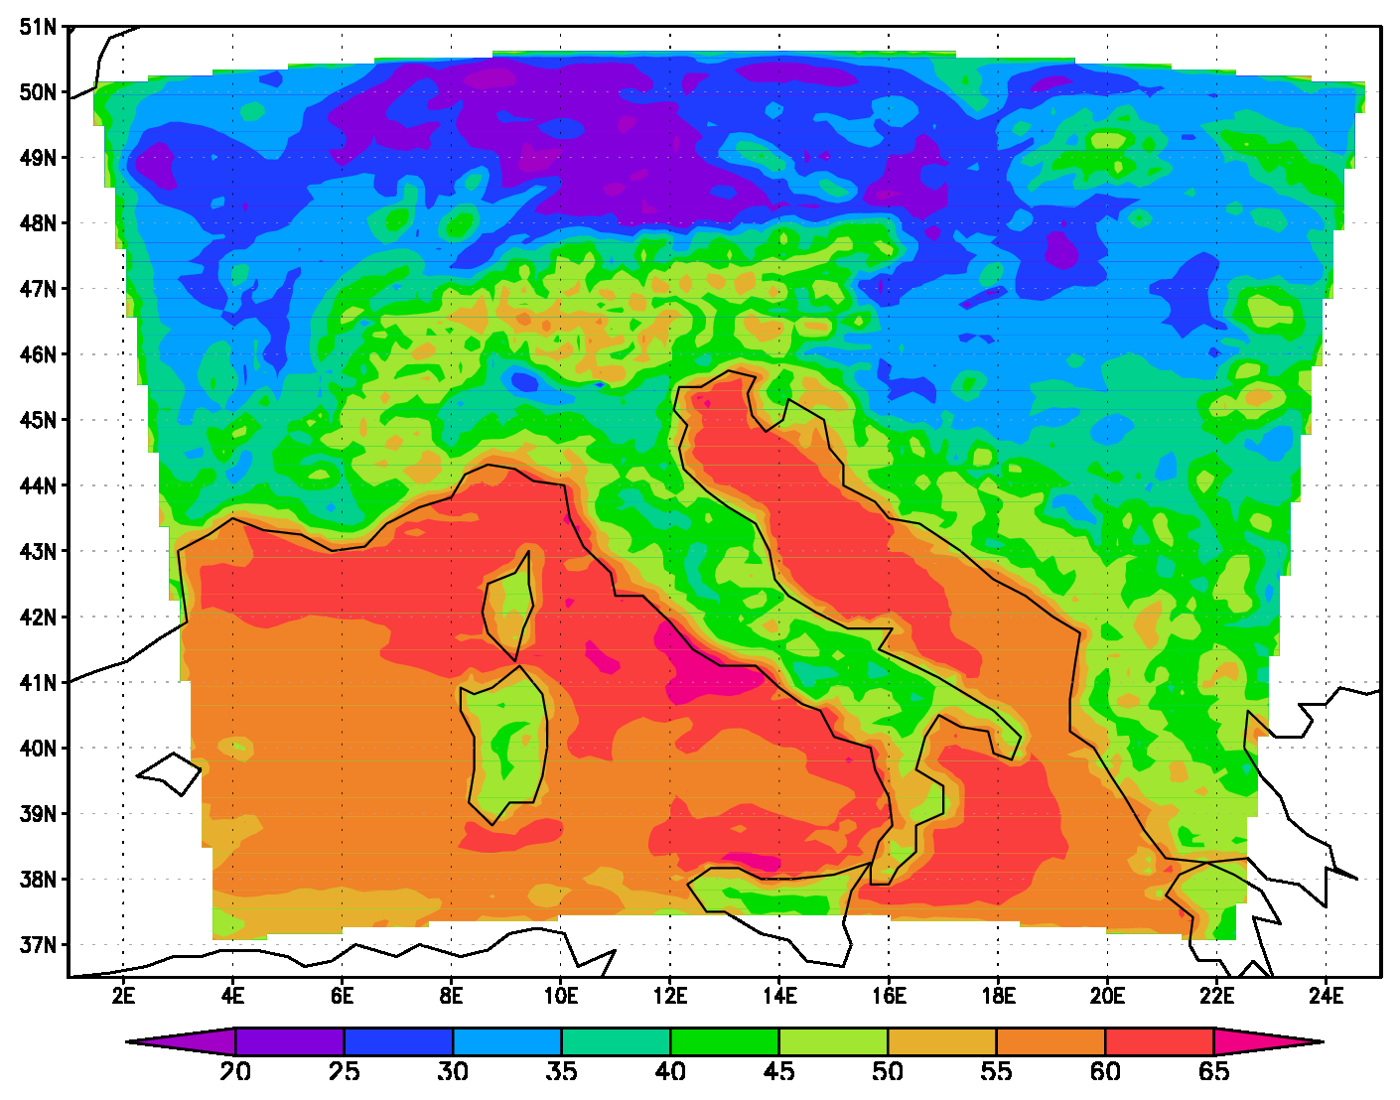
Research: EMEP4HR
The Unified EMEP model is coupled to ALARO meteorological output and run on 10km resolution.
This model setup called EMEP4HR is used for air quality studies in DHMZ
Monthly maximum surface ozone fields (in PPBV) for May

Slide 20
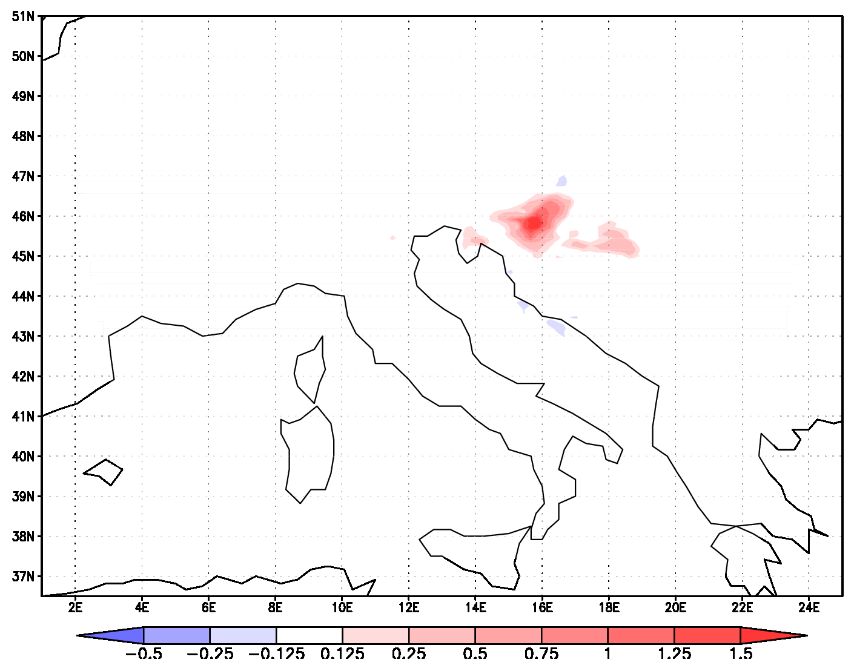
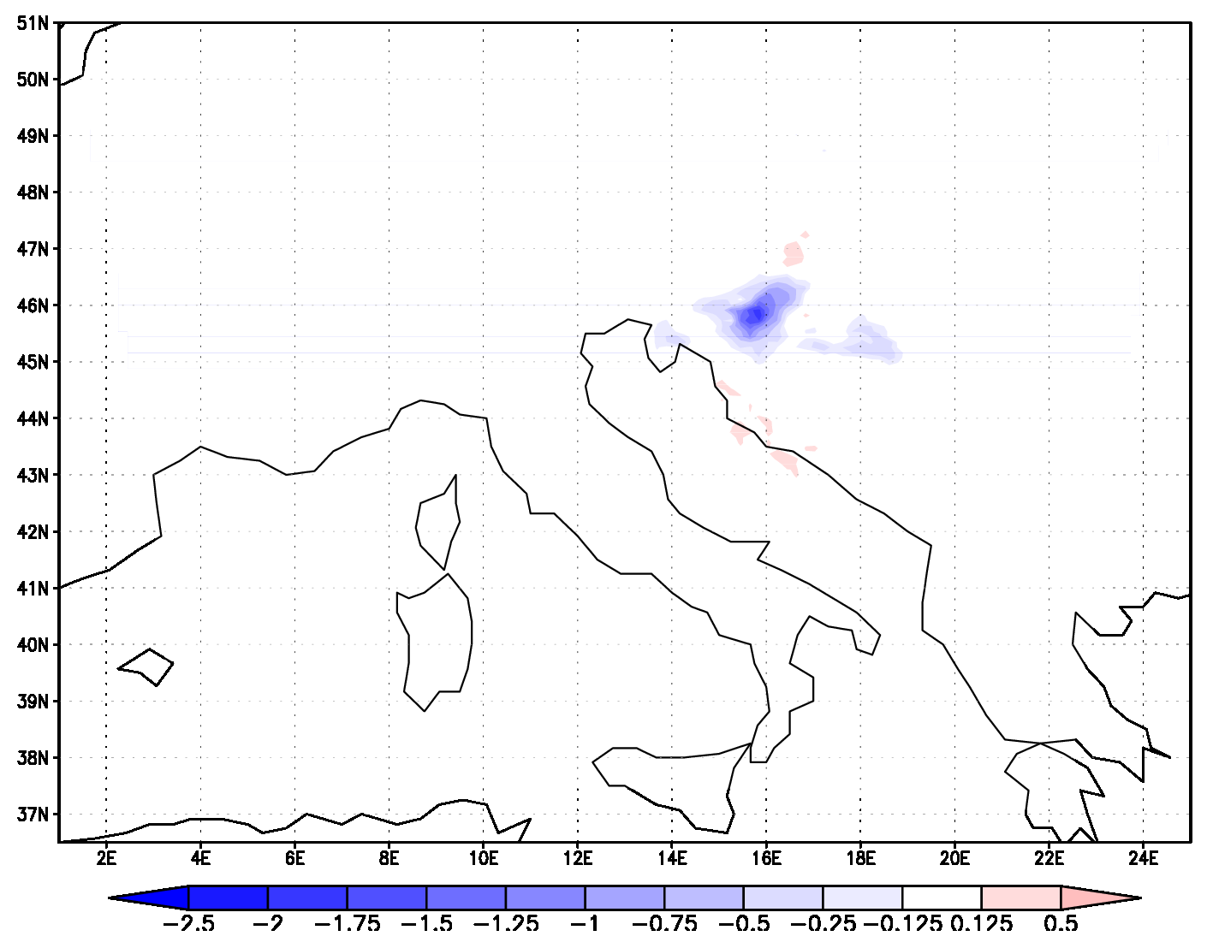
EMEP4HR
Example: Part of a study made to determine the influence of industrial and traffic emissions on ozone
Relative effects of 15% increase(left) and 15% decrease(right) of traffic based NOx and VOC emissions.
In the first case maximum ozone is increased while in the other it is decreased by approximately 1% in the area with very high traffic emissions. This study is made for the purposes of the Ministry of construction and environment of Croatia.

Slide 21
Research: Data assimilation
3DVar data assimilation for upper air fields and OI for surface fields in ALARO model
  Observations used: Synop, Temp, Aircraft, AMV, Wind profiler, Satellite (ATOVS AMSU-A,B,HIRS(NOAA), SEVIRI)
  External observation preprocessing - Hungary
  Local set up of assimilation cycling and production

Slide 22
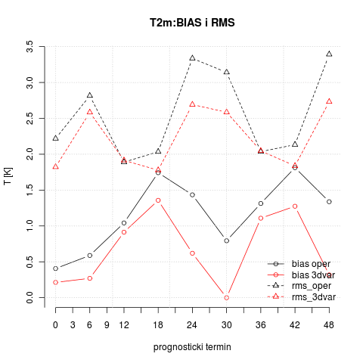
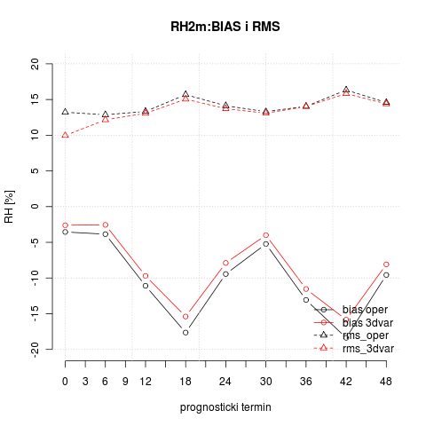
Research: Data assimilation
Statistics for operational (oper) and production from 3dvar (3dvar) calculated against synop and temp observations (2m fields)

Slide 23
Plans and needs
Plans (Research and Development Division):
  Turn on more sophisticated physical package already available for ALARO
  Operational assimilation
  Increase number of vertical levels
  Increase horizontal resolution
  Assimilate more data
Needs:
  More CPU power
  More storage place

Slide 24
OU - DHMZ collaboration
Contract between University of Oklahoma (OU) and Meteorological and Hydrological Service of Croatia (DHMZ) on Feasibility Study for the Meteorological and Hydrological Service Modernization Project in the Republic of Croatia
Optimize the overall HydroMet system modernization plan in Croatia
Study Team:
  Primary Authors: Dr. Keith A. Brewster, Dr. Kenneth C. Crawford, Mr. James E. Hocker, Dr.Renee A. McPherson, Mr. William G. McPherson Jr., Ms. Kodi L. Nemunaitis, Dr. MarijanaSumpor, and Dr. Daniel Sutter
  Contributors: Ms. Kara Bolognini, Mr. Donald W. Burgess, Dr. Boon Leng Cheong, Mr. Leslie R. Lemon, Dr. Donald R. MacGorman, Mr. Dale A. Morris, Mr. B. David Sherman, and Ms. Ellen J. Wardrop

Slide 25
OU - DHMZ collaboration
Some recommendations from Study Team:
  Establish DHMZ headquarters of weather and water research and operations in a modern, high-technology facility
  Significantly enhance the DHMZ IT infrastructure
  Modernize and expand the DHMZ network of Doppler radars
  Establish an integrated surface observing network for weather, water, and climate observing that provides high-quality data in real-time
  Establish a verification unit to demonstrate the ski( of modernized operations and to identify new opportunities for research and development
  Invest in the workforce to operate and thrive in a modernized DHMZ by providing positions for highly educated professionals, a salary structure appropriate for a highly educated and technology-driven workforce, and intensive instructional programs to re-educate the workforce

