Slide 1

Title Slide
Department of Defense
High Performance Computing Modernization Program
The Promise and Challenges of Computational Science and Engineering
Douglass Post, Chief Scientist, DoD HPCMP
University of Oklahoma
7 October 2009
www.hpcmo.hpc.mil, post@hpcmo.hpc.mil

Slide 2
Overview
High Performance Computing for Science and Engineering
  The Progress and The Promise
  The Challenges and The Opportunities
Some examples
  Goodyear
  CREATE

Slide 3

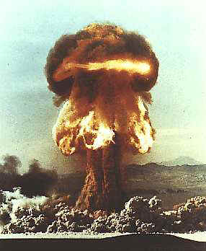
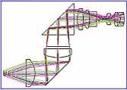
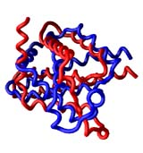
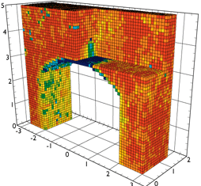
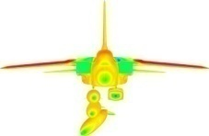

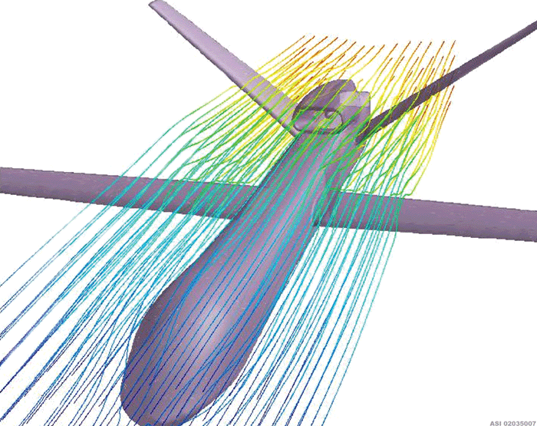
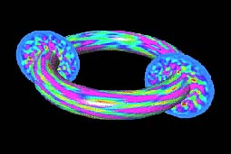
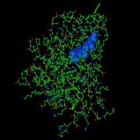

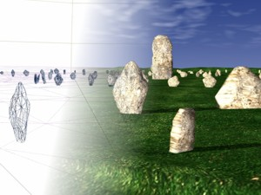

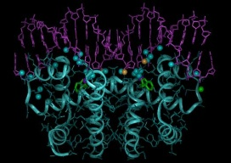
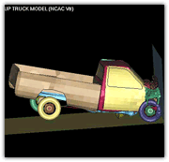

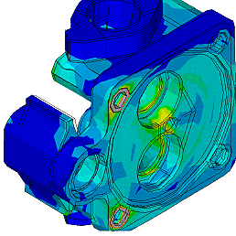
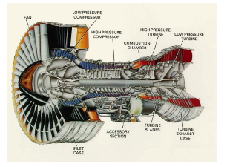
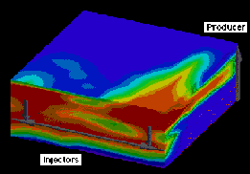
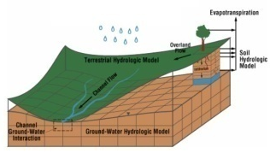
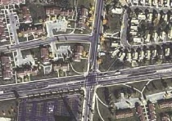

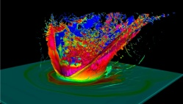
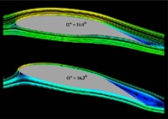

Computational Science And Engineering Is Becoming an Essential Tool for Theoretical Science And Engineering
Accelerator Design
Aircraft Design
Archaeology
Armor Design
Astrophysics
Atomic And Molecular Physics
Automobile Design
Bioengineering And Biophysics
Bioinfomatics
Chemistry
Civil Engineering
Climate Prediction
Computational Biology
Computational Fluid Dynamics
Cosmology
Cryptography
Data Mining
Drug discovery
Earthquakes
Economics
Engineering Design And Analysis
Finance
Fluid Mechanics
Forces Modeling And Simulation
Fracture Analysis
General Relativity Theory
Genetics
Geophysics
Groundwater And Contaminant Flow
High Energy Physics Research
Hydrology
Image Processing
Inertial Confinement Fusion
Integrated Circuit Chip Design
Magnetic Fusion Energy
Manufacturing
Materials Science
Medicine
Microtomography
Nanotechnology And Nanoscience
Nuclear Reactor Design And Safety
Nuclear Weapons
Ocean Systems
Petroleum Field Analysis And Prediction
Optics and Optical Design
Political Science
Protein Folding
Radar signature and antenna analysis
Radiation Damage
Satellite Image Processing
Scientific Databases
Search Engines
Shock Hydrodynamics
Signal Processing
Space Weather
Volcanoes
Weather Prediction
Wild Fire Analysis

Slide 4
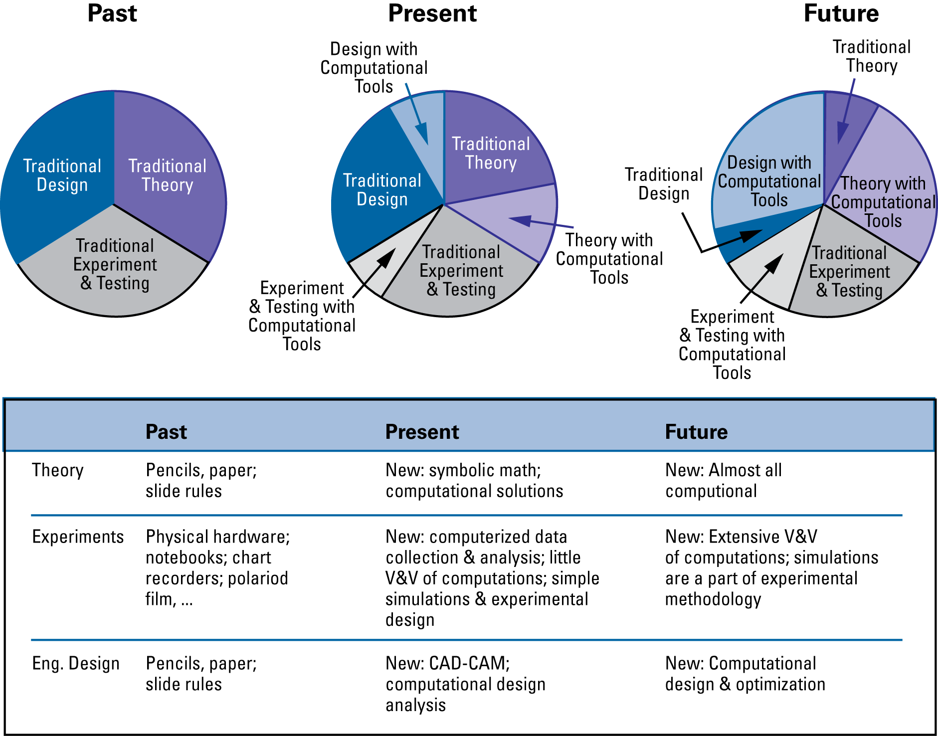
Computational Tools Are Becoming “Tools of the Trade” In Science And Engineering
Notes:
When I started at my first job at a national laboratory, I had to bring my slide rule. It was a tool of the trade, and it was my responsibility as a physicist to own one.

Slide 5
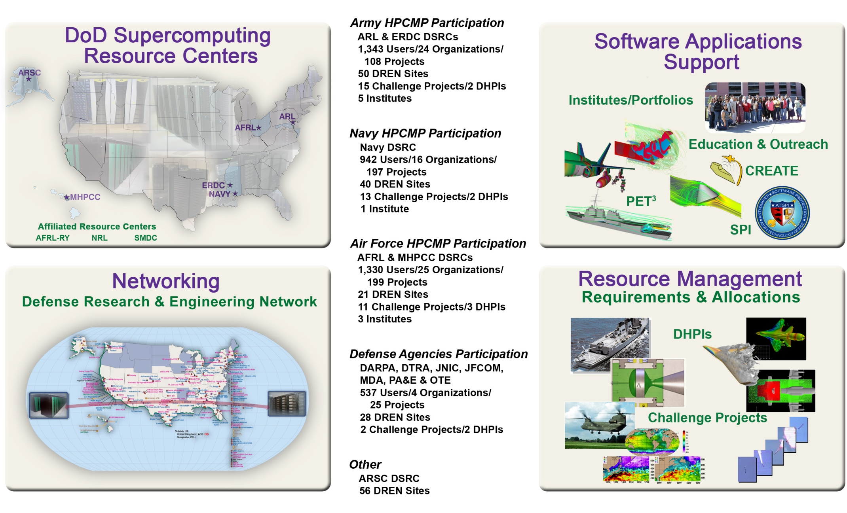
DoD HPC Modernization Program
Comparable capability at several other government agencies
90,000 processors &
900 TFLOPS
19 HPCs at 6 centers

Slide 6
Next Generation Computers Offer Society Unparalleled Power to Address Important Problems
Next generation computers (2020) will enable us to develop and deploy codes that are much more powerful than present tools:
  Utilize accurate solution methods
  Include all the effects we know to be important
  Model a complete system
  Complete parameter surveys in hours rather than days to weeks to months
In ~ 10 years, workstations will be as powerful as today’s supercomputers
Greatest opportunities for 2020 (and 2010) include large-scale codes that integrate many multi-scale effects to model a complete system
Computing Power For The World's Fastest Computer
Floating Point Operations/s)
10⁸
10⁶
Supercomputers
10⁴
Performance (GFLOP/s)
100
Cores
1
0.01
Workstation
Performance
0.0001
10⁻⁶
Moore’s “Law”
1940
1950
1960
1970
1980
1990
2000
2010
2020
Year

Slide 7
Physics-based Computational Engineering has great opportunities!
Computational Science won’t grow exponentially
  Everyone involved in theoretical physics, theoretical chemistry, theoretical material science, etc. already use supercomputers
Physics-based Computation Based Engineering—New frontier
  Only a small fraction of engineers now use Computation Based Engineering (CE)
Replace physical design-build-test iterations with computational “Design Through Analysis” , i.e. CAD-mesh-analyze iterations validated with a final physical test

Slide 8
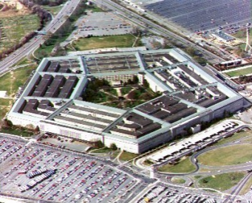
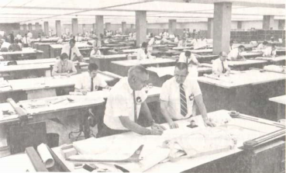

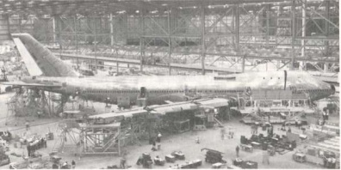
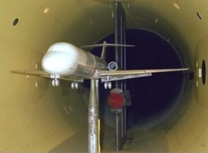

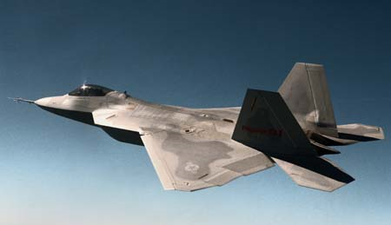
Design-build-test describes many product cycles
Requirements
Design
Build
Physical Product
Test
Physical Product
Market
(Many) Design iterations
F-22 Flight Test
Requires many lengthy and expensive design/build/test iteration loops
Process converges slowly, if at all
Design flaws discovered late in process
→ Long time to market

Slide 9



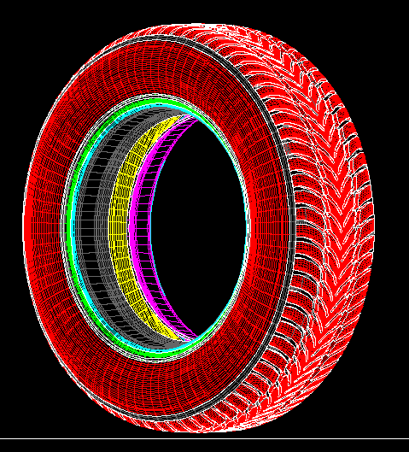

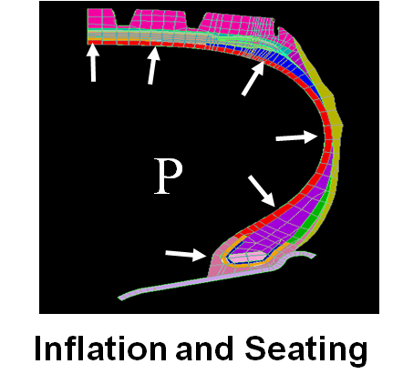
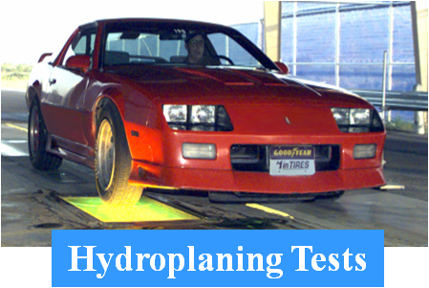
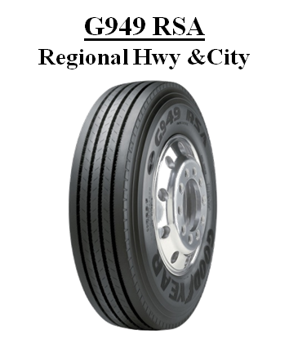

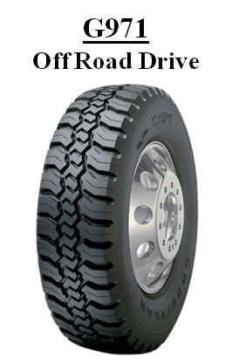
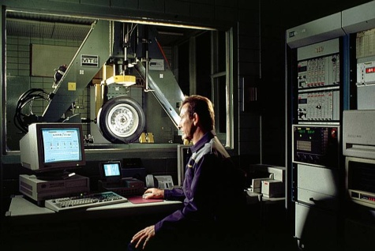
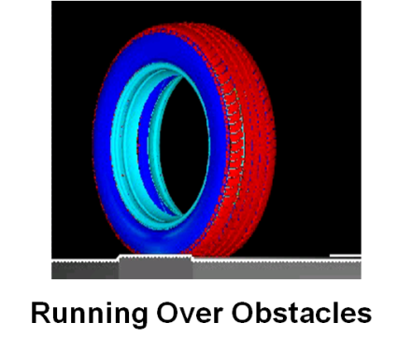
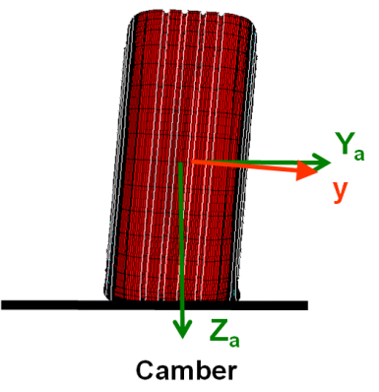
Replace physical design-build-test with computational design-build-test
Requirements
Design and Build Virtual Product
Analyze and Test
Virtual Product
Build and Test
Physical Product
Market
Reduced time to market from 3 years to 9 months
Increased new products delivery from 1 every 3 years to 5 per year
Saved the company
Design iterations

Slide 10
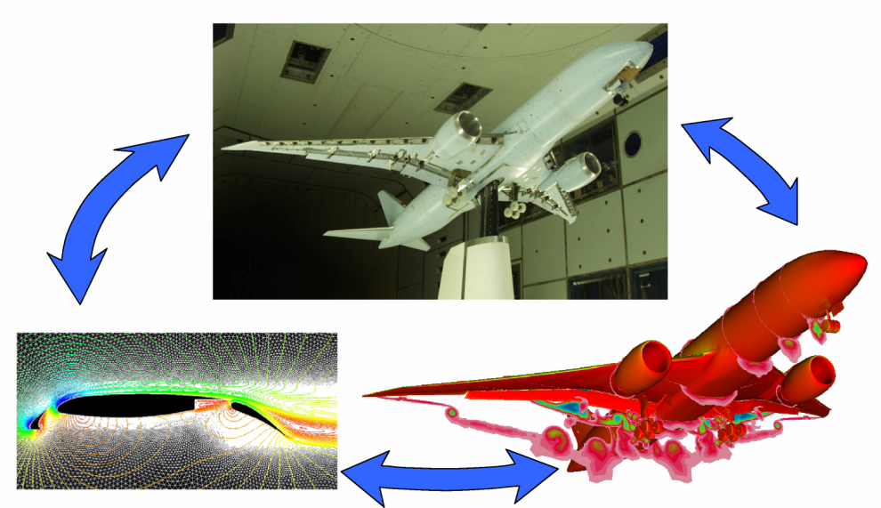
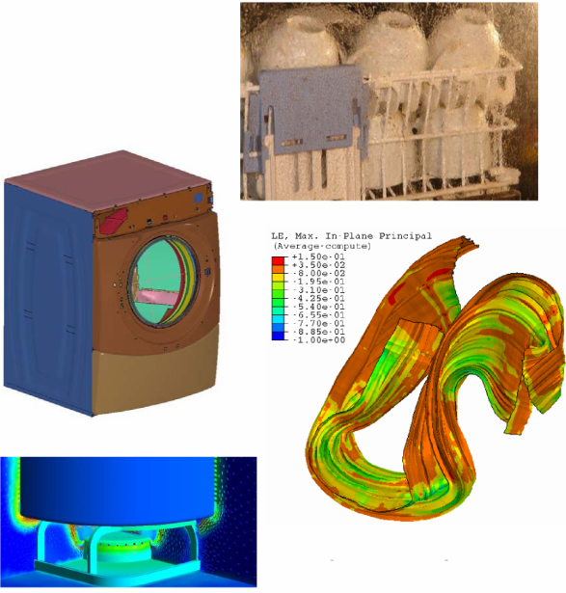
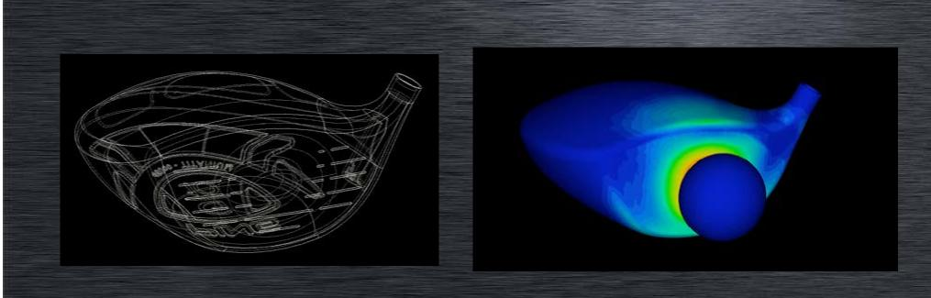
Industry Beginning to Replace Physical Design-build-test With Computational Design Through Analysis: “CAD→Mesh→Analyze”
Boeing-New 747, 20% improvement lift/drag, 787 better, quieter
Whirlpool designs washers, stoves, refrigerators,….
Proctor and Gamble uses CE extensively
Ping Golf
Auto industry…..
Boeing 787
Golf Clubs (and golf balls)
Whirlpool

Slide 11



Physics-based Computational Engineering helped the US build nuclear weapons and win the cold war.
Testing
Computer Power
Computational
Design
Weapon Capability
Nuclear weapons are complex, expensive, and hard to test
  ~ 5 to 10 tests per system
DOE NNSA uses computational tools for:
  Design development, optimization, & analysis.
DOE NNSA labs own the biggest supercomputers
1,000,000
GigaFlops/s
2010
Improved safety
Improved robustness
NIF
Improved yield
to weight
Increasing
Computational Design
Capability
Improvements over time:
Solution methods
Spatial resolution
Temporal resolution
Geometric fidelity
  1-D to 2-D to 3-D
Physics models
…….
MIRV
(even lighter,
smaller)
Test ban
SLBM
(even lighter,
smaller)
Underground
ICBM
(Lighter,smaller)
Heavy
Hydrogen
Bombs
0.000000001
GigaFlops/s
Air Tests
1945
Atomic Bombs

Slide 12
CSE and CE are very different, and CE has different challenges
Computational Science and Engineering (CSE) is challenging:
Develop a complex code, apply it to study a scientific research problem, and publish the findings.
Physics-Based Computational Engineering (CE)has different challenges:
Develop a complex code, and support its use by other groups
CSE
Developers
Develop
Code
CSE
Developers
Code
Use
CSE
Developers
Results &
Analysis
Journals
Design
Engineers
Test &
Evaluation
Operations
Test Fails
Develop
Code
Code
Use
Build Model
Test
Model
Build
System
Comp Eng
Developers
Model
Builders
Manufacturers
Notes:
New slide
CREATE: The Opportunities and Challenges
Douglass Post for The CREATE Team
Chief Scientist & CREATE Program Manager, DoD HPCMP
HPC Users’ Forum, Norfolk, VA April 14, 2008

Slide 13
It Takes A Village!
Sponsors → Provide mission, resources and support
    Designers—End-users
    → Engineers to use the tools to design products
      Codes
      → Takes a good team ~ 10 years and ~ $100M to develop a complex code
      V&V
      → Dedicated experiments and tests
      Computers
      → Capability to develop codes and run the problems quickly and conveniently

Slide 14
What are the challenges?
What can we do about them?
At Least Four Challenges arise from Complexity → Cope with it.
Complex physics and engineering
  Integrated modules, scalable algorithms, best practices, V&V
Complex computers and computer architectures
  Multidisciplinary teams; good tools, design, practices, V&V
Complex customer organizations and culture
  Connect with stakeholders, deliver products early and continually during life of program, design for whole life cycle
Complex Development Organizations → “Code development will no be longer a cottage industry!”—Brendan Godfrey, AFOSR
  Big codes require explicit funding for code development→ large funding brings lots of management attention, oversight, reporting and guidance, whether it helps or not!
Notes:
We understand our risks and are addressing them.

Slide 15


Computational Engineering Code Developer’s World – Six Major Challenges and Risks
Many strongly coupled effects and massively parallel computers
Zillions of complex processors linked with complicated and slow networks + Little help for dealing with this complexity
Complex
Science and
Mathematics
Large, multi-disciplinary, multi-institutional teams
Complex
Computer
Architectures
And Inadequate Tools
Complex
Organizations
Code
Development
Computer security and high fuel costs pose major barriers
Lengthy Problem Setup
Science &
User Driven
Requirements
Problem setup (e.g. mesh generation) takes too long for rapid design development
Rudimentary
V&V
Methods
Laws of nature & end-user needs win every time
Immature methods and few validation experiments

Slide 16

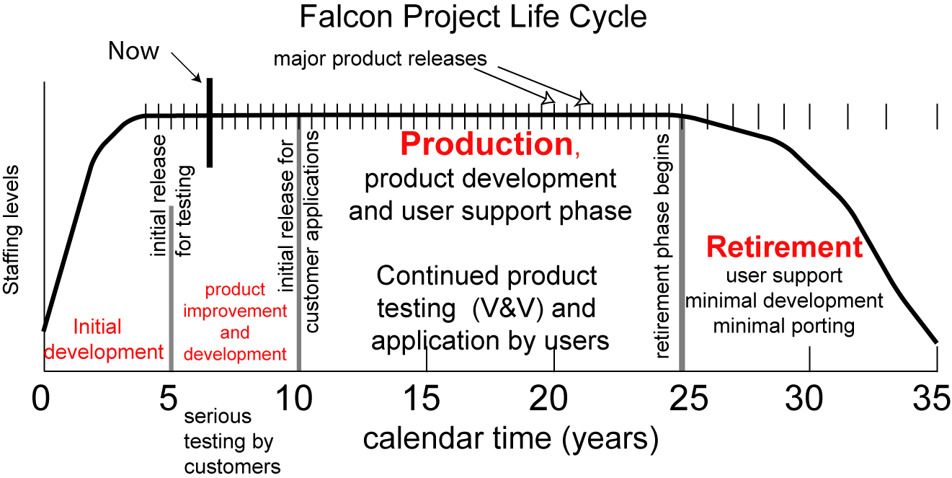
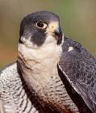

Developing a Large, Multi-scale, Multi-physics CE Code Takes a Large Team a Long Time
2003
~20
From: D. Post, R. Kendall and E. Whitney, “Case Study of the Falcon Code Project”, Proceedings of the Workshop on Software Engineering for High Performance Computing, International Conference on Software Engineering, May 15, 2005, St. Louis, Missouri.

Slide 17
CE Code Development Process is Complex
Not the WaterFall Model!
Optimize
Component
Initial
Analysis
Test
Component
Store
Results
Detailed
Goals
Optimize
runs
Execute
Runs
Requirements
Design
Code
Test
Run
Customer
input
Debug
Component
Schedule
Runs
Set global
Requirements
Identify
algorithms
Write
Component
Select
Programming
Model
Setup
Problems
Define
Goals
Formulate
questions
Develop
Approach
Develop
Code
V&V
Production
Runs
Analyze
Results
Decide;
Hypothesize
Identify
Customers
Define
tests
Complete
Run
Make
Decisions
Detailed
Design
Define
General
Approach
Verification
Tests
Document
Decisions
Analyze
Run
Recruit
Team
Regression
Tests
Identify
Next Run
Identify
Uncertainties
Identify
Models
Computing
environment
Validation
Expts.
Upgrade existing code or develop new code
Validation
Tests
Identify
Next Step
Formulate
questions
Develop
Approach
―D. E. Post, R. P. Kendall, Large-Scale Computational Scientific and Engineering Project Development and Production Workflows, CTWatch (2006), vol.2-4B,pp68-76.
17
10/7/2009

Slide 18






Computational Engineering Code Development is Risky!
Code Project Schedule For Six Large-scale Physics-based CBE Codes
Program Milestones Set
Milestones
Program Planning And Start
1st
2nd
3rd
New Code Projects
Launched
1992 — 1995
1996
1997
1998
1999
2000
2001
2004
Milestone Successes
Egret Code Project
Project Successes — 2004
Jabiru Code Project
Falcon Code Project
Kite Code Project
Finch Code Project
Missed Milestones
Gull Code Project
Project Work
Ceased
Project Start
*Computational Science Demands A New Paradigm, D. E. Post, L. G. Votta, Physics Today, 2005, 58 (1): P.35-41

Slide 19
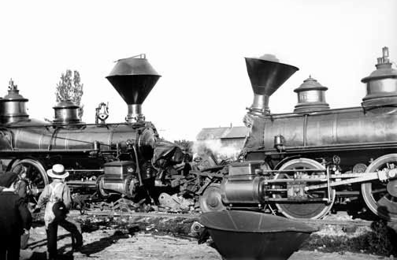
Another Perspective---Three Challenges
Performance, Programming and Prediction
Performance Challenge - Computers power increasing through growing complexity
  Massive parallelization, multi-core & heterogeneous (CELL, FPGA, GPU…) processors, complex memory hierarchies…..
Programming Challenge -Program Massively Parallel Computers
  Rapid code development of codes with good performance
Prediction Challenge —Developing predictive codes with complex scientific models
  Develop accurate predictive codes
    Verification
    Validation
    Code Project Management
Train wreck coming between the last two
Better software development and production tools are desperately needed for us to take full advantage of computers
Programming
Prediction
Hubbard, OR in 1902

Slide 20
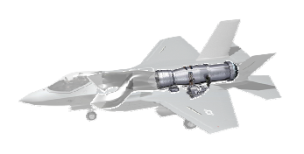

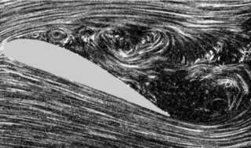
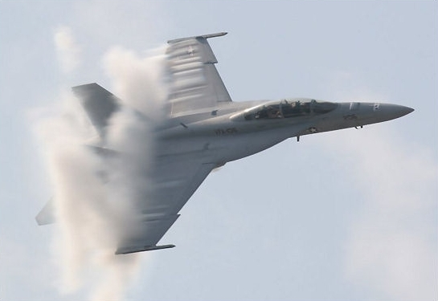
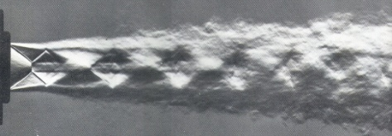
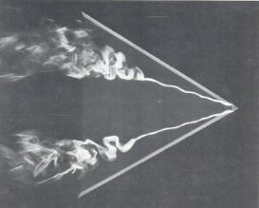


Multi-Disciplinary Optimization Challenge → Integrate Many Multi-Scale Physics Effects
Many different physics elements govern aircraft behavior
Turbulent CFD, structural layout, structural mechanics, flight control, structural layout, signatures, sensor design and integration, materials strength, response, crack propagation…..
Propulsion—CFD, Thermal transport, Structural Mechanics, Combustion,…
Turbulence
Separation
Aero-structure interaction
Jets
Vortices
Wakes
Shocks

Slide 21
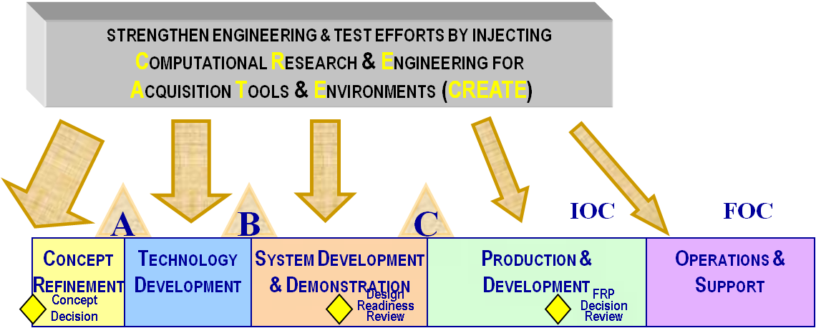
Computational Research and Engineering Acquisition Tools and Environments (CREATE)
CREATE goal is to enable major improvements in the DoD acquisition process
  Replace design paradigm based on historical data and experimental testing with physics-based computational design validated with experimental testing
  Detect and fix design flaws early in the design process
  Develop optimized designs for new concepts
  Begin system integration earlier in the acquisition process
  Increase acquisition program flexibility and agility to respond to rapidly changing requirements
  Enhance the productivity of the DoD engineering workforce
  Establish DoD capability to develop and Deploy these tools
Physics
Physics
Physics
Physics
Physics
Physics
Notes:
What are we trying to do
The goal of CREATE is to enable major improvements in DoD acquisition engineering design and analysis processes by developing and deploying scalable physics-based computational engineering software products.
Objective 1: Replace empirical design based on historical data and experimental testing with physics-based computational design validated with experimental testing
Objective 2: Detect and fix design flaws early in the design process before major schedule and budget commitments are made
Objective 3: Develop optimized designs for new concepts
Objective 4: Begin system integration earlier in the acquisition process
Objective 5: Increase acquisition program flexibility and agility to respond to rapidly changing requirements
Objective 6: Enhance the productivity of the DoD engineering workforce
Objective 7: Establish an organic capability to develop and deploy physics-based computational engineering software within the DOD

Slide 22
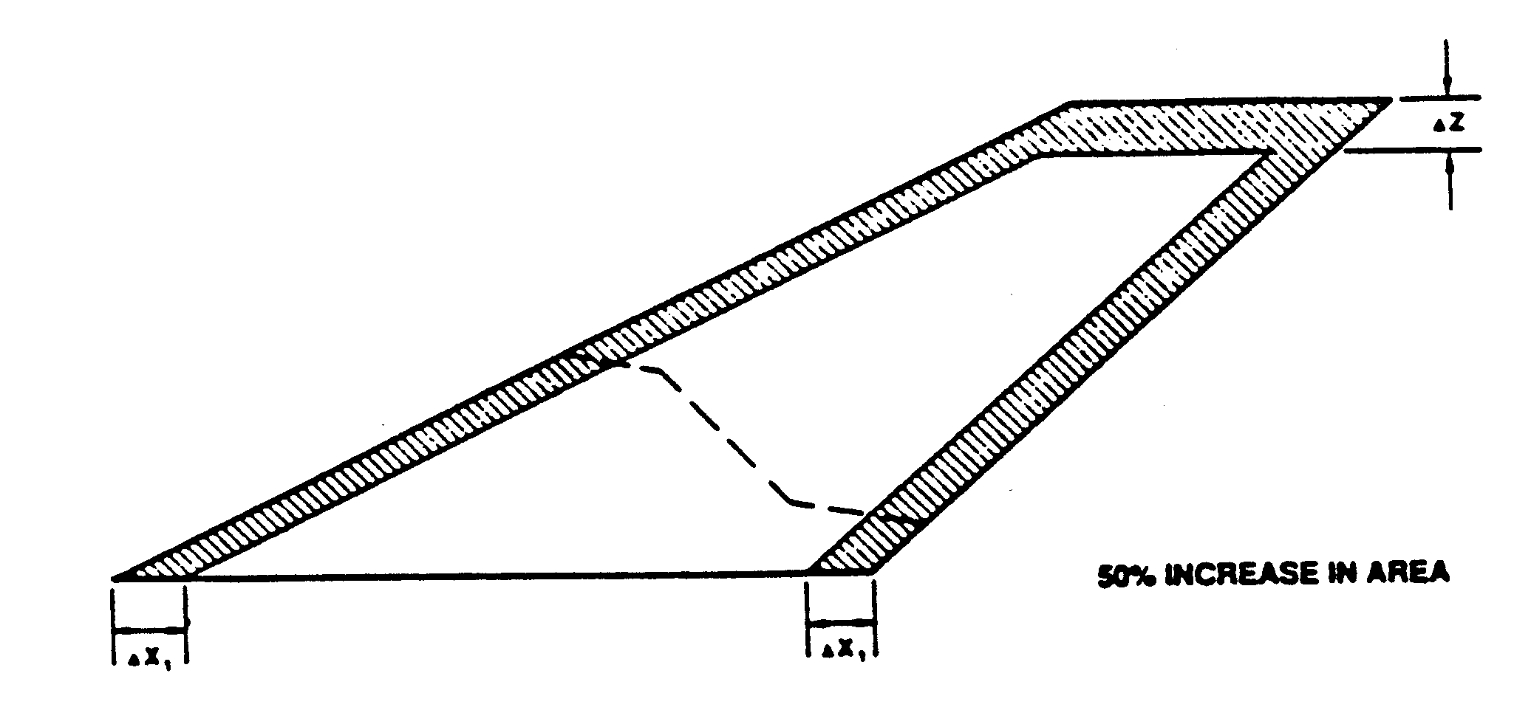
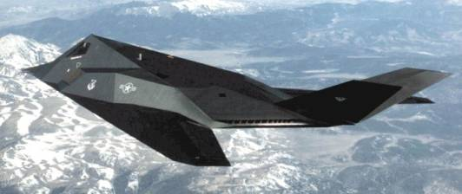
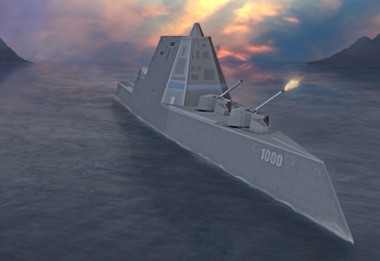
Acquisition Challenge Examples
Fighters– Vertical Tail Size; Ships-Capsize Stability
F-100, F102, F-105, F7U, F11F, F-16, F117
All Needed to increase tail fin size between 25% to 50% after initial design
F-117
  Defense News 04/02/07
  “Is New U.S. Destroyer Unstable?”
  Lesson Learned: Can’t base radically new designs on historical experience, it’s not a good guide
  Need physics-based design tools to extrapolate
Notes:
Getting the vertical tail size correct on the first try has been a challenge for over 50 years.
Most of the Century Series fighters suffered from roll coupling brought on by a combination of high rates of roll and insufficient stability to counter the resultant buildup in alpha and beta. Enlarging the vertical tails was the most common and successful solution.
Early tests of the “Have Blue” stealth prototype with its inward canted vertical tails proved unsatisfactory, so outward canted tails were selected for the F-117A. Even so, on the first flight of the F-117A (6/18/81), directional stability and control were both found to be far less than predicted, so the tails were increased in size by 50%. Dick Abrams, head of flight test at Lockheed, stated that “the same mistake wasn’t made on the YF-22”. On the YF-22, several methods were used to predict the required vertical tail size and the largest value was used with an additional safety factor included. No problems were encountered during flight test and the tail size for the proposed production configuration was actually decreased in size from the prototype.

Slide 23

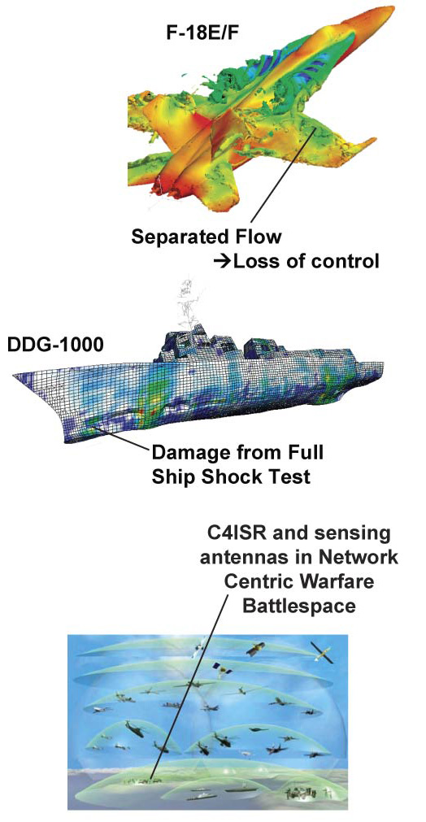
Computational Research and Engineering Acquisition Tools and Environments
$360M 12-year program to develop & deploy 3 computational engineering tool sets for acquisition engineers
Air Vehicle design tools: Aerodynamics, air frame, propulsion, control, early rapid design
Ship design tools: Early-stage design, shock damage and hydrodynamics performance
RF Antenna design tools: RF Antenna performance and integration with platforms
  Geometry and Mesh Generation

Slide 24
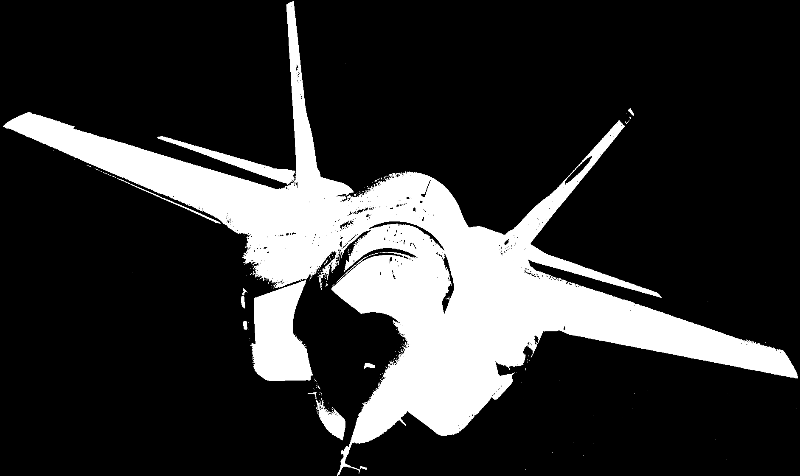





CREATE-AV
CREATE Air Vehicles Projects address major aircraft design challenges
0110 01010 1100100 01011100
Proposed Computational Engineering Software Products and Activity
DaVinci: Conceptual Design, next generation software to enable CSE insertion into early phase acquisition, advanced conceptual design, and virtual prototyping
KESTREL: Next generation high-fidelity multi-physics simulation for FIXED-WING air vehicles
HELIOS: Next generation high-fidelity multi-physics simulation for ROTARY-WING air vehicles
Firebolt: Next generation software to enable high-fidelity analysis of AIRFRAME/PROPULSION INTEGRATION
SHADOW-OPS: Primary mechanism to validate AV CSE software products and process changes to targeted acquisition workflows; transition CREATE-AV technology into acquisition workforce; and to build bridges between AV CSE software development teams and targeted acquisition organizations.
Technical & Development
Transition & V&V

Slide 25



CREATE-Ships Goal: Develop Optimized Total Warship Designs
Develop computational tools for:
Rapid Design Capability and Design Synthesis
  Rapid development, assessment, and integration of candidate ship designs to avoid cost versus capability mismatches
Ship Hydrodynamics
  Accelerate and improve all stages of ship hydrodynamic design
Ship Shock & Damage
  Provide analysis of shock and damage effects and reduce need for tests to assess ship shock and damage effects
FY03 OPNAV Sponsored Cruiser Concept
Notes:
New slide
CREATE: The Opportunities and Challenges
Douglass Post for The CREATE Team
Chief Scientist & CREATE Program Manager, DoD HPCMP
HPC Users’ Forum, Norfolk, VA April 14, 2008

Slide 26


CREATE-RF Tool Vision
Geometry Creation
Commercial CAD Tools
Mesh Generation
CREATE-MG
Boundary Condition & Material Specification
SENTRI / Pre-Processing
First-Order Codes
High-Fidelity Codes
Waveguides,
Infinite Periodic Structures,
Antenna Apertures in Ground Plane,
Small Antenna Systems
SENTRI / Workstation
Large Antennas,
Antennas on Platforms,
Antenna Interference
SENTRI / HPC
Near Field Imaging
SENTRI / Post-Processing

Slide 27


Mesh and Geometry Generation (MG) Project being launched
Problem Generation takes up to 90% of the calendar time
Every project needs geometry and mesh generation
Modeling and Geometry Interactive (MG) will provide the geometry and meshing tools needed by all the projects
C-130
X31
Notes:
New slide
CREATE: The Opportunities and Challenges
Douglass Post for The CREATE Team
Chief Scientist & CREATE Program Manager, DoD HPCMP
HPC Users’ Forum, Norfolk, VA April 14, 2008

Slide 28
Systems Engineering and Acquisition Approach: Begin With Prototype Codes and Replace Them With Next Generation Codes
Short Term Deliverables
Upgraded Existing Legacy Codes (Prototypes)
Concept Exploration and Demonstration
Long Term Deliverables:
Next Generation Codes For Next Generation Computers
Delivered Next Generation
Code Capability
Relative Code Development Effort
Knowledge
transfer
Users
1
4
Year
8
12
Transition Path Engages Customers
Enables Team to Track Customer Needs And Requirements
Yearly Product
Releases
1
2
3
4
5
6
7
8
9
10
11
Notes:
Systems Engineering Strategy,
Acquisition Strategy
Develop prototypes and build teams, conduct experiments with prototypes, use results to design and develop next generation codes for next generation computers
Annual releases ensure connection to customers, gather requirements, determine usability, track requirements,

Slide 29
CREATE Status
Project Teams formed
Requirements developed and validated
Initial plans developed and development started
First deliverables planned for this summer and fall (upgraded legacy codes)
Software Engineering Practices and Plans being formed
Six version 1.0 releases this calendar year

Slide 30
Our Community is Beginning to Work Out How to Develop Software
Software Engineering Practices
Goal is maintainable, extensible, portable and reliable software products
1. Requirements Management and Stakeholder Engagement
2. Software Quality Attributes
3. Design and Implementation
4. Software Configuration Management
5. Verification and Validation of CREATE Products
6. Software Release
7. Customer Support
Documents: Manuals: Technical, Developers, Users
Plans: Test, V&V, Risk, Development (EVMS), Financial, Management

Slide 31
You have an exciting future!!!!
Computational Science is revolutionizing scientific discovery
Physics-based Computationally engineering will revolutionize the way we design and build machines
You are coming in on the ground floor!!!!
Your generation has the computer skills and cultural orientation
You need only to acquire the subject matter skills, be fanatic about Verification and Validation and customer focus,
  and the world is yours

