Slide 1
Next Generation InfiniBand Clustering and Network Administration Tools
Brady Black
HPC Solutions Architect
QLogic Corporation

Slide 2
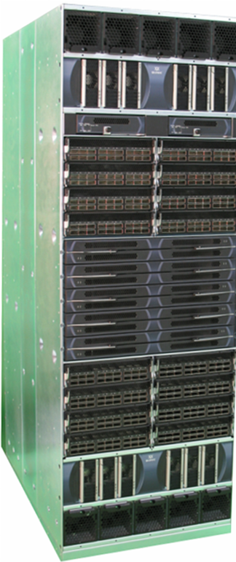
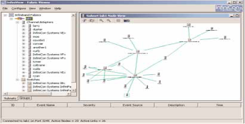

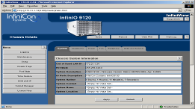

Agenda
Introduction
What is InfiniBand ‘IB’
QLogic Simplifying IB networking
  Deployment
  Administration

Slide 3










A Global Company
Headquarters
  Aliso Viejo, California
Products
  High Performance Networking for Storage & HPC
Employees
  Approx. 900
FY08 Revenue
  $597.9M
NASDAQ Symbol
  QLGC
Munich
London
Tokyo
United States
Dublin
Paris
Hong Kong
Beijing
Taipei
Guadalajara
Pune

Slide 4
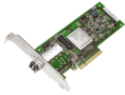
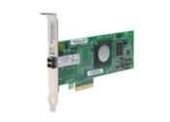

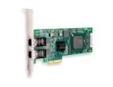

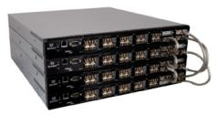
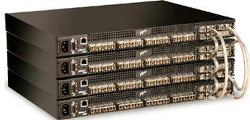











QLogic portfolio at Dell
Adapters
QLogic 2500 series
8Gb FC HBAs
Qlogic 2400 series
4Gb FC HBAs
Mezzanine Card
8Gb FC for Dell PowerEdge
Blade Servers
Mezzanine Card
4Gb FC for Dell PowerEdge
Blade Servers
1GbE iSCSI HBA
Switches / Routers
QLogic SB5802
Stackable 8Gb FC Switches
QLogic SB5600
Stackable 4Gb FC Switches
QLogic SB9000
4Gb FC Director Switches
QLogic 6140/6142
Intelligent Storage Routers
InfiniBand
12-xxx IB
Edge Switches
12800-xxx
IB Director Switches
QLogic 7000
IB HCAs
SilverStorm 9240, 9120, 9080, 8040
IB Director Switches
SilverStorm 902x
IB Edge Switches

Slide 5
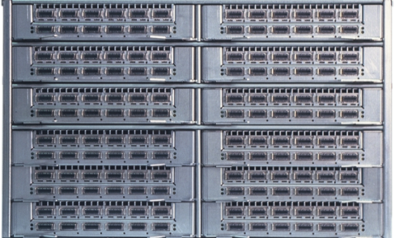
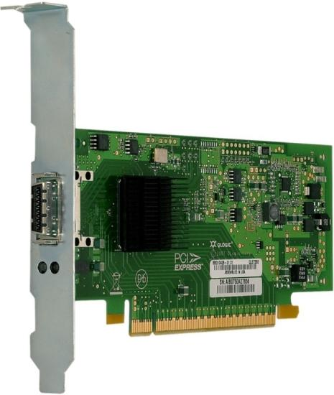
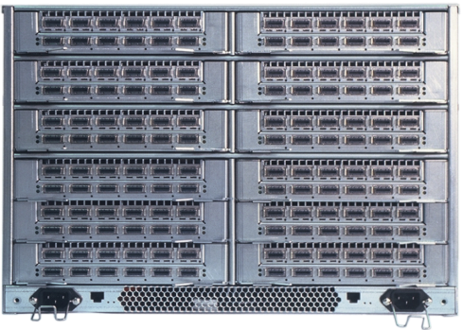
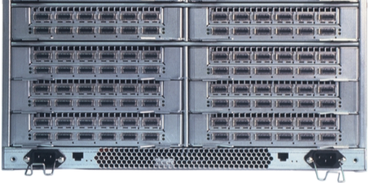
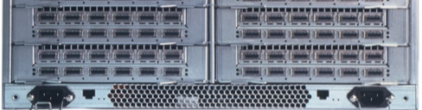

IB Director Design: Building Blocks
Module commonality across switch product line
  Spine cards
  Leaf cards
  Management card
  Power Supply
  Fan Module
Interchangeable components
Enclosures
  9240 (24 leaf cards)
  9120 (12 leaf cards)
  9080 (8 leaf cards)
  9040 (4 leaf cards)
  9020 (2 leaf cards)
9240
14U
9120
7U
9080
5U
9040
3U
9020
1U
5
QLogic Confidential - NDA Required
Notes:
5
QLogics’ unique design in Single Data Rate and Double Data Rate switching offers a set of interchangeable modules supported across the entire product line. This design has been successful for us in the past and we’ve leveraged it again in our newest products. Across each of our product lines you’ll find commonality where each chassis can accept the same spines, I/O leafs, management cards, power and fan modules throughout the entire director class. In configurations using these modular components, shelf sparing can be implemented since each component can be ordered from a single SKU without regards to the chassis type.

Slide 6
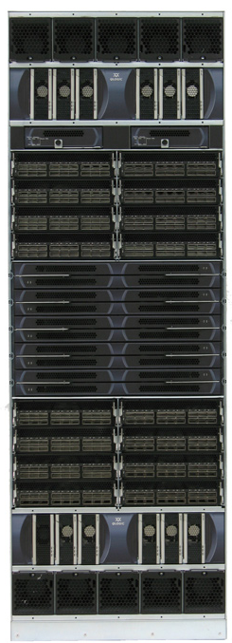

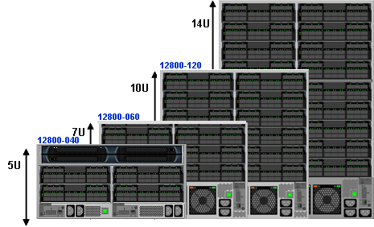
QLogic QDR Switches (12X00)
QLogic 36 Port QDR Switches
12800-360
29U
Managed (12300)
  Redundant hot swappable fan/power supplies
  Out of Band Management
  On board SM capabilities
Unmanaged (12200)
  Low Cost
  Single FRU
QLogic QDR Director Class Switches 12800
Module commonality across switch product line
  Spine cards
  Leaf cards
  Management card
  Power Supply
  Fan Module
12800-180
Modularity and Density in 12800 Switches
Ultra High Performance (UHP) 1:1
Ultra High Density (UHD) 2:1
  UHP UHD
  12800-360 648 ports 864 ports
  12800-180 324 ports 432 ports
  12800-120 216 ports 288 ports
  12800-060 108 ports 144 ports
  12800-040 72 ports 96 ports

Slide 7
IB Management Software
Notes:
This next section will outline our differentiating InfiniBand software, the Fabric Management Software Suite.

Slide 8
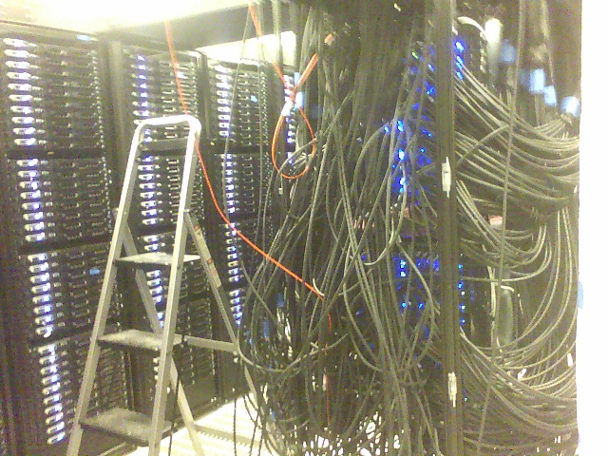
Fabric Verification
Can you find the loose cable?
What about the missing cable?
What about the one which was moved last night?
Which Server didn’t boot?
Which Switch has the wrong FW?
8
QLogic Confidential - NDA Required
Notes:
This is a scene most IT Administrators are all too familiar with: The mountain of cables; the lost node; un-authorized, undocumented changes to infrastructure; all of which can be a nightmare for IT infrastructure managers. When installing a large cluster it’s inevitable that something will go wrong… Which switch has the wrong firmware? How do you find a lose or missing cable? These potential sleep-encroaching IT challenges are the target of FastFabric.
8

Slide 9
InfiniBand Fabric Suite 2008
Fabric Manager
2048 node fabric initialization in <20 sec
Rapid response to fabric changes (<1sec)
Full SM/SA Redundancy; IBTA SM Failover
Sophisticated routing algorithms
Fabric verification / diagnostics support
FastFabric Toolset
Centralized Fabric Administration Tools
Rapid Fabric Installation/Upgrade
Powerful Verification & Diagnostic tools
Fabric Congestion Monitoring and Avoidance
Chassis and Element Management
No user intervention required
Hot swap FRU(s)
Optional redundancy
Common feature set, look and feel across all chassis/switch products
Notes:
The QLogic InfiniBand Fabric Suite 2008, referred to as IFS 2008, is composed of three distinct applications: Fabric Manager, FastFabric Toolset and the Chassis and Element Management.
Among the many advantages of this software suite are the rapid initialization of Fabric Manager, and the fabric response time. Fabric Manager probes the compute cluster, each node and all fabric connections and then constructs a routing table for each switch. Fabric Manager is so efficient, that in a high performance computing cluster of 10,000 nodes, the routing table can be constructed in under 60 seconds. Fabric Manager also identifies fabric changes very rapidly and can recalculate the routing table to accommodate changes as they occur. In a 10,000 node cluster, this information can be gathered and reported in less than 20 seconds and will be reflected through the Fabric Manager’s administration screen in under a second.
The FastFabric Toolset is the second application in the suite. FastFabric tool set provides a centralized console to manage any switch in our product suite. These management features are accomplished through in-band management over the InfiniBand protocol. The FastFabric toolset provides a rapid installation and upgrade utility for host software and firmware. It centralizes common fabric monitoring tasks such as diagnostic fabric verification, congestion monitoring and avoidance.
Rounding out IFS is the Chassis and Element Management application which, without user intervention, can give an indication of failed hot swappable modules. IFS also offers optional full redundancy within the software and provides a common user interface across our switch product suite.

Slide 10
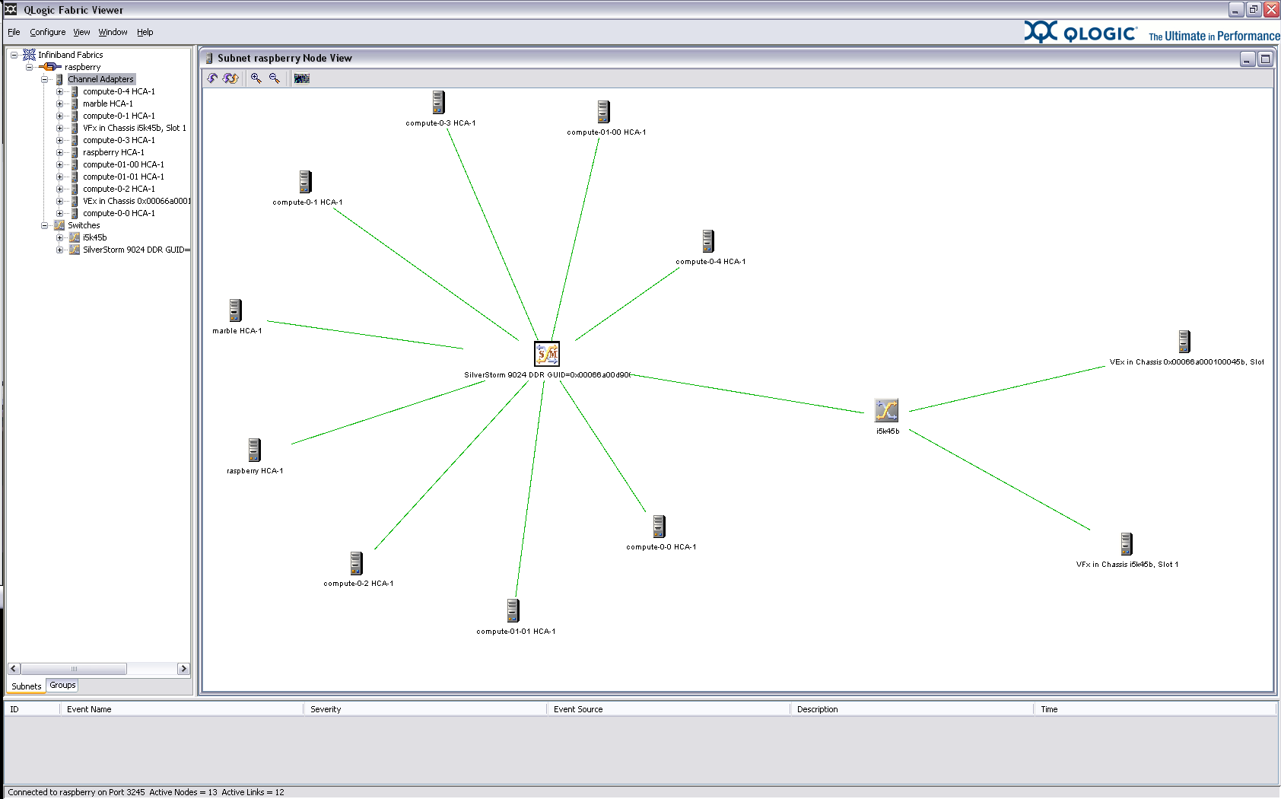
Topology View

Slide 11
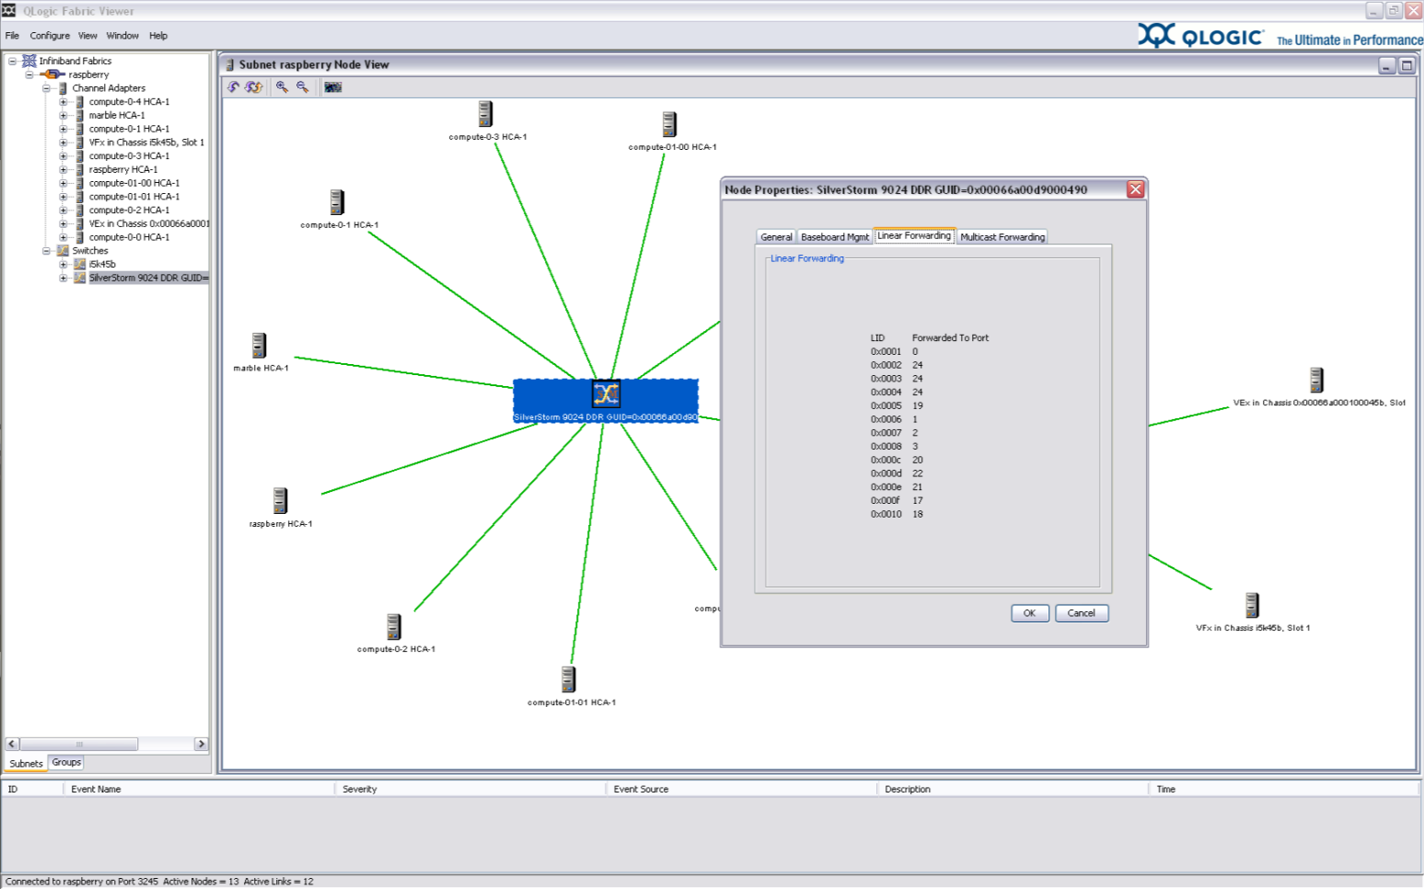
Switch details

Slide 12
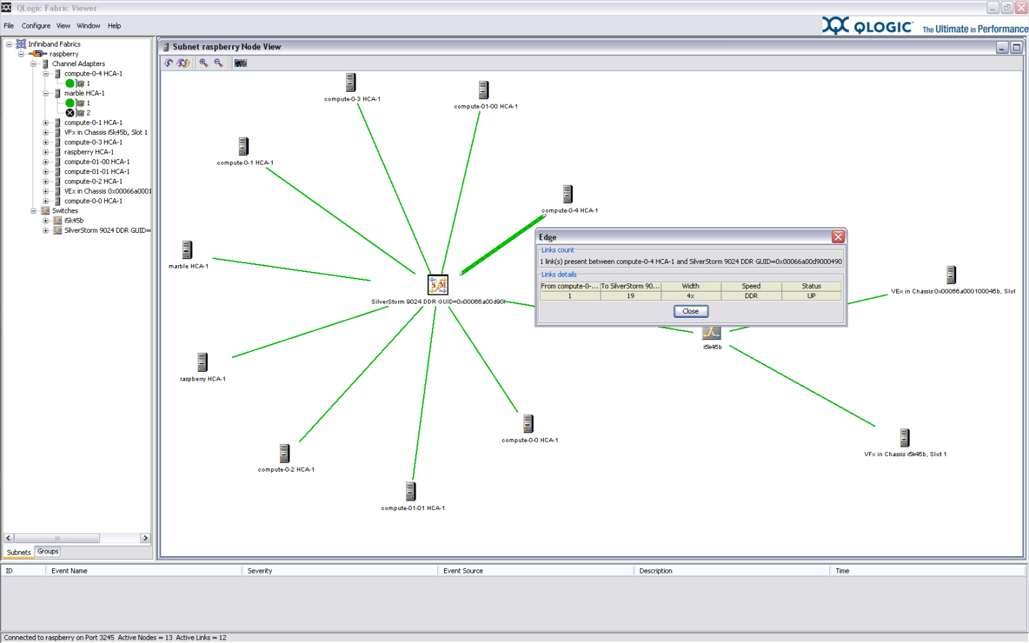
Link specific properties

Slide 13
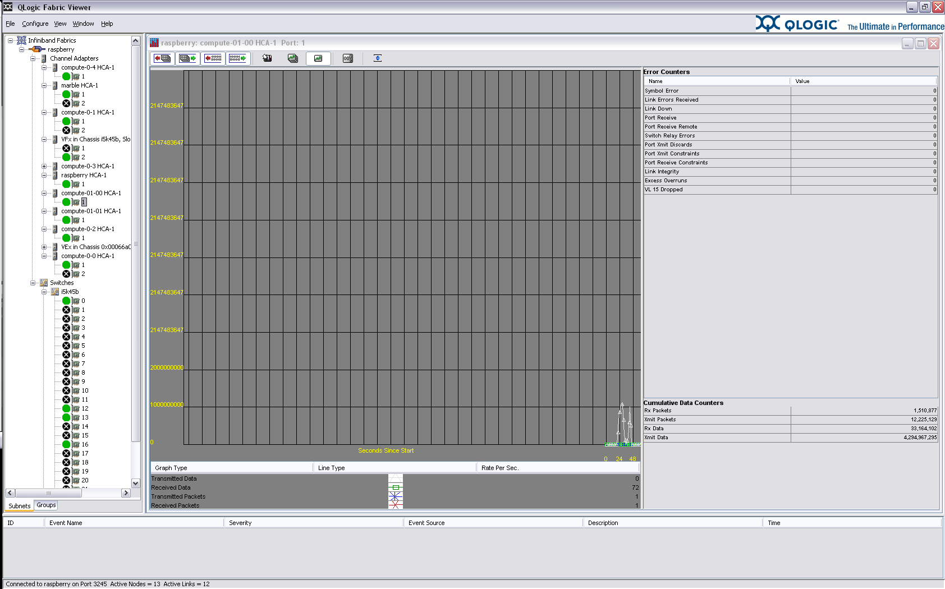
HCA Specific Performance Metrics

Slide 14
MPI Performance Tool Overview
Latency/Bandwidth Deviation Test is an analysis and diagnostic tool for performing pair-wise bandwidth and latency testing
Tool is available in FastFabric using the “Check MPI Performance” TUI menu option
Test will report pairs outside an acceptable tolerance range.
Will identify specific nodes which have problems and provide a concise summary of results.
The tool can also be invoked via iba_host mpiperfdeviation or directly by ./run_deviation

Slide 15
Sequential Mode Example
Running Sequential MPI Latency Tests - Pairs 3 Testing 3
Running Sequential MPI Bandwidth Tests - Pairs 3 Testing 3
Sequential MPI Performance Test Results
Latency Summary:
Min: 2.51 usec, Max: 3.52 usec, Avg: 3.18 usec
Range: +40.6% of Min, Worst: +10.7% of Avg
Cfg: Tolerance: +30% of Avg, Delta: 0.80 usec, Threshold: 4.14 usec
Message Size: 0, Loops: 4000
Bandwidth Summary:
Min: 941.6 MB/s, Max: 1304.1 MB/s, Avg: 1178.2 MB/s
Range: -27.8% of Max, Worst: -20.1% of Avg
Cfg: Tolerance: -20% of Avg, Delta: 150.0 MB/s, Threshold: 942.5 MB/s
Message Size: 2097152, Loops: 30
Bandwidth Details:
Result BW Dev Host (rank) --> Host (rank)
FAILED 941.6 -20.1% IBM-3550 (0) --> IBM-3455 (1)
Latency: PASSED
Bandwidth: FAILED

Slide 16
Verbose Output
Latency Details:
Result Lat Dev Host (rank) <-> Host (rank)
PASSED 3.73 -4.5% IBM-3550 (10) <-> st125 (0)
PASSED 3.34 -14.4% IBM-3550 (10) <-> st999 (1)
PASSED 3.81 -2.5% IBM-3550 (10) <-> IBM-3455 (2)
PASSED 3.79 -3.0% IBM-3550 (10) <-> IBM-3655 (3)
PASSED 3.98 +1.9% IBM-3550 (10) <-> IBM-3755 (4)
Bandwidth Details:
Result BW Dev Host (rank) --> Host (rank)
PASSED 838.0 -9.9% IBM-3550 (10) --> st125 (0)
PASSED 947.9 +1.9% IBM-3550 (10) --> st999 (1)
PASSED 946.7 +1.8% IBM-3550 (10) --> IBM-3455 (2)
PASSED 873.0 -6.1% IBM-3550 (10) --> IBM-3655 (3)
PASSED 947.6 +1.9% IBM-3550 (10) --> IBM-3755 (4)

Slide 17
iba_report
[root@tsg136 ~]$ iba_report
Getting All Node Records...
Done Getting All Node Records
Done Getting All Link Records
Done Getting All SM Info Records
Node Type Brief Summary
36 Connected CAs in Fabric:
NodeGUID Type Name
Port LID PortGUID Width Speed
0x0005ad0000013d94 CA tsg110
1 0x001e 0x0005ad0000013d95 4x 2.5Gb
2 0x001f 0x0005ad0000013d96 4x 2.5Gb
0x00066a00580001a6 CA VEx in Chassis 0x00066a005000010e, Slot 7
2 0x0023 0x00066a02580001a6 4x 2.5Gb
...
Generic helpful output about the fabric
Overview of the fabric, hosts, switches and SM

Slide 18
iba_report –o errors
[root@tsg136 ~]$ iba_report -o errors
Getting All Node Records...
Done Getting All Node Records
Done Getting All Link Records
Done Getting All SM Info Records
Getting All Port Counters...
Done Getting All Port Counters
Links with errors > threshold Summary
Configured Error Thresholds:
SymbolErrorCounter 100
LinkErrorRecoveryCounter 3
LinkDownedCounter 3
PortRcvErrors 100
PortRcvRemotePhysicalErrors 100
PortXmitDiscards 100
PortXmitConstraintErrors 10
PortRcvConstraintErrors 10
LocalLinkIntegrityErrors 3
ExcessiveBufferOverrunErrors 3
VL15Dropped 100
Rate NodeGUID Port Type Name
10g 0x00066a0001000108 1 SW i9k156 Leaf 5, Chip A
LinkDownedCounter: 12 Exceeds Threshold: 3
<-> 0x00066a0098005c31 1 CA tsg138
…
Rapid analysis of the fabric against
user defined threshold.
Editable threshold for flexibility
Easy to read output

Slide 19
Fabric Verification – FastFabric Can Find It !
# iba_reports –o errors –o verifylinks
Links with errors > threshold Summary
...
Rate MTU NodeGUID Port Type Name
Cable: CableLabel CableLen CableDetails
20g 2048 0x0002c90200217ac0 1 CA n002
<-> 0x00066a00d9000169 14 SW iS120
SymbolErrorCounter: 40156 Exceeds Threshold: 100
Cable: SS1145 11m Gore Passive Cu
2532 of 2532 Links Checked, 1 Errors found
-----------------------------------------------------------
Links Topology Verification
Rate MTU NodeGUID Port or PortGUID Type Name
Cable: CableLabel CableLen CableDetails
10g 2048 0x00066a0007000311 10 SW iS150
<-> 0x00066a009800413e 1 CA n040
Cable: SS1020 7m Gore Passive Cu
Missing Link
2532 of 2532 Input Links Checked
Total of 1 Incorrect Links found
1 Missing, 0 Unexpected, 0 Misconnected, 0 Duplicate, 0 Different
Rapid Fabric Wide Error Analysis
Quickly Pinpoint Bad Links
Identify Fabric Changes
Compare fabric against intended design
Concise Summary of errors
  Name, port #, Speeds, etc
19
QLogic Confidential - NDA Required
Notes:
Leveraging our 6 years within the High Performance Computing industry, QLogic has developed FastFabric to deliver a robust set of tools that can quickly discover a variety of infrastructure, hardware, firmware and software errors.
In this example, we see that FastFabric’s verification capabilities allow for broad error analysis including degrading network connections, fabric changes, and comparative design changes. FastFabric also provides error summary reporting. What ever the problem, FastFabric can find it.
19

Slide 20
Fabric Verification – FastFabric Can Find It !
# iba_reports –o errors –o verifylinks
Links with errors > threshold Summary
...
Rate MTU NodeGUID Port Type Name
Cable: CableLabel CableLen CableDetails
20g 2048 0x0002c90200217ac0 1 CA n002
<-> 0x00066a00d9000169 14 SW iS120
SymbolErrorCounter: 40156 Exceeds Threshold: 100
Cable: SS1145 11m Gore Passive Cu
2532 of 2532 Links Checked, 1 Errors found
-----------------------------------------------------------
Links Topology Verification
Rate MTU NodeGUID Port or PortGUID Type Name
Cable: CableLabel CableLen CableDetails
10g 2048 0x00066a0007000311 10 SW iS150
<-> 0x00066a009800413e 1 CA n040
Cable: SS1020 7m Gore Passive Cu
Missing Link
2532 of 2532 Input Links Checked
Total of 1 Incorrect Links found
1 Missing, 0 Unexpected, 0 Misconnected, 0 Duplicate, 0 Different
Rapid Fabric Wide Error Analysis
Quickly Pinpoint Bad Links
Identify Fabric Changes
Compare fabric against intended design
Concise Summary of errors
  Name, port #, Speeds, etc
Link found with
Excessive symbol errors
20
QLogic Confidential - NDA Required
Notes:
From a single command line execution, we’ve located excessive symbol errors which pin-points a place to start troubleshooting for specific problems.

Slide 21
Fabric Verification – FastFabric Can Find It !
# iba_reports –o errors –o verifylinks
Links with errors > threshold Summary
...
Rate MTU NodeGUID Port Type Name
Cable: CableLabel CableLen CableDetails
20g 2048 0x0002c90200217ac0 1 CA n002
<-> 0x00066a00d9000169 14 SW iS120
SymbolErrorCounter: 40156 Exceeds Threshold: 100
Cable: SS1145 11m Gore Passive Cu
2532 of 2532 Links Checked, 1 Errors found
-----------------------------------------------------------
Links Topology Verification
Rate MTU NodeGUID Port or PortGUID Type Name
Cable: CableLabel CableLen CableDetails
10g 2048 0x00066a0007000311 10 SW iS150
<-> 0x00066a009800413e 1 CA n040
Cable: SS1020 7m Gore Passive Cu
Missing Link
2532 of 2532 Input Links Checked
Total of 1 Incorrect Links found
1 Missing, 0 Unexpected, 0 Misconnected, 0 Duplicate, 0 Different
Rapid Fabric Wide Error Analysis
Quickly Pinpoint Bad Links
Identify Fabric Changes
Compare fabric against intended design
Concise Summary of errors
  Name, port #, Speeds, etc
Link found with
Excessive symbol errors
Missing Cable Found
21
QLogic Confidential - NDA Required
Notes:
Output from a link topology verification, displayed in the next section, indicates Fast Fabric has identified yet another problem. This one is a missing connection within the fabric. Typically, this type of problem would not be found by any competitive software, and while such problems can be very difficult to discover, FastFabric realizes where the connection should be and can even verify a missing connection.

Slide 22
Fabric Verification – FastFabric Can Find It !
# iba_reports –o errors –o verifylinks
Links with errors > threshold Summary
...
Rate MTU NodeGUID Port Type Name
Cable: CableLabel CableLen CableDetails
20g 2048 0x0002c90200217ac0 1 CA n002
<-> 0x00066a00d9000169 14 SW iS120
SymbolErrorCounter: 40156 Exceeds Threshold: 100
Cable: SS1145 11m Gore Passive Cu
2532 of 2532 Links Checked, 1 Errors found
-----------------------------------------------------------
Links Topology Verification
Rate MTU NodeGUID Port or PortGUID Type Name
Cable: CableLabel CableLen CableDetails
10g 2048 0x00066a0007000311 10 SW iS150
<-> 0x00066a009800413e 1 CA n040
Cable: SS1020 7m Gore Passive Cu
Missing Link
2532 of 2532 Input Links Checked
Total of 1 Incorrect Links found
1 Missing, 0 Unexpected, 0 Misconnected, 0 Duplicate, 0 Different
Rapid Fabric Wide Error Analysis
Quickly Pinpoint Bad Links
Identify Fabric Changes
Compare fabric against intended design
Concise Summary of errors
  Name, port #, Speeds, etc
Link found with
Excessive symbol errors
Missing Cable Found
Demonstrated Results: rapidly identified long standing problems in 3rd party fabrics, including problems internal to 3rd party large switches
22
QLogic Confidential - NDA Required
Notes:
FastFabric’s diagnostic capabilities not only identify issues with QLogic products, it can also find issues related to 3rd party components in a mixed fabric environment.

Slide 23
Analysis Tools - Fast Fabric
Usage Model for Monitoring Tools
Perform initial fabric install and verification
Optionally run tools in “health check only” mode
  Performs quick health check
  Duplicates some of steps already done during verification
Run tools in “baseline” mode
  Takes a baseline of present HW/SW/configuration
Periodically run tools in “check” mode
  Performs quick health check
  Compares present HW/SW/configuration to baseline
  Can be scheduled in hourly cron jobs
As needed rerun “baseline” when expected changes occur
  Fabric upgrades
  Hardware replacements/changes
  SW Configuration changes
  Etc.

Slide 24
Fast Fabric
Tool Categories
Fabric_analysis
  Checks for fabric level errors and/or link speeds
  Checks for fabric level changes
    Nodes added/removed, links added/removed
Chassis_analysis
  Checks for chassis configuration changes
  Checks chassis health
SM_analysis
  HOST SM and Embedded SM variations
  Check SM config and health
All_analysis
  User specified combination of the above

Slide 25



