Slide 1
Progress toward Predicting Viral RNA Structure from Sequence:
How Parallel Computing can Help Solve the RNA Folding Problem
Susan J. Schroeder
University of Oklahoma
October 7, 2008

Slide 2
We finished the genome map,
now we can’t figure out how to fold it!
Science (1989) 243, p.786

Slide 3
RNA

Slide 4
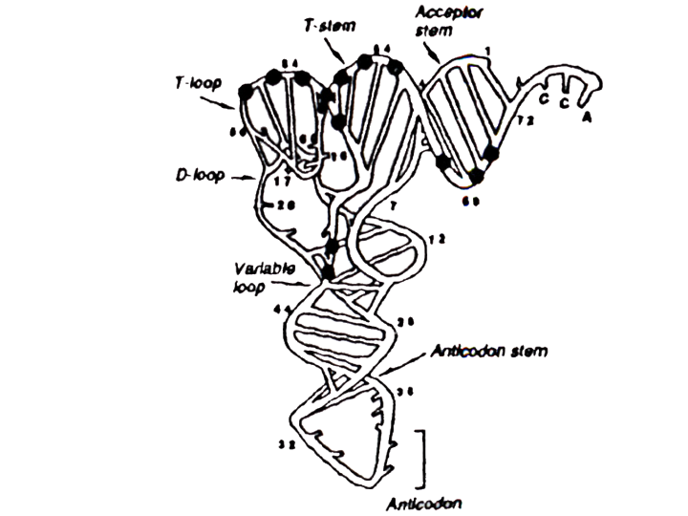
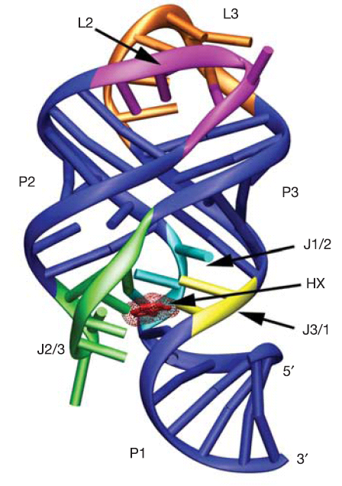
Sequence Structure Function
5’GCGGAUUUAG^{2M}CUCAGU^{DH}U^{DH}GGGAGAGCG^{M2}CCAGAC^{0M}UG^{OM}AAG^{Y}AU^{PS}C^{5M}UGGAGG^{7M}UC C^{5M}UGUGU^{5M}U^{PS}CGA^{1M}UCCACAGAAUUCGACCA
5’GGACAUAUAAUCGCGUGGAUAUGGCACGCAAGUUUCUACCGGGCACCGUAAAUGUCCGACUAUGUCCA
tRNA
Guanine Riboswitch
Batey, R. et al, 2004 Nature vol. 432, p. 412

Slide 5
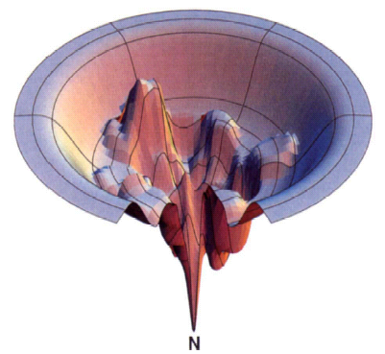
RNA Folding Problem
Folding a polymer with negative charge
Watson - Crick base pairing
Hierarchical folding
1º
2º
3º
Figure from Dill &Chan (1997) Nat. Struct. Biol. Vol. 4, pp. 10-19

Slide 6
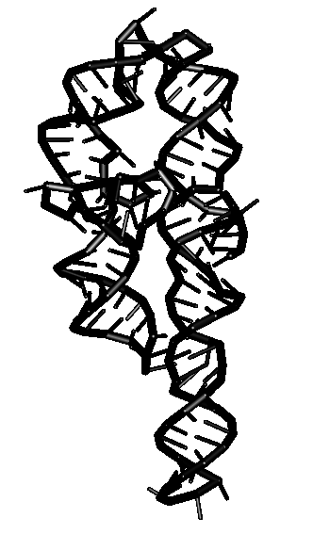
1º
2º
3º
AAUUGCGGGAAAGGGGUCAA
CAGCCGUUCAGUACCAAGUC
UCAGGGGAAACUUUGAGAUG
GCCUUGCAAAGGGUAUGGUA
AUAAGCUGACGGACAUGGUC
CUAACCACGCAGCCAAGUCC
UAAGUCAACAGAUCUUCUGU
UGAUAUGGAUGCAGUUCA
Waring &Davies 1984
Gene 28:277
Cate et al. 1996
Science 273:1678

Slide 7
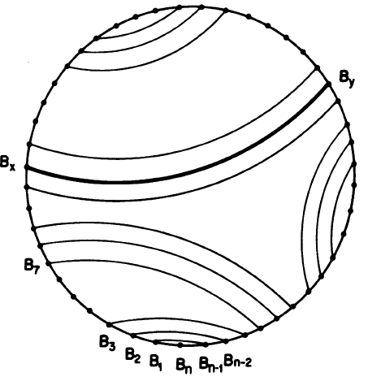
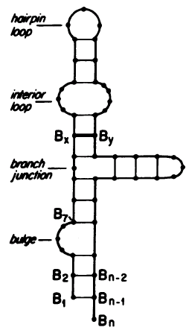
RNA Secondary Structure has Helices and Loops
Nussinov & Jacobson 1980 PNAS v 11 p 6310 Fig.1

Slide 8
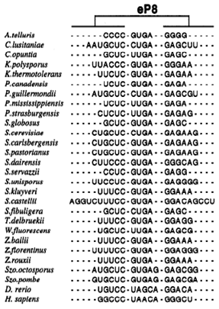
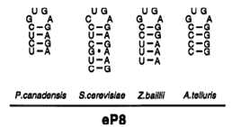
An example of phylogenetic alignment and structure prediction for RNAse P
Frank et al. 2000 RNA v 6 p1895

Slide 9
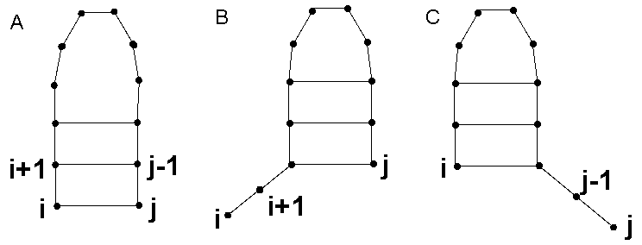
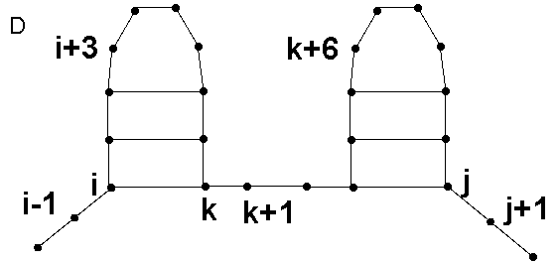
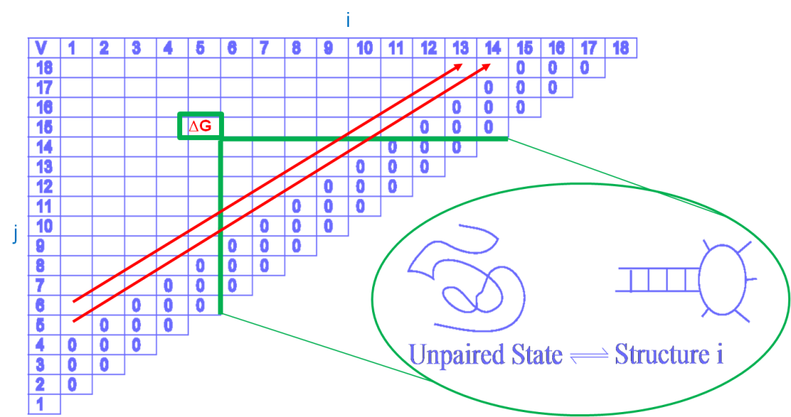
How Dynamic Programming Algorithms Calculate RNA Secondary Structure
Stochastic context-free grammar defines possible base pairs as 1 of 4 possible cases
Recursion statement finds maximum value for each small subset of RNA sequence
Fill an array with scores for each substructure
Traceback through the
array to find the lowest
free energy structure
O(N²) memory storage
O(N³) runtime

Slide 10
Websites for Folding Algorithms to Predict RNA 2º
MFOLD
http:// www.bioinfo.rpi.edu/applications/mfold
Vienna package http:// www.tbi/univie.ac.at/~ivo/RNA
RNAStructure http://rna.urmc.rochester.edu
SFOLD http://sfold.wadsworth.org
PKNOTS http:// selab.wustl.edu
STAR4.4 http://biology.leidenuniv.nl/~batenburg/STRAbout.html

Slide 11
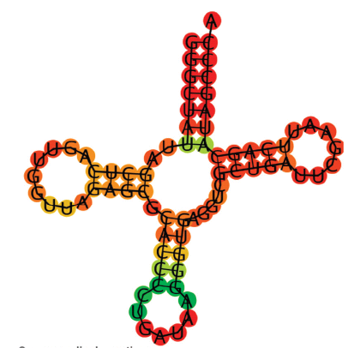
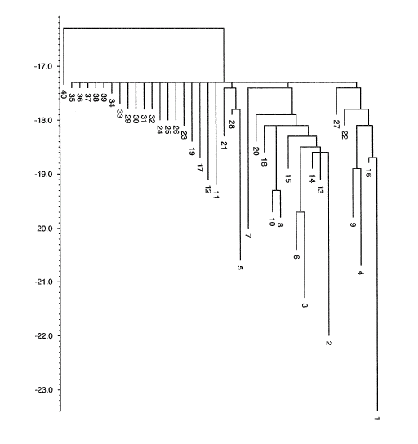
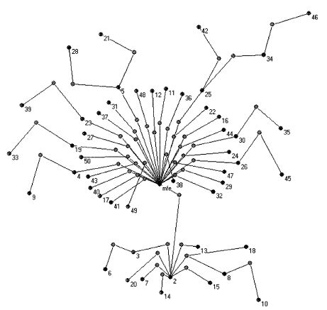
Representations of RNA Secondary Structure
dots & parentheses
tree
graph
merged landscape
Wuchty 2003, Nucl. Acids Res. v 31, p 1115 Fig. 7
Gruber et al. 2008, Nucl. Acids Res. v 36, p. W73 Fig. 1

Slide 12
RNAStructure Predicts Secondary Structure Well
Mathews et al. (2004) Proc. Natl. Acad. Sci. vol. 101, pp. 7287-7292

Slide 13
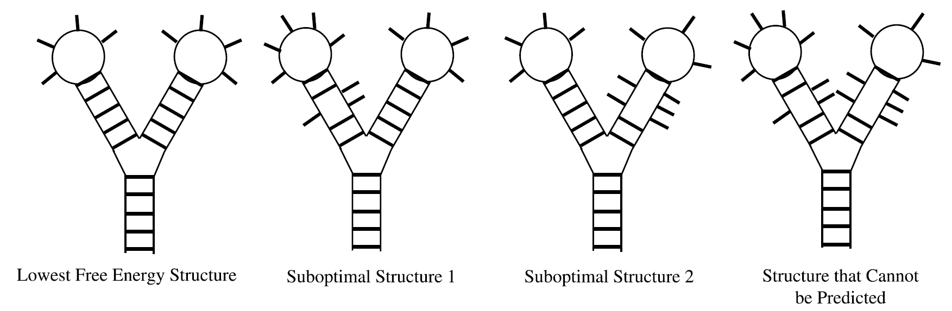
Mfold and RNAStructure Sample Suboptimal Structures
Mathews, 2006, J. Mol. Biol. V359 p. 528 Fig. 2

Slide 14
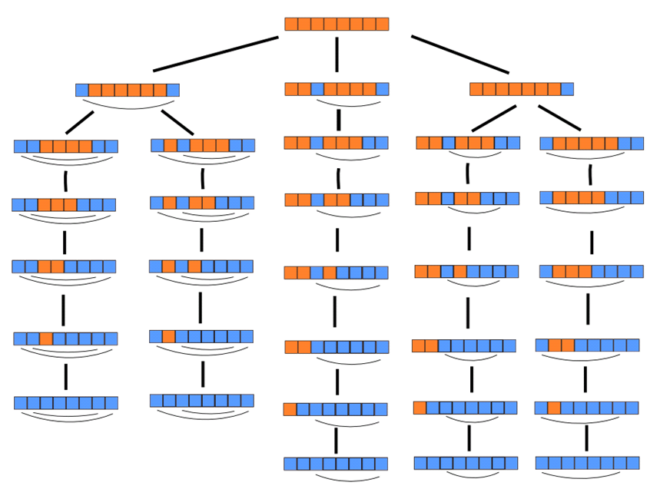
How Wuchty’s Algorithm is like a Tree

Slide 15
STMV RNA folding problem
Figure reproduced from VIPER website
Reddy et al. 2001
Crystal structure to 1.8 Å resolution (Larson et al., 1998)
59% of the 1,058 RNA nucleotides are in helices
RNA is icosahedrally averaged
Identity of nucleotides in helices remains obscure
Structure of 41% of the RNA remains unknown

Slide 16
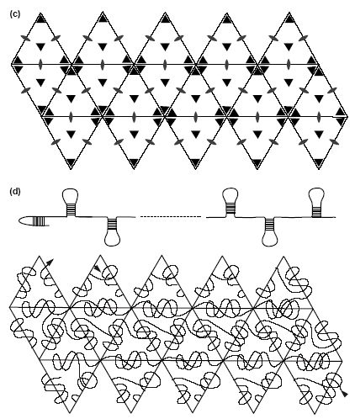
Current model for STMV RNA
Larson, S. & McPherson, A. Current Opinions in Structural Biology, vol. 11, p. 61.

Slide 17
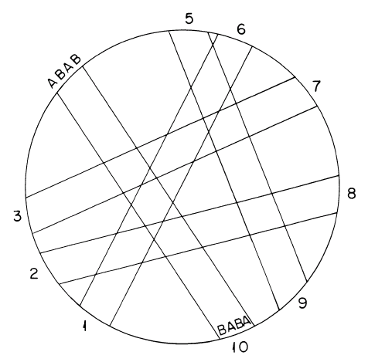
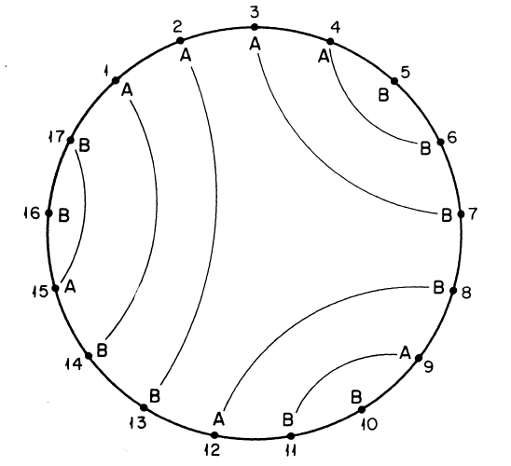
Nussinov algorithms for maximizing matches and blocks
Nussinov et al. 1978 SIAM v35, p. 71,78 Fig. 1, 5

Slide 18

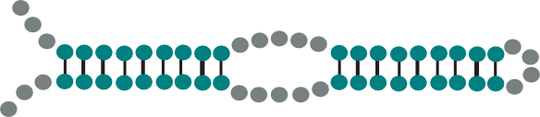
Combinatorial Search of STMV RNA
Locate potential helical structures between pairing bases i and j
Assemble non-overlapping potential helices (i,j) with (p>j,q) or (k>i+l, k+l<q<j)
Nested searching identifies
“helices within helices”
Over 144,000 perfect 6-pair helices, but
no possible simultaneous combination of 30 helices in STMV RNA

Slide 19
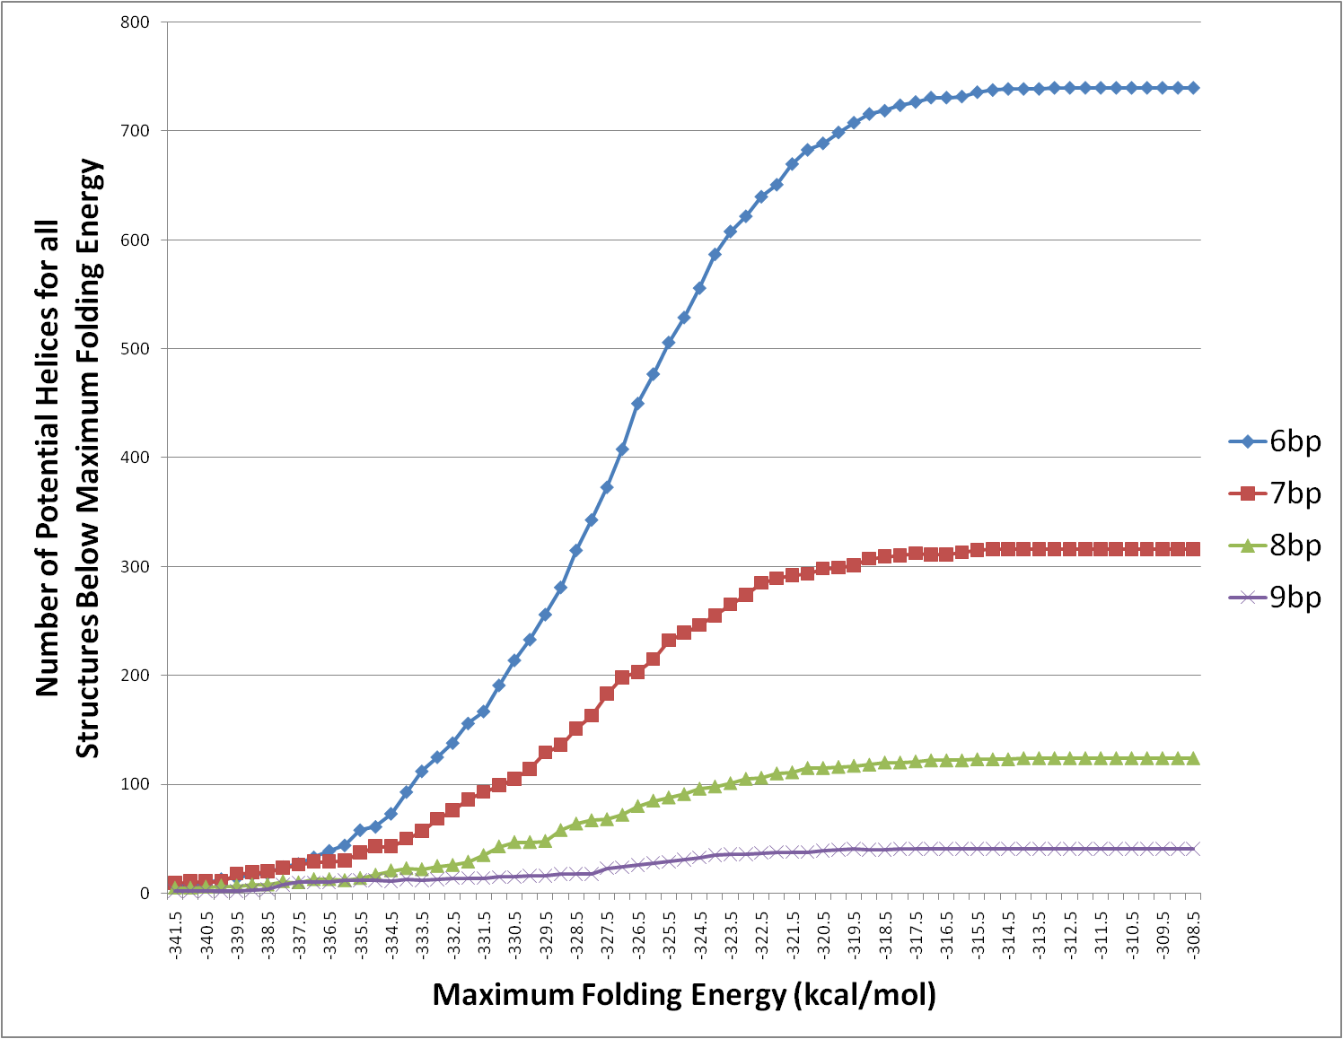
Many more possible structures contain 30 imperfect helices in the STMV sequence

Slide 20
Chemical modification data restrains possible base pairing
5’AAGAUGU^{AAA}CCAGGA3’
3’CUGCA _{AA} GGUCCU5’
5’AAGAUGU^{AAA}CCAGGA3’
3’CUGCA _{AA} GGUCCU5’
5’AAGAUGU^{AAA}CCAGGA3’
3’CUGCA _{AA} GGUCCU5’
5’AAGAUGU^{AAA}CCAGGA
3’CUGCA _{AA} GGUCCU
5’AAGAUGU^{AAA}CCAGGA
3’CUGCA _{AA} GGUCCU
5’AAGAUGU^{AAA}CCAGGA
3’CUGCA _{AA} GGUCCU

Slide 21
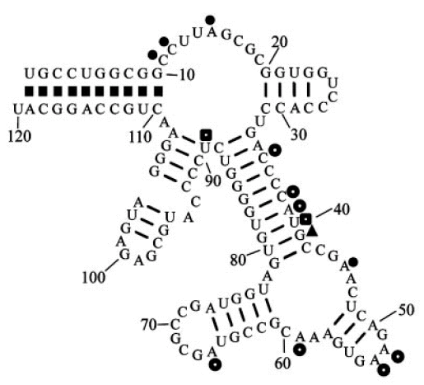
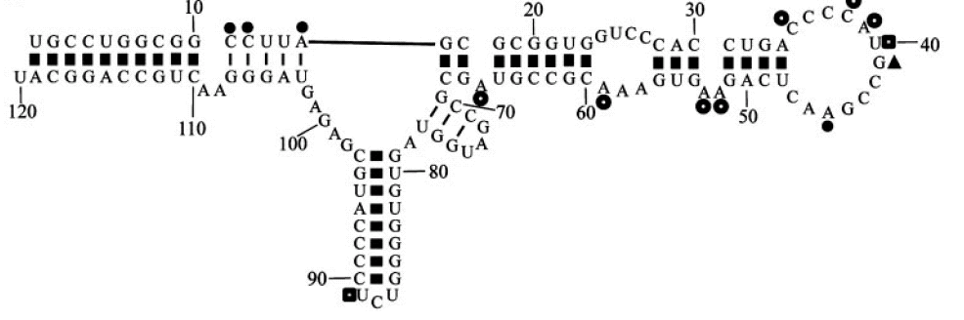
Including Results from Chemical Probing Improves Secondary Structure Prediction
E.coli 5S rRNA
Folded with constraints
from in vivo chemical modification
LOWEST 86.8 %
BEST 97.4 %
LOWEST 26.3 %
BEST 86.8 %
Mathews et al. (2004) Proc. Natl. Acad. Sci. 101, 7290 Figure 1

Slide 22
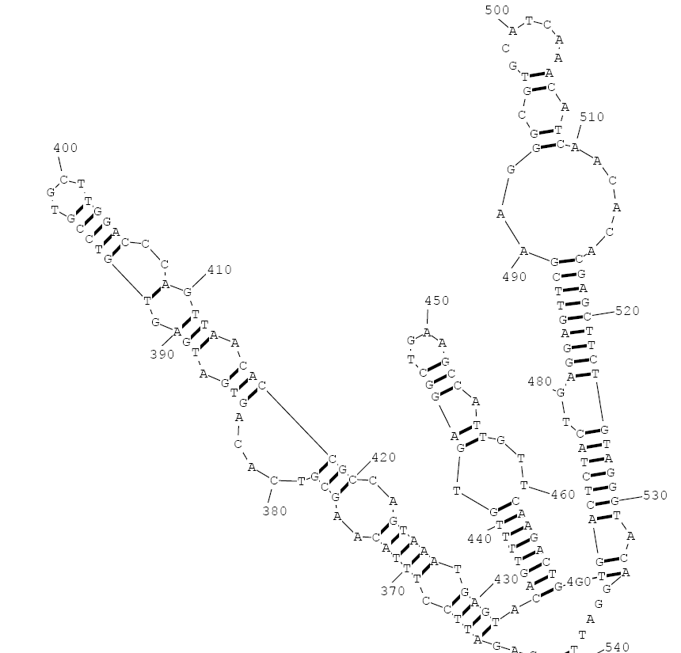
3 Restraints Can Change the Lowest Energy Fold
A527, A532, A537
restrained to be single stranded
-341.0.kcal/mol
Native -341.1 kcal/mol

Slide 23
Free Energy Landscape of STMV RNA
∆G
MFE
Wuchty
Zuker
Chemical data
Future data
# Helices>1mm
# Helices,1 mm
Goal

Slide 24
How can Parallel Computing Help Solve the RNA Folding Problem?
Utilize tree structure of RNA secondary structure prediction
Expand range of free energies that can be computed for an RNA free energy landscape
Explore more possible RNA structures

Slide 25




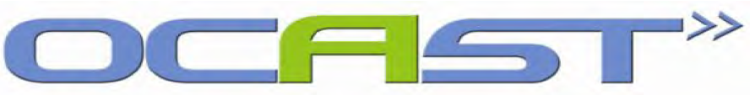
Acknowledgements
Deb Mathews, University California Riverside
David Mathews, University of Rochester
Jeanmarie Verchot-Lubicz, Oklahoma State University
Cal Lemke, Oklahoma University greenhouses
Lab Members:
Xiaobo Gu, Steven Harris, Koree Clanton-Arrowood, Brina Gendhar, Shelly Sedberry, Brian Doherty, Ted Gibbons, Sean Lavelle, John McGurk, Becky Myers, Mai-Thao Nguyen, Samantha Seaton, Jon Stone
Funding

