Slide 1






Oklahoma Science, Technology, Engineering, and Mathematics Mentorship Program

Slide 2
What is the OSTEMMP?
The Oklahoma STEM Mentorship Program is an educational outreach connecting networking professionals from OU, OSU, OneNet, and other institutions with students in the technology field.
It is part of an NSF grant to enhance Oklahoma’s educational and research capability through network improvements.
http://www.oscer.ou.edu/ostemmp.php
2

Slide 3
Job Shadowing
The goal:
IDENTIFY, DEVELOP and RECRUIT Talent
Activities include:
  Presentations to students throughout OK
  Job shadowing opportunities (on-site & virtual)
http://www.oscer.ou.edu/ostemmp.php
3

Slide 4
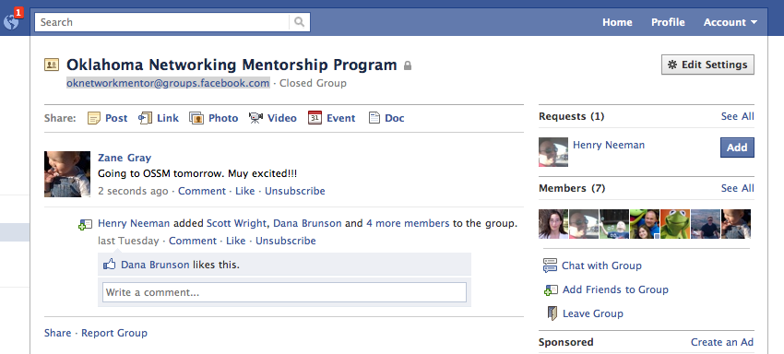
Job Shadowing
On-Site
  Schedule a time with us to see what we do!
Virtual
  e-mail us at network@ou.edu (OU IT Network Team)
  Facebook: oknetworkmentor@groups.facebook.com
http://www.oscer.ou.edu/ostemmp.php
4

Slide 5
Other Opportunities/Resources
Jobs at OU
  http://jobs.ou.edu
Jobs at OneNet
  http://www.okhighered.org/job-opportunities/
http://www.oscer.ou.edu/ostemmp.php
5

Slide 6
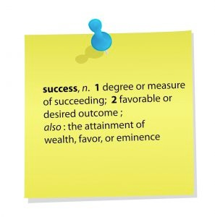
About This Presentation
What do I do in the IT field?
Lessons learned for getting this job.
Recommendations for keeping the job.
Being successful in this field.
http://www.oscer.ou.edu/ostemmp.php
6

Slide 7
About Me
Zane Gray:
  B.S. Chemical Engineering (OU 1996)
  USAF network deployments (1996-2001)
  OU computer networking (2001-present)
  Married since 1993 to an OSSM alumn!
  Nine (yes, “9”) kids
  One ball python (I hate snakes!)
  Two cats (adopted strays)
http://www.oscer.ou.edu/ostemmp.php
7

Slide 8
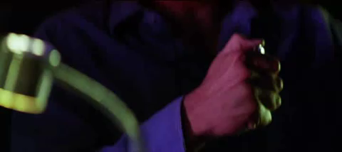
So, what’s it like?
Warning… PG-13 material ahead!
http://www.oscer.ou.edu/ostemmp.php
8

Slide 9
About My Job (Manager)
OU IT Network Services:
  Connect 200,000+ “unique” devices this year!
  Support 30,000+ “wireless” users every day.
  Support 15,000+ “wired” devices every day.
  Support ~2000 wireless access points
  Support ~1200 security cameras
  Support ~1250 network switches and routers
  Support ~8000 telephony devices (VoIP and analog)
  Over 200 physical and virtual servers
  Migrating to a single datacenter that spans three cities
http://www.oscer.ou.edu/ostemmp.php
9

Slide 10
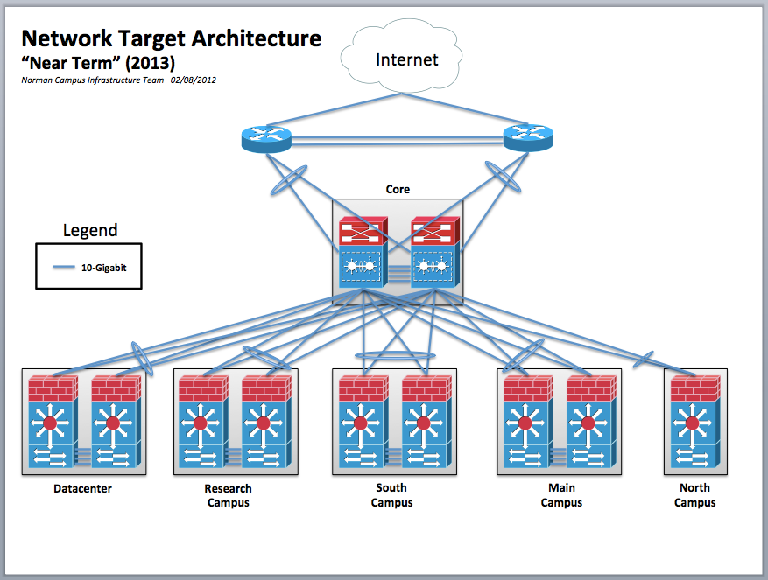
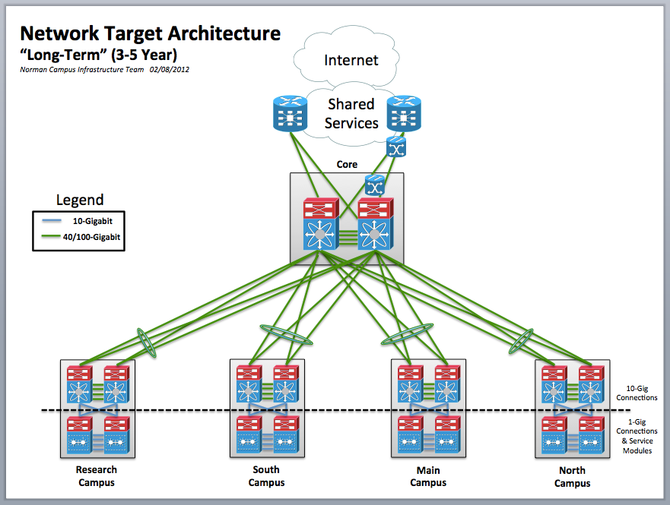
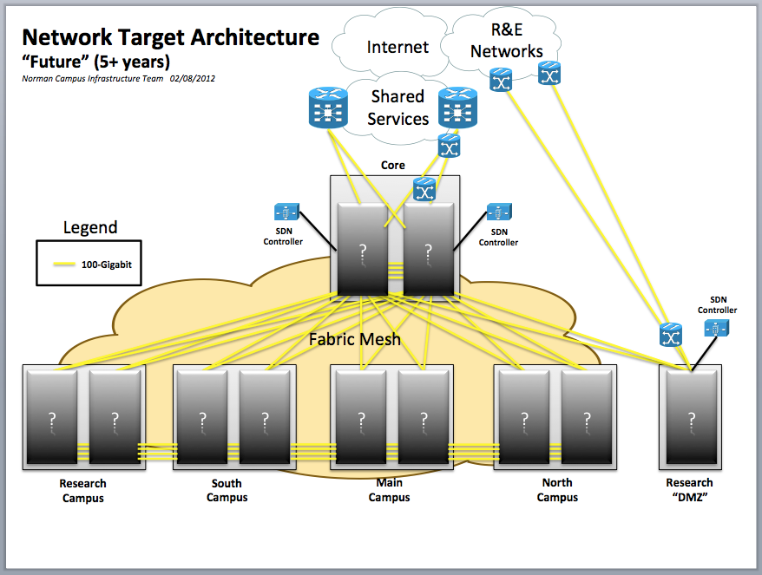
Strategic Planning and Vision
http://www.oscer.ou.edu/ostemmp.php
10

Slide 11
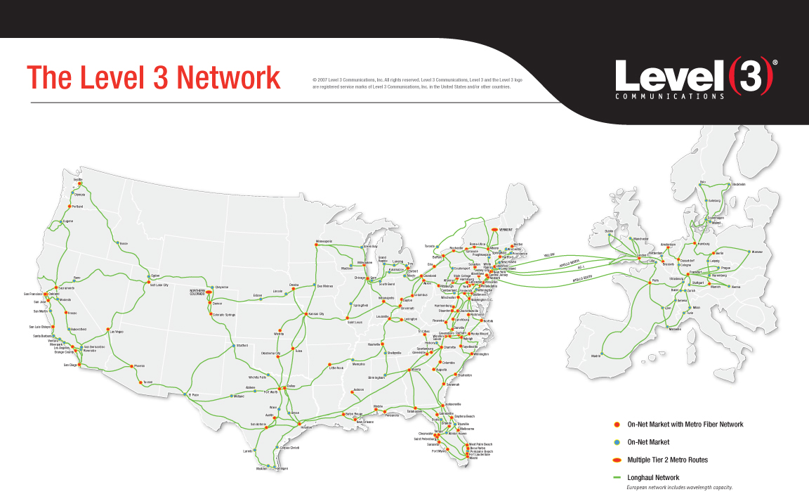
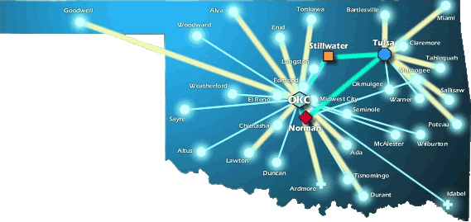
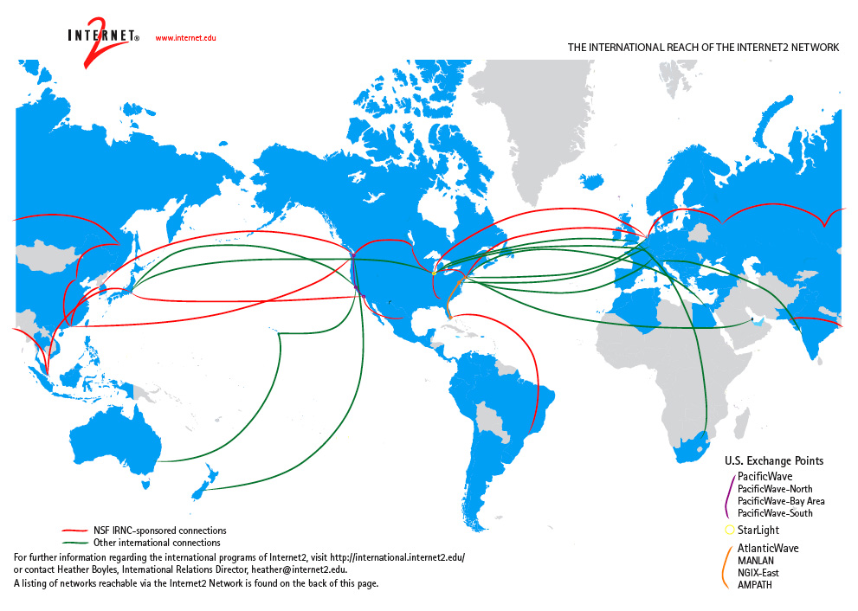
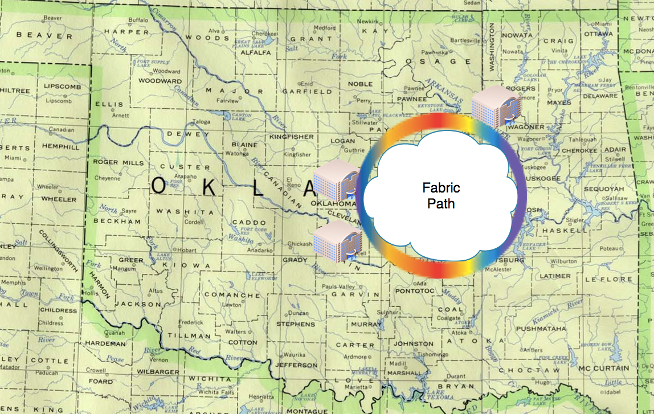
National Research & Education
Networks (World-Wide)
http://www.oscer.ou.edu/ostemmp.php
11

Slide 12

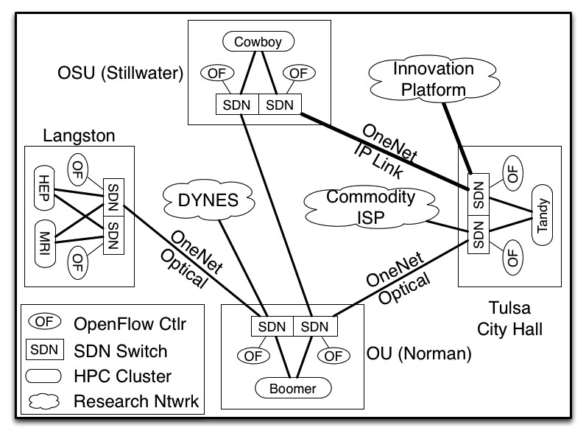
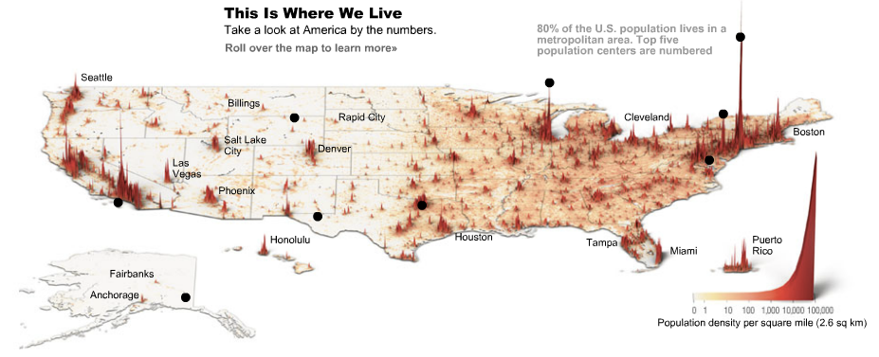
Trends in Technology Landscapes
Software Defined Networking
Data Visualization
http://www.oscer.ou.edu/ostemmp.php
12

Slide 13
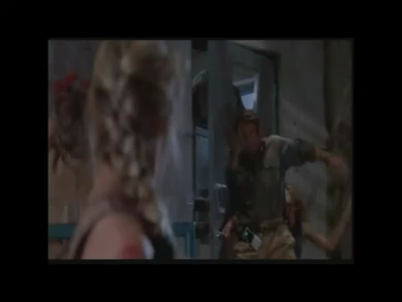
How Do We Manage It All?
http://www.oscer.ou.edu/ostemmp.php
13

Slide 14
Tools of the Trade
http://www.oscer.ou.edu/ostemmp.php
14

Slide 15
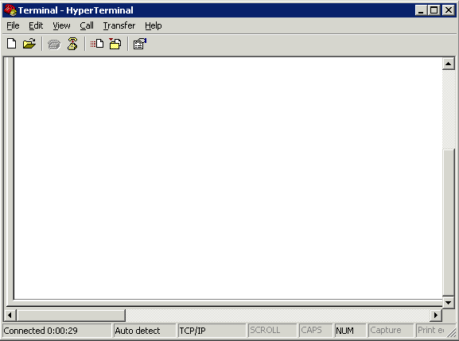
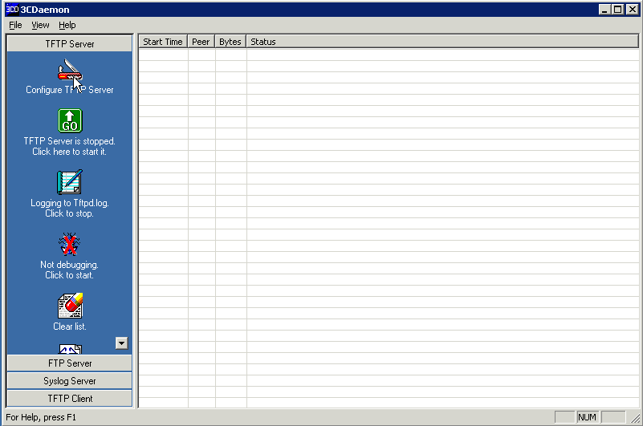
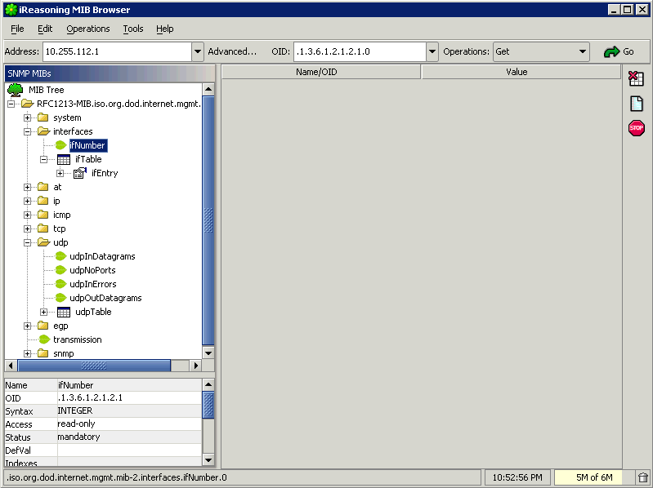
Tools of the Trade
http://www.oscer.ou.edu/ostemmp.php
15

Slide 16
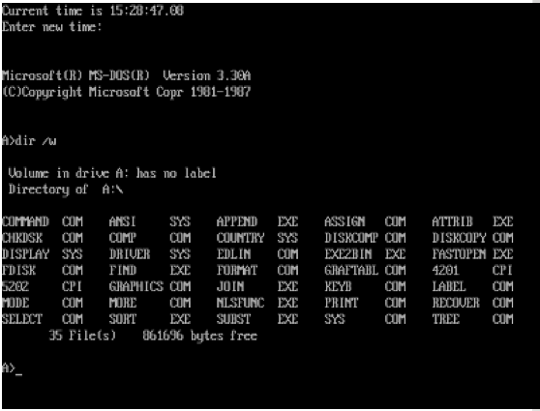
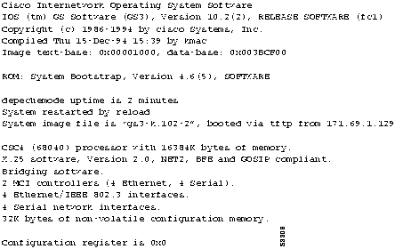
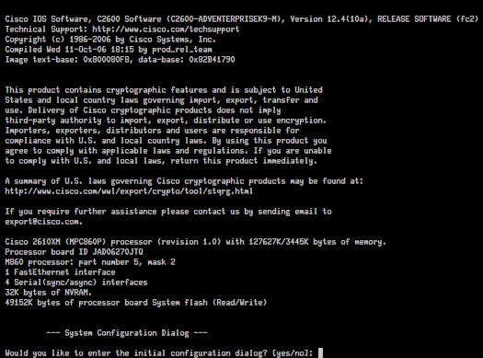
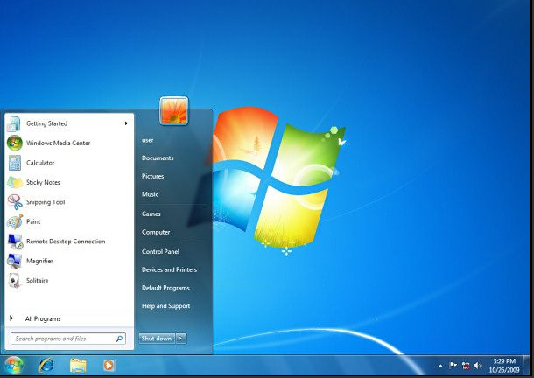
Tools of the Trade
Client OS’ (1980’s and Today)
Network OS’ (1980’s and Today)
http://www.oscer.ou.edu/ostemmp.php
16

Slide 17
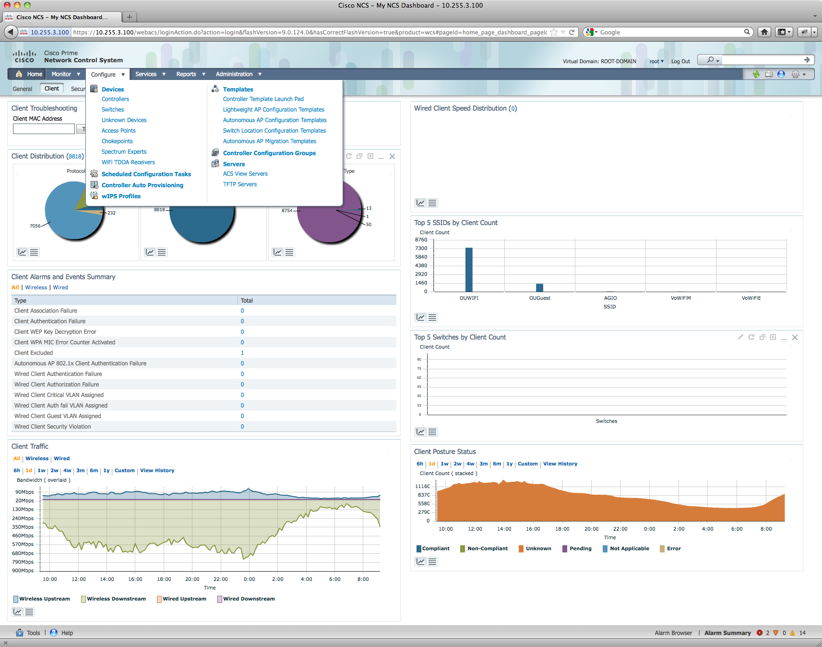
Tools of the Trade
But that’s changing!
  TRILL
  OpenFlow
  CAPWAP
  ~50% Parity
http://www.oscer.ou.edu/ostemmp.php
17

Slide 18
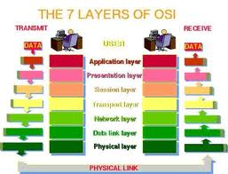
Troubleshooting
Technical Stuff for Network Engineers…
  Know the OSI model. It will save you days of troubleshooting time!
http://www.oscer.ou.edu/ostemmp.php
18

Slide 19
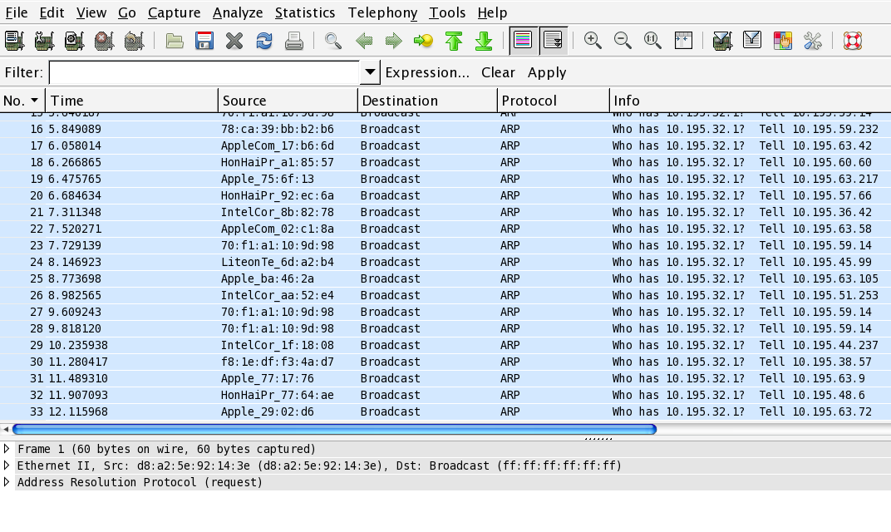

Troubleshooting
http://www.oscer.ou.edu/ostemmp.php
19

Slide 20
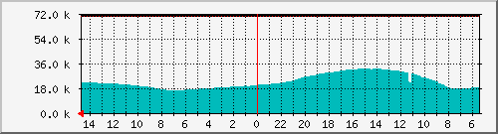
Operations & Maintenance
http://www.oscer.ou.edu/ostemmp.php
20

Slide 21
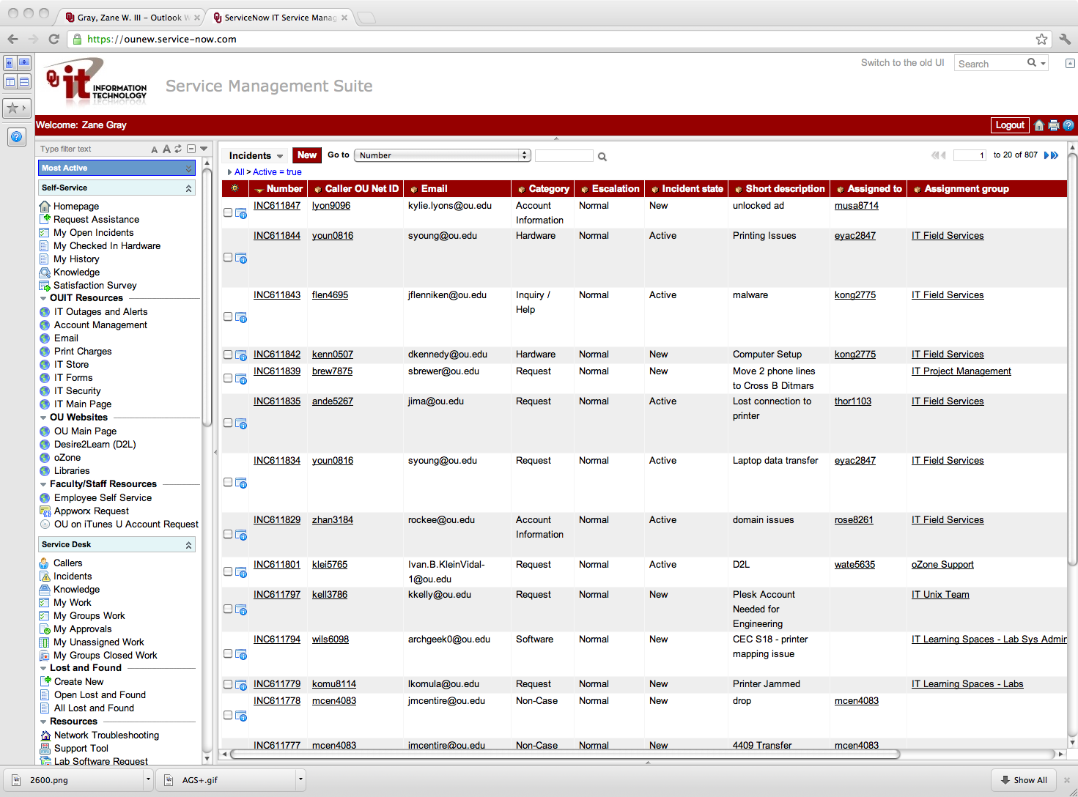
Change Management
Change Management and Control is a Necessary Evil
  Process
  Compliance
  Knowledge
  Audit Trail
http://www.oscer.ou.edu/ostemmp.php
21

Slide 22
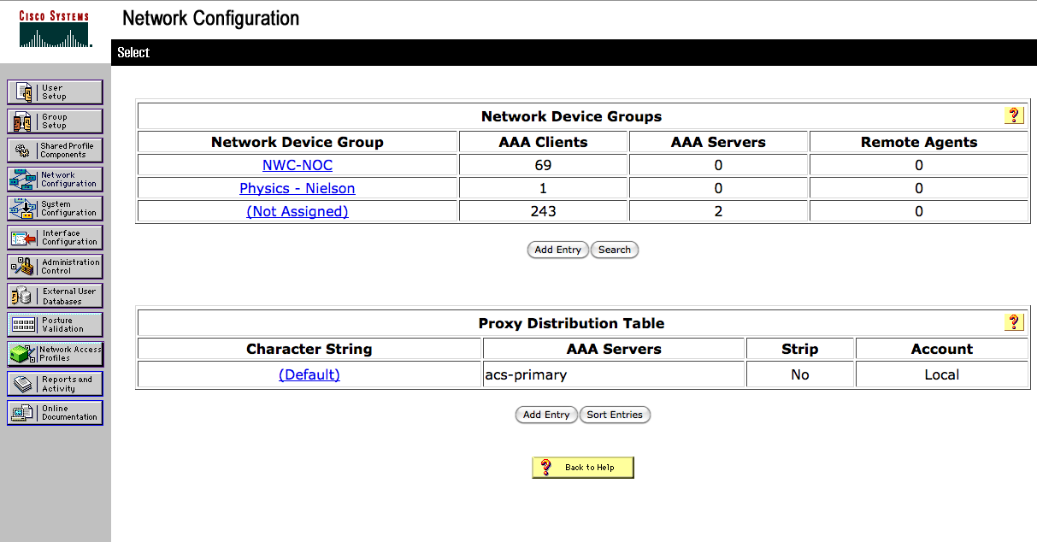
Change Control
AAA
  Authentication
  Authorization
  Accounting
http://www.oscer.ou.edu/ostemmp.php
22

Slide 23
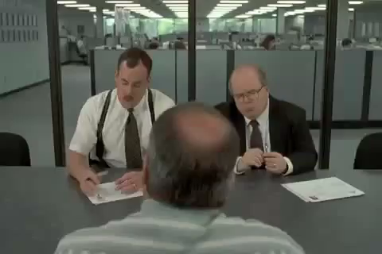
So, What is it Like to be Me?
http://www.oscer.ou.edu/ostemmp.php
23

Slide 24
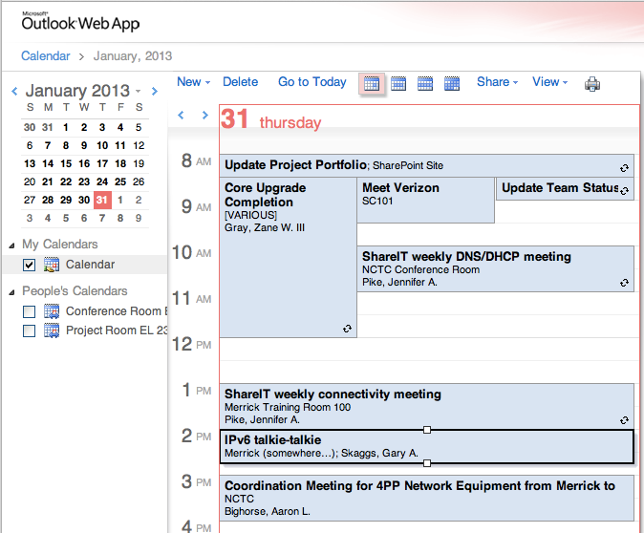
A Day in My Life…
http://www.oscer.ou.edu/ostemmp.php
24

Slide 25
A Day in My Life…
Prioritize!
  Know what is important
  Don’t let the “immediate” overshadow the “important”
Delegate!
  Know when to ask for help
  Build a circle of trust
  Give credit where it is due
http://www.oscer.ou.edu/ostemmp.php
25

Slide 26
A Day in My Life…
Get to know your customer
  Get out from behind the desk
  Don’t be afraid to drop in on someone
  Follow up on issues
Overcome fears
  Step out of the “comfort zone”
  Take charge when things are going wrong
  Be accountable (it’s OK to be wrong)
http://www.oscer.ou.edu/ostemmp.php
26

Slide 27

A Day in My Life…
Be the trusted advisor
  Subject matter expert in your field
  Know both the “trees” as well as the “forest”
http://www.oscer.ou.edu/ostemmp.php
27

Slide 28

A Day in My Life…
Have fun!
  Breaks can get you out of a rut (not too frequent…)
  Make your office the place you enjoy being at.
  Be that person everyone wants to be around
  Lead by example!
http://www.oscer.ou.edu/ostemmp.php
28

Slide 29
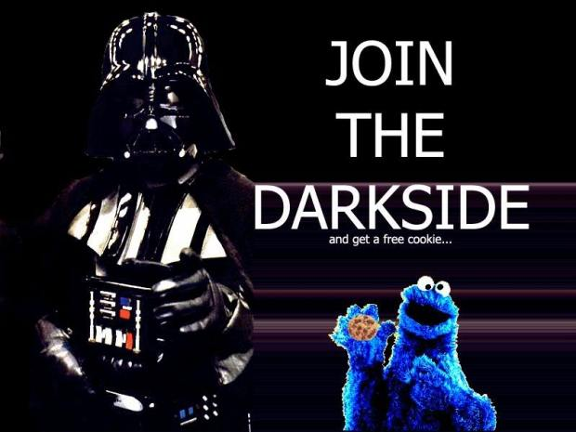
How Do I Get This Job?!
http://www.oscer.ou.edu/ostemmp.php
29

Slide 30
The Resume…
What I look for in a resume… (the basics)
  College diploma in a relevant field
  Experience
  Certifications
  I never look at salary (that’s up to HR)
What I look for in a resume… (under the hood)
  Someone who doesn’t change jobs every 1 to 2 years (probably won’t last long)
  Someone who understands the “lingo”
  Someone who knows how to keep it “brief” but “relevant”
http://www.oscer.ou.edu/ostemmp.php
30

Slide 31
The Resume…
A Brief Note About Resumes…
  Keep it brief!
    No more than 2 pages (3 at most).
    You don’t need to write a novel, because we won’t read it.
  Keep it relevant!
    Tailor your resume to match the job you are targeting.
    Leave out extraneous details. These will come out in the interview process.
  Sell yourself…. Yourself!
    Don’t let a recruiter/headhunter sell you.
http://www.oscer.ou.edu/ostemmp.php
31

Slide 32
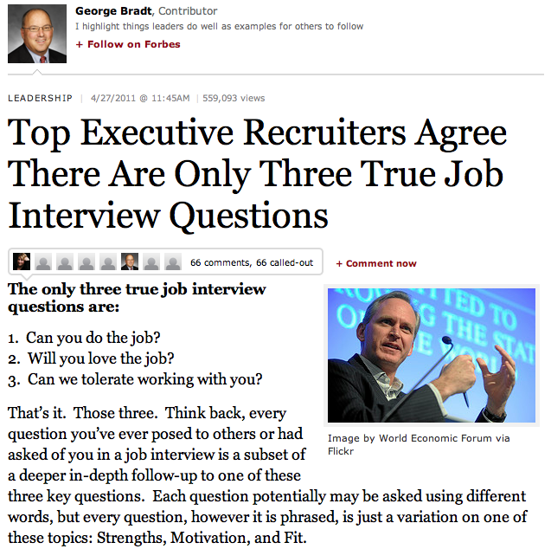
The Interview…
  Can you do it?
  Will you love it?
  Will we like you?
http://www.oscer.ou.edu/ostemmp.php
32

Slide 33
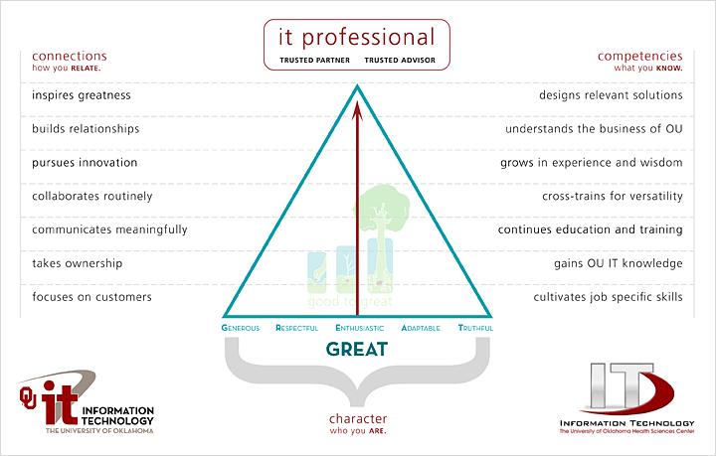
The Interview…
http://www.oscer.ou.edu/ostemmp.php
33

Slide 34

Preparing yourself…
What you should do before then…
  College diploma in a relevant field… this is worth up to 5 years of relevant experience!
  Experience… internships during college can be applied toward this (kill two birds at the same time).
  Certifications… start small, and work your way up. Do this during college, or even during high school.
  Build relationships… sometimes, it isn’t WHAT you know, it’s WHO you know.
http://www.oscer.ou.edu/ostemmp.php
34

Slide 35
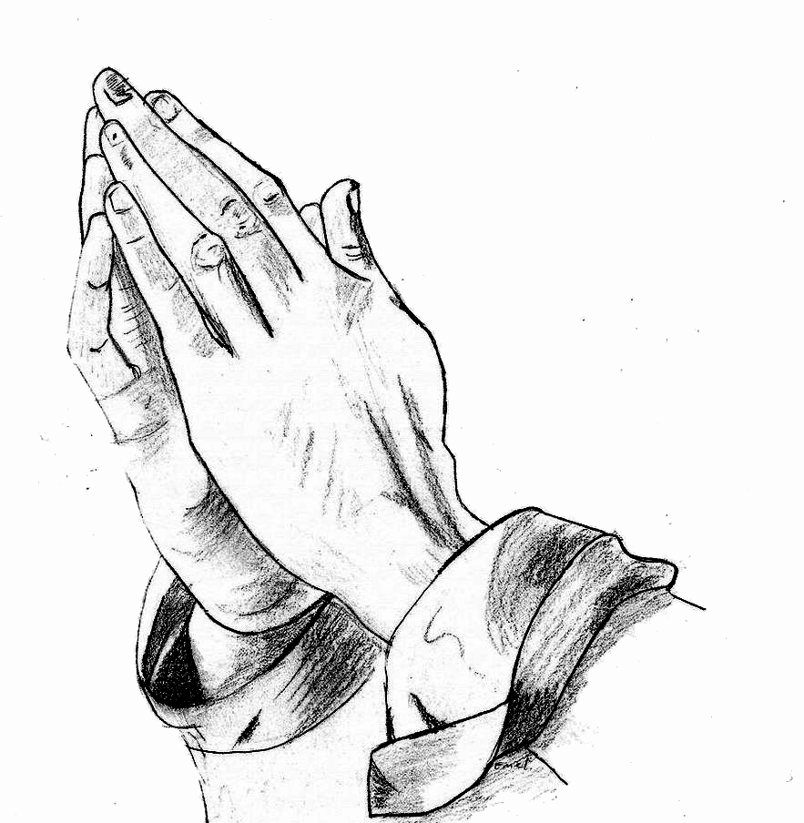
Preparing yourself…
What you should do… (cont.)
  Prayer never hurts!
  Be positive.
  Have a back-up plan.
  Have someone else critique your resume.
  Pass the interview.
    Be honest during the interview.
    Practice the interview
    Thank the interviewer both in person, and later in writing.
http://www.oscer.ou.edu/ostemmp.php
35

Slide 36

Now, about that job…
What to look for…
  Money isn’t everything. There are sometimes trade-offs for higher
  salaries:
    More hours
    More travel
    Fewer benefits
  Reputation. Find a place that everyone is talking about. Ask the people that work there if it is worth it!
  Family friendly environment. Flexible work hours can be important.
http://www.oscer.ou.edu/ostemmp.php
36

Slide 37
Now, about that job…
What to look for… (cont.)
  Look at the “whole package”
    Dress code?
    Distance to work?
    Free parking?
    Starbucks (or pub) nearby?
    Shared office space?
    Time-off policy?
    Condition of office?
    Training and learning opportunities!
http://www.oscer.ou.edu/ostemmp.php
37

Slide 38
Now, about that job…
What to look for… (cont.)
  Interview the interviewer.
    Don’t be scared. This is a two-way partnership.
    Ask for a guided tour.
    Ask to meet your “team”.
    Ask the interviewer how they like the job.
  This is a long-term commitment!
    Trust your instincts! If your gut says “no”, then turn down the job.
    Keep that back out plan in place until the probationary period is over.
http://www.oscer.ou.edu/ostemmp.php
38

Slide 39

Congratulations! But now…
Suggestions for success…
  Never compromise your morals.
  Be honest… it’s hard to remember all of the lies you’ve told, and who you told them to.
  Be there for other people… and they will be there for you.
  Be positive! It’s contagious.
http://www.oscer.ou.edu/ostemmp.php
39

Slide 40
Congratulations! But now…
Suggestions for success… (cont.)
  Don’t take things personally… in the grand scheme of things, it’s just a job!
  Rule your destiny.
  Step outside of your comfort zone. (ref. Office Space, the movie)
  Nothing in your job is worth getting angry over.
  Your customer is why you are where you are. Be there for them.
http://www.oscer.ou.edu/ostemmp.php
40

Slide 41

Be relevant…
Technical Stuff… (cont.)
  Document everything! Trust me, it will save you time in the long run.
http://www.oscer.ou.edu/ostemmp.php
41

Slide 42
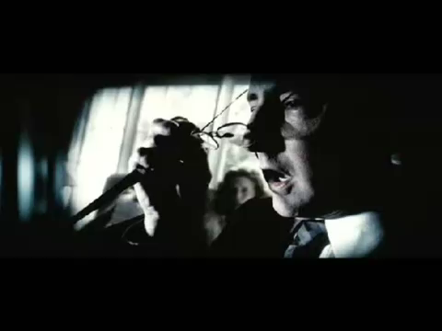
Be relevant…
Technical Stuff… (cont.)
  Ask for the cool toys!
http://www.oscer.ou.edu/ostemmp.php
42

Slide 43

Be relevant…
Technical Stuff… (cont.)
  You will never have enough time or money… always have a backup plan.
http://www.oscer.ou.edu/ostemmp.php
43

Slide 44
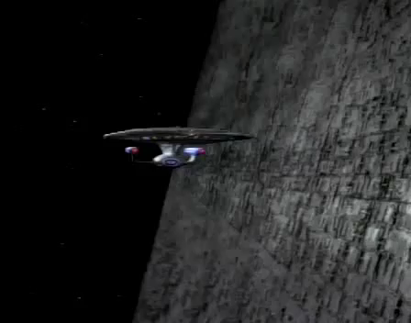
Be relevant…
Technical Stuff… (cont.)
  Technology changes fast! Try to keep pace, and don’t wait for “futures”…

Slide 45

If you got ‘em, ask ‘em!

Slide 46
Evaluation Time!
Please take a moment to fill out the evaluations…
or NOT! The evaluations are completely optional!
No personal or personally identifiable data is collected.
Data is used by the grant providers to gauge success.

Slide 47

The End (about time too…)

