Slide 1
Oklahoma Science, Technology, Engineering, and Mathematics Mentorship Program

Slide 2
What is the OSTEMMP?
The Oklahoma STEM Mentorship Program is an educational outreach connecting networking professionals from OU, OSU, OneNet, and other institutions with students in the technology field.
It is part of an NSF grant to enhance Oklahoma’s educational and research capability through network improvements.
http://www.oscer.ou.edu/ostemmp.php
2

Slide 3
Job Shadowing
The goal:
IDENTIFY, DEVELOP and RECRUIT Talent
Activities include:
Presentations to students throughout OK
Job shadowing opportunities (on-site & virtual)
http://www.oscer.ou.edu/ostemmp.php
3

Slide 4
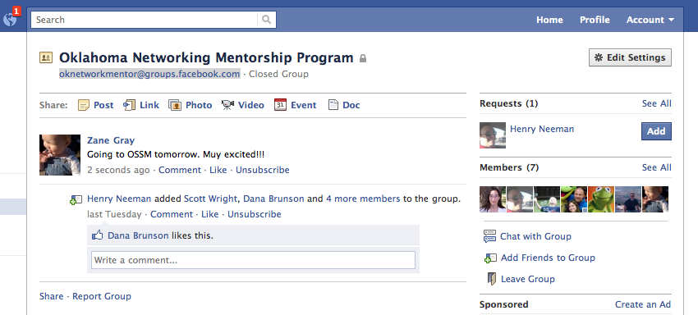
Job Shadowing
On-Site
Schedule a time with us to see what we do!
Virtual
e-mail us at network@ou.edu (OU IT Network Team)
Email us at pmo@ou.edu ( OU Enterprise Project Mgmt Team)
Facebook: oknetworkmentor@groups.facebook.com
http://www.oscer.ou.edu/ostemmp.php
4

Slide 5
Other Opportunities/Resources
Jobs at OU
http://jobs.ou.edu
Jobs at OneNet
http://www.okhighered.org/job-opportunities/
http://www.oscer.ou.edu/ostemmp.php
5

Slide 6
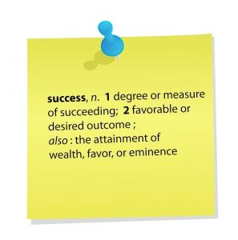
About This Presentation
What do I do in the IT field?
Lessons learned for getting this job.
Recommendations for keeping the job.
Being successful in this field.
http://www.oscer.ou.edu/ostemmp.php
6

Slide 7
What is…
Project management is the discipline of planning, organizing, motivating, and controlling resources to achieve specific goals (Wikipedia)
A Project is defined as a temporary endeavor designed to produce a unique product, service or result. (PMBOK)
At OU- 40 hours or work, OR requires a purchase, OR needs to be tracked for compliance or leadership.
http://www.oscer.ou.edu/ostemmp.php 5

Slide 8
Project Lifecycle
Initiation
Planning
Execution
Close-Out
Purpose
Strategic Fit
Objectives
Scope (draft)
Draft Schedule
Budget Estimate
Leadership Approval
Scope-Final
Select Team Members
Plan Deliverables
Quality Plan
Baseline Schedule
Baseline Budget
Risk & Issues Register
Business Case
Communications Plan
Production of Deliverables
Monitor/Control
Quality Management
Time Management
Cost Management
Risk Management
Issue Resolution
Change Control
Reporting
Communications
Celebrate!
Contract Closeout
Team Feedback
Recommendations for further action
Post Implementation Review
http://www.oscer.ou.edu/ostemmp.php 6

Slide 9
Traits of a Project Manager
Active Listener Self Starter
Strategic Thinker Motivator
Organization Skills Persistence
Communications Adaptable
Leadership Facilitator
Referee- Conflict Resolution Baking Skills!
Multi-tasker
http://www.oscer.ou.edu/ostemmp.php 7

Slide 10
Leadership and Project Management
Trust Productivity Cost
Trust Productivity Cost
http://www.oscer.ou.edu/ostemmp.php 13

Slide 11
My Journey
http://www.oscer.ou.edu/ostemmp.php 8

Slide 12
Lisa Hendrix, PMP
Began my career at OU IT in 1999 in Telecommunications
Bachelors of Liberal Studies 2002
Changed positions 5 times in 6 years.
Project Management Office was formed in 2005
First Project was implementation of online parking permits
Credentials, PMP- 2009
New Construction
Service Level Agreement Rep- Expanded my horizon
http://www.oscer.ou.edu/ostemmp.php 9

Slide 13
Career Path….
Shift to Portfolio Management
Opportunity to grow.
Enterprise Portfolio Manager for the Education and Natural Resources Business Segment for the Office of Management and Enterprise Services for the State of Oklahoma.
76 State Agencies
State CIO
http://www.oscer.ou.edu/ostemmp.php 10

Slide 14
Boomer…ang!
Another Opportunity….
Returned to University of Oklahoma in July 2013 after 1 year absence.
Enterprise Portfolio Manager-
Project Management Tool Implementation
Project Governance Implementation
And- moving 500 servers into a new data center.
http://www.oscer.ou.edu/ostemmp.php 11

Slide 15
About the OU EPMO
Provide Project Portfolio Management Support to the Organization
Conduct Portfolio Review with Each Group
Manage Large Scale Projects
Provide insights on:
Organizational Resources
Projects
Project Portfolio Governance
http://www.oscer.ou.edu/oitmp
15

Slide 16
Tools
http://www.oscer.ou.edu/ostemmp.php 15

Slide 17
Reporting

Slide 18
Resource Management
http://www.oscer.ou.edu/ostemmp.php 15

Slide 19
About Me
Zane Gray:
B.S. Chemical Engineering (OU 1996)
USAF network deployments (1996-2001)
OU computer networking (2001-present)
Married since 1993 to an OSSM alumn!
Nine (yes, “9”) kids
One ball python (I hate snakes!)
Two cats (adopted strays)
http://www.oscer.ou.edu/ostemmp.php
19

Slide 20
So, what’s it like?
Warning… PG-13 material ahead!
http://www.oscer.ou.edu/ostemmp.php
20

Slide 21
About My Job (Manager)
OU IT Network Services:
Connect 200,000+ “unique” devices this year!
Support 30,000+ “wireless” users every day.
Support 15,000+ “wired” devices every day.
Support ~2000 wireless access points
Support ~1200 security cameras
Support ~1250 network switches and routers
Support ~8000 telephony devices (VoIP and analog)
Over 200 physical and virtual servers
Migrating to a single datacenter that spans three cities
http://www.oscer.ou.edu/ostemmp.php
21

Slide 22
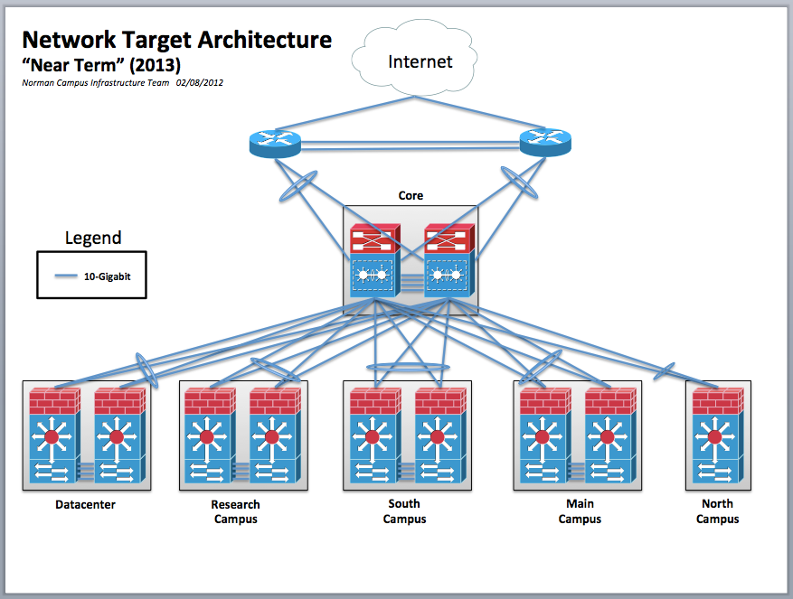
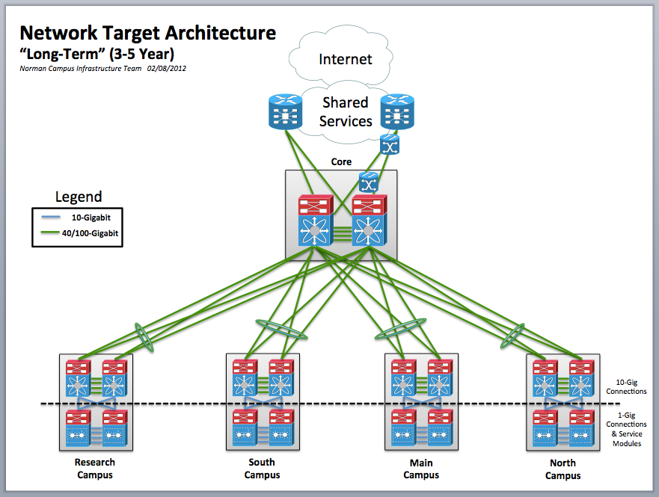
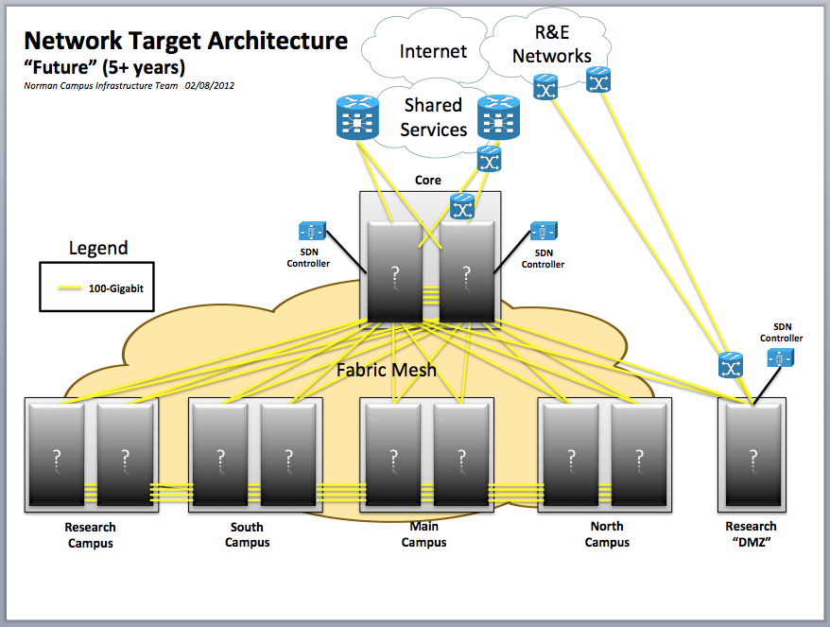
Strategic Planning and Vision
http://www.oscer.ou.edu/ostemmp.php
22

Slide 23
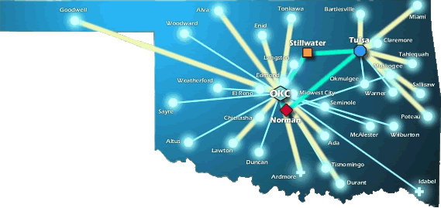
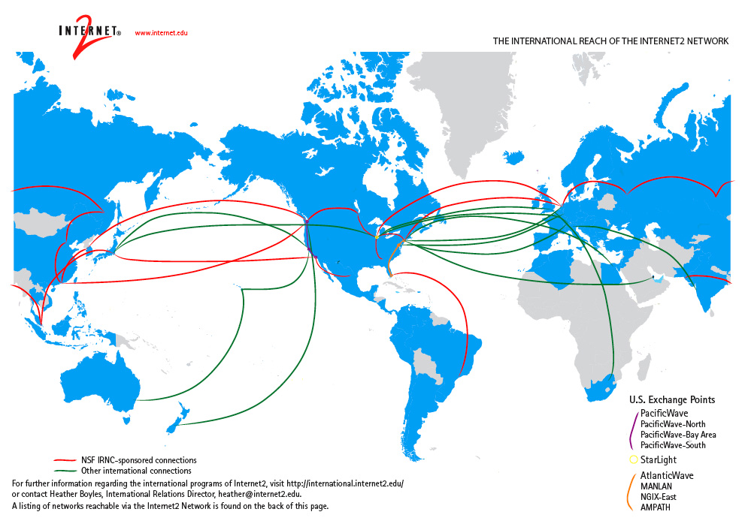
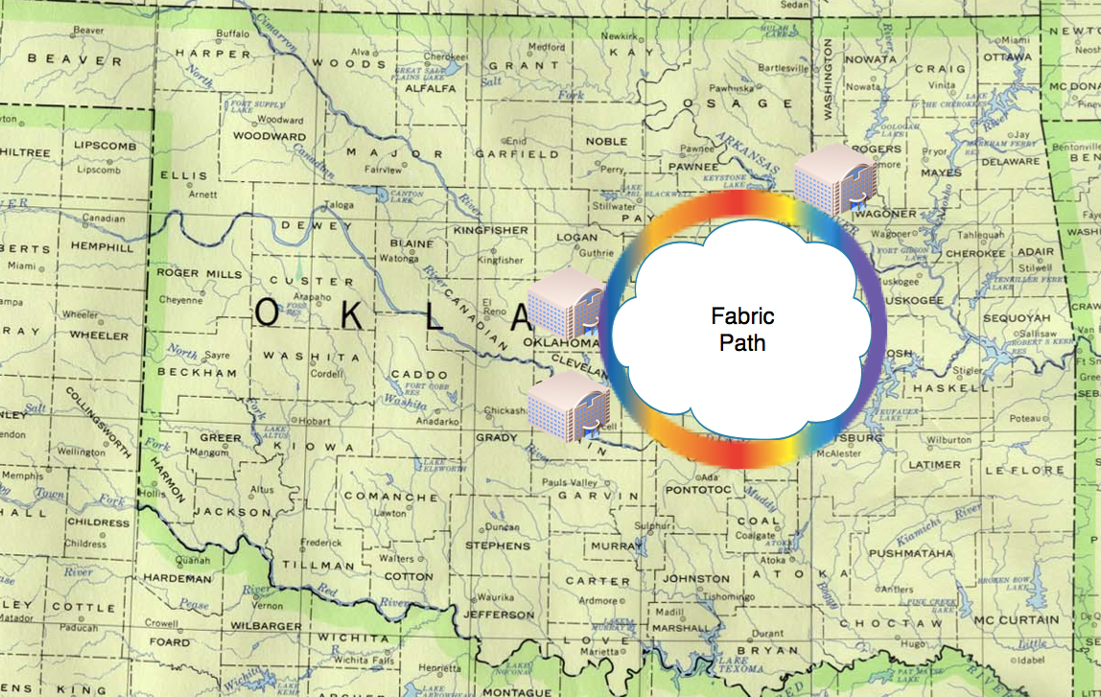
National Research & Education Networks (World-Wide)
http://www.oscer.ou.edu/ostemmp.php
23

Slide 24
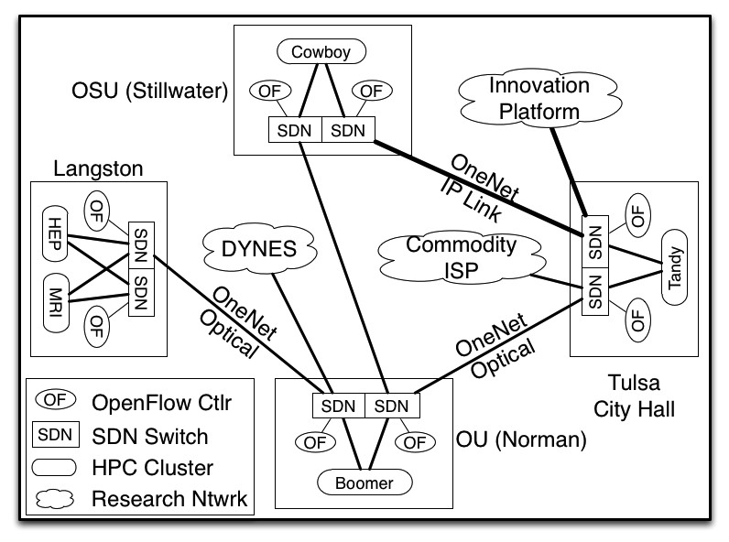
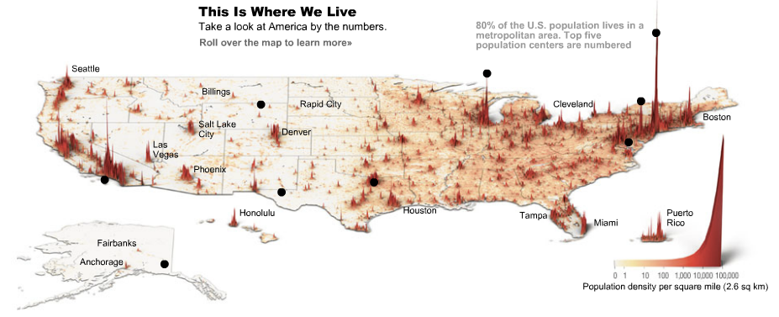
Trends in Technology Landscapes
Software Defined Networking
Data Visualization
http://www.oscer.ou.edu/ostemmp.php
24

Slide 25
How Do We Manage It All?
http://www.oscer.ou.edu/ostemmp.php
25

Slide 26
Tools of the Trade
http://www.oscer.ou.edu/ostemmp.php
26

Slide 27
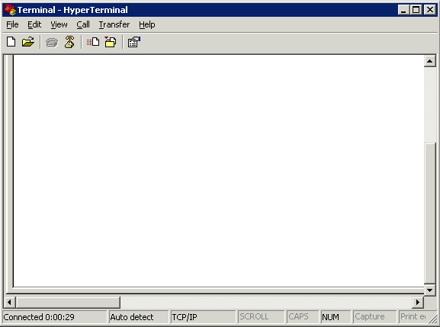
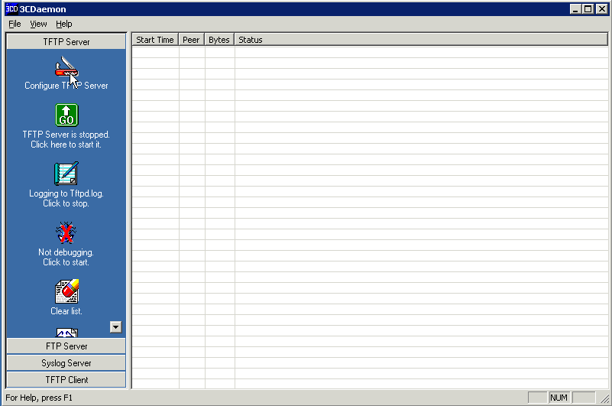
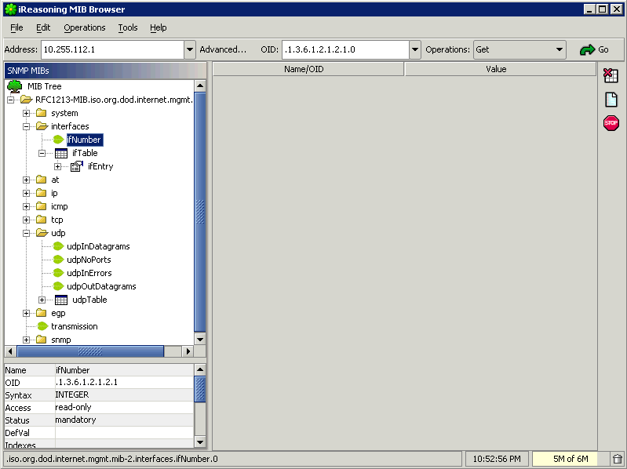
Tools of the Trade
http://www.oscer.ou.edu/ostemmp.php
27

Slide 28
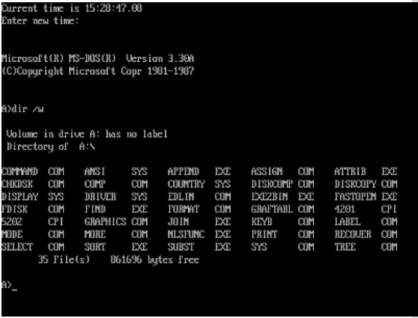
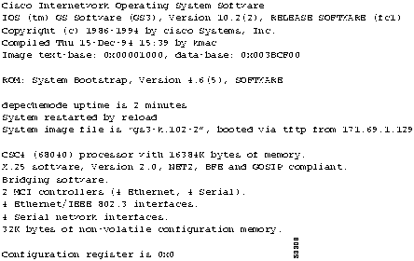
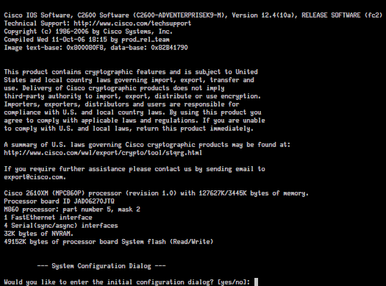
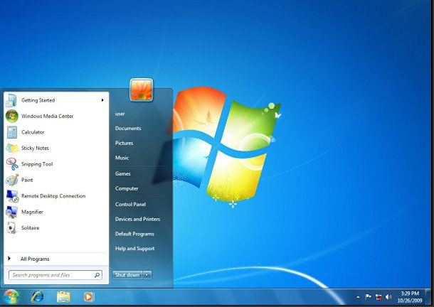
Tools of the Trade
Client OS’ (1980’s and Today)
Network OS’ (1980’s and Today)
http://www.oscer.ou.edu/ostemmp.php
28

Slide 29
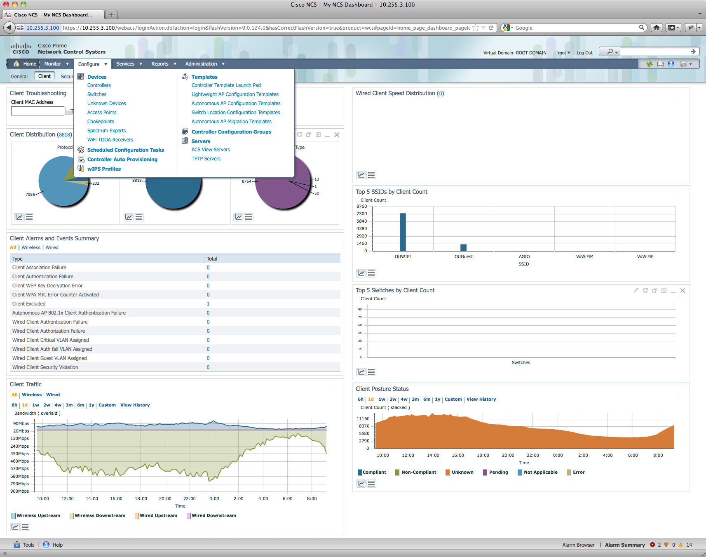
Tools of the Trade
But that’s changing!
TRILL
OpenFlow
CAPWAP
~50% Parity
http://www.oscer.ou.edu/ostemmp.php
29

Slide 30
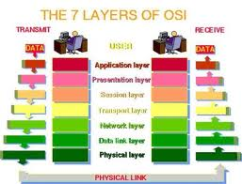
Troubleshooting
Technical Stuff for Network Engineers…
Know the OSI model. It will save you days of troubleshooting time!
http://www.oscer.ou.edu/ostemmp.php
30

Slide 31
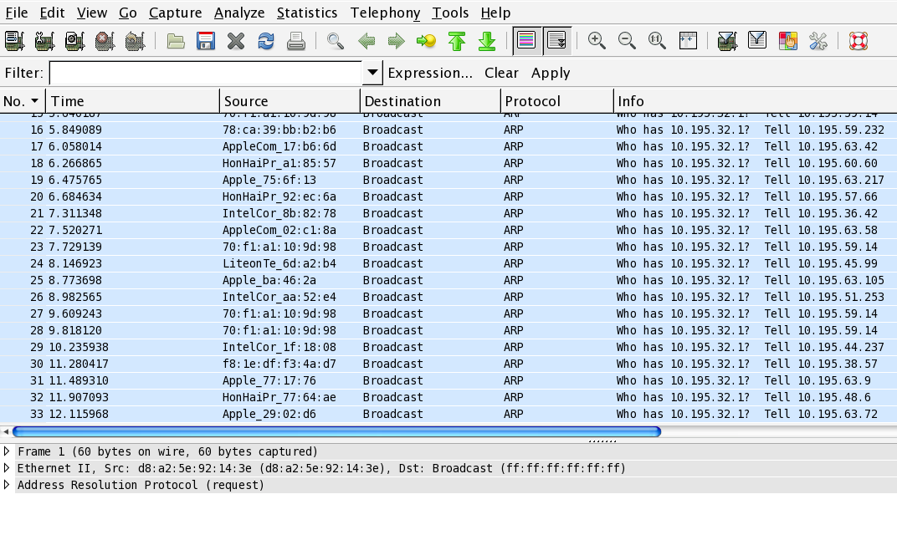
Troubleshooting
http://www.oscer.ou.edu/ostemmp.php
31

Slide 32
Operations & Maintenance
http://www.oscer.ou.edu/ostemmp.php
32

Slide 33
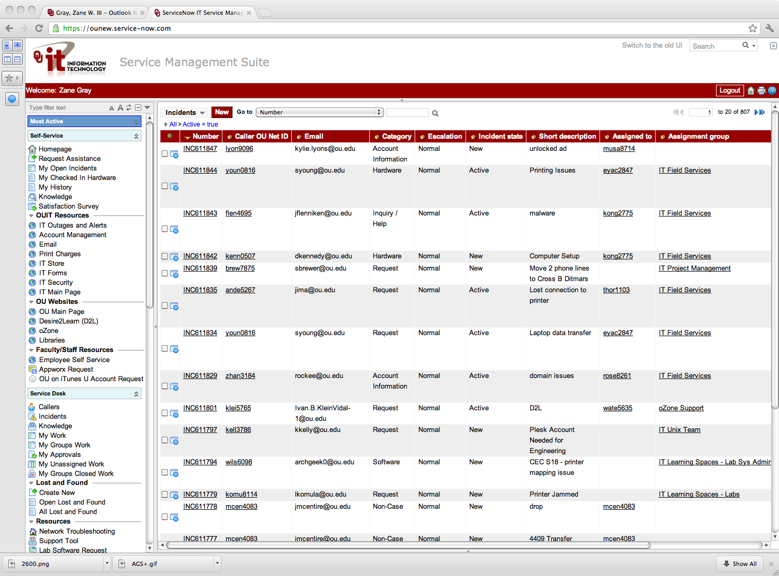
Change Management
Change Management and Control is a Necessary Evil
Process
Compliance
Knowledge
Audit Trail
http://www.oscer.ou.edu/ostemmp.php
33

Slide 34
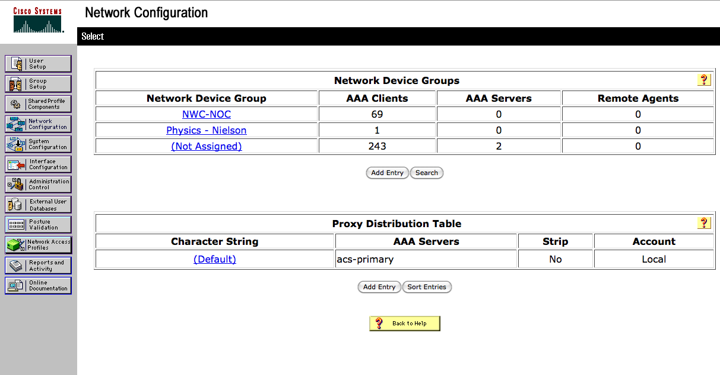
Change Control
AAA
Authentication
Authorization
Accounting
http://www.oscer.ou.edu/ostemmp.php
34

Slide 35
So, What is it Like to be Me?
http://www.oscer.ou.edu/ostemmp.php
35

Slide 36
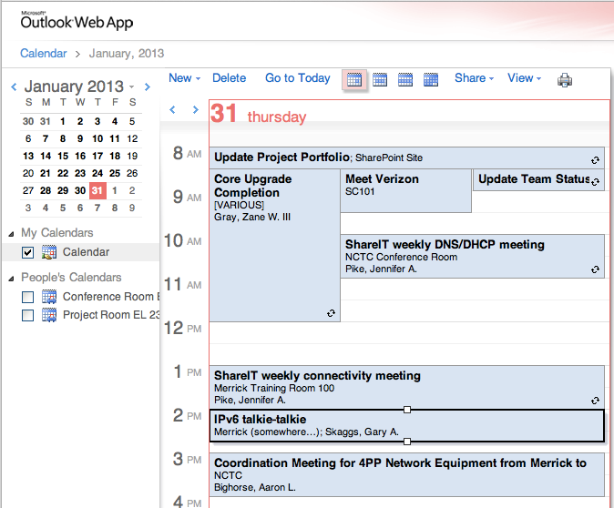
A Day in My Life…
http://www.oscer.ou.edu/ostemmp.php
36

Slide 37
A Day in My Life…
Prioritize!
Know what is important
Don’t let the “immediate” overshadow the “important”
Delegate!
Know when to ask for help
Build a circle of trust
Give credit where it is due
http://www.oscer.ou.edu/ostemmp.php
37

Slide 38
A Day in My Life…
Get to know your customer
Get out from behind the desk
Don’t be afraid to drop in on someone
Follow up on issues
Overcome fears
Step out of the “comfort zone”
Take charge when things are going wrong
Be accountable (it’s OK to be wrong)
http://www.oscer.ou.edu/ostemmp.php
38

Slide 39
A Day in My Life…
Be the trusted advisor
Subject matter expert in your field
Know both the “trees” as well as the “forest”
http://www.oscer.ou.edu/ostemmp.php
39

Slide 40
A Day in My Life…
Have fun!
Breaks can get you out of a rut (not too frequent…)
Make your office the place you enjoy being at.
Be that person everyone wants to be around
Lead by example!
http://www.oscer.ou.edu/ostemmp.php
40

Slide 41
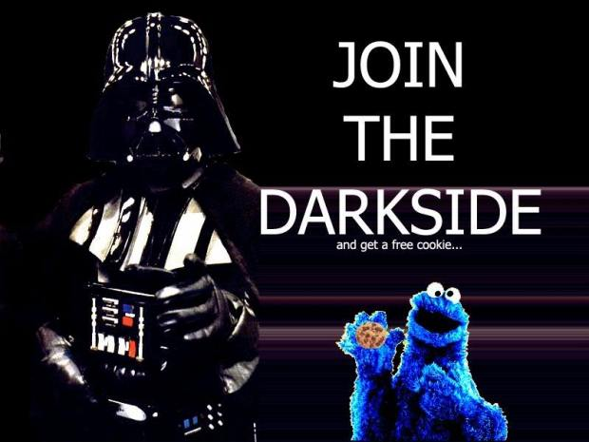
How Do I Get This Job?!
http://www.oscer.ou.edu/ostemmp.php
41

Slide 42
The Resume…
What I look for in a resume… (the basics)
College diploma in a relevant field
Experience
Certifications
I never look at salary (that’s up to HR)
What I look for in a resume… (under the hood)
Someone who doesn’t change jobs every 1 to 2 years (probably won’t last long)
Someone who understands the “lingo”
Someone who knows how to keep it “brief” but “relevant”
http://www.oscer.ou.edu/ostemmp.php
42

Slide 43
The Resume…
A Brief Note About Resumes…
Keep it brief!
No more than 2 pages (3 at most).
You don’t need to write a novel, because we won’t read it.
Keep it relevant!
Tailor your resume to match the job you are targeting.
Leave out extraneous details. These will come out in the interview process.
Sell yourself…. Yourself!
Don’t let a recruiter/headhunter sell you.
http://www.oscer.ou.edu/ostemmp.php
43

Slide 44
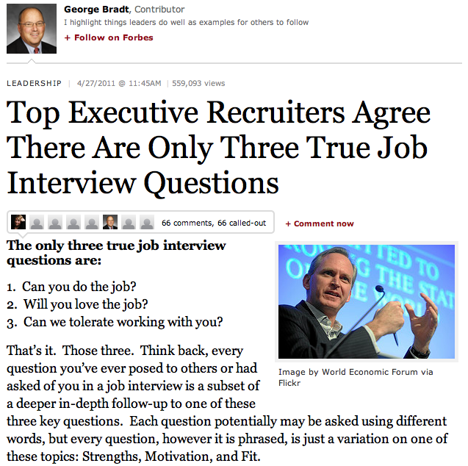
The Interview…
Can you do it?
Will you love it?
Will we like you?
http://www.oscer.ou.edu/ostemmp.php
44

Slide 45
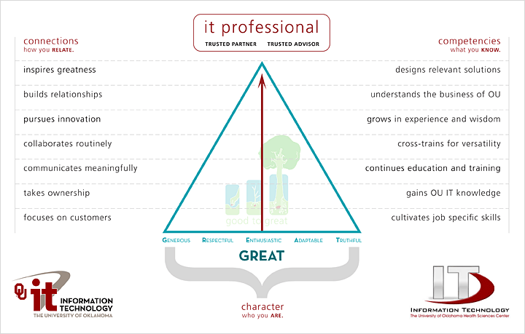
The Interview…
http://www.oscer.ou.edu/ostemmp.php
45

Slide 46
Preparing yourself…
What you should do before then…
College diploma in a relevant field… this is worth up to 5 years of relevant experience!
Experience… internships during college can be applied toward this (kill two birds at the same time).
Certifications… start small, and work your way up. Do this during college, or even during high school.
Build relationships… sometimes, it isn’t WHAT you know, it’s WHO you know.
http://www.oscer.ou.edu/ostemmp.php
46

Slide 47
Preparing yourself…
What you should do… (cont.)
Prayer never hurts!
Be positive.
Have a back-up plan.
Have someone else critique your resume.
Pass the interview.
Be honest during the interview.
Practice the interview
Thank the interviewer both in person, and later in writing.
http://www.oscer.ou.edu/ostemmp.php
47

Slide 48
Now, about that job…
What to look for…
Money isn’t everything. There are sometimes trade-offs for higher
salaries:
More hours
More travel
Fewer benefits
Reputation. Find a place that everyone is talking about. Ask the people that work there if it is worth it!
Family friendly environment. Flexible work hours can be important.
http://www.oscer.ou.edu/ostemmp.php
48

Slide 49
Now, about that job…
What to look for… (cont.)
Look at the “whole package”
Dress code?
Distance to work?
Free parking?
Starbucks (or pub) nearby?
Shared office space?
Time-off policy?
Condition of office?
Training and learning opportunities!
http://www.oscer.ou.edu/ostemmp.php
49

Slide 50
Now, about that job…
What to look for… (cont.)
Interview the interviewer.
Don’t be scared. This is a two-way partnership.
Ask for a guided tour.
Ask to meet your “team”.
Ask the interviewer how they like the job.
This is a long-term commitment!
Trust your instincts! If your gut says “no”, then turn down the job.
Keep that back out plan in place until the probationary period is over.
http://www.oscer.ou.edu/ostemmp.php
50

Slide 51
Congratulations! But now…
Suggestions for success…
Never compromise your morals.
Be honest… it’s hard to remember all of the lies you’ve told, and who you told them to.
Be there for other people… and they will be there for you.
Be positive! It’s contagious.
http://www.oscer.ou.edu/ostemmp.php
51

Slide 52
Congratulations! But now…
Suggestions for success… (cont.)
Don’t take things personally… in the grand scheme of things, it’s just a job!
Rule your destiny.
Step outside of your comfort zone. (ref. Office Space, the movie)
Nothing in your job is worth getting angry over.
Your customer is why you are where you are. Be there for them.
http://www.oscer.ou.edu/ostemmp.php
52

Slide 53
Be relevant…
Technical Stuff… (cont.)
Document everything! Trust me, it will save you time in the long run.
http://www.oscer.ou.edu/ostemmp.php
53

Slide 54
Be relevant…
Technical Stuff… (cont.)
Ask for the cool toys!
http://www.oscer.ou.edu/ostemmp.php
54

Slide 55
Be relevant…
Technical Stuff… (cont.)
You will never have enough time or money… always have a backup plan.
http://www.oscer.ou.edu/ostemmp.php
55

Slide 56
Be relevant…
Technical Stuff… (cont.)
Technology changes fast! Try to keep pace, and don’t wait for “futures”…

Slide 57
If you got ‘em, ask ‘em!

Slide 58
Evaluation Time!
Please take a moment to fill out the evaluations…
or NOT! The evaluations are completely optional!
No personal or personally identifiable data is collected.
Data is used by the grant providers to gauge success.

Slide 59
The End (about time too…)

