Slide 1
Oklahoma Information Technology Mentorship Program

Slide 2
What is the OITMP?
The Oklahoma Information Technology Mentorship Program is an educational outreach connecting IT professionals from OU, OneNet, and other institutions with students in the technology field.
It is part of an NSF grant to enhance Oklahoma’s educational and research capability through network improvements.
http://www.oscer.ou.edu/oitmp
2

Slide 3
Job Shadowing
The goal:
IDENTIFY, DEVELOP and RECRUIT Talent
Activities include:
Presentations to students throughout OK
Job shadowing opportunities (on-site & virtual)
http://www.oscer.ou.edu/ostemmp.php
3

Slide 4
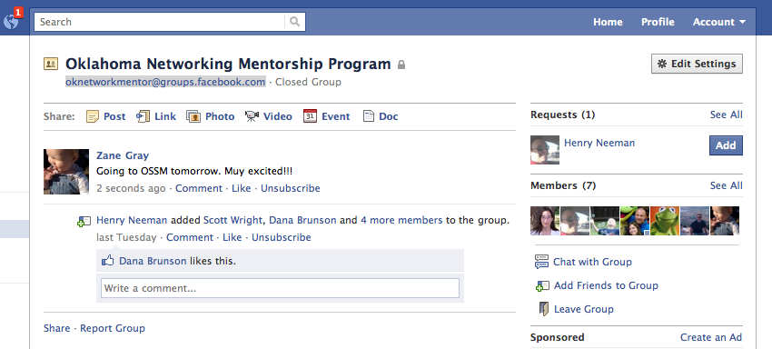
Job Shadowing
On-Site
Schedule a time with us to see what we do!
Virtual
e-mail us at pmo@ou.edu (OU IT Project Management Office)
Facebook: oknetworkmentor@groups.facebook.com
http://www.oscer.ou.edu/ostemmp.php
4

Slide 5
What is…
Project management is the discipline of planning, organizing, motivating, and controlling resources to achieve specific goals (Wikipedia)
A Project is defined as a temporary endeavor designed to produce a unique product, service or result. (PMBOK)
http://www.oscer.ou.edu/ostemmp.php 5

Slide 6
Traits of a Project Manager
Active Listener Self Starter
Strategic Thinker Motivator
Organization Skills Persistence
Communications Adaptable
Leadership Facilitator
Referee- Conflict Resolution Baking Skills!
Multi-tasker
http://www.oscer.ou.edu/ostemmp.php 7

Slide 7
My Journey
http://www.oscer.ou.edu/ostemmp.php 8

Slide 8
Lisa Hendrix, PMP
Began my career at OU IT in 1999 in Telecommunications
Bachelors of Liberal Studies 2002
Changed positions 5 times in 6 years.
Project Management Office was formed in 2005
First Project was implementation of online parking permits
Credentials, PMP- 2009
New Construction
Service Level Agreement Rep- Expanded my horizon
http://www.oscer.ou.edu/ostemmp.php 9

Slide 9
Career Path….
Shift to Portfolio Management
Opportunity to grow.
Enterprise Portfolio Manager for the Education and Natural Resources Business Segment for the Office of Management and Enterprise Services for the State of Oklahoma.
76 State Agencies
State CIO
http://www.oscer.ou.edu/ostemmp.php 10

Slide 10
Boomer…ang!
Another Opportunity….
Returned to University of Oklahoma in July 2013 after 1 year absence.
Enterprise Portfolio Manager-
Project Management Tool Implementation
Project Governance Implementation
And- moving 600 servers into a new data center.
http://www.oscer.ou.edu/ostemmp.php 11

Slide 11
About the OU EPMO
Provide Project Portfolio Management Support to the Organization
Conduct Portfolio Review with Each Group
Manage Large Scale Projects
Provide insights on:
Organizational Resources
Projects
Project Portfolio Governance
http://www.oscer.ou.edu/oitmp
11

Slide 12
Project Lifecycle
Initiation
Planning
Execution
Close-Out
Purpose
Strategic Fit
Objectives
Scope (draft)
Draft Schedule
Budget Estimate
Leadership Approval
Scope-Final
Select Team Members
Plan Deliverables
Quality Plan
Baseline Schedule
Baseline Budget
Risk & Issues Register
Business Case
Approvals
Communications Plan
Production of Deliverables
Monitor/Control
Quality Management
Time Management
Cost Management
Risk Management
Issue Resolution
Change Control
Reporting
Communications
Celebrate!
Contract Closeout
Team Feedback
Recommendations for further action
Post Implementation Review
http://www.oscer.ou.edu/ostemmp.php 6

Slide 13
Leadership and Project Management
Trust Productivity Cost
Trust Productivity Cost
http://www.oscer.ou.edu/ostemmp.php 13

Slide 14
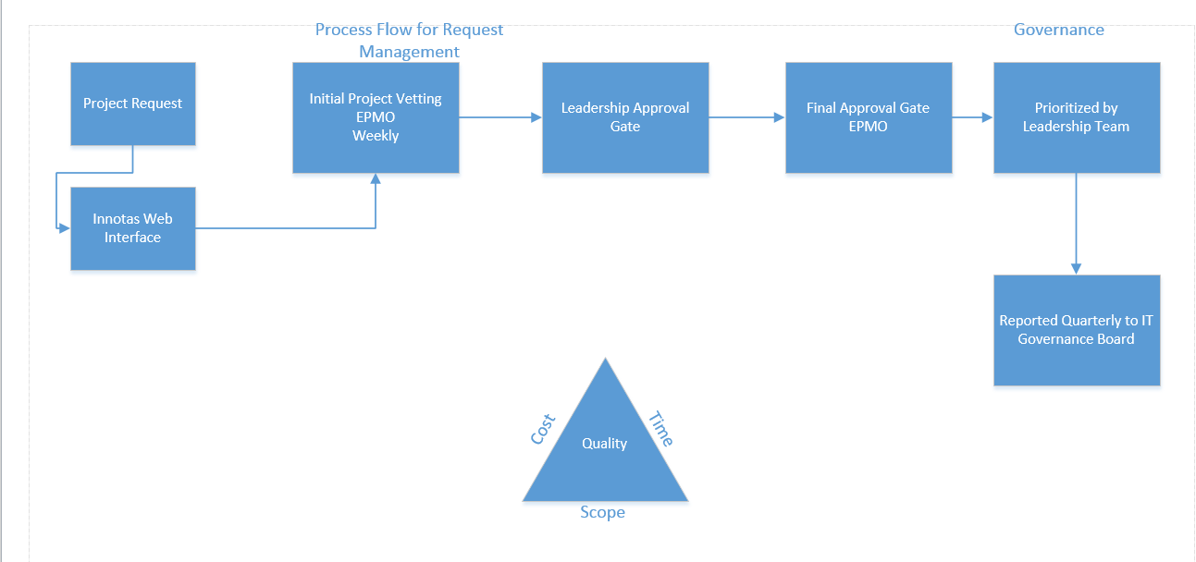
Project Portfolio Governance
http://www.oscer.ou.edu/ostemmp.php 14

Slide 15
Tools
http://www.oscer.ou.edu/ostemmp.php 15

Slide 16
Reporting

Slide 17
Resource Management
http://www.oscer.ou.edu/ostemmp.php 15

Slide 18
A Day in My Life…
Prioritize!
Know what is important
Don’t let the “immediate” overshadow the “important”
Delegate!
Know when to ask for help
Build a circle of trust
Give credit where it is due
http://www.oscer.ou.edu/oitmp
16

Slide 19
A Day in My Life…
Get to know your customer
Get out from behind the desk
Don’t be afraid to drop in on someone
Follow up on issues
Overcome fears
Step out of the “comfort zone”
Take charge when things are going wrong
Be accountable (it’s OK to be wrong)
http://www.oscer.ou.edu/oitmp
17

Slide 20
A Day in My Life…
Have fun!
Breaks can get you out of a rut (not too frequent…)
Make your office the place you enjoy being at.
Be that person everyone wants to be around
Lead by example!
http://www.oscer.ou.edu/oitmp
18

Slide 21
The Resume…
A Brief Note About Resumes…
Keep it brief!
No more than 2 pages (3 at most).
You don’t need to write a novel, because we won’t read it.
Keep it relevant!
Tailor your resume to match the job you are targeting.
Leave out extraneous details. These will come out in the interview process.
Sell yourself…. Yourself!
Don’t let a recruiter/headhunter sell you.
http://www.oscer.ou.edu/ostemmp.php 19

Slide 22
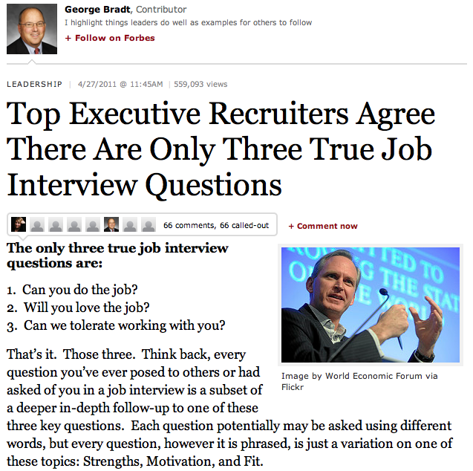
The Interview…
Can you do it?
Will you love it?
Will we like you?
http://www.oscer.ou.edu/ostemmp.php 20

Slide 23
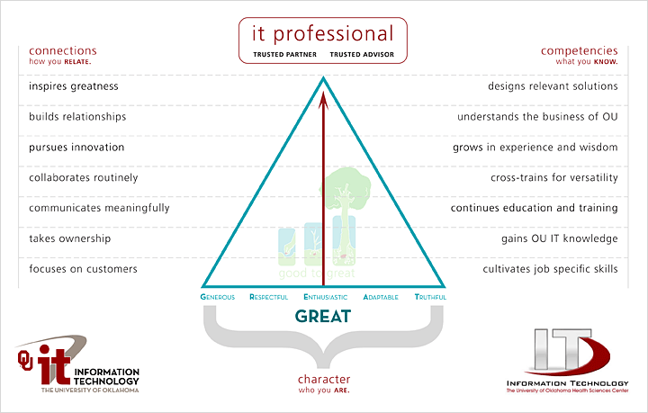
The Interview…
http://www.oscer.ou.edu/ostemmp.php 21

Slide 24
Preparing yourself…
What you should do…
Be positive.
Have someone else critique your resume.
Research your potential employer
The interview….
Be honest during the interview.
Practice the interview
Ask relevant questions
Thank the interviewer both in person, and later in writing.
http://www.oscer.ou.edu/ostemmp.php 22

Slide 25
Now, about that job…
What to look for…
Money isn’t everything. There are sometimes trade-offs for higher salaries
More hours
More travel
Fewer benefits
Reputation. Find a place that everyone is talking about. Ask the people that work there if it is worth it!
Family friendly environment. Flexible work hours can be important.
http://www.oscer.ou.edu/ostemmp.php 23

Slide 26
Now, about that job…
What to look for… (cont.)
Look at the “whole package”
Dress code?
Distance to work?
Free parking?
Starbucks nearby?
Shared office space?
Time-off policy?
Condition of office?
Retirement
Training and learning opportunities!
http://www.oscer.ou.edu/ostemmp.php 24

Slide 27
Congratulations! But now…
Suggestions for success…
Never compromise your morals.
Be honest… it’s hard to remember all of the lies you’ve told, and who you told them to.
Be there for other people… and they will be there for you.
Be positive! It’s contagious.
http://www.oscer.ou.edu/ostemmp.php 25

Slide 28
Congratulations! But now…
Suggestions for success… (cont.)
Don’t take things personally… in the grand scheme of things, it’s just a job!
Rule your destiny.
Step outside of your comfort zone – and be ready for change.
Nothing in your job is worth getting angry over.
Your customer is why you are where you are. Be there for them.
http://www.oscer.ou.edu/ostemmp.php 26

Slide 29
Be relevant…
You will never have enough time or money… always have a backup plan.
http://www.oscer.ou.edu/ostemmp.php 27

Slide 30
Other Opportunities/Resources
Jobs at OU
http://jobs.ou.edu
Jobs at OneNet
http://www.okhighered.org/job-opportunities
http://www.oscer.ou.edu/oitmp
28

Slide 31
If you got ‘em, ask ‘em!
http://www.oscer.ou.edu/ostemmp.php 29

Slide 32
Evaluation Time!
Please take a moment to fill out the evaluations…
or NOT! The evaluations are completely optional!
No personal or personally identifiable data is collected.
Data is used by the grant providers to gauge success.
http://www.oscer.ou.edu/ostemmp.php 30

Slide 33
The End (about time too…)

